Slide 1

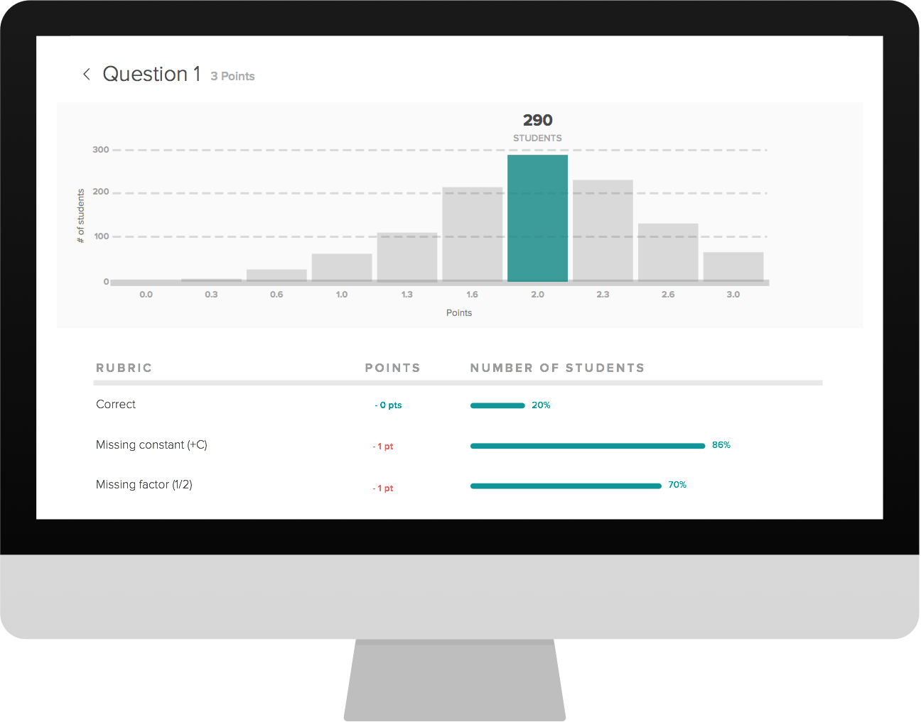
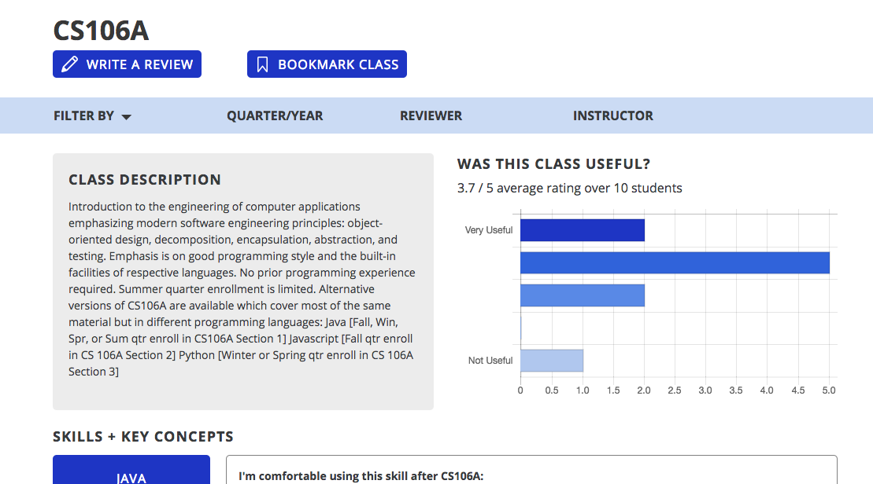
ClassLens
Class feedback that’s actually useful
Former students review past classes
Current students explore careers, skills and courses
Teachers ​view feedback​ and revise courses

