Slide 1
Making education more personal
Hope Casey-Allen, Amy Liu, Yash Tambawala

Slide 2
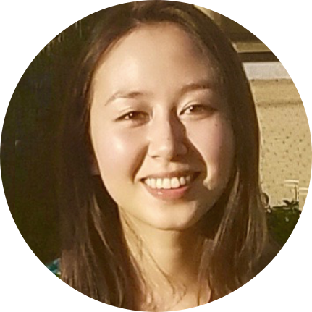

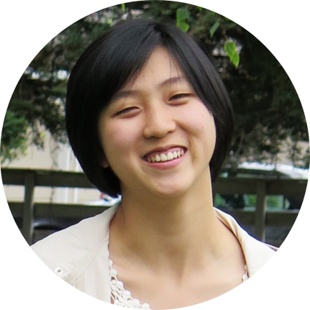
Our team

Slide 3

Notes:
Motivation: reflecting on our own education, we remembered times where we felt like we really engaged in learning/connected with the professor and our peers, but also times where it felt like we were just a part of the system, churning out homework, etc.
Image source: http://www.clipartpanda.com/categories/idea-light-bulb-clip-art-black-and-white

Slide 4
Scale meaningful interactions in education

Slide 5
Scale meaningful interactions in education
How do people interact in large lectures or online courses?

Slide 6
Scale meaningful interactions in education
What do people value most about the educational experience?

Slide 7
Needfinding process

Slide 8
Stakeholders
professors
& educators
people in online education space
students
Notes:
We identified major stakeholders in our problem space and made sure that we covered all groups when deciding who to interview

Slide 9
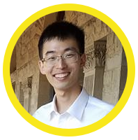

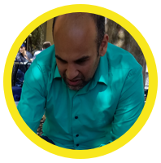
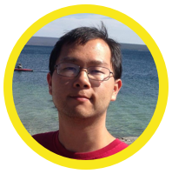

Stakeholders
professors
& educators
people in online education space
students
PhD student @ Berkeley
MBA student
@ SF state
(former) student @ UC Riverside
(former) student @ MIT
(former)
post-doc
@ Oxford
Notes:
We ended up interviewing 5 students from a wide variety of schools to capture a diverse set of experiences.

Slide 10

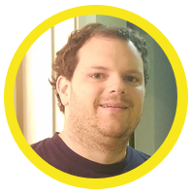

Stakeholders
professors
& educators
people in online education space
students
Lecturer
@ Stanford
Educator
@ Palantir
(former) educator
@ the Exploratorium
Notes:
We interviewed educators in an academic setting, in industry, and in an informal learning setting

Slide 11
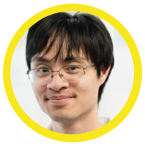
Stakeholders
professors
& educators
people in online education space
students
Developer
@ Coursera
Notes:
With more time, one area we could have done more needfinding in is people in the online education space. Specifically, talking to more online curriculum developers and students currently taking online classes.

Slide 12
Interview questions
broad
focused

Slide 13
“Tell us about a time you had a great classroom experience…”

Slide 14
“Tell us about a time you had a great classroom experience…”
“What factors do you feel contribute most to your learning?”

Slide 15
“Tell us about a time you had a great classroom experience…”
“What factors do you feel contribute most to your learning?”
“In large classes, how do you evaluate whether or not students have met course objectives?”
Notes:
Full list of questions we asked:
General:
Tell me about a time you had a great classroom (online) experience...what made it a good experience?
(students)
Why did you decide to take this class?
What were you hoping to gain from the course?
(educators)
How did you decide on the format of your class?
What were your learning objectives for the course?
How does your ideal student engage with your course?
Tell me about a time you had a less than great classroom (online) experience...what made it a poor experience?
(Repeat above)
What’s your typical classroom experience (online)?
How would you describe your ideal classroom?
Students:
Tell me about a time you felt like you really learned in a classroom?
Tell me about a time you had a question about the course material. How did you resolve it? ...how did you feel?
What factors do you feel contribute most to your learning?
(If they haven’t mentioned class size) Do you think classroom size plays a factor in your learning experience?
How do you feel learning in a small classroom vs. a large classroom?
What aspects of a small classroom environment do you miss most in a large classroom? Vice-versa?
Educators:
Tell me about a time you felt your students were really understanding the material
Do you feel connected with online/remote students?
How do you evaluate whether or not students have met course objectives?
How do you evaluate a successful course?
Online education (like Coursera guy (domain expert for online), students taking online courses):
Why did you decide to take an online class?
Did you take the class for free or pay for it?
Tell me about a time you had a question about the course material. How did you resolve it? ...how did you feel?
Tell me about a time you felt like you really learned in an online classroom?

Slide 16
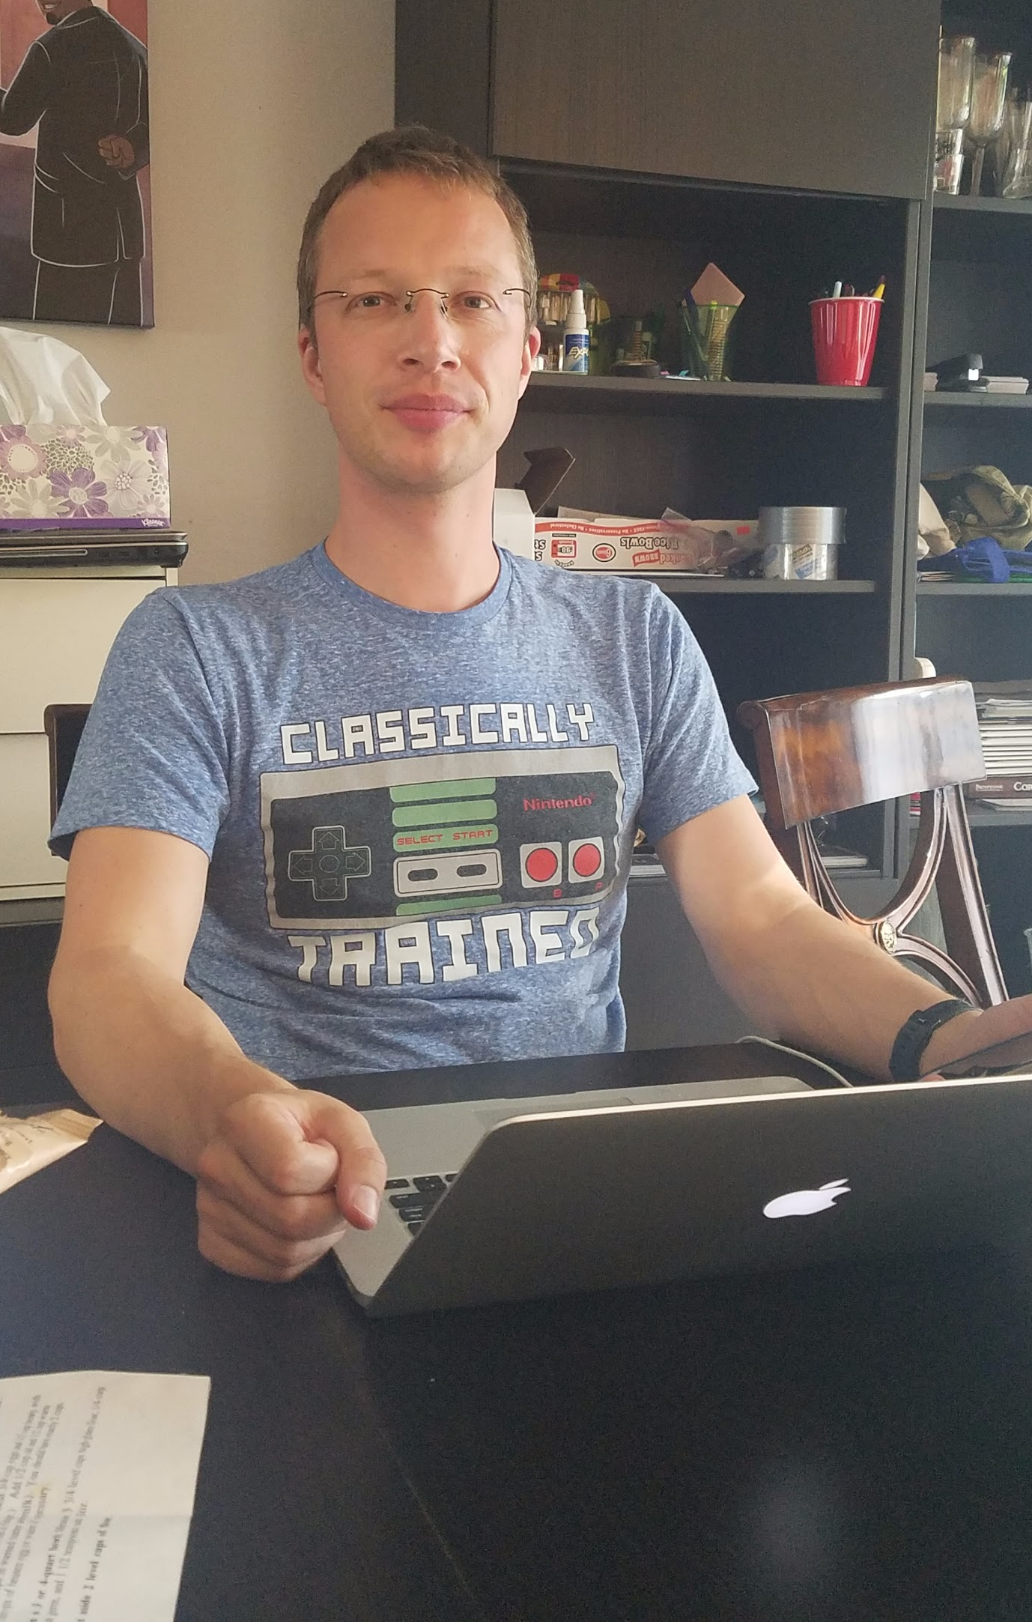
Interview techniques
In person interviews
Existing connections
Snowball sampling
Notes:
These interviews occurred in people’s homes/offices.

Slide 17
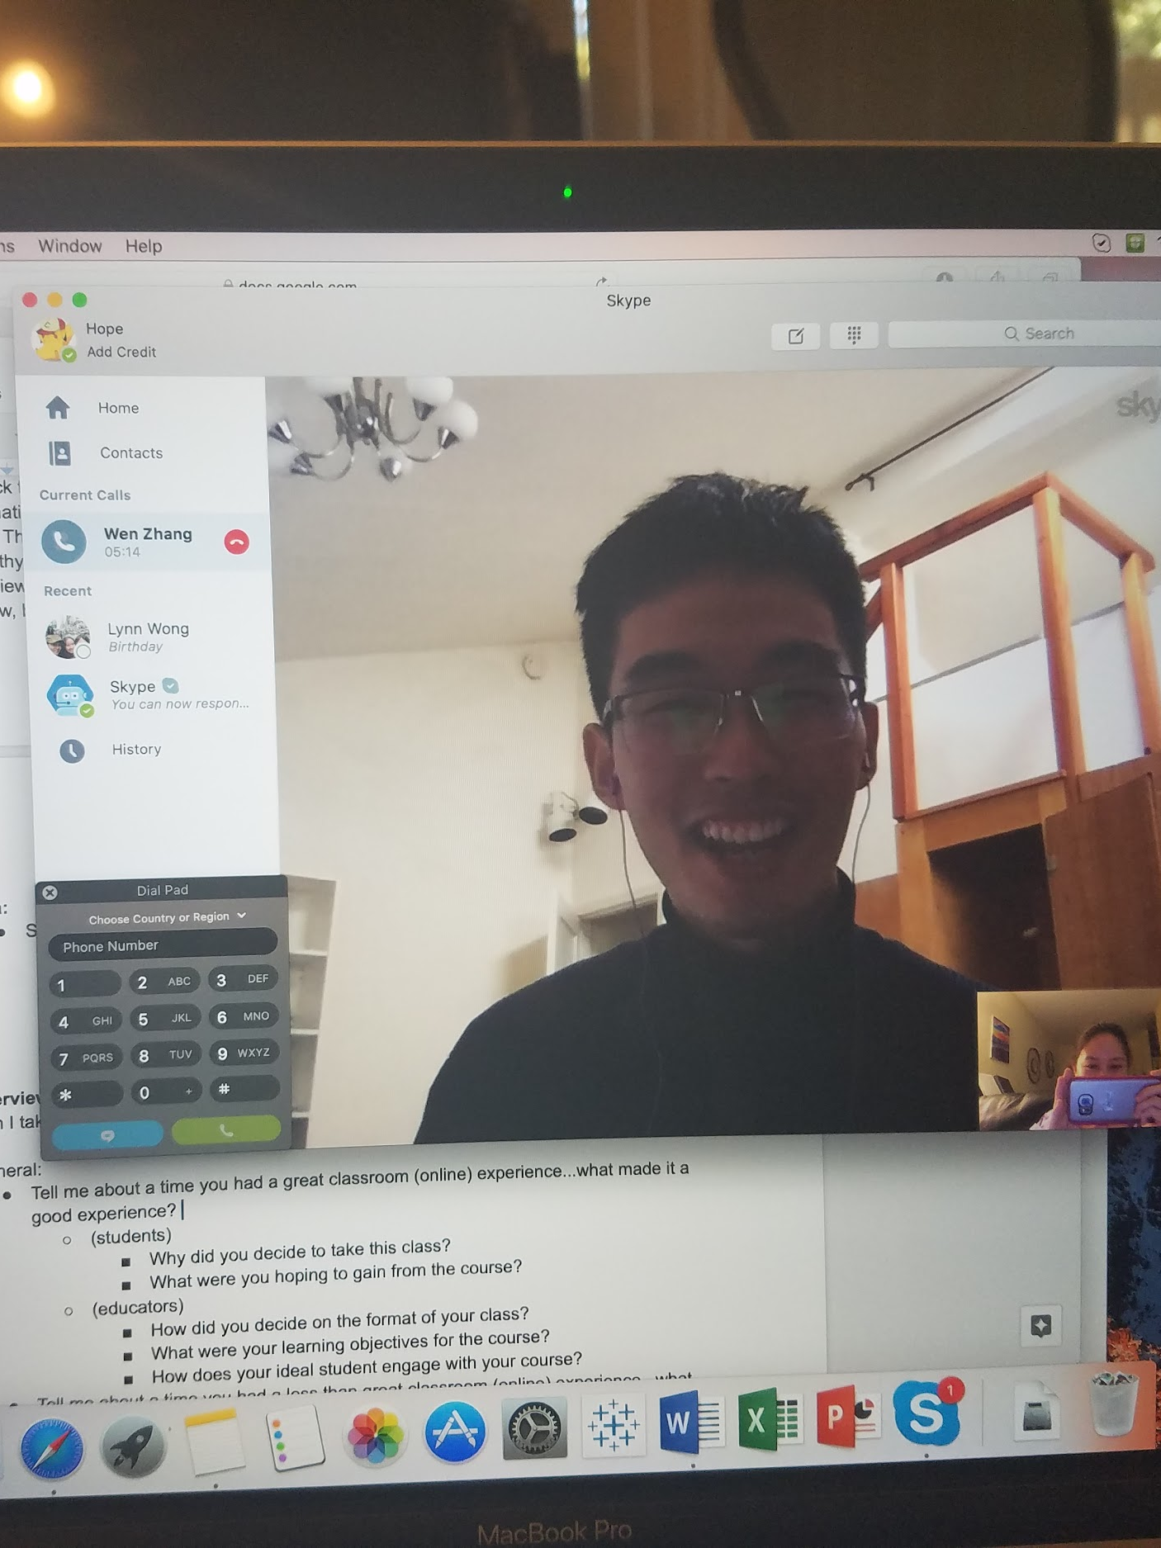
Interview techniques
Skype interviews
Allowed us to connect with people from diverse backgrounds/locations

Slide 18
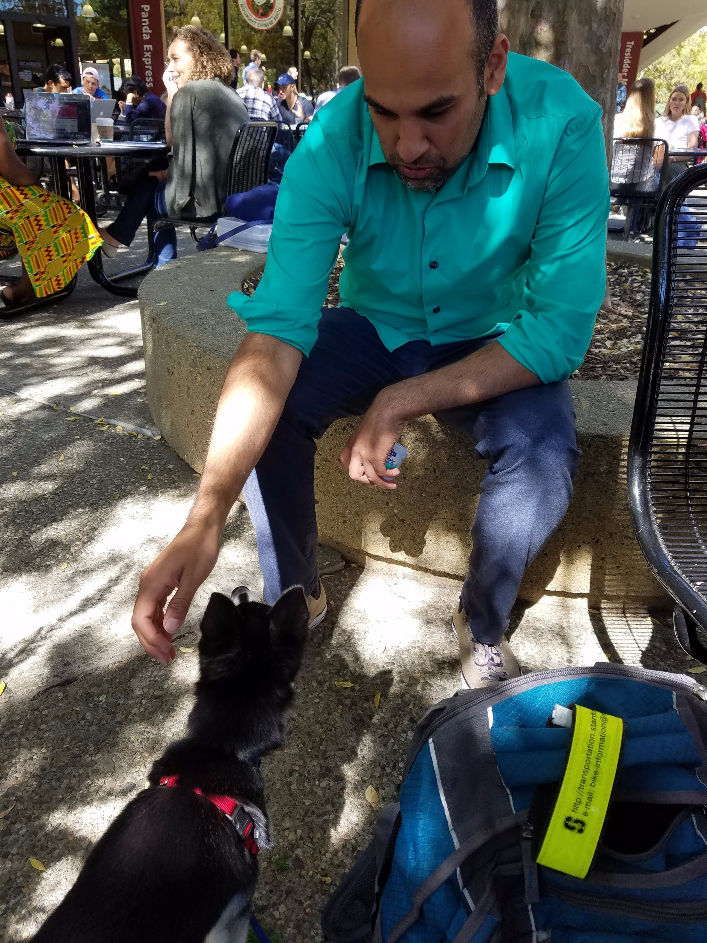
Interview techniques
(our favorite) Recruiting strangers w/ Hope’s puppy
Sat in areas with lots of students, found that people wanted to approach us
Notes:
These interviews occurred in Tressider/White Plaza

Slide 19
Interview findings
Notes:
Initial interview findings that helped frame later interviews/identify areas we could dig into

Slide 20

“Having a small class size doesn’t matter unless the professor is good.”

Slide 21
“Having a small class size doesn’t matter unless the professor is good.”
Finding:
Class size isn’t as important as we originally thought.

Slide 22

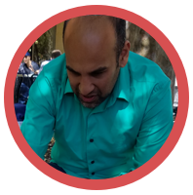
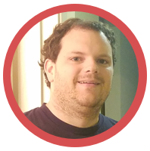
“As you go from
5 → 50 → 500 → 5000 students, you completely lose the ability to give human feedback.”
“I really valued when my professors took the time to help me one-on-one.”
“Getting feedback throughout on how students were doing helped reassure me that they got the concepts.”

Slide 23
“As you go from
5 → 50 → 500 → 5000 students, you completely lose the ability to give human feedback.”
Finding:
“I really valued when my professors took the time to help me one-on-one.”
Feedback is very valuable.
“Getting feedback throughout on how students were doing helped reassure me that they got the concepts.”

Slide 24
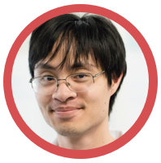
“[In an online classroom experience] everyone can learn at their own pace. But we
have to keep up the illusion that they’re not.”
Notes:
“When we first rolled out courses, they were scheduled at specific times. Ppl would get discouraged if they fell behind or couldn’t work ahead. So we did massive push for on demand. Sign up, can complete at your own pace. Everyone loved it but……..never finished a thing.”

Slide 25
“[In an online classroom experience] everyone can learn at their own pace. But we have to keep up the illusion that they’re not.”
Finding:
Students want flexibility in their learning, but too much can be detrimental.

Slide 26

“Everyone being somewhat challenged by material gave some sense of community.”
“My professor would turn off the wifi in the classroom to force us to stay engaged.”

Slide 27
“Everyone being somewhat challenged by material gave some sense of community.”
“My professor would turn off the wifi in the classroom to force us to stay engaged.”
Finding:
Adding challenges can drive
engagement.
Notes:
Students aren’t necessarily opposed to making the material more challenging, it can actually drive engagement

Slide 28
Analysis and interpretations

Slide 29




Say
Think
Do
Feel
Notes:
Icons from The Noun Project:
https://thenounproject.com/search/?q=speak&i=530975
https://thenounproject.com/search/?q=think&i=1132247
https://thenounproject.com/search/?q=feeling&i=1141056
https://thenounproject.com/search/?q=walking&i=95239

Slide 30
Say
“I like to feel like I contributed to the class discussion. I engage by saying meaningful stuff.”
“If I feel stupid, it’s probably my own fault.”
“You lose the apprenticeship model in large classrooms.”
“I didn’t really enjoy going to lectures as a student. I didn’t find it as useful as independent study, working on projects.”
“I can’t do online classes, I need to be with other people.”
“I don’t know if it was overwhelmed, but it was tending in that direction. There were a lot of people to help, and not enough of me.”
“I like wrestling with the material.”
“My ideal classroom is very interactive and discussion based.”
“The class was so large, I couldn’t find anyone to work with.”
“I need to have full attention, be captured and be looking forward to the next day.”

Slide 31
Do
Make sure every single question is geared towards a particular concept in the problem set
Refrain from asking questions in a large class if they think others know the material better
Stop going to lecture if they feel like it’s not useful
Reach out to course staff when they’re confused about a concept
People’s eyes light up and they get excited when remembering a good educational experience
Try and give direct feedback when possible
Reach out to individual students if they’re struggling
Find or make friends with other students and work through the class together
Read the students’ code over their shoulders as they were helping them to debug

Slide 32
Think
I learn best when I’m working with other people
I value the support system around my education, people care if I fall behind
I wish I could engage with more students one on one, too many students
I want my students to care about the material - “What was the major turning point for a student?”
I want to make my professor think. I value contributing meaningfully to the class
I prefer learning from others and collaborating rather than being subjected to a lecture
I learn best when the professor engages the class with interactive activities
I shouldn’t waste other students’ time if I’m behind. I should put more work in to catch up.
A small classroom is more personal, but also more competitive

Slide 33
Feel
Happy when students are engaged and learning
Overwhelmed when helping large number of students
Bored in classes where the professor wasn’t engaging/didn’t care, regardless of class size
Stressed when having to balance school and working full time
Confident when well prepared to teach a class
Lost when they’re taking a class and they don’t know anyone
Ashamed when taking up lecture time with questions
Annoyed when they know the class material already and have to sit through lecture
Uncomfortable not paying attention to the professor in a small classroom
Nervous when put on the spot to solve a problem in front of the class

Slide 34
“You lose the apprenticeship model in large classrooms.”
When teachers reach out and tell me how I’m doing, it feels like my learning is important to them
“Getting feedback throughout on how students were doing helped reassure me that they got the concepts.”
I wish I could engage with more students one on one, too many students
Try and give direct feedback when possible
More confident when you know how you’re doing relative to other people
Read the students’ code over their shoulders as they were helping them to debug
Happy when students are engaged and learning

Slide 35
Observation:
Interpretation:
Need:
Both students and teachers feel that constant feedback is important, but more difficult to achieve as class size increases
People learn more effectively when they care about how they’re doing
Confidence that learning objectives are being met

Slide 36
“I didn’t really enjoy going to lectures as a student.”
I prefer learning from others and collaborating rather than being subjected to a lecture
“In a small classroom, I miss the ability to look at Facebook without the professor noticing.”
Stop going to lecture if they feel like it’s not useful
Discouraged if they fell behind or couldn’t work ahead (in an online course)
Reach out to course staff when they’re confused about a concept

Slide 37
Observation:
Interpretation:
Need:
Students want to have the flexibility to do what they want in class
People value feeling in control of how they learn
A sense of agency over one’s own education

Slide 38
“I like to feel like I contributed to the class discussion. I engage by saying meaningful stuff.”
I want to make my professor think. I value contributing meaningfully to the class
“Having a small class size doesn’t matter unless the professor is good.”
A small classroom is more personal, but also more competitive
Ashamed when taking up lecture time with questions
Refrain from asking questions if they think others know the material better
Nervous when put on the spot to solve a problem in front of the class

Slide 39
Observation:
Interpretation:
Need:
Students don’t ask questions if they feel others know the answer, even in small classrooms
Students want to contribute without feeling judged
A way to build relationships and trust in classrooms of all sizes

Slide 40
Scale meaningful interactions in education
What do people value most about the educational experience?

Slide 41
Scale meaningful interactions in education
Feedback, sense of agency, community

Slide 42
Thank you!
Questions?
Notes:
Feedback as empowerment

