Slide 1

ClassLens
Midway Milestone Presentation
CS 147 - Fall 2017

Slide 2



Our Team
Hope Casey-Allen
Yash Tambawala
Amy Liu

Slide 3
Value Proposition
Making downstream feedback accessible to teachers and students

Slide 4
Problem
Currently, there's no organized way for teachers and students to understand if and how specific course objectives are useful in downstream classes or jobs.

Slide 5
Solution
ClassLens is a ​web-based ​platform ​for ​former ​students ​to ​give ​feedback ​on ​skills ​gained ​in ​a ​class ​ and how ​those ​skills are ​ being ​used ​in ​downstream ​classes ​and ​jobs.
​Teachers ​can ​use ​this feedback ​to ​see ​how ​to ​revise their courses, ​and ​students ​can ​ see ​whether ​a course ​is ​valuable ​for ​their ​short ​and ​long-term ​goals

Slide 6
Heuristic Evaluation Results

Slide 7
Heuristic Evaluation Results
“Write a Review” Page

Slide 8
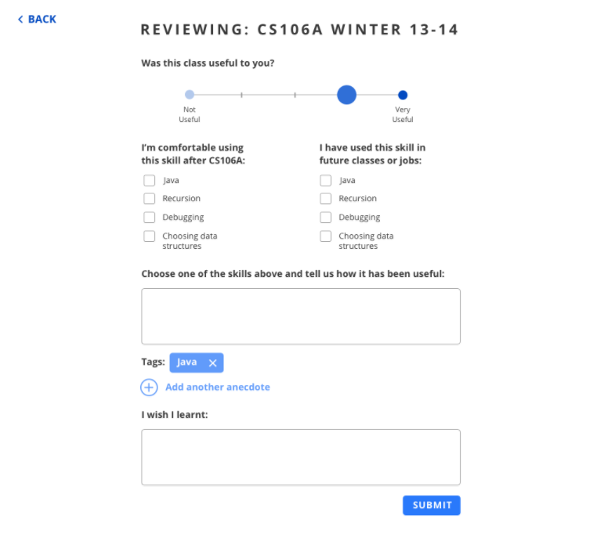
Severity 3 No Indication of Required Fields
Severity 4 Unclear that tag is about skills
Severity 4 Replace word “anecdote” - unclear
Severity 3 Clicking on submit leads to review page. No option to go back
“Write a review” page
BEFORE

Slide 9
Severity 3 No Indication of Required Fields
Fixed it. Marked the required fields with asterix and the text “required”
Severity 4 Unclear that tag is about skills
Fixed it. We rename it as “Which skills does your feedback apply to?”
Severity 4 Replace word “anecdote” - unclear
Removed - add another anecdote
Severity 3 Clicking on submit leads to review page. No option to go back
Will fix it in the hi-fi prototype. This was an issue with the medium-fi prototype tool
Changes Made - “Write a review” page
AFTER

Slide 10
Heuristic Evaluation Results
Top Right Menu Bar

Slide 11
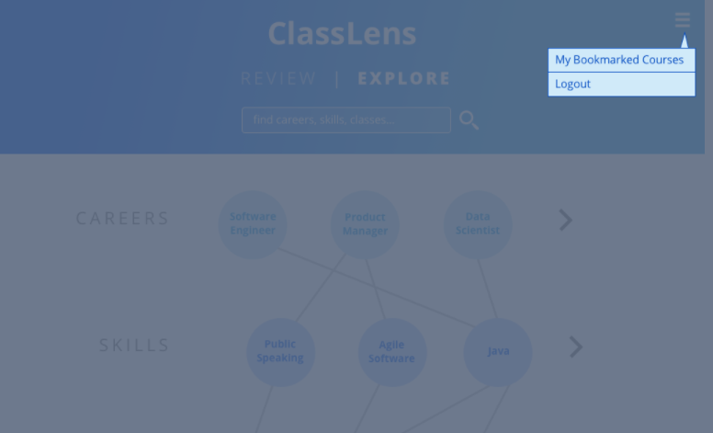
Severity 3 No way to read what you have written
Severity 3 No way to set current career through a profile page
More Personalization Required
BEFORE

Slide 12
Severity 3 No way to read what you have written
Added a “My reviews” page
Severity 3 No way to set current career through a profile page
Added a “My Profile” page
More Personalization Required
AFTER

Slide 13
Heuristic Evaluation Results
Pinning Feedback Action

Slide 14
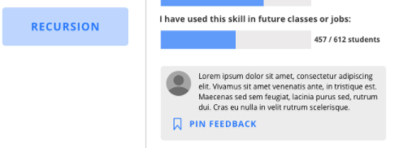
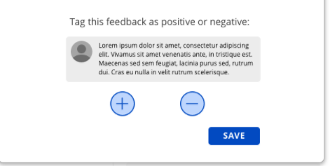
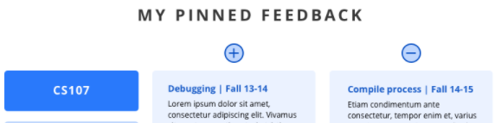
Severity 3 Status of pinned feedback doesn’t change after pinning
Severity 3 + and - button doesn’t make sense
Severity 3 Feedback can be pinned without choosing a polarity
Severity 3 Cannot edit the pinned feedback list
Pinning Feedback action needs changes
BEFORE

Slide 15
Severity 3 Status of pinned feedback doesn’t change after pinning
Resolved. Change the color of the icon and call it “Feedback Pinned”
Severity 3 + and - button doesn’t make sense
Change the positive and negative to happy, sad and neutral smileys
Severity 3 Feedback can be pinned without choosing a polarity
Grey out the save button until a polarity hasn’t been chosen
Severity 3 Cannot edit the pinned feedback list
Add a cross sign next to each feedback to remove it
Pinning Feedback action needs changes
AFTER

Slide 16
Summary of Changes
Making the “write a review” experience easy
Adding more personalization related features
Making the feedback pinning interactions more familiar

Slide 17
Prototype Implementation Status

Slide 18
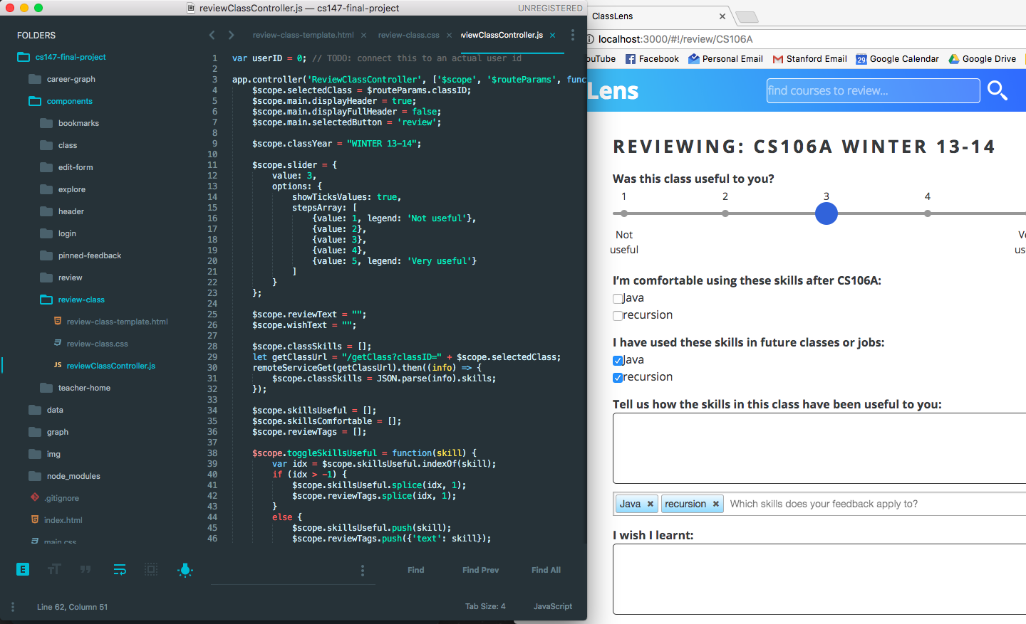
Tools used
Front-end: Angular, Node.JS
D3.js for visualizing career graph
Backend based on dynamic JSON files

Slide 19
Implemented Features
Front-end:
Write a review page
Student review homepage
Login page
Top bar component
Back-end:
Reviews Data Model
Skill and career tags
Teacher’s pinned feedback

Slide 20
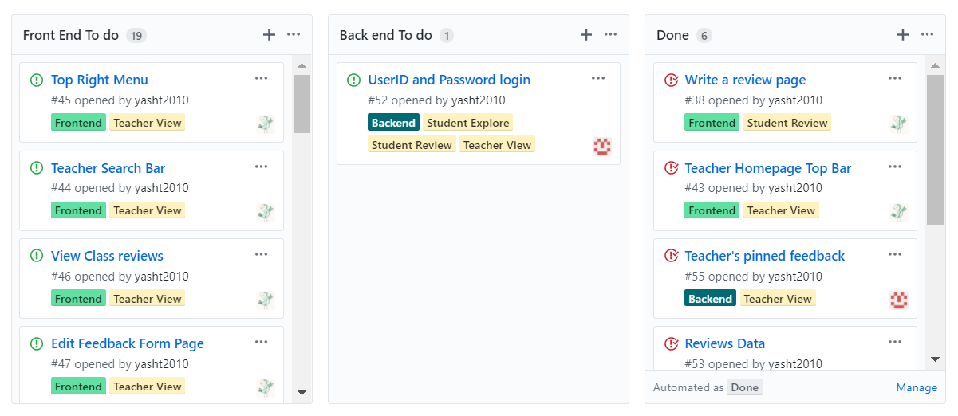
Unimplemented Features
Front-end
Student explore courses task
Teacher view feedback task
Back-end
UserID and password
User Profile Information
Using GitHub Project to keep a track of the unimplemented features

Slide 21
Hard Coded Data
Importing Course Information from Explore Courses
Skills in courses (Based on ExploreCourses Information)
Course reviews
Skills required for various careers based on reviewer profession

Slide 22
Issues in Implementation
Implementation of Career graph on the student home page
Currently using D3.js for this. However, we are facing many issues in implementing it exactly according to our requirement.
D3 cluster layout doesn’t allow multi-parent nodes
Suggestions would be welcome!

Slide 23
Demo!

Slide 24
Summary
Resolving all possible issues of severity 2,3 and 4 from the heuristic evaluation
Adding additional pages related to personalized user settings - Profile page, my reviews
On track to finish - using GitHub Projects and issues for project management

Slide 25
Thank you!

