Slide 1

ClassLens
Hope Casey-Allen, Amy Liu, Yash Tambawala
Notes:
Icon created by corpus delicti from Noun Project

Slide 2
Problem/Solution Overview, Value Proposition
Problem:
Currently, there’s no organized way for teachers and students to understand:
1) how well students are meeting course objectives (i.e., learning skills)
2) if the objectives / skills are useful in downstream classes or jobs
Solution:
A web-based platform for former students to give feedback on skills gained in a class and how those skills are being used today/in later classes/in later jobs.Teachers can use this feedback to see how to revise their courses, and students can use it to see whether a course is valuable for their short and long-term goals.
Value Proposition:
ClassLens: Reimagining course feedback and selection!
Notes:
Icon created by corpus delicti from Noun Project

Slide 3
Three Tasks
Former students give feedback on skills gained, how those skills are being used today/in later class/ in later jobs, and on specific topics (Complex)
Teachers browse feedback (Medium)
Students browse feedback, choose which classes to take based on skills and trajectory toward jobs (Medium) [REVISED - Students browse feedback to explore classes and careers]
Notes:
Icon created by corpus delicti from Noun Project

Slide 4
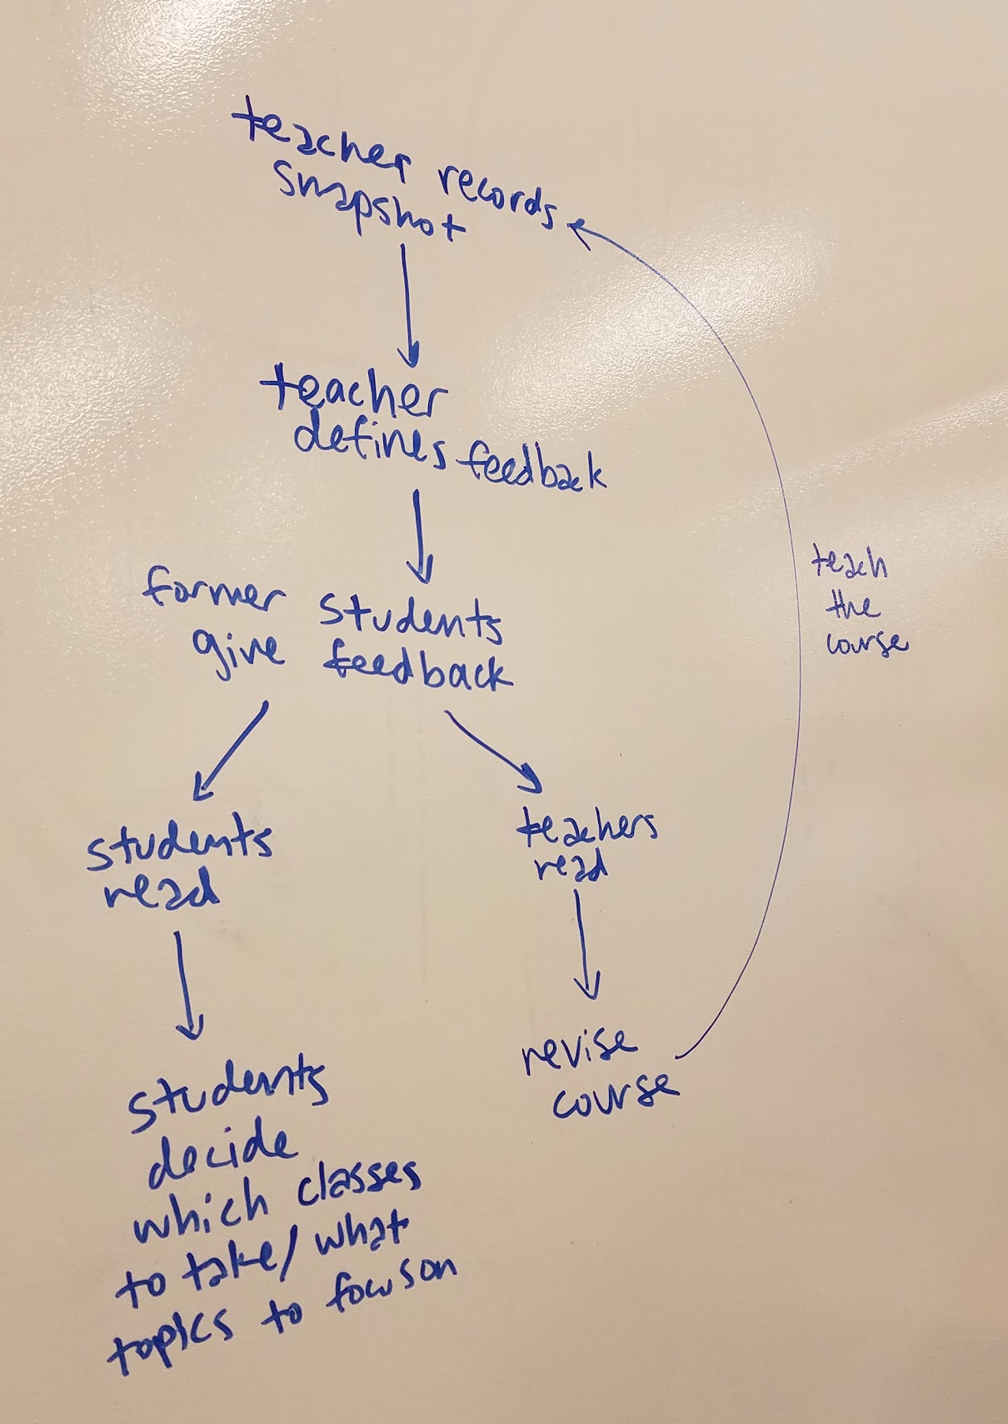
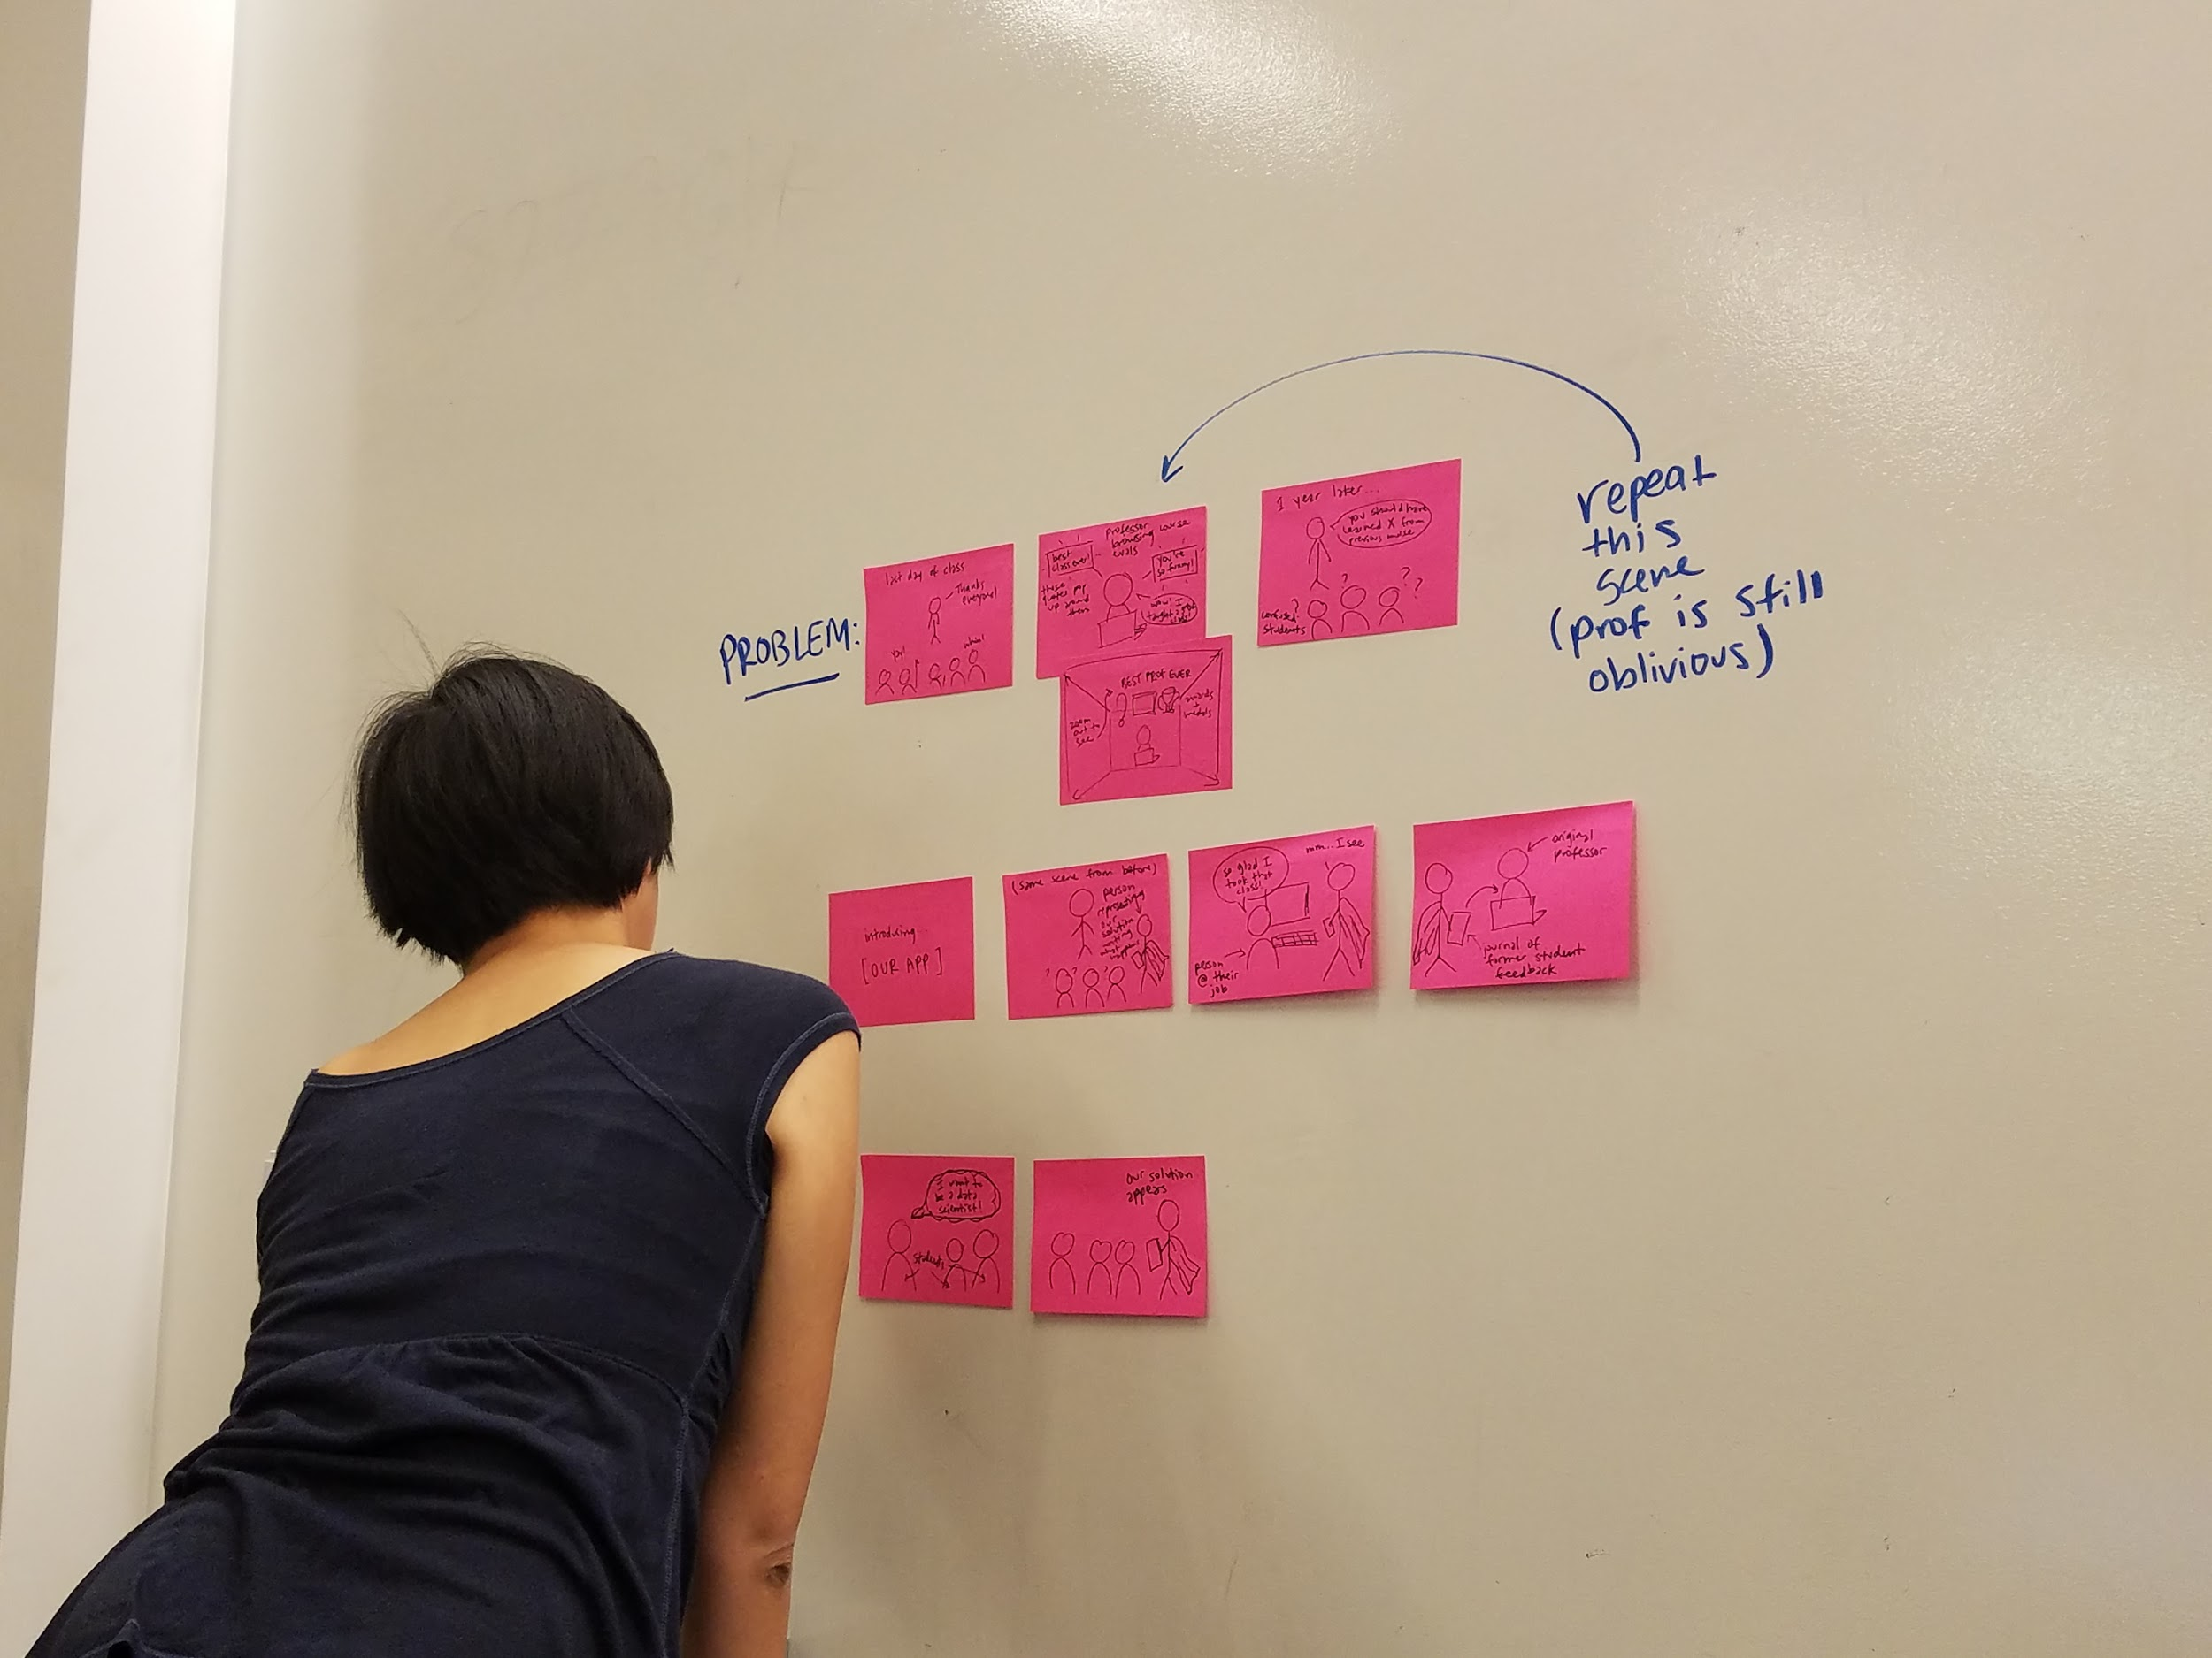
Video Storyboards

Slide 5
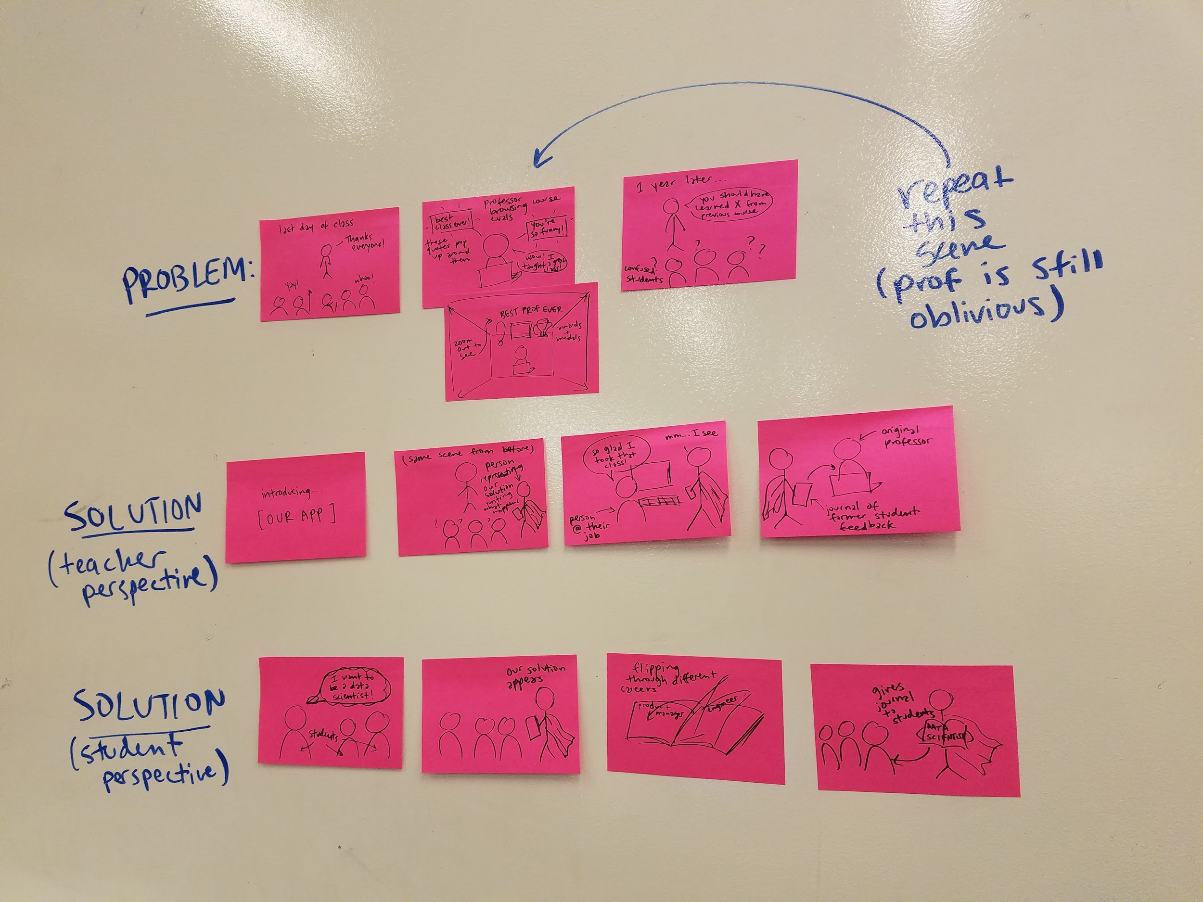

Slide 6
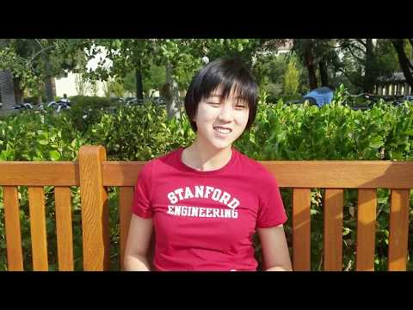
Concept Video

