Slide 1
Human Abilities: Vision & Cognition
November 6, 2017
Notes:
1:55 min with 5 min for quiz and only one in class experiments.
2 min over. Skipped through summary slides. Start on time and we will be fine!
broke at 40 minutes in (started 5 min late – TA took questions)
For 15 minutes

Slide 2
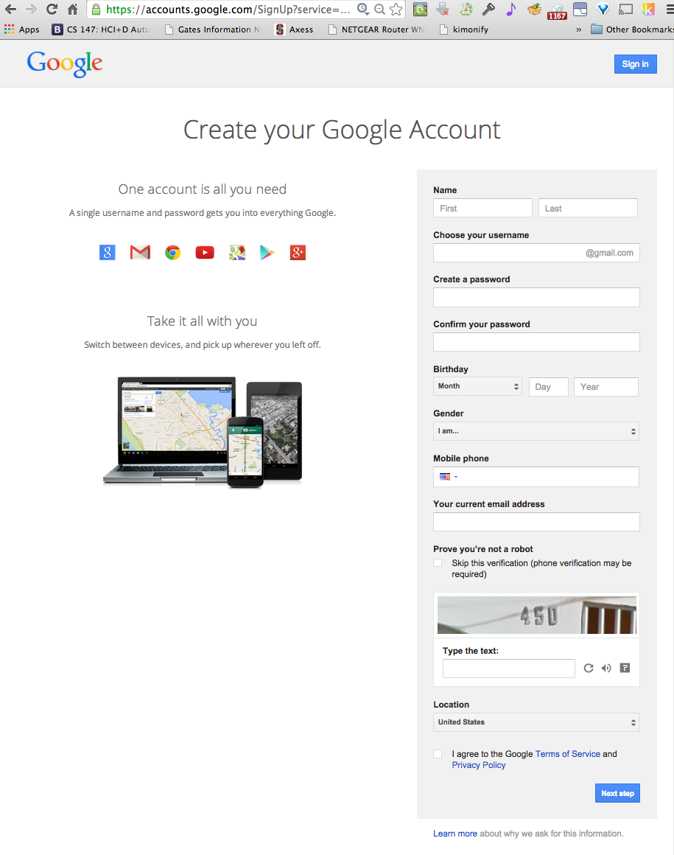
Hall of Fame or Shame?

Slide 3
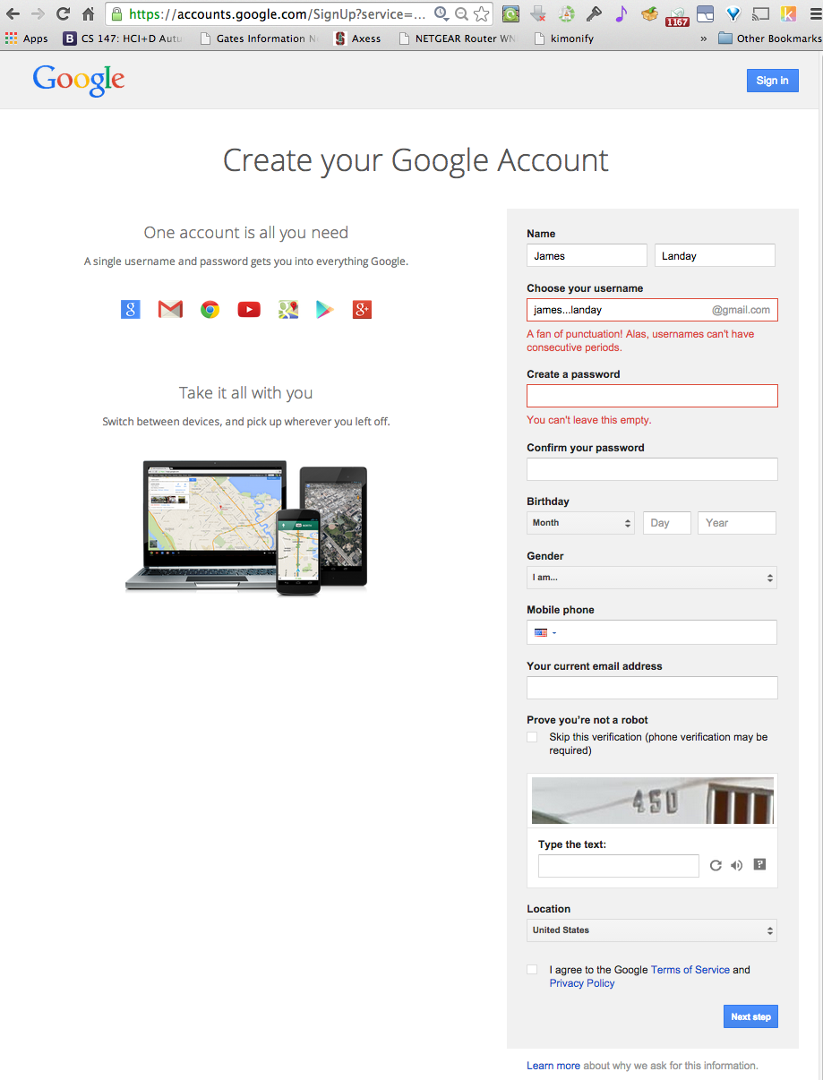
Hall of Fame or Shame?

Slide 4
Hall of Fame!
Clearly highlights error (red text & box)
Tells me what I did wrong/how to fix it
In user’s language
(careful w/ humor)
Red may be issue, more later..

Slide 5
Hall of Fame or Shame?

Slide 6
Hall of Shame!
Error Messages
where is the error?
what’s wrong with it?
parse & fix it yourself!

Slide 7
Human Abilities: Vision & Cognition
November 6, 2017

Slide 8
Outline
Human visual system
Guidelines for design
Team Break
Two in class experiments
Models of human performance (MHP)
Memory

Slide 9
Why Study Color?
Color can be a powerful tool to improve user interfaces by communicating key information
Inappropriate use of color can severely reduce the performance of systems we build

Slide 10
Visible Spectrum

Slide 11
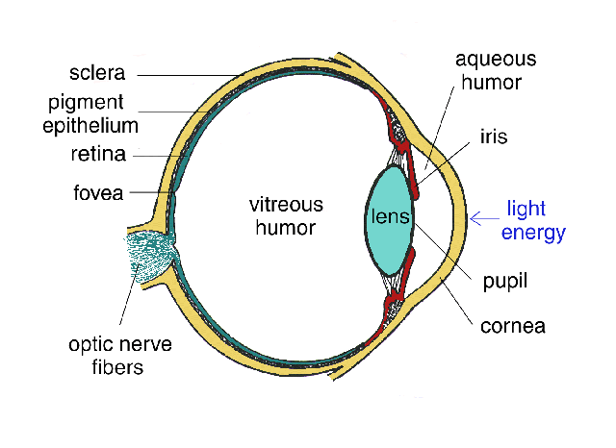
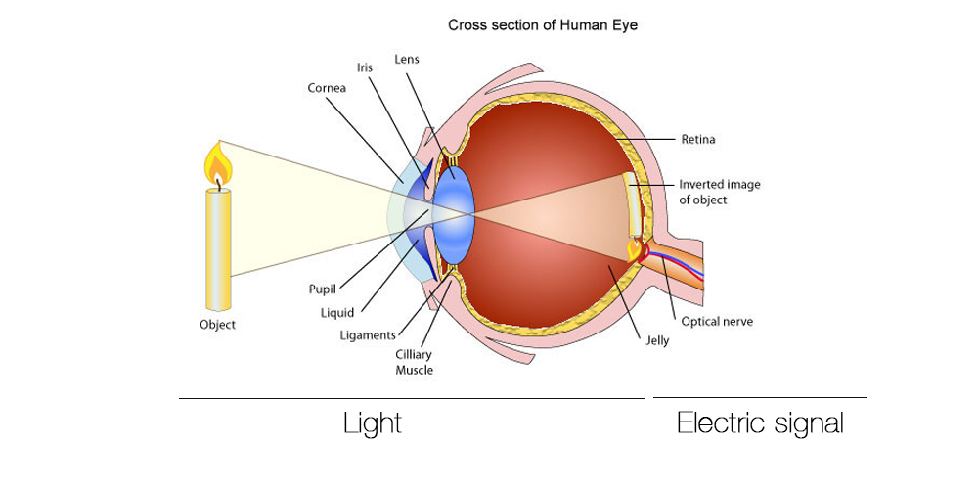
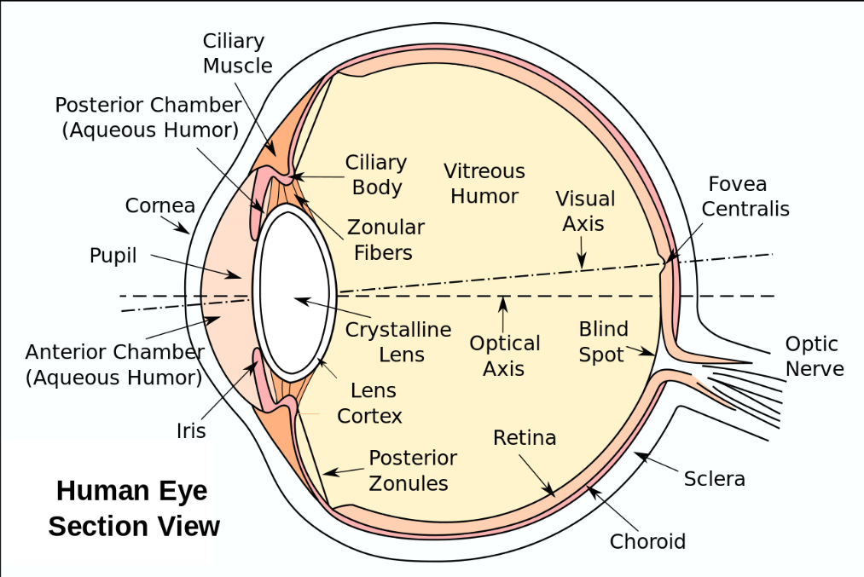
Human Visual System
http://obsessive-coffee-disorder.com/wp-content/uploads/2014/11/eye1.jpg
Light passes through lens
Focused on retina

Slide 12
Retina
Retina covered with two types of light-sensitive receptors called?
rods
primarily for night vision & perceiving movement
sensitive to broad spectrum of light
can’t discriminate between colors
sense intensity or shades of gray
cones
used to sense color

Slide 13
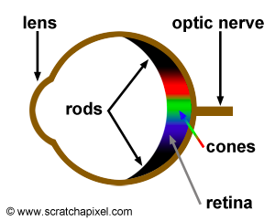
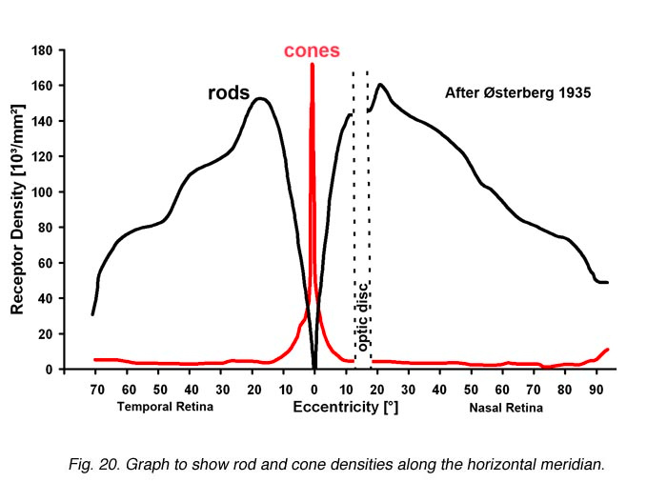
Retina
Center of retina has most of the cones →
allows for high acuity of objects focused at center
Edge of retina is dominated by rods →
allows detecting motion of threats in periphery
http://www.webexhibits.org/causesofcolor/1G.html
http://webvision.med.utah.edu/imageswv/Ostergr.jpeg

Slide 14
Color Perception via Cones
“Photopigments” used to sense color
3 types: blue, green, “red” (really yellow)
each sensitive to different band of spectrum
ratio of neural activity of the 3 → color
other colors are perceived by combining stimulation

Slide 15
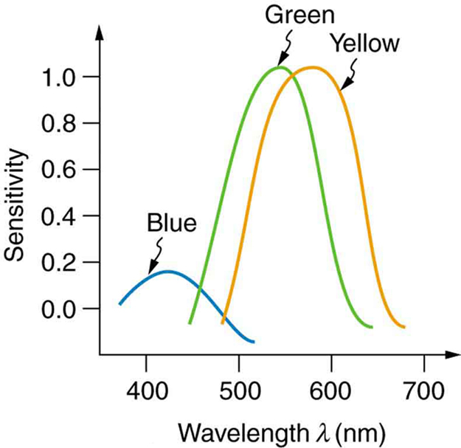
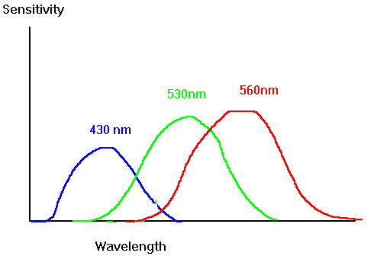
Color Sensitivity
AKA Red
lots of overlap
not as sensitive to blue
http://archive.cnx.org/contents/d42c807d-a9fa-4e3d-83d0-0f7c745b51a0@4/color-and-color-vision#import-auto-id1844887
https://www.siggraph.org/education/materials/HyperGraph/color/images/colorspc.gif
Notes:
See anything interesting here?
We are NOT as sensitive to blue
There is lots of overlap between the 3 photopigments
Image from: http://archive.cnx.org/contents/d42c807d-a9fa-4e3d-83d0-0f7c745b51a0@4/color-and-color-vision#import-auto-id1844887

Slide 16
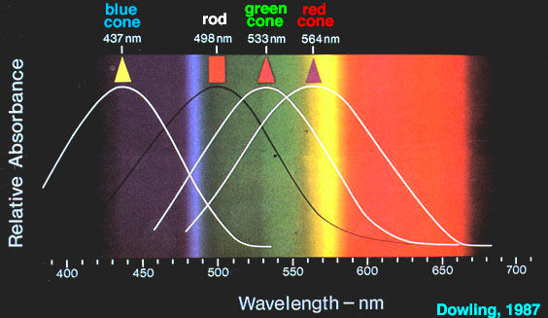
Color Sensitivity
Centered on yellow
http://retina.umh.es/webvision/imageswv/spectra.jpeg

Slide 17
Distribution of Photopigments
Not distributed evenly – mainly reds (64%) & very few blues (4%) →
insensitivity to short wavelengths (blue)
Few blue cones in retina center (high acuity) →
“disappearance” of small blue objects you fixate on
As we age lens yellows & absorbs shorter wavelengths →
sensitivity to blue is even more reduced
Implication
don’t rely on blue for text or small objects!
http://www.webexhibits.org/causesofcolor/1G.html
Notes:
Original choice of blue links on the web was a bad idea!

Slide 18
Focus
Different wavelengths of light focused at different distances behind eye’s lens
need for constant refocusing → ?
causes fatigue
be careful about color combinations
Notes:
Left image saturated, right desaturated (how much gray)
Decreasing lightness helps, but much better on right with desaturated colors than saturated
(sweater will still “pop”)

Slide 19
Focus
Different wavelengths of light focused at different distances behind eye’s lens
need for constant refocusing → ?
causes fatigue
be careful about color combinations
Pure (saturated) colors require more focusing than less pure (desaturated)
don’t use saturated colors in UIs unless you really need something to stand out
http://www.pallasweb.com/color.html
Notes:
Left image saturated, right desaturated (how much gray)
Decreasing lightness helps, but much better on right with desaturated colors than saturated
(sweater will still “pop”)

Slide 20
Color Deficiency (Also known as “color blindness”)
Trouble discriminating colors
besets about 9% of population
Two main types
different photopigment response most common
reduces capability to discern small color diffs
red-green deficiency is best known
lack of either green or red photopigment → can’t discriminate colors dependent on R & G

Slide 21
Color Guidelines
Avoid simultaneous display of highly saturated, spectrally extreme colors
e.g., no cyans/blues at the same time as reds, why?
refocusing!
desaturated combinations are better → pastels

Slide 22
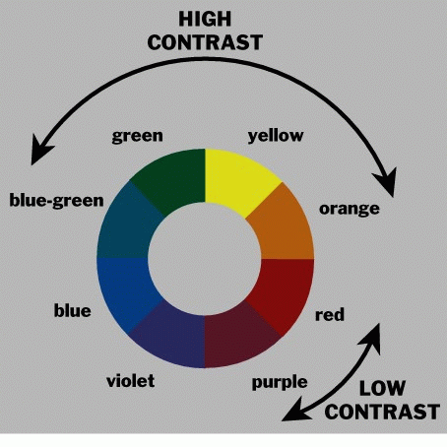
Use the Hue Circle
Pick non-adjacent colors
opponent colors go well together
(red & green) or (yellow & blue)
Notes:
We will cover more of this in the visual design lecture

Slide 23
Color Guidelines (cont.)
Avoid pure blue for text, lines & small shapes
also avoid adjacent colors that differ only in blue
blue makes a great background color
TO BLUE
Notes:
Mainly an issue for lots of text
blue makes a fine background color

Slide 24
Color Guidelines (cont.)
Size of detectable changes in color varies
hard to detect changes in reds, purples, & greens
easier to detect changes in yellows & blue-greens
older users need higher brightness levels
Hard to focus on edges created by only color
use both brightness & color differences
Avoid single-color distinctions
mixtures of colors should differ in 2 or 3 colors
helps color-deficient observers
Notes:
blue makes a fine background color

Slide 25
T E A M B R E A K
Notes:
broke at 40 minutes in (started 5 min late – TA took questions)
For 15 minutes

Slide 26
Administrivia
Quiz 2 grades
Average: 3.25 / 4
Median: 3 / 4
Std. Dev.: .5
Range 2-4
Have your Heuristic Evaluation ready to go when you arrive in studio Thur/Fri

Slide 27
Notes:
What is NOT one of the processing stages of the Model Human Processor (MHP)? https://www.polleverywhere.com/multiple_choice_polls/FIPK55Q9tSIgTAx

Slide 28
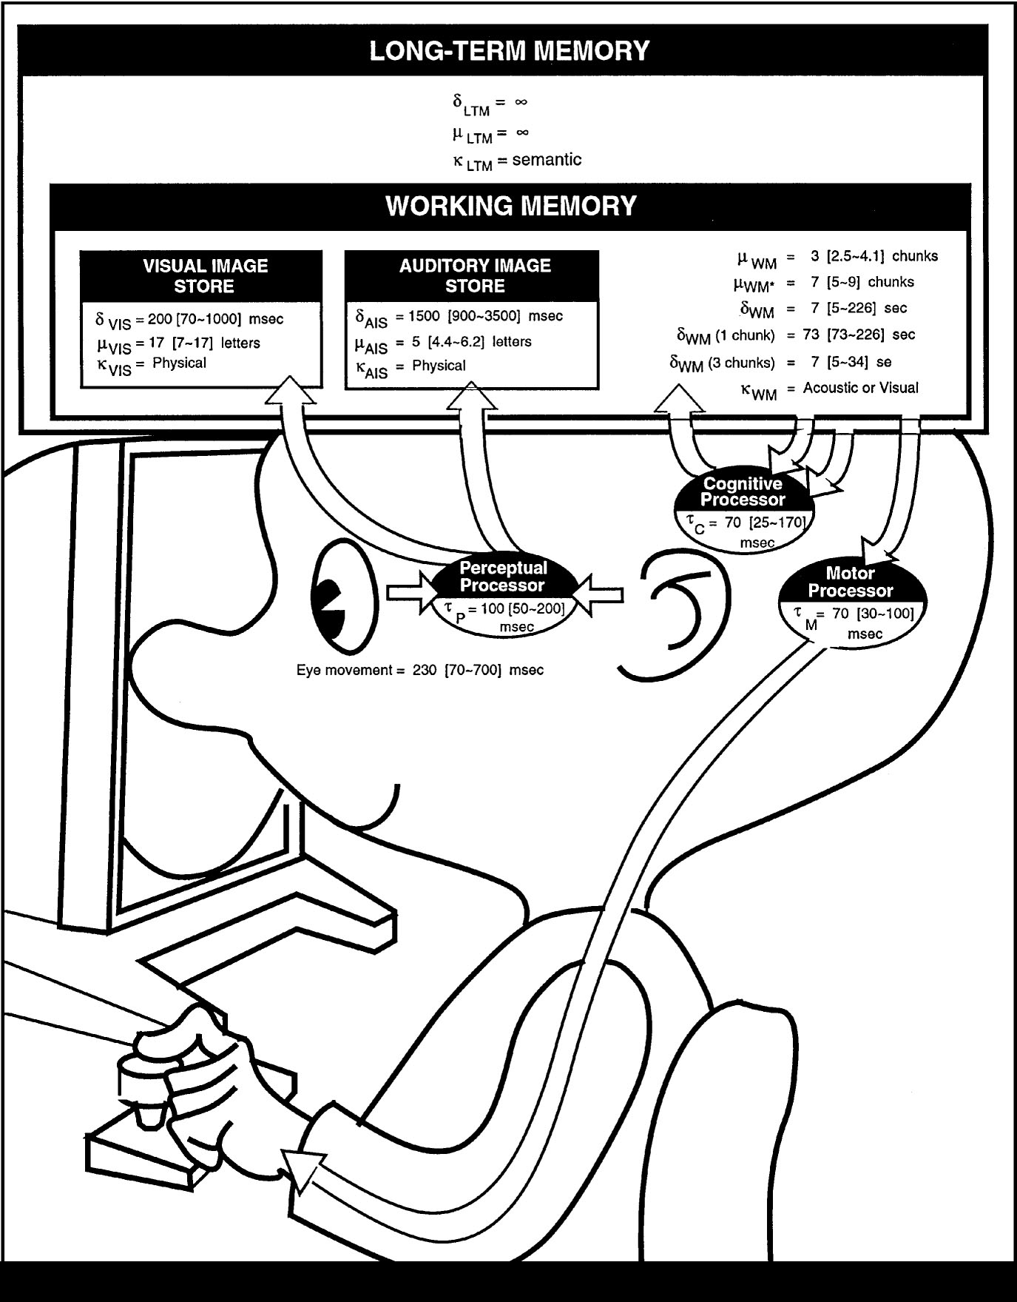
The Model Human Processor
Developed by Card, Moran & Newell (’83)
based on empirical data
Notes:
We model human performance to test understanding and
To predict the influence of new technology.
This is the classic image form the book “The Psychology of Human-Computer Interaction”

Slide 29
The Model Human Processor
Developed by Card, Moran & Newell (’83)
based on empirical data
Long-term Memory
Working Memory
sensory
buffers
Visual Image
Store
Auditory Image
Store
Eyes
Perceptual
Processor
Motor
Processor
Cognitive
Processor
Ears
Fingers, etc.
Notes:
I’ll use this simpler model

Slide 30
MHP Basics
Sometimes serial, sometimes parallel
serial in action & parallel in recognition
pressing key in response to light (serial)
driving, reading signs & hearing at once (parallel)
Parameters
processors have cycle time (T) ~ 100 ms
memories have capacity, decay time & type

Slide 31
What is missing from MHP?
Long-term Memory
Working Memory
sensory
buffers
Visual Image
Store
Auditory Image
Store
Eyes
Perceptual
Processor
Motor
Processor
Cognitive
Processor
Ears
Fingers, etc.
Notes:
Haptic memory
Moving from sensory memory to working memory
Moving from working memory to long-term memory

Slide 32
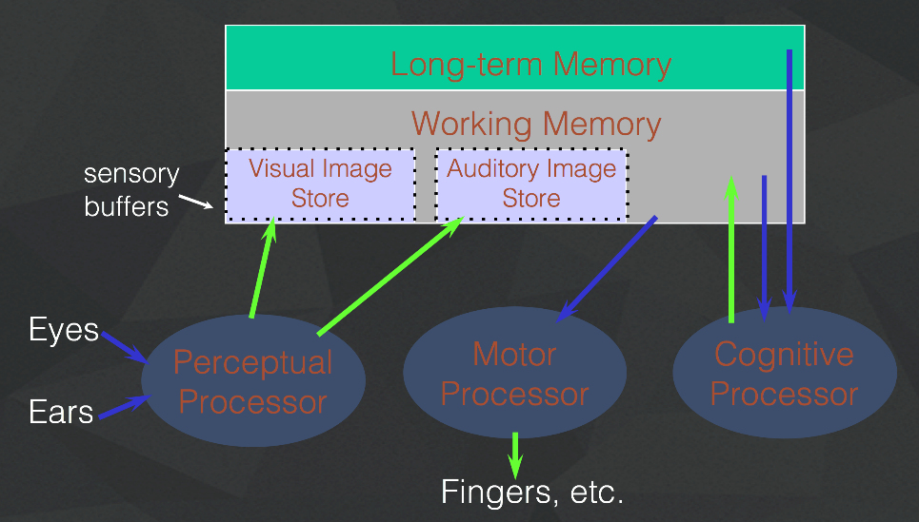
What is missing from MHP?
Haptic memory
for touch
Moving from sensory memory to WM
attention filters stimuli & passes to WM
Moving from WM to LTM
elaboration
Notes:
Perception of Touch… Smell… Taste….

Slide 33
Notes:
Why do we care about memory…

Slide 34
Memory
Working memory (short term)
small capacity (7 ± 2 “chunks”)
6174591765 vs. (617) 459-1765
NBCIBMGMC vs. NBC IBM GMC
rapid access (~ 70ms) & decay (~200 ms)
pass to LTM after a few seconds of continued storage
Long-term memory
huge (if not “unlimited”)
slower access time (~100 ms) w/ little decay

Slide 35
MHP Principles of Operation
Recognize-Act Cycle of the CP
on each cycle contents in WM initiate actions associatively linked to them in LTM
actions modify the contents of WM

Slide 36
MHP Principles of Operation
Long-term Memory
Working Memory
sensory
buffers
Visual Image
Store
Auditory Image
Store
Eyes
Perceptual
Processor
Motor
Processor
Cognitive
Processor
Ears
Fingers, etc.
Notes:
I’ll use this simpler model

Slide 37
MHP Principles of Operation
Recognize-Act Cycle of the CP
on each cycle contents in WM initiate actions associatively linked to them in LTM
actions modify the contents of WM
Discrimination Principle
retrieval is determined by candidates that exist in memory relative to retrieval cues
interference by strongly activated chunks

Slide 38
Experiment
Task: Quickly tap each target 50 times accurately
Conditions:
Two ½” diameter targets 6” apart
Two ½” diameter targets 24” apart
Two 2” diameter targets 24” apart
Two 2” diameter targets 24” apart (no accuracy required)
Turn to neighbor: discuss what will happen
Notes:
Draw two circles on the board
both around 1/2 inches in diameter
1) distance of 6 inches
2) Repeat by extending the distance to 24 inches
Ask volunteer to put mark in circle 50 times each quickly, but accurately (outside of circle at most 4 times)
Now do it 24" apart and still 1" diameter
TURN to a partner and discuss what you think will happen and WHY????
ID=Log2(d/w+1) : try easy ID of 4 and hard of ID 8
log2 (13)=3.7
Log2 (49)=5.6
Now try it again with 24 inches but make the target 2 inches wide
3) log2 (13)=3.7
) Now try again asking the person to go as fast as they can independent of accuracy (should get more speed but see spread of circles outside)
Results:
30 sec
48 sec
31 sec (as predicted, almost the same as #1)
21 sec (lots of spread)

Slide 39
Experimental Results
Task: Quickly tap each target 50 times accurately
30 sec
48 sec
31 sec
21 sec (lots of spread)
Notes:
Draw two circles on the board
both around 1/2 inches in diameter
1) distance of 6 inches
2) Repeat by extending the distance to 24 inches
Ask volunteer to put mark in circle 50 times each quickly, but accurately (outside of circle at most 4 times)
TURN to a partner and discuss what you think will happen and WHY????
ID=Log2(d/w+1) : try easy ID of 4 and hard of ID 8
log2 (13)=3.7
Log2 (49)=5.6
Now try it again with 24 inches but make the target 2 inches wide
3) log2 (13)=3.7
) Now try again asking the person to go as fast as they can independent of accuracy (should get more speed but see spread of circles outside)
Results:
30 sec
48 sec
31 sec (as predicted, almost the same as #1)
21 sec (lots of spread)

Slide 40
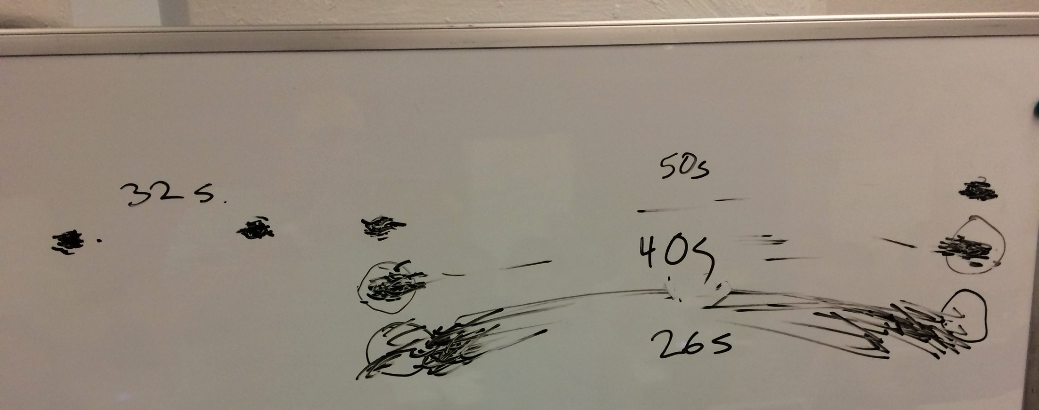
Experimental Results
Task: Quickly tap each target 50 times accurately
30 sec
48 sec
31 sec
21 sec (lots of spread)
Notes:
Draw two circles on the board
both around 1/2 inches in diameter
1) distance of 6 inches
2) Repeat by extending the distance to 24 inches
Ask volunteer to put mark in circle 50 times each quickly, but accurately (outside of circle at most 4 times)
TURN to a partner and discuss what you think will happen and WHY????
ID=Log2(d/w+1) : try easy ID of 4 and hard of ID 8
log2 (13)=3.7
Log2 (49)=5.6
Now try it again with 24 inches but make the target 2 inches wide
3) log2 (13)=3.7
) Now try again asking the person to go as fast as they can independent of accuracy (should get more speed but see spread of circles outside)
Results:
30 sec
48 sec
31 sec (as predicted, almost the same as #1)
21 sec (lots of spread)

Slide 41
Principles of Operation (cont.)
Fitts’ Law
moving hand is a series of microcorrections
correction takes T_{p +} T_{c +} T_{m} = 240 msec
time T_{pos} to move the hand to target size S which is distance D away is given by:
T_{pos} = a + b log₂ (D/S + 1)
summary
time to move the hand depends only on the relative precision required

Slide 42
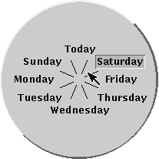
Fitts’ Law Example
Pop-up Linear Menu
Pop-up Pie Menu
Today
Sunday
Monday
Tuesday
Wednesday
Thursday
Friday
Saturday
Which will be faster on average?
pie menu (bigger targets & less distance)
Notes:
Outer edge of screen

Slide 43
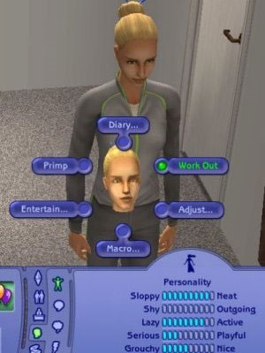
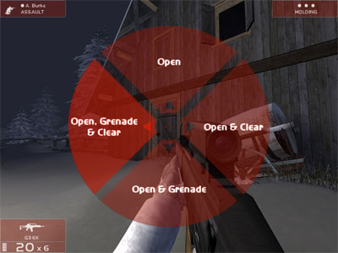
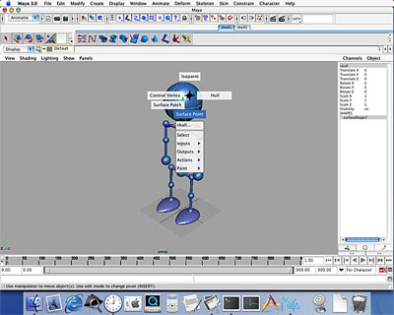
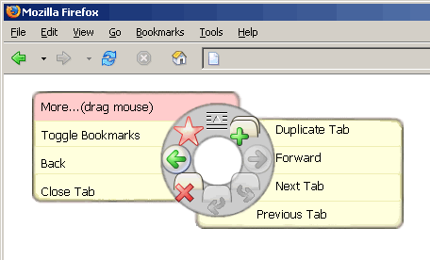
Pie Menus in Use Today
Rainbow 6
The Sims
Maya
Notes:
Anyone know of good examples?
In many pieces of software, but still haven’t reached ubiquity… why?

Slide 44
Apple Watch
Notes:
Very hard to accurate tap on icons… leads to errors… example of Fitts’ Law in action

Slide 45
Simple Experiment
Volunteer
Start saying colors you see in list of words
when slide comes up
as fast as you can
Say “done” when finished
Everyone else time it…

Slide 46
Paper
Home
Back
Schedule
Page
Change

Slide 47
Simple Experiment
Do it again
Say “done” when finished

Slide 48
Bandana
Forward
Home
Test
Basket
Paper

Slide 49
Simple Experiment
Do it again
Say “done” when finished

Slide 50
Yellow
White
Black
Blue
Red
Green

Slide 51
Memory
Interference
two strong cues in working memory
link to different chunks in long term memory
Why learn about memory?
know what’s behind many HCI techniques
helps you understand what users will “get”
aging population of users

Slide 52
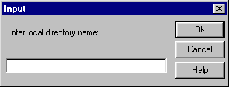
Design UIs for Recognition over Recall
Recall
info reproduced from memory
e.g., command name & semantics
Recognition
presentation of info provides knowledge that info has been seen before
e.g., command in menu reminds you of semantics
easier because of cues to retrieval
cue is anything related to item or situation where learned
e.g., giving hints, icons, labels, menu names, etc.

Slide 53
Human Abilities Summary
Color can be helpful, but pay attention to
how colors combine
limitations of human perception
people with color deficiency
Model Human Processor
perceptual, motor, cognitive processors + memory
model allows us to make predictions
Memory
three types: sensor, WM & LTM
interference can make hard to access LTM
cues in WM can make it easier to access LTM
Key time to remember from MHP: ~100 ms cycle time and memory access time

Slide 54
Further Reading Vision and Cognition
Books
The Psychology Of Human-Computer Interaction, by Card, Moran, & Newell, Erlbaum, 1983
Human-Computer Interaction, by Dix, Finlay, Abowd, and Beale, 1998.
Perception, Irvin Rock, 1995.
Pages 66-99 of “Cognitive Aspects in Interaction Design”, from Interaction Design, 3rd Edition by Rogers, Sharp, & Preece
Applying Fitts’ Law to Mobile Interface Design by Justin Smith

Slide 55
Next Time
Conceptual Models & Interface Metaphors
Read "The Psychology of Everyday Things" (Ch. 1), from The Design of Everyday Things by Donald Norman
Studio
Ad-hoc group heuristic evaluation
Must be present to get credit on assignment
Notes:
5 minutes over and skipped color experiment

