Slide 1
Design Exploration Through Sketching & Experience Prototyping
This work is licensed under the Creative Commons Attribution-
Noncommercial-Share Alike 3.0 Unported License. To view a copy of
this license, visit http://creativecommons.org/licenses/by-nc-sa/3.0/
October 16, 2017
* slides marked Buxton are courtesy of Bill Buxton, from his talk “Why I Love the iPod, iPhone, Wii and Google”, remix uk, 18-19 Sept. 2008, Brighton
Notes:
65 minutes until the team break
Finished at exactly at 1:50 min (on time)

Slide 2
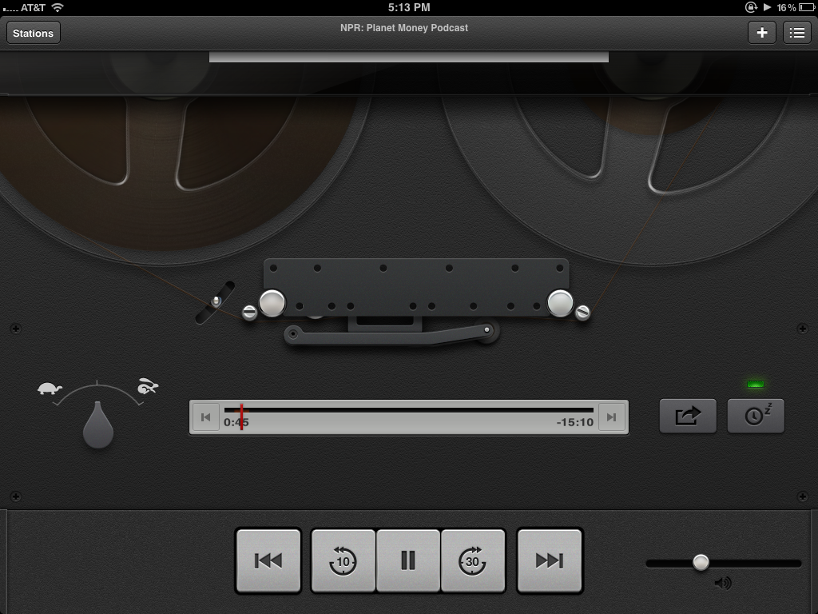
Hall of Fame or Shame?
Podcasts App
Apple Inc.
Notes:
prime example of Apple's foray in skeuomorphism
Skeuomorphism is the design concept of making items represented resemble their real-world counterparts.

Slide 3
Hall of Fame or Shame?
Good
At first glance, is fun and unique
Well polished, aesthetically pleasing
Bad
What does a tapedeck have to do with podcasts? – confused metaphor is difficult to understand
Focus on ‘retro’ means the user has to wait 5 seconds to watch animation of tape loading before anything plays
Podcasts App
Apple Inc.

Slide 4
Hall of Shame!
Good
At first glance, is fun and unique
Well polished, aesthetically pleasing
Bad
What does a tapedeck have to do with podcasts? – confused metaphor is difficult to understand
Focus on ‘retro’ means the user has to wait 5 seconds to watch animation of tape loading before anything plays
Podcasts App
Apple Inc.

Slide 5
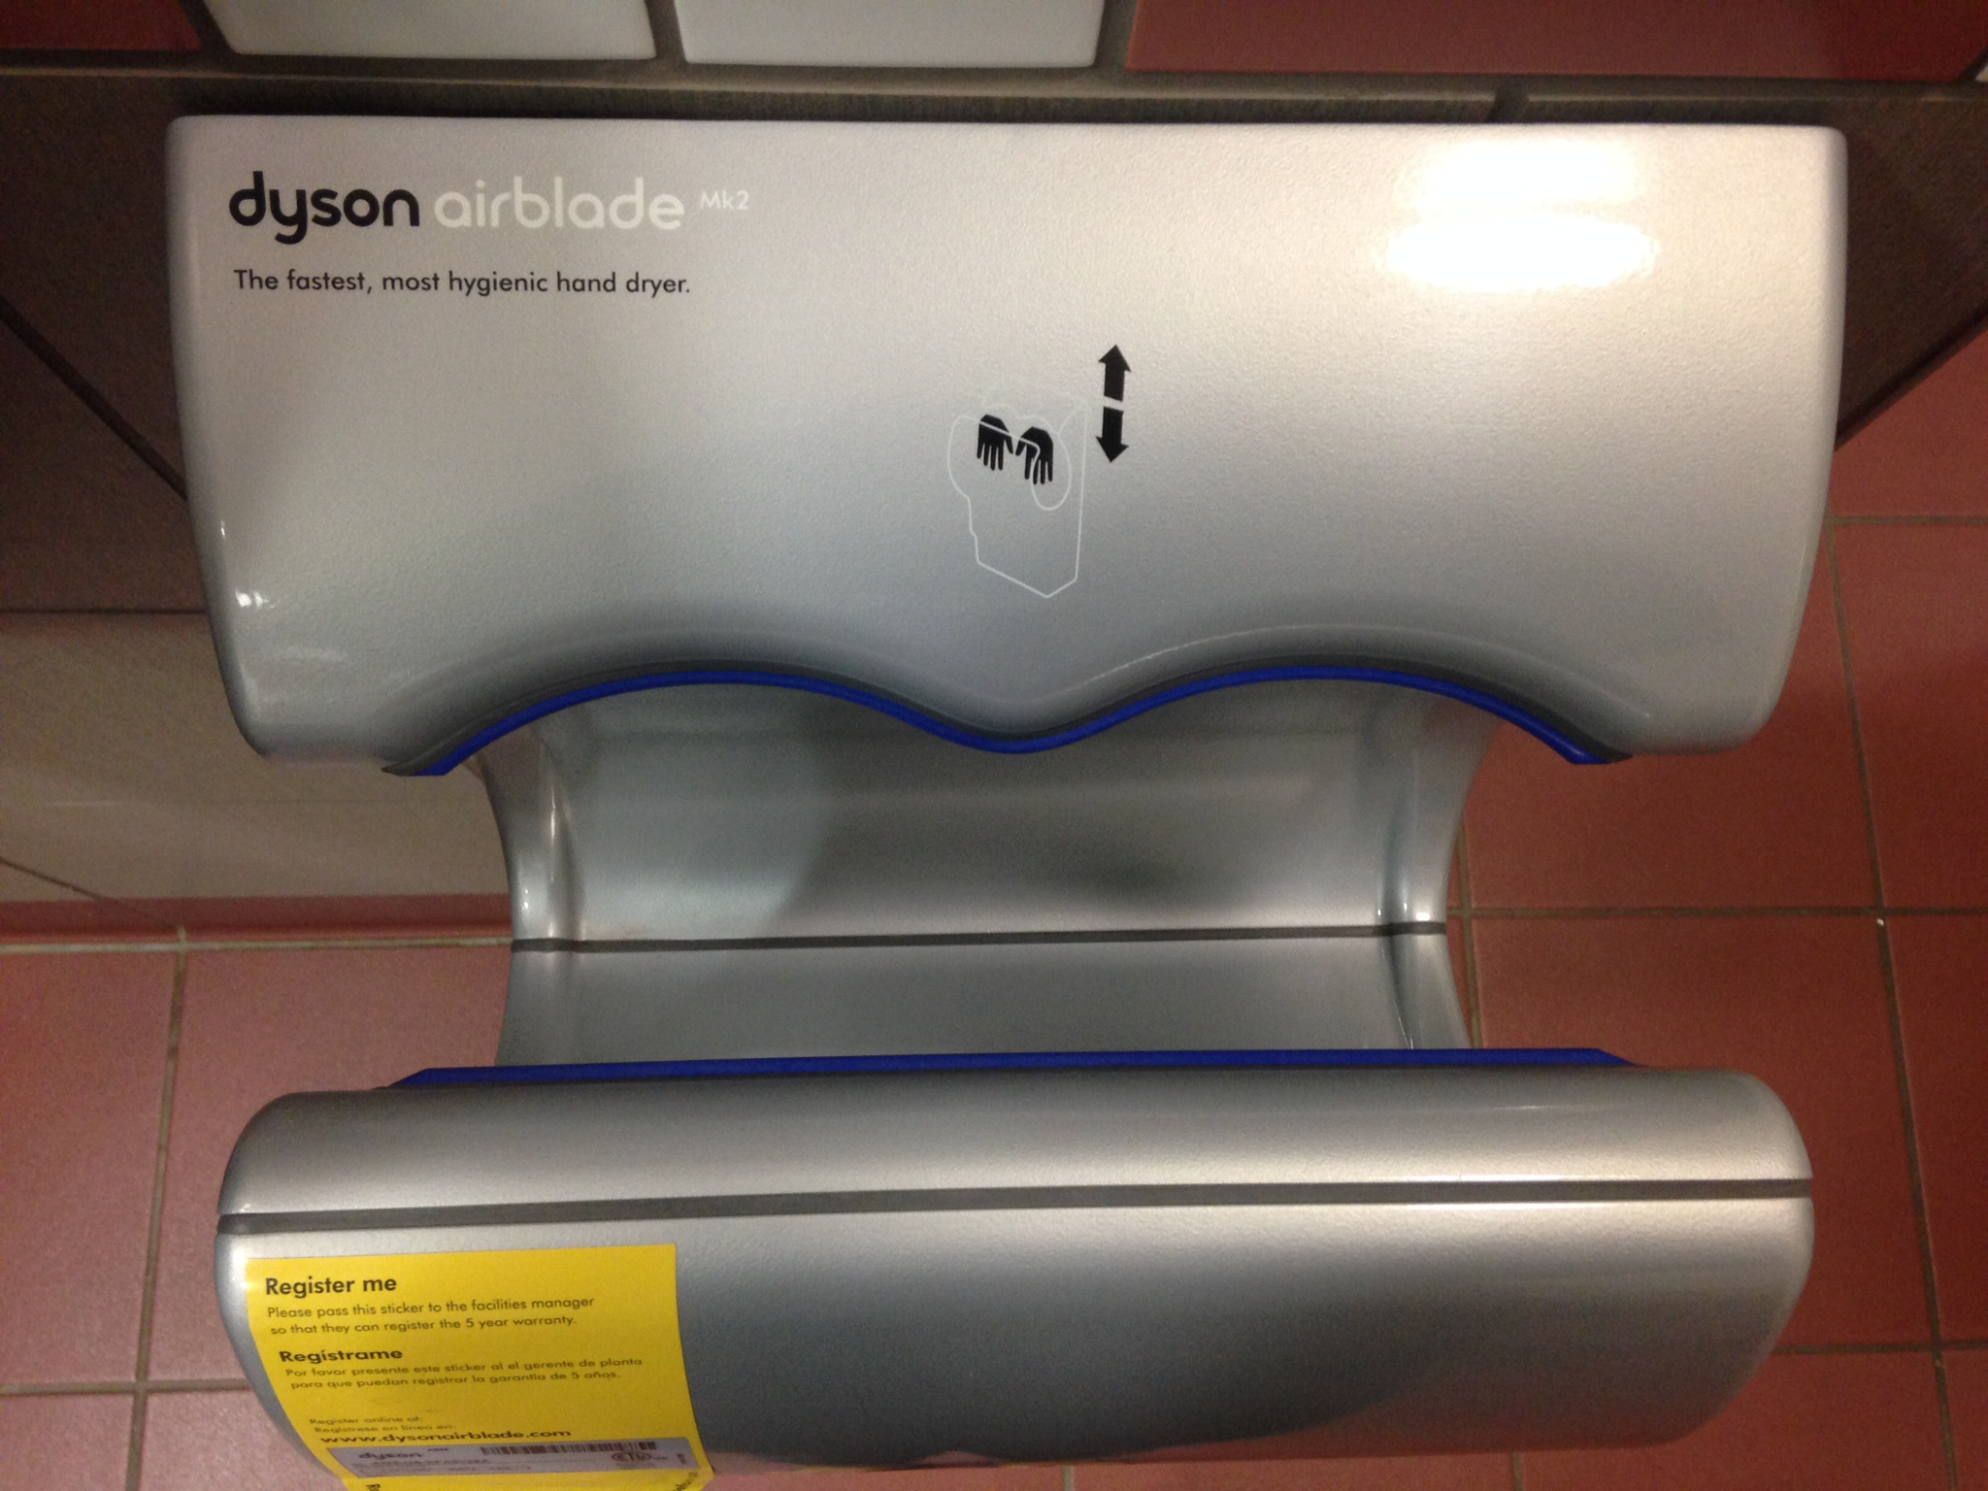
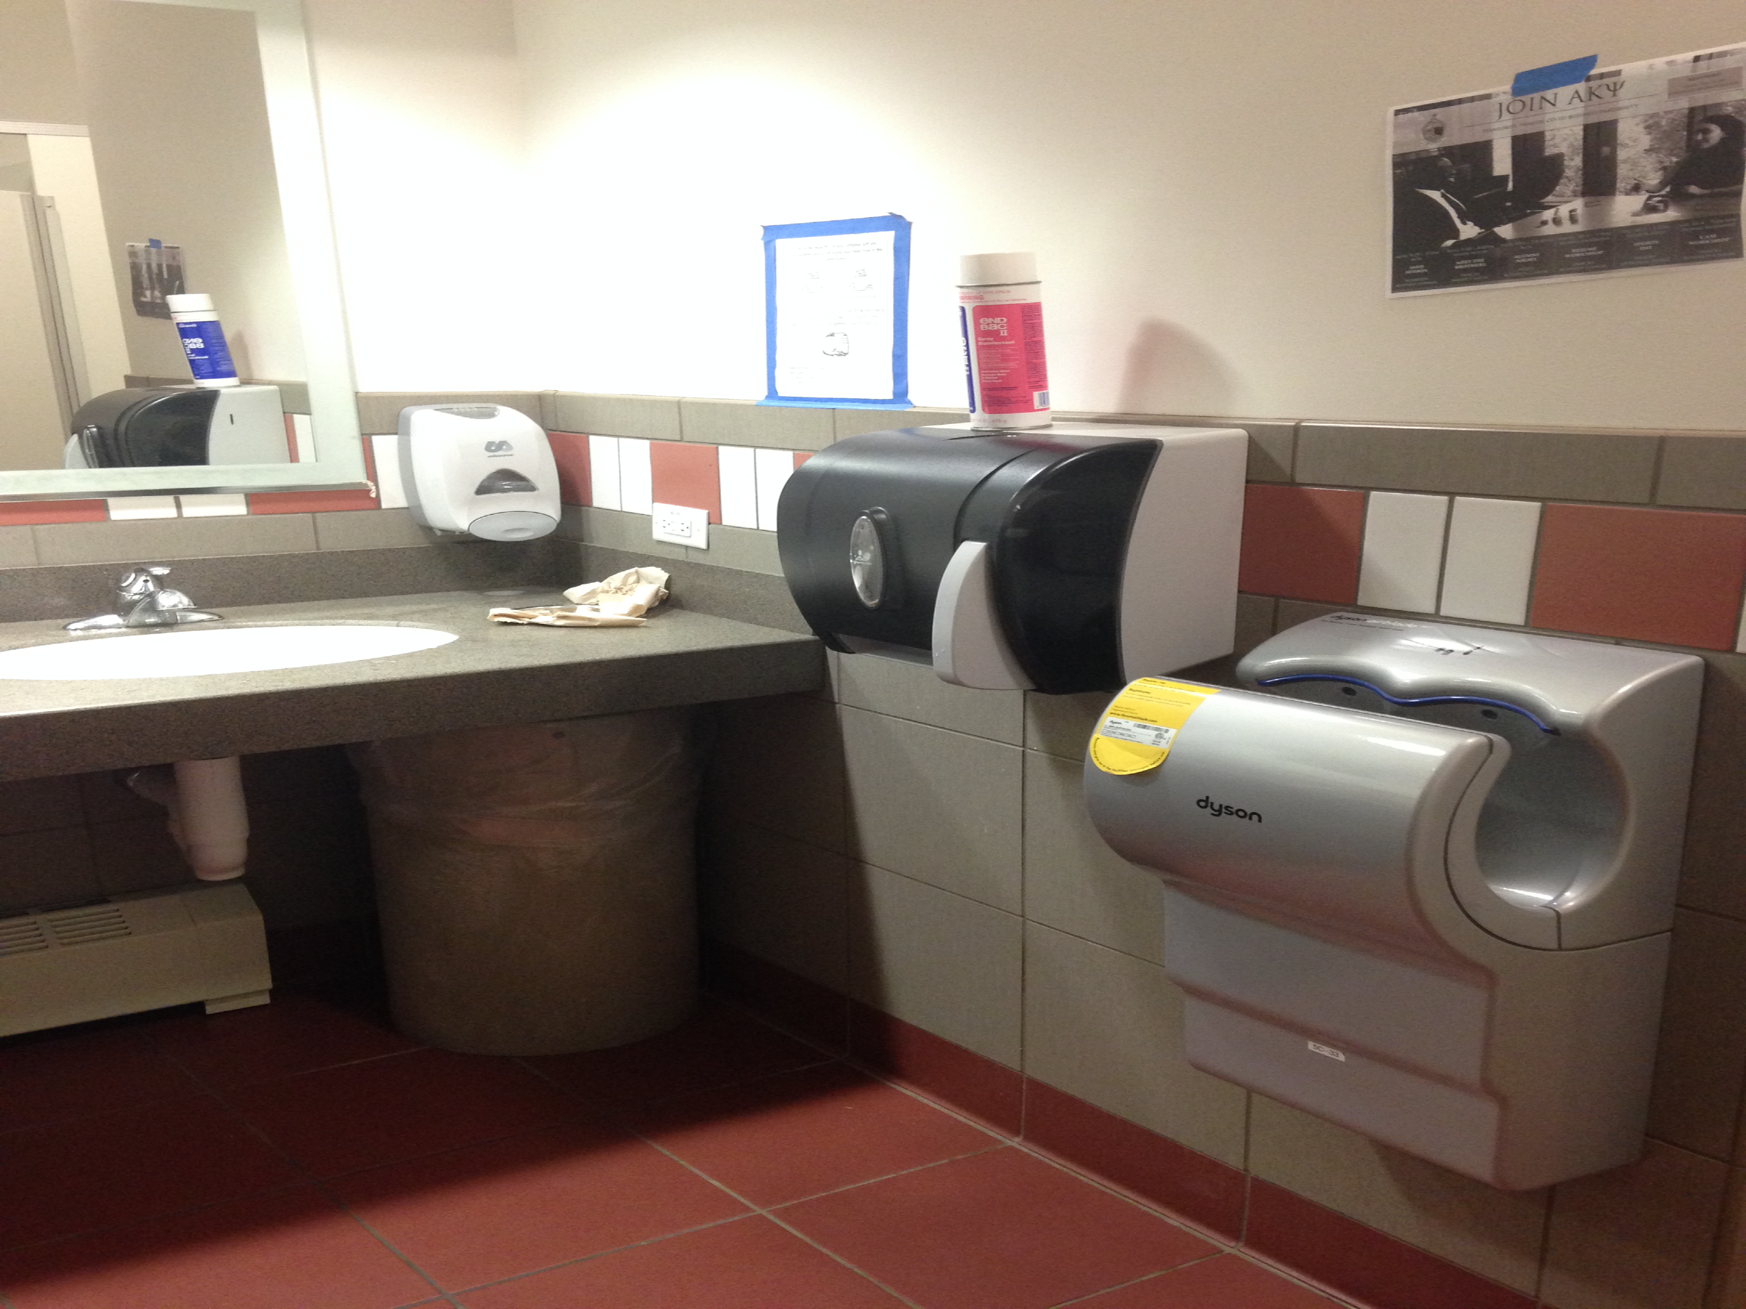
Interface Hall of Fame or Shame?
Dyson AirBlade hand dryer
example courtesy of Maya I.

Slide 6
Interface Hall of Fame or Shame?
Good
shape indicates function
so simple that instructions fit in 1 image
fun!
Bad
dripping water?
too much noise
still takes too long
Dyson AirBlade hand dryer
example courtesy of Maya I.

Slide 7
Interface Hall of Fame!
Good
shape indicates function
so simple that instructions fit in 1 image
fun!
Bad
dripping water?
too much noise
still takes too long
Dyson AirBlade hand dryer
example courtesy of Maya I.

Slide 8
Design Exploration Through Sketching & Experience Prototyping
This work is licensed under the Creative Commons Attribution-
Noncommercial-Share Alike 3.0 Unported License. To view a copy of
this license, visit http://creativecommons.org/licenses/by-nc-sa/3.0/
October 16, 2017
* slides marked Buxton are courtesy of Bill Buxton, from his talk “Why I Love the iPod, iPhone, Wii and Google”, remix uk, 18-19 Sept. 2008, Brighton

Slide 9
Outline
Review tasks
Review concept videos
Sketching to explore user experiences

Slide 10
Task. The structured set of activities or high-level actions required to achieve a high level user goal.
what a user wants to do

Slide 11
Task Example
Check missed calls and call back Manny is in the city at a club and would like to call his girlfriend, Sherry, to see when she will be arriving a the club. She called from a friends house while he was on the subway, so he couldn’t answer the phone. He would like to check his missed calls and find the number so that he can call her back.
High level goal – meet up with girlfriend
Task – check missed calls & call back
task should say what but not how

Slide 12
Selecting Tasks
Real tasks customers have faced / will face
collect any necessary materials
Should provide reasonable coverage
compare check list of functions to tasks
Mixture of simple & complex tasks
simple task (common or introductory)
moderate task
complex task (infrequent or for power customers)

Slide 13
What Should Tasks Look Like?
Say what customer wants to do, but not how
allows comparing different design alternatives
Be specific – stories based on facts!
say who customers are (use personas or profiles)
based on needfinding
design can really differ depending on who
name names (allows getting more info later)
characteristics of customers (job, expertise, etc.)
forces us to fill out description w/ relevant details
example: dentists forms
Some should describe a complete goal
forces us to consider how features work together
example: phone-in bank functions
Notes:
“Wixon and colleagues were developing an interface for a file management system. It passed lab tests with flying colors, but bombed as soon as customers got it. The problem was that it had a scrolling file list that was (say) twenty characters wide, but the file names customers used were very long, and in fact often identical for more than twenty characters (the names were made up by concatenating various qualifiers, and for many names the first several qualifiers would be the same.) Customers were not amused by needing to select from a scrolling list of umpty-ump identical entries that stood for different files. And this wasn't an oddball case, it was in fact typical. How had it been missed in the lab tests? Nobody thought it would matter what specific file names you used for the test, so of course they were all short.” – from Chapter 2 of TASK-CENTERED USER INTERFACE DESIGN A Practical Introduction by Clayton Lewis and John Rieman.

Slide 14
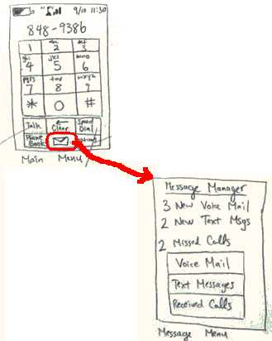
Task Flows Show How to Do the Task
Task Flows are design specific, tasks aren’t
Task Flows force us to
show how various features will work together
settle design arguments by seeing examples
only examples → sometimes need to look beyond
Show users storyboards of task flows to get feedback

Slide 15
What
How
Task
Task Flow
Concept Video
Video Prototype
Notes:
We have this continuum between saying “What” and “how” to achieve it for Tasks to Task Flows.
[Advance]
Similarly we have this same continuum between “Concept Videos” and “Video Prototypes”
Concept Videos focus on the “what” and Video Prototypes focus on the “how”.
I’ll start with Video Prototypes.

Slide 16
Making a Concept Video
Define
What is the message of the film?
What is the value proposition you offer? Can you describe it in a few lines?
Make a basic plot
Discuss plot ideas until you get a few that really make sense, decide characters
Storyboard
Turn these into multiple storyboards of scenes to plan how you will film it
* note: not UI storyboards!
Notes:
Define: Make a statement about your project, refer back to it throughout the entire process. VALUE PROPOSITION
Make a Plot: Create several plotlines, mix and match and decide on a few to storyboard
Storyboarding: Draw pictures, label the kind of shot you might have and what the actor should do.

Slide 17
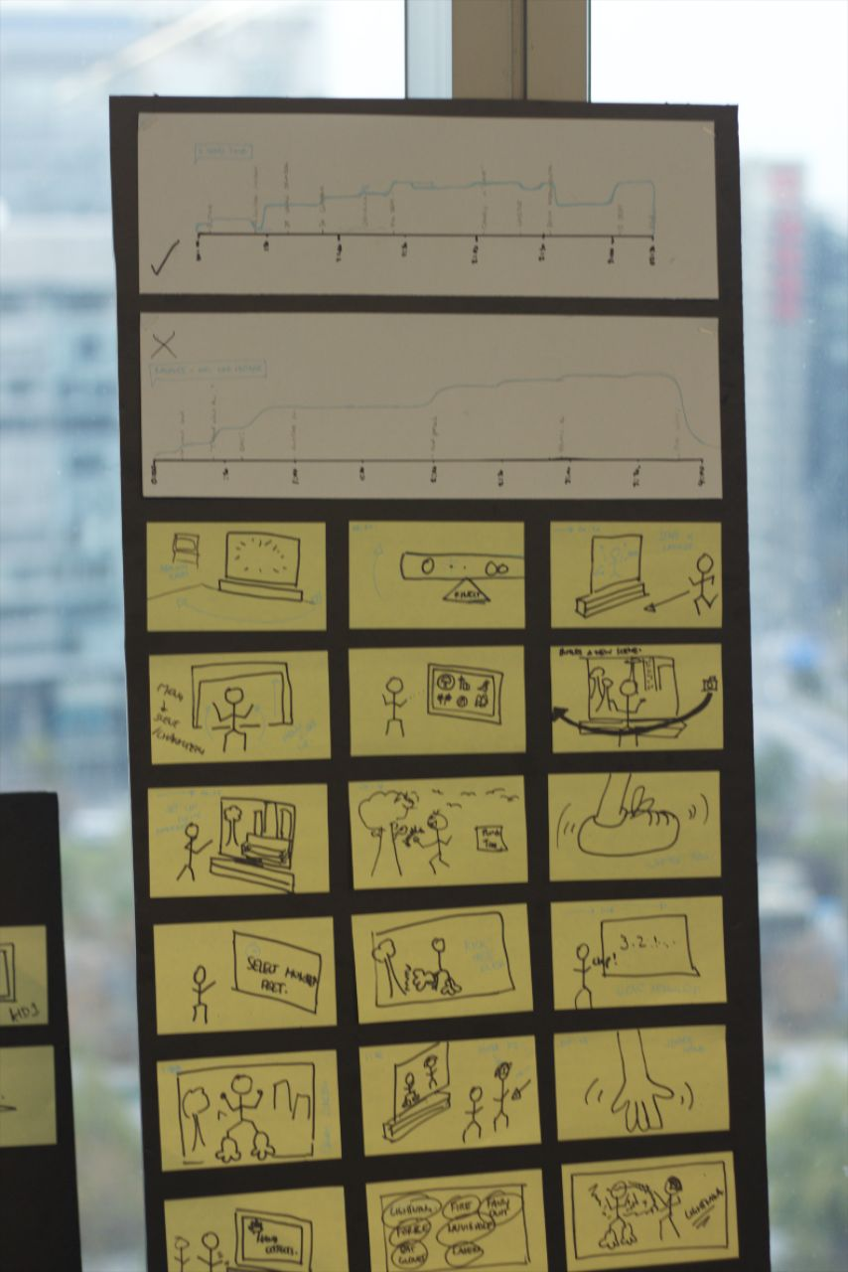
Storyboarding
Use sticky notes so scenes can be moved
Include lines to be spoken if necessary
Use appropriate angles
Notes:
Storyboarding: Draw pictures, label the kind of shot you might have and what the actor should do.
Show scenes, characters, camera angles & zoom (dialog)

Slide 18
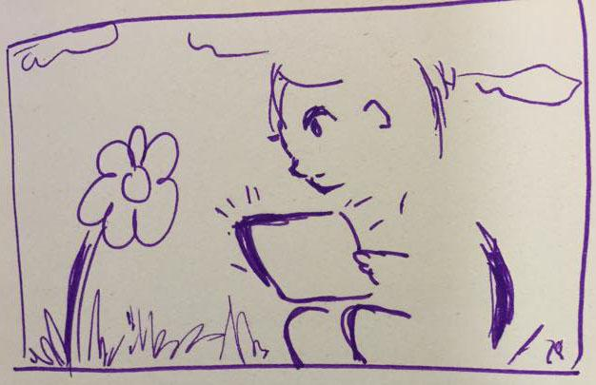
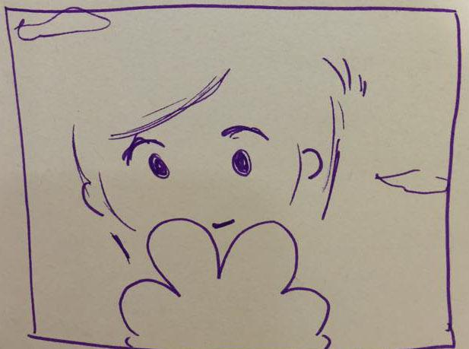
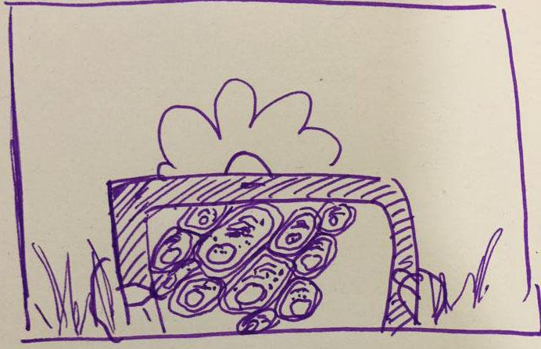
Storyboarding
SCENE 4
Words On Screen: Investigate
Voiceover: The mitochondria are the powerhouse of the cell
SHOT 1
beautiful flower, child’s eyes are wide looking at it head is cocked to the side, inquisitive
SHOT 2
tablet pans into view, image on screen shows the cellular structure of the plant
Notes:
Storyboarding: Draw pictures, label the kind of shot you might have and what the actor should do.
Show scenes, characters, camera angles & zoom (dialog)

Slide 19
Shoot your Film
Get as many shots (angles, close ups, distance…) as you can! you never know what might be useful later.
If you choose to use music
Now might be a good time to pick some songs. Music can be very powerful if chosen well. (see Vimeo for music you can use free)
Edit your Film
Use your storyboard! This part should be simple if you have storyboarded correctly.

Slide 20
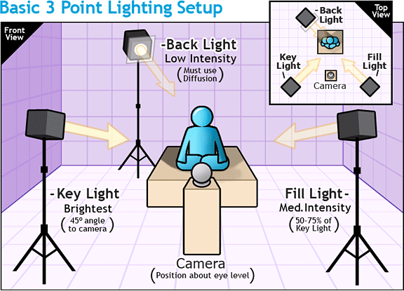
Notes:
This is the right way to do it, but REALLY hard for amateurs… so film somewhere with LOTS OF NATURAL light!

Slide 21
Use Close-Up shots
Capture emotion
Avoid conversation
(This is the hardest to get right and ends up distracting)
Use the right person for the role-ask friends
People

Slide 22
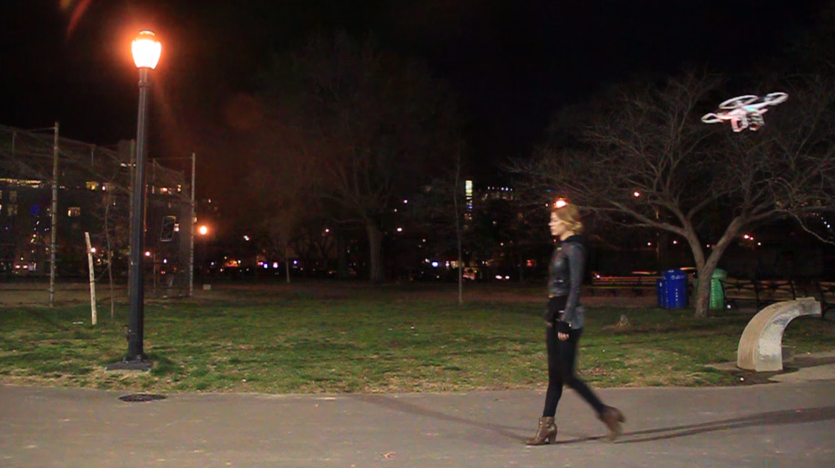
Plan your story – Storyboard it.
Is the story believable?
Film multiple angles
Film longer than the shot needs (you can always cut down)
Context

Slide 23
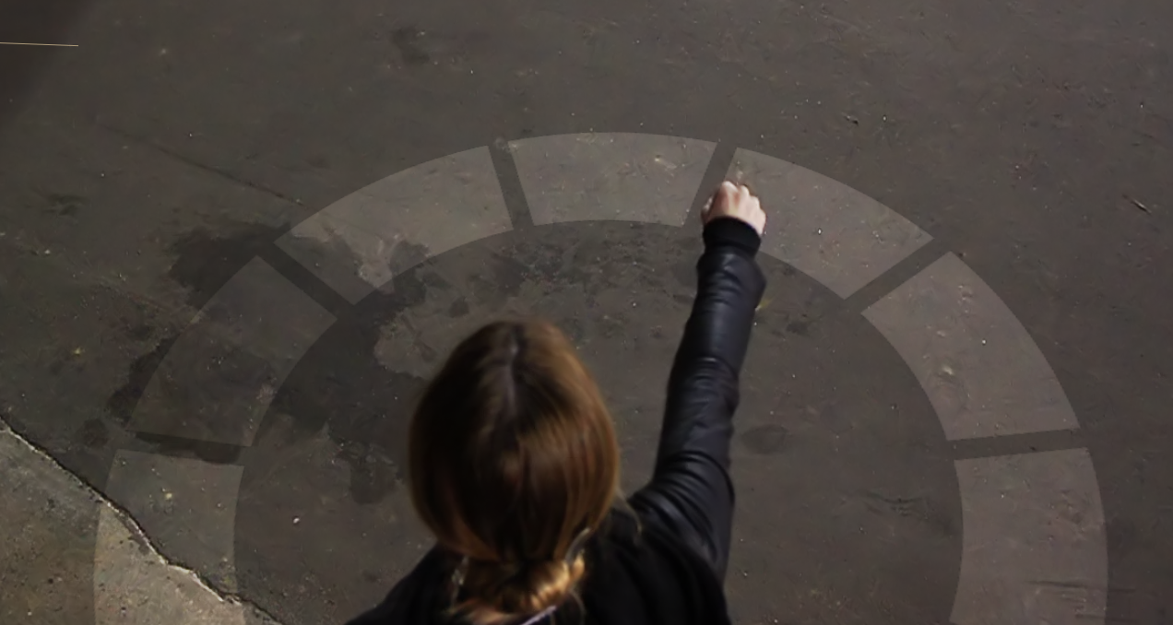
Wow Effect Show your solution at it’s best, save the best for last
Subtlety Show how the solution makes the user feel – subtly
Don’t ‘Sell’ it Don’t tell people to use your solution, show them why
The Solution

Slide 24
Questions on Tasks or Concept Videos

Slide 25
Design Process: Discovery
Assess Needs
understand client’s expectations
determine scope of project
characteristics of customers & tasks
evaluate existing practices & products
Discovery
Design Exploration
Design Refinement
Production

Slide 26
Design Process: Exploration
Expand Design Space
brainstorming
sketching
storyboarding
prototyping
Discovery
Design Exploration
Design Refinement
Production
Notes:
Expand design space:
brainstorming, sketching, storyboarding, prototyping

Slide 27
Iteration
At every stage!
Design
Prototype
Evaluate
Sketch
Paper
Video
Tool
Program
Gut
Crit
Expert Eval Lo-fi Test
User Study

Slide 28
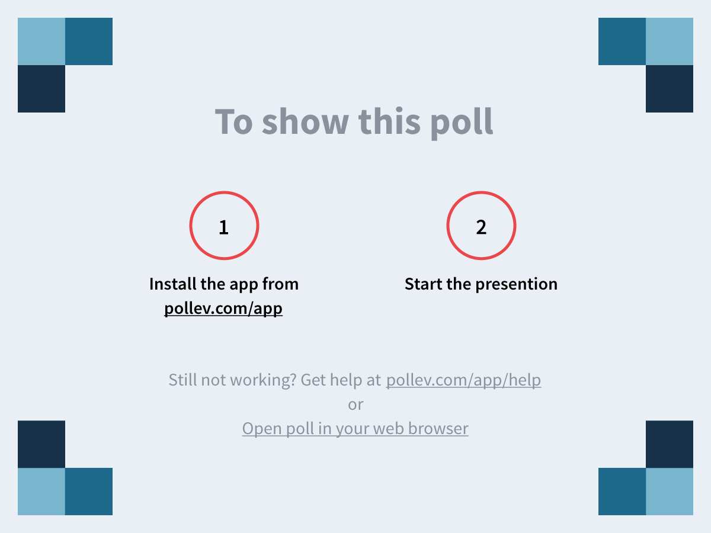
Notes:
Which group in the ceramics class described in the Buxton reading produced the highest quality pots? https://www.polleverywhere.com/multiple_choice_polls/D26SMQGMKxQQO5n

Slide 29
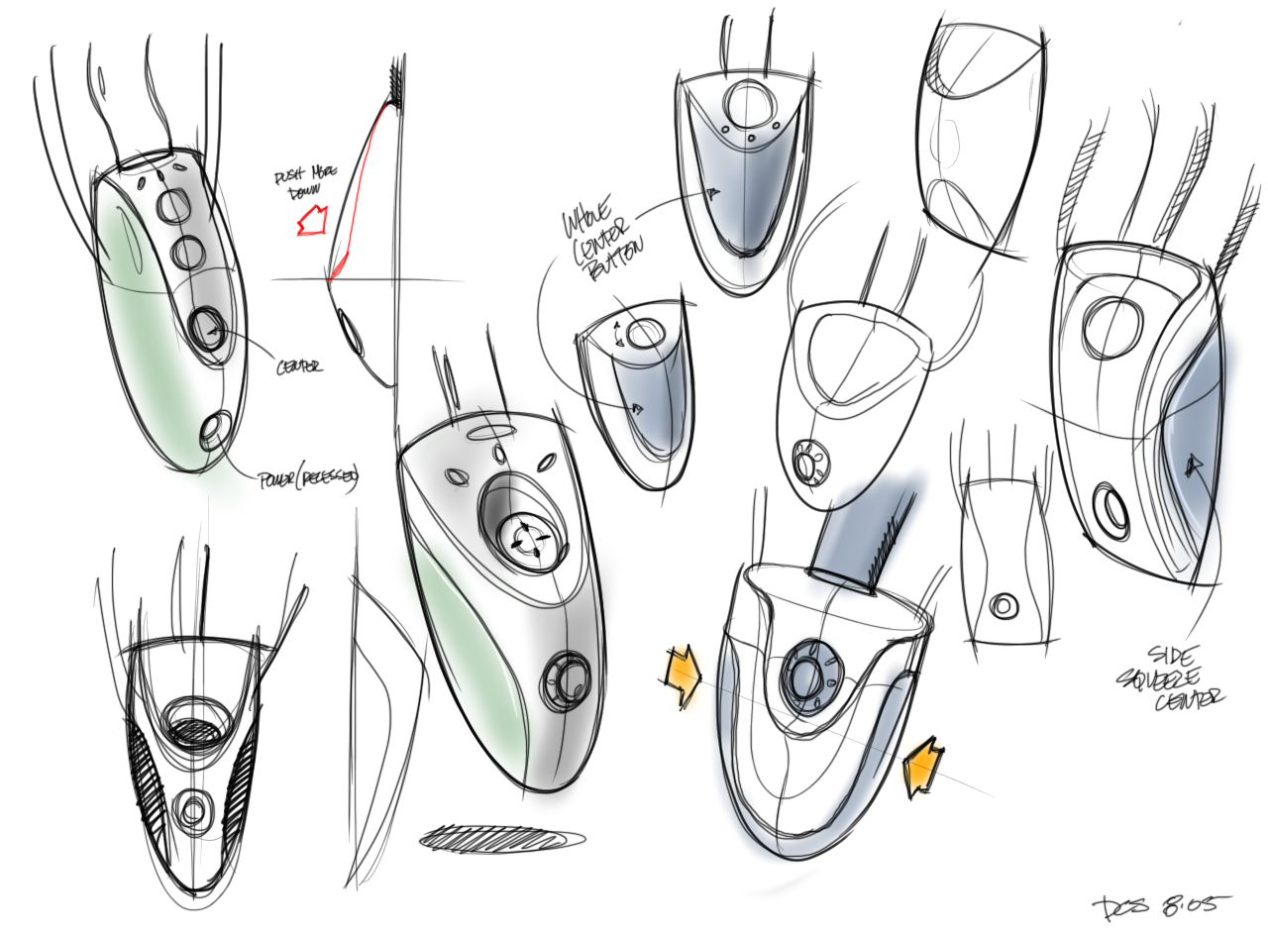
Sketching: A Quintessential Activity of Design
* Courtesy Bill Buxton
Notes:
Design and Innovation comes from sweat. From trying many ideas. Sketching them. Building prototypes.

Slide 30
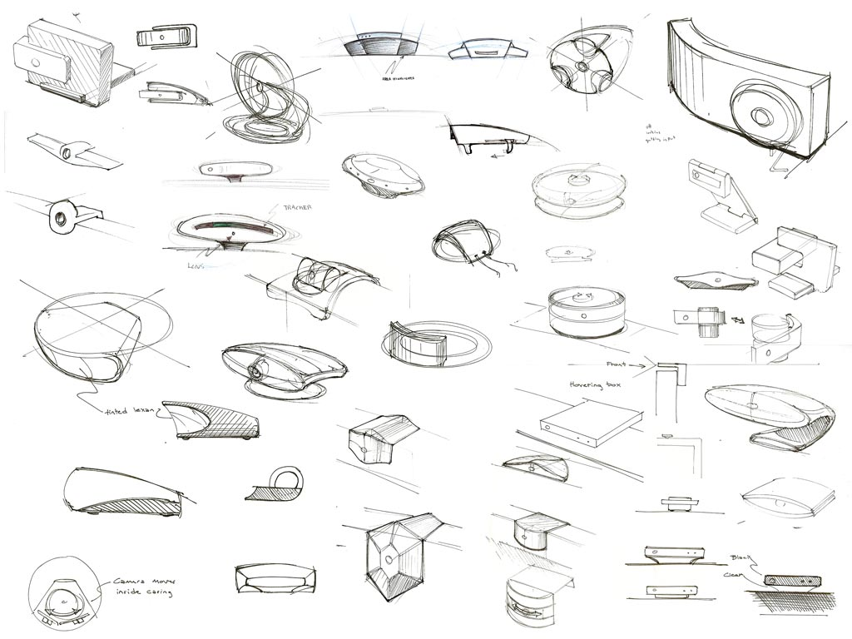
Kicker Studio, www.kickerstudio.com
Notes:
Trying literally dozens and dozens of ideas.

Slide 31
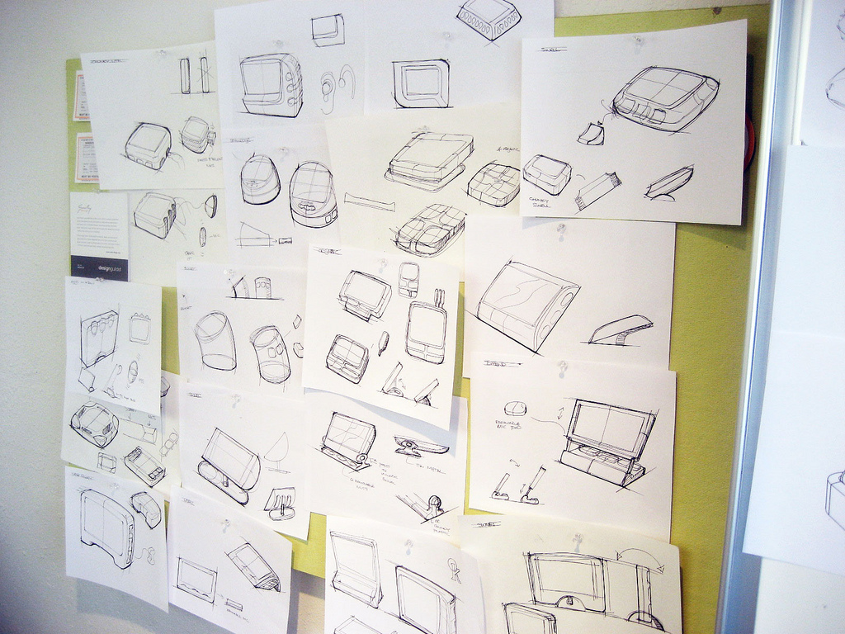
Kicker Studio, www.kickerstudio.com
Notes:
Trying them out with people and observing what occurs.

Slide 32
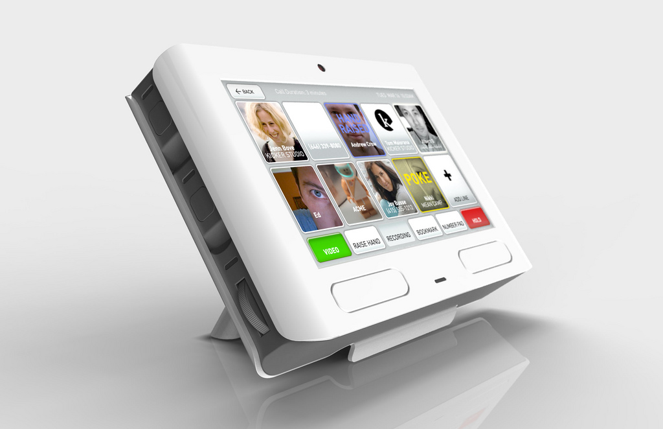
Kicker Studio, www.kickerstudio.com
Notes:
Until you find ideas/products/services that evoke an emotional response with your customers. Ideas that give new experiences that people value. The differences of opinion are on how you might get to this point.

Slide 33
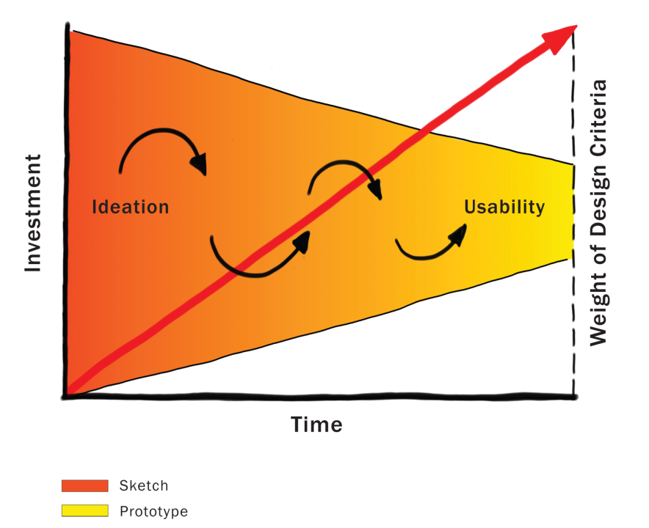
CS 147
CS 194H
Courtesy Bill Buxton
Notes:
Because investment is low in the early stages, this is the one time in the product pipeline when one can afford to play, explore, learn, and really try and gain a deep understanding of the undertaking.
This is where YOUR TEAM WILL be for most of this quarter!!!!

Slide 34
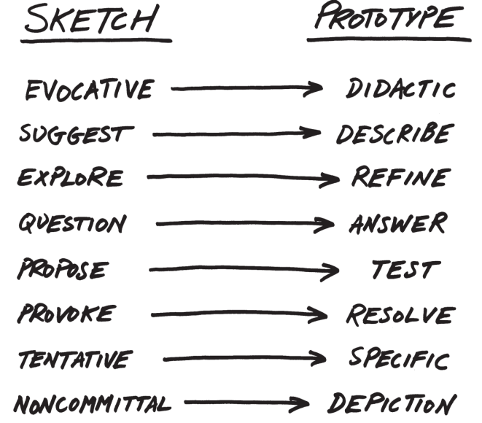
From Sketch to Prototype
Difference in intent rather than in form
Courtesy Bill Buxton
Notes:
This is a continuum, not an either/or proposition
[ADVANCE SLIDES]
The difference between the two is as much a contrast of purpose, or intent, as it is a contrast in form

Slide 35
The Anatomy of “Sketching”
Quick / Timely
Inexpensive / Disposable
Plentiful
Clear vocabulary. You know that it is a sketch (lines extend through endpoints, …)
No higher resolution than required to communicate the intended purpose/concept
Resolution doesn’t suggest a degree of refinement of concept that exceeds actual state
Ambiguous
Courtesy Bill Buxton

Slide 36
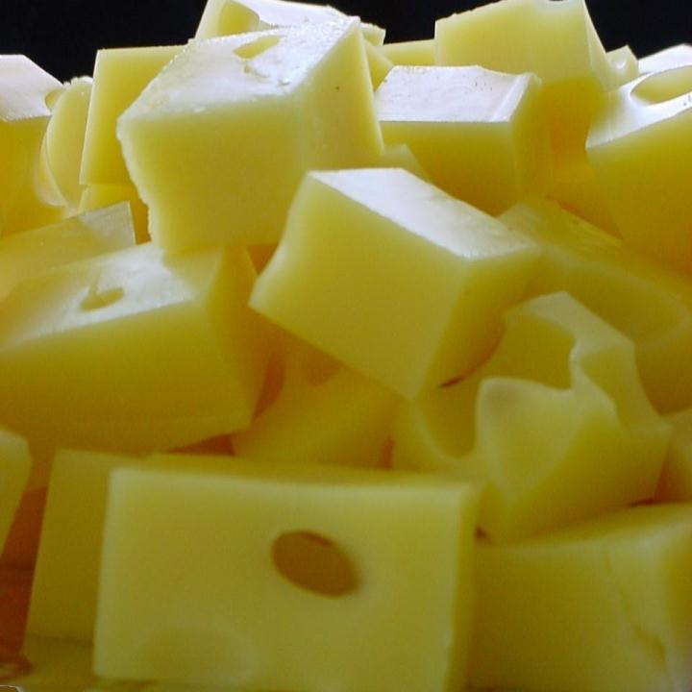
If you want to get the most out of a sketch, you need to leave big enough holes.
There has to be enough room for the imagination.
Courtesy Bill Buxton
Notes:
Ambiguity in sketches is VERY important

Slide 37
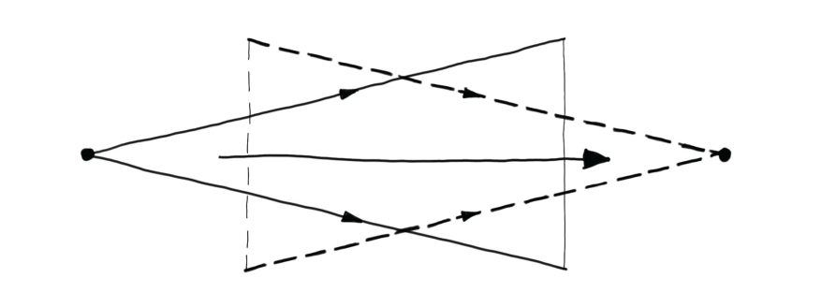
Design as Choice
Elaboration (“Flare”)
Reduction (“Focus”)
Courtesy Bill Buxton
Laseau (1980)
Notes:
Choice where there are two key places for creativity:
the creativity that you bring to enumerating meaningfully distinct options from which to choose
the creativity that you bring to defining the criteria, or heuristics, according to which you make your choices
Design is both GENERATIVE and REDUCTIVE

Slide 38
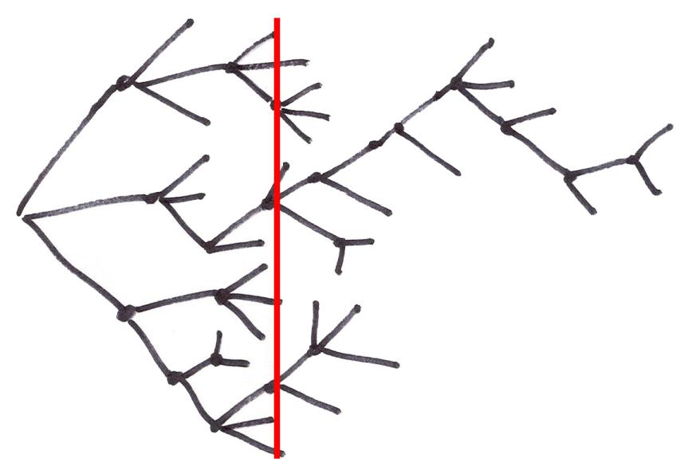
Exploration of Alternatives
… a designer that pitched three ideas would probably be fired. I’d say 5 is an entry point for an early formal review (distilled from 100’s). … if you are pushing one you will be found out, and also fired. … it is about open mindedness, humility, discovery, and learning. If you aren’t authentically dedicated to that approach you are just doing it wrong!
Alistair Hamilton
VP Design
Symbol Technologies
Courtesy Bill Buxton
Notes:
Design is NOT a straight path
We must generate and discard much more than we keep
All of these representations of the design process converge.
Some of the ideas thrown out may be your’s! – you need to learn to embrace this [ADVANCE]

Slide 39
Exploration of Alternatives
People on a design team must be as happy to be wrong as right. If their ideas hold up under strong (but fair) criticism, then great, they can proceed with confidence. If their ideas are rejected with good rationale, then they have learned something.
…
There are no dumb questions. There are no ideas too crazy to consider. Get it on the table, even if you are playing around. It may lead to something.
Bill Buxton
Sketching User Experiences
pg. 147-149
Courtesy Bill Buxton
Notes:
bringing “design rationale” or reasoning for decisions is key to making this work well
diverse teams help make this work better & that is why we created such teams in this class

Slide 40
Administrivia
Concept Videos due Thur/Fri
We will watch the top ones in class on Monday
Vote on awards
Project Selection Criteria
novelty
significant UI component
e.g., bad if all smart AI but no UI
impact (e.g., frequency, density & pain)
Workshops this week
Web Site w/ Sage & Dylan, Tue. 7pm, Hewlett 102
Sketch w/ Kerry & Amy, Wed. at 7pm 10/25, Gates 415
Landay office hours (390 Gates)
Monday 3-4 PM
Thursday 10-11 AM

Slide 41
Team Break
Reflect on last week’s assignment (5-10 min)
what did you like about your team work?
what do you wish could be improved?
This weeks assignment (20 min)
what will it take to get finished?
what remains to be done? plan it!
can you address the critique from your TA in what you are doing for this week?
work on it now
Notes:
30 minute break at 65 minutes in

Slide 42
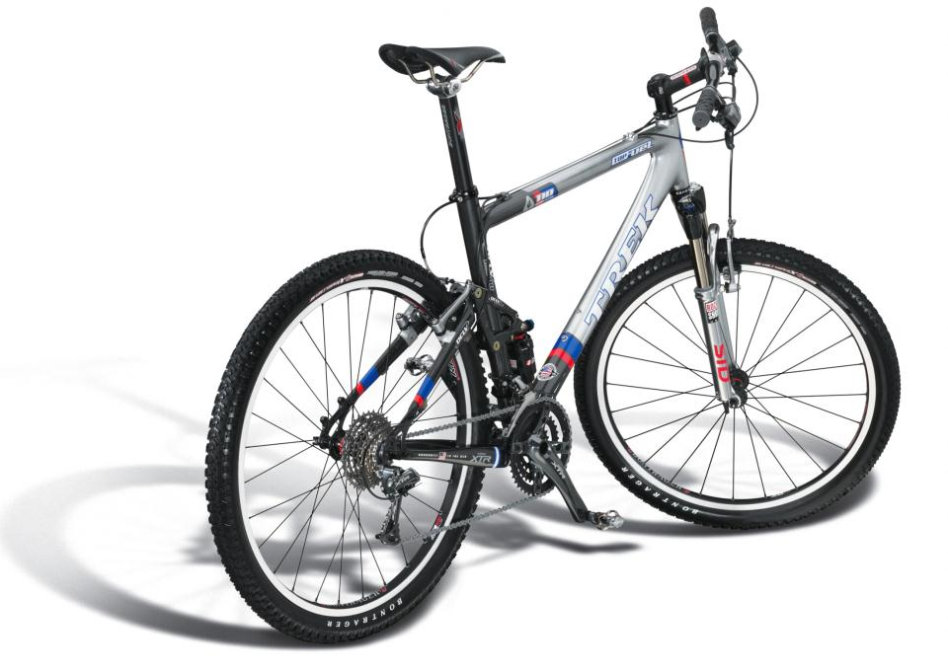
Design
What does the customer want to buy?
Courtesy Bill Buxton
Notes:
This clearly shows the DESIGN of the bike…
[ADVANCE]
But, What does the customer want to buy?
The bike owner wants to buy [ADVANCE]

Slide 43
Experience Design
“The experience of even simple artifacts does not exist in a vacuum but, rather, in dynamic relationship with other people, places, and objects” – Buchenau & Suri 2000
Courtesy Bill Buxton
Notes:
The EXPERIENCE of using the bike. The aspiration (and hopefully the reality) of the experience
Experience depends on the bike, your equipment, the weather, the terrain, your skill, your current state of mind, etc.

Slide 44
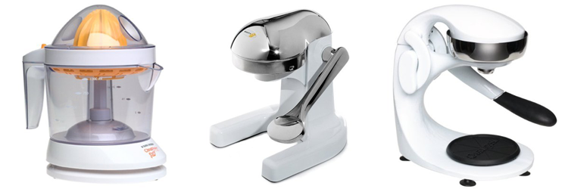
Experience vs. Interface Design
CitrusMate Plus Mighty OJ Manual Juicer OrangeX Manual Juicer
Notes:
He loved his first juicer every morning… complained he didn’t have it at the cabin
Then got the gift of the second for his cabin. Quiet!!! Loved the experience and now no longer liked the original!
Complained… then got a gift of the 3rd for home… Same interface as the second…
but DIFFERENT experience. Easy at end of pulling down lever.
USER EXPERIENCE was partly the UI but also the situation and environment
And the relative experience to what had come before!

Slide 45
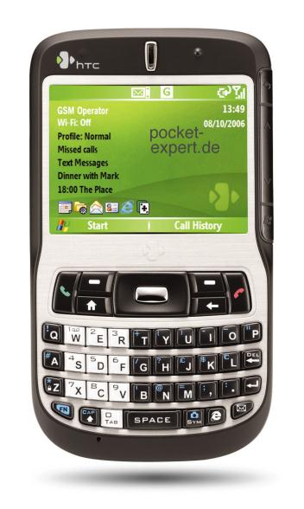
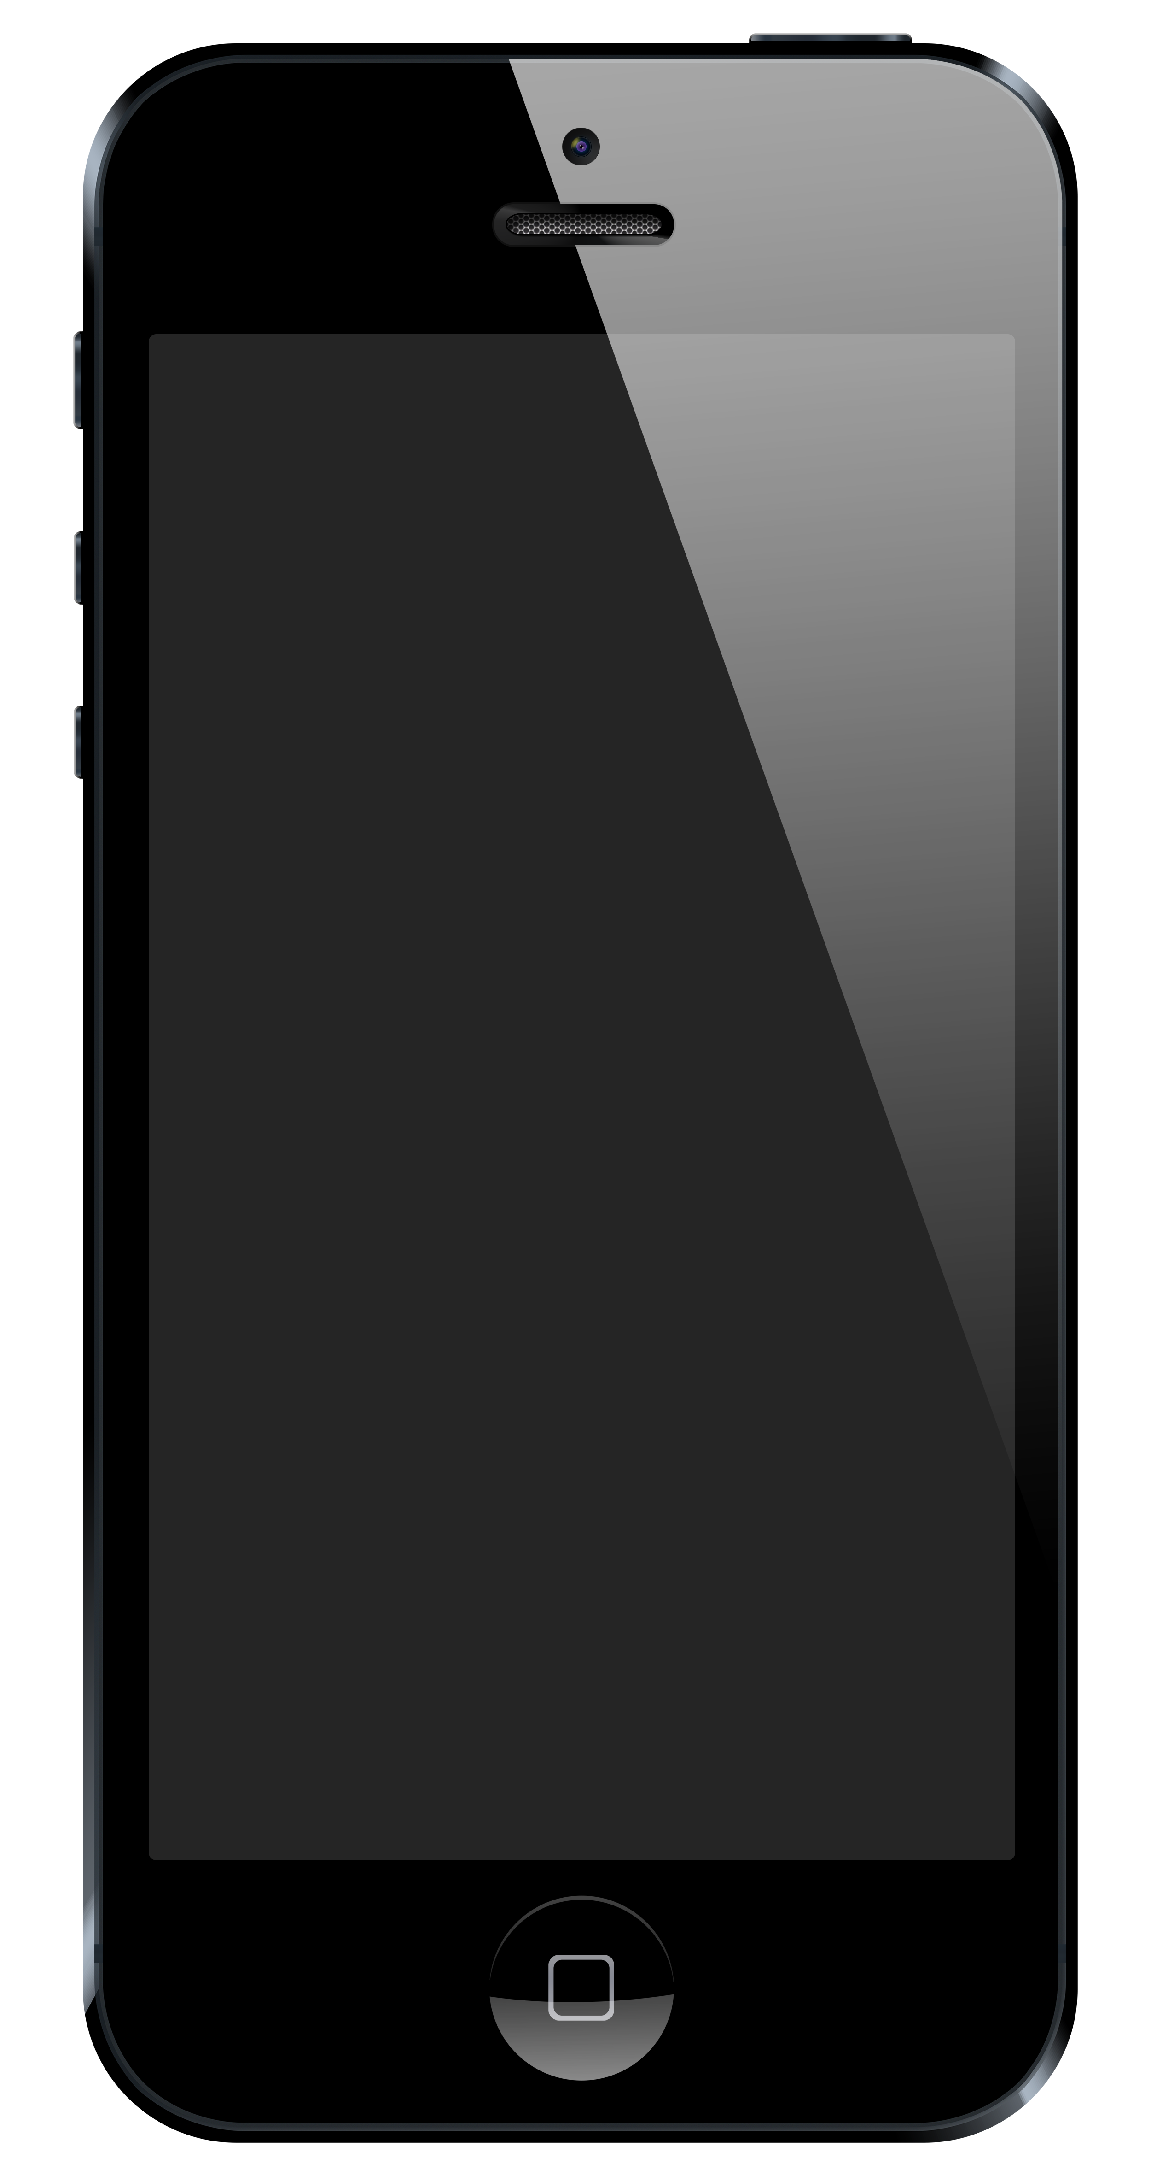
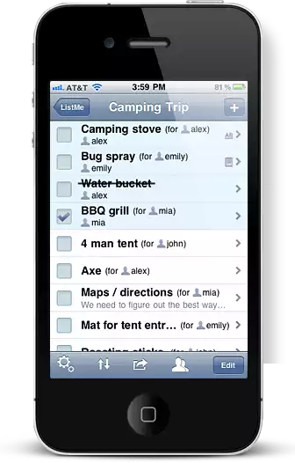
Experience Design for a Phone App?
Draw my phone
Draw my app’s interface
Draw the experience of using my app
Which is the true object of design?
http://www.listmeapp.com/
Courtesy Bill Buxton
Notes:
What is the experience design for our phone app?

Slide 46
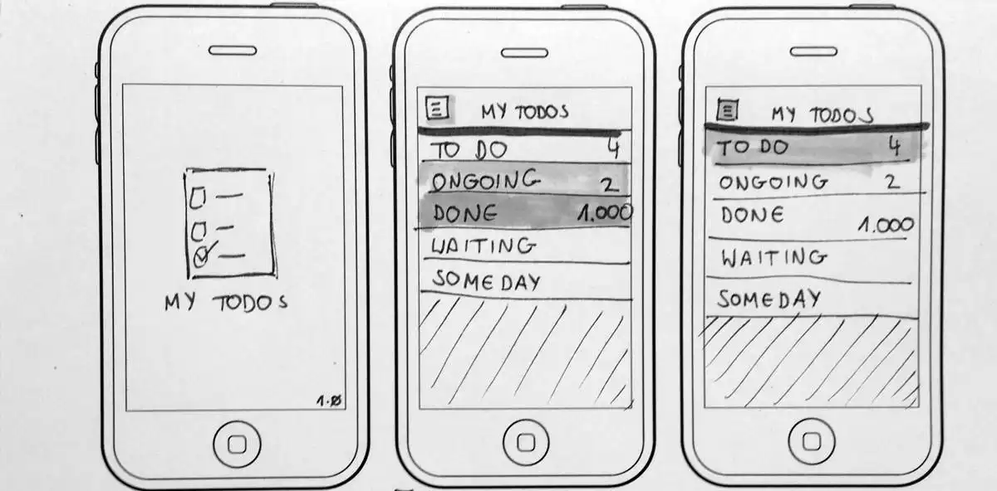
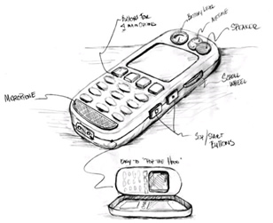
Minimal Detail
Include only what is required to render the intended purpose or concept
http://www.smashingmagazine.com/2013/06/sketching-for-better-mobile-experiences/
Notes:
Abstract it

Slide 47
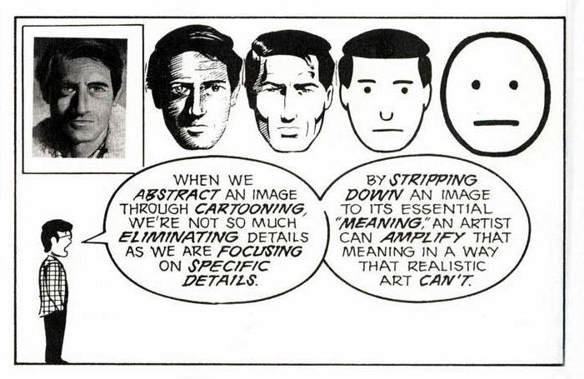
Scott McCloud’s Understanding Comics
People think focusing is about saying “yes.” But…
“Focusing is about saying no.” – Steve Jobs
Notes:
Scott McCloud’s Understanding Comics

Slide 48
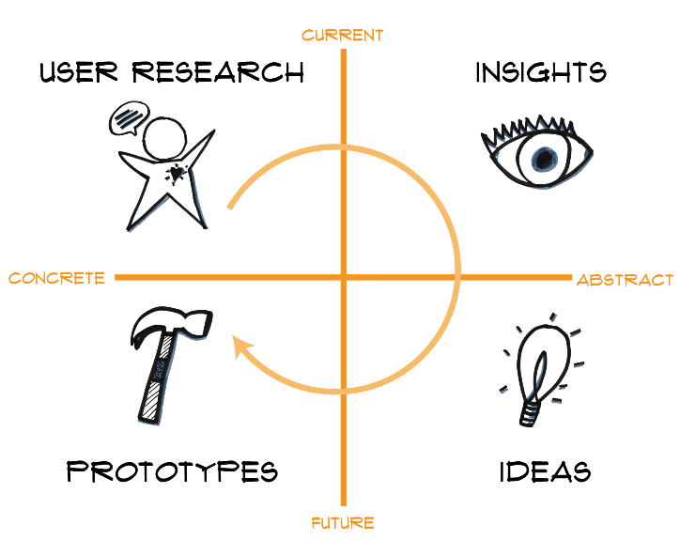
Design Thinking is Iterative

Slide 49
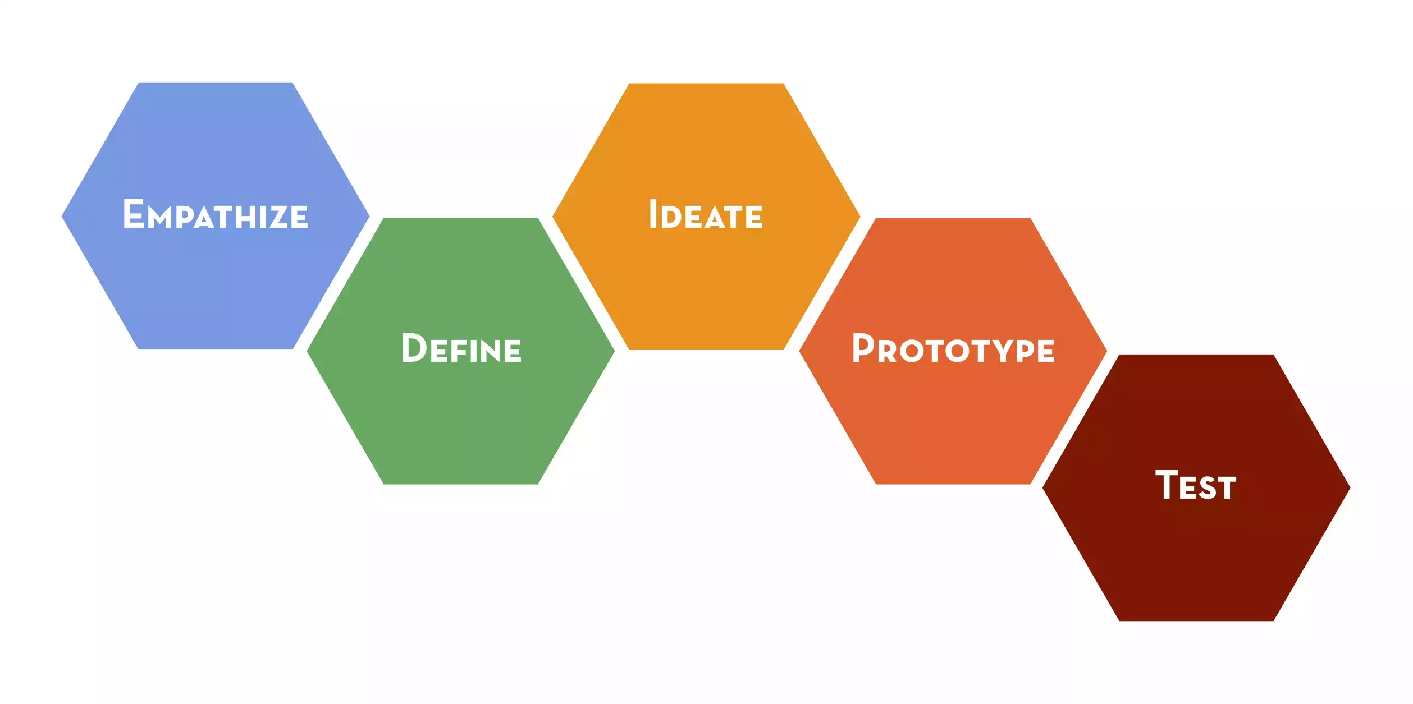
Design Thinking

Slide 50
Design Thinking

Slide 51
Summary
Sketching allows exploration of many concepts in the very early stages of design
As investment goes up, need to use more and more formal criteria for evaluation

Slide 52
Next Time
Lecture
Lo-fi Prototyping
Project (due Thur/Fri in studio)
Concept Video
Short (90 seconds ideal)
Tell a story more than show an interface
Storyboard first!
Glad to look at rough cuts

