Slide 1
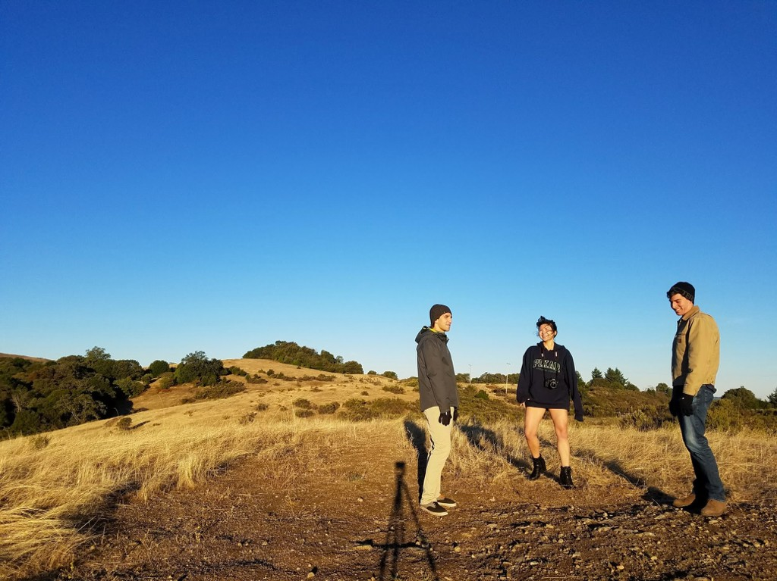

Slide 2
Share your vision.
Get your shot.
value prop

Slide 3

Photographers have intricate ideas.
Conveying them is hard.
problem

Slide 4
Right now, we talk. But we could be using…
Color Palettes
Text Pictures
Music
Movies
Movement
…all in an immersive AR experience.
solution

Slide 5
TASKS

Slide 6


Convey your settings and your features.
simple task

Slide 7


Convey color - palette, weight, perspective.
medium task

Slide 8
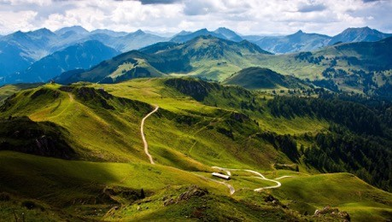

Convey mood and scale.
complex task

Slide 9
Be understood.

Slide 10
STORY BOARDS

Slide 11
