Slide 1
Empowering the Modern Storyteller
Needfinding, POVs, and Experience Prototypes

Slide 2

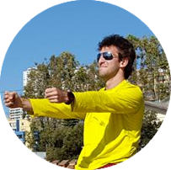


Kaley
Alex
Hana
Josh

Slide 3
We met a collection of individuals who
work on challenging problems as a certain form of catharsis.

Slide 4
We met a collection of individuals who
work on challenging problems as a certain form of catharsis.
We were amazed to realize
how fragile and broken process can be for them, despite some truly incredible end products.

Slide 5
We met a collection of individuals who
work on challenging problems as a certain form of catharsis.
We were amazed to realize
how fragile and broken process can be for them, despite some truly incredible end products.
It would be game changing if we could make the creative process more secure and safe, and ultimately more powerful.

Slide 7




James
Lauren
Scott
Micah
Traveling muralist and studio artist. Cares about artist communities and “wall porn”
Lecturer in fiction. Cares about graphic novels, writing process, and storytelling education.
Theater producer.
Cares about storytelling in theater and the overall theatergoer experience.
Gamer. Cares about powerful gaming systems, superheroes, and minority representation in media.

Slide 8



Jonatan
Reilly
Stephen
Narrative filmmaker.
Cares about Shakespeare, detail in screenwriting, and creative process.
Student athlete on the Stanford crew team.
Cares about life organization and flow states in work and athletics.
Lighting and set designer. Cares about theater lighting pre- visualization and lighting setup.

Slide 10
Storytelling

Slide 11
We met Scott
Hutchins, a fiction writer and novelist.

Slide 12
We were amazed to realize that
graphic novels give Scott another dimension of expression, which allows him to convey scenes he wouldn’t be able to describe in writing.

Slide 13
It would be game-changing to add an AR
dimension to storytelling to allow writers to relay new types of experiences.

Slide 15

We met Lauren YS, a traveling muralist.

Slide 16
We were amazed to realize that being in
a “shared space” makes her feel capable of making art.

Slide 17
It would be game-changing to bring Lauren the
feeling of a “shared space” wherever she creates art.

Slide 19

We met Jonatan
Lind, a narrative filmmaker.

Slide 20
We were amazed to realize how many
details Jonatan plans for his characters before he starts filming.

Slide 21
It would be game-changing to help filmmakers
capture more detail in their final shots.

Slide 23
How might we
use MR to tell a nonfiction story in the location it actually occurred?

Slide 24
How might we
allow artists to express the inspiration and process behind their creative works?

Slide 25
How might we
use AR to tell a story in which the viewer is a central character?

Slide 27
Prototype 1: Narrative Scavenger Hunt
Leading viewers on an active scavenger hunt around a city or campus, helping them to explore the nooks and crannies of a new place.

Slide 28
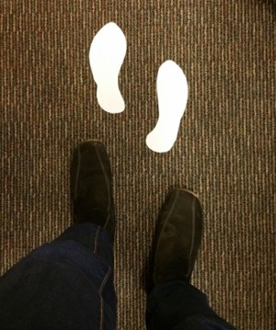
Prototype 1: Narrative Scavenger Hunt
•
Results: Loved acting as a character, and following their own virtual footprints. Didn’t like the linearity of the story.
•
Validity: Seemed to improve story experience, but hard to tell given that the tester was already familiar with the character.

Slide 29
Prototype 2: Interactive Mood Board
Giving viewers a peak at the moods, sounds, and visuals that inspired an artist to create the work.

Slide 30
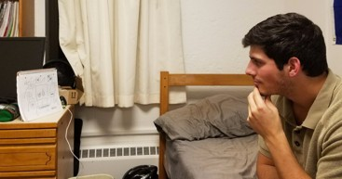
Prototype 2: Interactive Mood Board
•
Results: Our subject more eager to dive into the mural once he had an idea of the inspirations for it. The functionality of the mood board, though, wasn’t clear.
•
Validity: Improved the viewer experience, but confusing.

Slide 31
Prototype 3: Art In Layers
Giving viewers a look at the various stages of an artists’ creative process, all while they’re looking at the final piece.

Slide 32
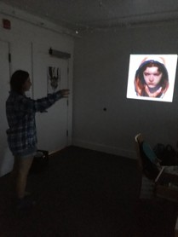
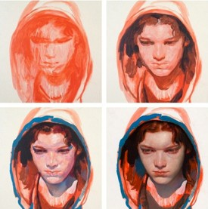
Prototype 3: Art In Layers
•
Results: Initially, a lot of excitement. Made art accessible, and process felt educational.
•
Validity: Confirmed assumption that people are interested in viewing creative process.

Slide 33
Prototype 4: Bringing Historical Nonfiction to Life
Allowing storytellers to craft a nonfiction experience where viewers live through the story in the location it actually occurred.

Slide 34
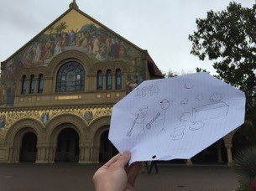
Prototype 4: Bringing Historical Nonfiction to Life
•
Results: Excited about the new way she could view a historical event, but had difficulty getting engaged in the experience.
•
Validity: Seems to provide a new medium of communication, but could be difficult to design an experience that feels natural.

Slide 36
Thank you.

