Slide 1
Needfinding
Empowerment through Mixed Reality Applications

Slide 2
Introduction
Members: Alex, Kaley, Hana, Josh
Problem Domain: Empowerment through Mixed Reality Applications

Slide 3
Methodology
Wanted to interview people who are passionate about something: art, gaming, sports, theater…
Chose people whose lives revolve around their dedication to a particular hobby or interest
Interviewed people in comfortable, familiar locations (dorm rooms) or over the Internet (Skype)

Slide 4
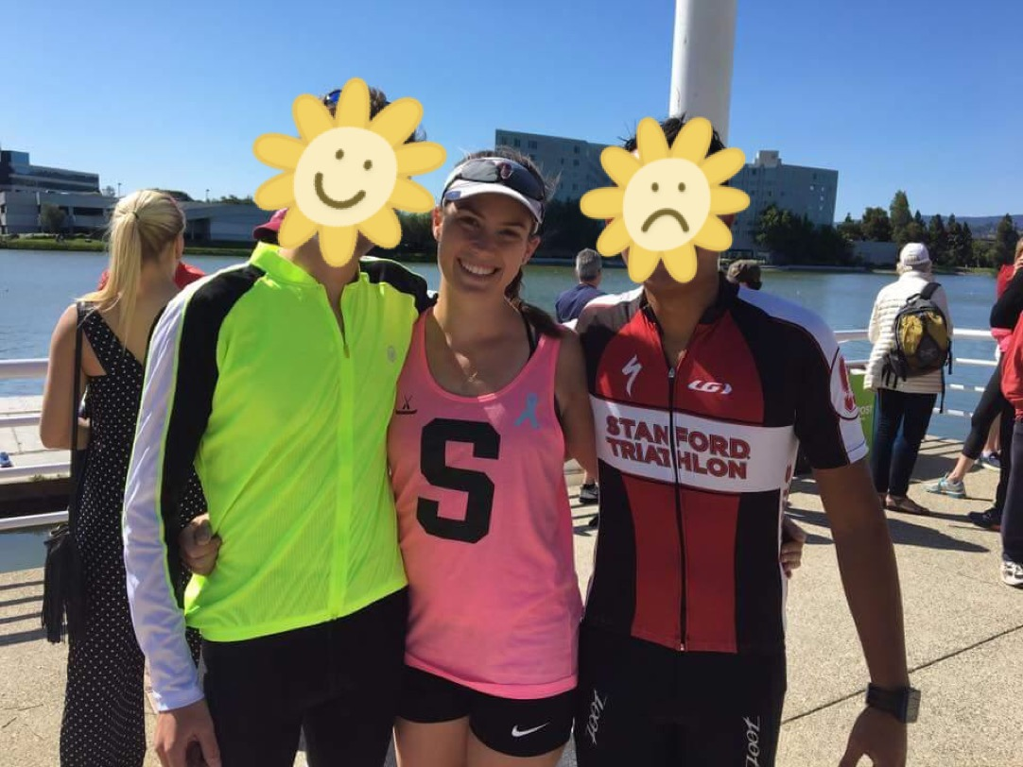
Interviewee #1: Reilly
Athlete (rower)
Dedicates 30+ hours a week to rowing
Mechanical engineer
Enjoys camping

Slide 5
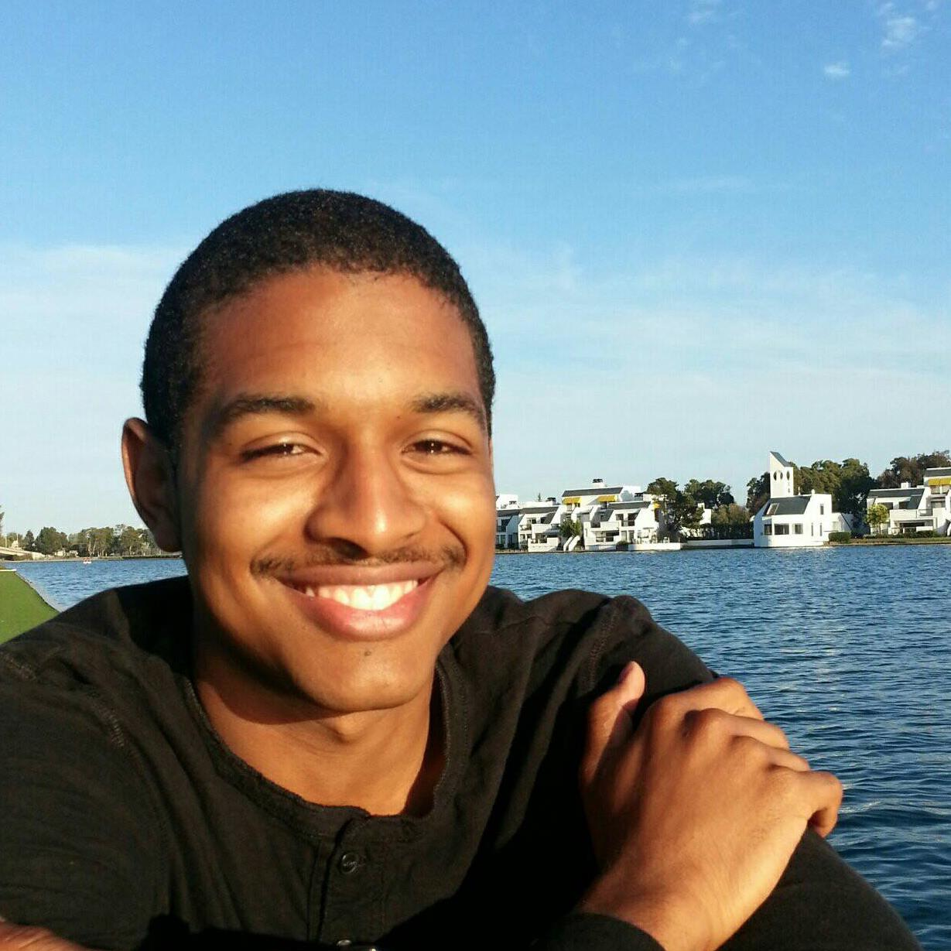
Interviewee #2: Micah
Gamer
Has several gaming setups (desktop, console, etc.)
Marvel fan
Proud of his academic accomplishments

Slide 6
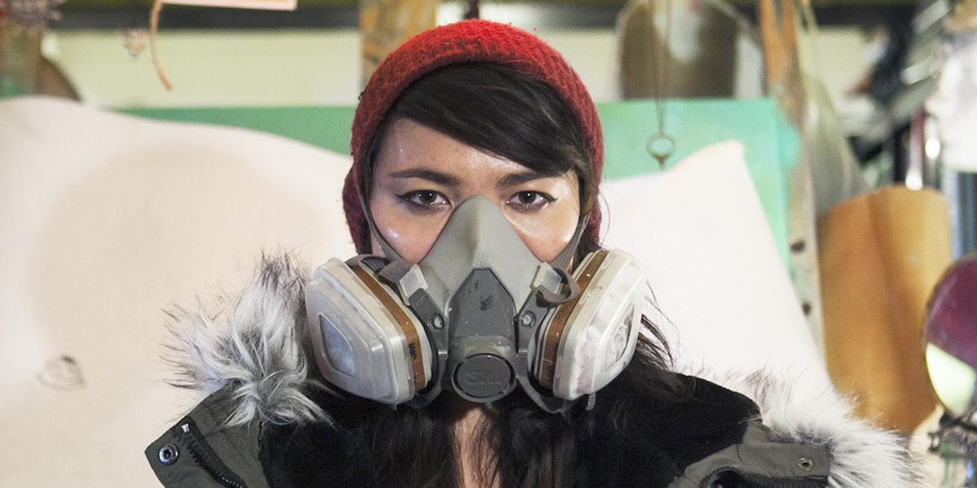
Interviewee #3: Lauren
Artist/Muralist
Following her passions
Feels strongly connected to her surroundings
Complex relationship w/ people

Slide 7
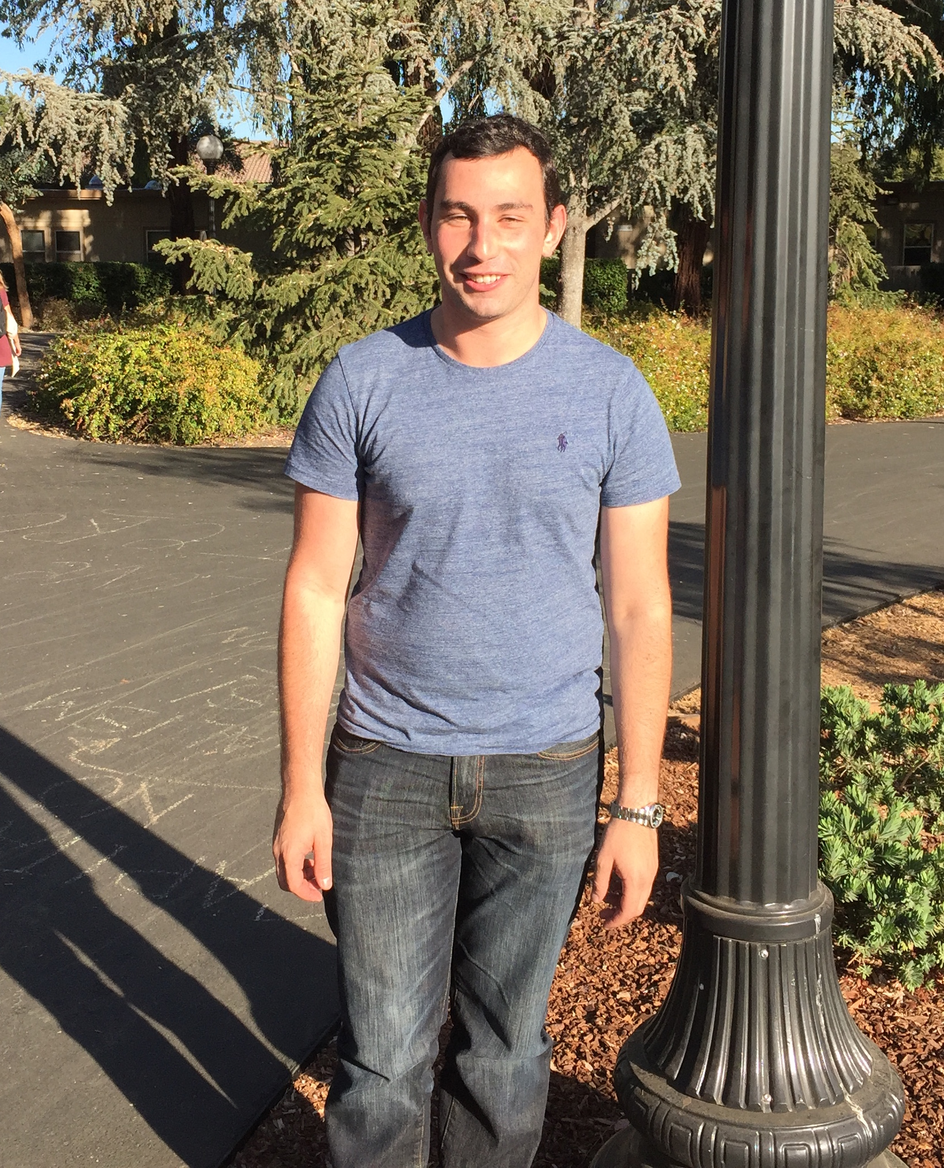
Interviewee #4: James Sherwood
Theater (producer)
The experience of waiting for a show to start is boring
Pre-visualization for lights takes 60 hours, and stage prep for lights takes 80 hours
Pre-visualization software can be inaccurate

Slide 8
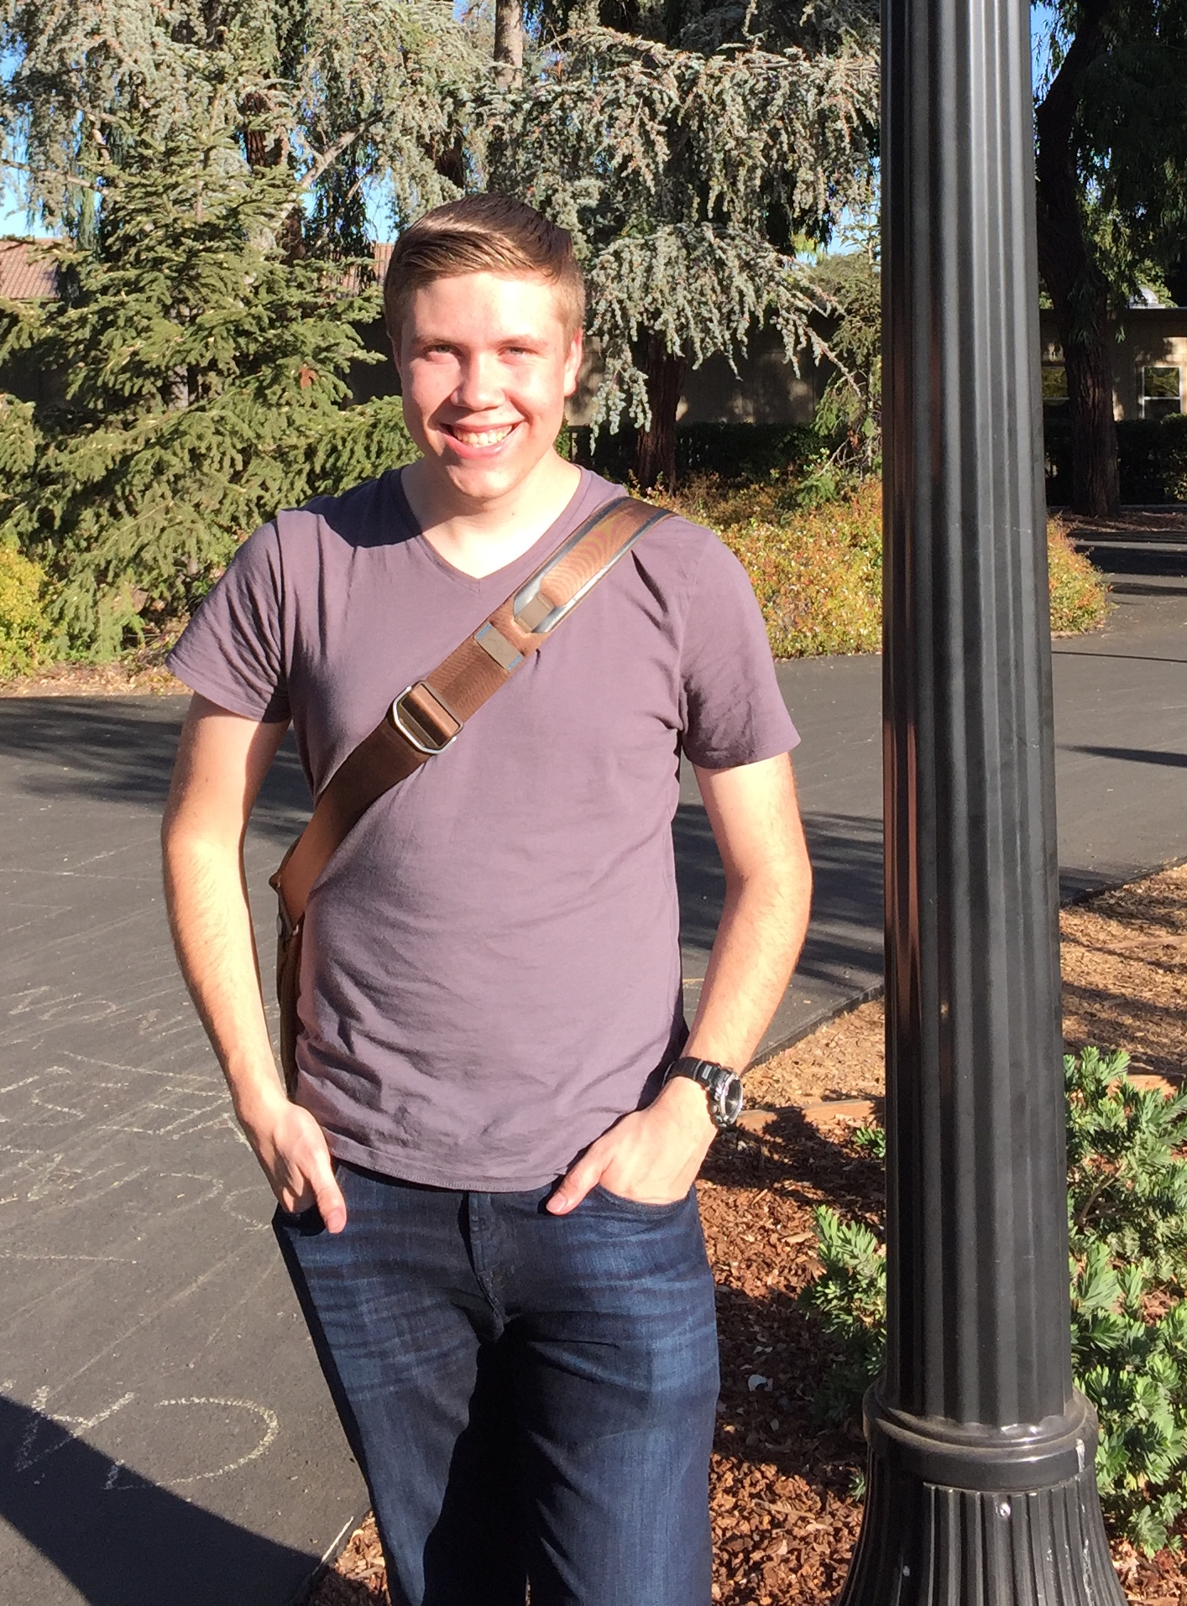
Interviewee #5: Steven Hitchcock
Theater (lighting/set designer)
There are hundreds of individual controls for theater lighting and sound
Lighting pre-visualization can be inaccurate, and it can be difficult to tell which light is causing problems

Slide 9

Results
Everything in Reilly’s routine ties back to rowing
She enters a “flow state” when she rows
She spends a lot of time commuting to and from rowing practice

Slide 10
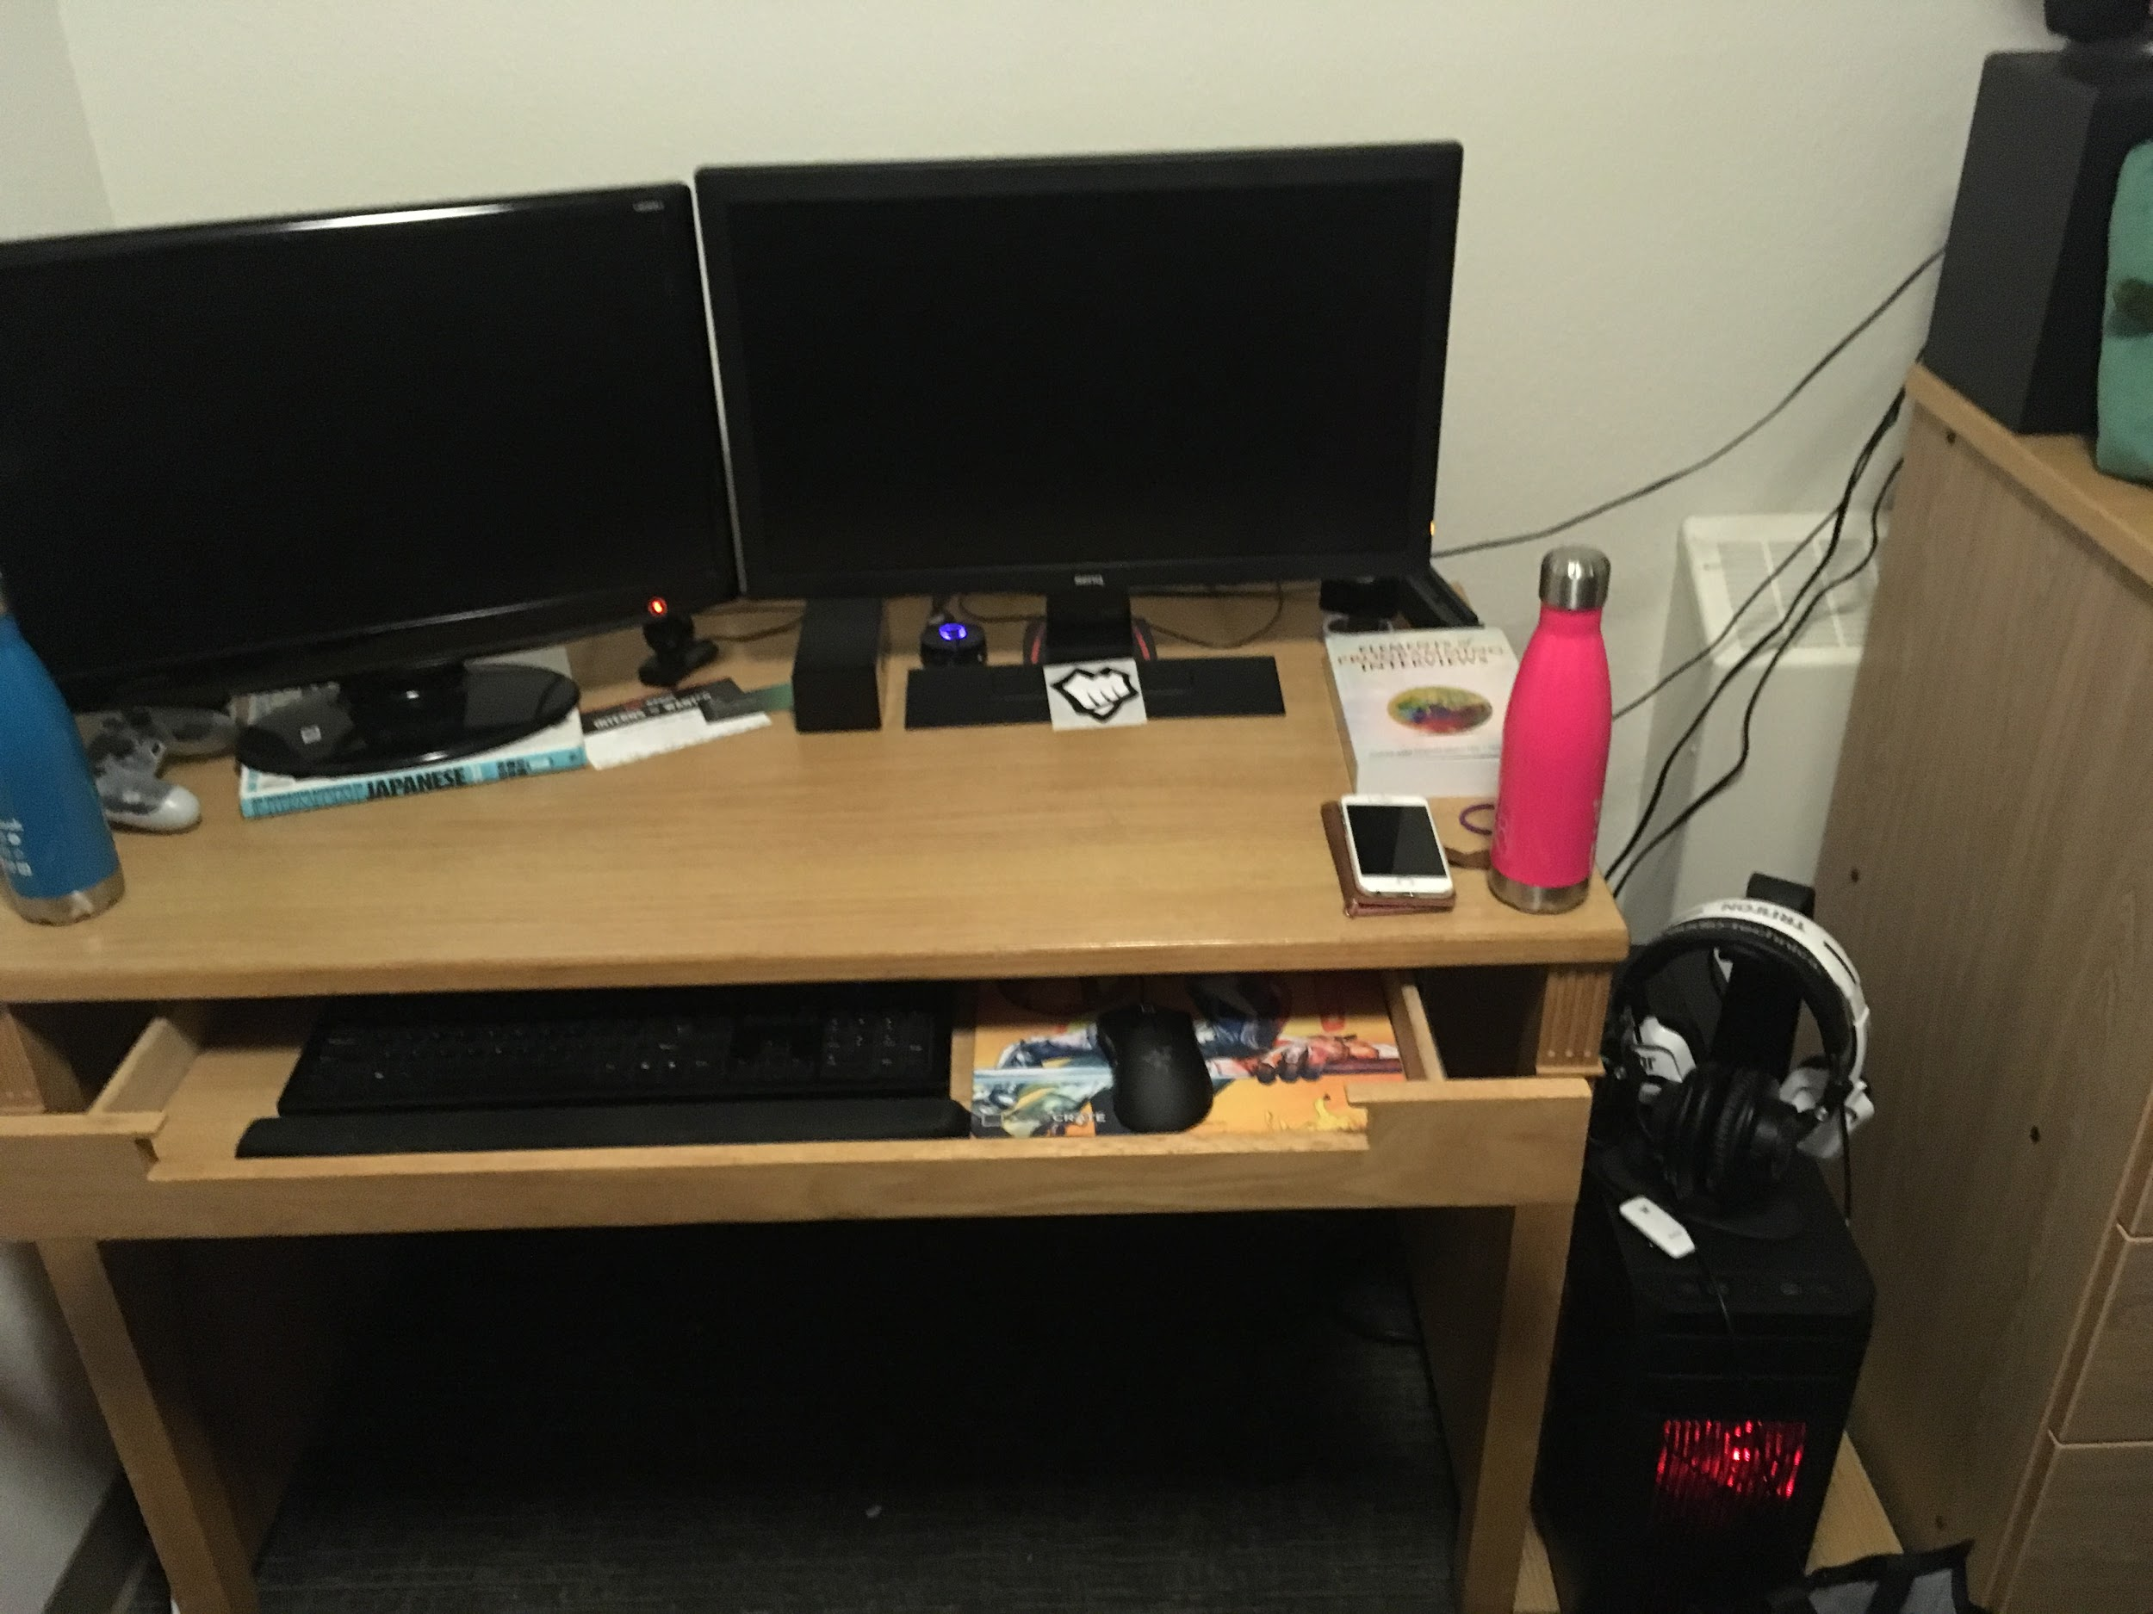
Results
Micah doesn’t want to “seem interesting”
He games at night so he doesn’t “waste time” during the day
He wants to make the “best lemonade”

Slide 11
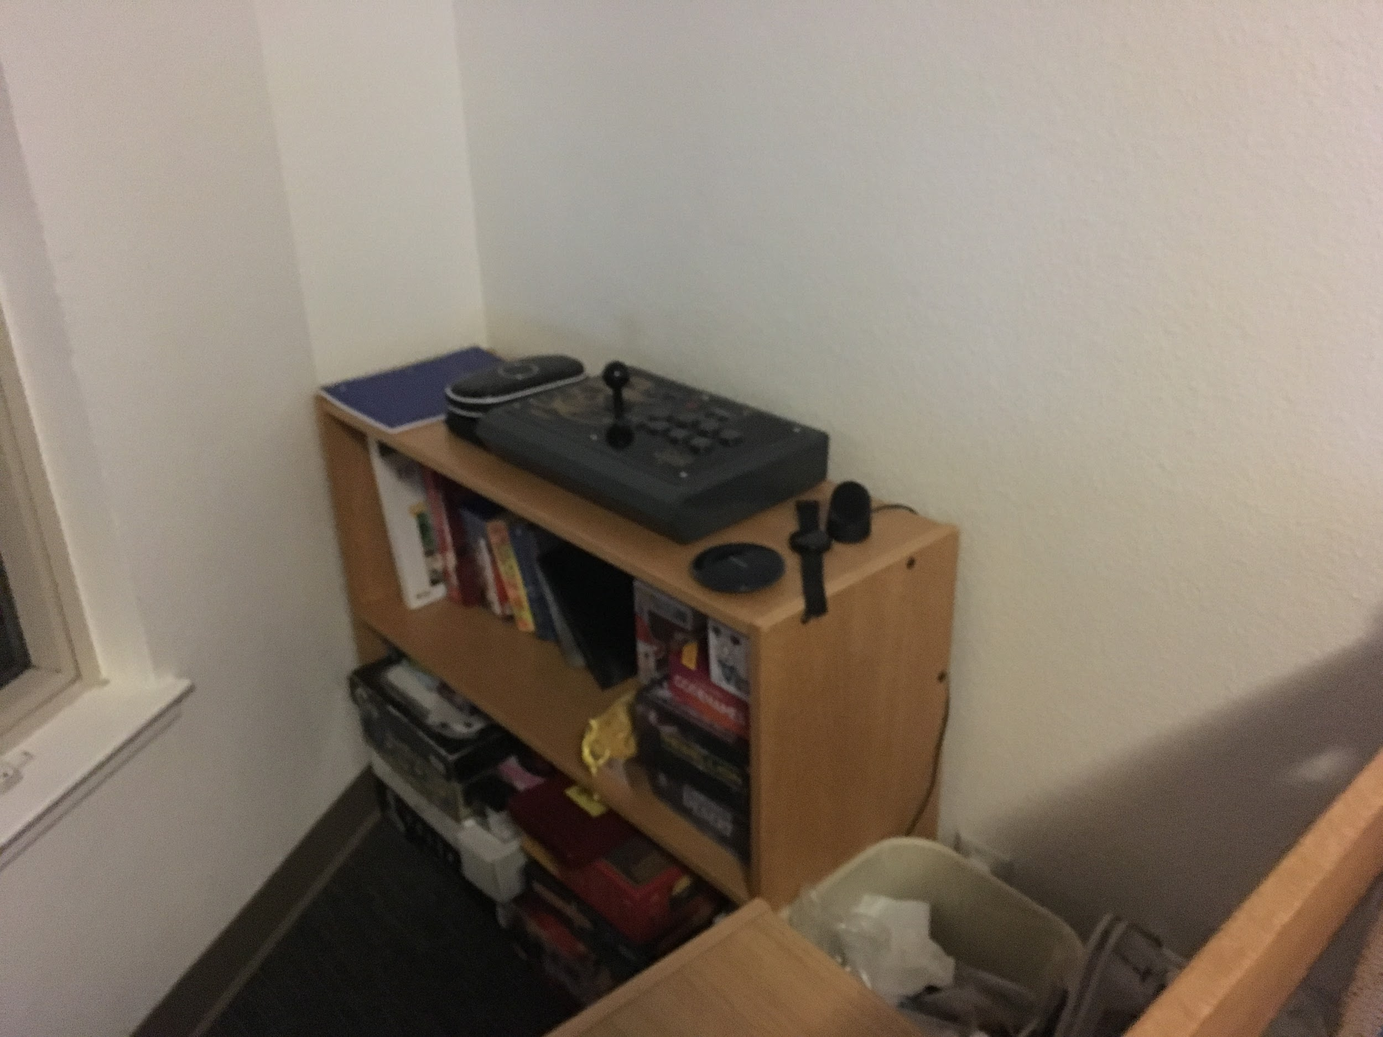
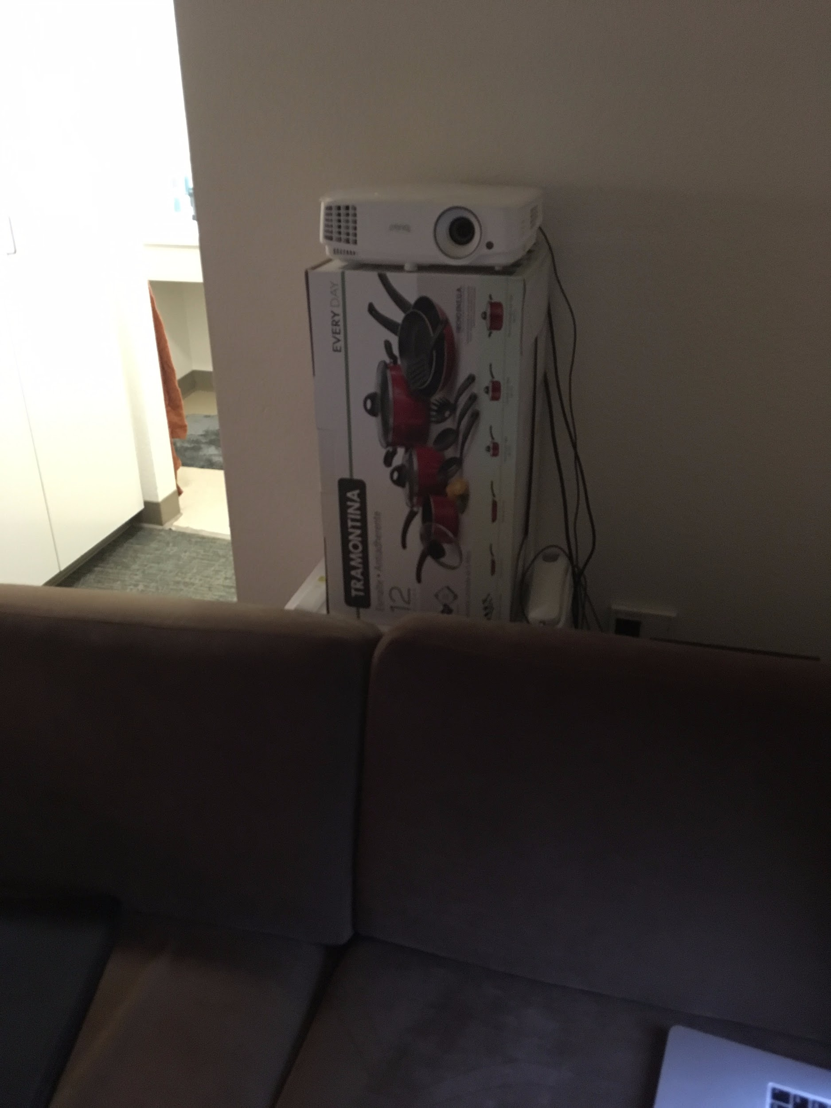
Results

Slide 12
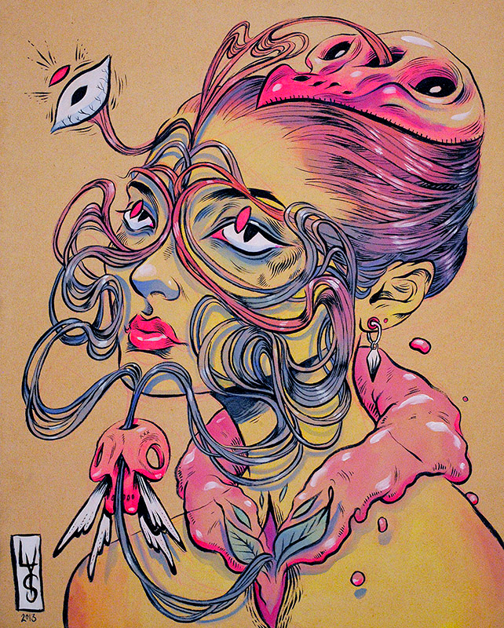
Results
Lauren YS didn’t want to show us her face
She prefers working outdoors and finds studios lonely
The best way to truly know someone is to “share a bed with them”

Slide 13
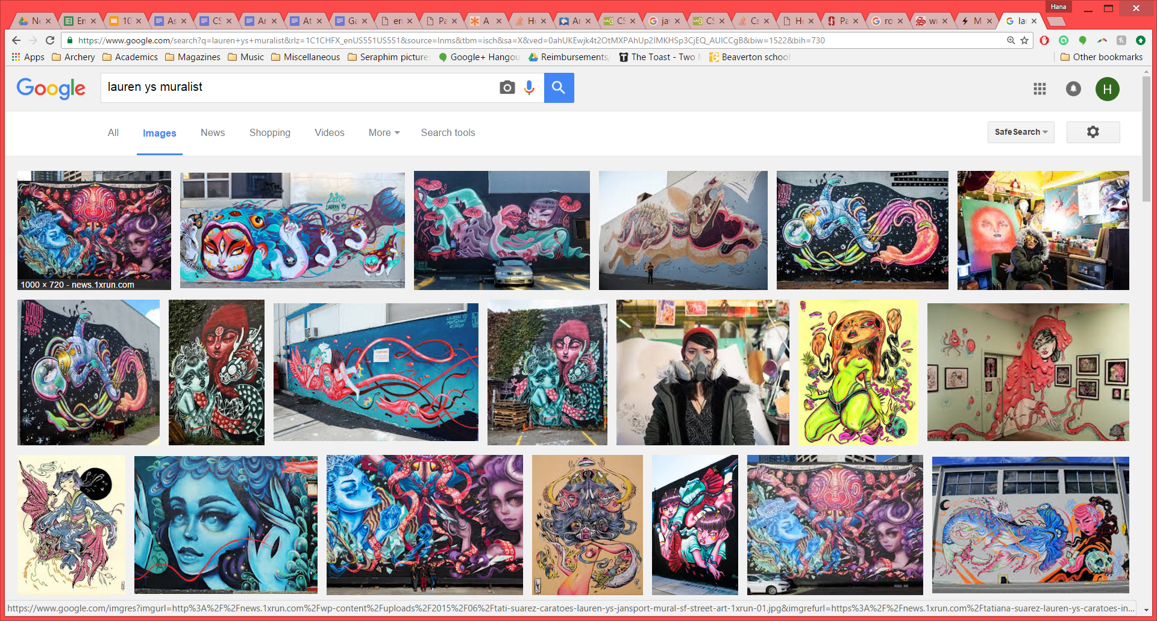
Results

Slide 14
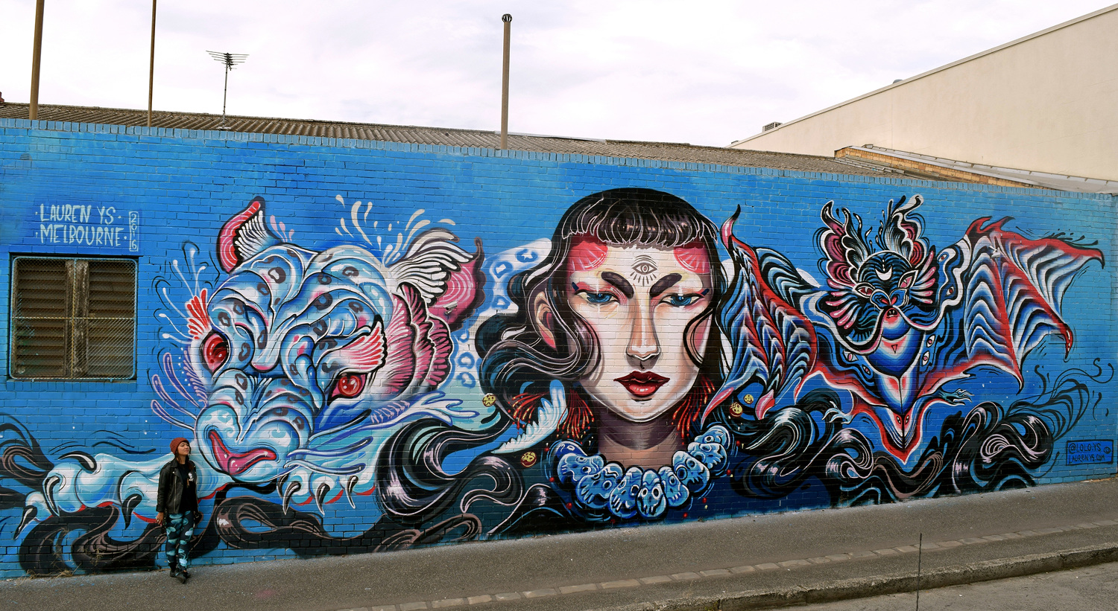
Results

Slide 15
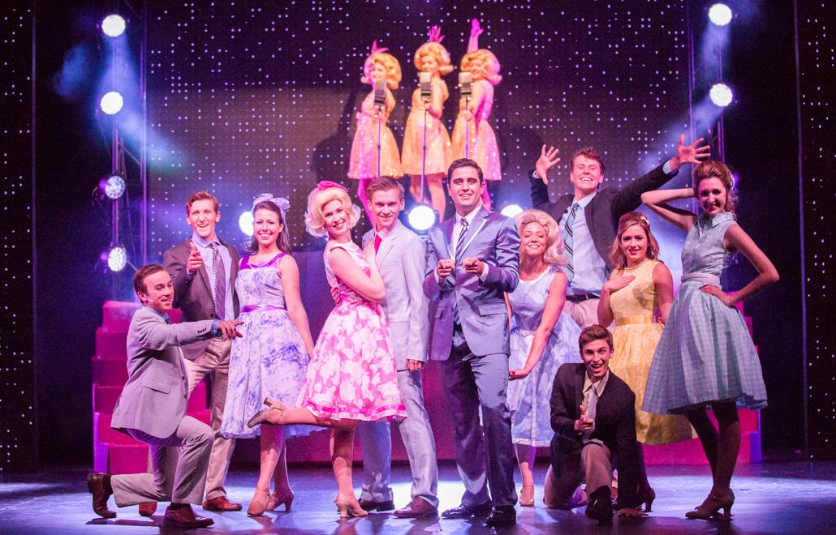
Results
James Sherwood felt that waiting for a show to start is boring
He also felt like that pre-show set up can be iterative, time-consuming, and frustrating

Slide 16
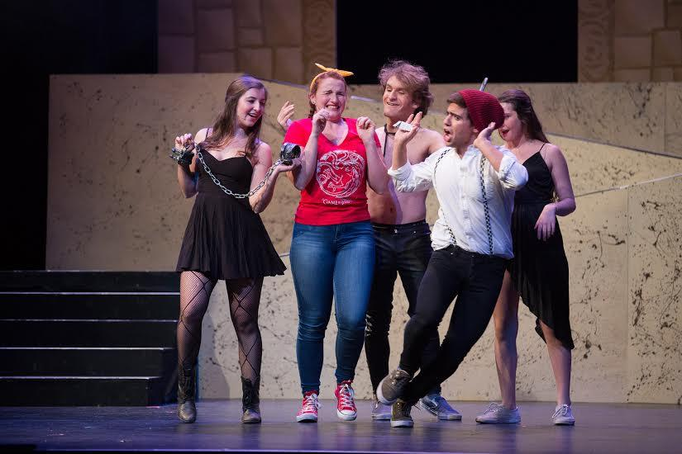
Steven Hitchcock
Steven Hitchcock found lighting pre-visualization software to be inaccurate.
He wished that there were easier ways to track lights in a show during set setup.

Slide 17
Analysis - Reilly
Say
Hates driving 10hrs/wk
Thinks in terms of teams
Enjoys external validation
Likes making others feel loved
Think
Interview messing with bedtime
Why do I only talk about rowing?
What would life be like without this long commute?
Do
“Loves oversharing”
Leaned forward, open
Visibly excited about compliments
Visibly angry about past coach
Feel
It bugs me when the routine breaks down
I wish I was more confident that I was doing everything right
I like having my life figured out

Slide 18
Analysis - Micah
Say
Wakes up and “checks channels”
Feels guilty gaming during day
Wants to make the “best lemonade”
Think
Gaming is embarrassing
I have to break stereotypes
I want to accommodate other people
Do
Stiff and nervous for most of interview
Lights up when discussing Marvel/lemonade
Embarrassed/hesitant about gaming
Feel
Guilty about the way I spend my time
Embarrassed to talk about passions
Excited about Marvel, lemonade, cooking

Slide 19
Analysis - Lauren YS
Say
“I don’t do FaceTime video”
Process: “2-day banger”
Likes “busted houses,” “color of rust,” and “the way people talk” in Detroit
Think
I can be better
I’m doing what I love and I’m lucky
Following a passion is important
Feel
I feel intimate with other artists
I feel lonely in a studio
I feel a lot of potential in an empty wall
I feel lonely in my own head
Do
Wouldn’t show her face
F-bombs, relatable, earnest
Sadder, lower register when discussing her depression

Slide 20
Analysis - James Sherwood
Say
“Playbills are outdated”
“Set plans are created on paper, usually”
“We have two days to complete a lighting setup”
Think
Show production is extremely stressful
The theater experience is primarily about storytelling
Do
Used hand-motions to describe stressful situations
Frowned when thinking smartphone-assisted special effects in theater
Feel
Excited about reducing pre-show preparation stress
Excited about improving the experience of someone who’s waiting for a show to start.

Slide 21
Analysis - Steven Hitchcock
Say
“There are hundreds of lights to control on stage”
“It’s difficult to tell where lights are on stage during set up”
Think
Lighting pre-visualization software is lackluster
I wish I had a better way to understand where my lights are during set up
Do
Grinned when talking about late nights in theater
Grinned when talking about all of his theater lighting gadgets
Feel
Frustrated that lighting pre-visualization software is often inaccurate
Thankful that pre-vis software exists

Slide 22
Needs and Insights
Reilly has a need for external validation; it impacts everything else
She has a fractured work style at times - 15 minutes at a time
She needs to be always reaching toward something

Slide 23
Needs and Insights
Micah needs to feel confident and inspired
He needs to feel like he’s not wasting time when he indulges his passion for gaming
He wants to fit into the crowd and not stand out

Slide 24
Needs and Insights
Lauren wants to feel connected to other people, but she also wants to maintain a barrier (hiding her face)
She needs to feel open spaces and sunlight
She needs to feel like she’s not in her own head when she’s working
She feels like giving and making murals is worth it on their own; doesn’t need validation

Slide 25
Needs and Insights
James wants the set and lighting design process to be intuitive, but appreciates the complexity and importance of existing tools.
He’s skeptical about the use of theater-goer facing technology during a show--he thinks it might be distracting--but he thinks that such technology might improve the theater experience before the show starts.

Slide 26
Needs and Insights
Steven wants the process of creating lighting and effects for a production to be as intuitive as possible, and feels that it’s incredibly complex and stressful right now.
He loves theater and tech, and is optimistic about how new technology can enhance the experience of a theater-goer.

Slide 27
Summary
We discovered a need to feel confident and not get wrapped up in your own thoughts, as well as a desire to escape the need for others’ validation
We found both satisfaction and guilt about devoting your entire life to one hobby or interest
In theater, we found a lot of pain points associated with the lighting and production process. We also found that some aspects of the theater-goer experience could be improved.

