Slide 1
Voxyl
Medium Fi Prototype

Slide 2
Value Proposition

Slide 3
Share your vision.
Get your shot.
Notes:
The artists we interviewed struggled to find ways to communicate details that were crucial to their inspiration process, and they expressed desires to connect one-on-one with other artists in a deeply creative, non-superficial way. Voxyl is our solution to both of these problems.

Slide 4
Provide a natural, physical way for artists to form representations of their ideas.
Notes:
The artists we interviewed struggled to find ways to communicate details that were crucial to their inspiration process, and they expressed desires to connect one-on-one with other artists in a deeply creative, non-superficial way. Voxyl is our solution to both of these problems.

Slide 5
Tasks

Slide 6
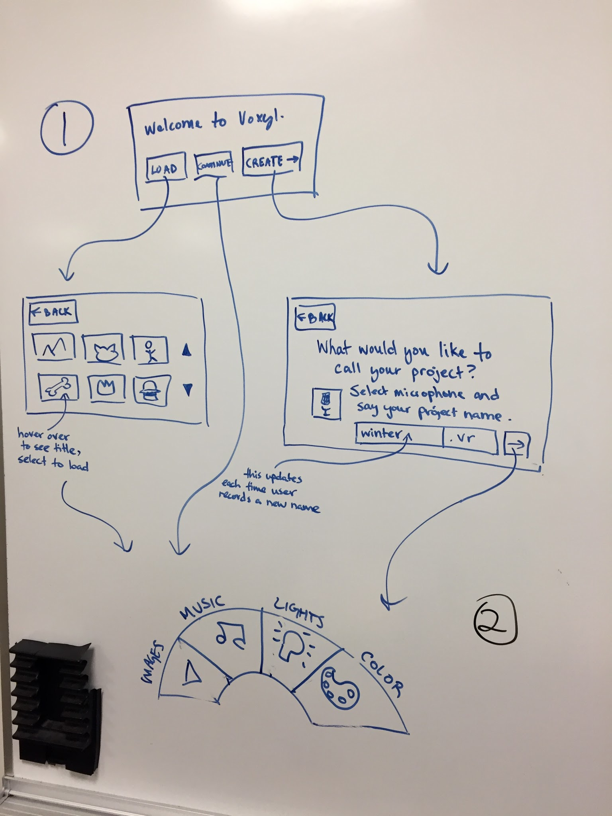
Simple Task
Create a new vision or load a previously created project.
Notes:
Changed task to incorporate loading previous project instead of just “pressing a button to continue”

Slide 7
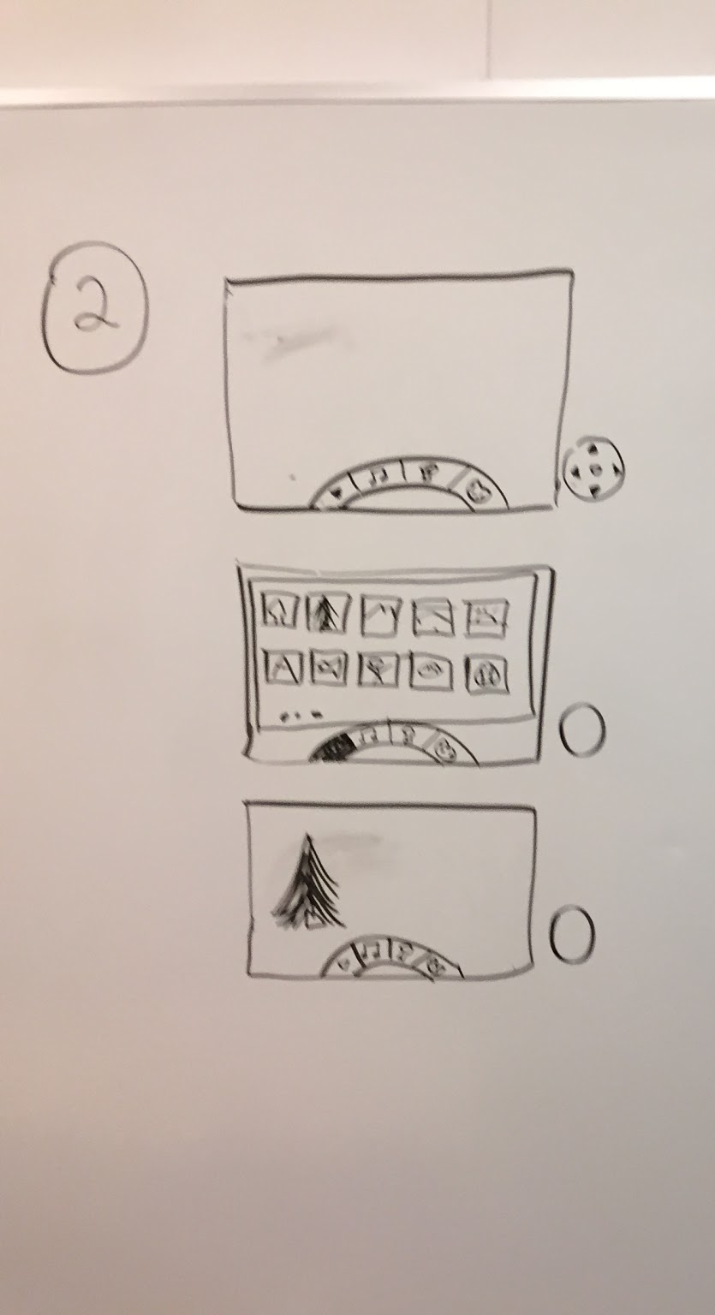
Medium Task
Choose a piece of media from the gallery and add it to the 3D canvas.
Notes:
Simplified medium task to simply choosing a piece of media and adding it to the canvas; more complex aspects such as adding color were moved to the complex task.

Slide 8
Complex Task
Update and refine vision by scaling and moving media and adding music/lighting/color.
Notes:
Changed complex task to incorporate not only scaling and repositioning media, but also adding light sources, playable music, and tinting the canvas (adding color).

Slide 9
Interface Revisions

Slide 10
Simple Task

Slide 11
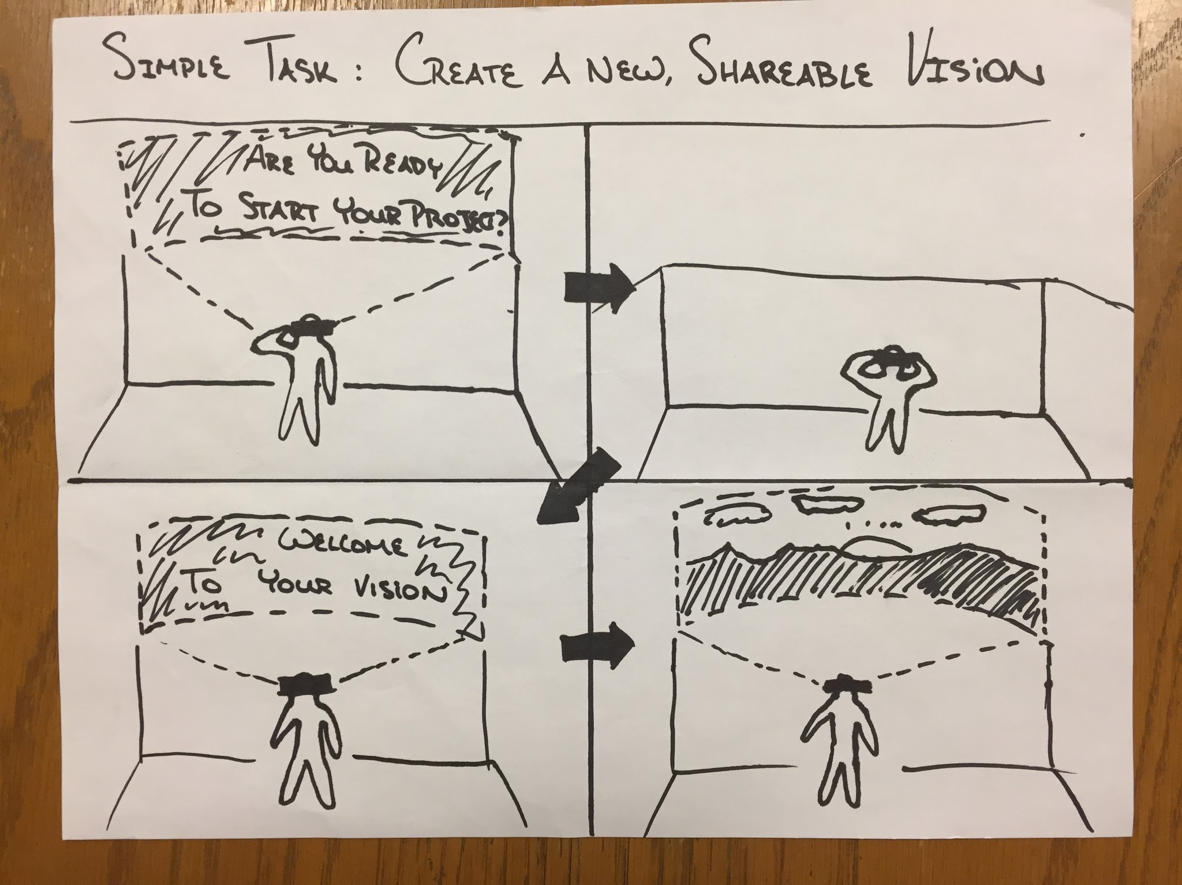
Notes:
Changes we made:
add a way to load the most recent project, to make it easy to keep working
Use speech recognition to name projects (hard to type in VR)

Slide 12
Medium Task

Slide 13
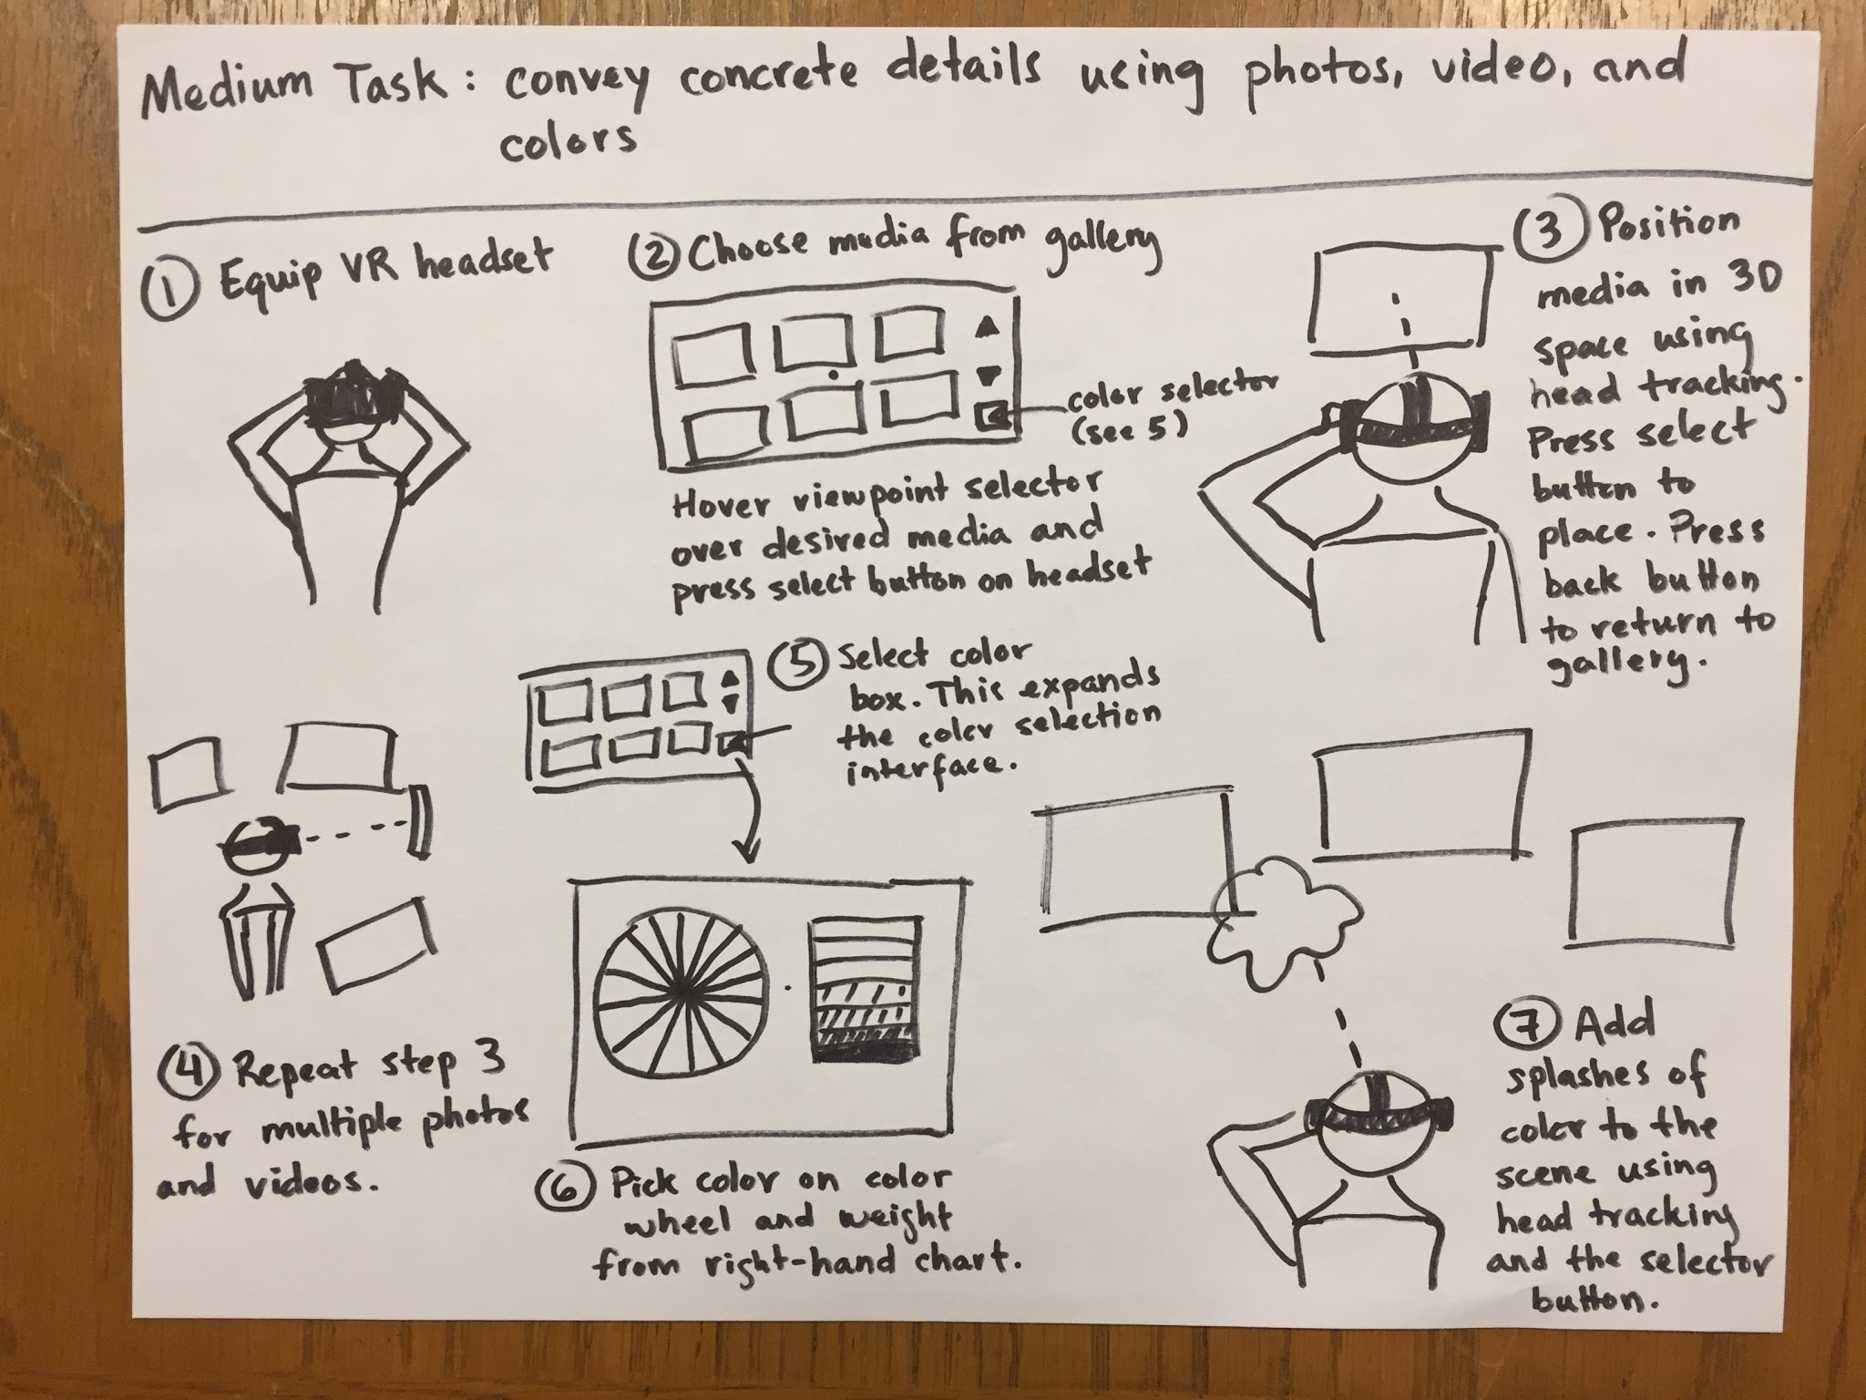
Notes:
Changes we made:
New radial menu appears by user’s feet (HUDs cause motion sickness)
No longer need to use buttons/tap headset to simply place media (buttons reserved for more complex tasks)

Slide 14
Complex Task

Slide 15
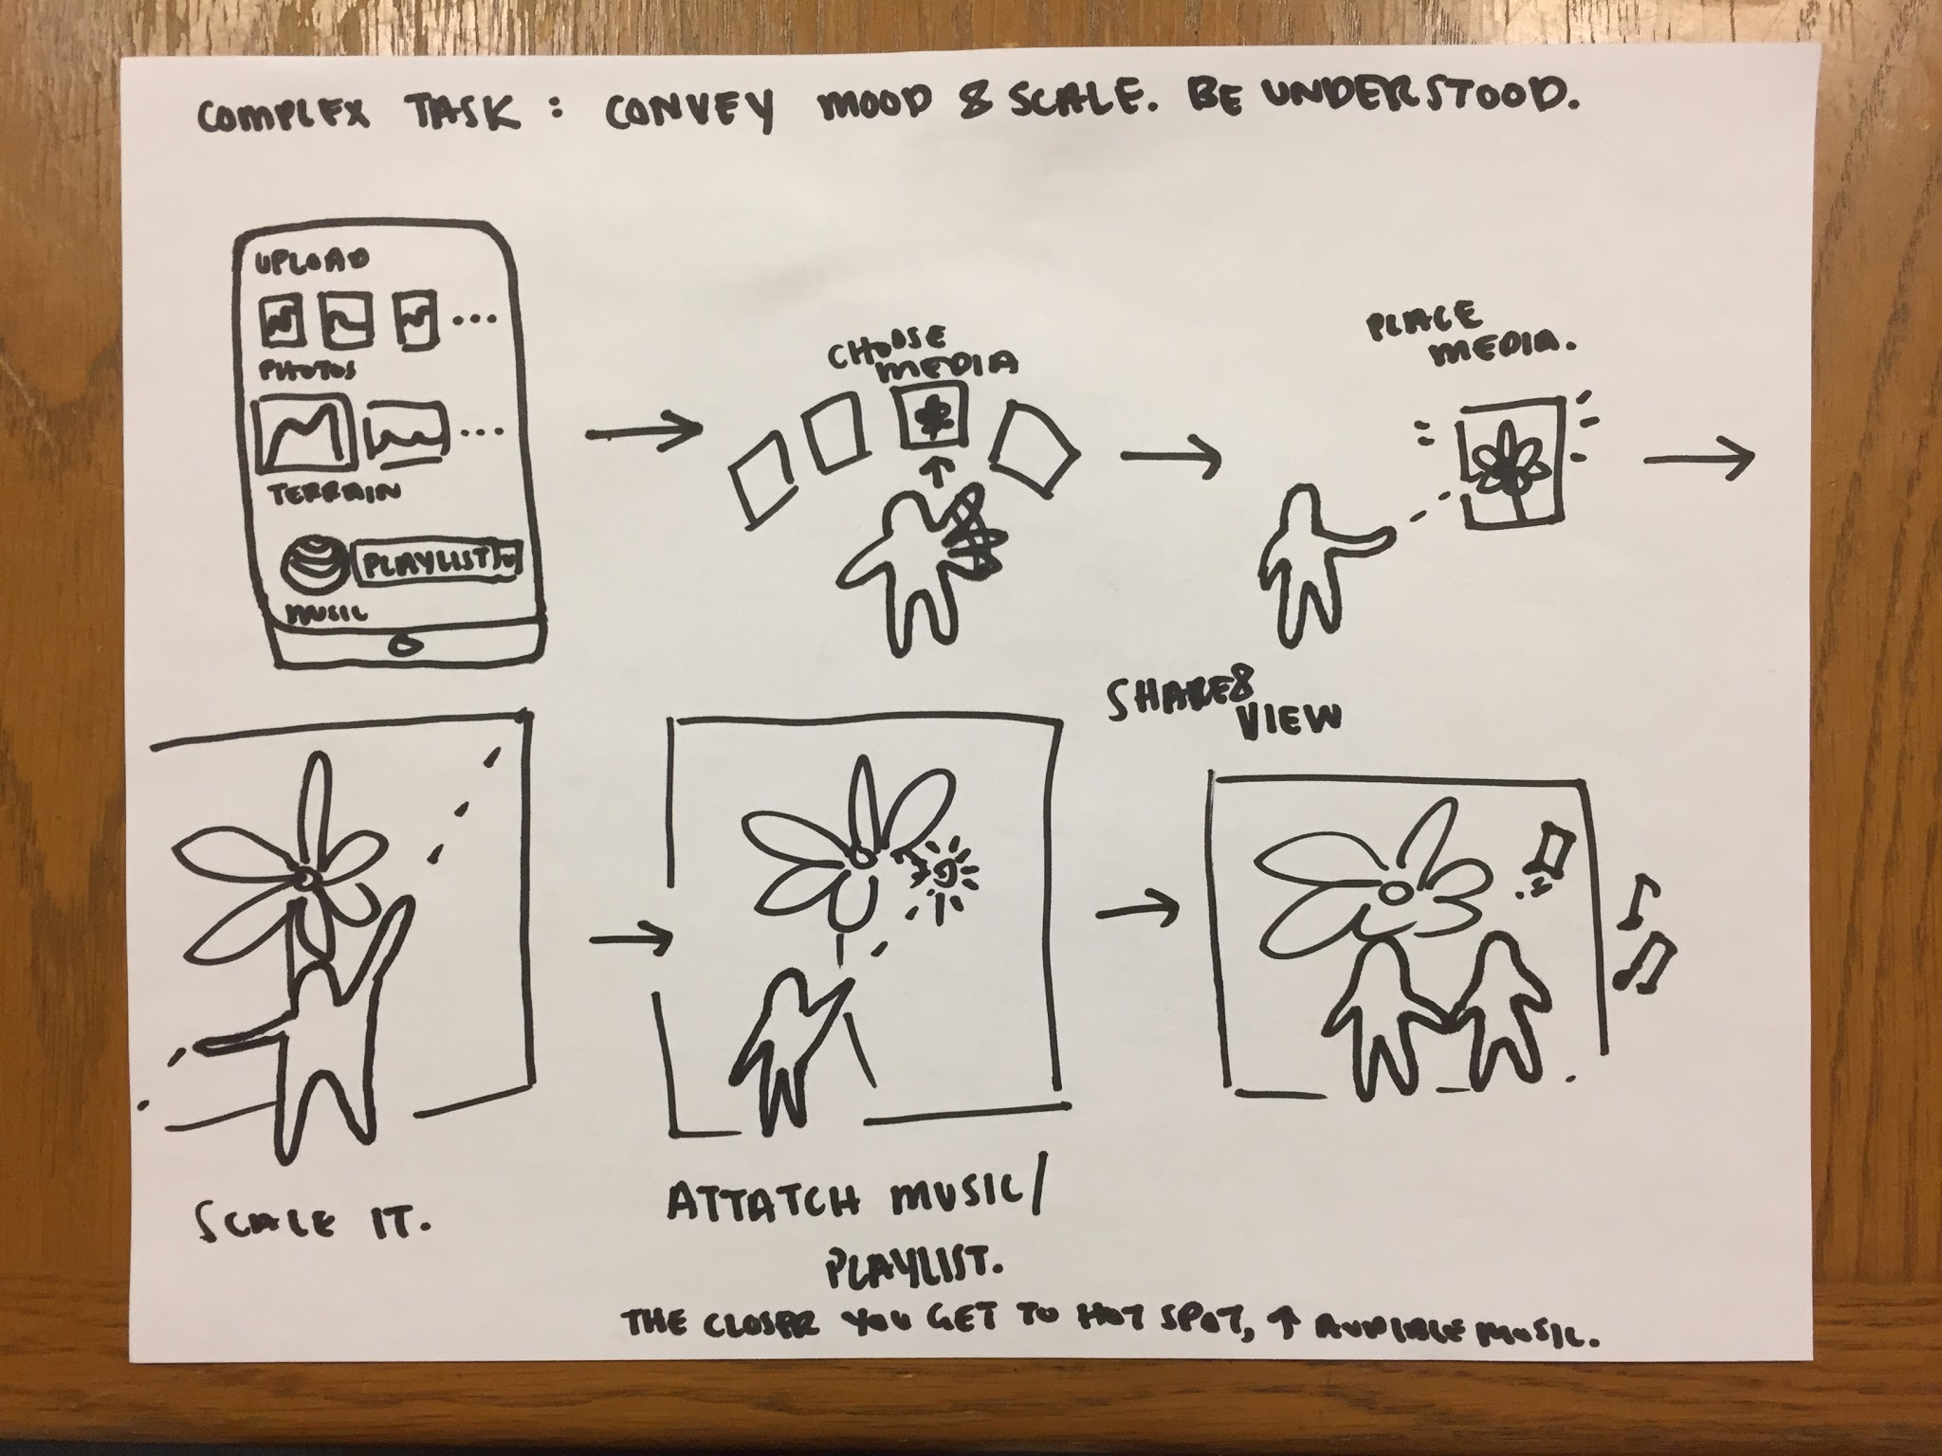
Notes:
Changes we made:
Scaling now done by using touchpad on headset instead of gestures (requires only 1 piece of tech instead of 2)
“Edit” menu available behind user; they turn around to save, undo, redo, or finish (physical impact of “turning away” from completed canvas); in testing, users were confused about how to finish their project, so we added a menu option

Slide 16
Task Flows

Slide 17
Simple Task

Slide 18


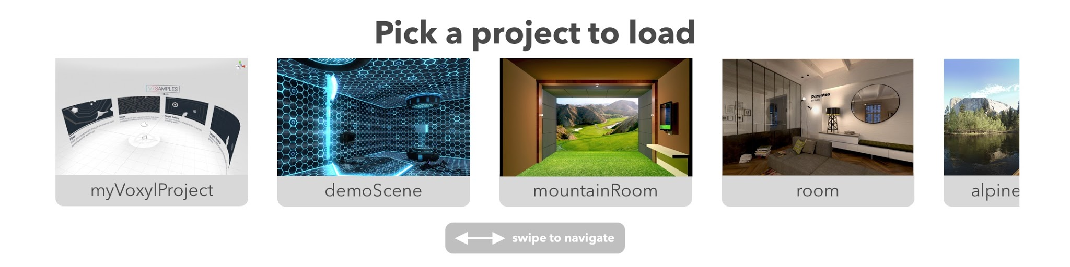


Slide 19
Medium Task

Slide 20
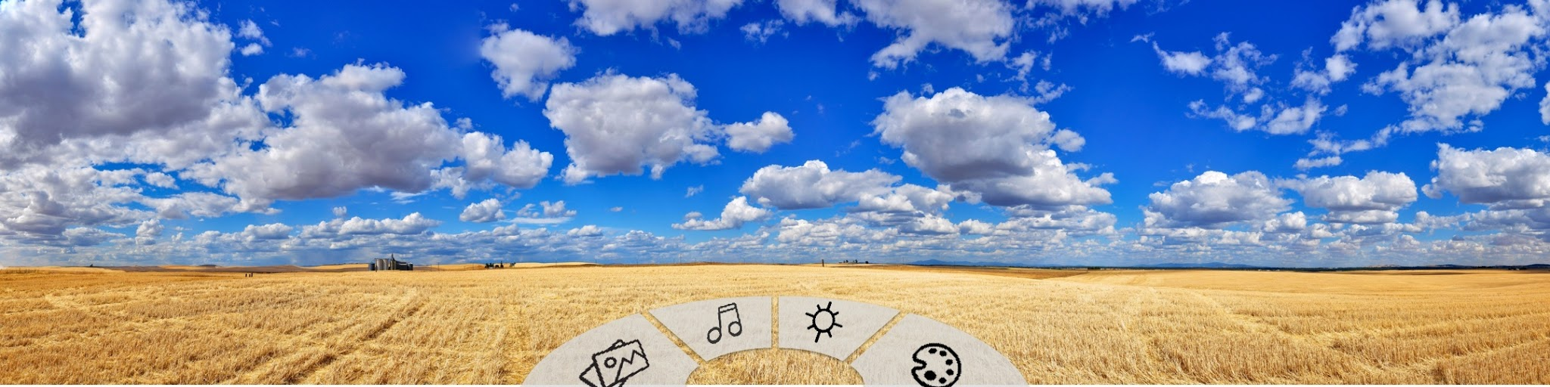
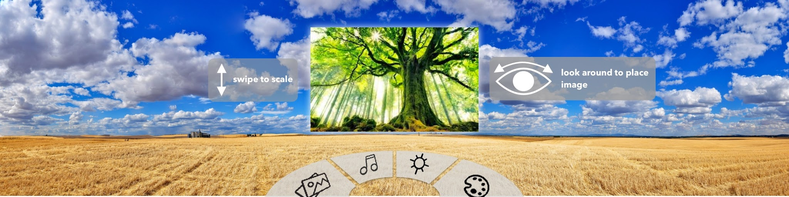
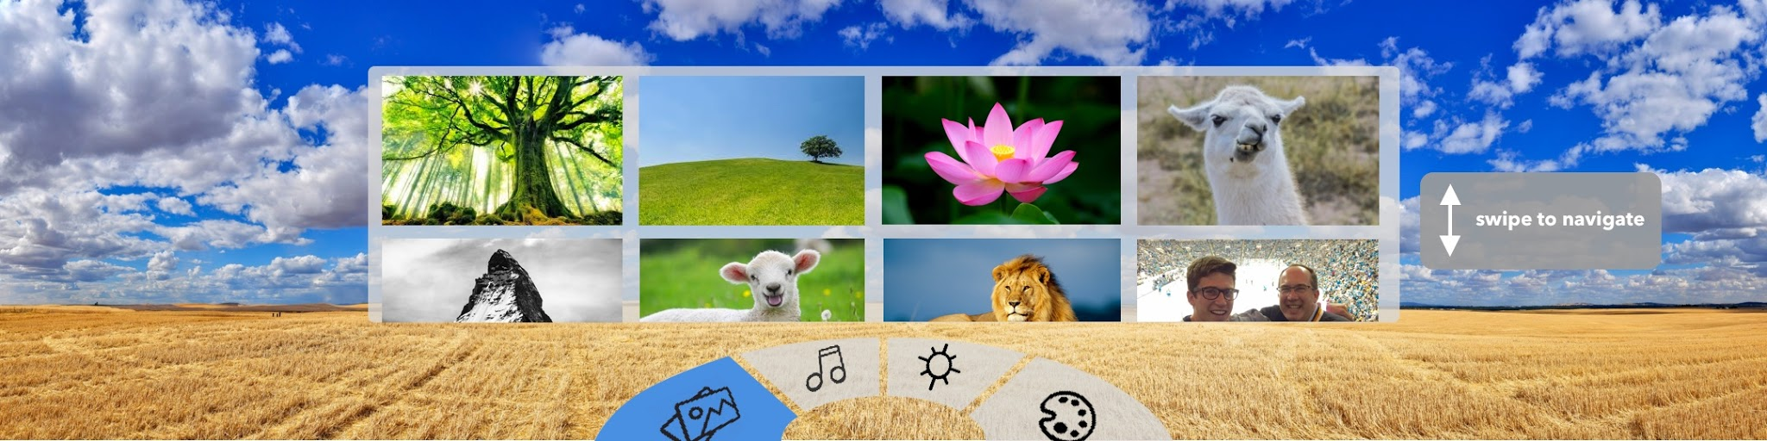
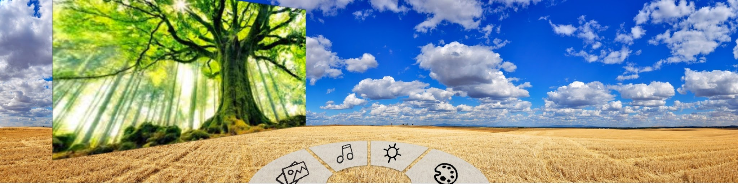
Notes:
Empty canvas.
Select button to add media.
Choose media from gallery.
Look around to place media, or swipe on the touchpad to scale.
Pressing the select button places the media on the canvas.

Slide 21
Complex Task

Slide 22
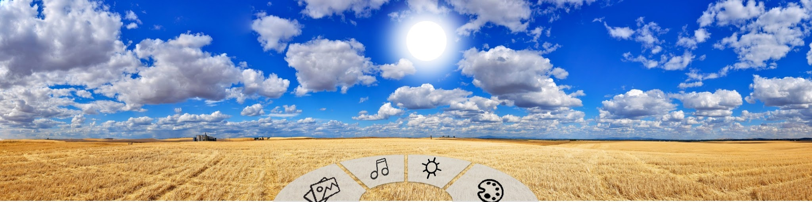
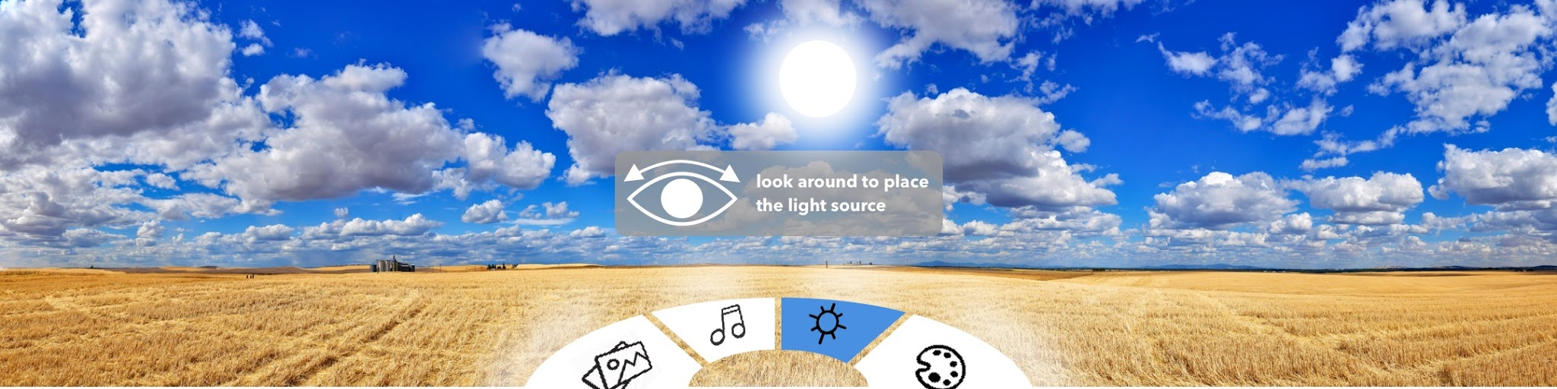
Notes:
Back to empty canvas.
Click light button to add a light to the canvas.
Look around and press select to place light.

Slide 23


Notes:
Back to empty canvas.
Click palette button to tint the canvas.
Select RGB values, then select button to tint canvas.

Slide 24

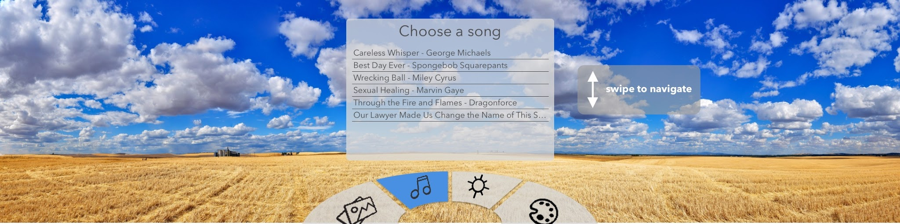

Slide 25


Slide 26
Prototyping Overview

Slide 27

Notes:
We used InVision, a collaborative in-browser prototyping tool that lets you prototype for web, mobile, and even wearable platforms. Sadly they don’t have a VR platform option, so we prototyped Voxyl as a web application.

Slide 28
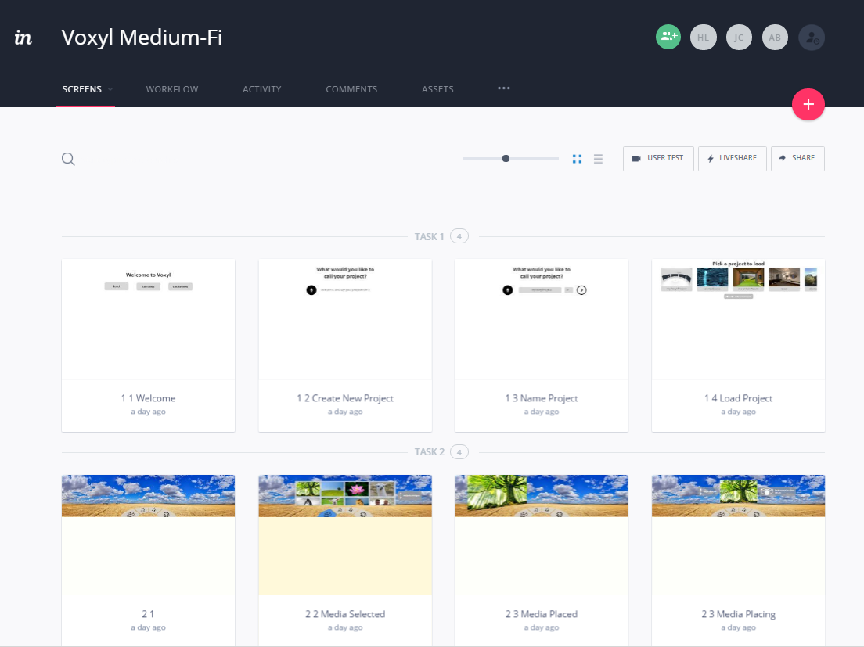
Notes:
We really liked the online collaborative aspect; we could work on it simultaneously from different computers, which was great for efficiency.

Slide 29
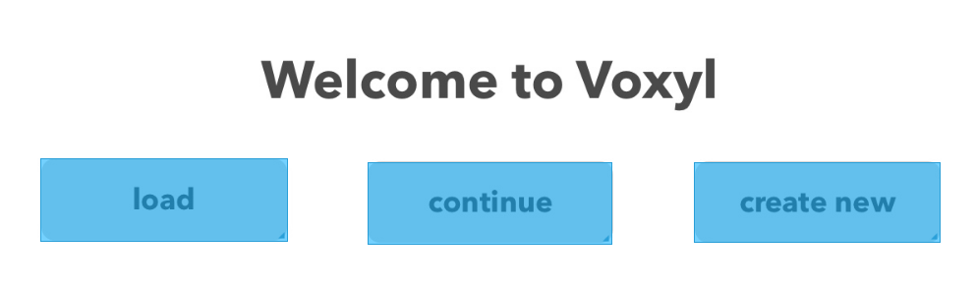
Notes:
It was easy to use and the interface was simple. You just load in all the screenshots of your prototype and link them up by using hotspots to simulate buttons.

Slide 30
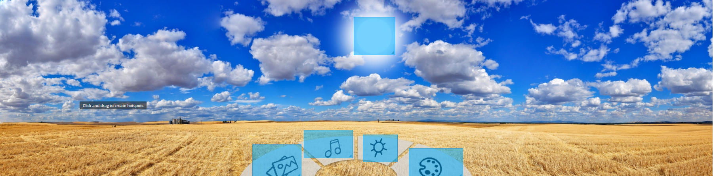
Notes:
It didn’t have some of the tools we would have liked, like being able to overlay different UI elements depending on what the user had selected up to that point; it was more like a choose-your-own-adventure novel. So we had to handwave a lot of the more freeform aspects of our app, like being able to place different combinations of media, music, colors, and lights, and focus on prototyping one feature at a time.

Slide 31
Notes:
We had to hard code in a lot of things, like this picture of a tree, as well as the positions and customizable portions of other pieces of media that were added to the canvas. InVision simply didn’t support a lot of user freedom in that regard. We also had to handwave a lot of the more VR-dependent aspects of the product, like being able to move your head to reposition things and using the touchpad on the headset to scale.

Slide 32
https://invis.io/4996VI2ZQ
Notes:
That’s our medium fi prototype. Thanks for watching! Any questions?

