Slide 1
voxyl
share your vision. get your shot.

Slide 2
Where We’re At
Notes:
During our interviews something that really stuck with us was the concept of a “clicking point”
A photographer we interviewed described a shoot to us. Shaky in the beginning. Lack of confidence?
Shoots until something hits kinda close to right, then turns the camera around
“Find themselves in the shot”
From then on everything flows. Both parties understand the vision. IT’s true collaboration and that’s when art can be made.

Slide 3
Team Mission Statement
Art happens when your vision can find its place in the context of another person’s mind

Slide 4
Team Mission Statement
Make your vision understood.
Notes:
Voxyl is a tool for photographers and other visual artists to share their inspiration with creative collaborators through the medium of virtual reality

Slide 5
Team Mission Statement
Make your vision understood.
Notes:
Voxyl consists of 3 parts.
Creation phase
sharing phase
viewing phase

Slide 6
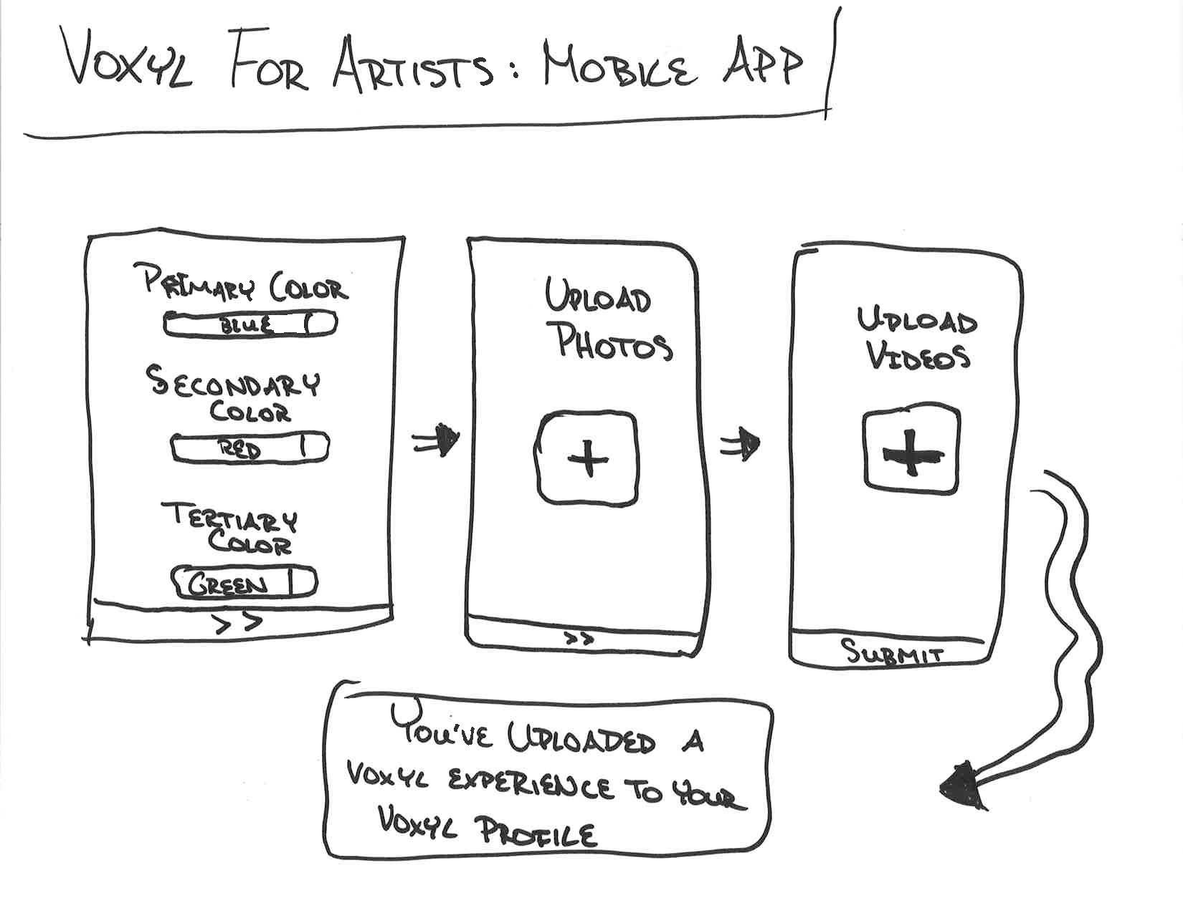
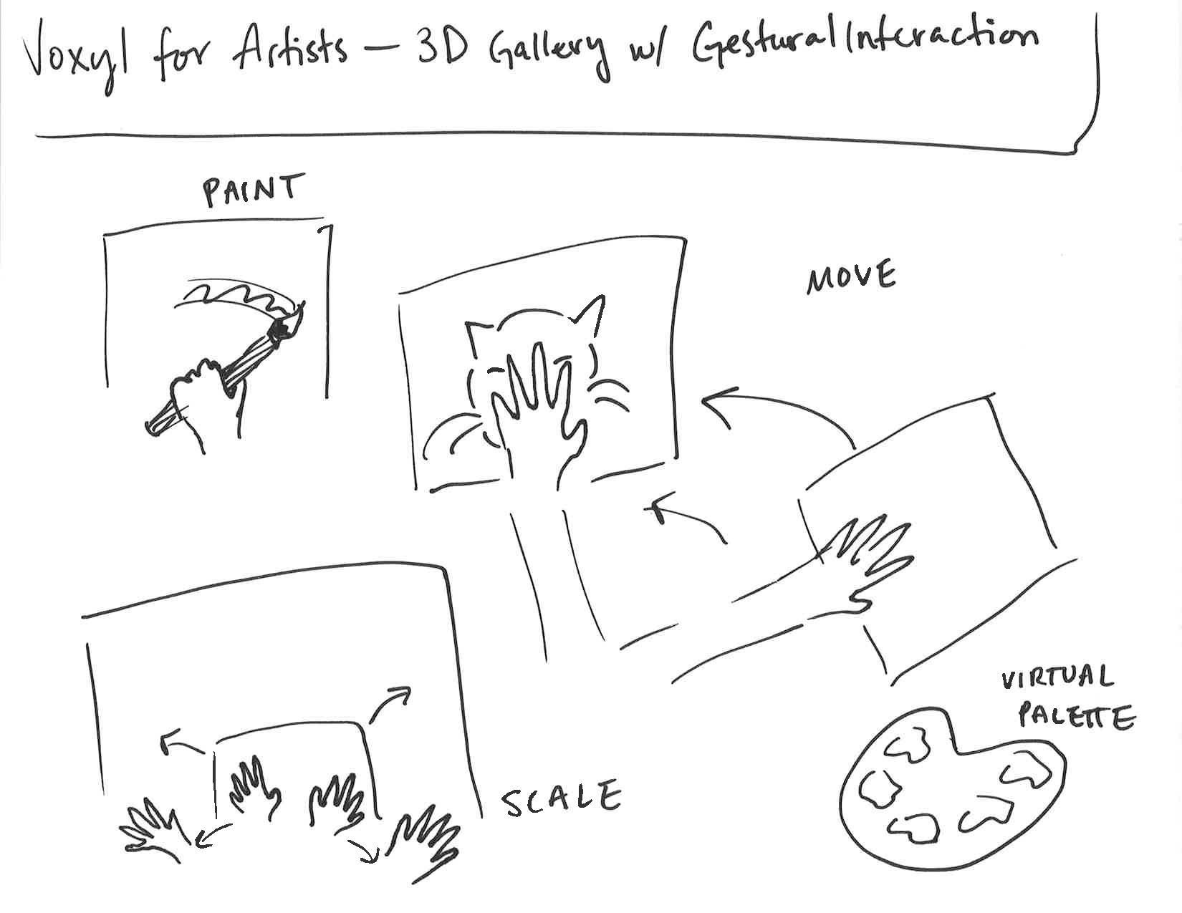
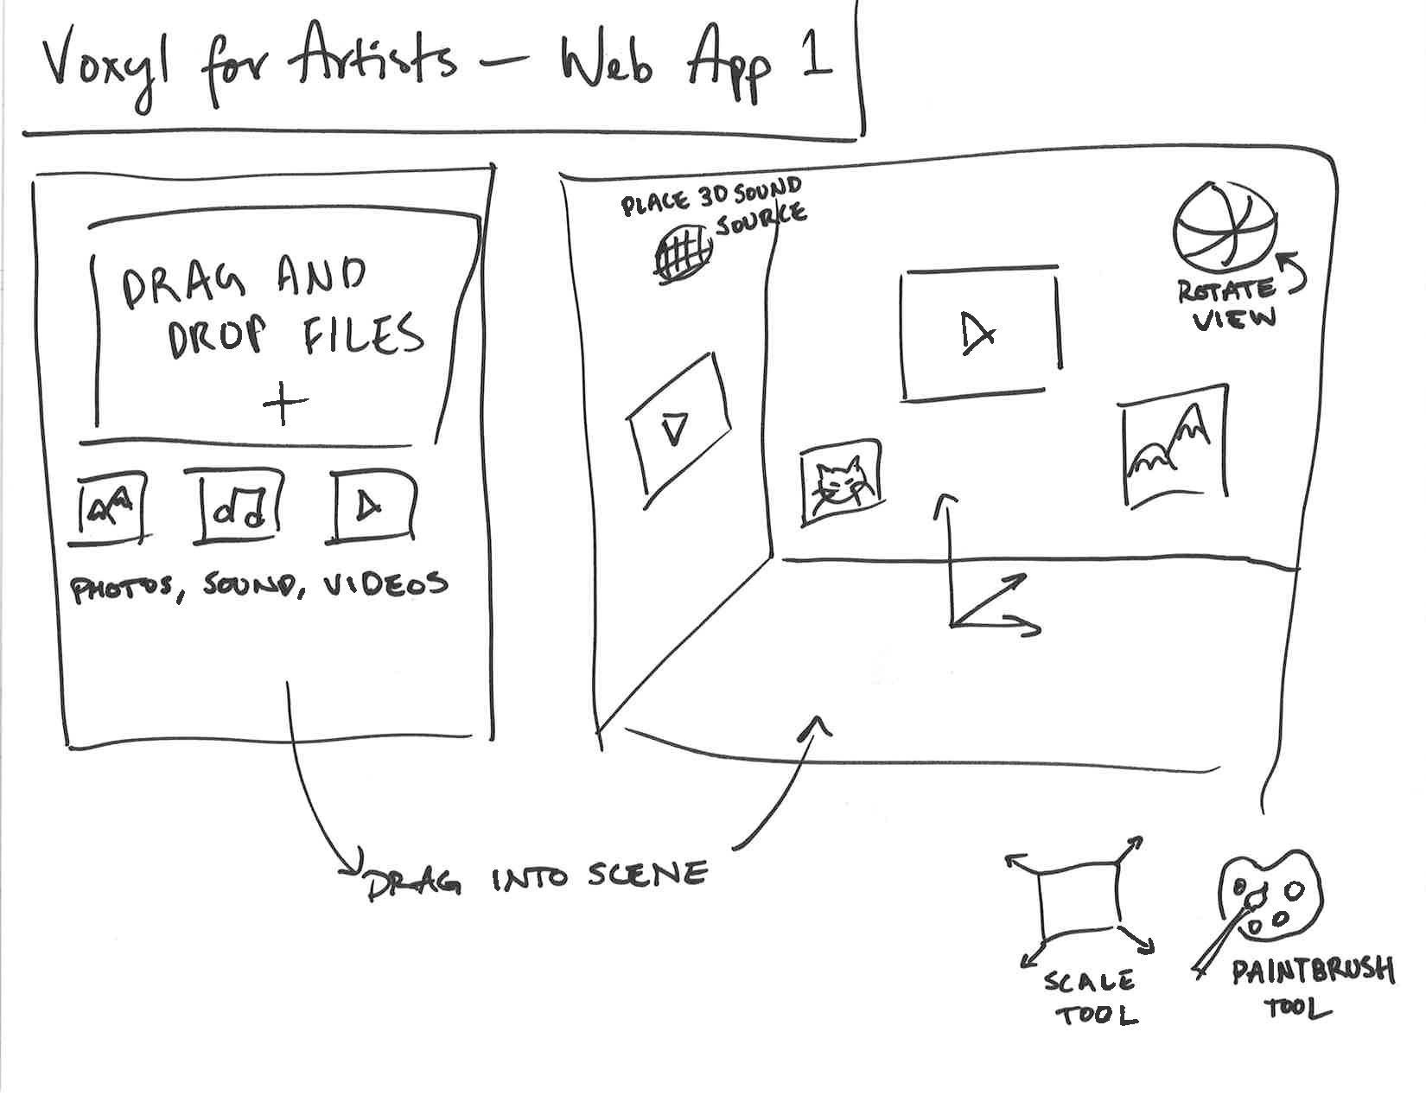
Notes:
We played around with various mediums and how those would play out in each phase
We also considered varying degrees of automation and control

Slide 7
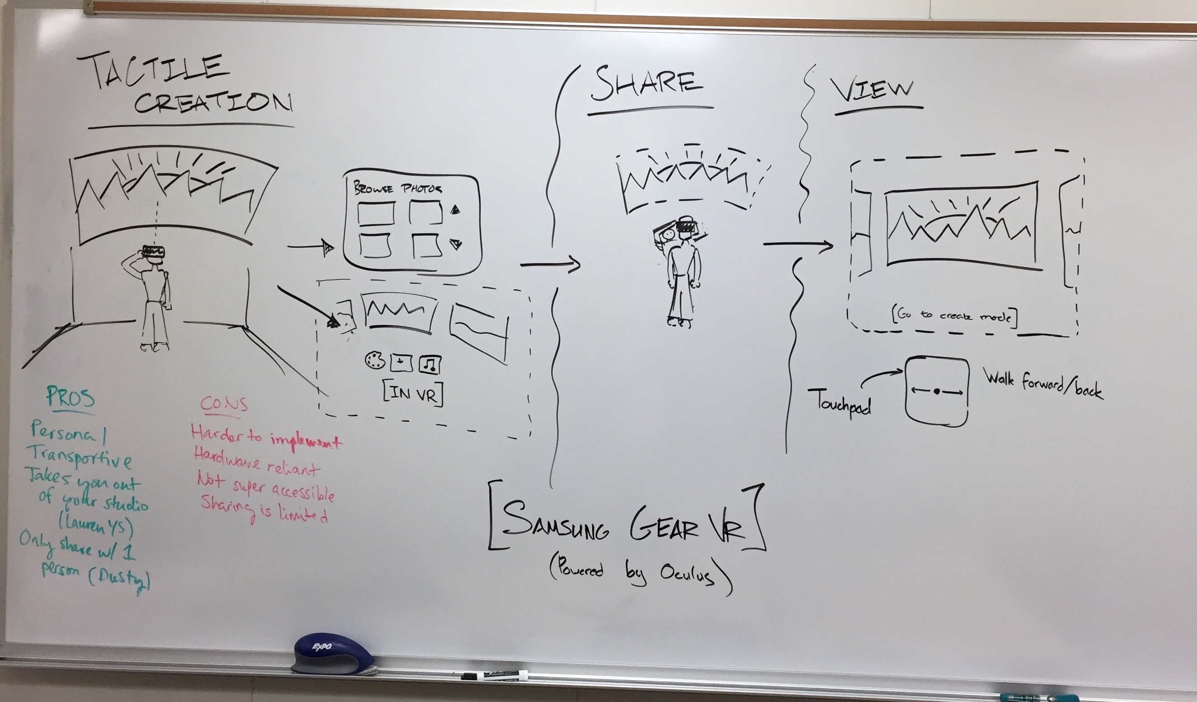
Selected Interface
Notes:
Eventually settled on
Tactile Creation interface
makes the most out of VR, transportive
When communicating ideas body language comes in naturally, playing with what people naturally want to do
an intimate creation and sharing process
Our other ideas
Too similar to things that already exists
doesn't give the control that a creative would want

Slide 8
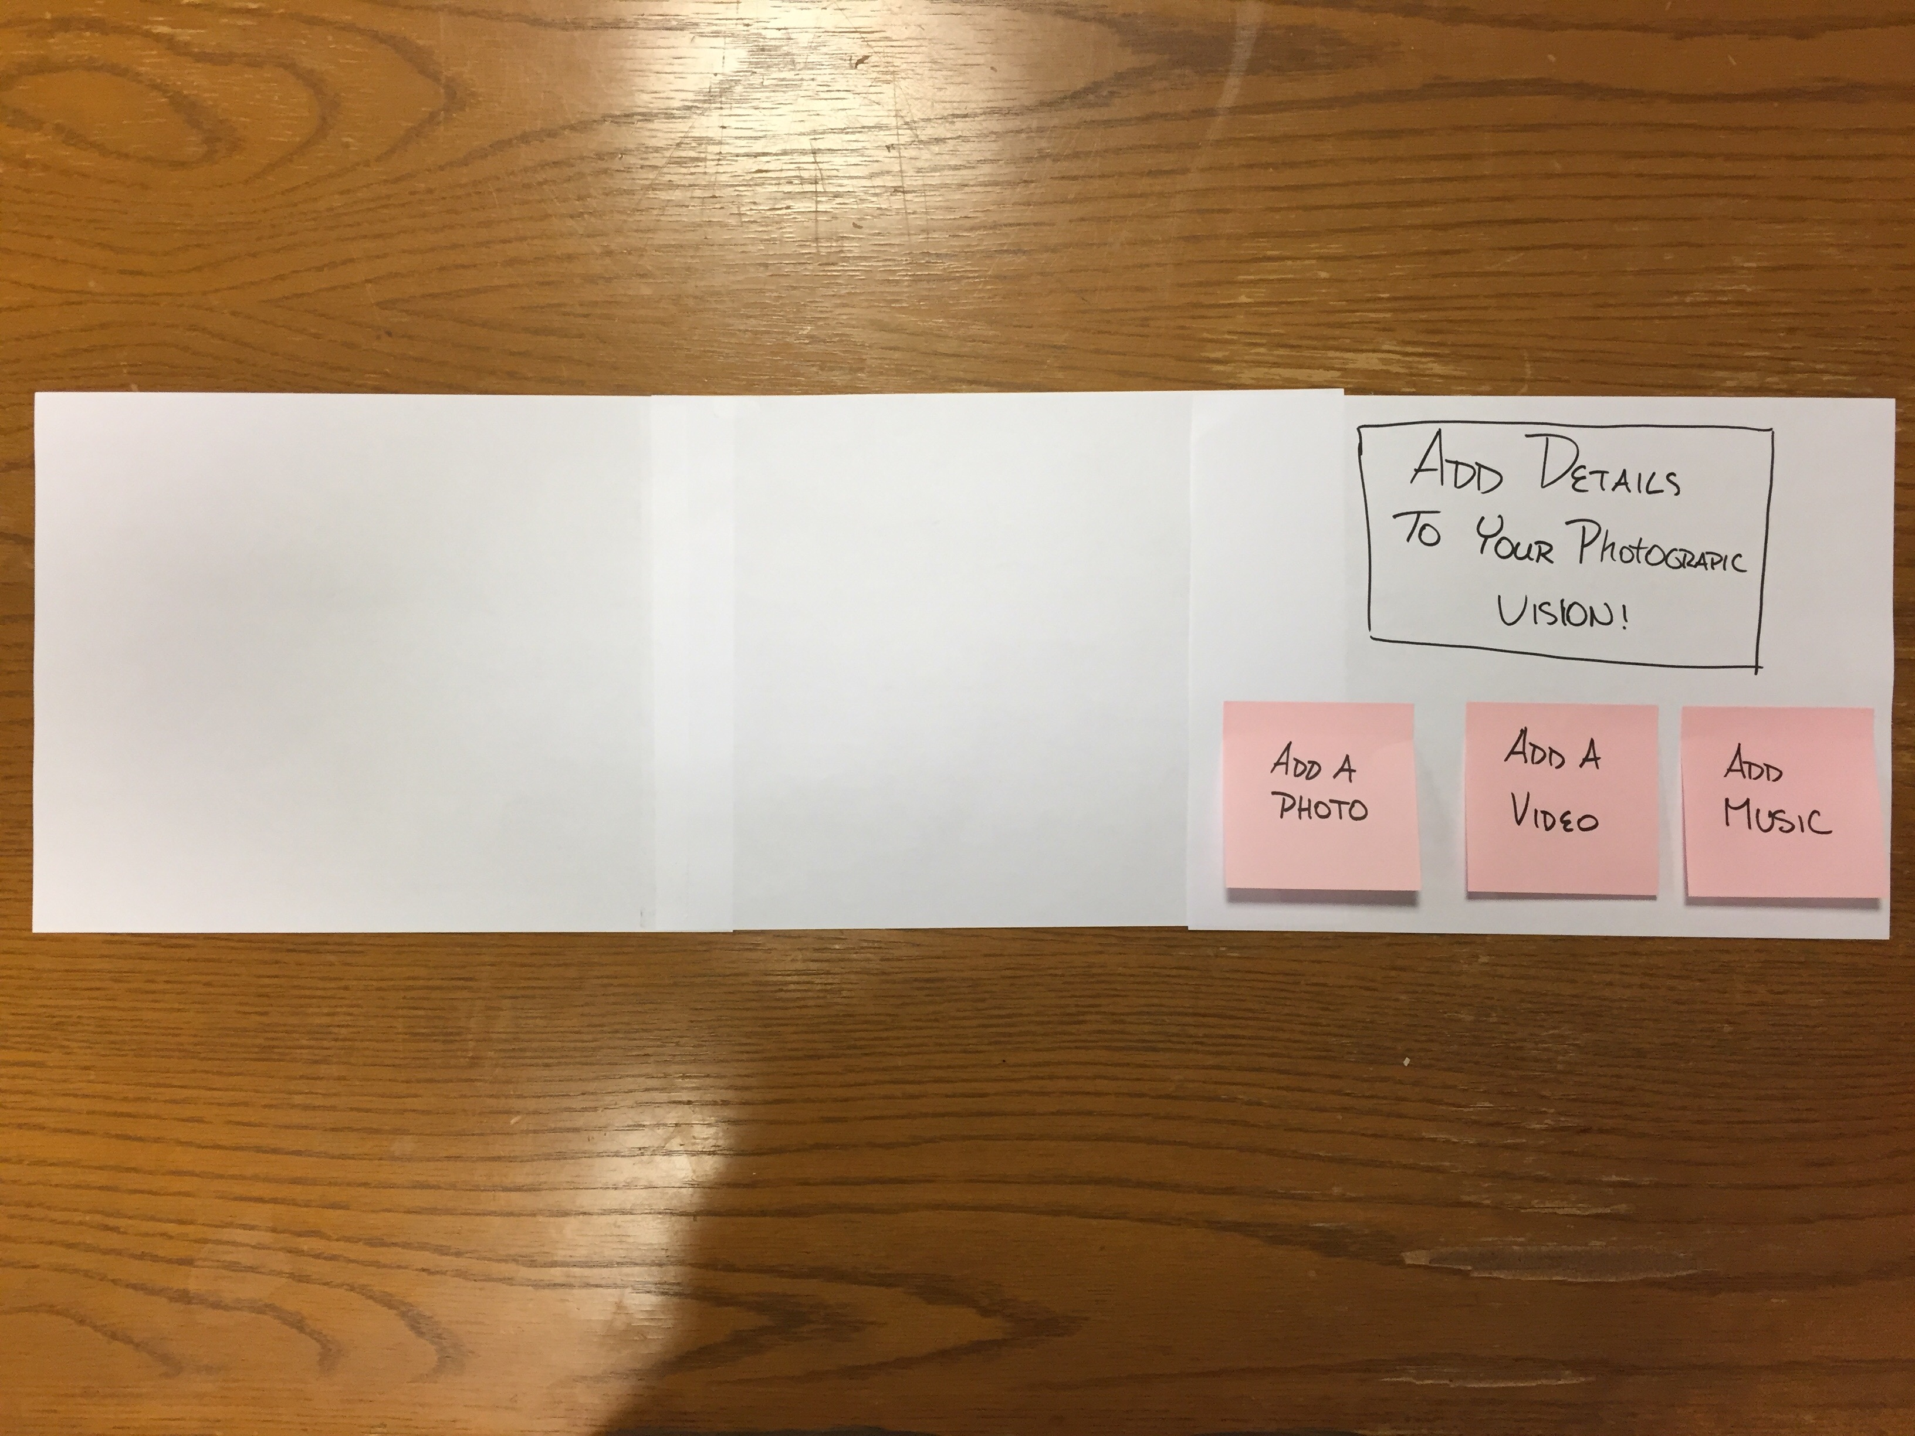
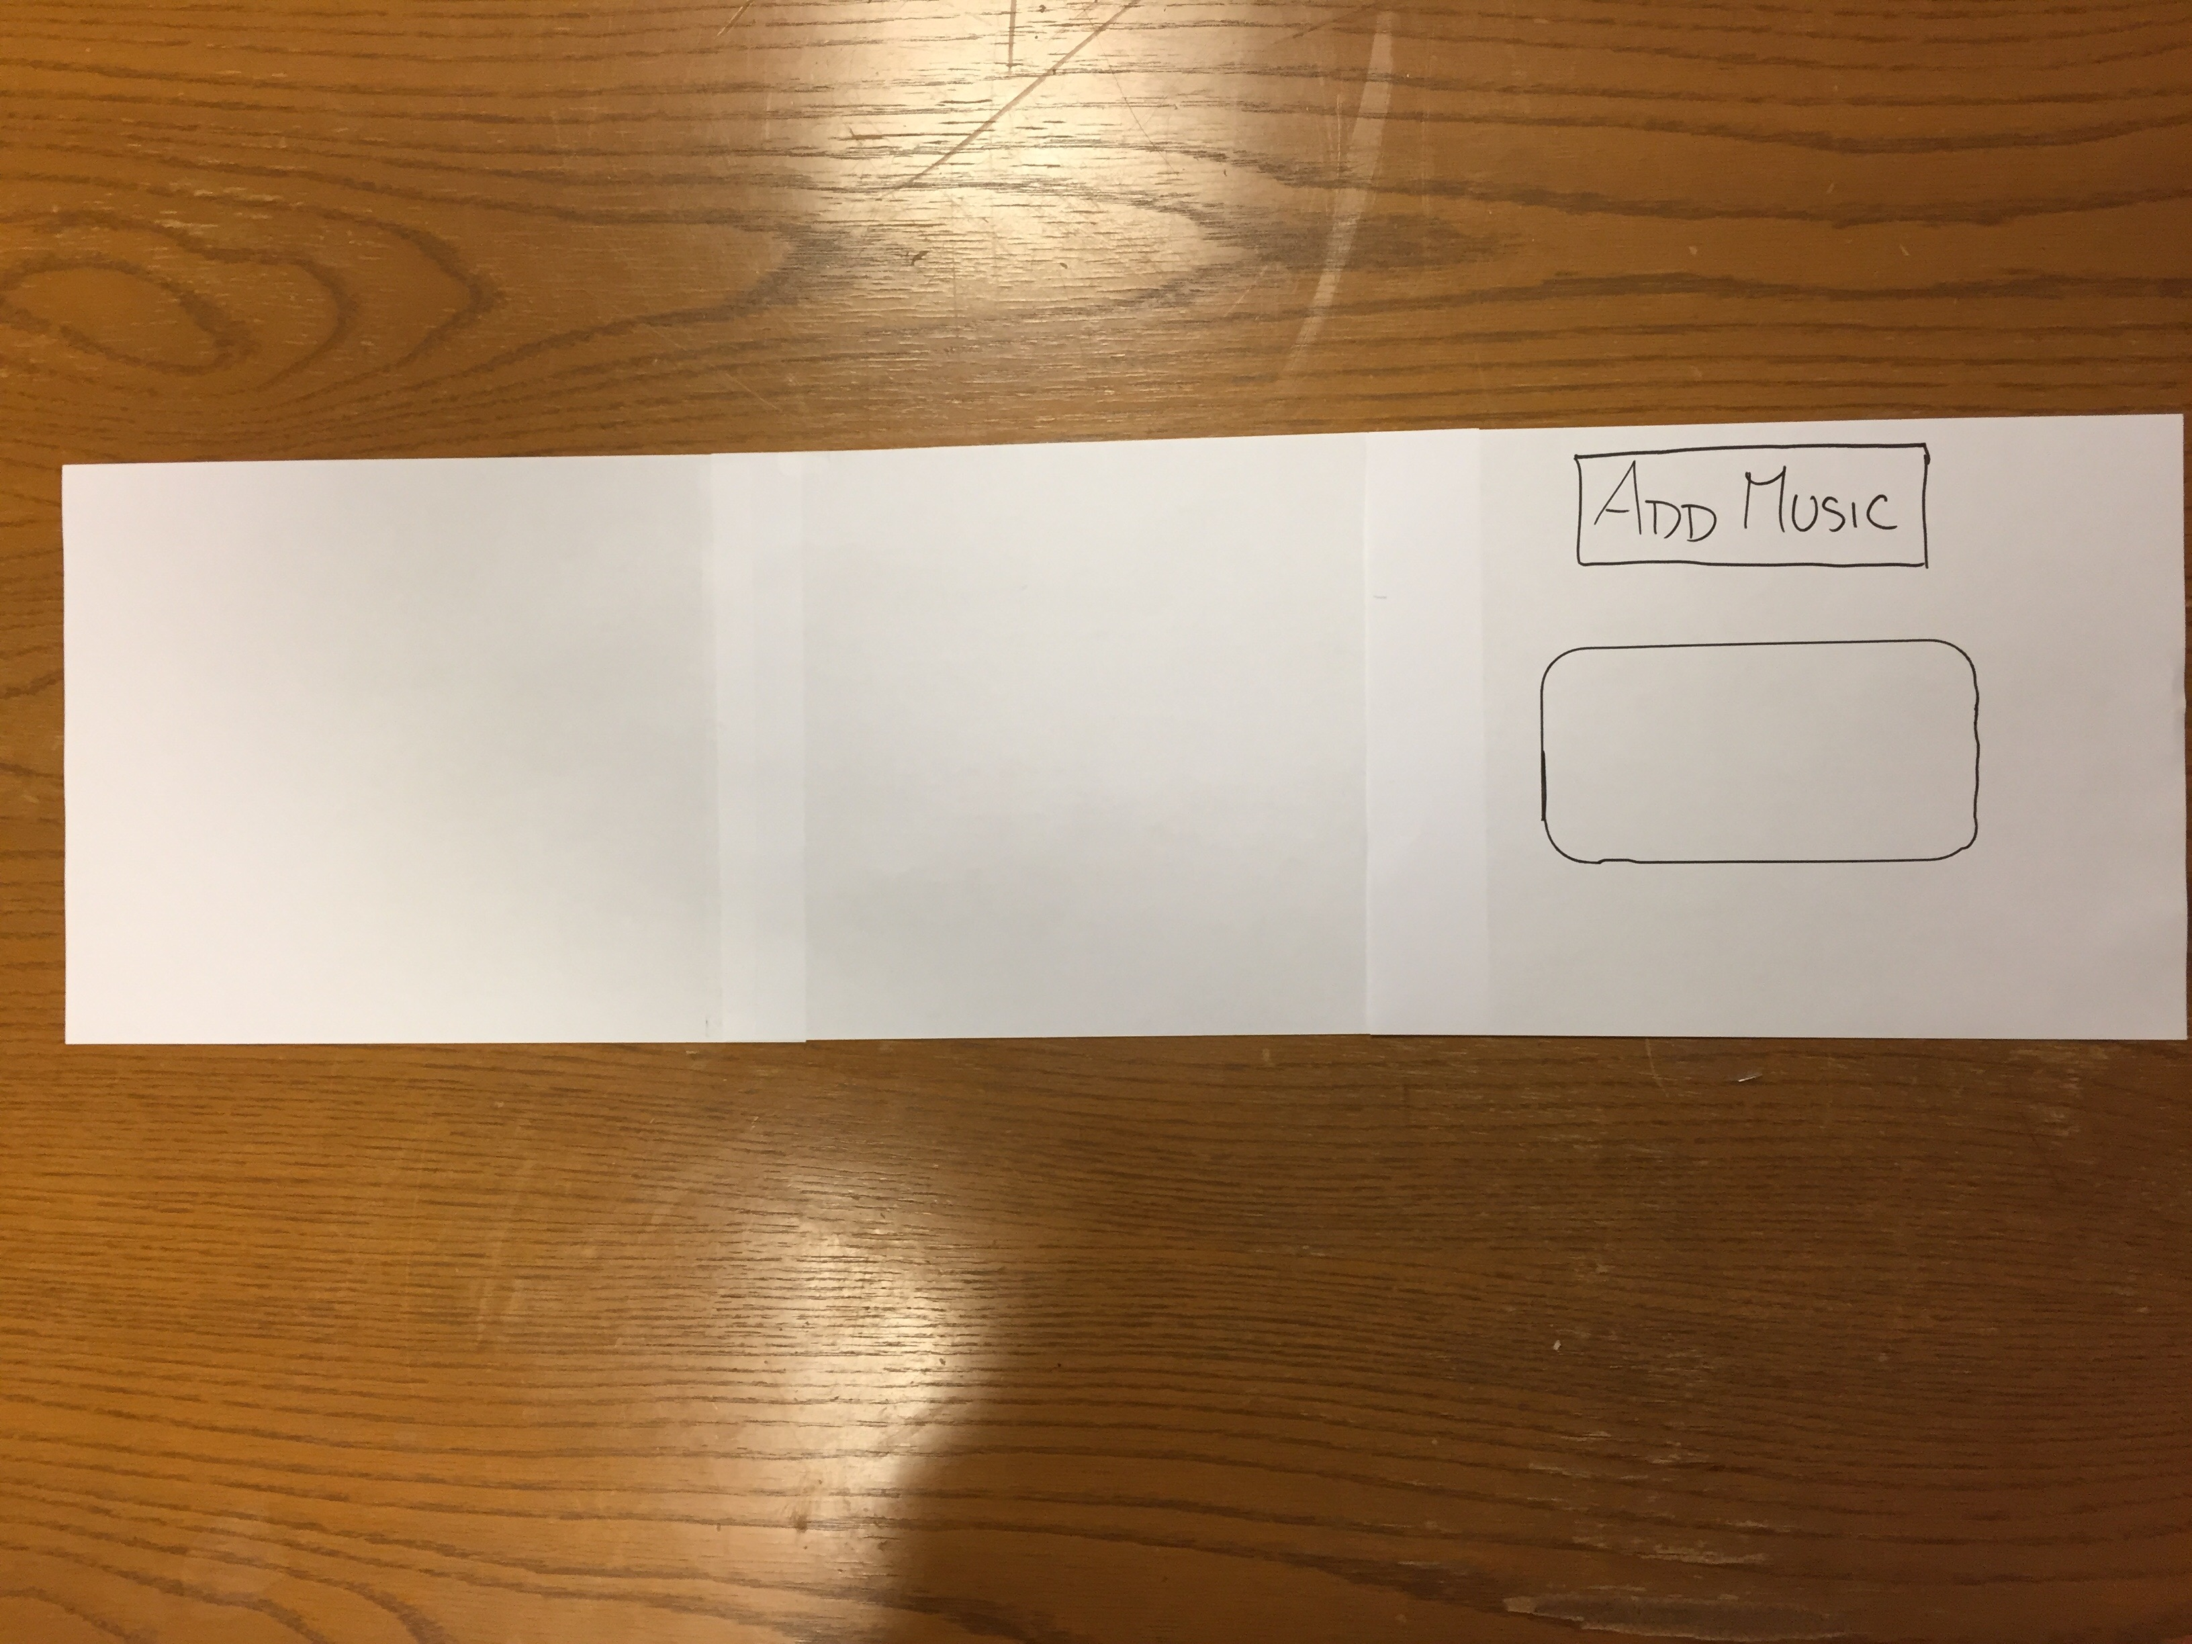
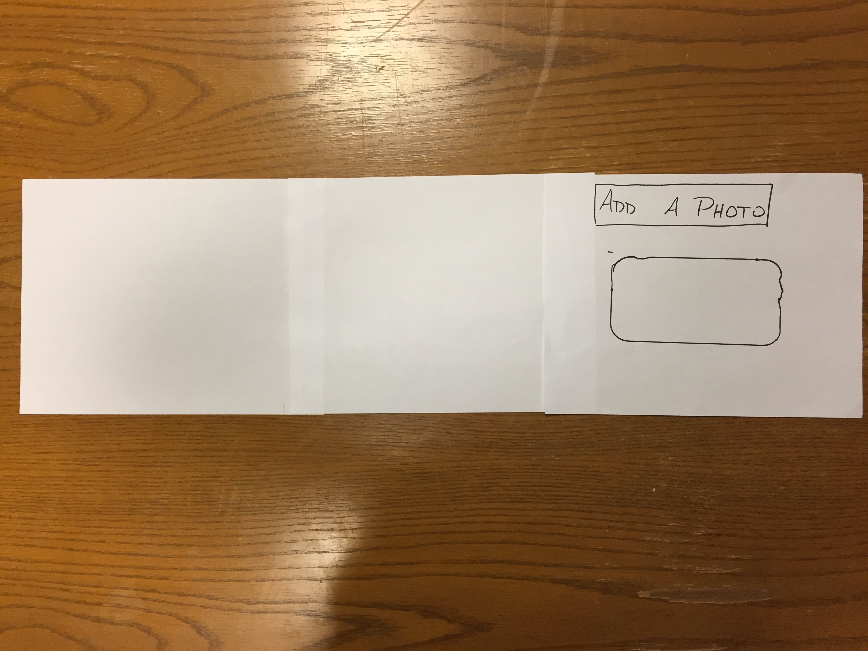
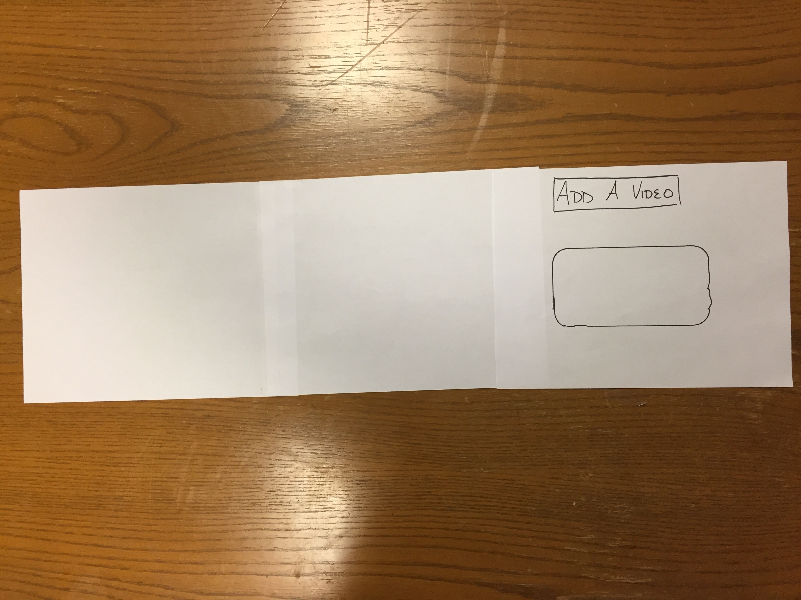
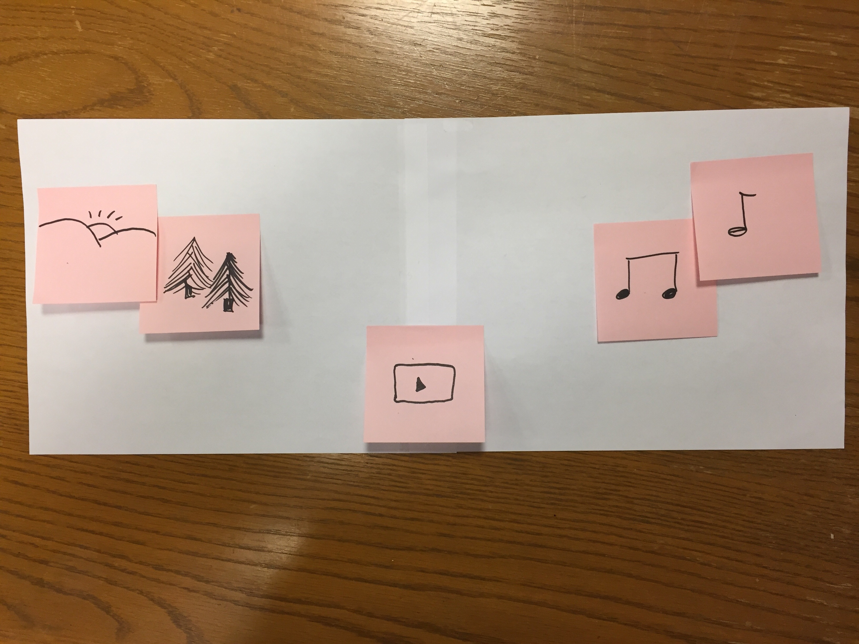
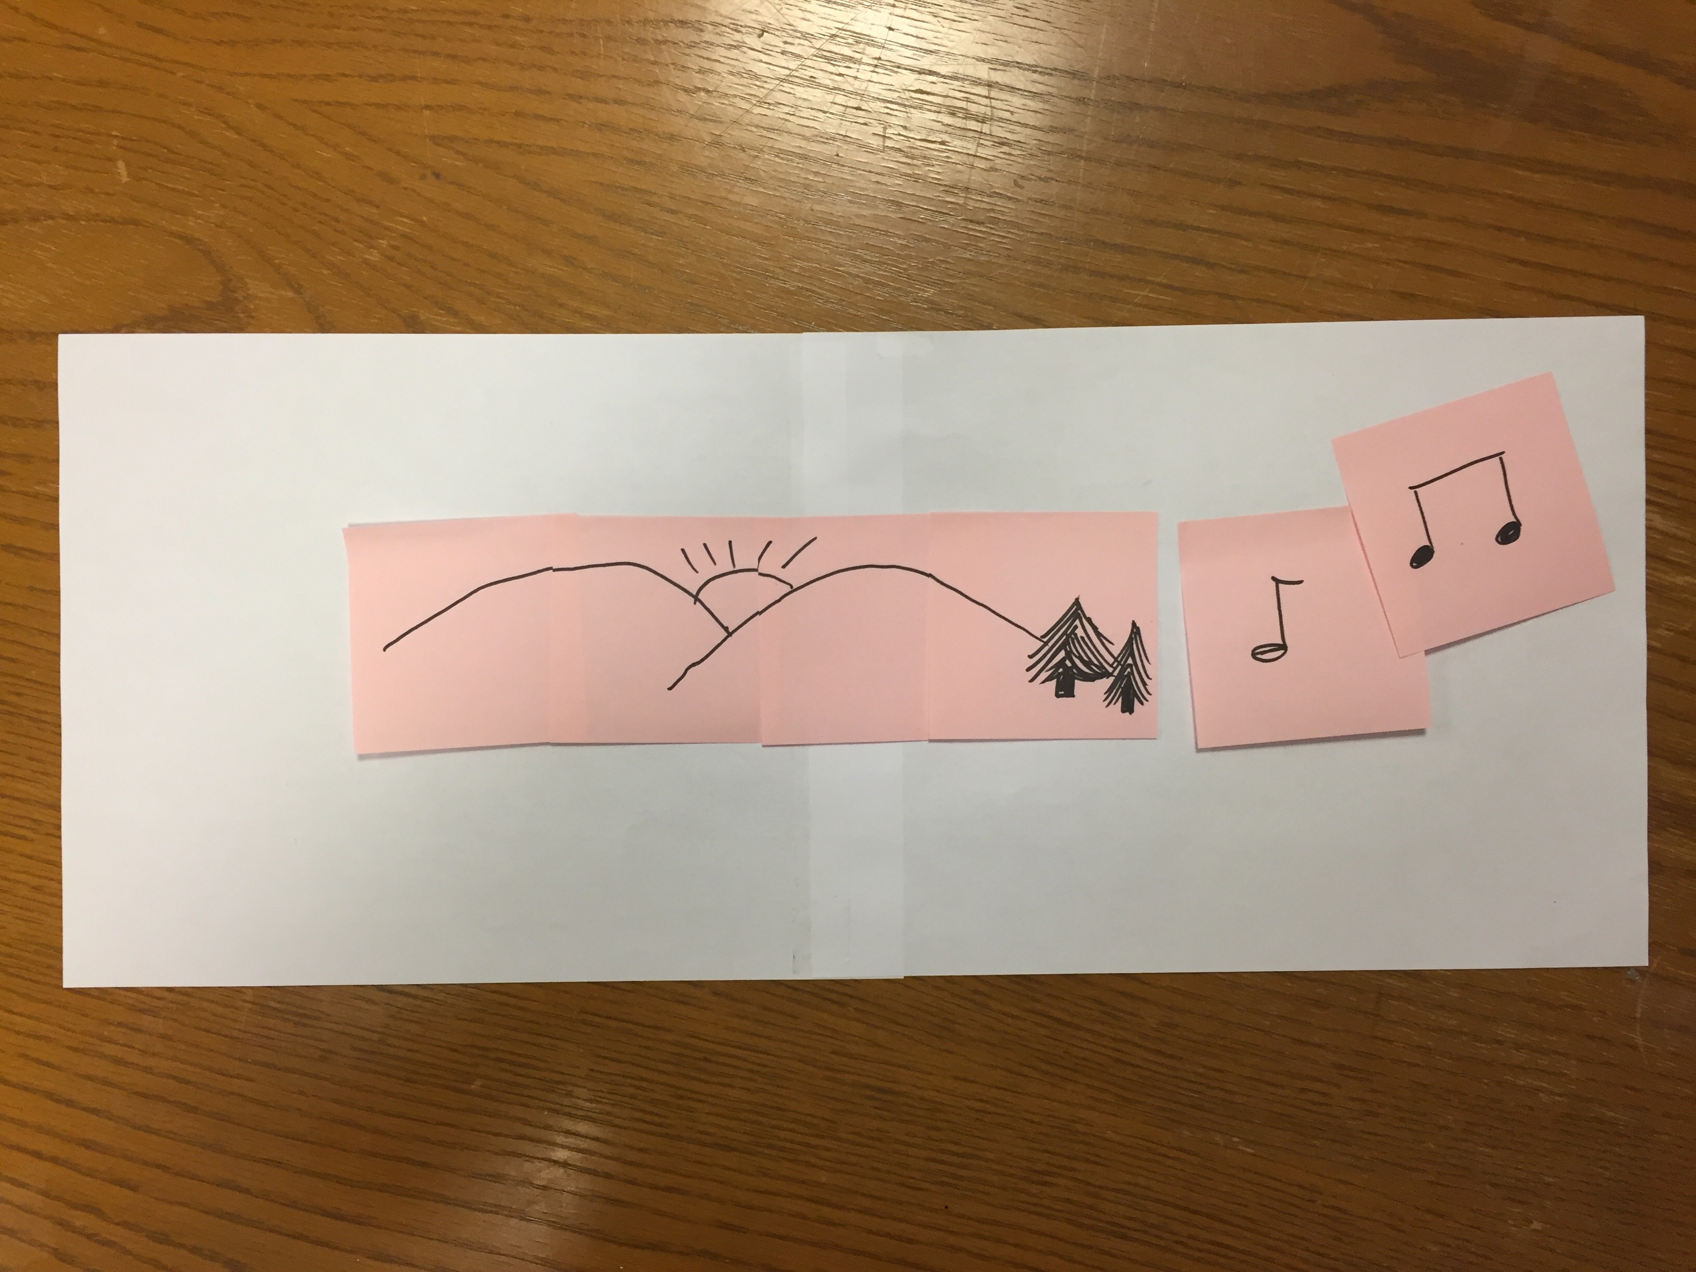
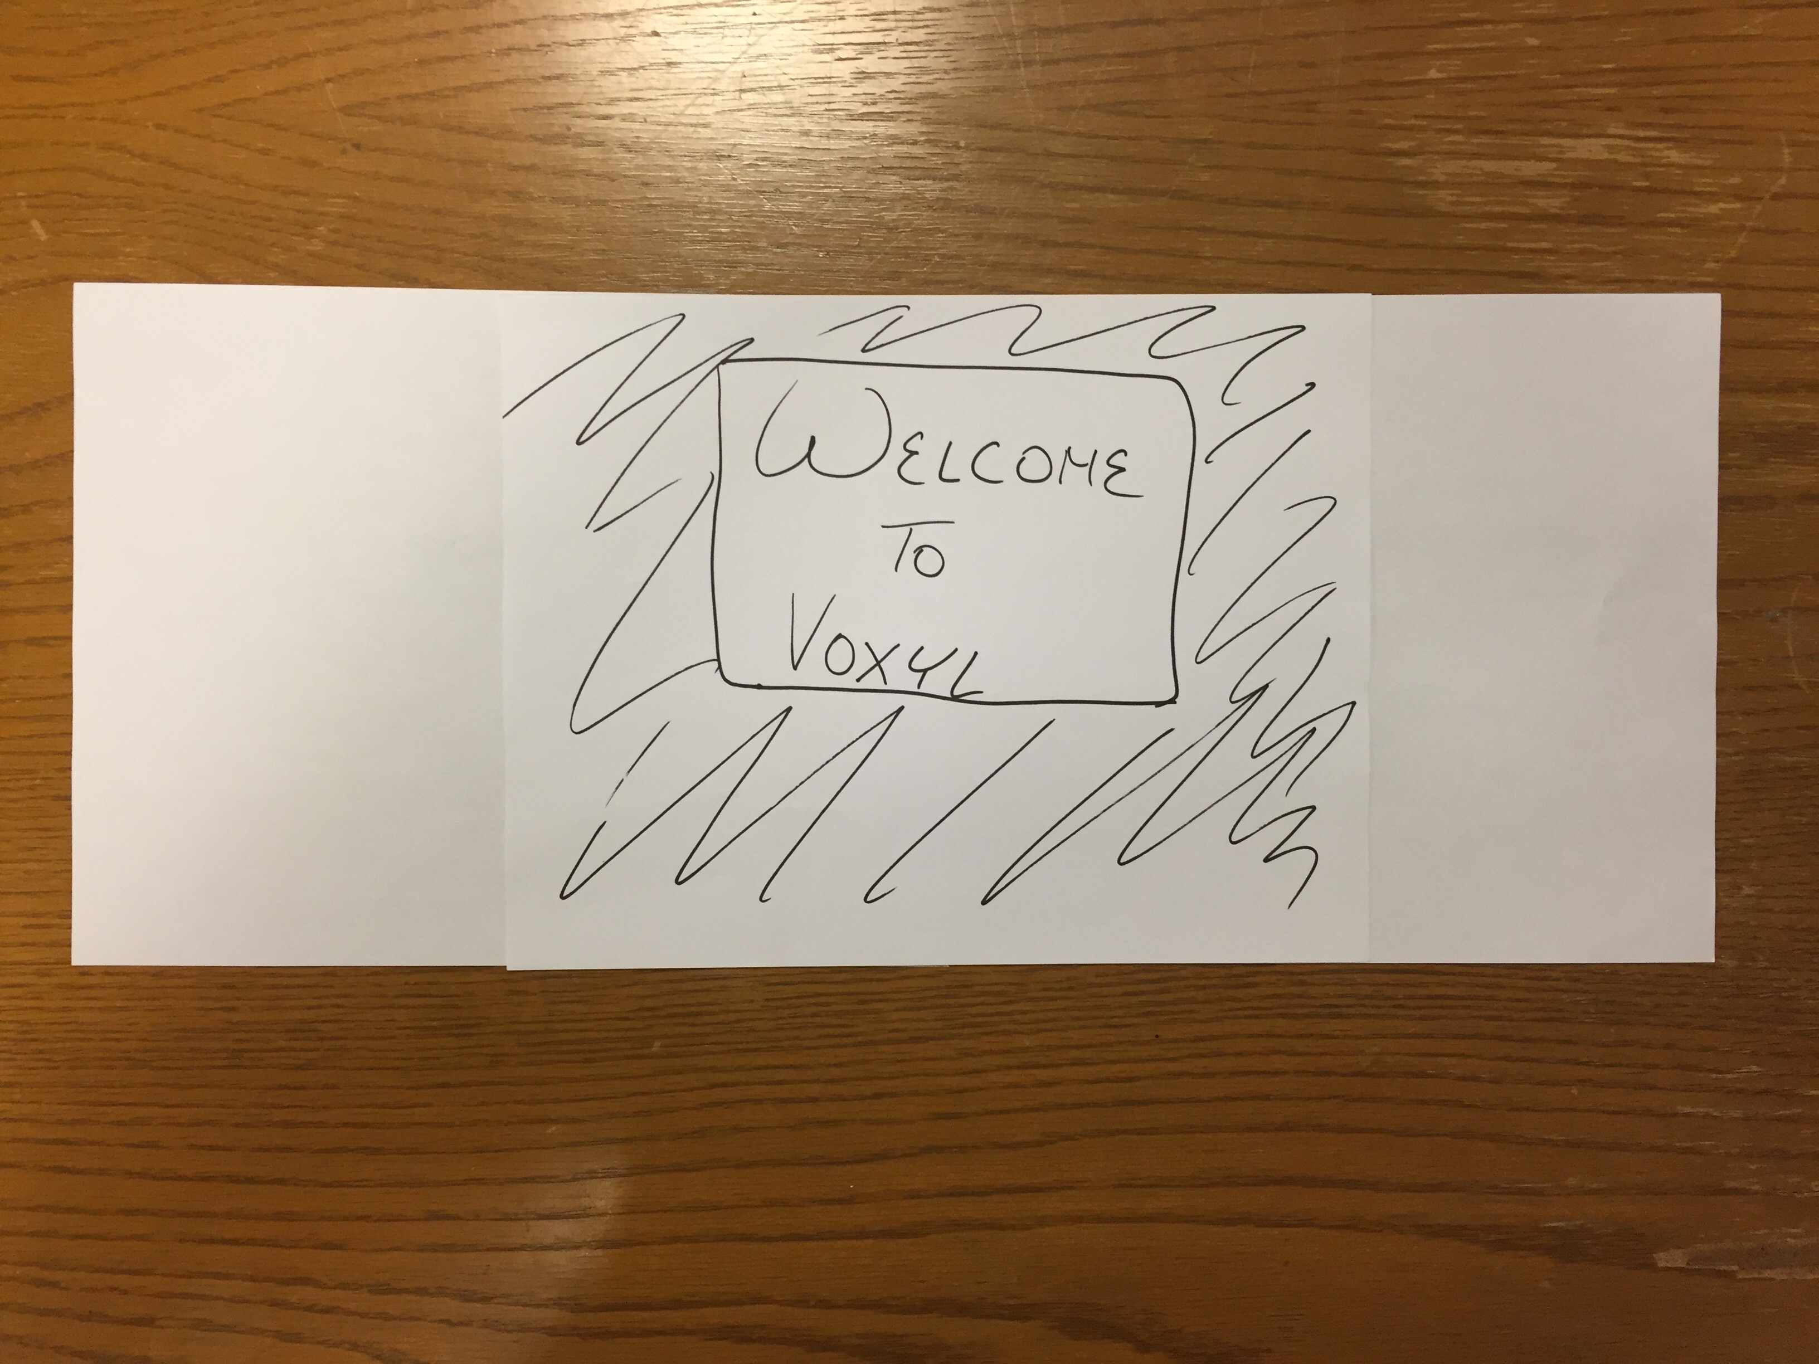
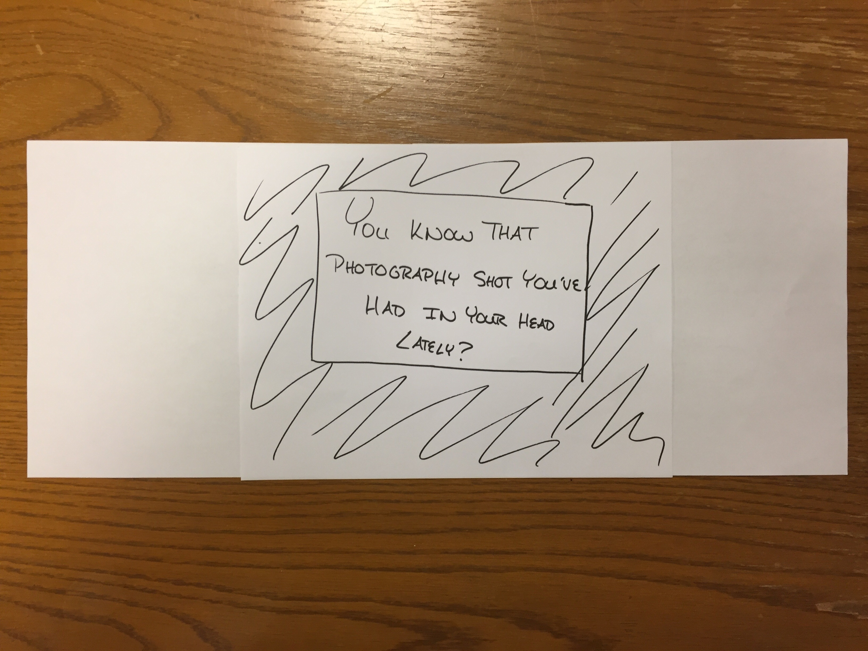
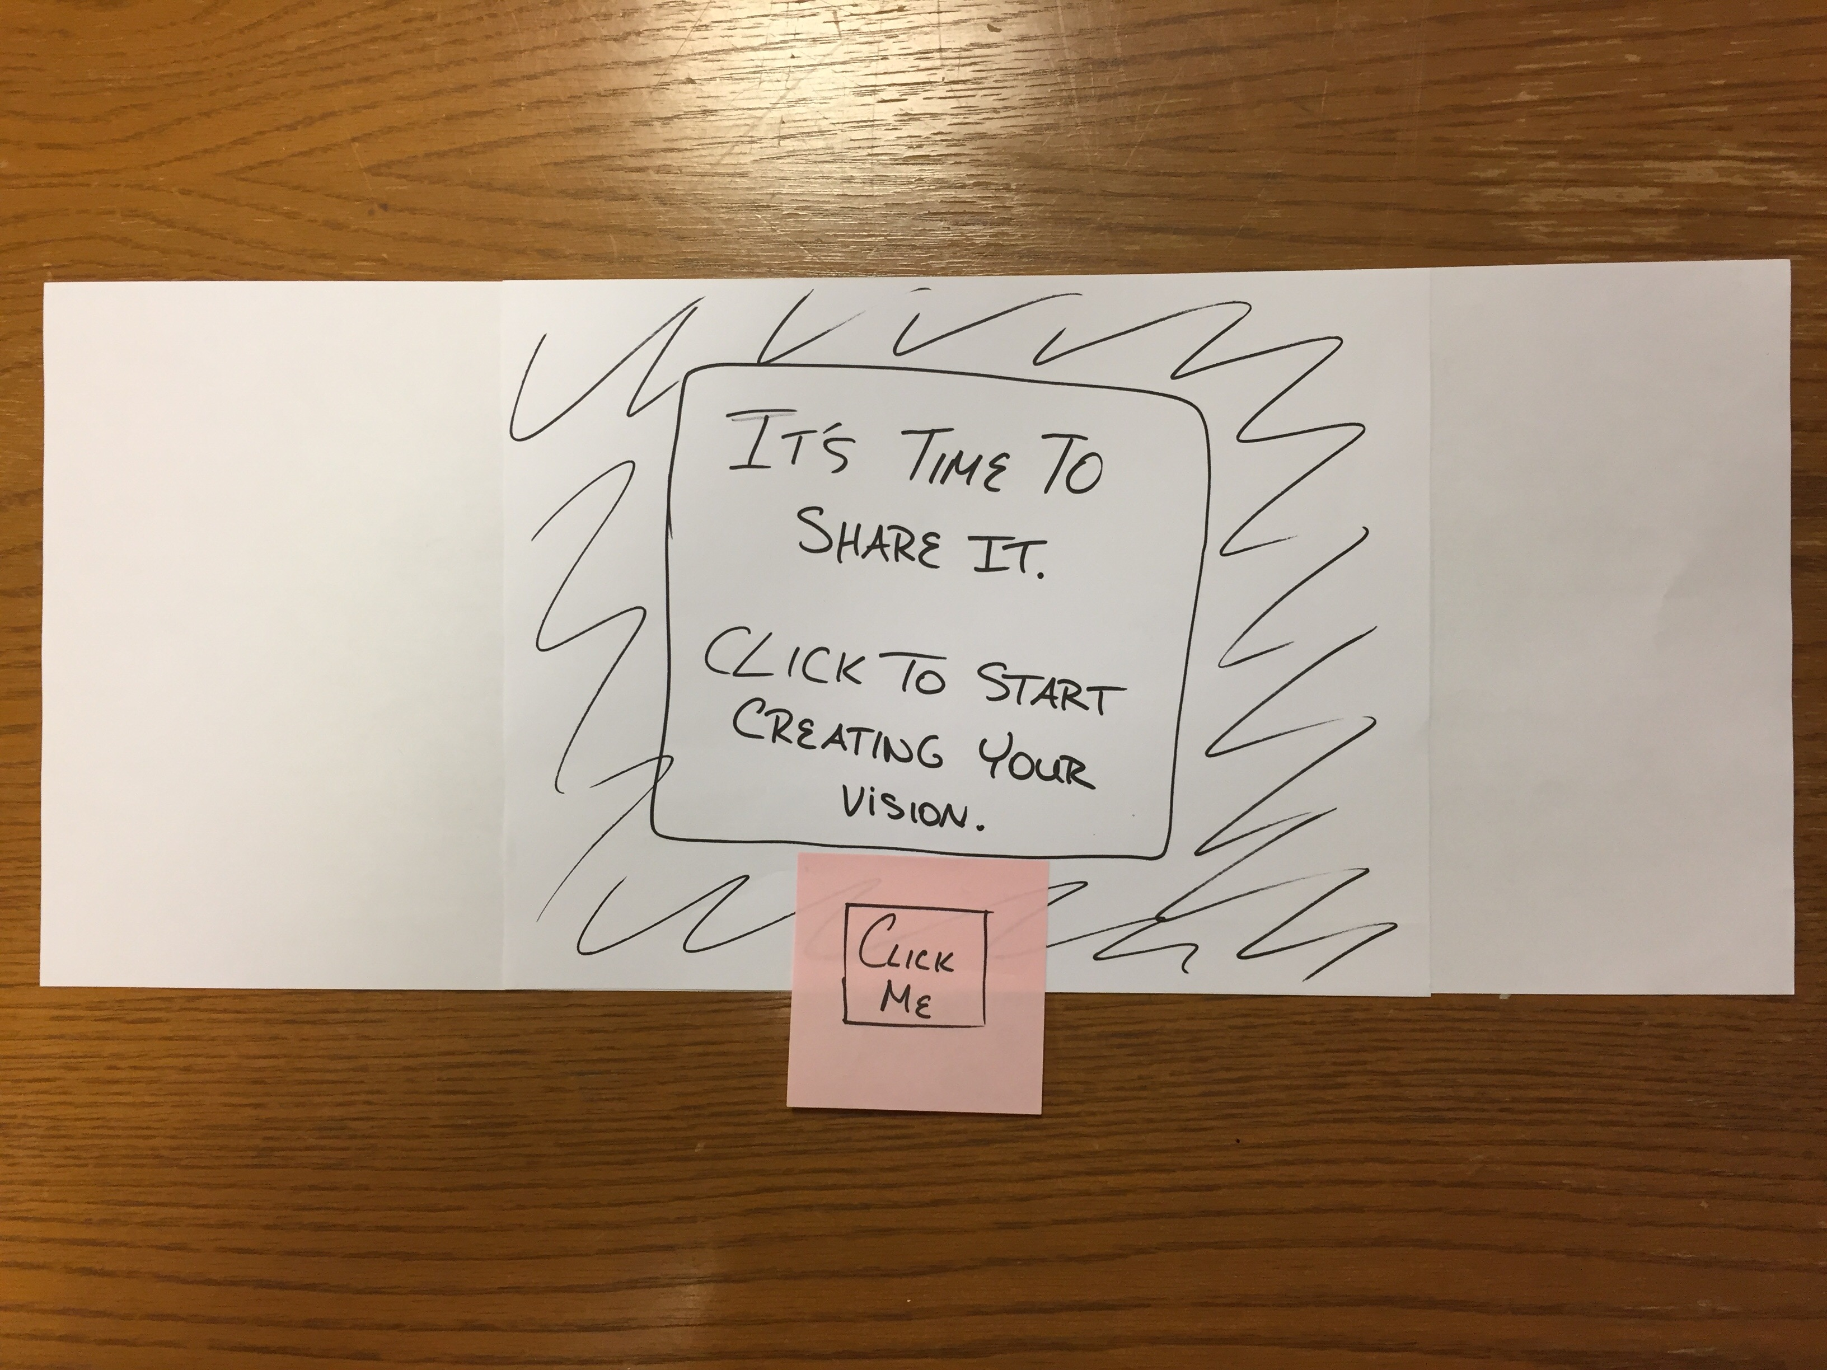
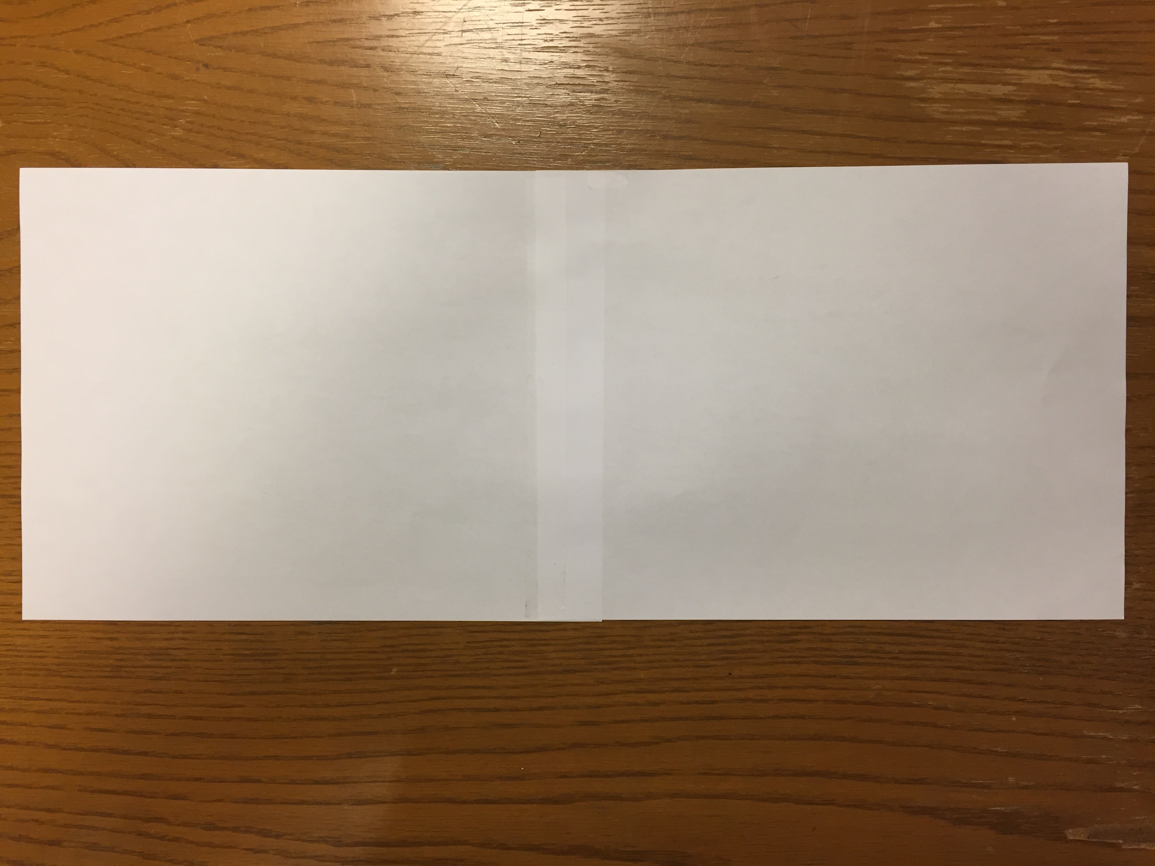
Low-fi Prototype Structure
Notes:
Low fi prototype - blank canvas
A Voxyl team member acted as the computer behind the interface, tracking the user’s head movements and hand gestures and simulating the way the interface would respond.

Slide 9
Low-fi Prototype Structure

Slide 10
Low-fi Prototype Structure

Slide 11
Low-fi Prototype Structure

Slide 12
Low-fi Prototype Structure

Slide 13
Low-fi Prototype Structure
Notes:
The user scaled and repositioned their media using gestures: moving their hands apart to scale up a piece of media, moving their hands closer together to scale down, and focusing on a feature to “select it” and repositioning it to where they wanted it on the canvas.

Slide 14
Low-fi Prototype Structure
Notes:
To convey color scheme, we had our users color their paper in whatever pattern they desired. We also played music for them, and positioned a flashlight where they wanted it in the room to convey lighting.

Slide 15
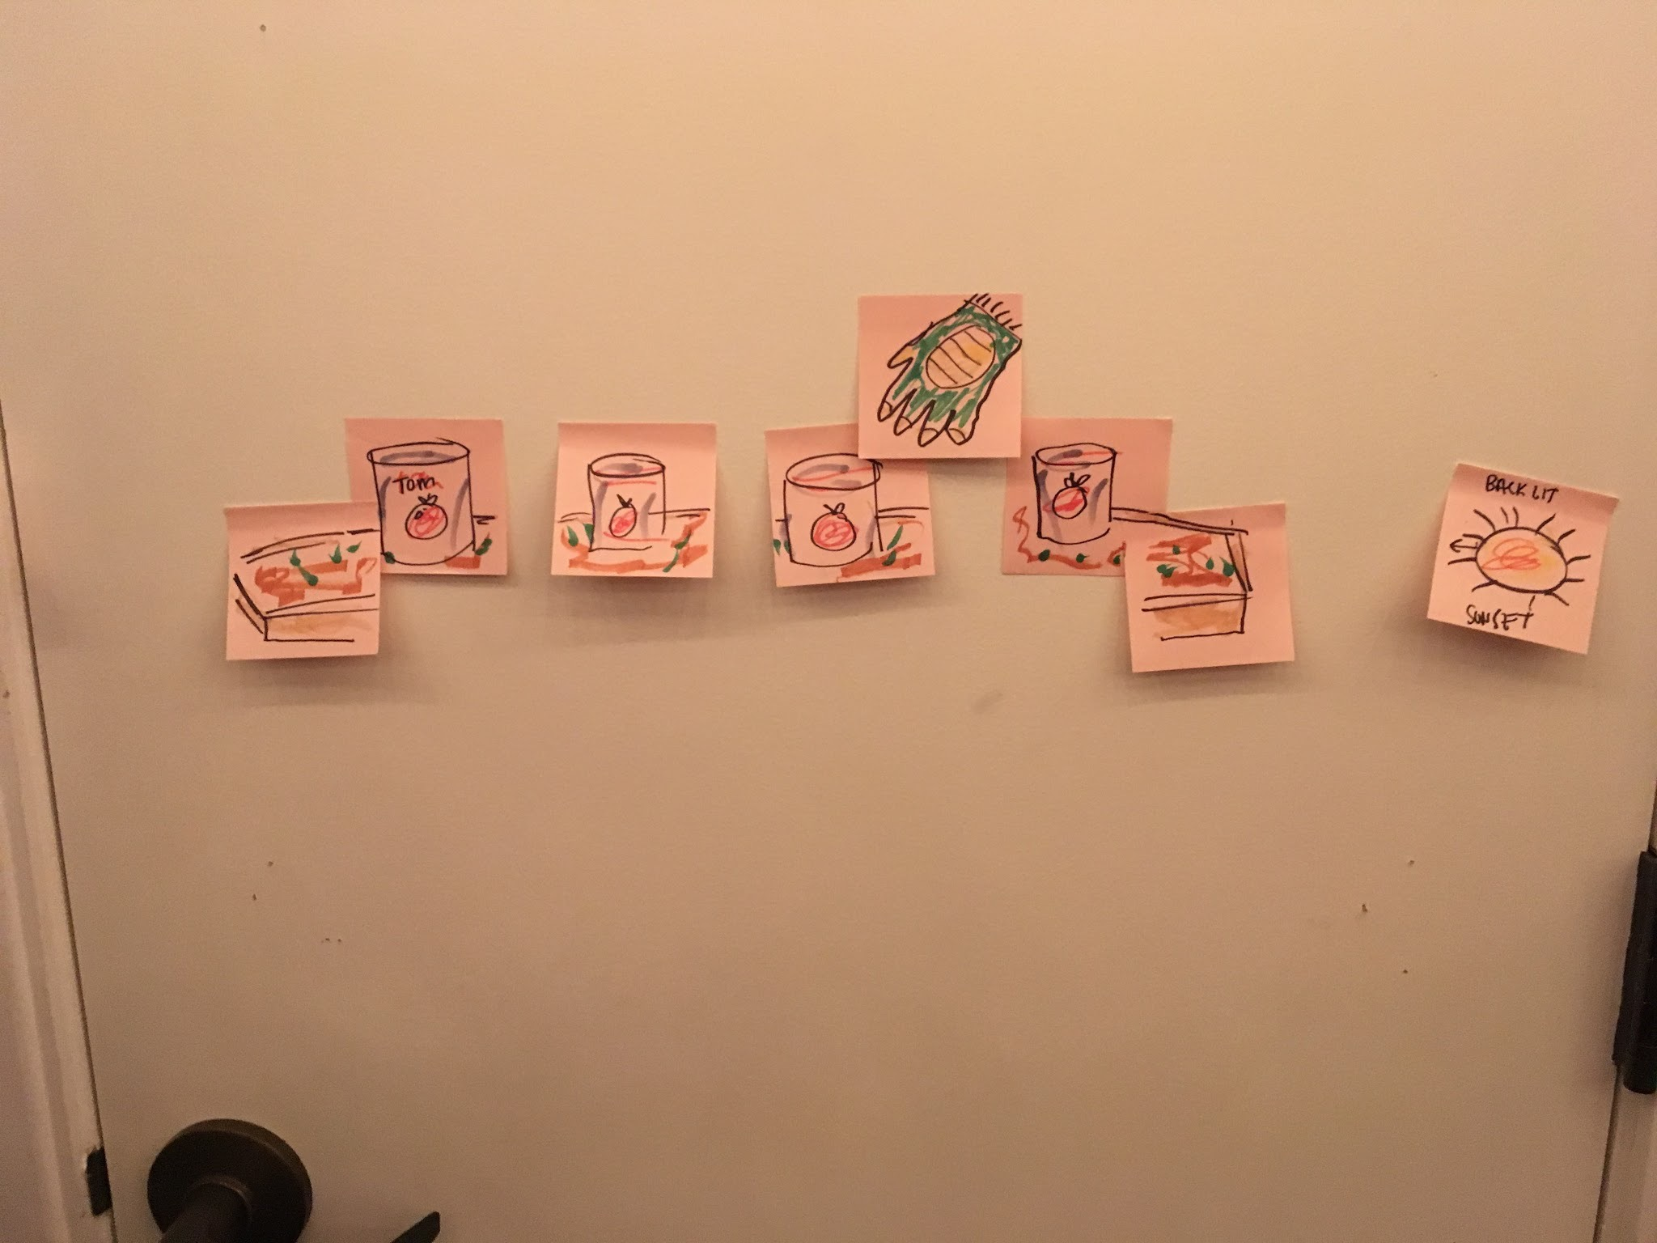
Low-fi Prototype Structure
Notes:
To convey color scheme, we had our users color their paper in whatever pattern they desired. We also played music for them, and positioned a flashlight where they wanted it in the room to convey lighting.

Slide 16
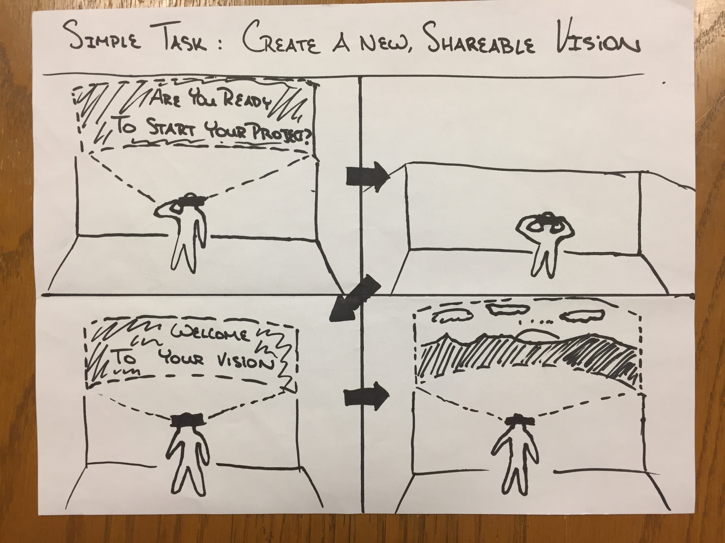
Simple Task
Create a new Voxyl project

Slide 17
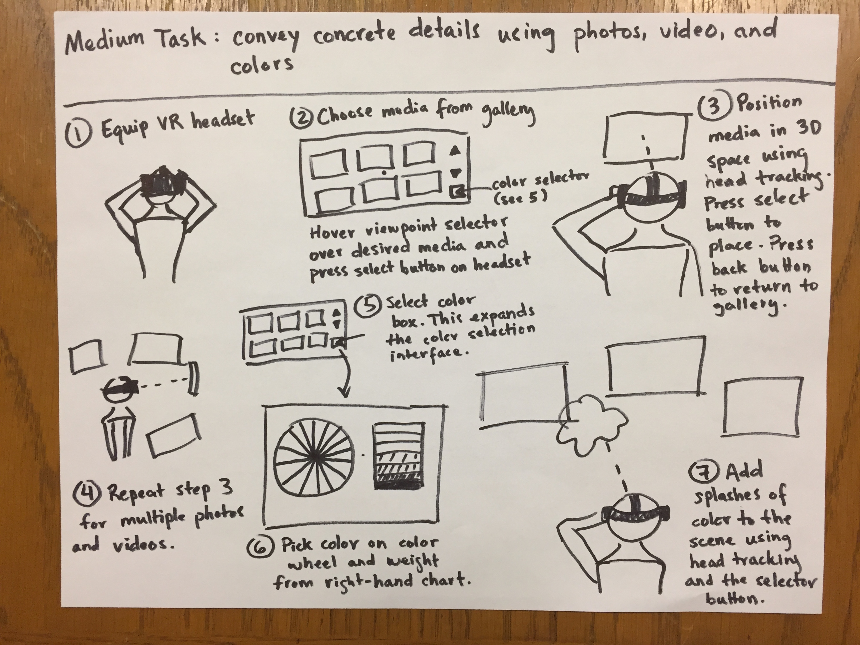
Medium Task
Communicate features and color

Slide 18
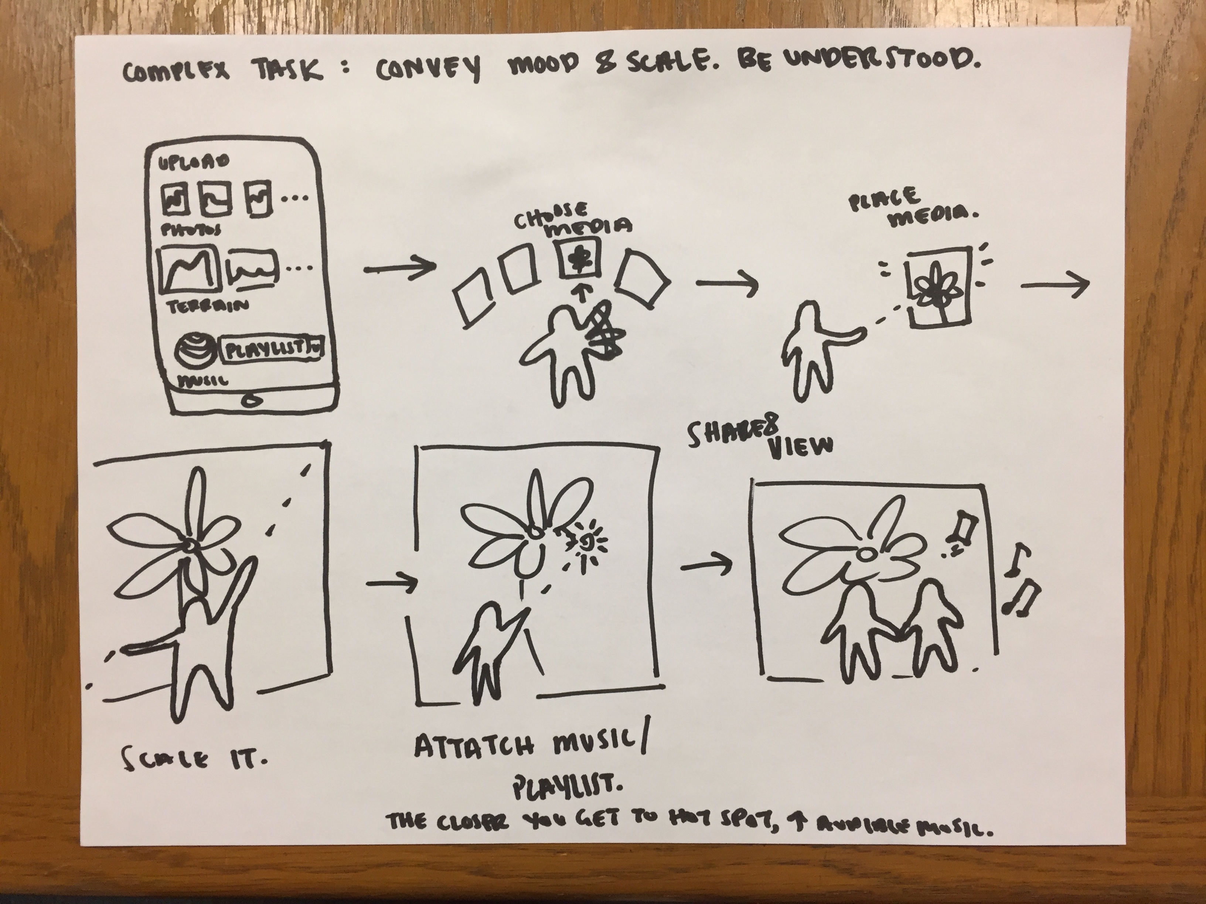
Complex Task
Convey mood and scale

Slide 19
Experimental Method
Notes:
Experimental Method
We recruited participants for our testing based on involvement with photography and visual art.
We tasked them with coming up with an idea for a photo shoot location, and then using our prototype to try to convey that idea to us.
Starting with importing media and building up to complex tasks like conveying mood
Testing was carried out in ordinary rooms, the goal being to see if we could create an immersion and experience without the need for excessive isolation.
We then asked them for feedback
we then did a second feedback session after describing what we had gotten from what they had shown us to see what we could add or change to help the communicate their vision with greater accuracy

Slide 20
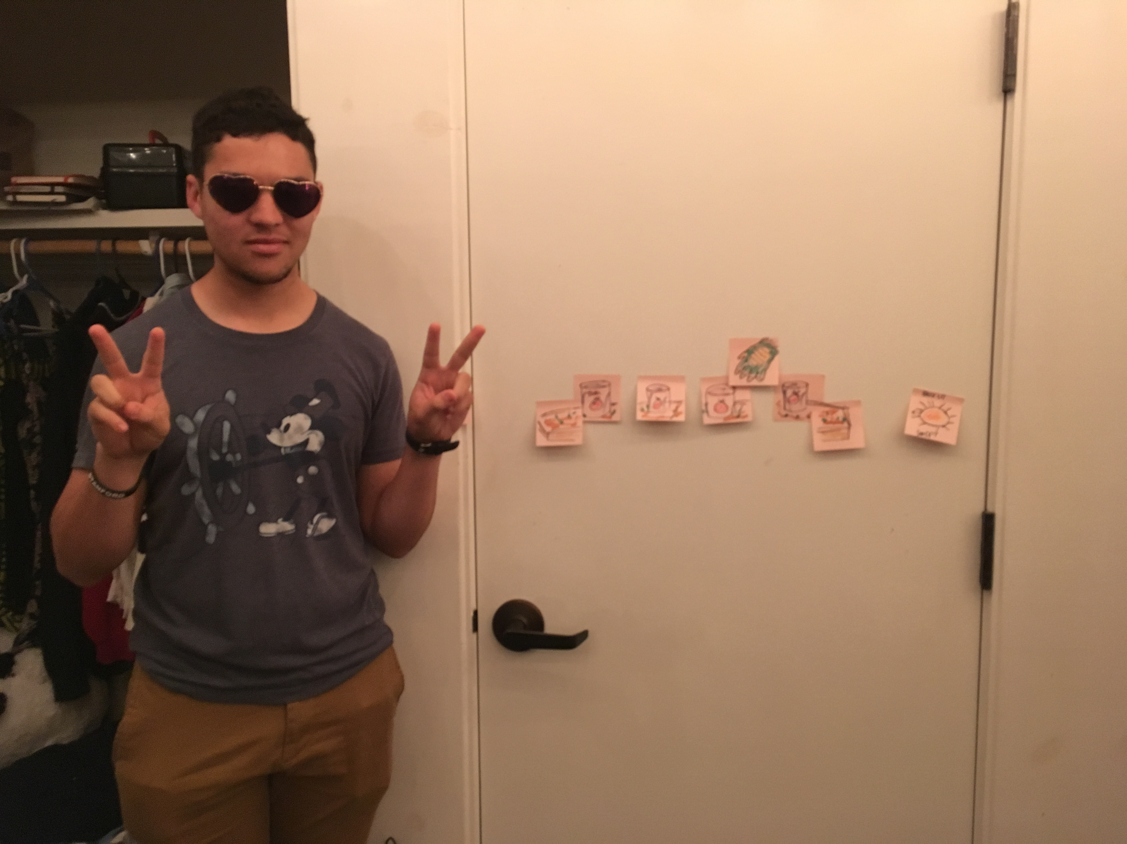
Experimental Results
Notes:
Overall, our participants seemed happy with the tool as a whole.
There was a lot immediate satisfaction and “cool!”s
they understood the purpose and immediately took to using it
We found that additionally the product helped participants solidify their vision in their own head. It serves as a form of creative rapid prototyping for them.
This indicates to us that we’re on at least a reasonable approximation of the right path. Our job in the remaining weeks, then, would seem to be to iron out interactions to preserve that feeling.

Slide 21
Suggested UI Changes
More robust and explicit navigation tools
More open-ended labels
Quick blank space filler
Collaboration mode
Notes:
There was a bit of confusion over the purpose of head movement, and frustration of the slowness of the process.
Most of this will be solved when porting to an actual VR headset
Additionally, we realized our UI was very sparse, and had holes in navigation. While trying to keep the experience pure and immersive we lost functionality. Some labels also funneled users into a shallower way of thinking.
We will work on creating a set of controls that are intuitive, robust, and dismissable
Some participants also expressed desire for some sort of co-creation mode
The most interesting finding was that one of our participants mentioned that their canvas had too much white space.
Unlike some other problems mentioned, this become more prevalent in VR
How do we fill the space without creating much more work for the creators?
Overall, our testing would indicate that we have a viable idea which, if executed properly, should provide a fulfilling and inspiring experience.

Slide 22


