Slide 1
Making Education Accessible
Targeted need-finding, points of view, and experience prototypes

Slide 2
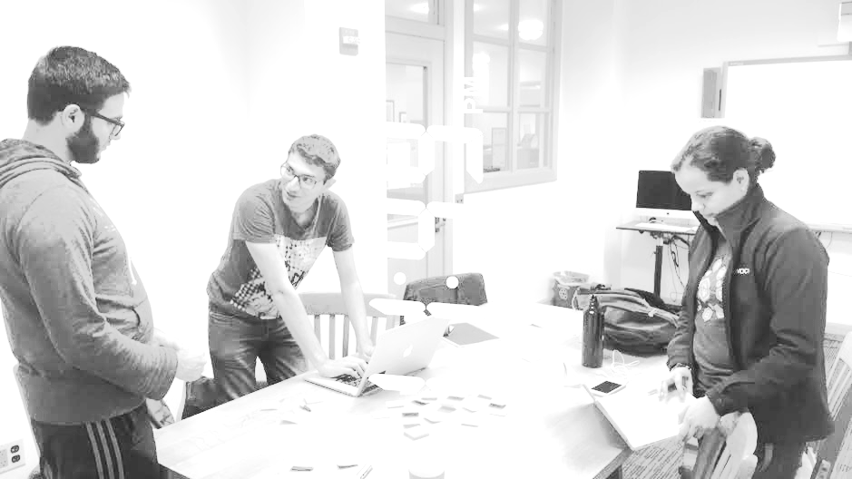
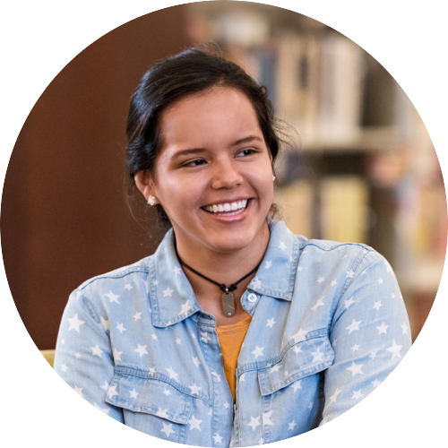
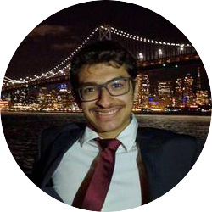
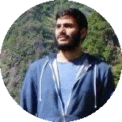
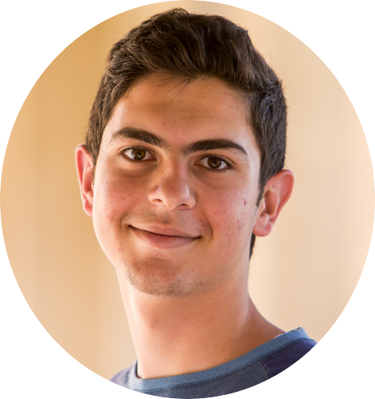
Team
Alejandrina G.R.
Ammar A.
Ahmed S.
Abdallah A.

Slide 3
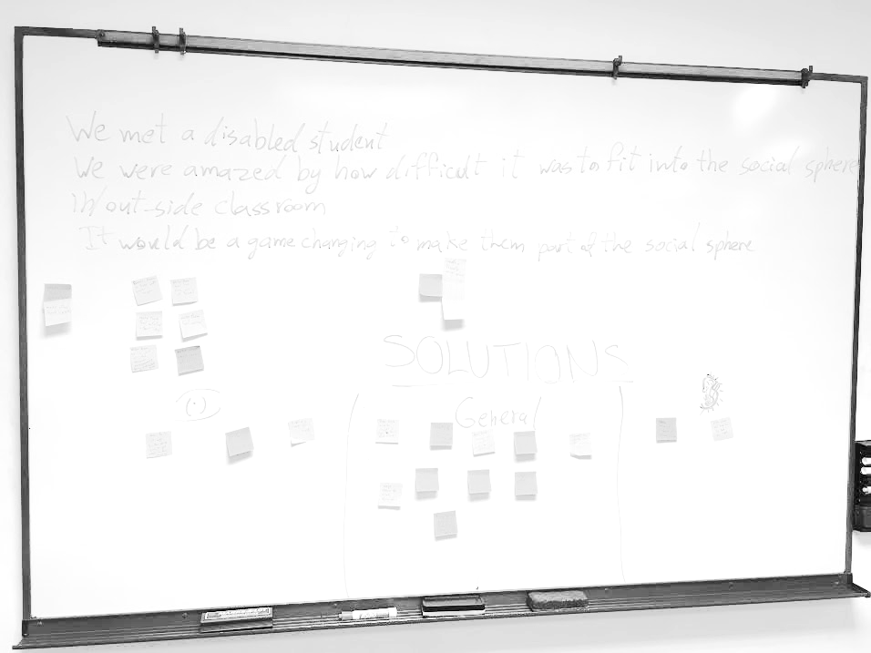
Problem
Education
+
Accessibility

Slide 4
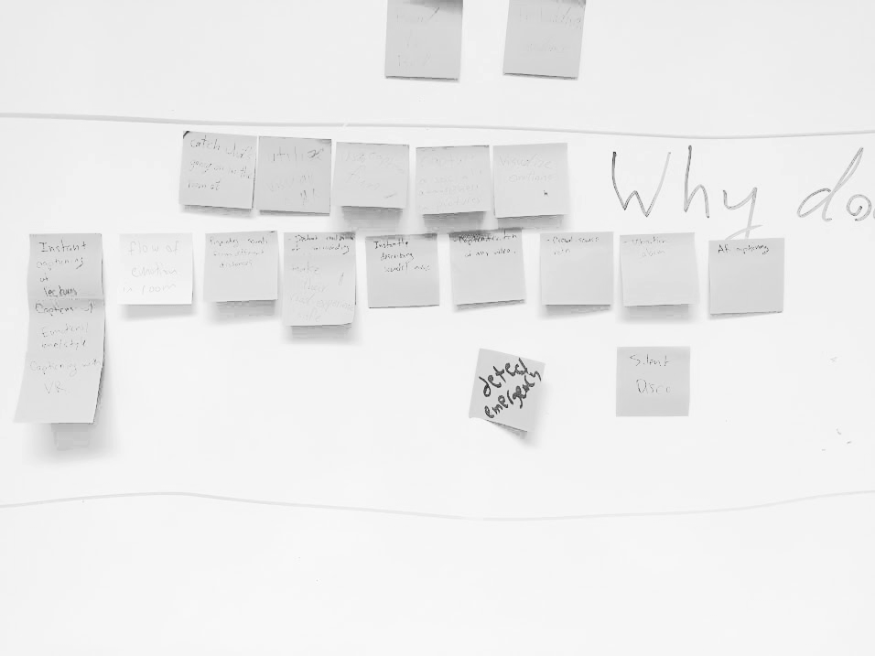
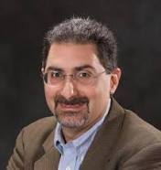
Preliminary POV
We met Mehran. He’s a Stanford professor
We were amazed to learn how much accessibility disabled students needed within the classroom
It would be game changing to use tech to enhance their in-class experience

Slide 5
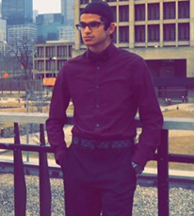
Additional Need-Finding
Dean Hudson
Blind engineer from the Bay Area
Every task becomes more difficult
Visually-impaired people can still be independent
Mentioned the importance of usability over accessibility
Saad Ghani
Hearing-impaired college student

Slide 6
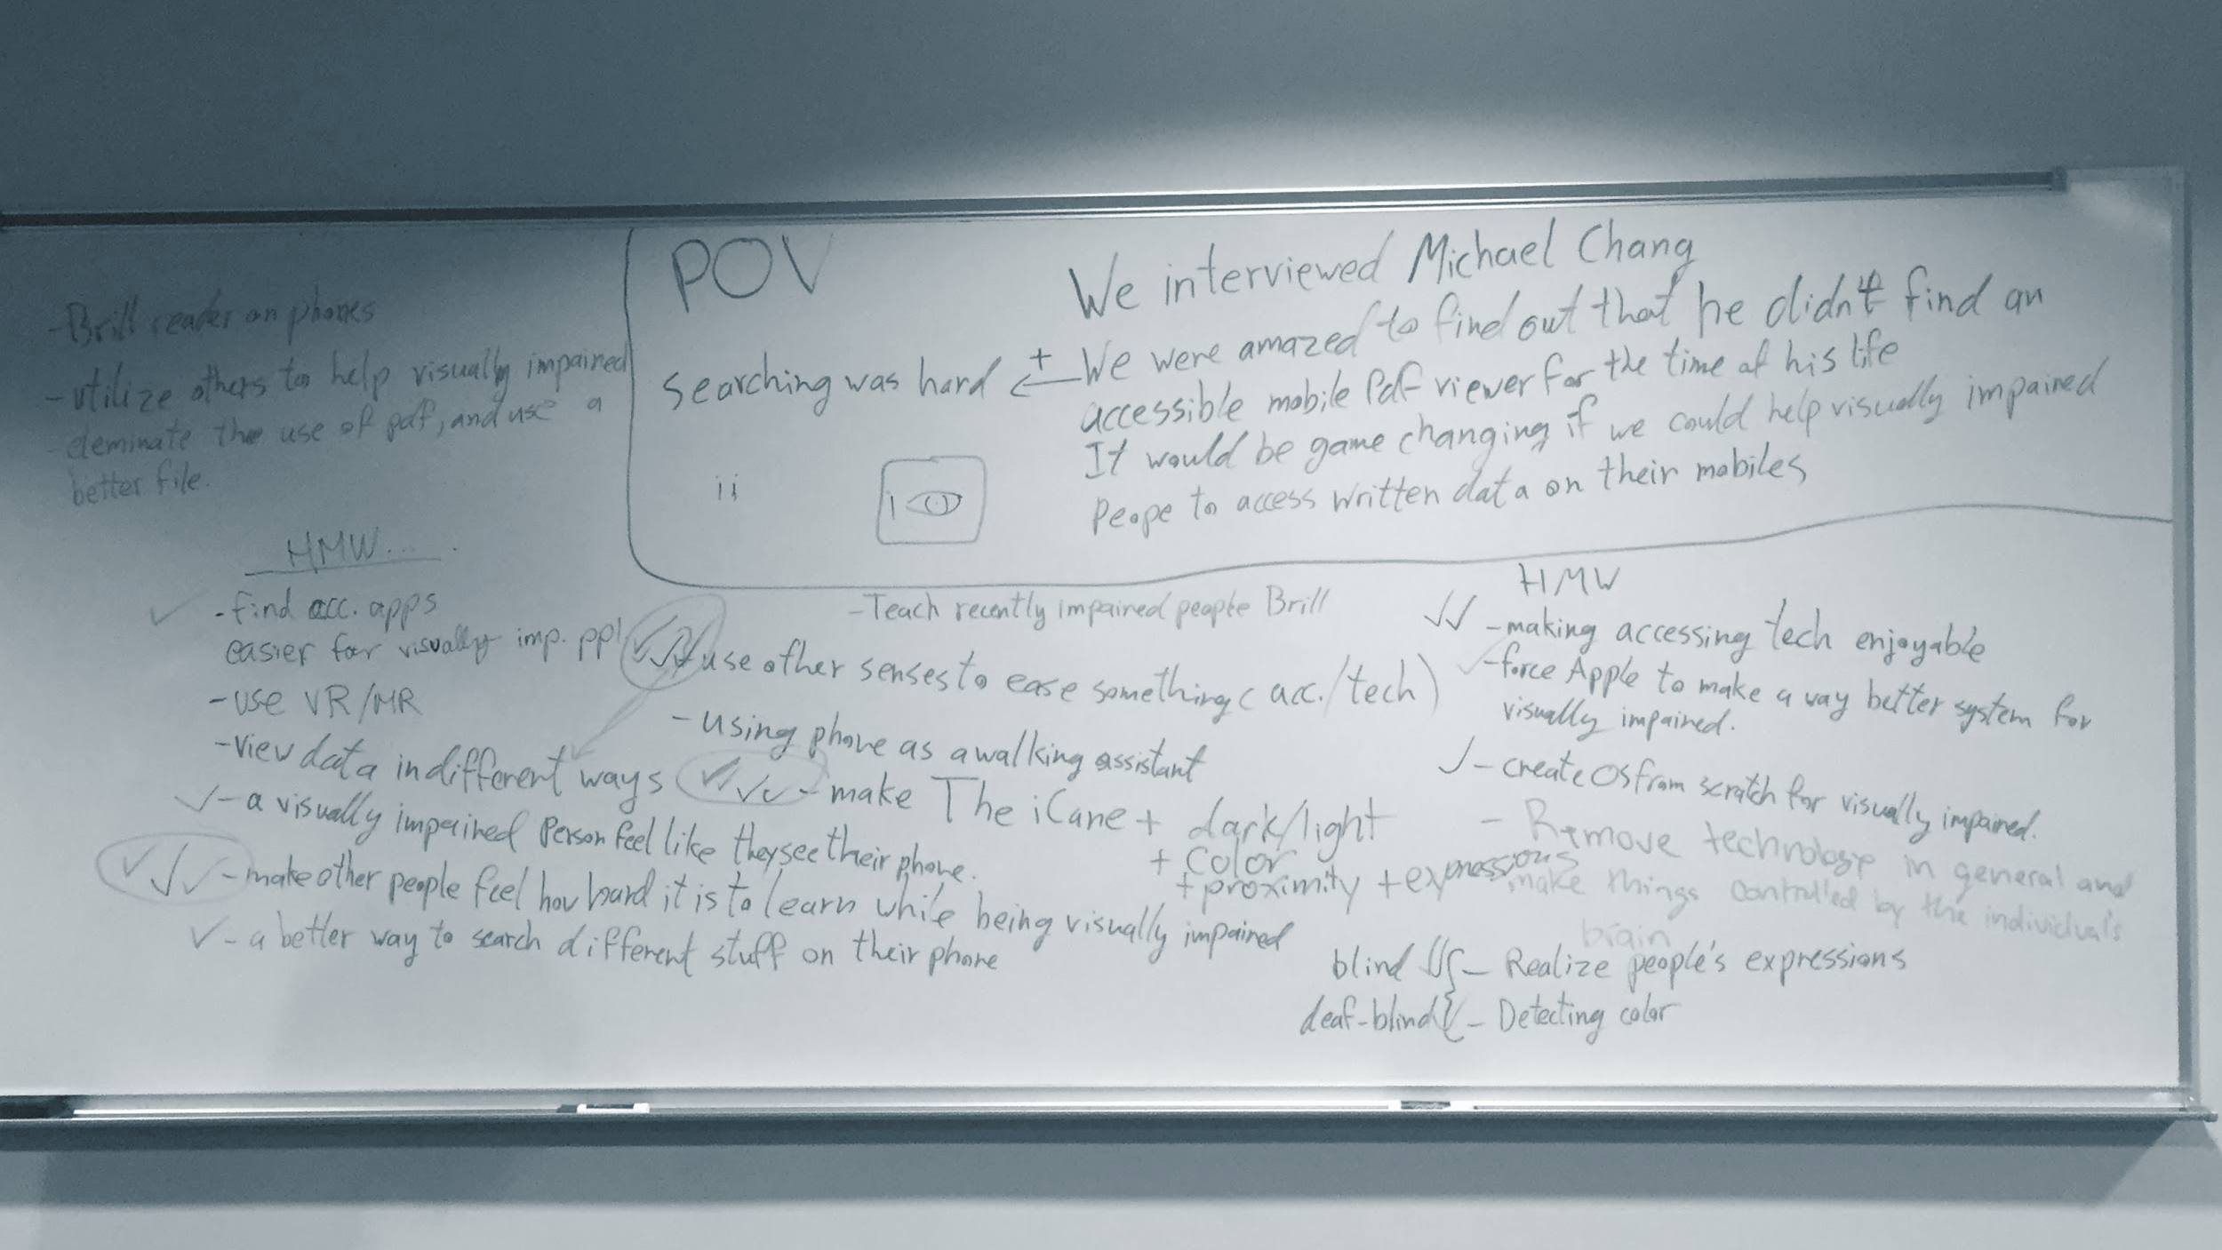
Point Of View #1

Slide 7
We talked to Michael, a vision-impaired former Stanford student.
We were amazed to learn how some simple technologies remained inaccessible to the visually impaired in education
It would be game-changing if technology could help make education universally accessible

Slide 8
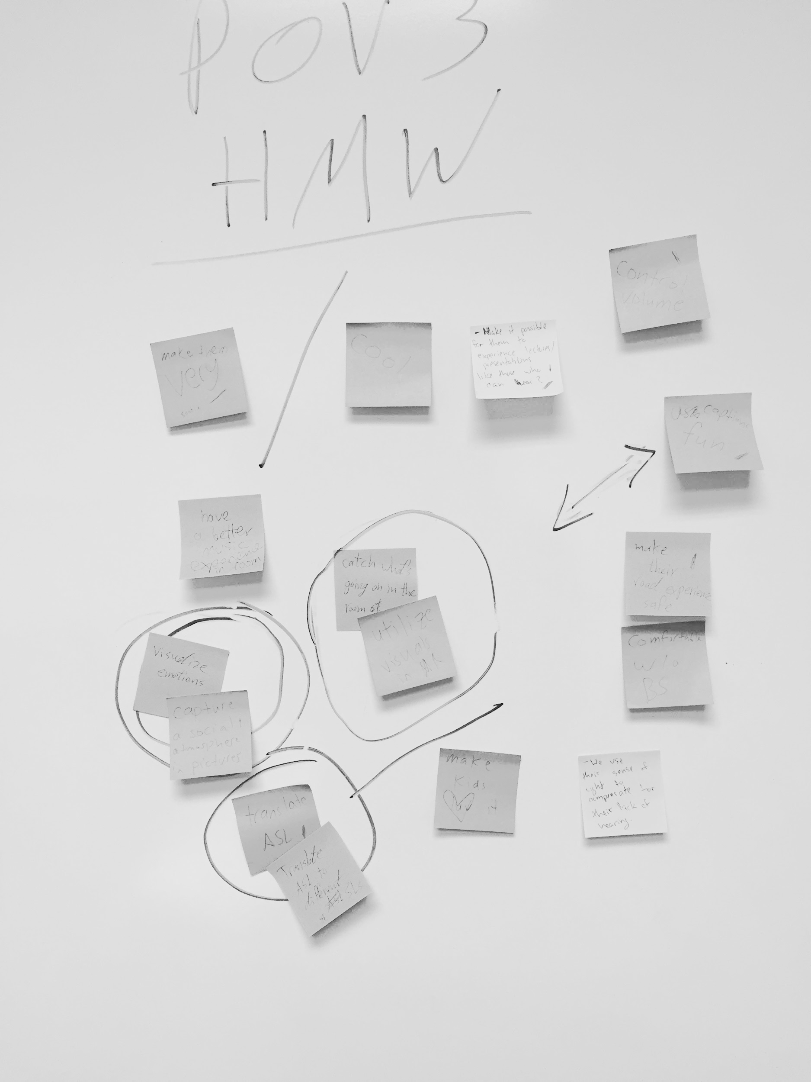
How Might We
make reading documents easier for the visually impaired | use other senses to make mobile phones more accessible | design from scratch for visual impairment

Slide 9
Experience Prototype

Slide 10
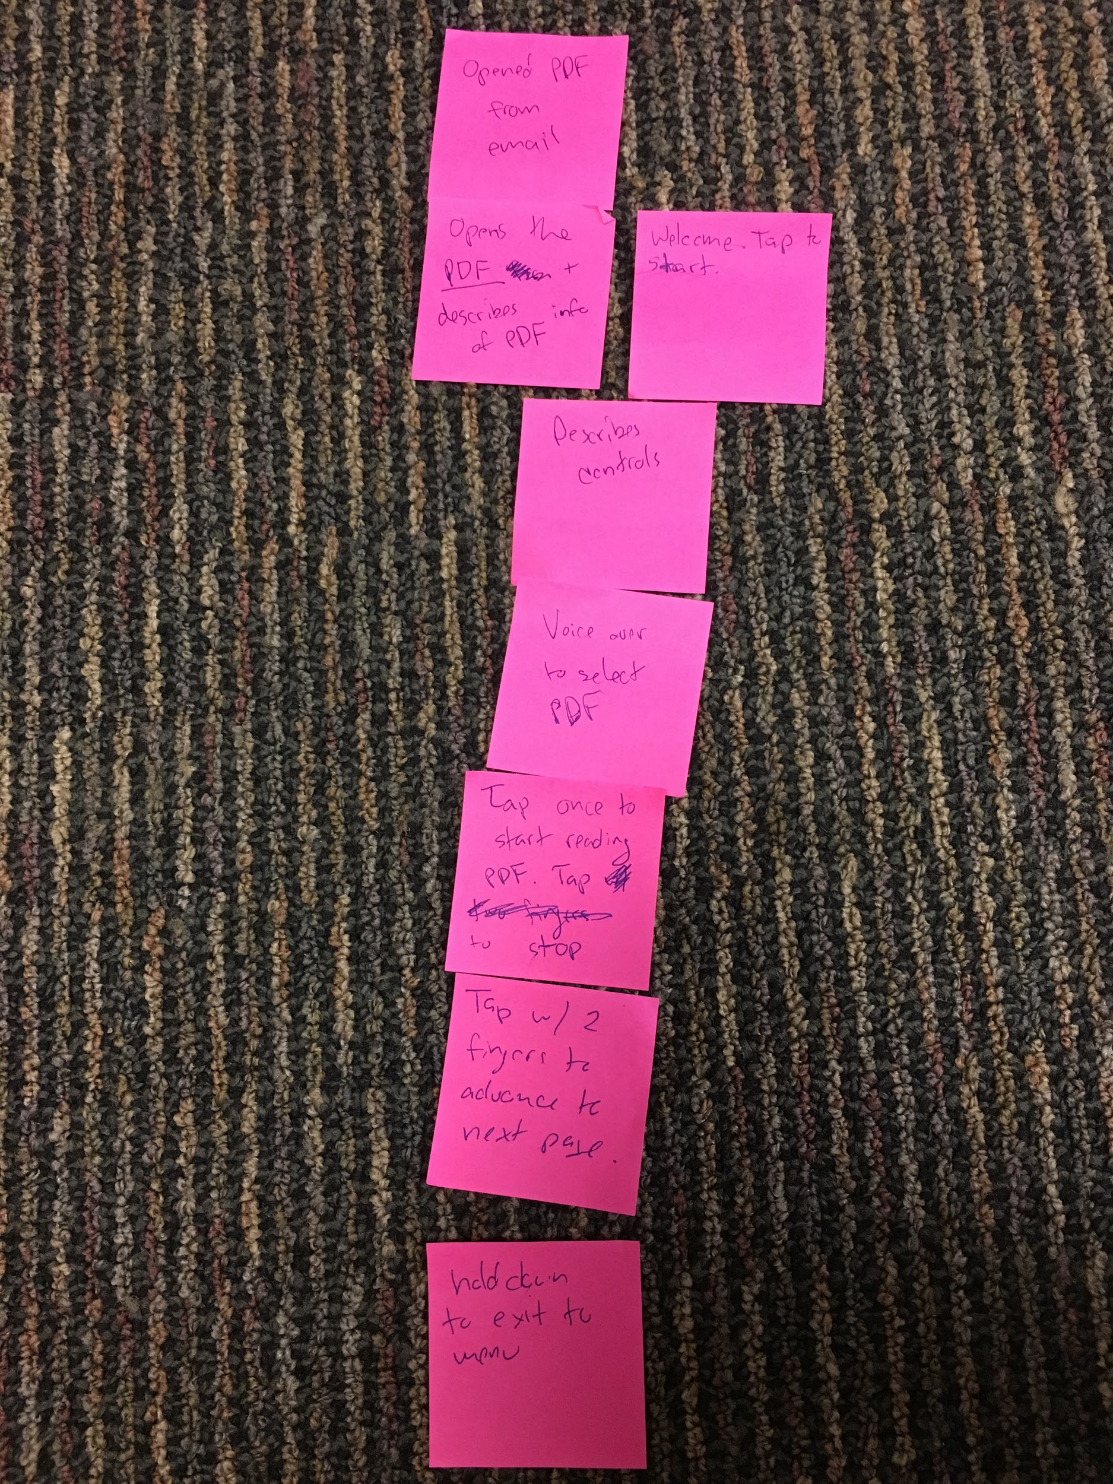
App flow

Slide 11
Assumptions
visually-impaired people would prefer natively accessible apps to voice-over

Slide 12
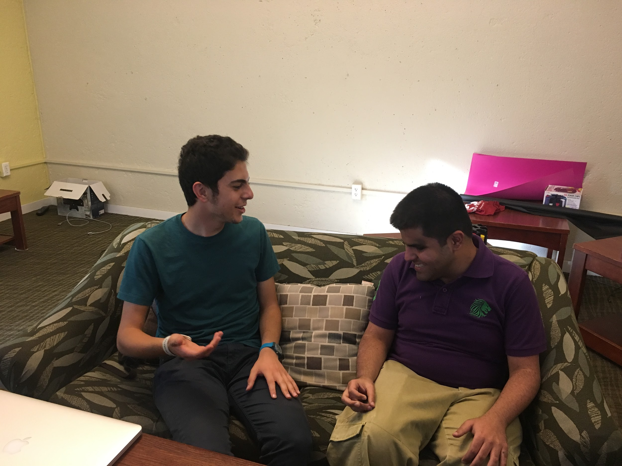

Slide 13
Results & Surprises
Worked...
Didn’t work...
Richness in features
Disliked learning new UI
Prefers adding accessibility features to existing apps
Function before form

Slide 14
Point Of View #2

Slide 15
We talked to Zina, a hearing-impaired Stanford student
We were amazed to learn how hearing accessibility technology detracted from the social experience in ed.
It would be game-changing if we could make hearing accessibility technology more palatable

Slide 16
Experience Prototype
Instant captioning of speech
Enhances captions of a video or lecture by giving life to the captions - motion, color, and size

Slide 17
How Might We
visualize tone and emotion | capture the social atmosphere of a place | translate different sign languages

Slide 18
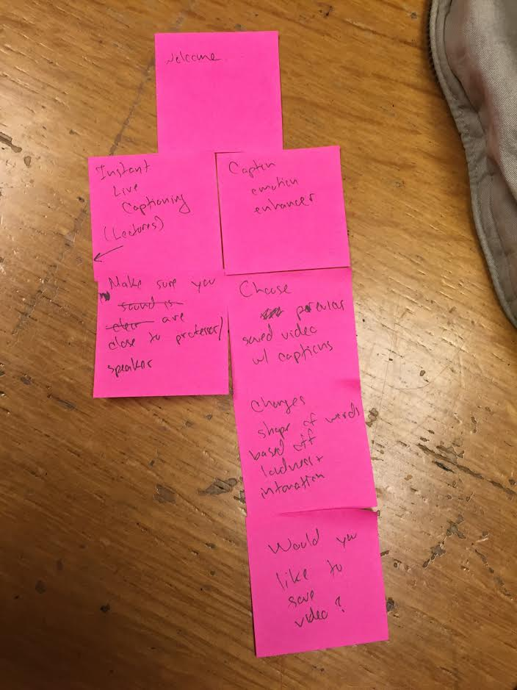
App flow

Slide 19
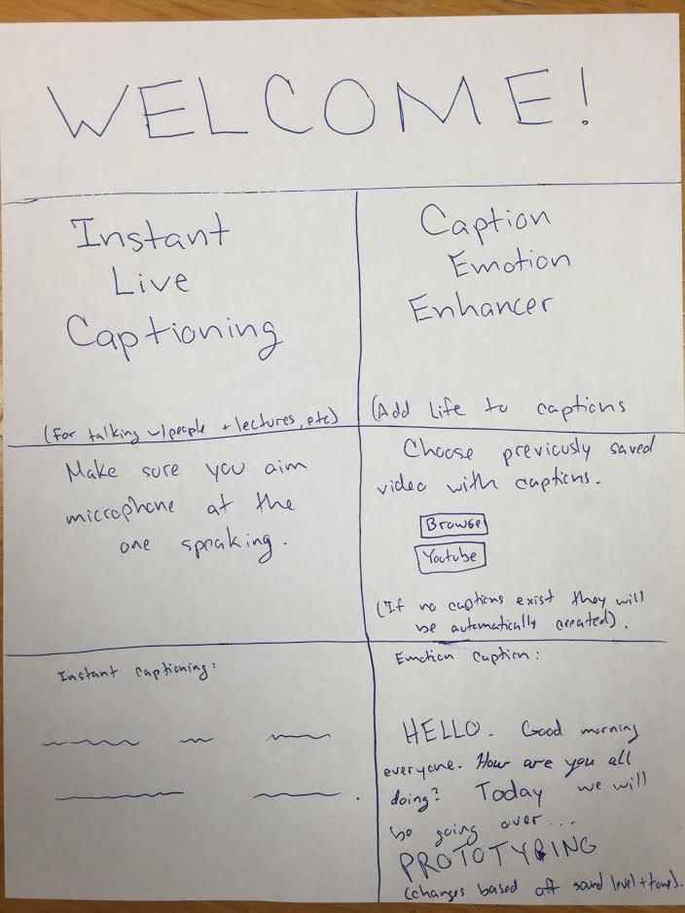
One-page representation of the app and all its screens.

Slide 20
Assumptions
captioning is prevalent
captions are unengaging

Slide 21
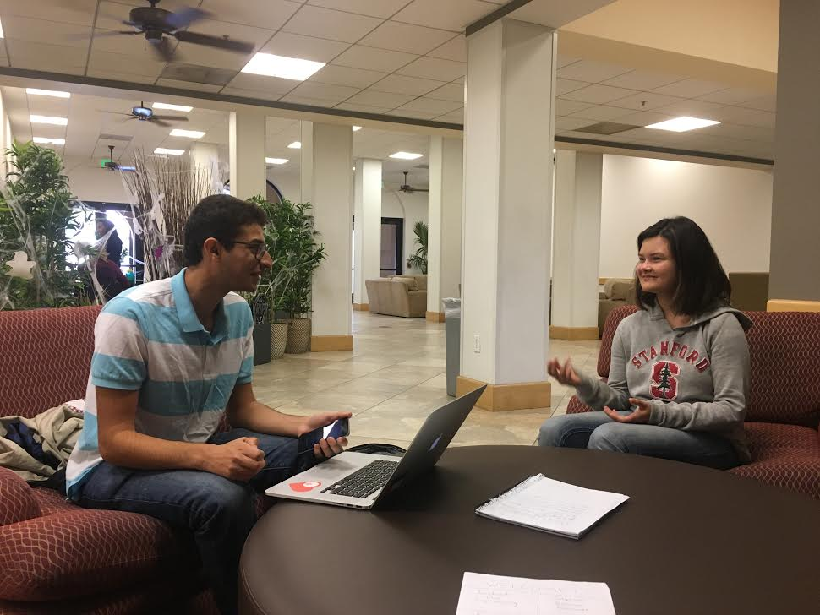

Slide 22
Results & Surprises
Worked...
Didn’t work...
Saad appreciated capturing emotions in captions
Many people don’t need captioning
Technical and institutional limitations
Juleh would use the application even though she doesn’t need captioning

Slide 23
Point Of View #3

Slide 24
We met Chris.
He’s an education PhD student at Stanford.
We were amazed to learn that the social aspect of the educational process is as important as the didactic
It would be game changing if we could make disabled students and minorities feel that they fit in the school.

Slide 25
How Might We
create a positive digital social sphere | use crowdsourcing to make university students feel more welcome | help students get engaged in the classroom
Notes:
We picked the centeral HMW

Slide 26
Experience Prototype
find nearby friends
find urgent help

Slide 27
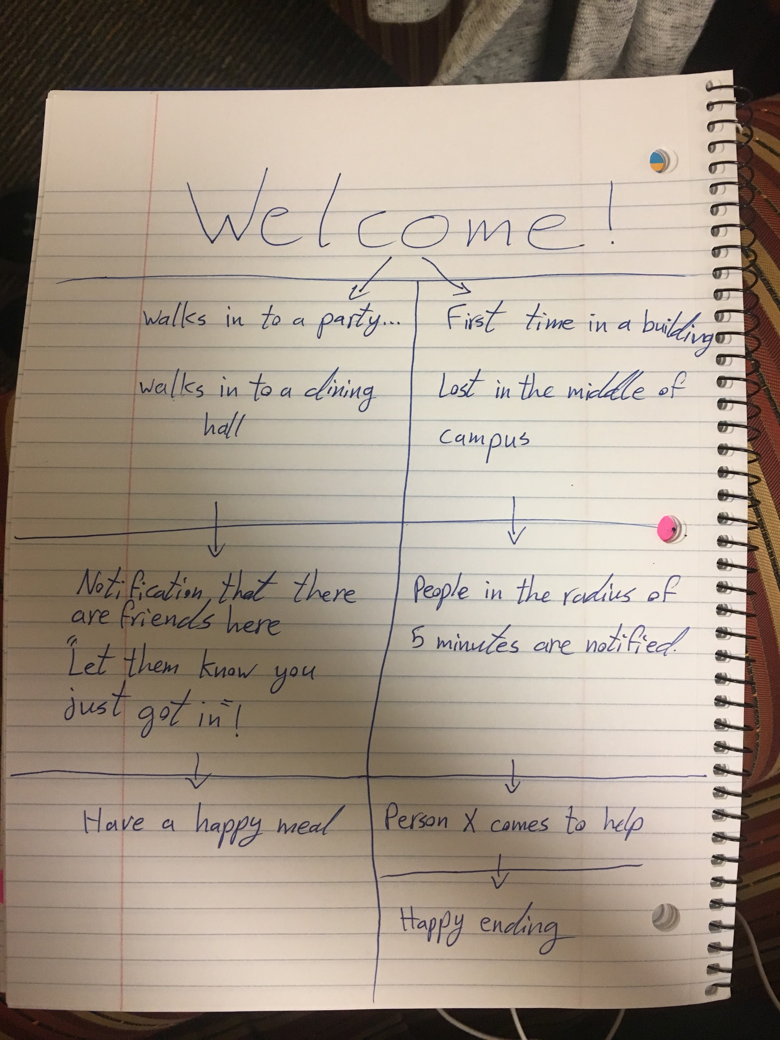
App flow

Slide 28
Assumptions
students prefer company to being alone
students would want to meet their friends when they’re nearby

Slide 29
Results & Surprises
Worked...
Didn’t work...
concerned about privacy
people do struggle to find meal mates
sometimes prefer being alone
recognized specific situations when they had the need in their own lives

Slide 30
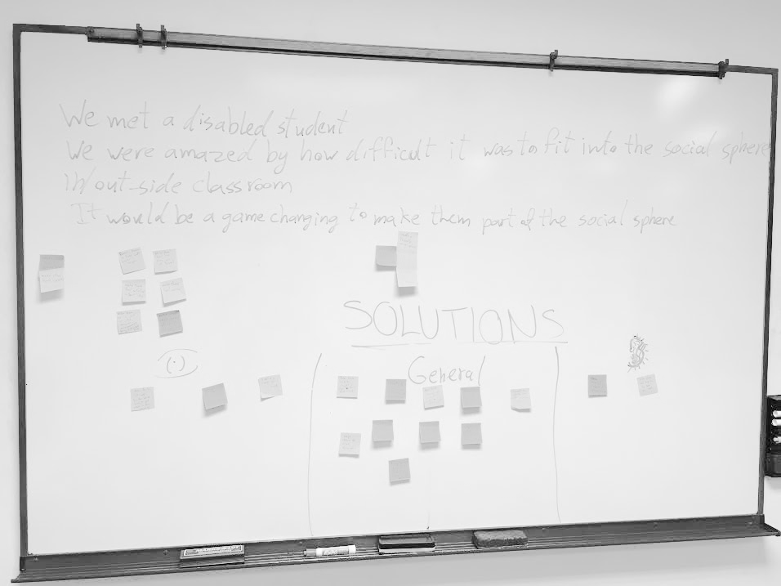
Conclusion
Prototype 2! (Fun Captions)
Pain
Impact

Slide 31
More pics...

Slide 32
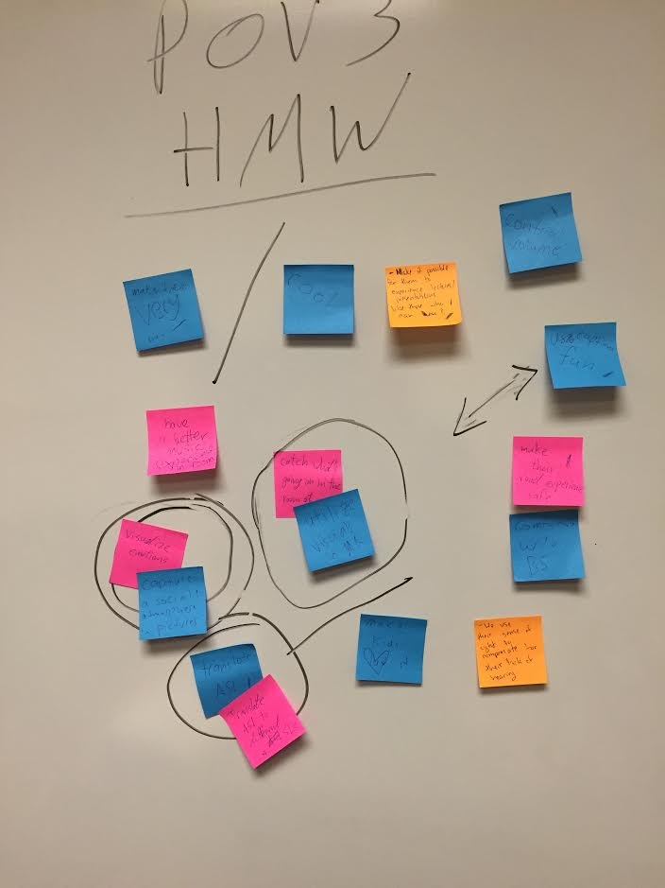

Slide 33
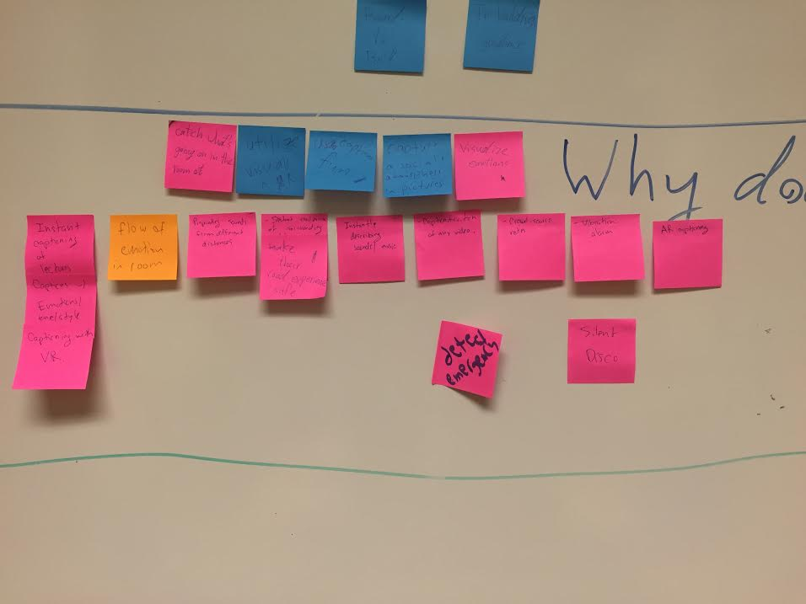

Slide 34
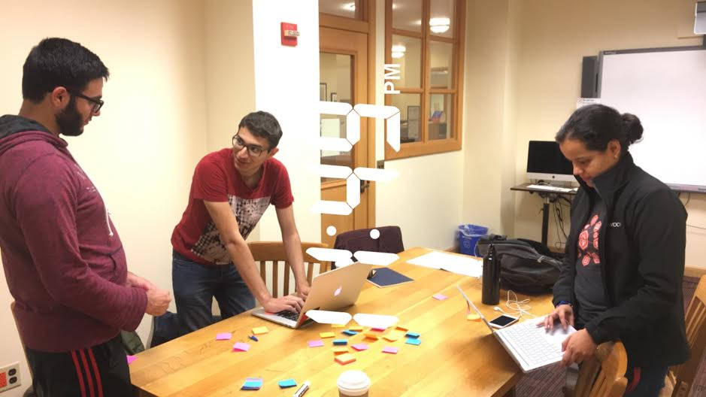

Slide 35
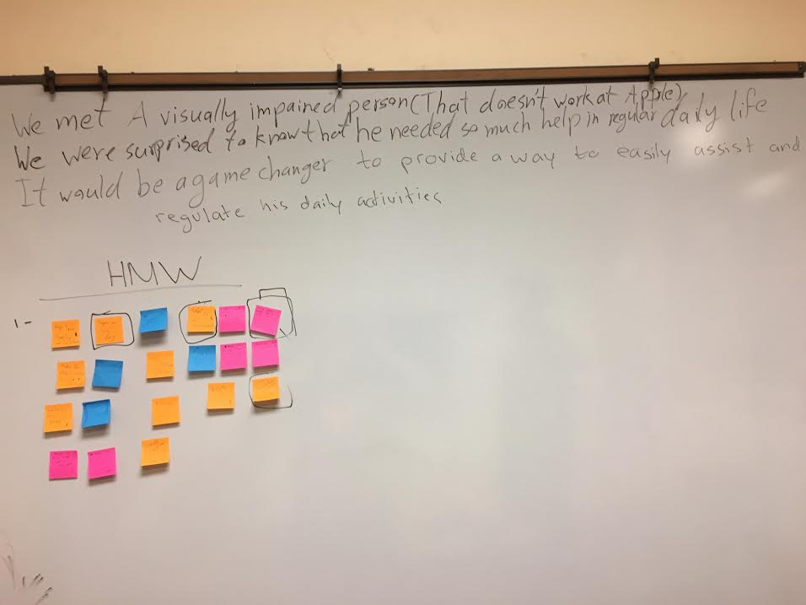

Slide 36
