Slide 1
Polytone
Convey volume and emotion through text.
By: A Team

Slide 2
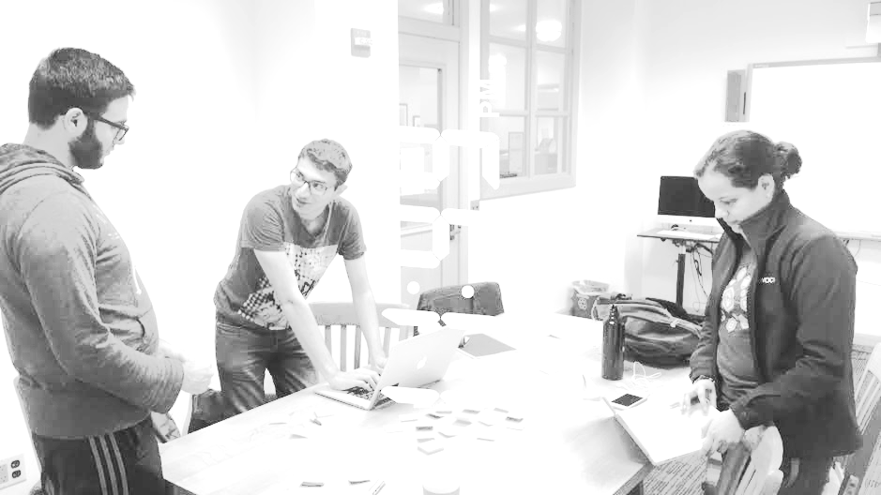
Team
Alejandrina G.R.
Ammar A.
Ahmed S.
Abdallah A.

Slide 3
Mission Statement
“Your voice is more than just words”
We aim to be able to display emotions through text to benefit those with deafness and beyond.

Slide 4
Problem and Solution
Text fails to display tone and emotions conveyed through verbal communication. For a deaf student, this poses a real problem.
Our solution is to introduce live captioning with words of manipulated size and shape to display their volume. The other approach is by enabling texting friends through also manipulating the text in a manner that will reflect one’s emotions

Slide 5
Overview
Heuristic Evaluation Results
Revised Design
Prototype Implementation Status
Demonstration

Slide 6
Heuristic Evaluation Results
Our greatest issues dealt with the absence of small features along with structural flaws that created great difficulty for the user.
Thus, we aimed to fix these design flaws through creating and implementing small features (features as small as confirmation pages or buttons) along with rearranging the positioning of the app’s buttons to make using the app easier and more efficient.

Slide 7
Top Issues
[H2-1 Visibility of System Status] [H2-3 User control and freedom] [H2-4 Consistency and Standards] [Severity 3].​ When a user clicks on “Caption”, the interface directly transitions a user to the voice recognition portion of the app. This does not seem intuitive; a user would likely expect to click a button to record.
[H2-7 Flexibility and efficiency of use] [Severity 3].​ The process for changing which style is currently selected seems complicated and confusing; I couldn’t figure out how to do it. On the “Change Style” screen, the current style should be clearly marked and there should be a quick one-tap method of selecting a different style.

Slide 8
Top Issues
[H2-7 Flexibility and efficiency of use] [H2-8 Aesthetic and minimalist design] [Severity 4].​ The Converse split-screen does not seem to be a very efficient way of conducting a two-way conversation under many circumstances. The only application where this makes sense is if the phone is sitting on a flat surface and the two users are sitting across from each other. Another likely scenario is that the phone is being passed back and forth between people, in which case they would need to constantly rotate the phone 180 degrees between messages.
[H2-8 Aesthetic and Minimalist Design] [Severity 4] . ​It is not immediately clear what the “Change Style” functionality accomplishes. Does it change the general appearance of the app? The appearance of text in captions? More than that, it is unclear why changing style in any of these areas would be particularly important. It might make sense to remove the “Change Style” button, or to make the functionality of changing text style more central to app purpose.

Slide 9
Top Issues
[H2-5 Error Prevention] [Severity 3] . I​n the “Converse” flow, the “x” button in the middle of the screen is in a location that would suggest central functionality. A user might accidentally click on this button when looking at the other person’s message.
[H2-1 Visibility of System Status] [H2-3 User Control and Freedom] [Severity 4] On the “Caption” screen, it is unclear whether the information being recorded is being autosaved continuously, or whether the user must take some action to manually save the information. If it is the latter, then there is a problem; there is no icon visible that may allow the user to save the content. There should be a “Save” icon prominently displayed on this screen.

Slide 10
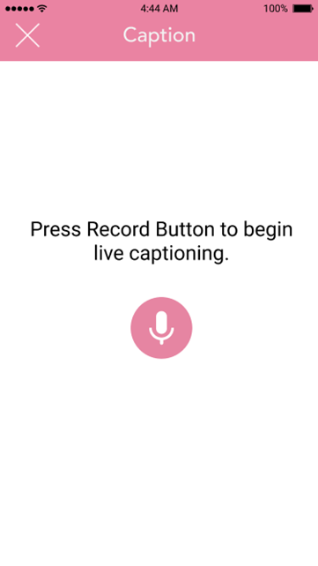
Design Change 1 (Severity 3)
Caption immediately starts instead of asking the user to initiate captioning. New screen asks user if they want to begin captioning.

Slide 11
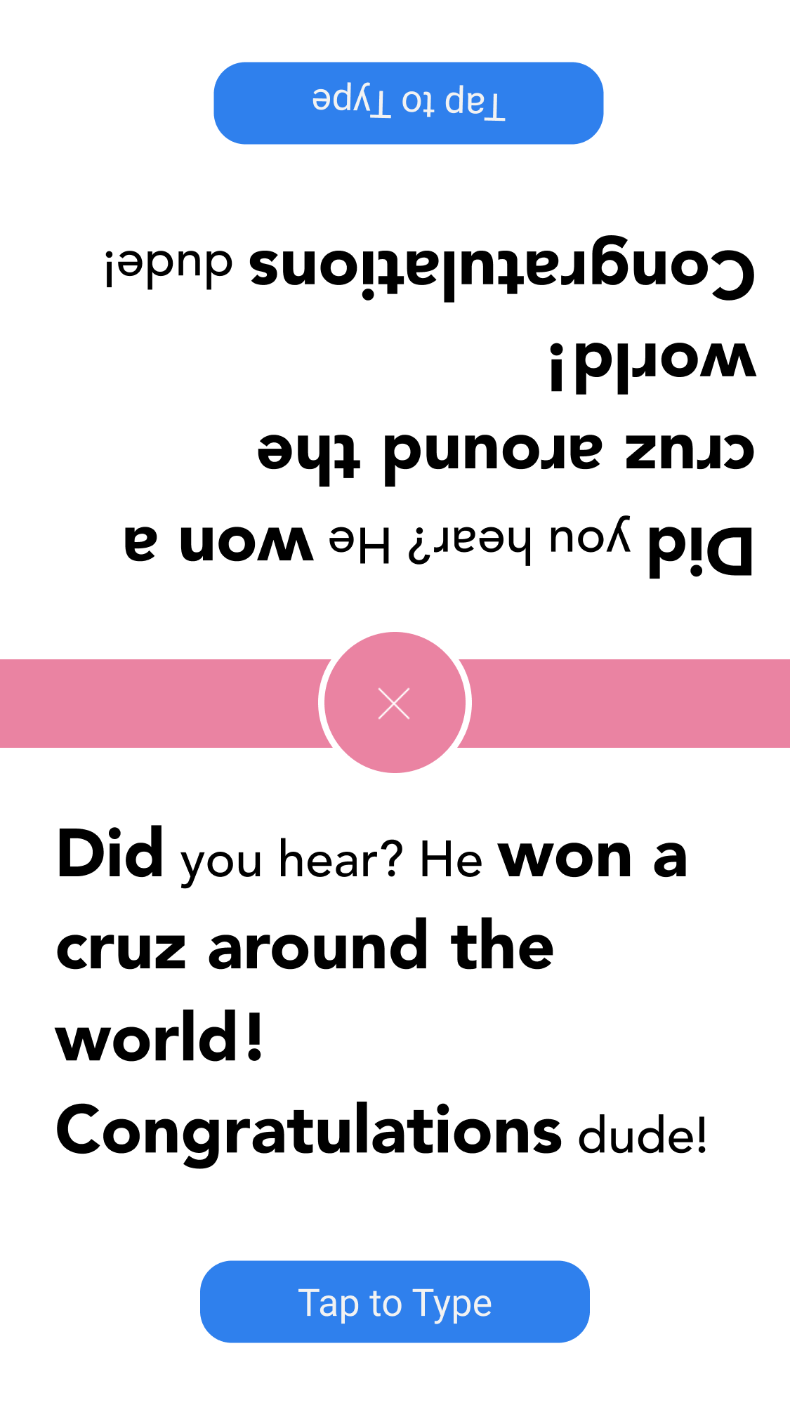
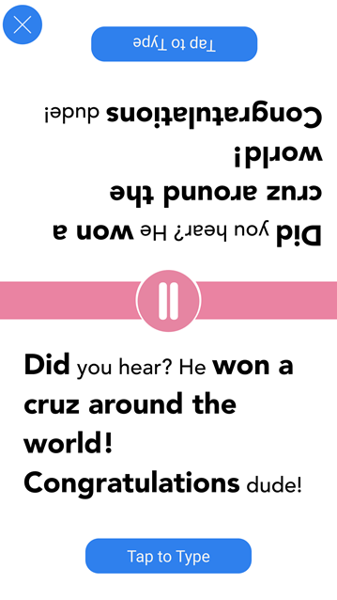
Design Change 2 (Severity 3)
The exit button was in the middle of the screen and was in the way for the users.
We created a record and pause button (similar to the last design change) and moved the exit button to the corner.

Slide 12
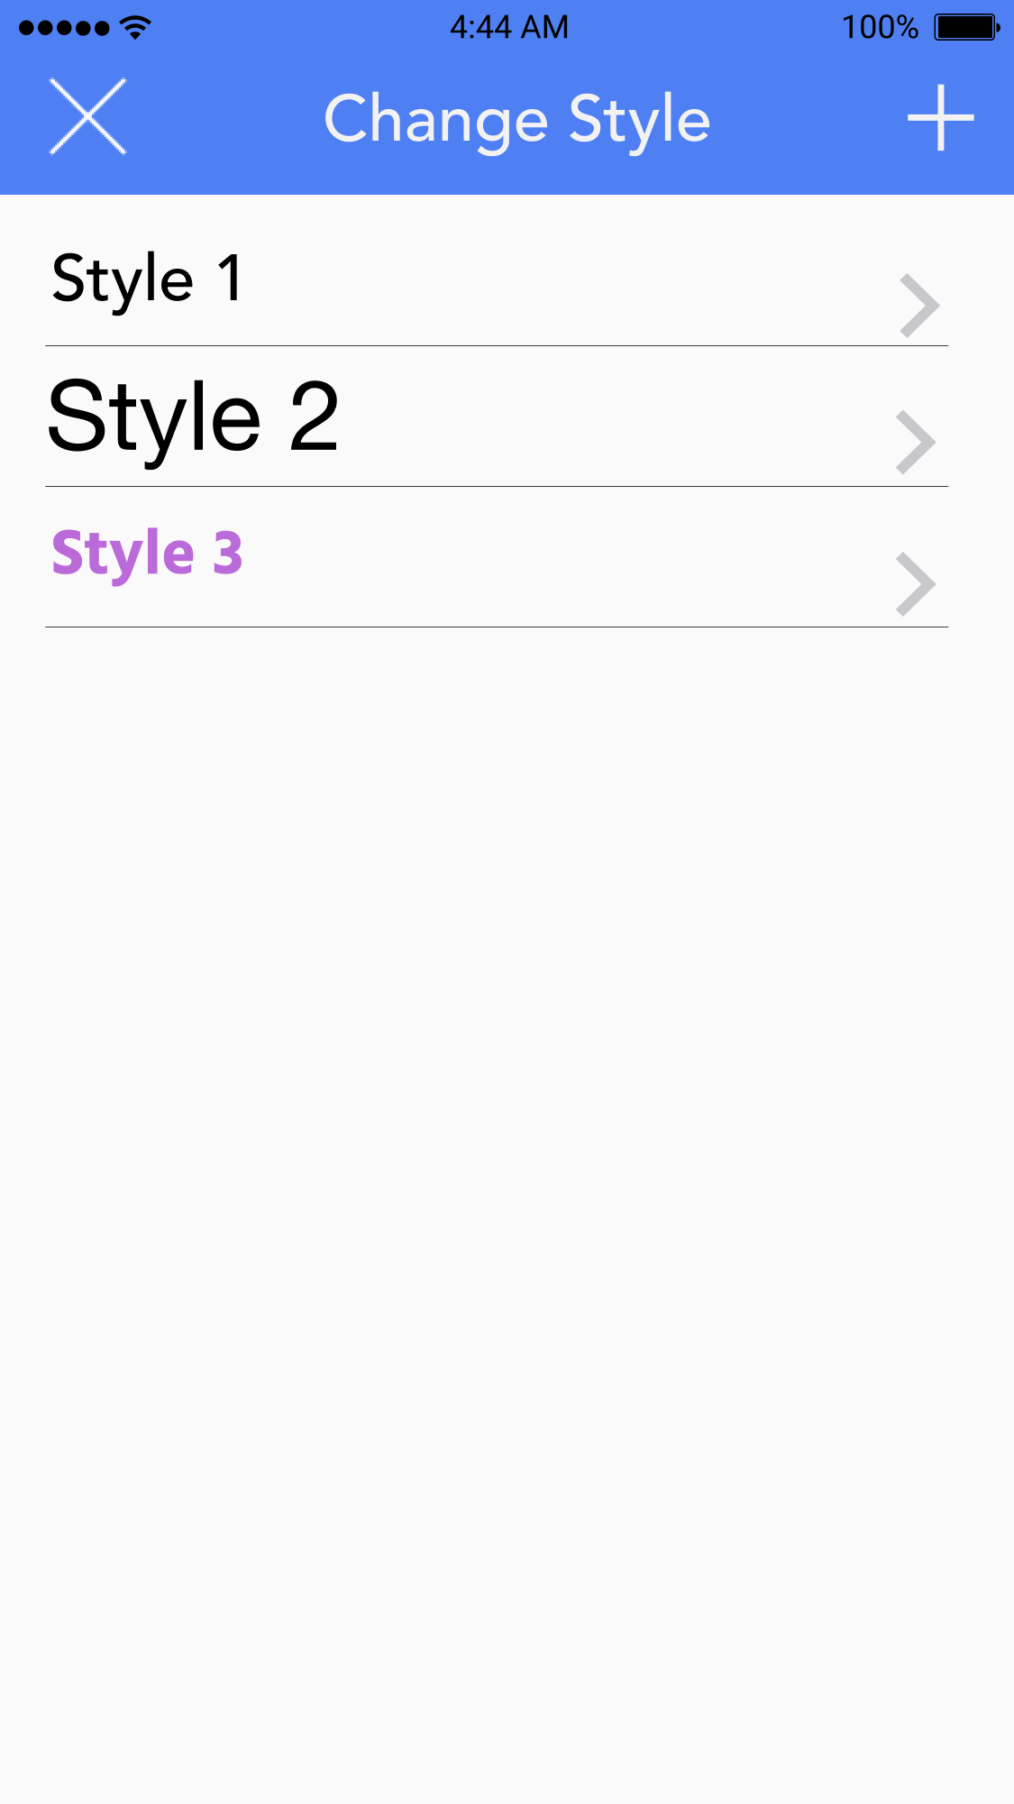
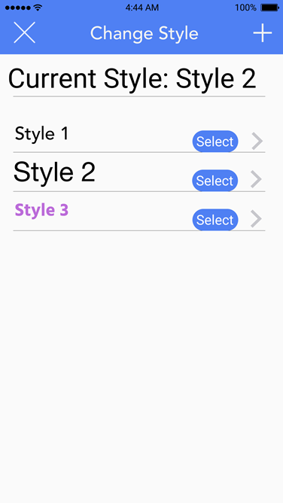
Design Change 3 (Severity 3)
The new design clearly displayed the current style for easy reference.
It also possesses a quick select button to allow the user to easily switch to another style.

Slide 13
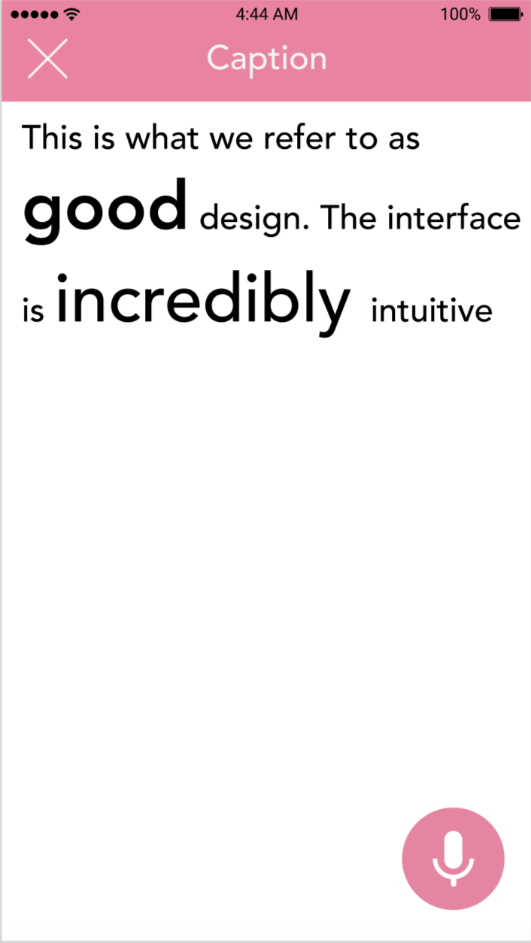
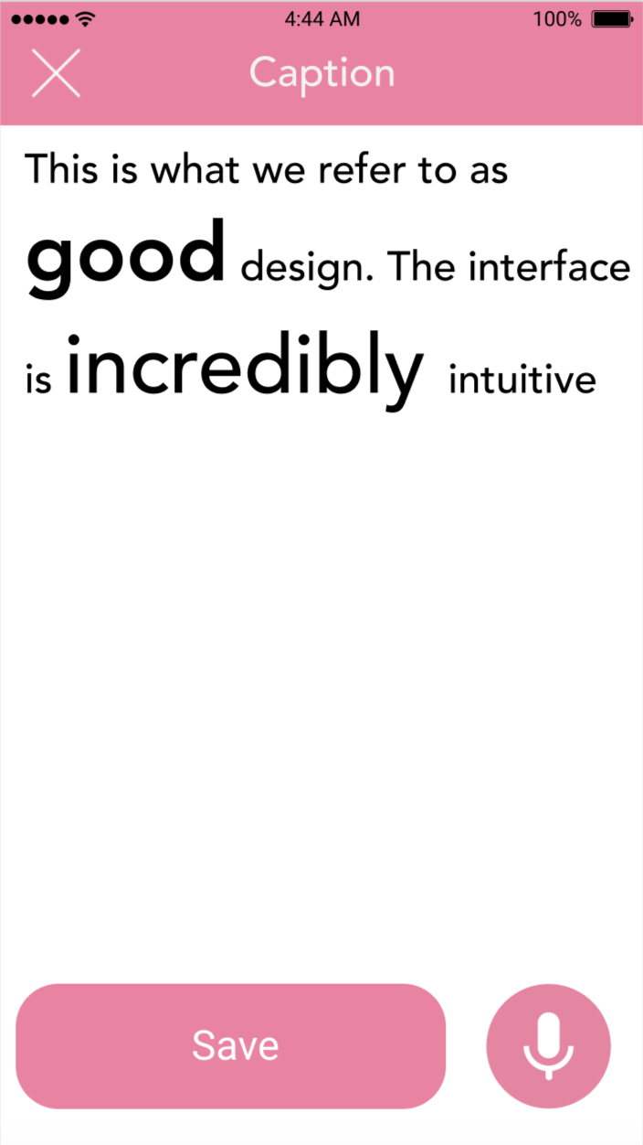
Design Change 4 (Severity 4)
The user had no way of knowing that their recorded material could be saved if they exit.
We added a save button to make that functionality clear to users.

Slide 14
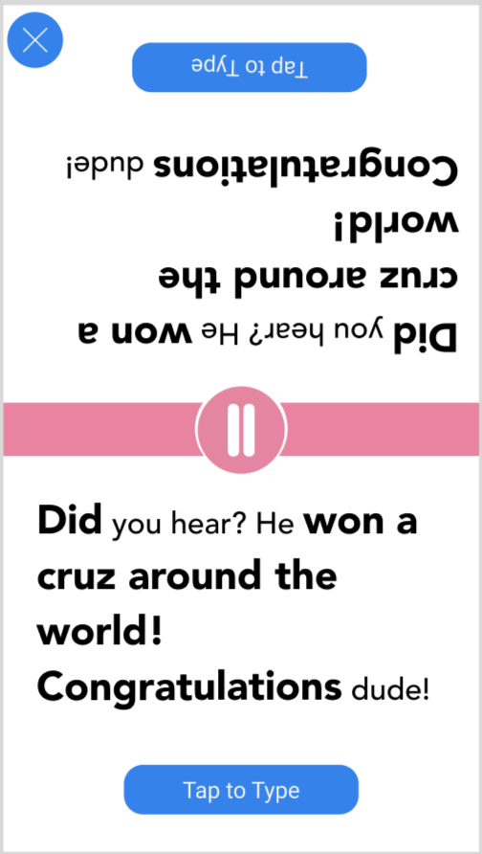
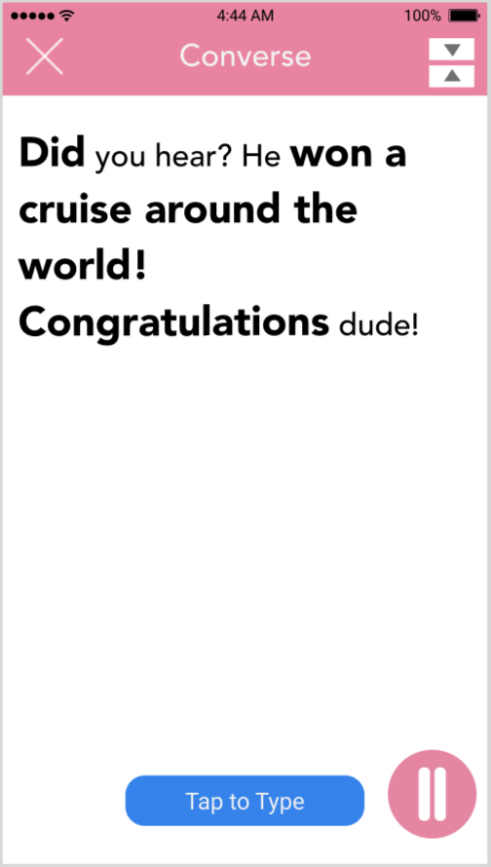
Design Change 5 (Severity 4)
We didn’t account for cases where users wouldn’t want to split their screen when having a conversation.
We added an option to switch between single screen and split-screen in the conversation task.

Slide 15
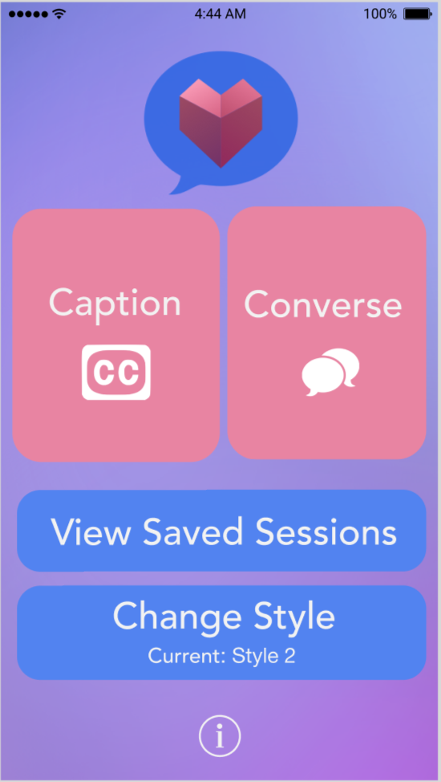
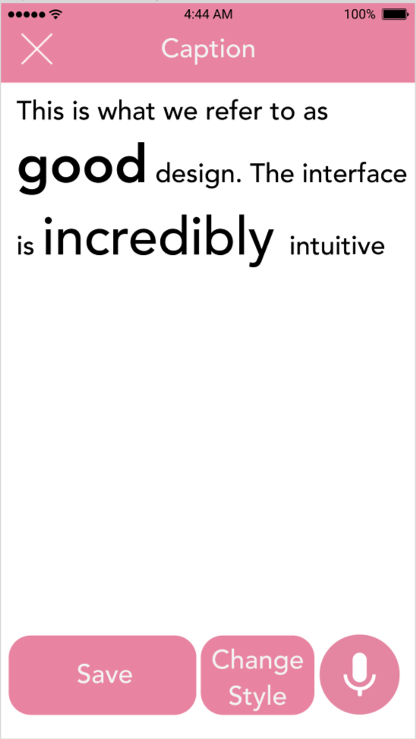
Design Change 6 (Severity 4)
It wasn’t clear what changing the style in the application did.
We moved the “Change Style” button to within a recording session to make it clear that it changes the font for that particular session.

Slide 16
Prototype Implementation Status
Tools being used:
We are implementing this app for iOS, so we are using xcode to build it. Since we are using Speech technology by Apple, the app is compatible with iOS 10 and higher.

Slide 17
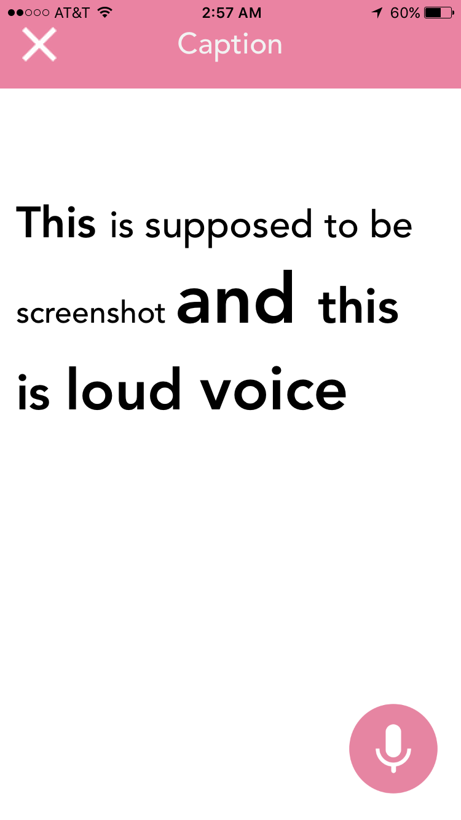
Prototype Implementation Status
Implemented features:
Allows speech to text, and showing the user live feedback.
Resizes words depending on the loudness.
Saves the recording temporarily.

Slide 18
Prototype Implementation Status
Unimplemented Features
iMessage extension still has no code at all.
Converse: Converse’s implementation is similar to Caption, so this won’t take much time
Plan to finish
Have core functionality implementation finished by the middle of next week, and finish details by the end of the week.

Slide 19
Prototype Implementation Status
Wizard of Oz Techniques
We might use Wizard of Oz Techniques with the iMessage extension

Slide 20
Prototype Implementation Status
Hard-coded Data
Text default style
Saved styles
Saved sessions

Slide 21
Prototype Implementation Status
Issues/Questions
We still have not explored the iMessage extension, but most likely we will be able to make it work.
Still missing most iMessage implementation
Text animation shows at the end when recording is over, not live as intended.

Slide 22
Demo

Slide 23
Summary
The heuristic evaluation allowed for us to recognize flaws in small features and the structure of some of the app’s changes.
The design changes are not hard to change, which will help us in fixing the mentioned violations at a low cost
Implementing the application is not all easy, but it is doable with some digging

Slide 24
Thank you

