Slide 1
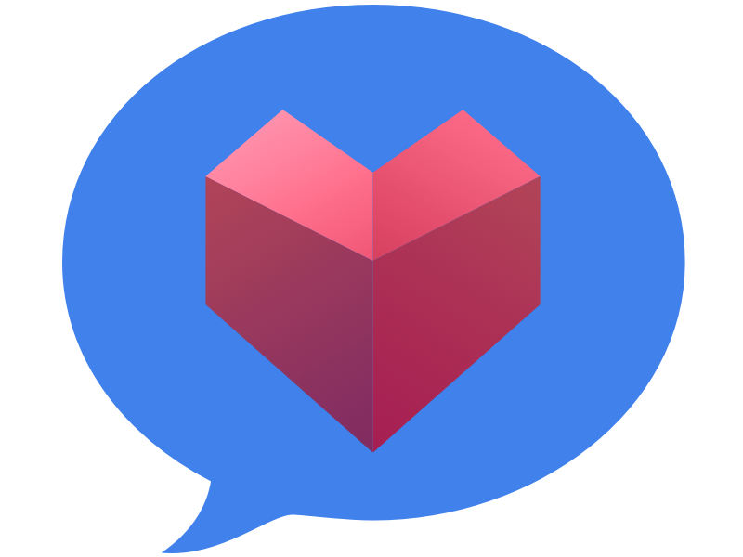
Polytone
Medium-fi Prototype
By: A Team

Slide 2
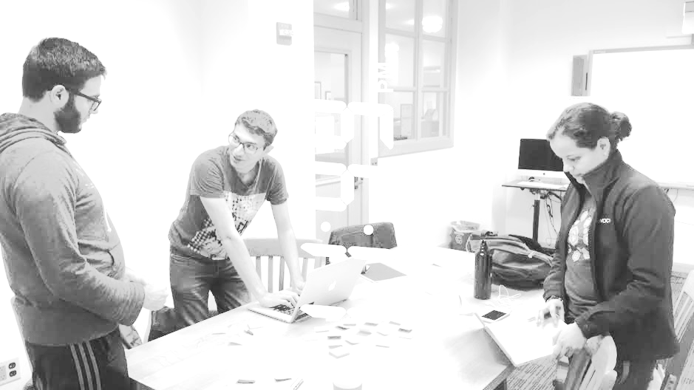
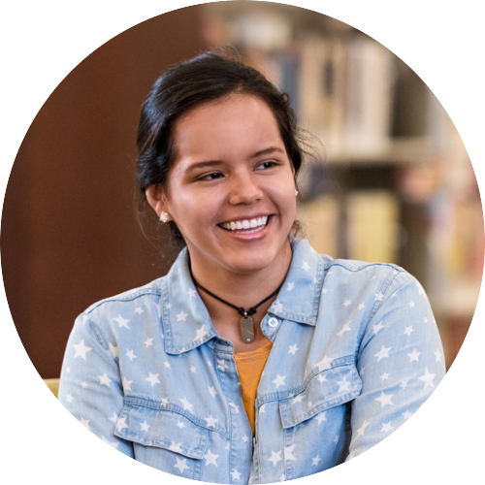
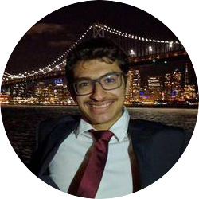
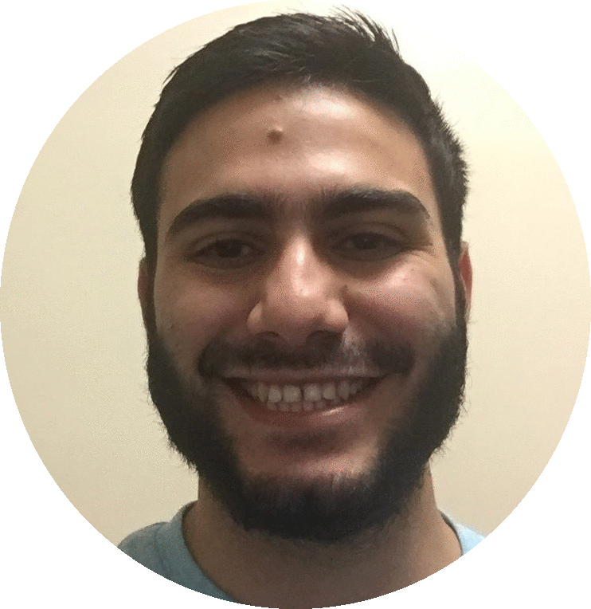
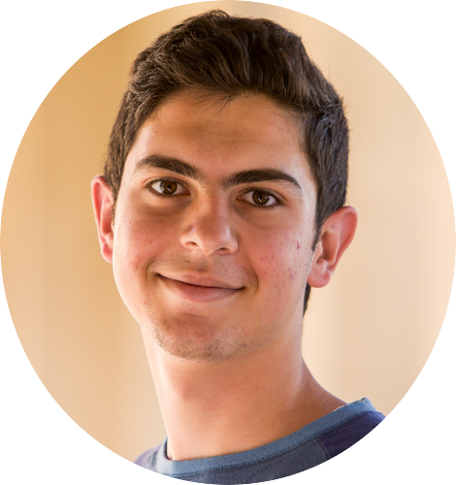
Team
Alejandrina G.R.
Ammar A.
Ahmed S.
Abdallah A.

Slide 3
Overview
Mission Statement
Tasks
Interface Design
Prototype Overview

Slide 4
Mission Statement
“Your voice is more than just words”
We aim to be able to display emotions through text to benefit those with deafness and beyond.

Slide 5
Tasks
Slight changes were made to the specificity of the tasks at hand

Slide 6
Task 1 (Simple)
As a deaf student, I want to be able to visually understand the volume of a lecture.
(change made to focus simply on volume for now)

Slide 7
Task 2 (Medium)
I want to communicate with deaf people in 1-on-1 conversations without the need to learn sign language.

Slide 8
Task 3 (Complex)
I want text to reflect my emotion and deliver it to other people so that they don’t necessarily need sound.

Slide 9
Revised Interface Design

Slide 10
Design Changes

Slide 11
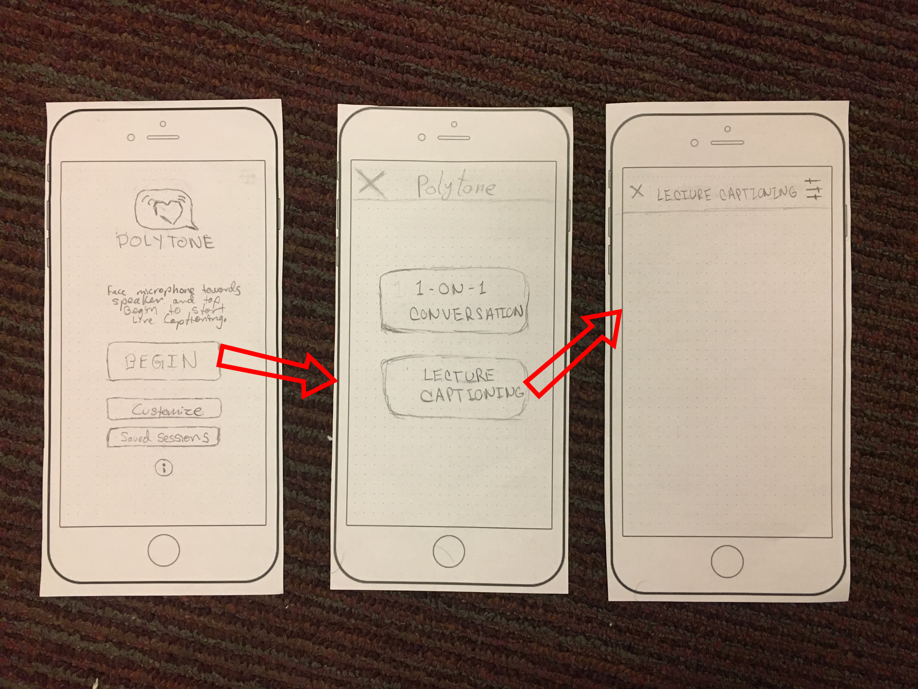
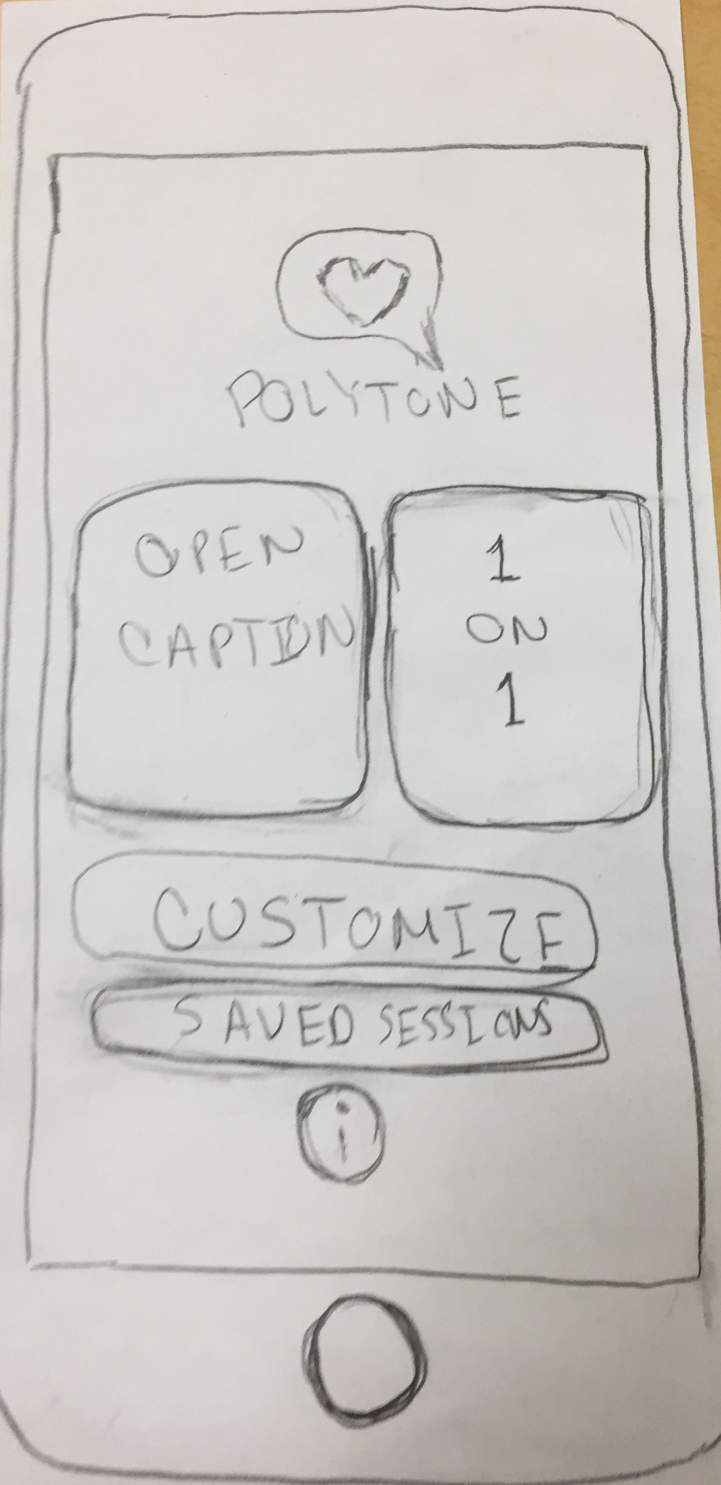
Design Change #1
Lecture Captioning and 1-on-1 Conversation options accessible from main screen
No useless intermediate screen any longer
No small explanation on main screen

Slide 12
Rationale
Some of the interviewees expressed concern with how cumbersome it was to navigate back and forth through countless screens. Thus, we decided, to simplify it as much as possible in many instances. In this instance, we removed the intermediate screen and made two other screen accessible from the main page.

Slide 13
Design Change #2
Add a record (and a pause button) to easily and directly record a lecturer’s captions (transcript with emotions)
Add a save button directly to the lecture captioning screen

Slide 14
Rationale
One of our interviewees found it very time consuming to save a lecture then navigate all the way back to the main screen in order to share a saved session. So, we thought it necessary to simplify the process by making it possible to share a session directly after saving it.

Slide 15
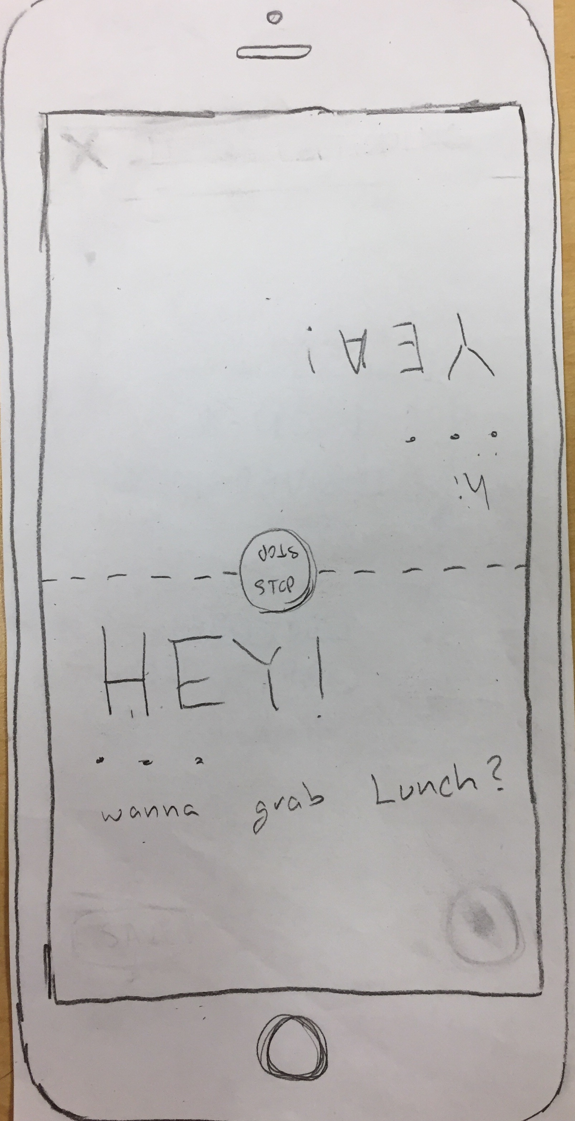
Design Change #3
Making the 1-on-1 conversation screen more enjoyable and interactive between two participants by halving a split-screen format

Slide 16
Rationale
Our interviewees expressed concerns with the extreme similarity between lecture captioning and having a 1-on-1 conversation. Thus, fulfilled our original goal of making the 1-on-1 conversation aspect more interactive and enjoyable through creating a split-screen format for the two participants to directly and easily communicate with one another.

Slide 17
Task Flows

Slide 18
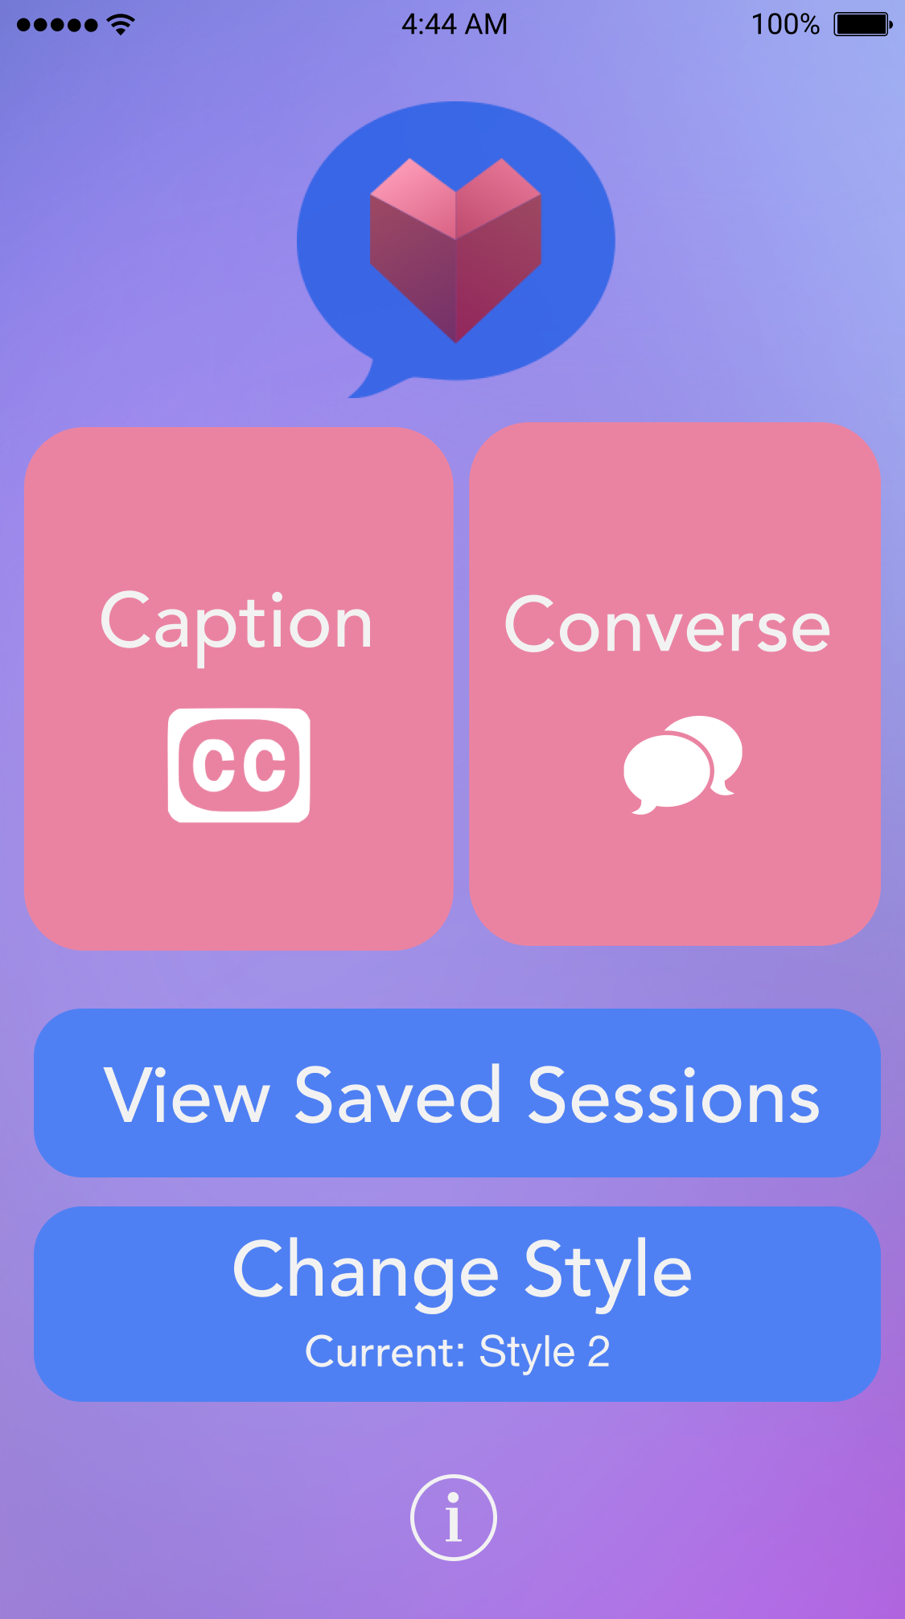
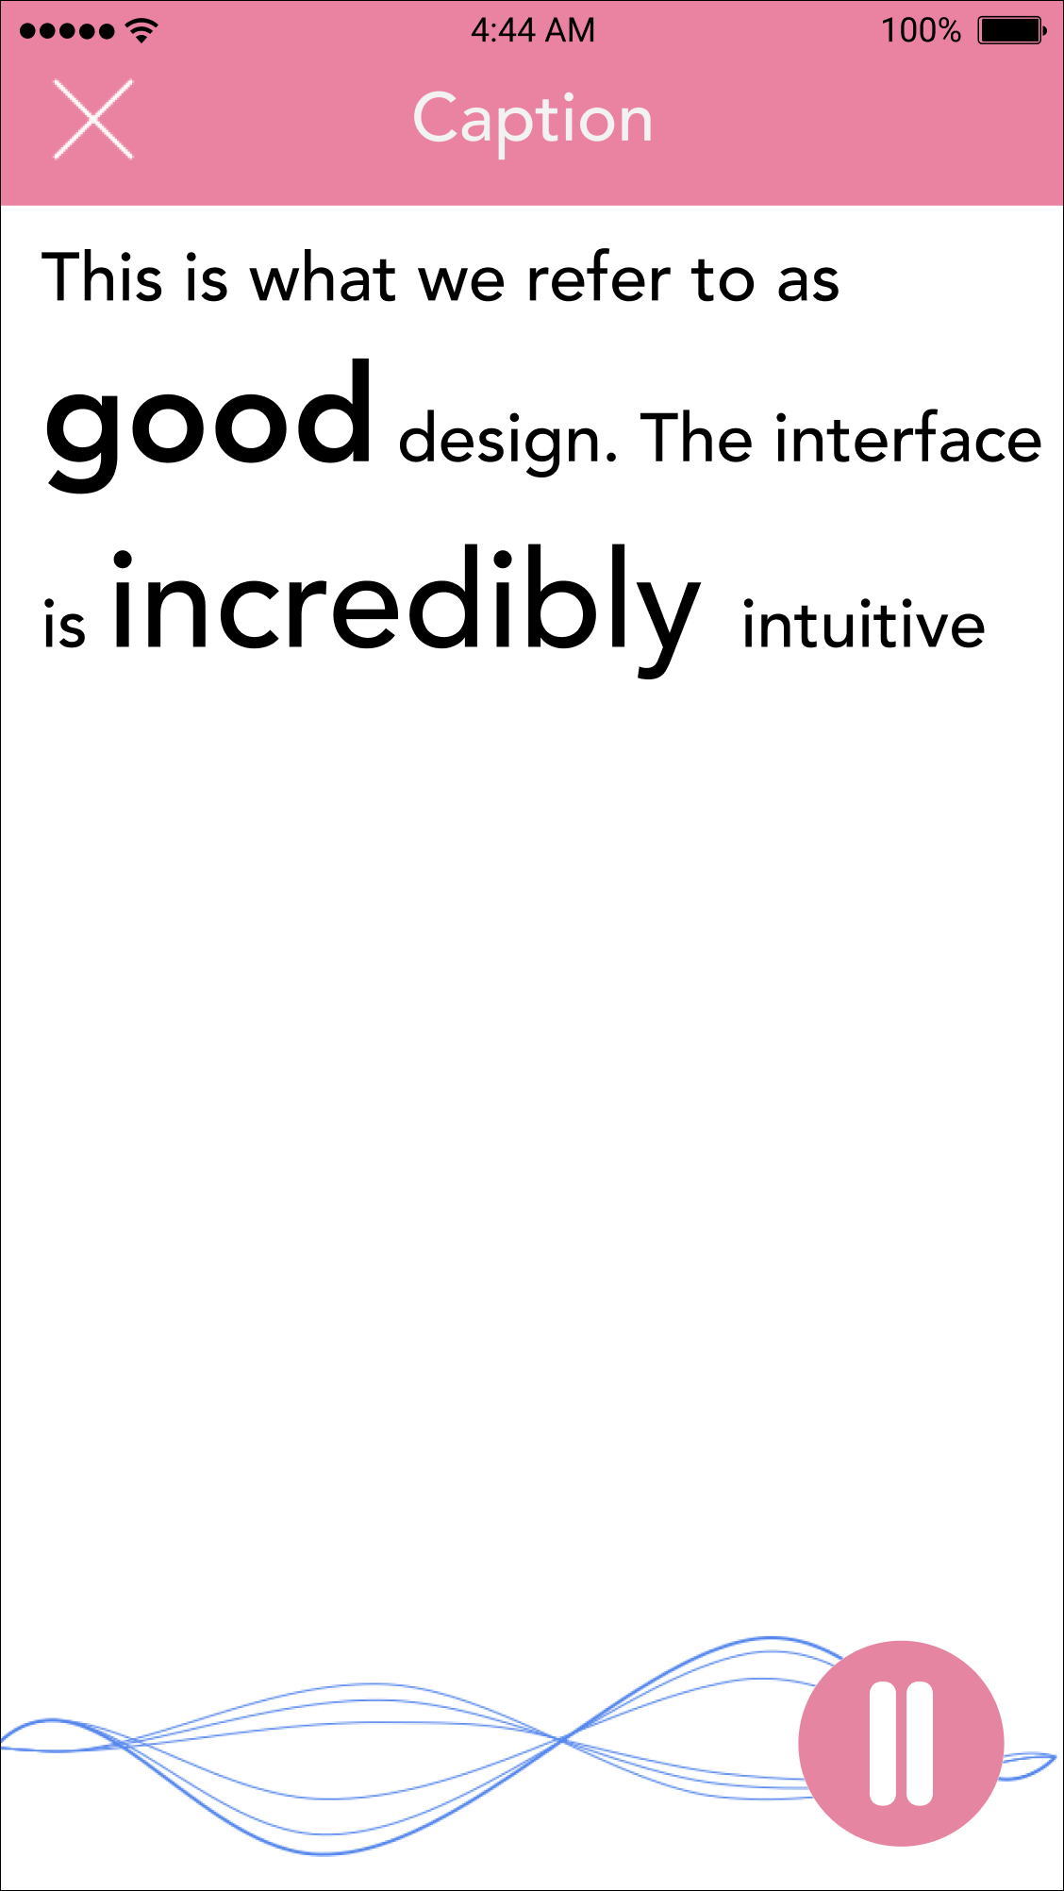
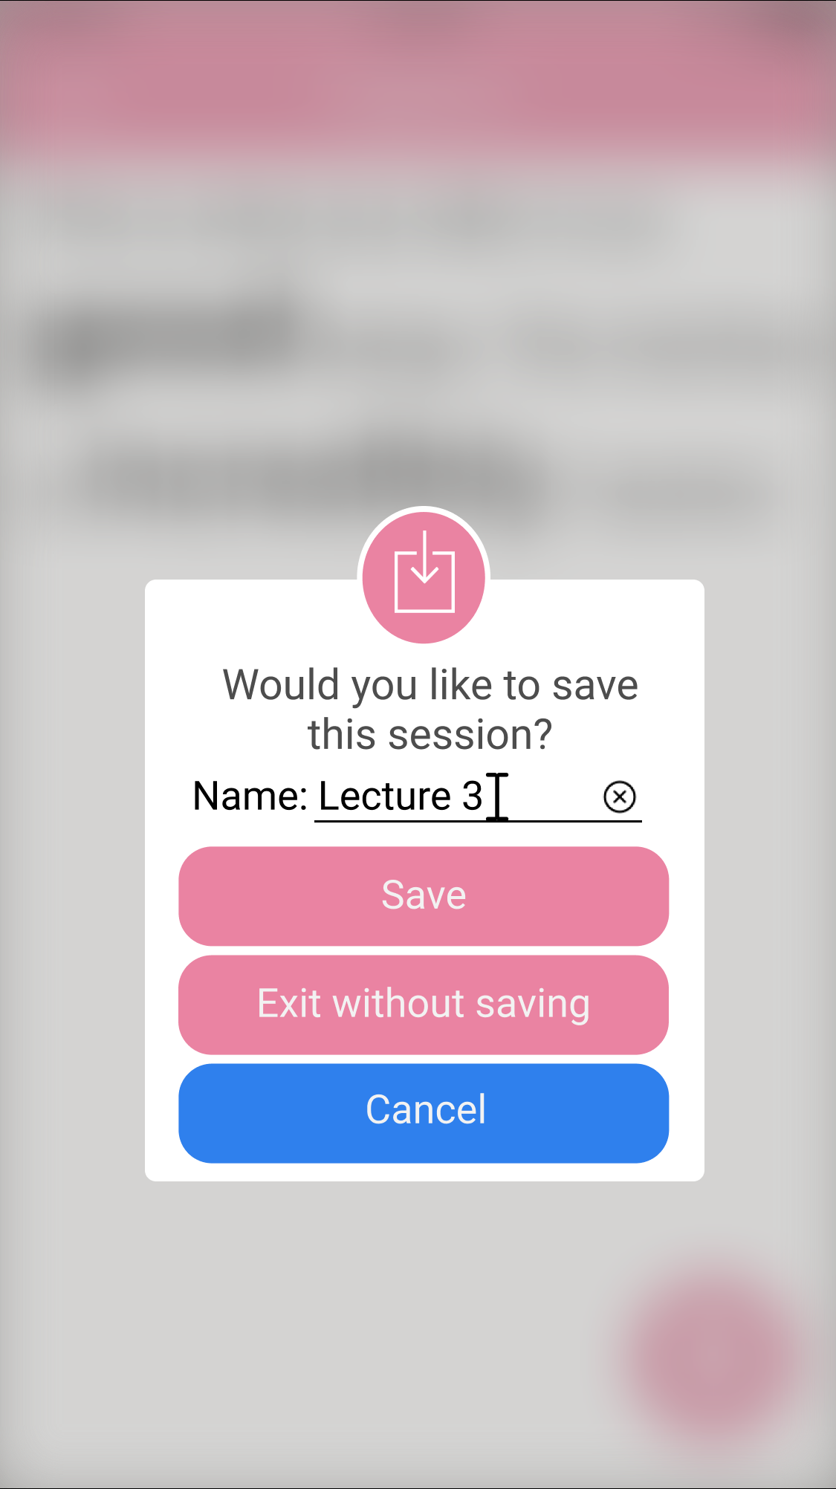
Task 1- Lecture Captioning (Simple)

Slide 19
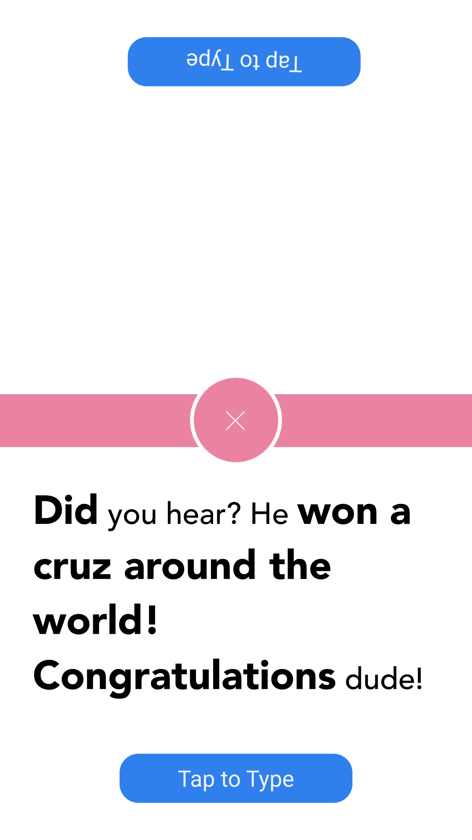
Task 2- 1-on-1 Conversation (Medium)

Slide 20
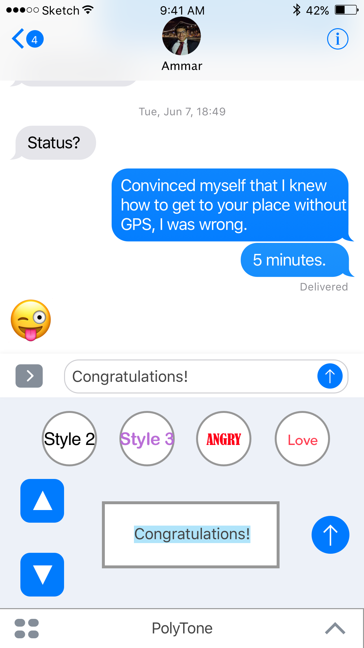
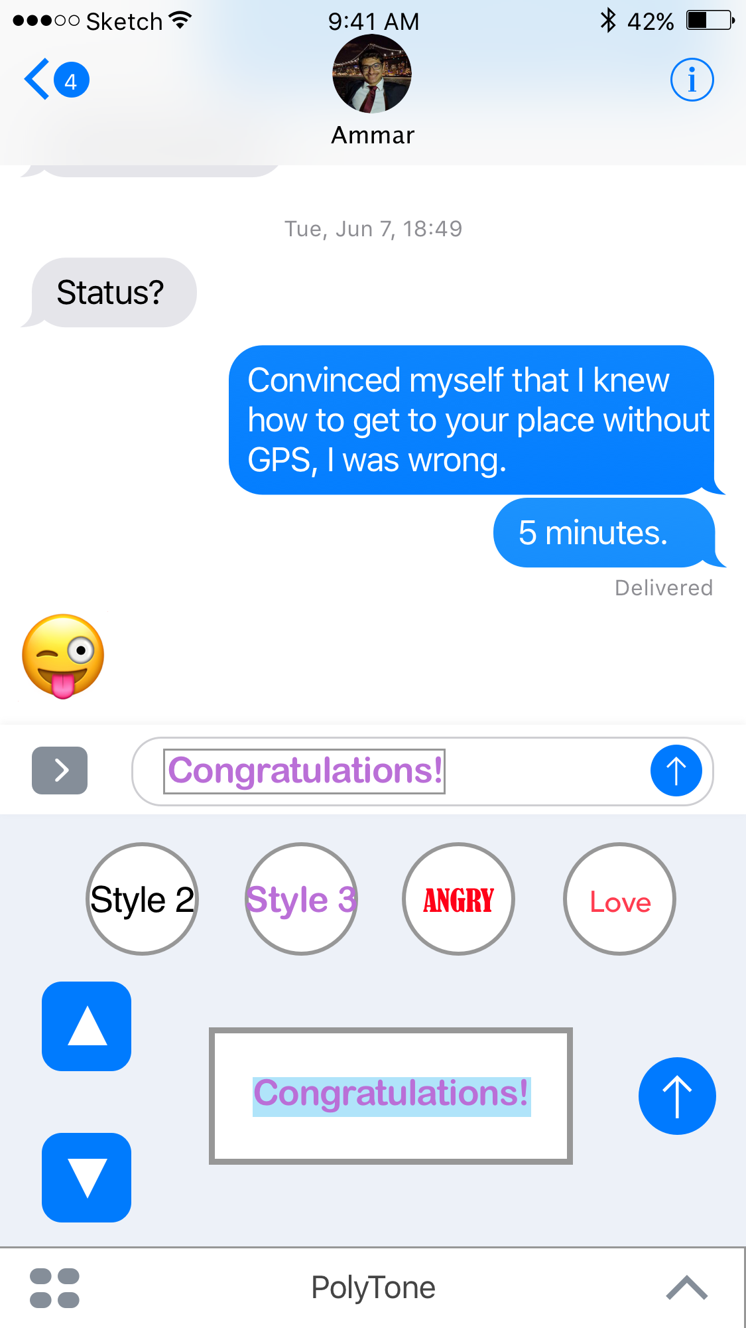
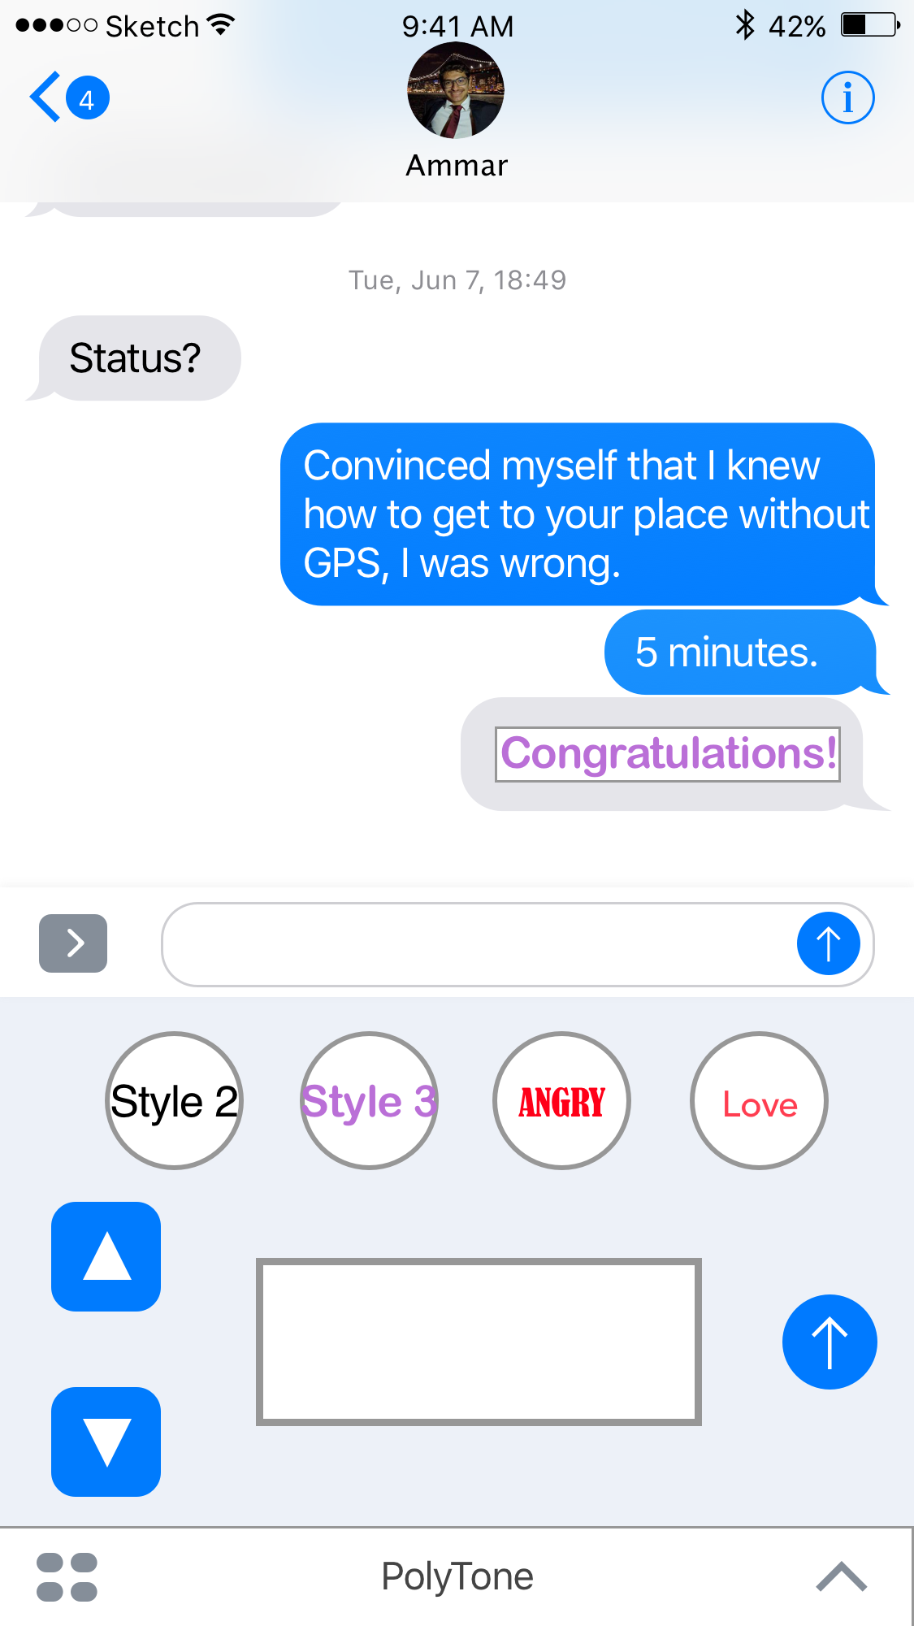
Task 3- iMessage (Complex)

Slide 21
Prototyping Overview

Slide 22
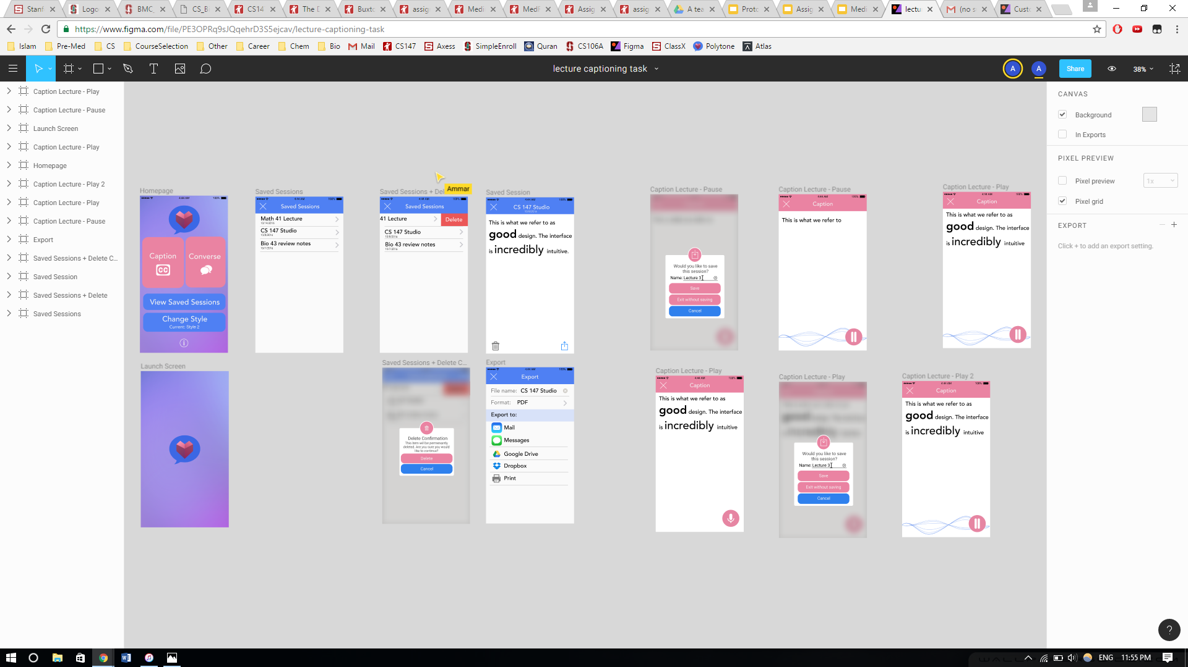
Tools Used: Figma + InVision

Slide 23
Figma: Pros and Cons
Pros (how it helped) | Cons (how it didn’t help)
Allows for collaborative work (multiple people working at a time) Easy to import from sketch Easy to export screens/ grouped items | Difficult to learn to use Difficult to piece images/fragments together Very slow compared to sketch Frequent issues with inserting text

Slide 24
InVision: Pros and Cons
Pros (how it helped) | Cons (how it didn’t help)
Does not need a tutorial to know how to use it Allows using a bunch of the most common gestures Allows different types of transitions Easy to embed into the website | Lack of interactivity (static frames) Sometimes mis-reading gestures

Slide 25
Limitations and Tradeoffs of Current Prototype
In a lot of cases we didn’t give the user a choice in what to do. He was guided.
The idea of med-fi is to show the user a sample of how the actual app might look like, and that does not require prototyping every choice.
Some of the transitions are not exactly how they’re gonna look like on the actual app.
The core concept of the app which is changing the style of font and customize it to convey emotions is not clear in the prototype, since it depends on voice recognition, which made it hard to prototype.

Slide 26
Wizard of Oz Techniques
We used Wizard of Oz techniques where we were supposed to do voice recognition.

Slide 27
Hard Coded Features and Why Required
All data used like different styles are hard coded.
It’s hard to allow adding in a med-Fi prototype
The captioning for lectures is just a text.
It’s not possible to do transcripting using invision.

Slide 28
Thank you

Slide 29
Additional Prototype Slides
Customization Feature:

Slide 30
Customization Feature Cont.

Slide 31
Sharing saved sessions

