Slide 1
Polytone
By ATeam

Slide 2
Overview
Mission Statement
Selected interface
Low-fi prototype
Task Flows
Method Results
UI Changes
Summary

Slide 3
Mission Statement
“Your voice is more than just words”

Slide 4
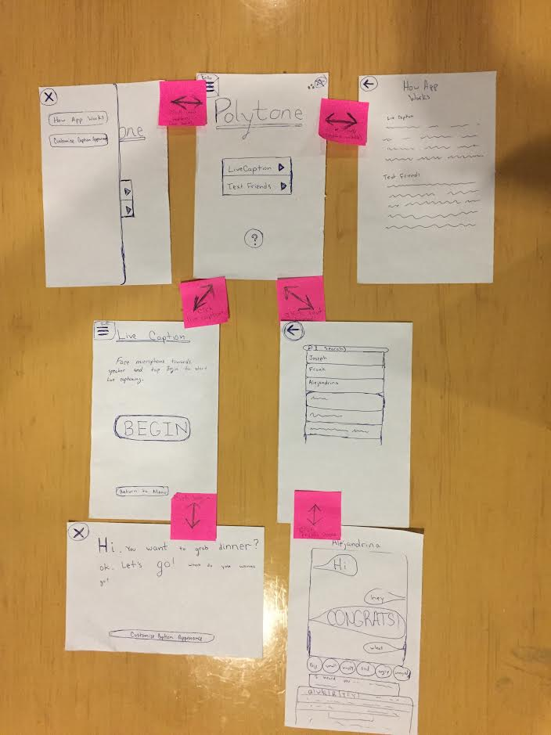
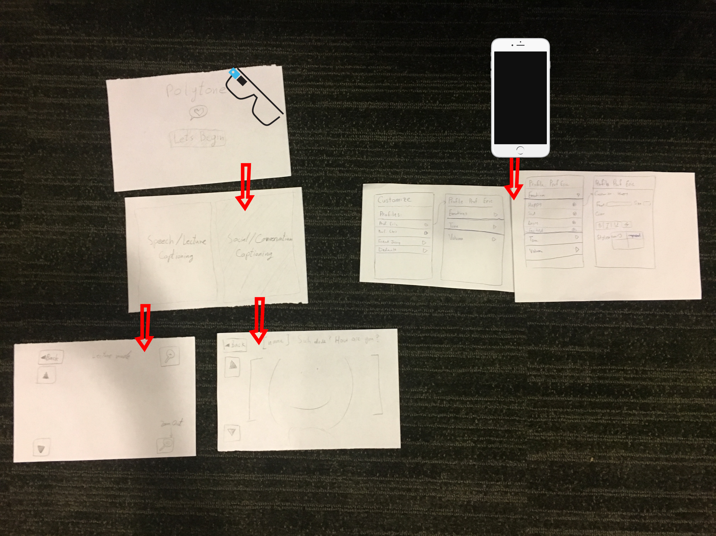
Selected Interface

Slide 5
 | Pros | Cons
Prototype 1 | Minimal UI Augments Reality | Stands out Not widely available Needs complementary UI on mobile
Prototype 2 | Accessible extension Very easy to learn and use with its familiar mobile UI More subtle as an assistive technology in class | Doesn’t greatly utilize augmented reality Complicated integration of different forms of verbal communication all in one form of text.

Slide 6
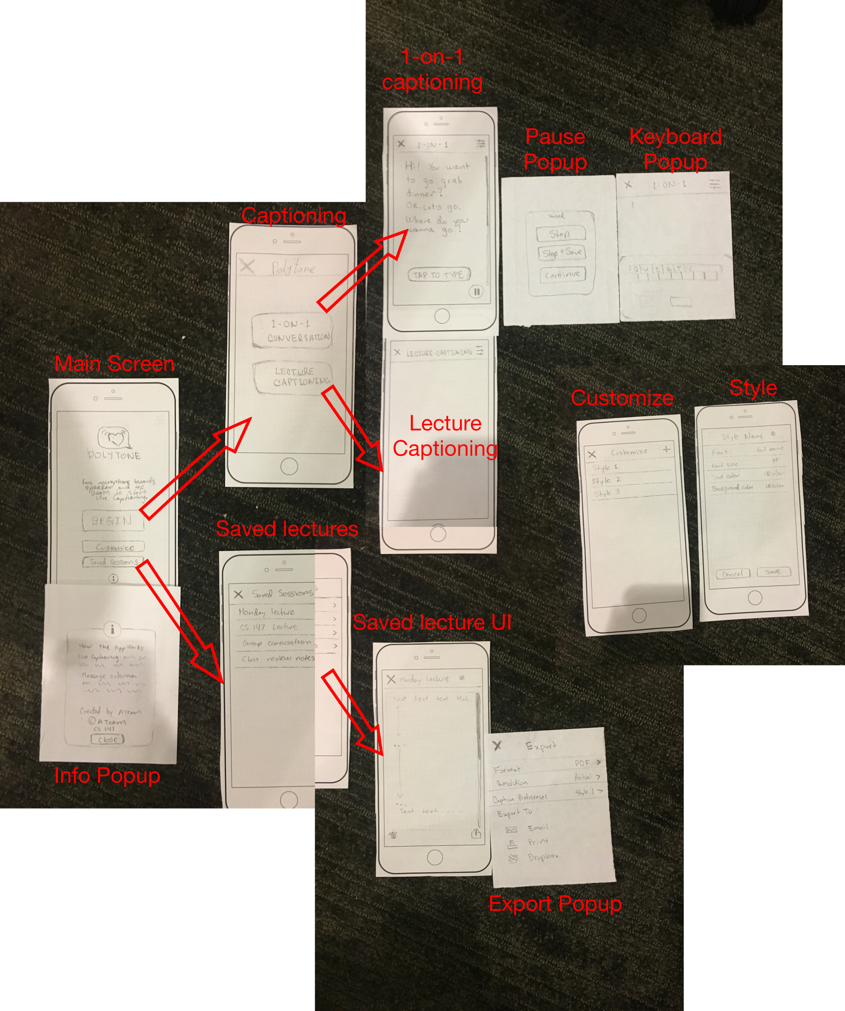
Prototype

Slide 7
Task Flows

Slide 8
Tasks
As a deaf student, I want to be able to visually understand tone, style, and volume of a lecture - simple.
I want to communicate with deaf people in 1-on-1 chats without the need to learn sign language - medium.
I want text to reflect my emotion and deliver it to other people so that they don’t necessarily need sound - complex.
As a teacher, I want to be able to able to easily add emotional meta-data that can be displayed visually to my verbal communication - complex.

Slide 9
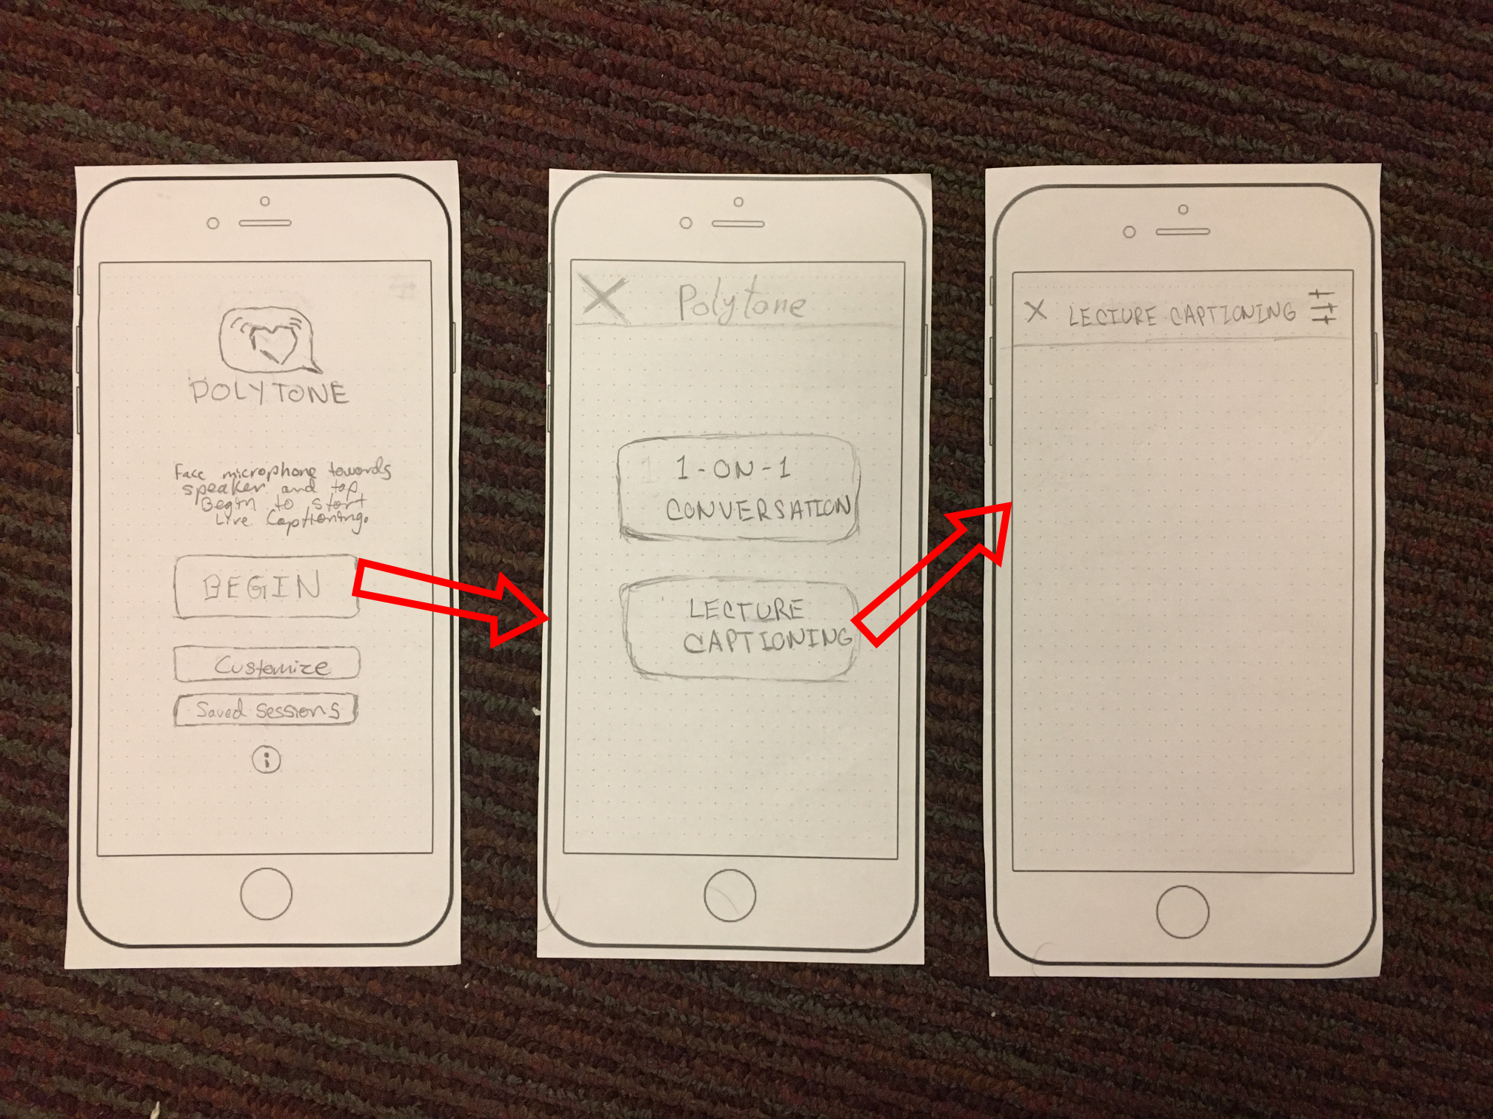
Task #1: As a deaf student, I want to be able to visually understand tone, style, and volume of a lecture - simple

Slide 10
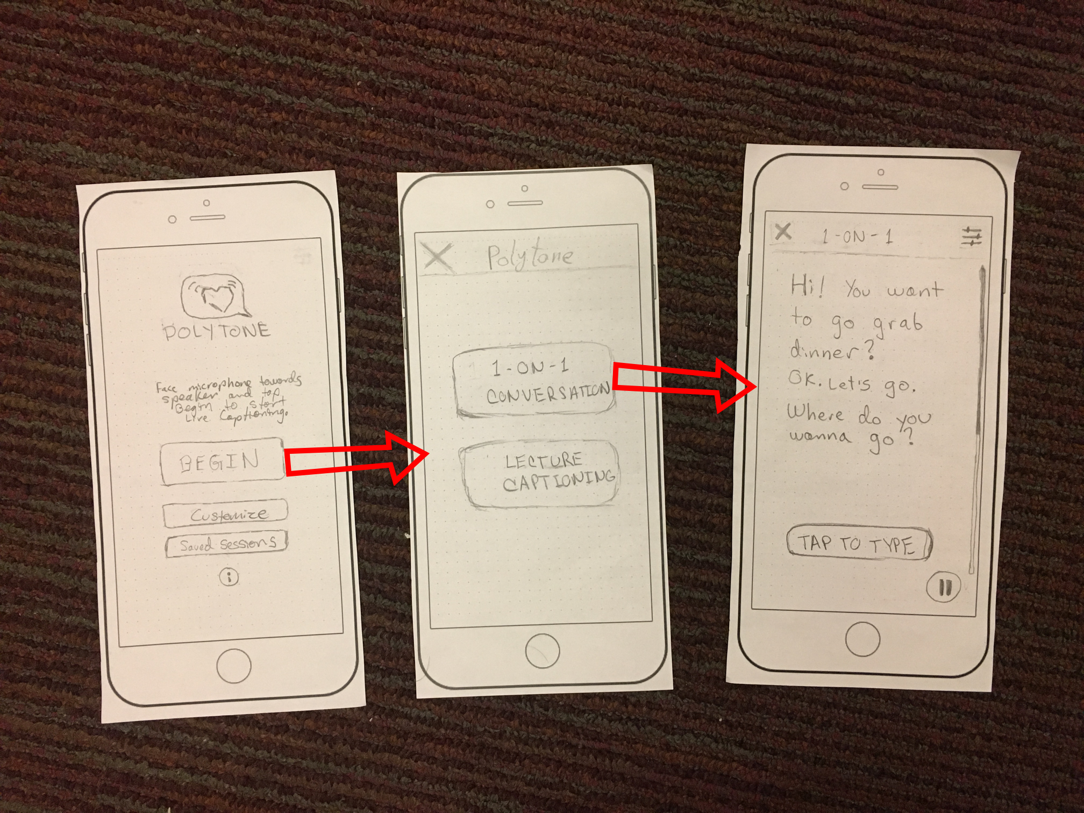
Task #2: I want to communicate with deaf people in 1-on-1 chats without the need to learn sign language - medium.

Slide 11
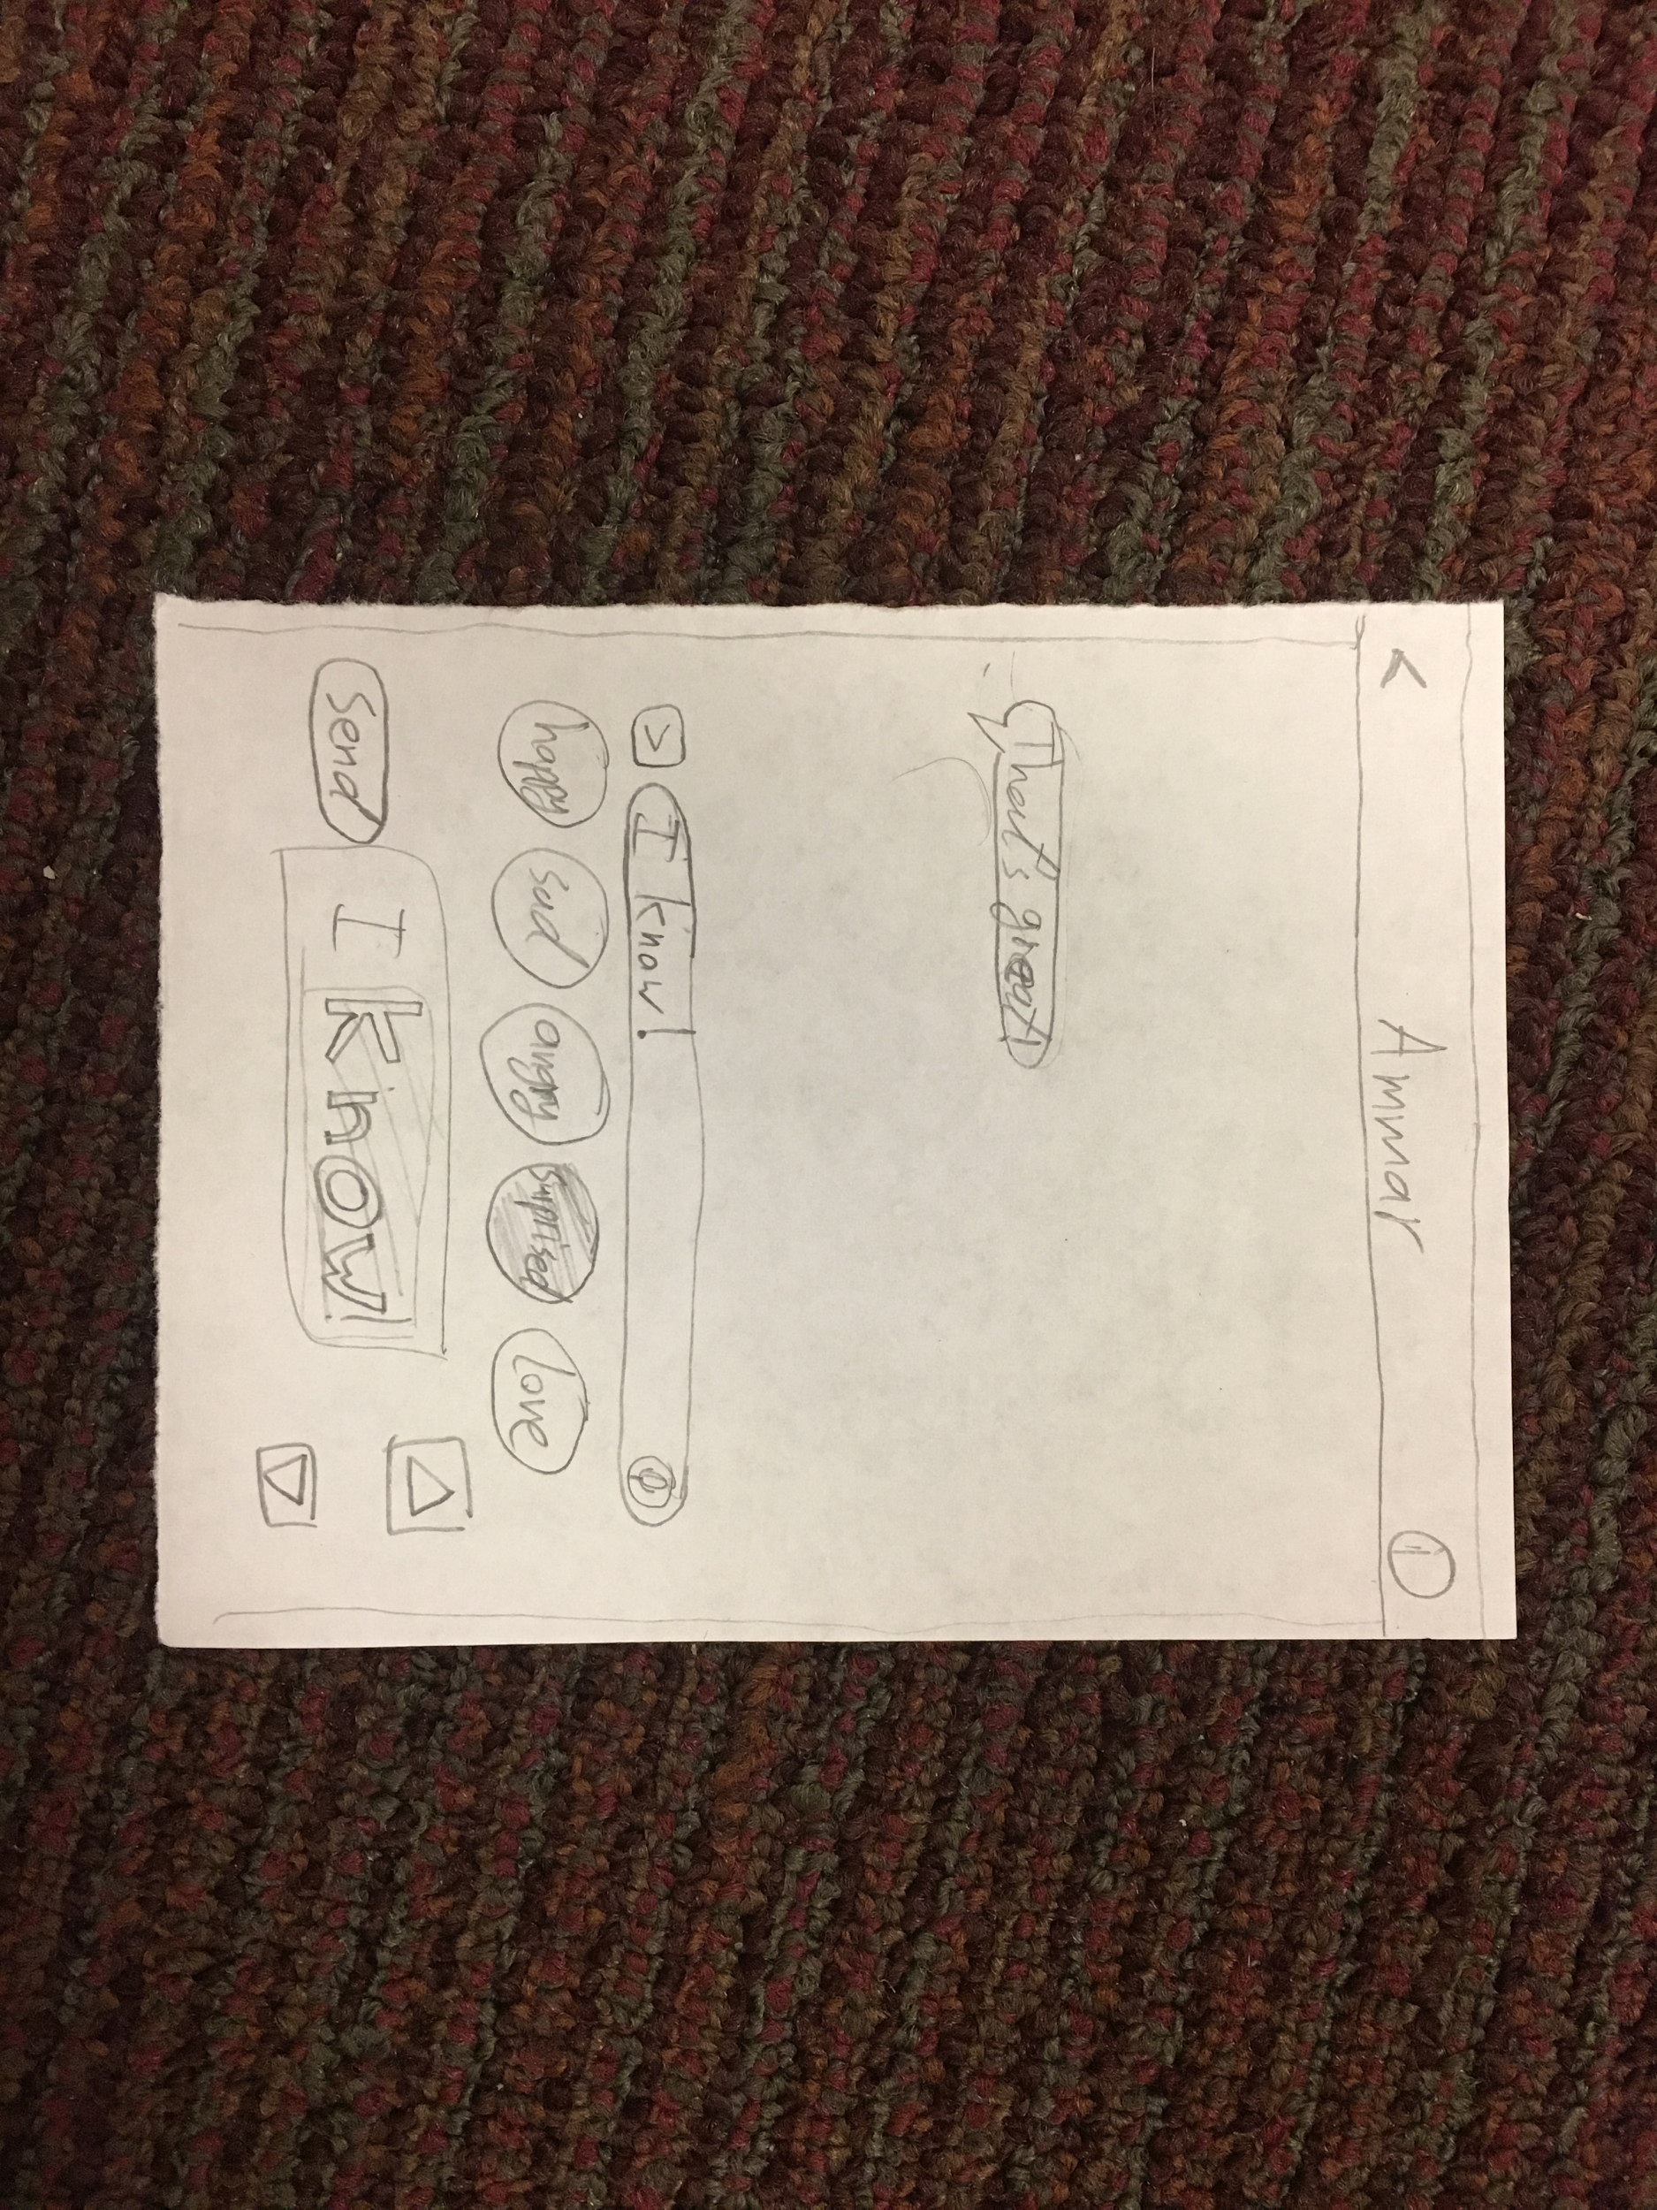
Task #3: I want text to reflect my emotion and deliver it to other people so that they don’t necessarily need sound - complex.

Slide 12
Experimental Method
Participants
Environment
Tasks
Procedure
Test Measures

Slide 13
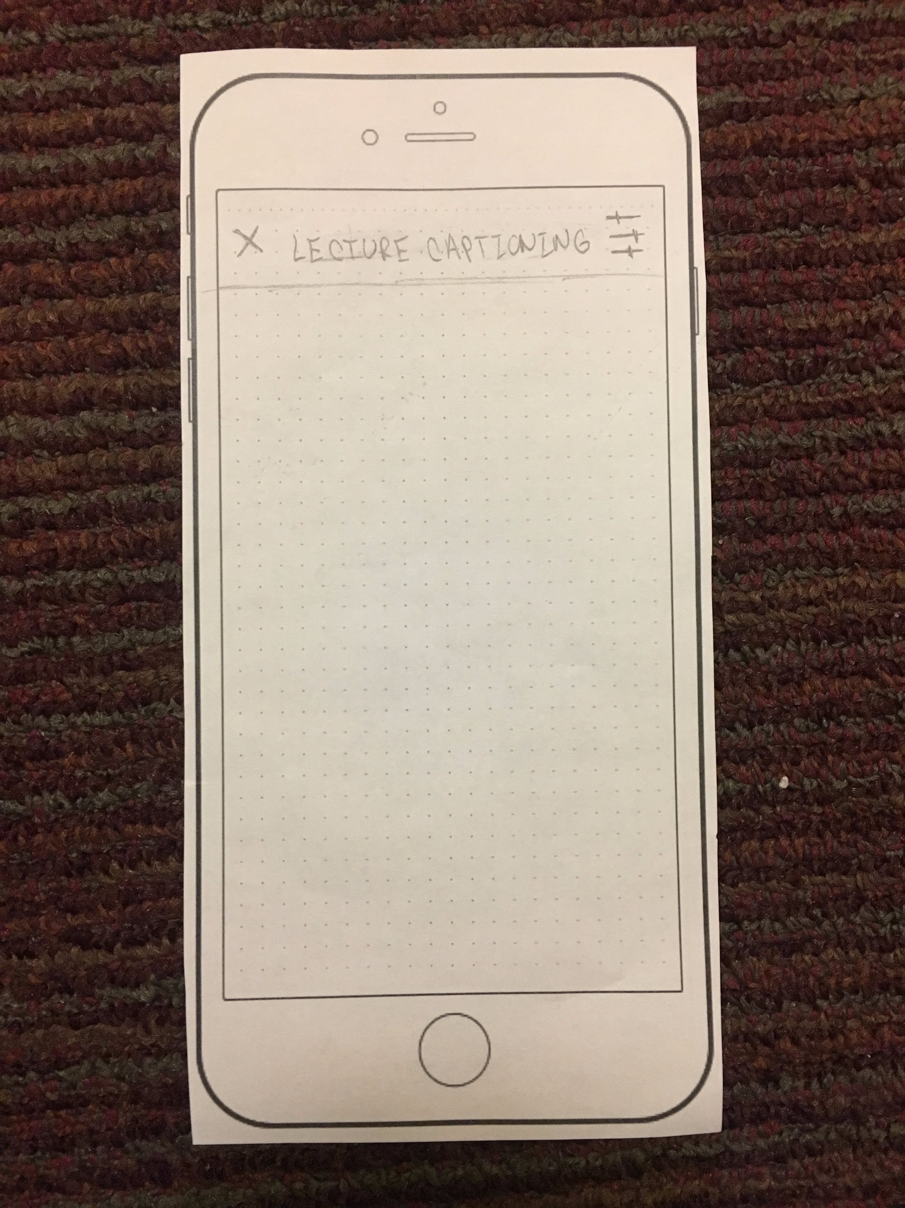
Experimental Results
Needed to pause transcripting lectures without exiting

Slide 14
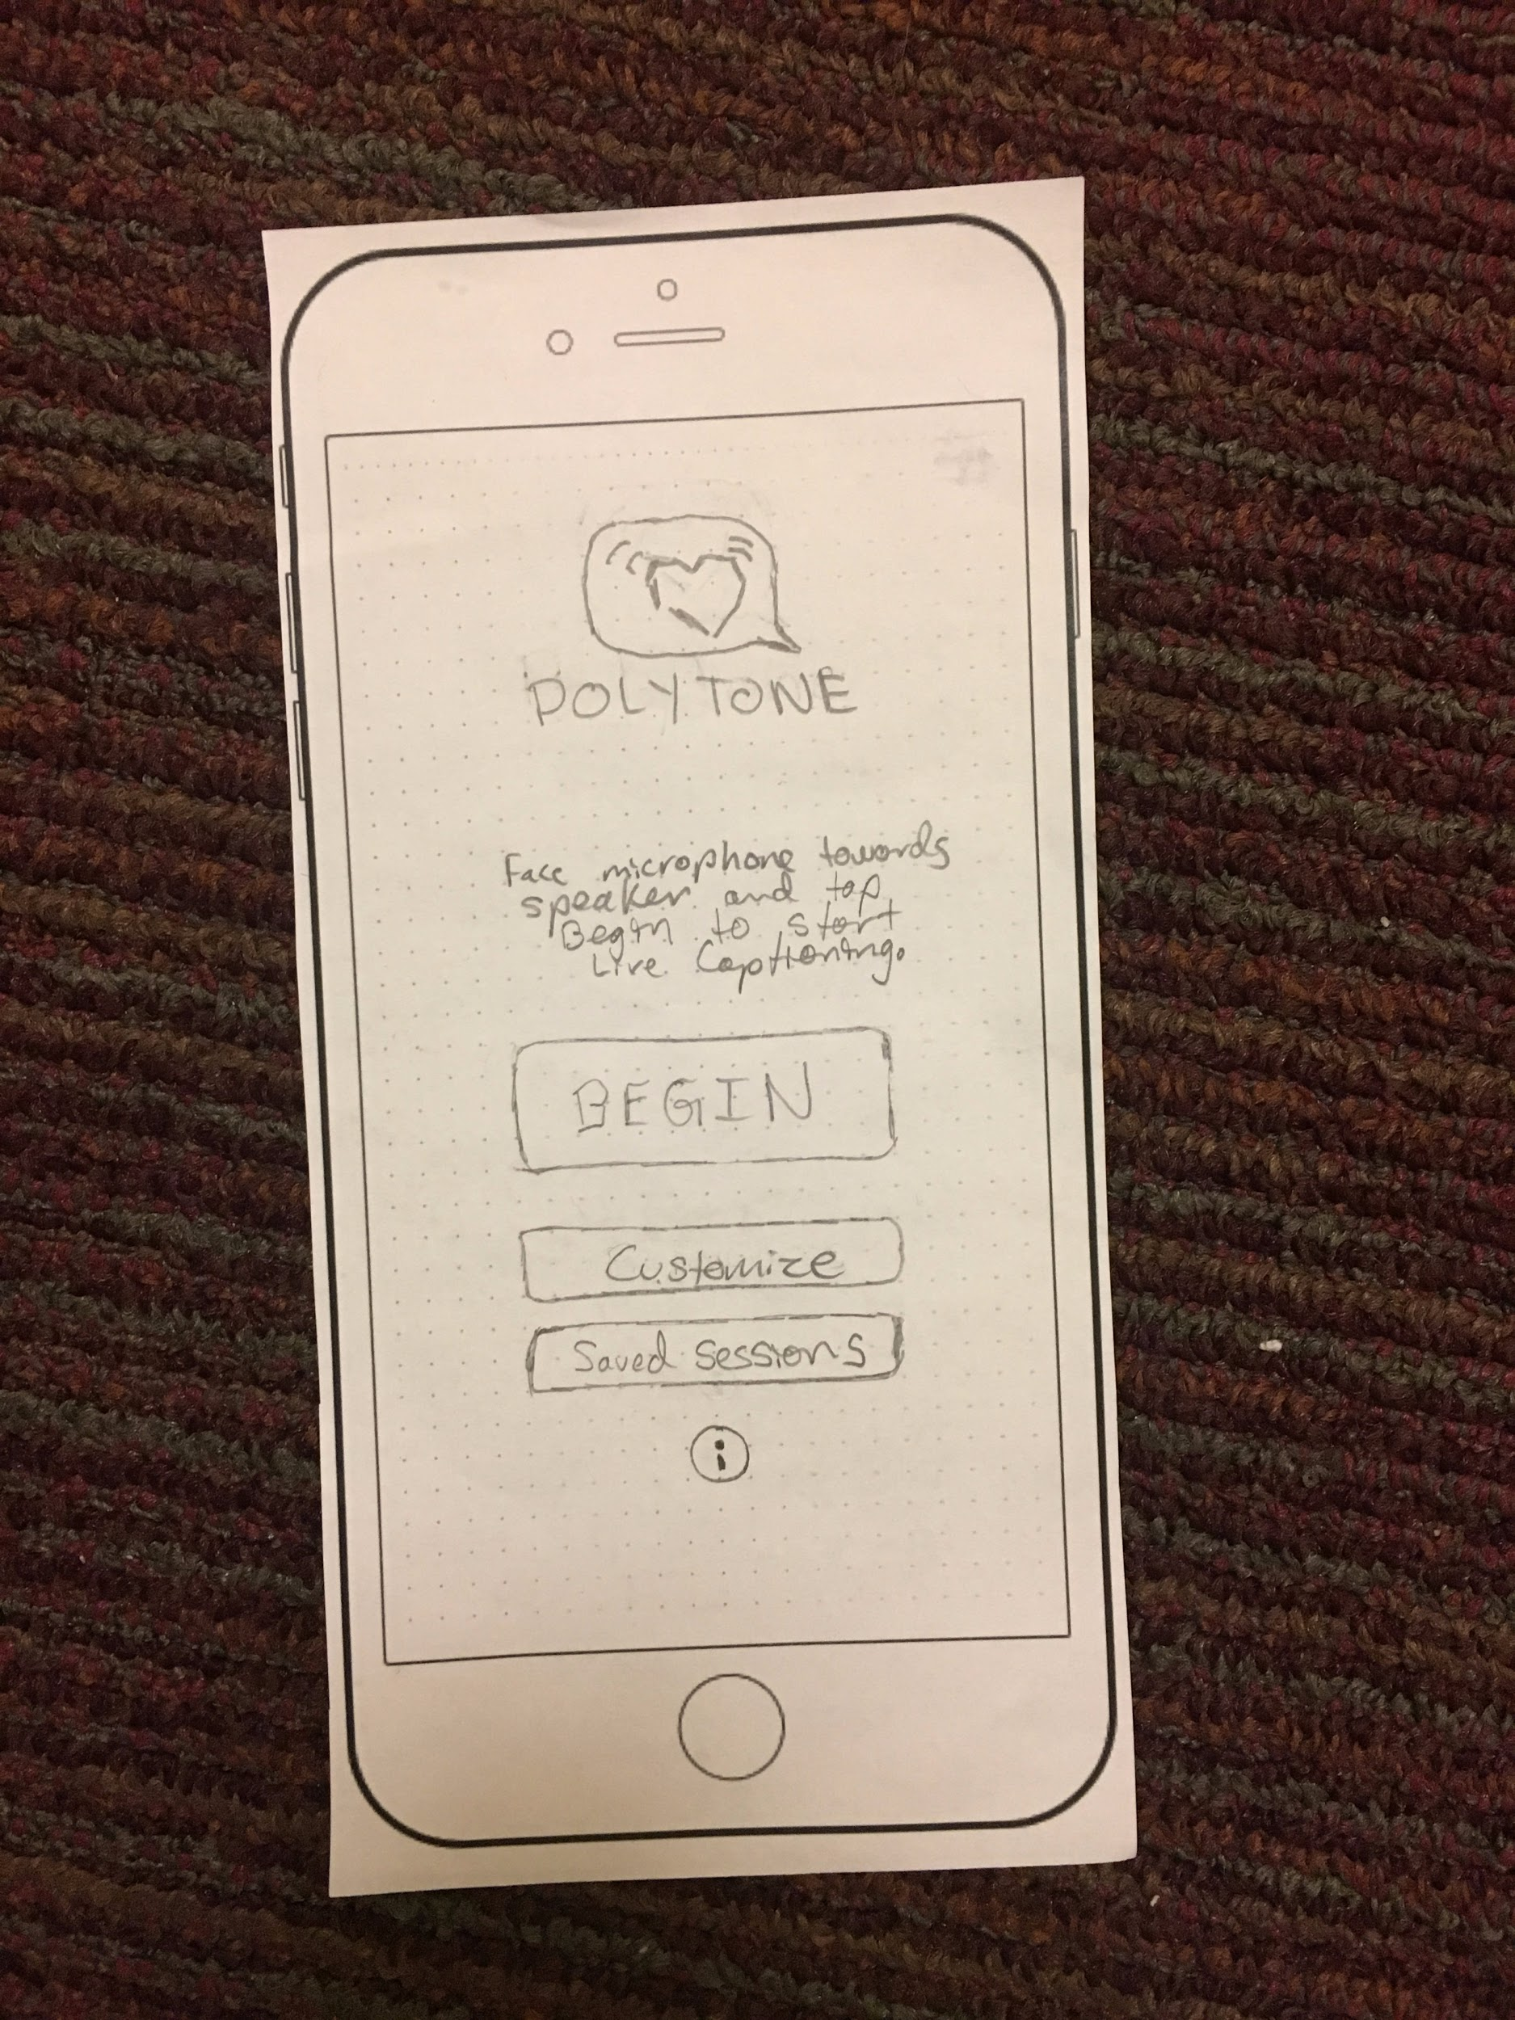
Experimental Results
Liked the cleanness, clearness and the easy navigation

Slide 15
Experimental Results
Likes the shortcuts that the extension provides

Slide 16
Experimental Results
Was concerned about mistakenly hitting the exit button, and deleting everything.
Preferred text populating and scrolling instead of swapping text

Slide 17
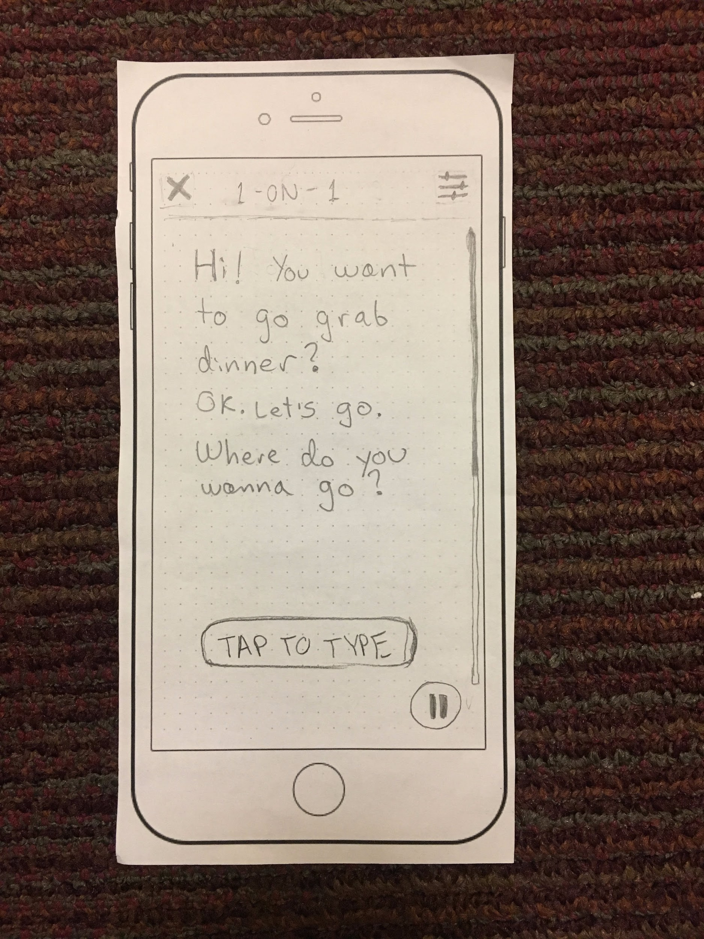
Experimental Results
Not sure if the division is necessary

Slide 18
Experimental Results
Was confused with the fact that you have to navigate all the way back to share a lecture rather than sharing it directly here

Slide 19
Experimental Results
Expressed concerns with how accurate current speech recognition software would be in correctly and accurately recognizing what is said.

Slide 20
UI Changes
Add a pause button to lecture captioning
Add a share button to lecture captioning
Add a pop-up before exiting

Slide 21
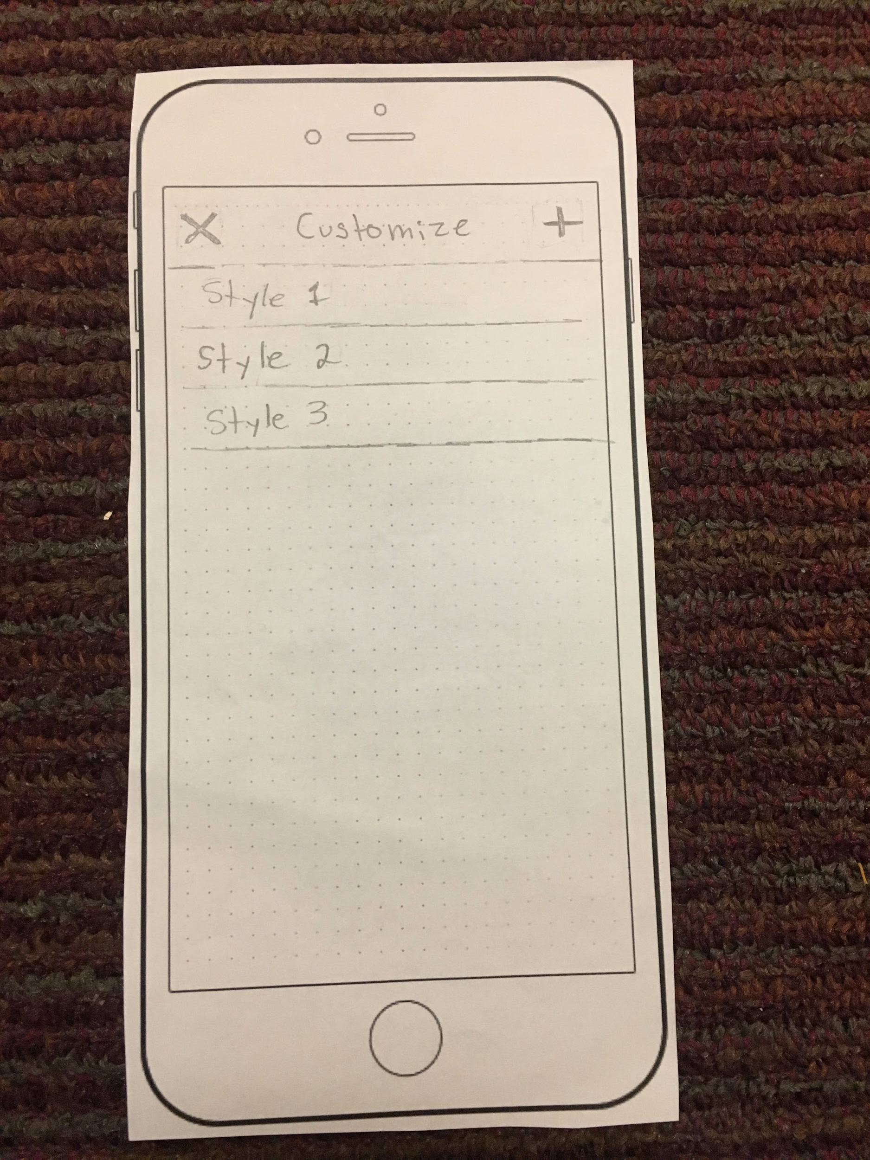
UI Changes
Enabling deleting saved styles simply by sliding

Slide 22
UI Changes
Asking the user to set up his default style right after tutorial instead of having the same default for the every user

Slide 23
UI Changes
The ability to scroll back through text that has been already transcripted

Slide 24
Summary

Slide 25
Thank you

Slide 26
Deleted Slides

Slide 27
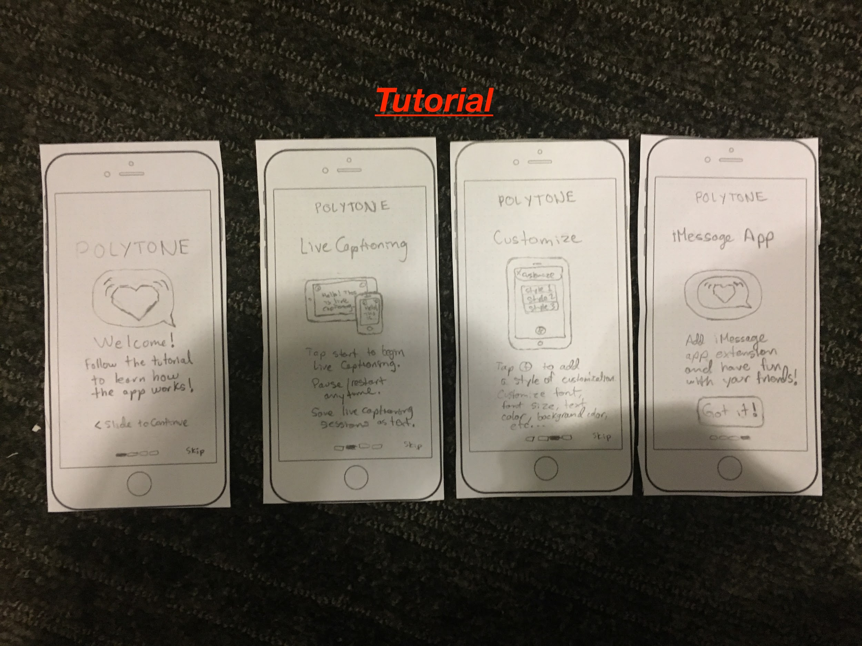

Slide 28
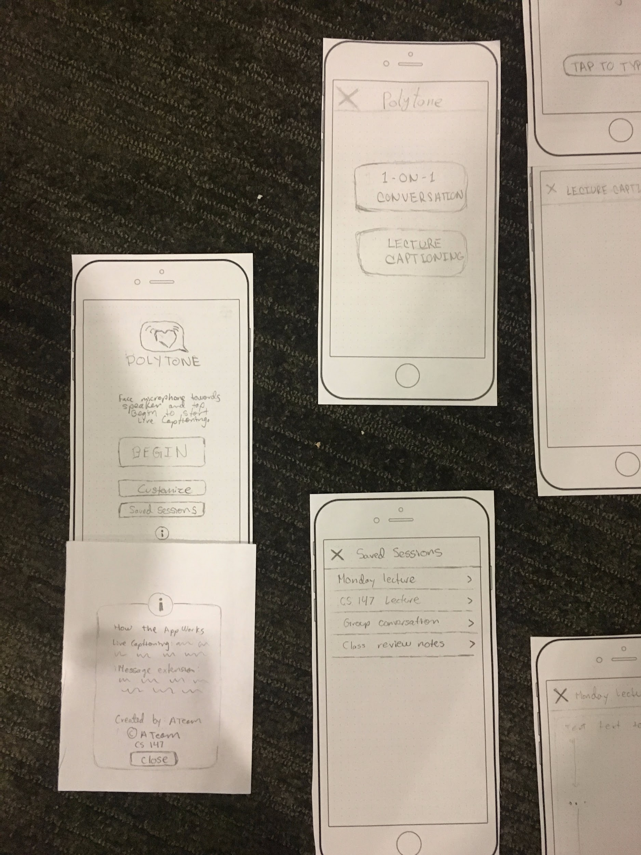
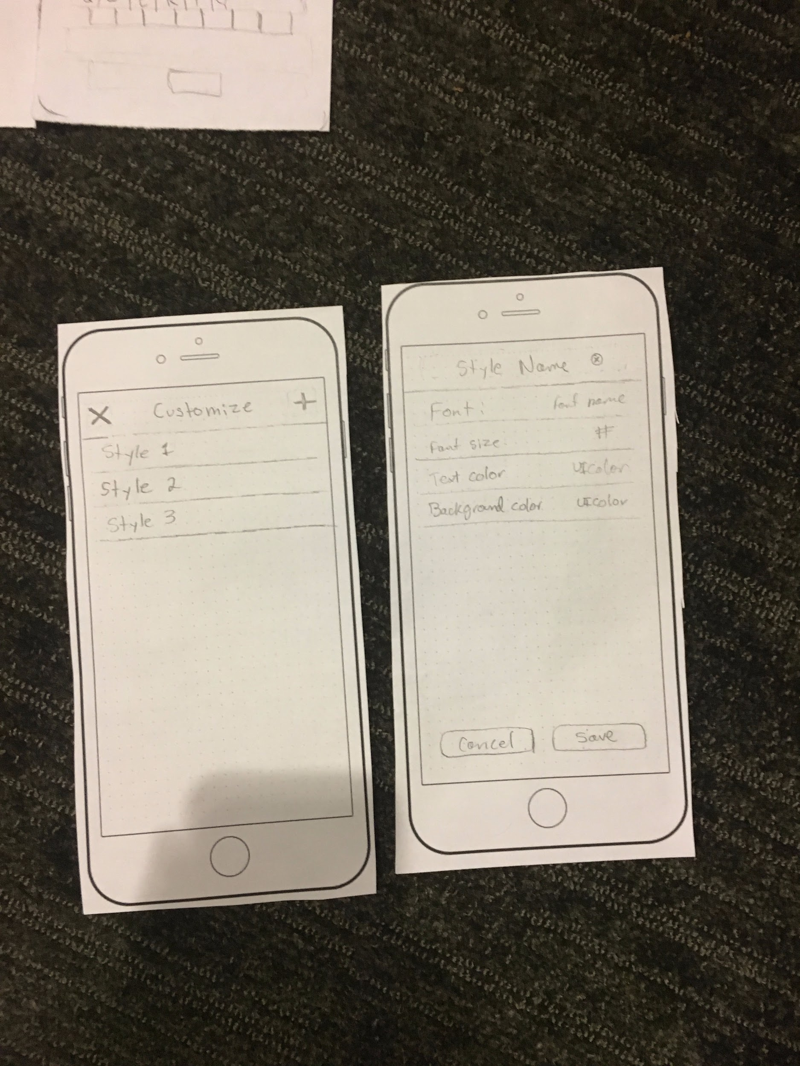

Slide 29
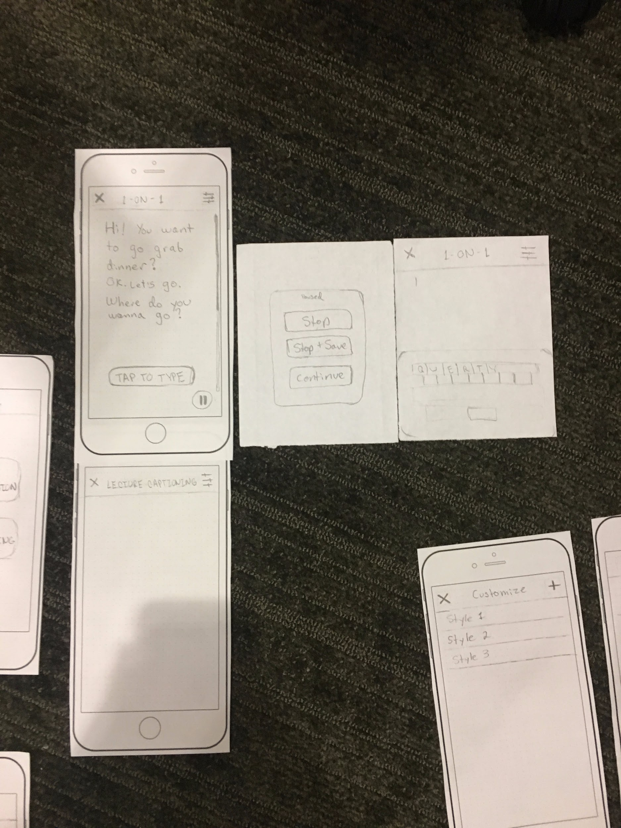
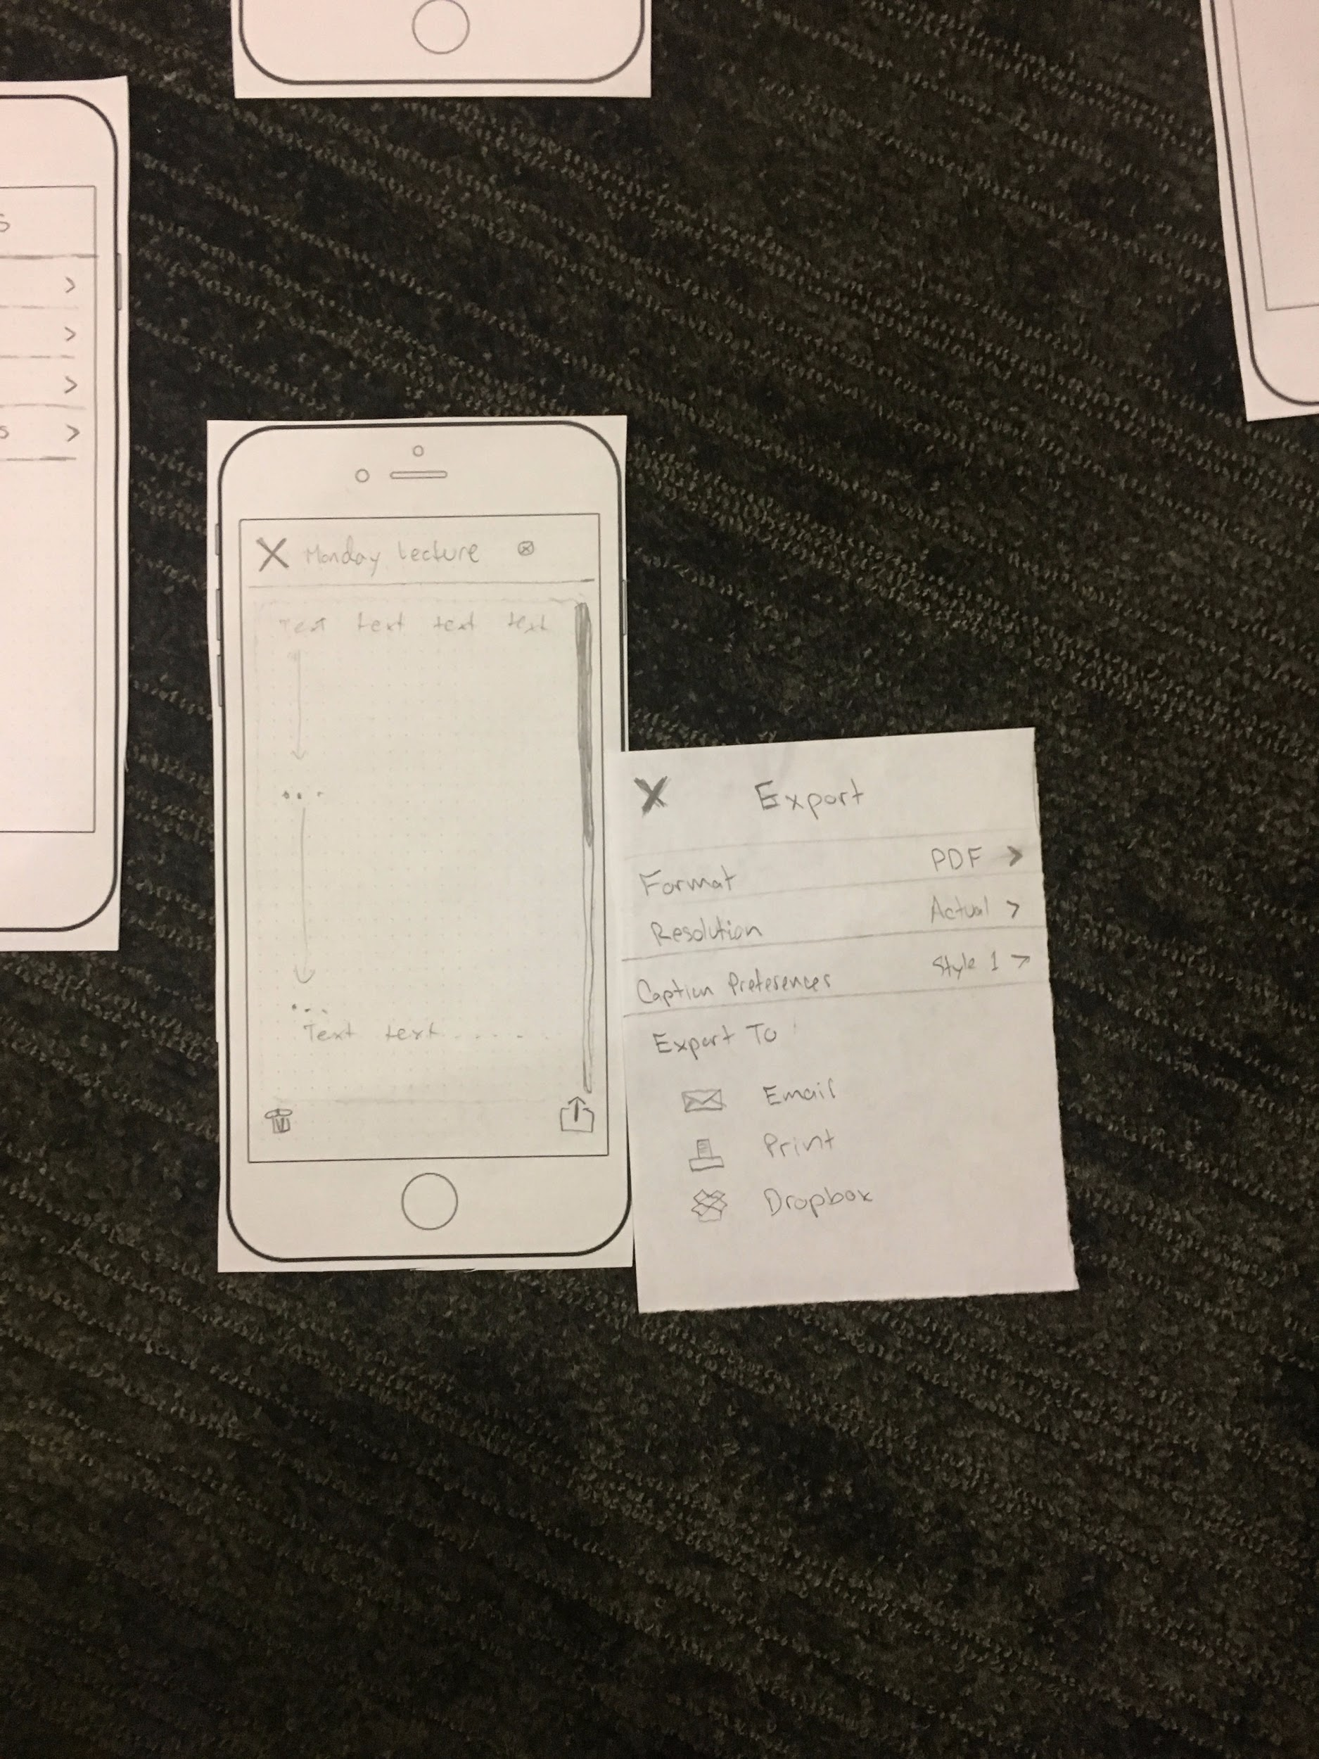

Slide 30
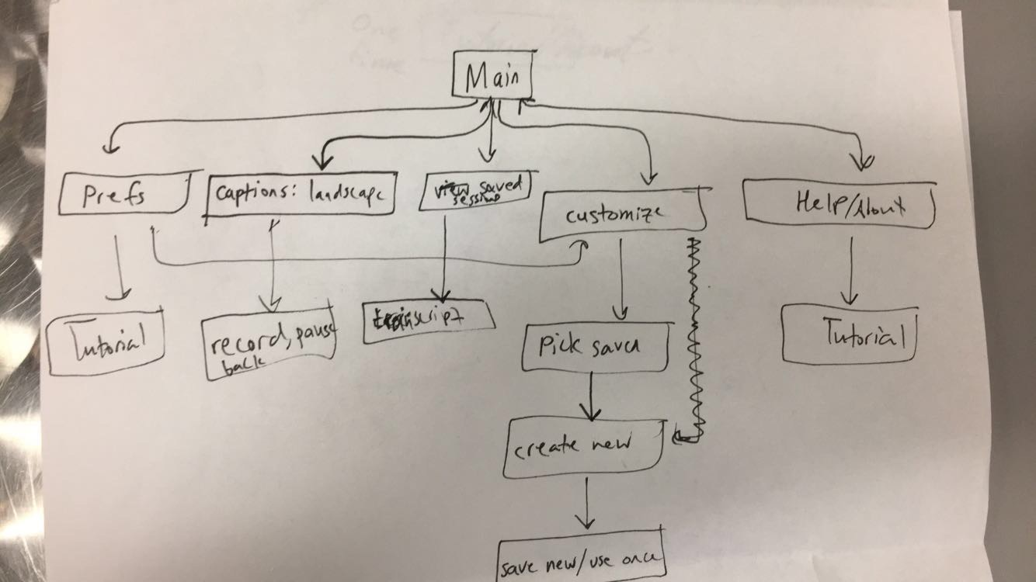
Workflow

