Slide 1
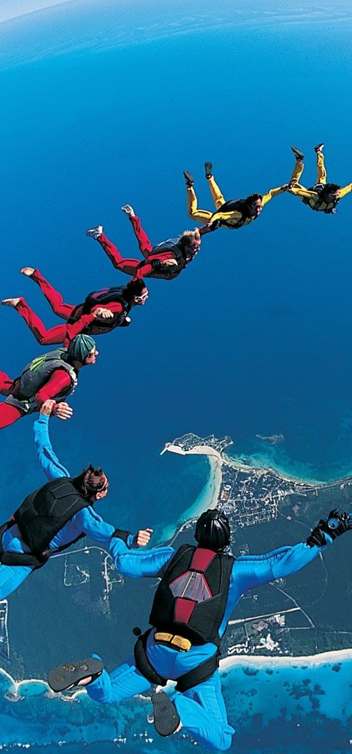
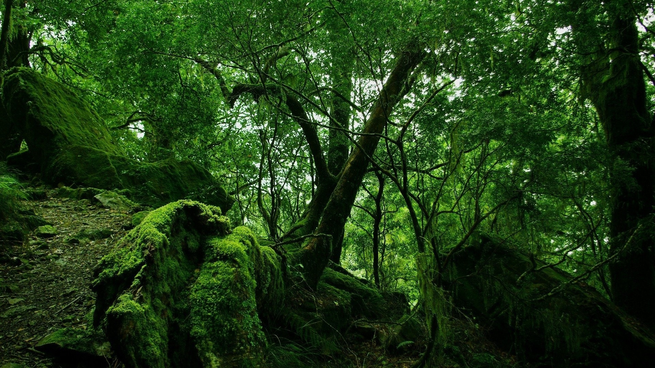
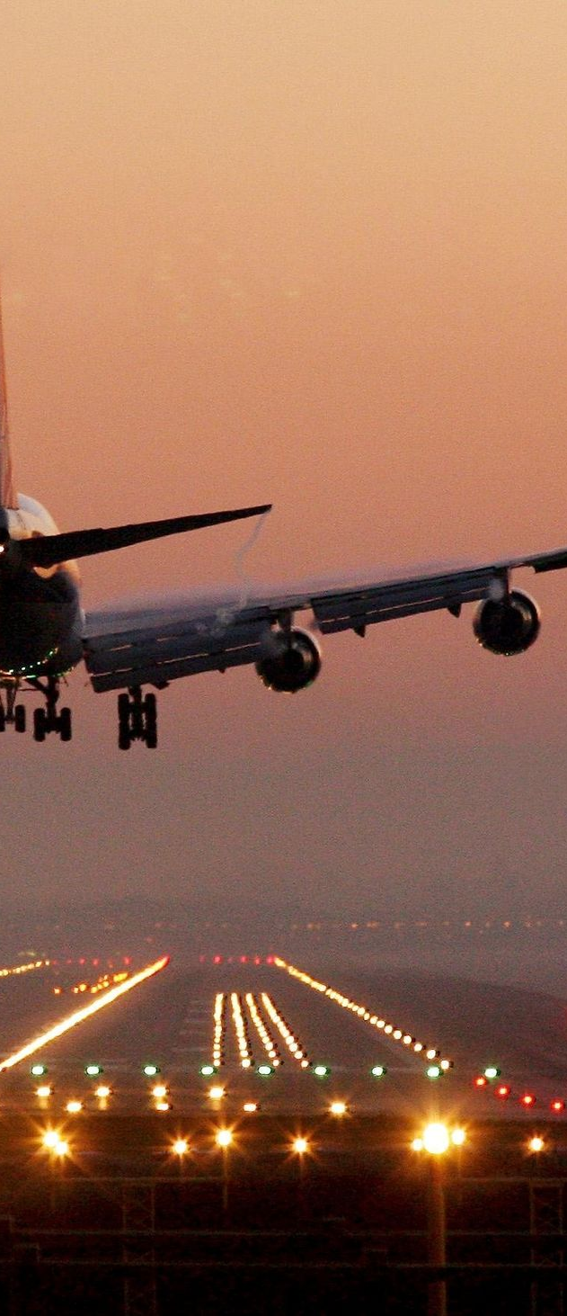
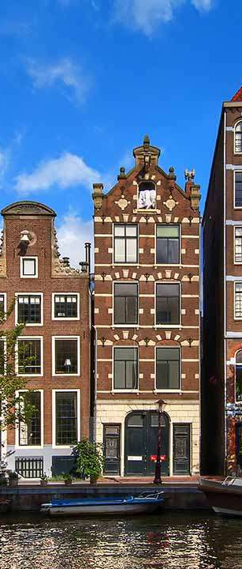

Slide 2
TACKLING TRAVEL
[ M I C R O ] A D V E N T U R E
Notes:
Intro: We’ll be talking about the POVs gained from needfinding, and how we answered those POVs with experience prototypes.

Slide 3

Introduction
Initial POV
Additional Needfinding Results
Revised POVs
Top HMWs
Experience Prototypes
Summary

Slide 4
Introduction
Initial POV
Additional Needfinding Results
Revised POVs
Top HMWs
Experience Prototypes
Summary

Slide 5
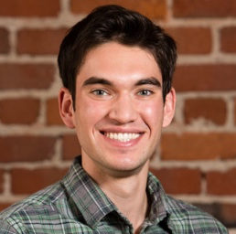
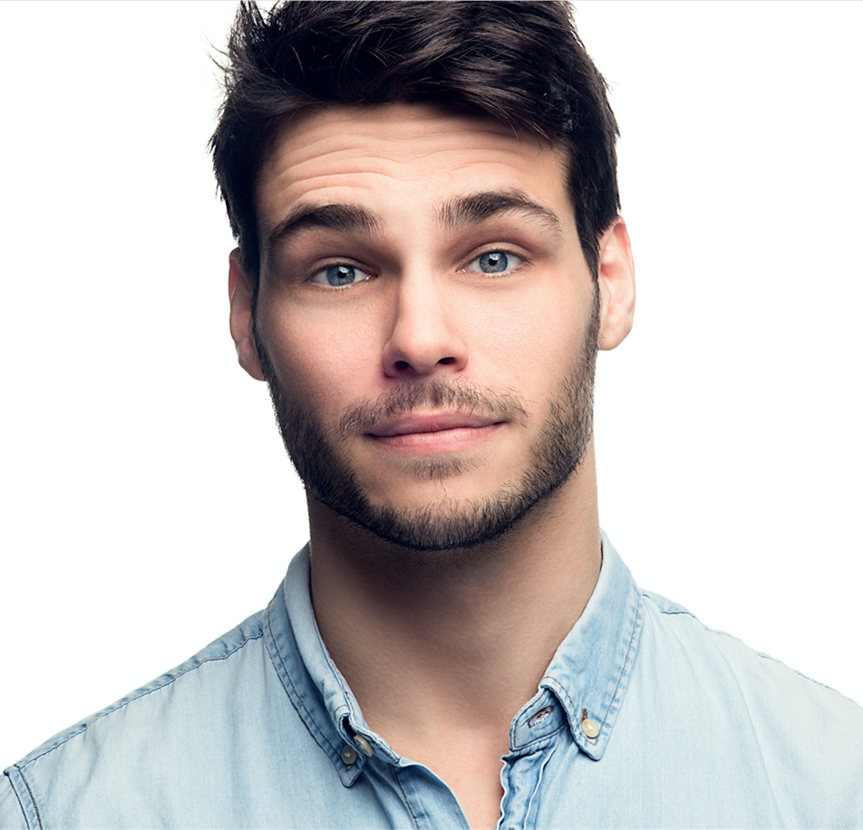
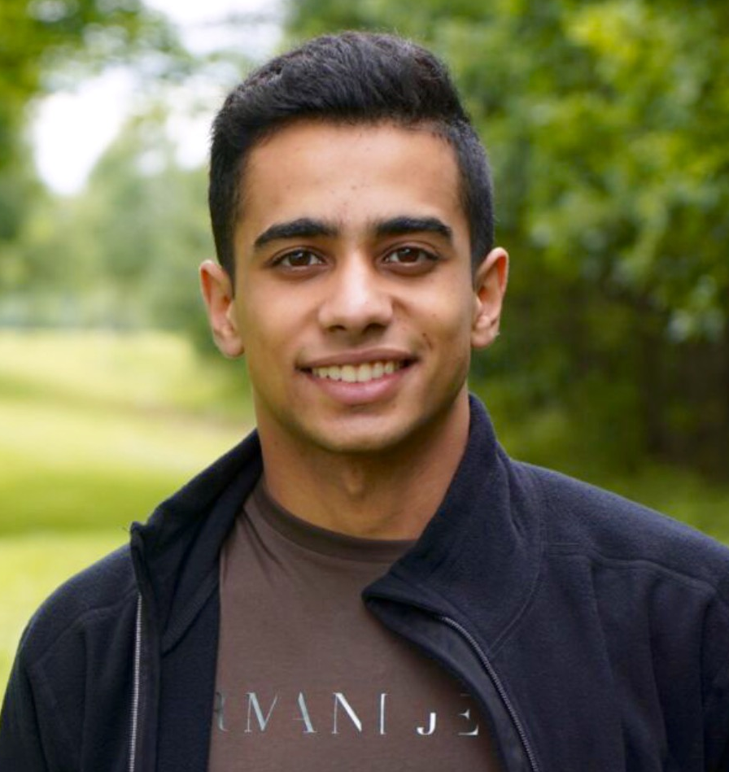
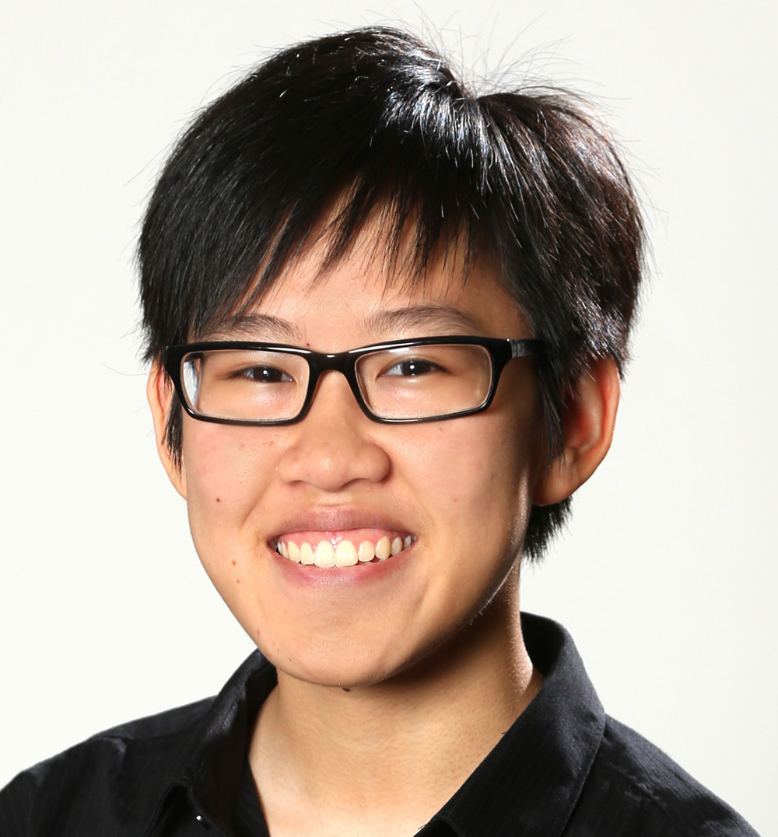
O U R T E A M
Alex Alexandre Basel Kim

Slide 6

O U R P R O B L E M D O M A I N
Decreasing the negative and burdensome aspects of traveling
Notes:
What we noticed from our interviews was that the act of adventuring narrowed down to TRAVELING
Traveling itself is never the most important part of an adventure; people always talk about the destination/goal
How can we make it ‘part of the adventure’

Slide 7
Introduction
Initial POV
Additional Needfinding
Revised POVs
Top HMWs
Experience Prototypes
Summary

Slide 8
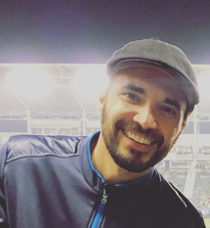
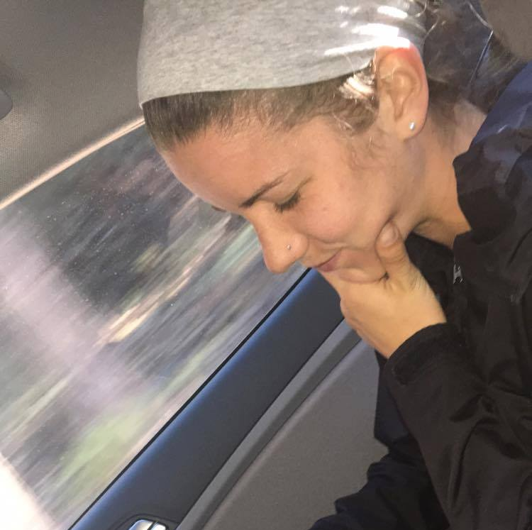
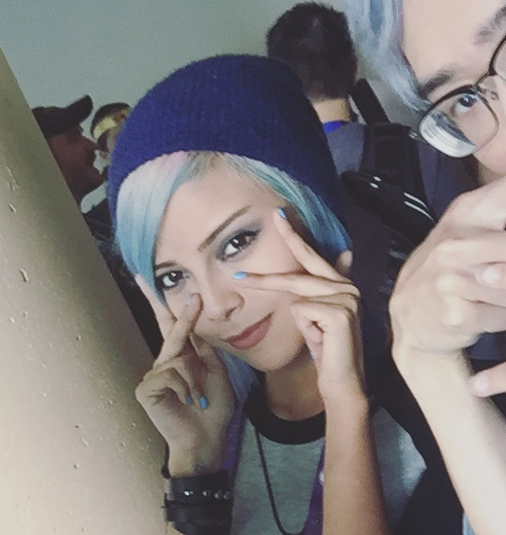
I N I T I A L P O V
WE MET a man who traveled often for business
WE WERE AMAZED to learn there was a hyperbolic ‘curve of excitement’ for traveling over time, and that he found traveling burdensome rather than exciting
IT WOULD BE GAME CHANGING to increase the length of ‘upward excitement’ or to prevent the ‘downhill disillusionment’ of traveling
Notes:
Man who traveled for business taught us the PARABOLIC curve of ‘enjoyment’ of traveling. Is there a way to extend positive aspect

Slide 9

Introduction
Initial POV
Additional Needfinding
Revised POVs
Top HMWs
Experience Prototypes
Summary

Slide 10
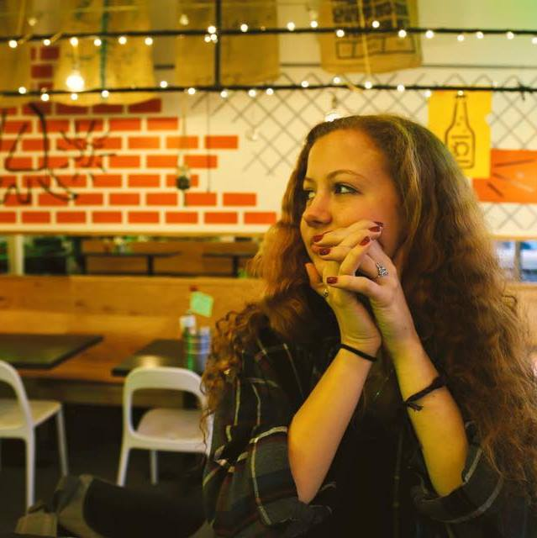
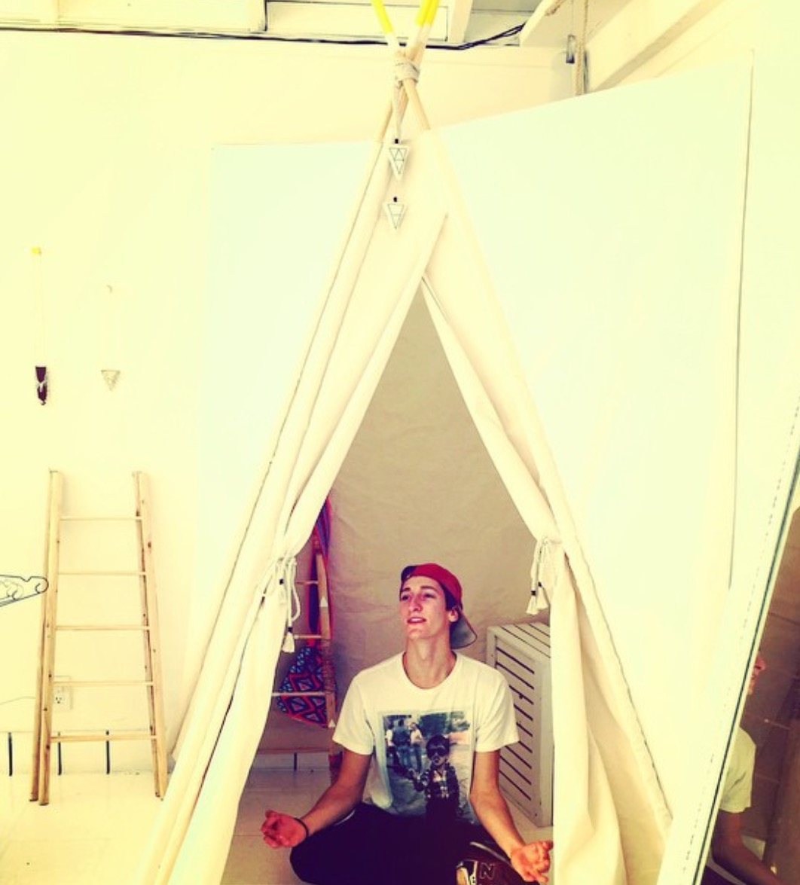
O U R P A R T I C I P A N T S
Angelica Matthew

Slide 11
M A T T H E W
T H E T R A V E L E N T R E P R E N E U R
WHO Actor and entrepreneur
WHY Gives us a unique perspective, does needfinding on travel himself
HOW Goes to the same gym as a mutual friend
WHERE Originally from Venice, LA but now living in NYC

Slide 12
M A T T H E W
T H E T R A V E L E N T R E P R E N E U R
WE DISCOVERED that he likes the ‘unknowns’ of travelling, but dislikes the concept of planning to travel (finding a place to stay, transport, etc.)
HE WISHES for tons of luck. “Sometimes you're traveling and everything just falls into place so perfectly and sometimes every single thing goes wrong.”
“I don't especially like anything that limits spontaneity.”
Notes:
Matthew: you have to know everything about your trip before you even go on it -- SO WHERE’S THE UNKNOWN?

Slide 13
A N G E L I C A
T H E N O N – T R A V E L L E R
WHO Freelance artist
WHY Another unique perspective – someone who is unlikely to benefit from our solution
HOW Stranger we met on the street
WHERE Amsterdam

Slide 14
A N G E L I C A
T H E N O N – T R A V E L L E R
WE DISCOVERED that she dislikes traveling because she
always feels like a foreigner wherever she goes
SHE WANTS to discover her own world that she’s living in. It’s too much of a hassle for her to discover it elsewhere
“It’s like you’re always a foreigner,
I don’t need more of this feeling in my life.”
Notes:
Angelica feels like she’s already discovering more about the world where she is; doesn’t feel obligated to travel to discover the world.

Slide 15

Introduction
Initial POV
Additional Needfinding Results
Revised POVs
Top HMWs
Experience Prototypes
Summary
Notes:
FROM THIS additional needfinding and results from last week, we extrapolated new POVs.

Slide 16
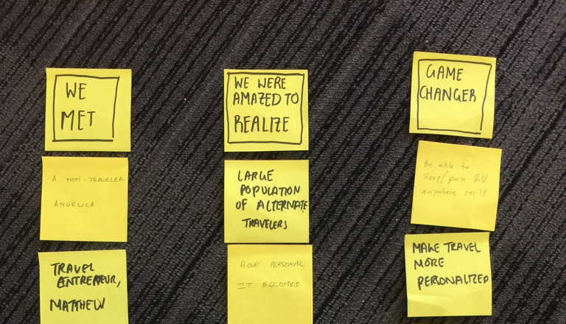
B R A I N S T O R M I N G

Slide 17
W H Y P R O T O T Y P E
Feasible, quick to mock up and compile for individuals
Took advantage of locations (i.e. Amsterdam trip)

Slide 18



P O V I
WE MET a casual traveler
WE WERE AMAZED to learn that she preferred going to places that were off the beaten path
IT WOULD BE GAME CHANGING to compile a list of places near you that are small, exclusive, & unique to a location

Slide 19


P O V II
WE MET an extreme traveler
WE WERE AMAZED to learn that she spends a lot of time planning her next steps
IT WOULD BE GAME CHANGING if you could easily be told exactly what to do and where to go and know you will have a good time

Slide 20


P O V III
WE MET a person interested in history and culture
WE WERE AMAZED to learn that she just manually googled information about the places she visited
IT WOULD BE GAME CHANGING to easily give people an intimate understanding of the culture and history of the place they are visiting

Slide 21

Introduction
Initial POV
Additional Needfinding Results
Revised POVs
Top HMWs
Experience Prototypes
Summary

Slide 22
H O W M I G H T W E X
Tell people what’s interesting around them anywhere they go? I
Cater cultural information to people’s specific interests? III
Compile all interesting, relevant information into an easy to use package? III
C L A S S I F I E D B Y P R O T O T Y P E
Notes:
HMW 1: Like Yelp, but for general categories of ‘cool’, ‘fun’, ‘weird’ places to go
HMW 2: People want to learn more about new things; how can we promote history/education when traveling?
HMW 3: Travel Wikipedia -- quick, easy info about a location allows ease of access.

Slide 23

Introduction
Initial POV
Additional Needfinding Results
Revised POVs
Top HMWs
Experience Prototypes
Summary

Slide 24
E X P E R I E N C E P R O T O T Y P E S

Slide 25
P R O T O T Y P E I

Slide 26
P R O T O T Y P E I
GOAL Decrease boredom and wasted time during moments of travel (ie. in a car, train) by providing interesting fun facts and relevant information along the way to the destination
ASSUMPTIONS People do actually get bored in these moments, and they’re usually considered wasted time

Slide 27
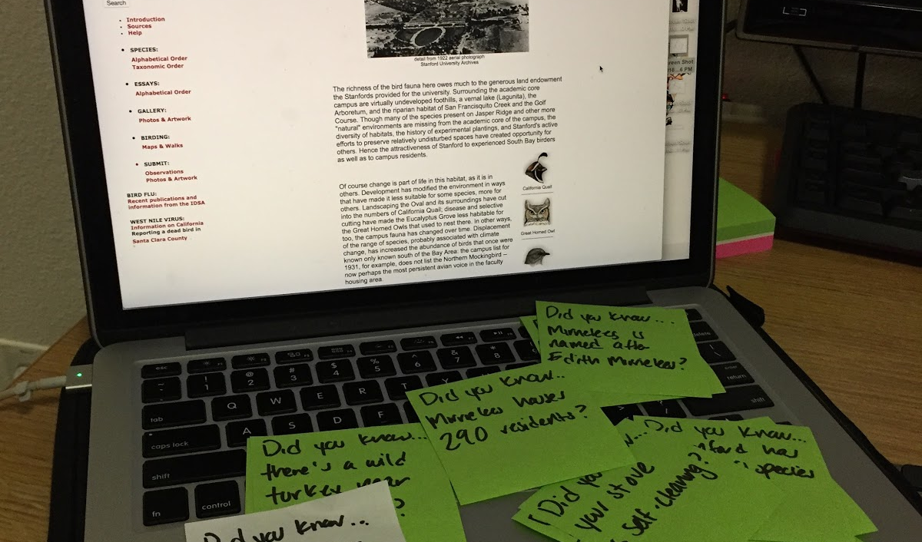
P R O T O T Y P E I

Slide 28
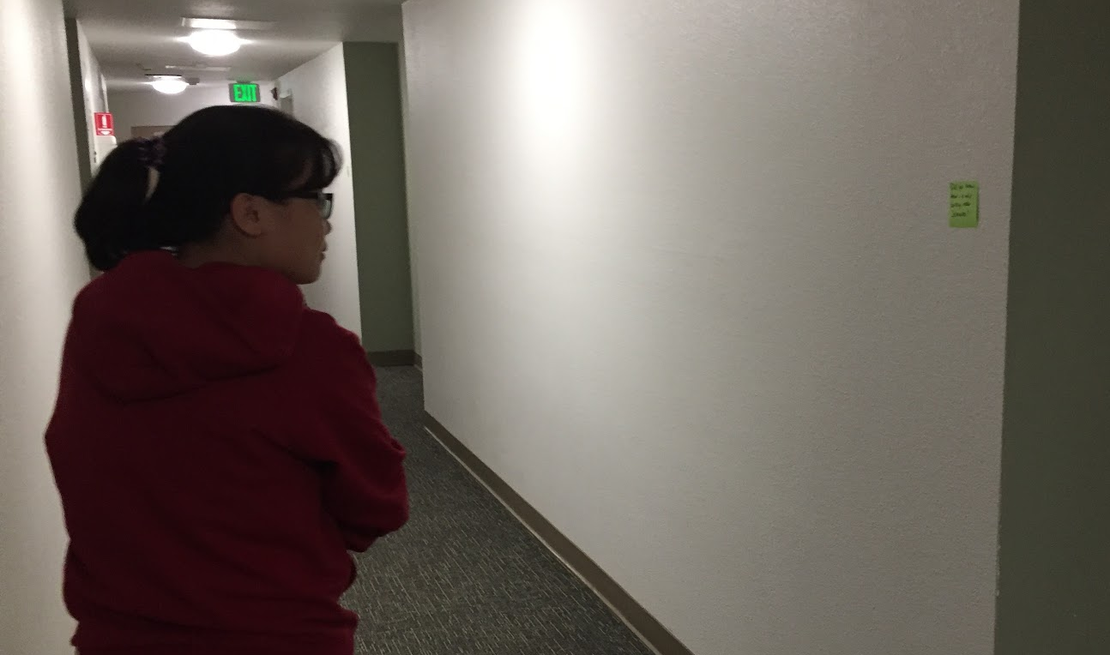
P R O T O T Y P E I

Slide 29
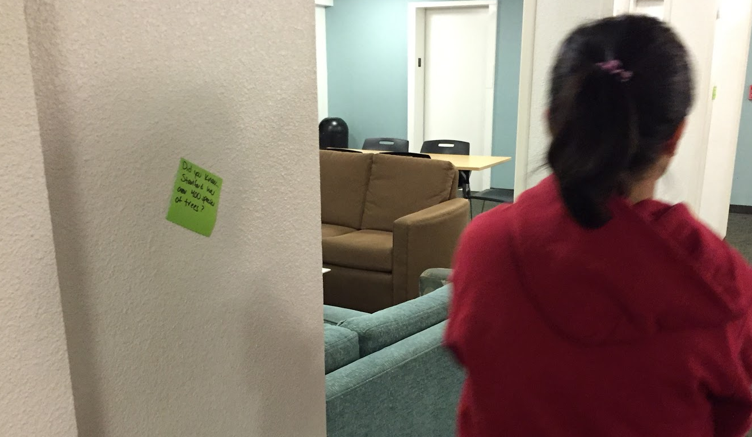
P R O T O T Y P E I

Slide 30
P R O T O T Y P E I
WHAT WORKED Short fun facts kept act of moving through a space interesting and motivated users to keep moving
WHAT DIDN’T WORK Users felt obligated to explore ALL sticky notes, users followed the sticky notes instead of ‘traveling’ to a set destination
WE LEARNT People like brief facts if on the move. People tend to explore open spaces and don’t explore narrow paths. People follow what they see
VALIDITY Assumption is false in this case; people can multitask when traveling
Notes:
Things that didn’t work: (wouldn’t be able to do this if you had unlimited facts about a place),
EXPLAIN: How creation worked, who it was used on

Slide 31
P R O T O T Y P E II

Slide 32
P R O T O T Y P E II
GOAL Personally cater and tell a user of activities to do around them, tailored to their interests, but with a touch of spontaneity
ASSUMPTIONS Travelers enjoy spontaneity, and are open to random suggestions and are willing to go through with these suggestions

Slide 33
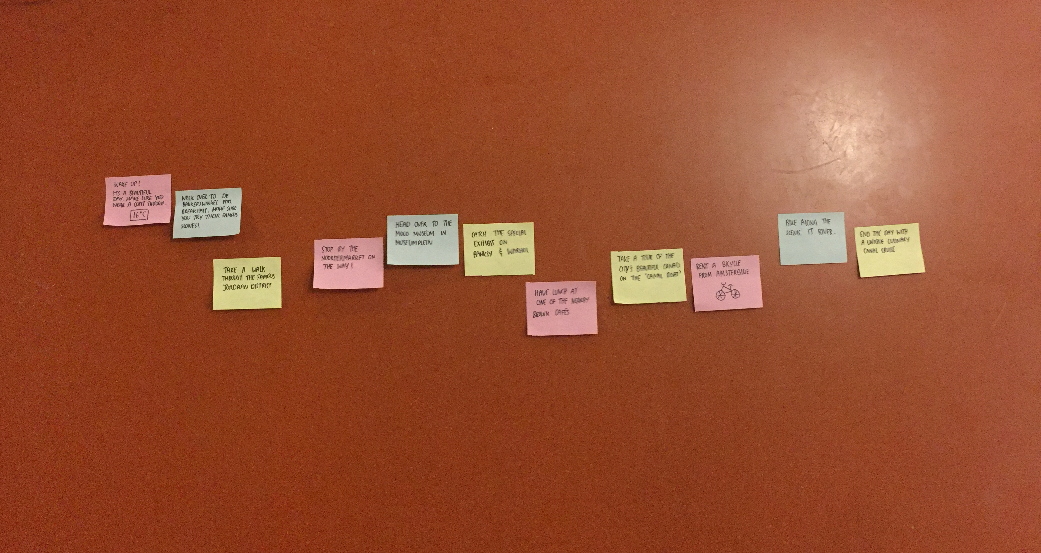
P R O T O T Y P E II

Slide 34
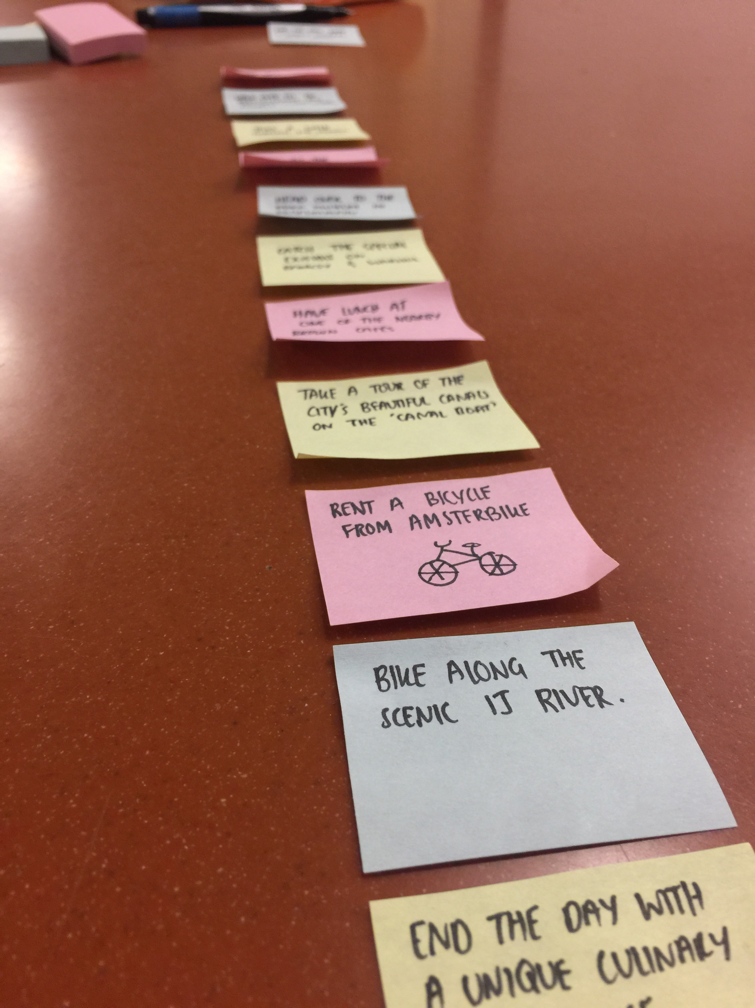
P R O T O T Y P E II

Slide 35
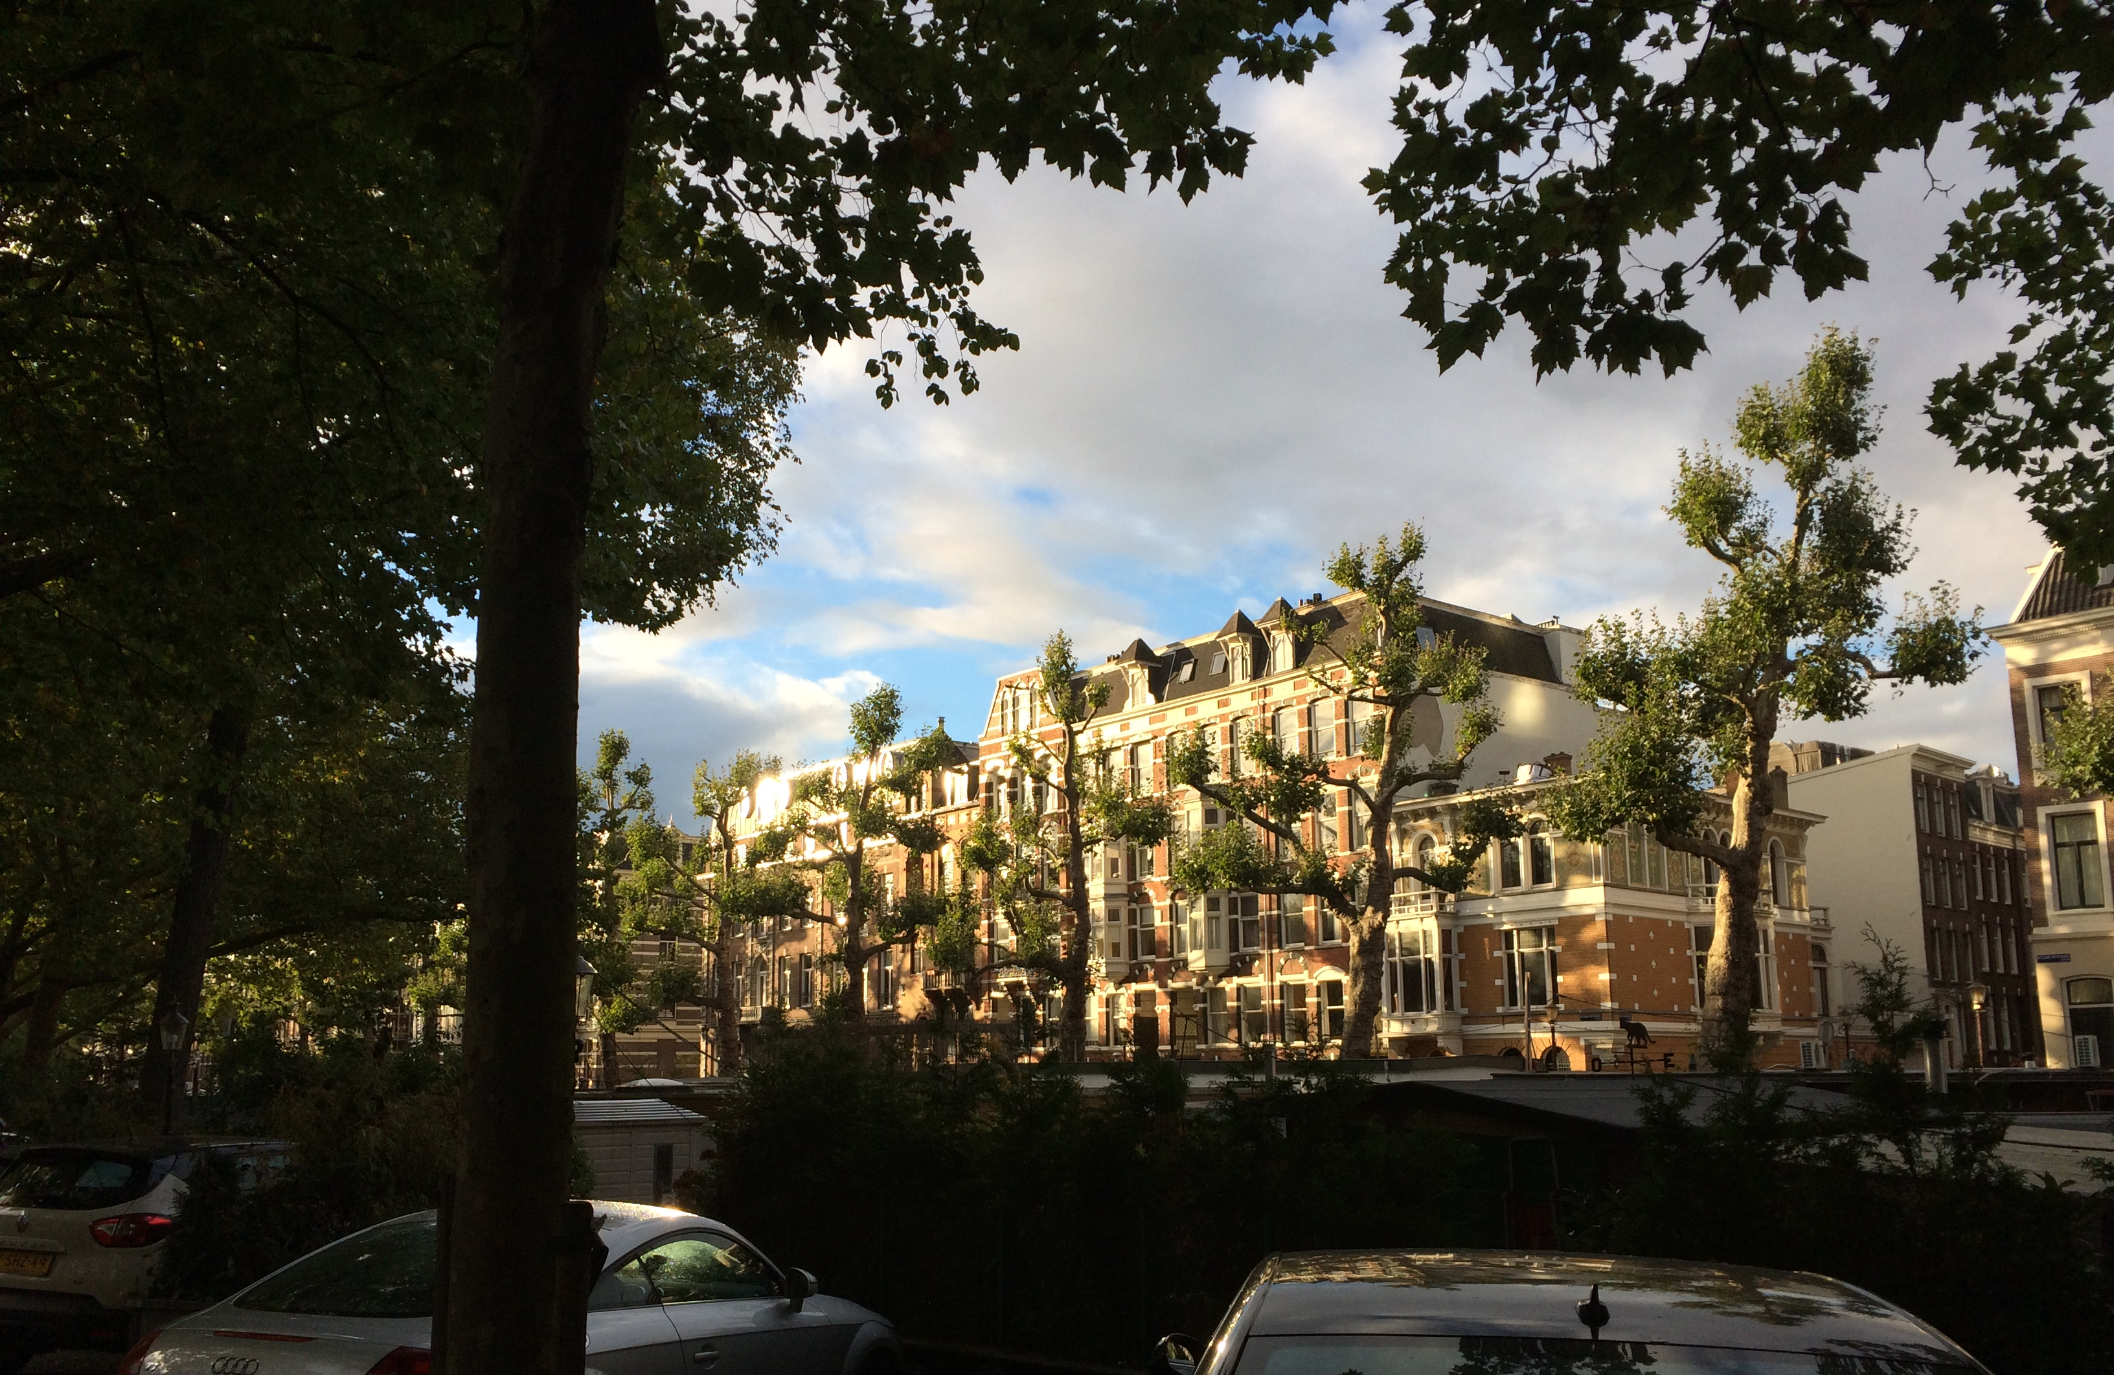
P R O T O T Y P E II

Slide 36
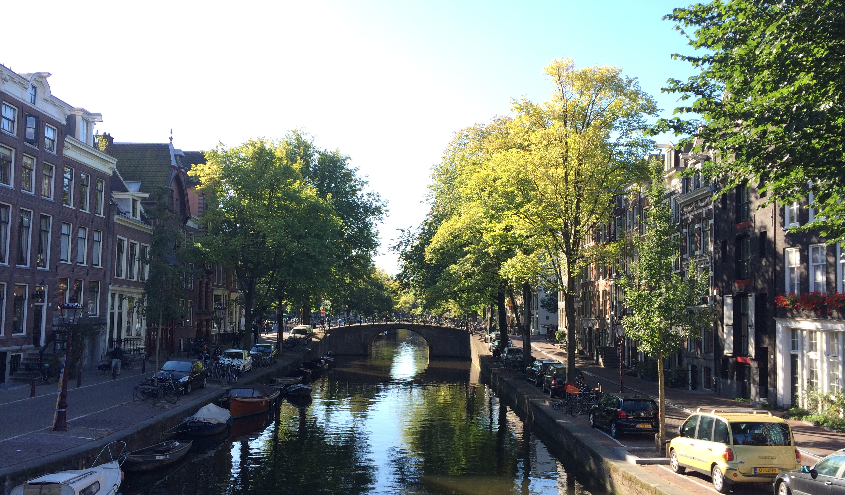
P R O T O T Y P E II

Slide 37
P R O T O T Y P E II
WHAT WORKED Fast communication, events were related to what user might be interested in at current moment
WHAT DIDN’T WORK Budget of suggested events wasn’t accounted for, schedule of user was unknown and had to be worked around
WE LEARNT We need more than just what the user prefers doing and where they are; we need info about user’s current status too
VALIDITY Assumption somewhat failed in this case; true spontaneity is limited
Notes:
EXPLAIN: How creation worked, who it was used on

Slide 38
P R O T O T Y P E III

Slide 39
P R O T O T Y P E III
GOAL Tell user in a fast, concise manner the culture and history of a location
ASSUMPTIONS The traveler wants a brief overview of the interesting and relevant aspects of their location

Slide 40
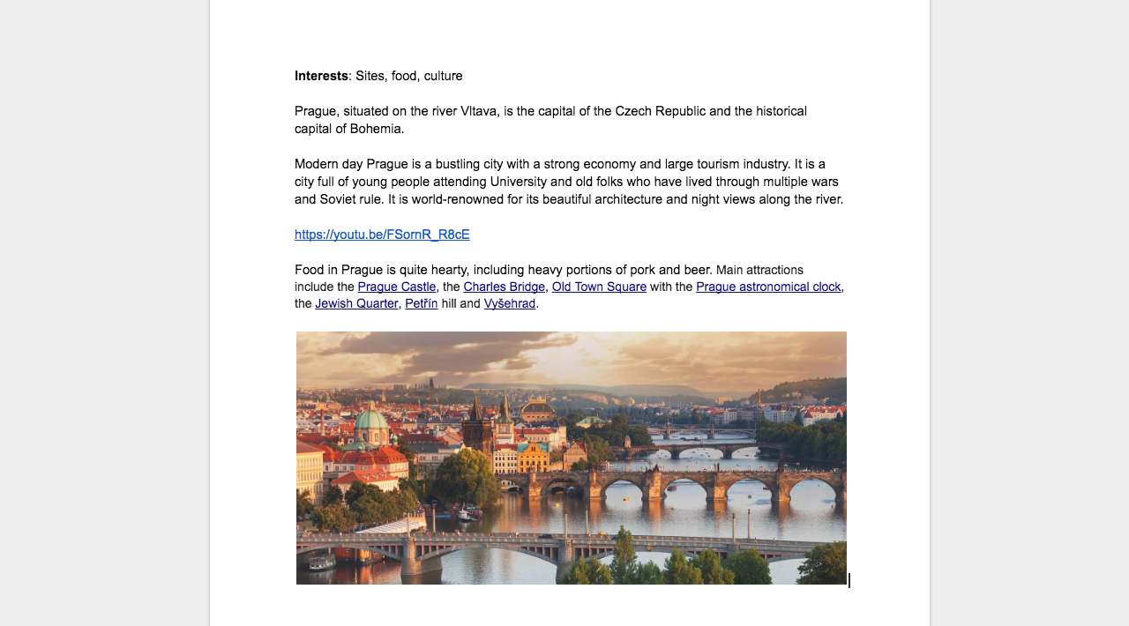
P R O T O T Y P E III

Slide 41
P R O T O T Y P E III
WHAT WORKED Multimedia, not just text, makes info brief. Ease of use - input location, output info
WHAT DIDN’T WORK Uncertainty of what user prefers to learn. Individual work to provide info was time-constraining
WE LEARNT Crowdsourcing might be a better option to compile multimedia info about a location. Single input, single output was easy to learn and use
VALIDITY True, in this case

Slide 42

Introduction
Initial POV
Additional Needfinding Results
Revised POVs
Top HMWs
Experience Prototypes
Summary

Slide 43
K E Y T A K E A W A Y S
people only explore what they see and want
immediate input->output is easy to use,
but presents challenges
spontaneity is limited by possibility

Slide 44

M O V I N G F O R W A R D
Notes:
Need to understand more about user preferences -- not only subjective things, but objective things like location/money/schedule
Realize that multitasking while sedentary is an action -- can we utilize that to make traveling more exciting?
How to simplify down interesting information without cutting out too much

Slide 45

Q U E S T I O N S

