Slide 1
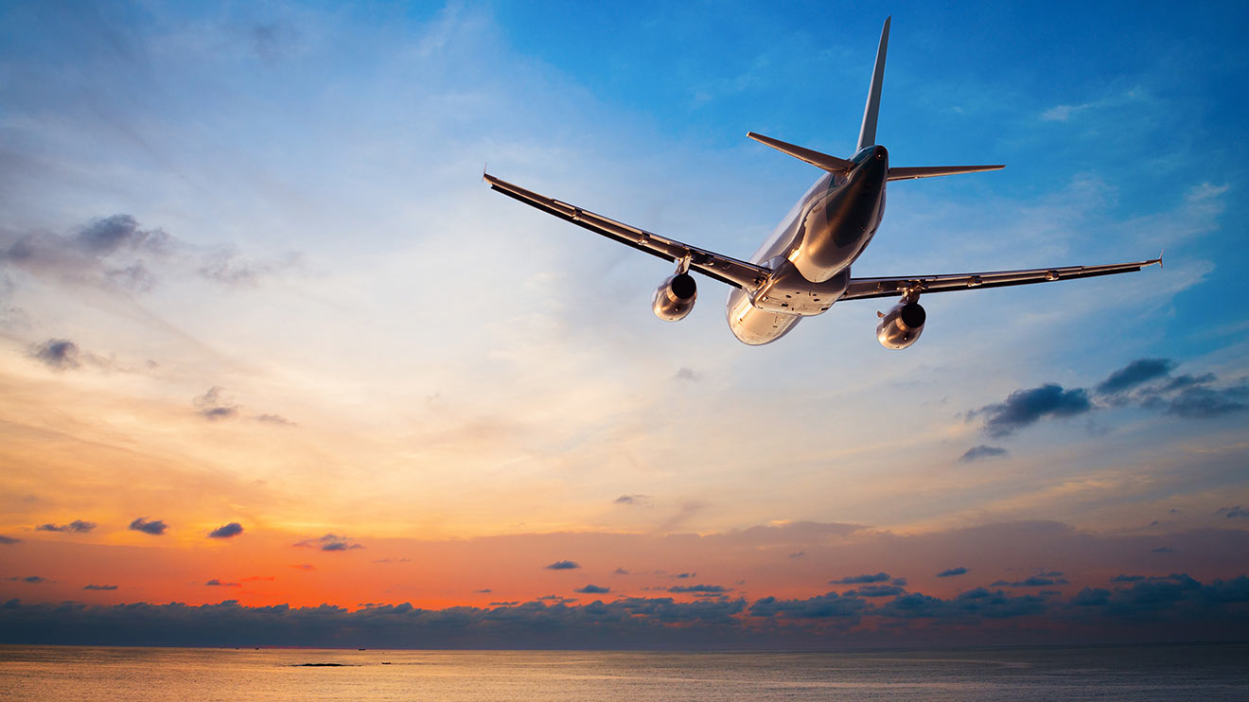

NEEDFINDING TRAVEL
[Micro] Adventure

Slide 2
Introduction
Needfinding Methodology
Interview Results
Analysis
Summary

Slide 3
Introduction
Needfinding Methodology
Interview Results
Analysis
Summary

Slide 4
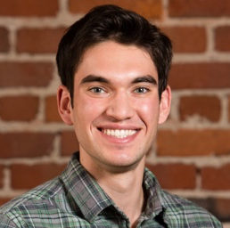
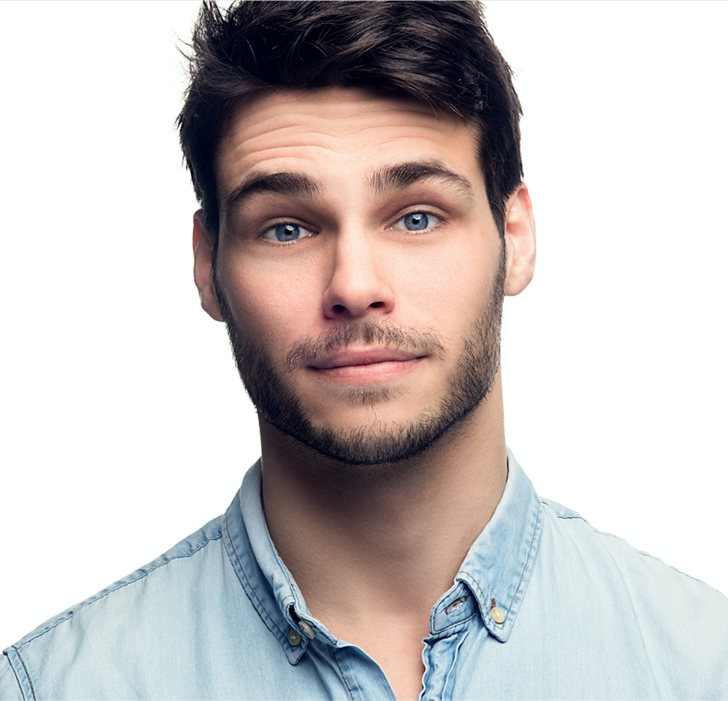
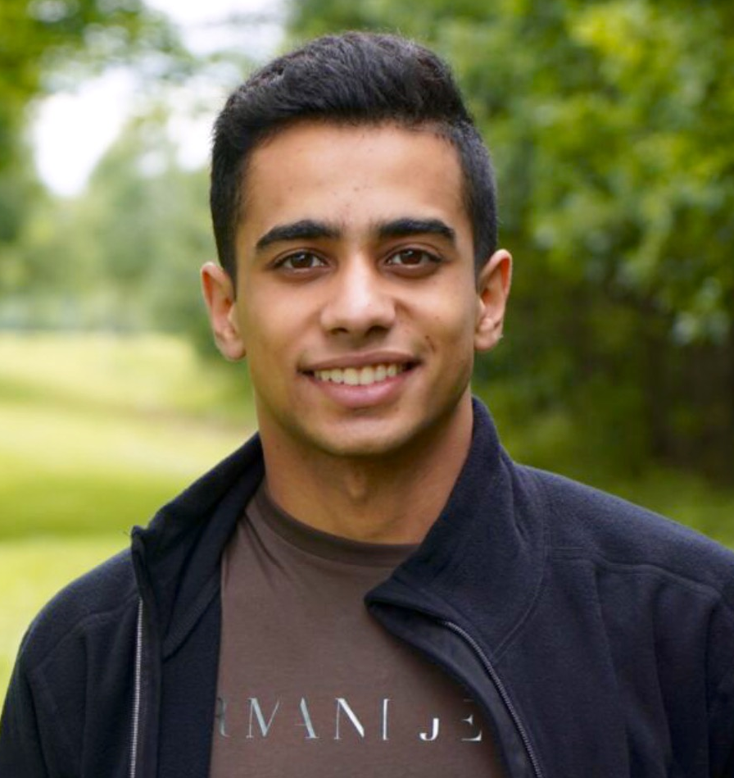
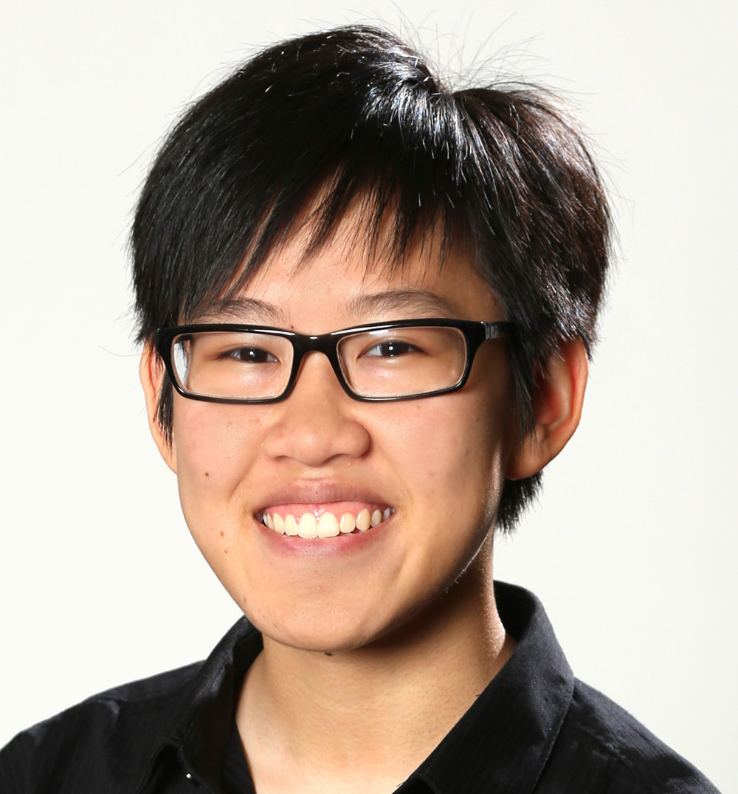
O U R T E A M
Alex Alexandre Basel Kim

Slide 5




O U R P R O B L E M D O M A I N
Motivating ordinary people into exploration and discovery
The process of learning and experiencing new things
Getting more out of travel – simpler, easier, more accessible
The spontaneity of travel

Slide 6

Introduction
Needfinding Methodology
Interview Results
Analysis
Summary

Slide 7
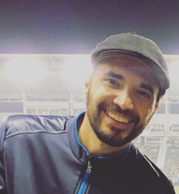
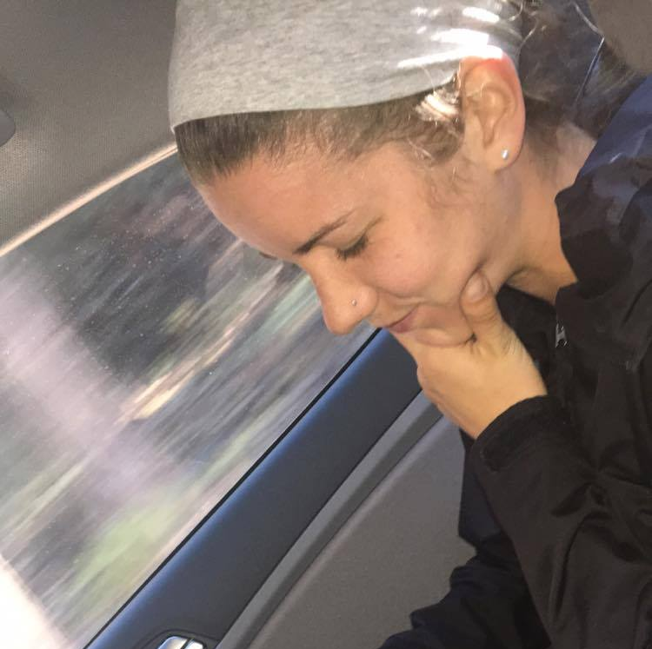
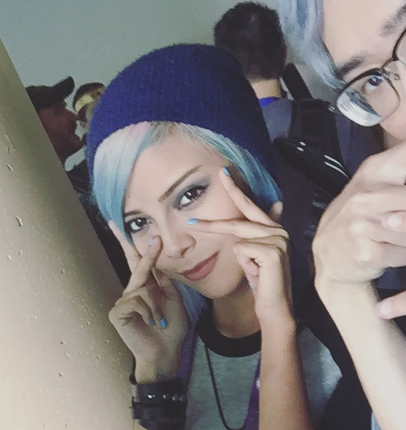
O U R P A R T I C I P A N T S
Jesse Tina Amethyst

Slide 8



J E S S E
T H E W O R K T R A V E L E R
WHO Weekly international traveler, mostly for work
WHY Consistency & recurrence with travel makes him a valuable interviewee
HOW Long time friend
WHERE Last weekend in LA
Notes:
Jesse, 32 years old, agent for a model agency

Slide 9
J E S S E
T H E W O R K T R A V E L E R
What is the most stressing/annoying part of travelling?
What are your favorite apps to prepare and while you’re travelling?
What would make a trip more enjoyable, easy, or simply convenient?
What would push you to travel more often?
Tell me more about your travel habits?

Slide 10


T I N A
T H E P O W E R A D V E N T U R E R
WHO Power adventurer, loves to travel the country via RV
WHY Ideal extreme user
HOW Friend
WHERE Interviewed at Alex’s house
Notes:
Tina, 25 years old, masseuse

Slide 11
T I N A
T H E P O W E R A D V E N T U R E R
Tell me about how you decide what to do on a given day? Do you plan ahead? If so, how?
During the day or the adventure, do you use any tools to assist you?
Can I watch you research your next week's trip?
Why road trip?

Slide 12



A M E T H Y S T
T H E C O N V E N T I O N E N T H U S I A S T
WHO Cosplayer who travels to conventions around the country
WHY Frequent traveler, often travels by herself
HOW Friend, met her at a convention
WHERE Interviewed at her house
Notes:
Amethyst 20 years old, professional cosplayer

Slide 13
A M E T H Y S T
T H E C O N V E N T I O N E N T H U S I A S T
Why do you go on adventures?
How do you find the less beaten path?
What’s a unique experience to you?
Do you like traveling alone or with people?
Why do you like seeing new things?

Slide 14
Introduction
Needfinding Methodology
Interview Results
Analysis
Summary

Slide 15
J E S S E
T H E W O R K T R A V E L E R
PROBLEMS RAISED Catching up on time, travelling with neophytes and non-experienced travelers, keeping motivated, too many apps
FAVORITE TOOLS Kayak, travel agencies, functional apps, mile-counting app, human advice
“The most exhausting thing is to be standing and doing nothing.”

Slide 16
T I N A
T H E P O W E R A D V E N T U R E R
WHAT DRIVES HER Wanting to see more of the country, inklings or suggestions from other people
FAVORITE TOOLS Roadtrippers app, couchsurfing, Tripadvisor, Yelp, freecampsites.net, allstays.com
“I love the Roadtrippers app. It helps me find great, off-the- beaten path activities to do along my trip.”

Slide 17
A M E T H Y S T
T H E C O N V E N T I O N E N T H U S I A S T
FAVORITE KIND OF ADVENTURES Along less beaten paths, exploring beaches & cities at night, places that are historically significant or related to pop culture
FAVORITE TOOLS Word of mouth, google searching, driving aimlessly until she discovers something
“Never thought I’d have the chance to see new things.”

Slide 18
E M P A T H Y M A P

Slide 19
S A Y
T H I N K
D O
F E E L

Slide 20
“You’ve no idea how intimate or damn personal it becomes at some point” (J)
“I never thought I’d have the chance to see these places” (A)
“I like going off the beaten path” (A)
“I just go wherever I feel and only plan a day ahead” (T)
“Google searching, word of mouth, driving aimlessly” (A)
“I like using public transportation” (A)
“The frustrating is that you’re forced to do nothing at some point” (J)
“No matter where I am, at some point you’re s tired you just spend your free time at the hotel” (J)
“How did you get in my house?”
T H I N K
D O
F E E L

Slide 21
S A Y
T H I N K
Stress (J)
Pointed at photos in room (A)
Showed travel videos that inspire her (A)
Found all information on her phone (T)
Asked me for advice on places to visit (T)
Looked relaxed and laid on the couch trying to find information about Yosemite. (T)
F E E L

Slide 22
S A Y
Traveling is a chance to go out and experience new POVs (A)
Need to see things that matter to me, or mattered in history (A)
As a woman traveling alone, need to always be cautious (A)
Public transport in a city is best way to learn the city (A)
There are so many options on places to go, which do I choose? (T)
What can I afford? (T)
Traveling is a time, energy and thoughts consuming process that need to be easier to live (J)
People need to be more prepared to it - make it more accessible (J)
How do I find a cool place to go to? (A)
I want my adventures to be like those idealized travel videos (A)
D O
F E E L

Slide 23
S A Y
T H I N K
Happiness at sharing experiences w/ friends (A)
Understanding at being at the place where history happened (A)
Photos let her know she made a mark at a place (A)
Excitement about the next step in the trip (T, J)
Uncertainty about the logistics (T, A)
Fulfillment at going somewhere new
Need assistance to make the whole experience easier and more comfortable (either for first time or recurrent travels)
Need to make it more relaxing
Need to trigger excitement
D O

Slide 24
Introduction
Needfinding Methodology
Interview Results
Analysis
Summary

Slide 25





I N F E R E N C E S
Making the internet more accessible
Apps that take care of everything from start to end
Activities that keep travelers excited moving
Suggestions from other people can be influential
Adventures in less traditional spots

Slide 26
T E N S I O N S, S U R P R I S E S &
C O N T R A D I C T I O N S
There is a large population of alternative travelers (e.g. people who sleep in Wal-Mart parking lots)
Traveling by yourself induces risk
Even though we are all doing the same (taxi-plane-hotel) the experience is constantly punctuated by personal experience - very intimate process
Exhausting in every level (not only physical)
Liked exploring new places, but goes to historical landmarks
Wasted free time in transit

Slide 27
N E E D S & I N S I G H T S
Smarter apps that are more personalized, and take care of everything from start to end
Ways to know safe places to visit for lone travelers
Some way to identify deeper the personality and the taste of the traveler to adjust the experience to his/her needs
Enjoy the ‘idealized’ version of adventuring (being at the destination, not traveling to it)

Slide 28

Introduction
Needfinding Methodology
Interview Results
Analysis
Summary

Slide 29




P E O P L E W A N T
spontaneity
new experiences
personalized travel
ease

Slide 30

Q U E S T I O N S

