Slide 1

M E D – F I P R O T O T Y P E
[ M I C R O ] A D V E N T U R E

Slide 2

Introduction
Value Prop, Problem and Solution Overview
Tasks
Revised Interface Design
Medium-Fi Prototype Task Flows
Prototype Overview
Summary

Slide 3
Introduction
Value Prop, Problem and Solution Overview
Tasks
Revised Interface Design
Medium-Fi Prototype Task Flows
Prototype Overview
Summary

Slide 4



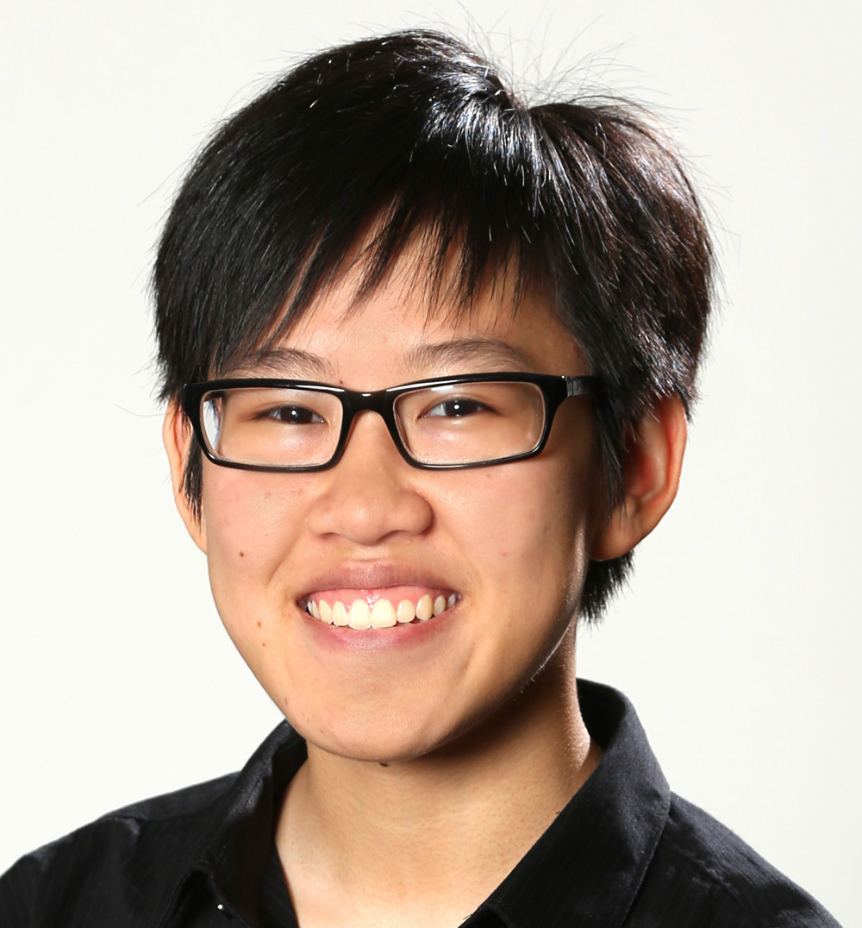
O U R T E A M
Alex Alexandre Basel Kim
Usability Testing
Software Engineering
Design
Team Manager

Slide 6
Introduction
Value Prop, Problem and Solution Overview
Tasks
Revised Interface Design
Medium-Fi Prototype Task Flows
Prototype Overview
Summary

Slide 7
V A L U E P R O P O S I T I O N
We want to help travelers
make the most out of their adventures
Let a personal guide help you plan your adventure

Slide 8

P R O B L E M
Planning a fun adventure takes too much time and effort

Slide 9
S O L U T I O N O V E R V I E W
We’ll connect you with a local guide,
on-demand wherever you go

Slide 10
Introduction
Value Prop, Problem and Solution Overview
Tasks
Revised Interface Design
Medium-Fi Prototype Task Flows
Prototype Overview
Summary

Slide 11
T A S K S

Slide 12
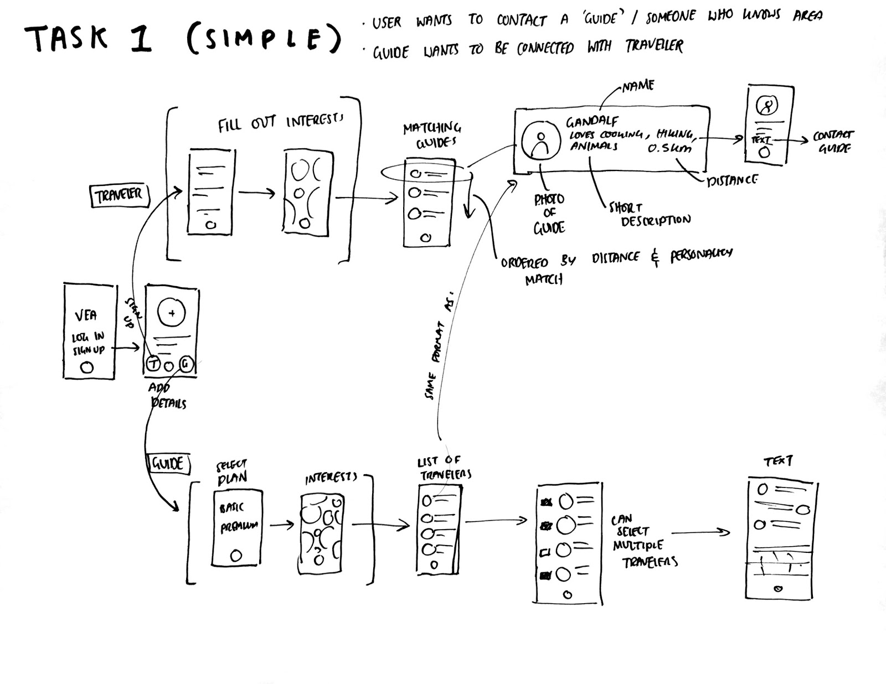
T A S K I

Slide 13
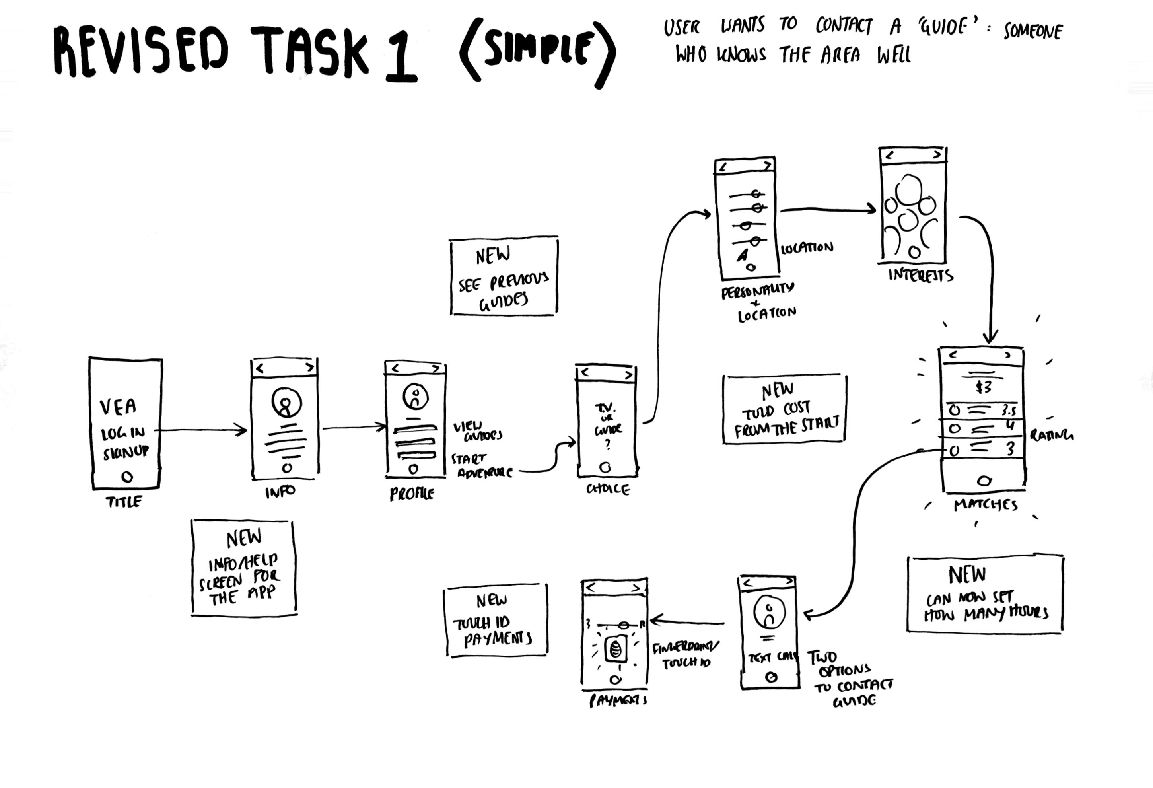
T A S K I

Slide 14
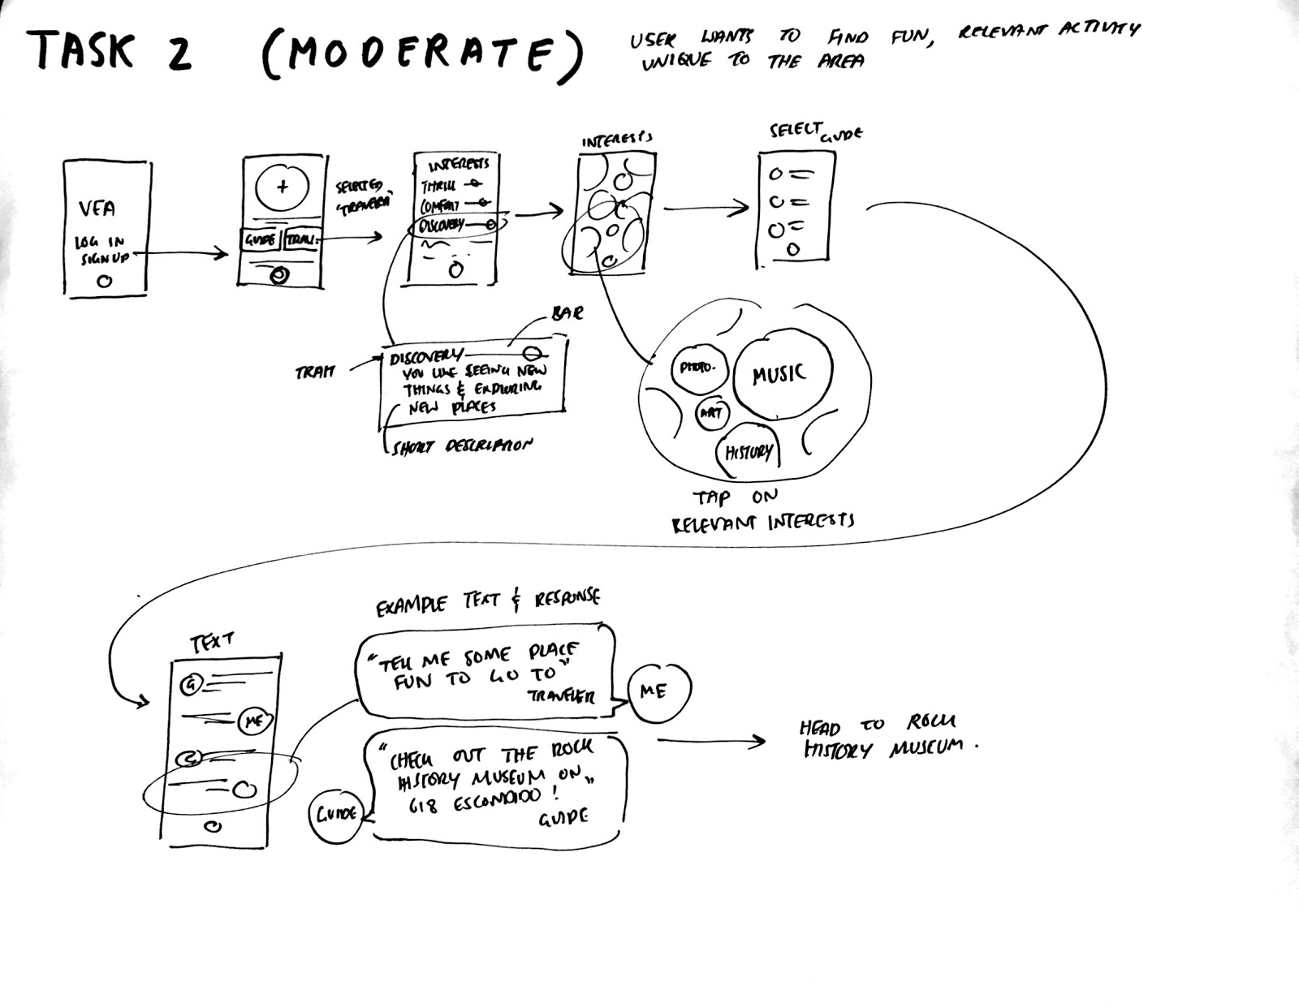
T A S K II

Slide 15
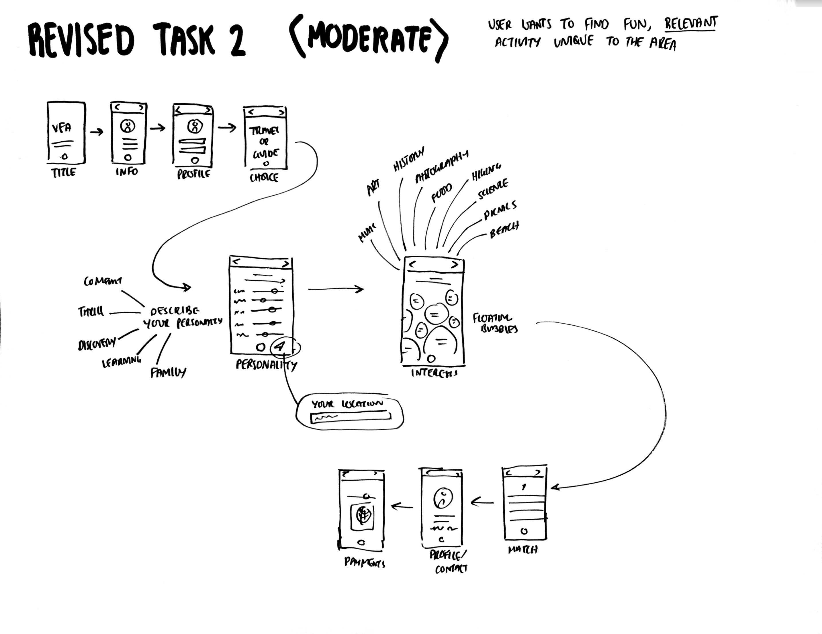
T A S K II

Slide 16
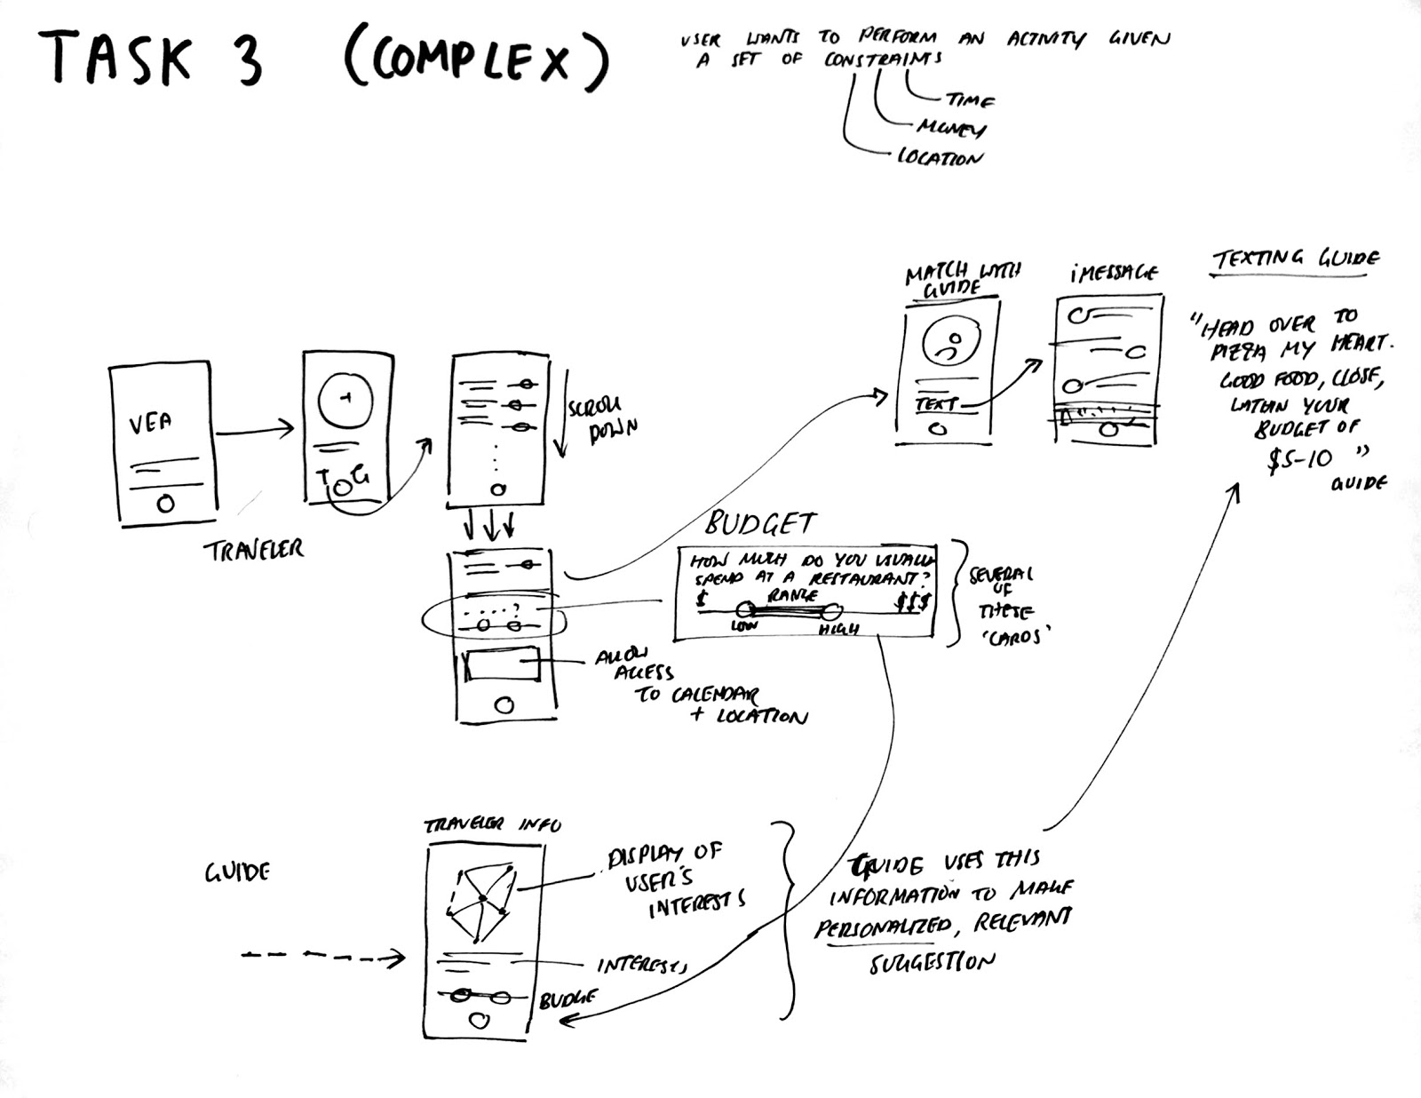
T A S K III

Slide 17
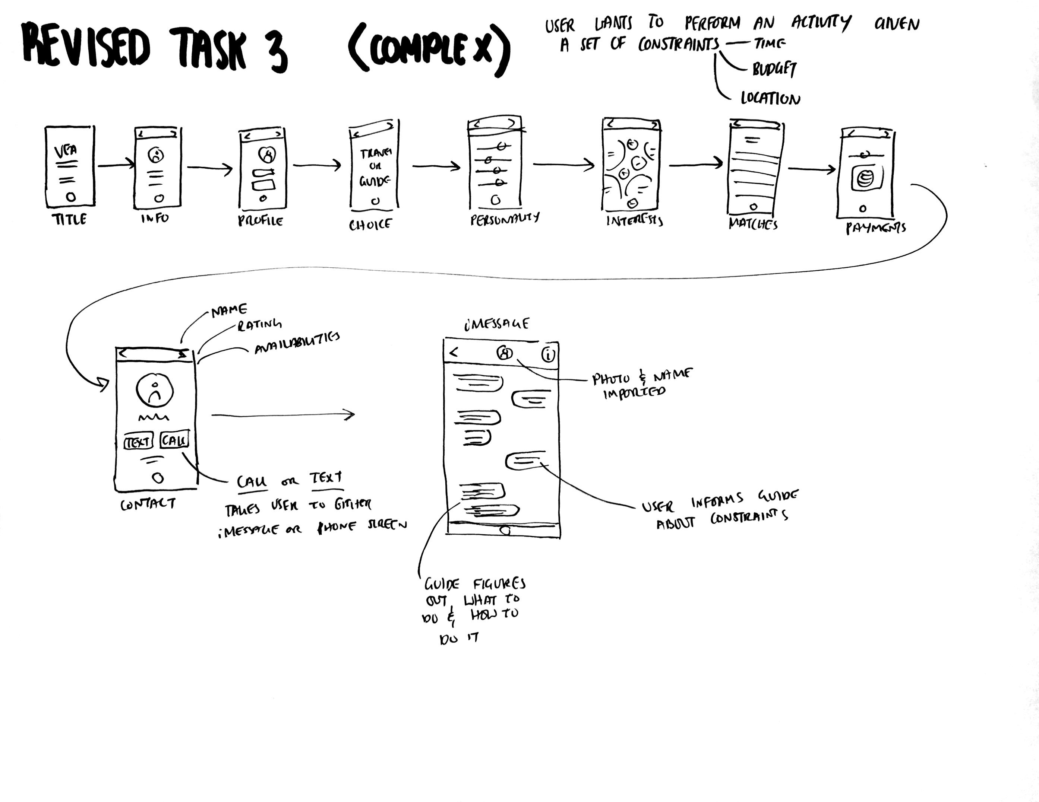
T A S K III

Slide 18
Introduction
Value Prop, Problem and Solution Overview
Tasks
Revised Interface Design
Medium-Fi Prototype Task Flows
Prototype Overview
Summary

Slide 19
C H A N G E S
Modified ‘payment’ plan for easier use; also due to tight deadline on our app. If we had more time, we’d discuss the economics of our app.
Changed how ‘Guides’ get connected to travelers. We let the travelers pick guides on-demand and guides set their shifts, similar to Uber. Easier to implement, no need for calendar use.
Addition of a small info page upon sign-up that clarifies what Vea is and how to use it.

Slide 20
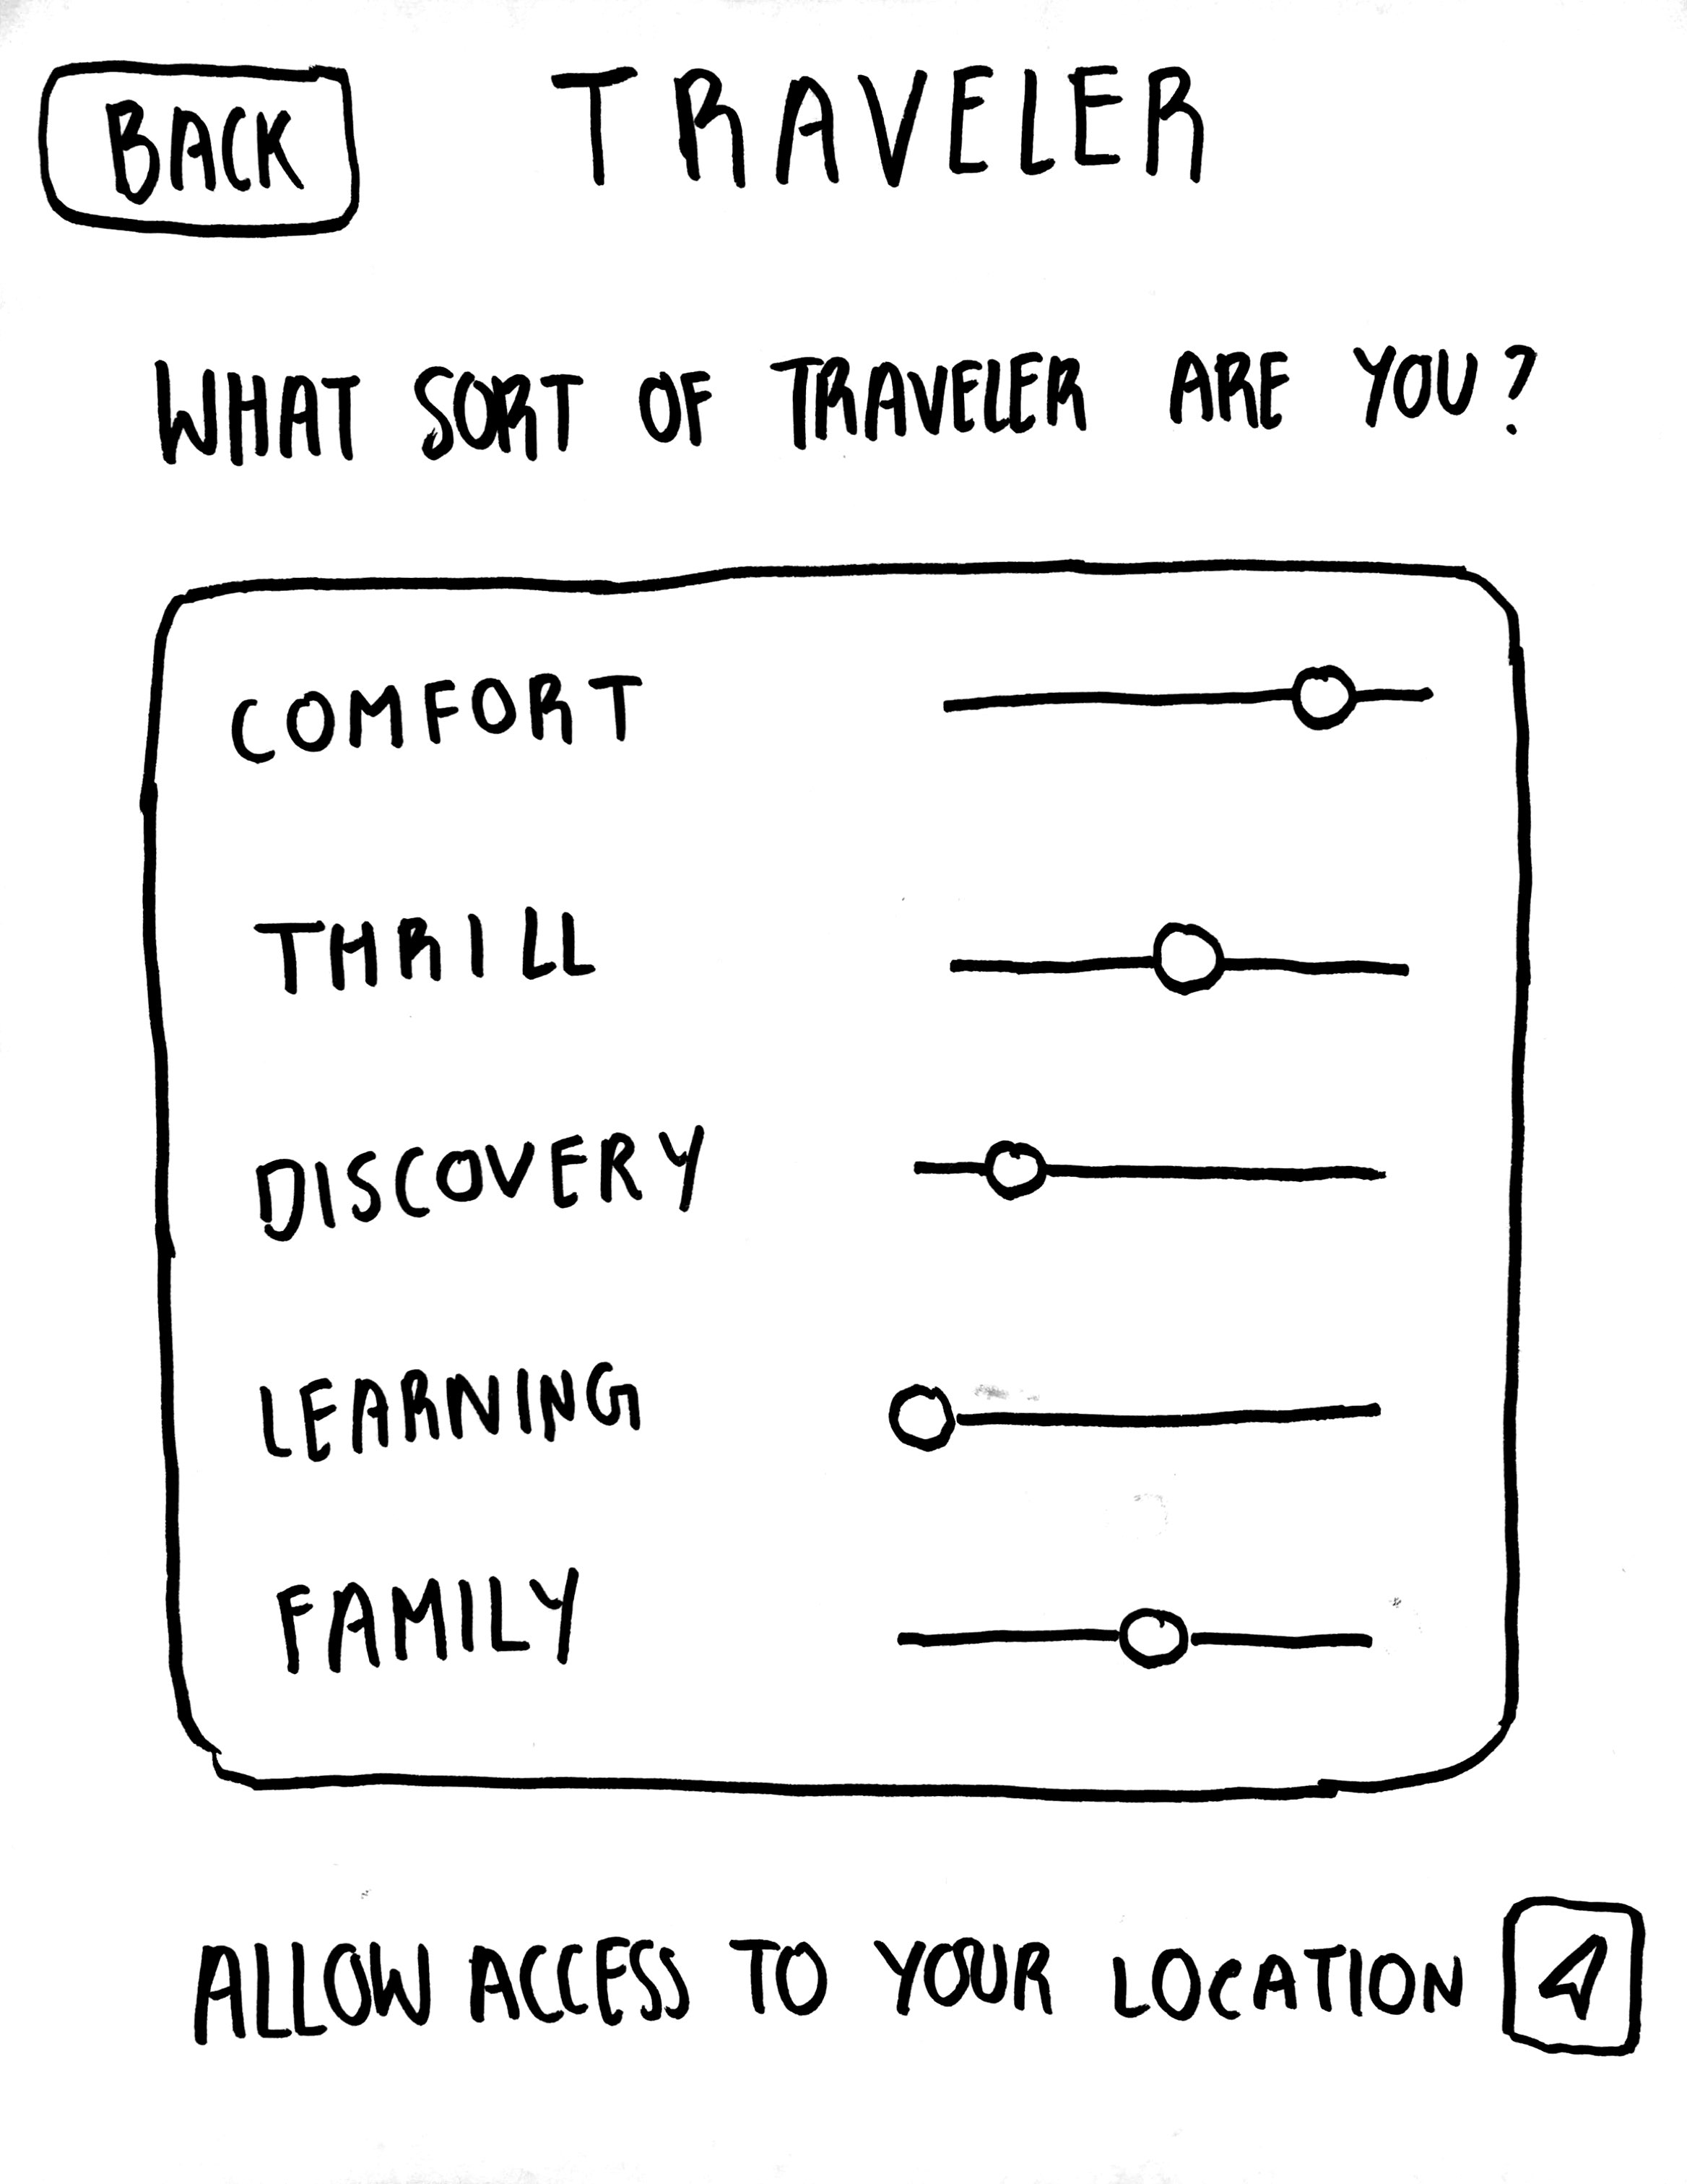
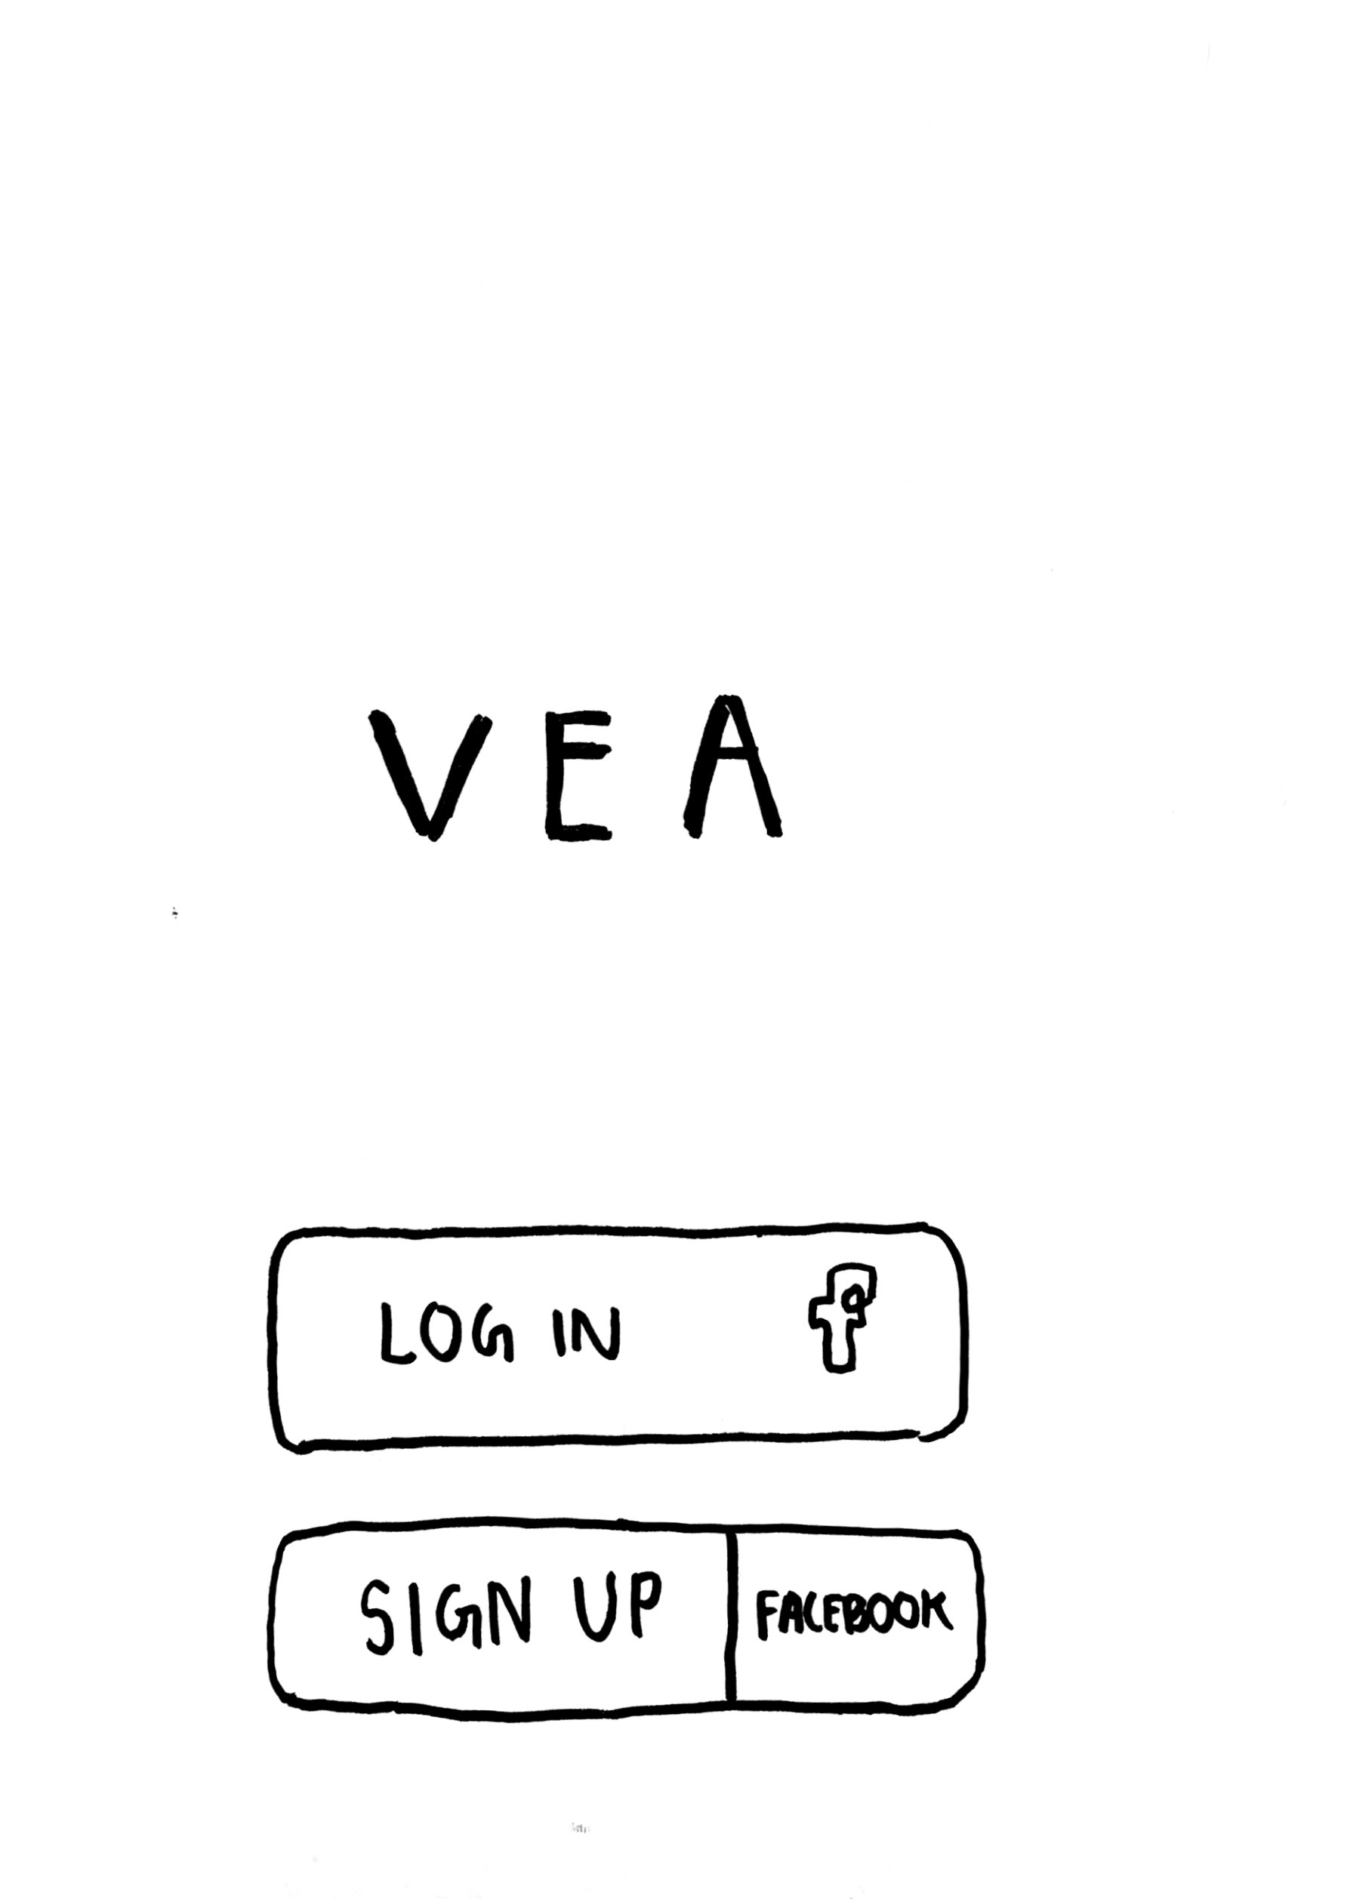
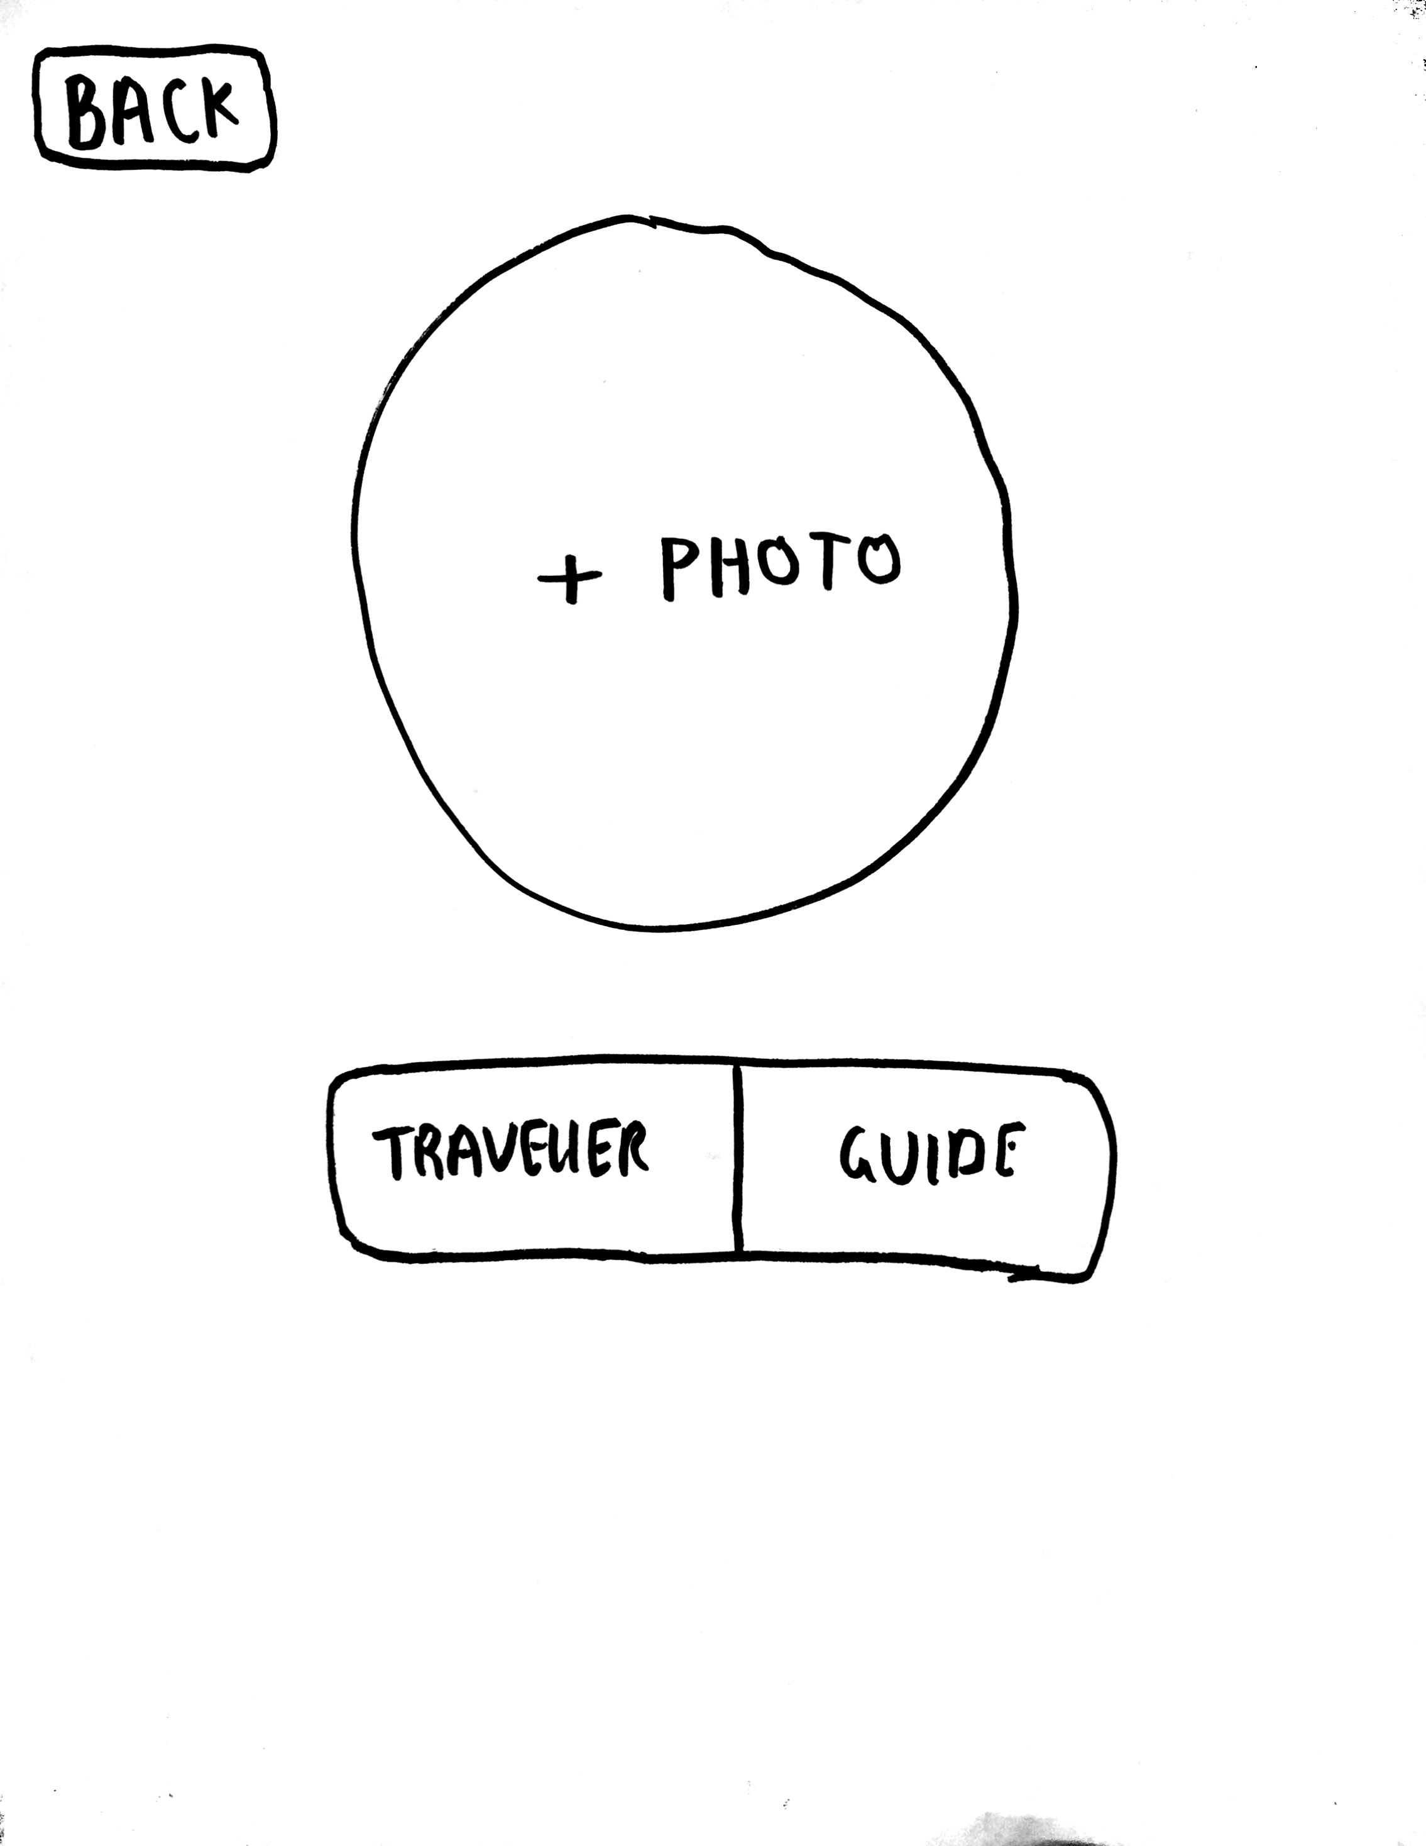
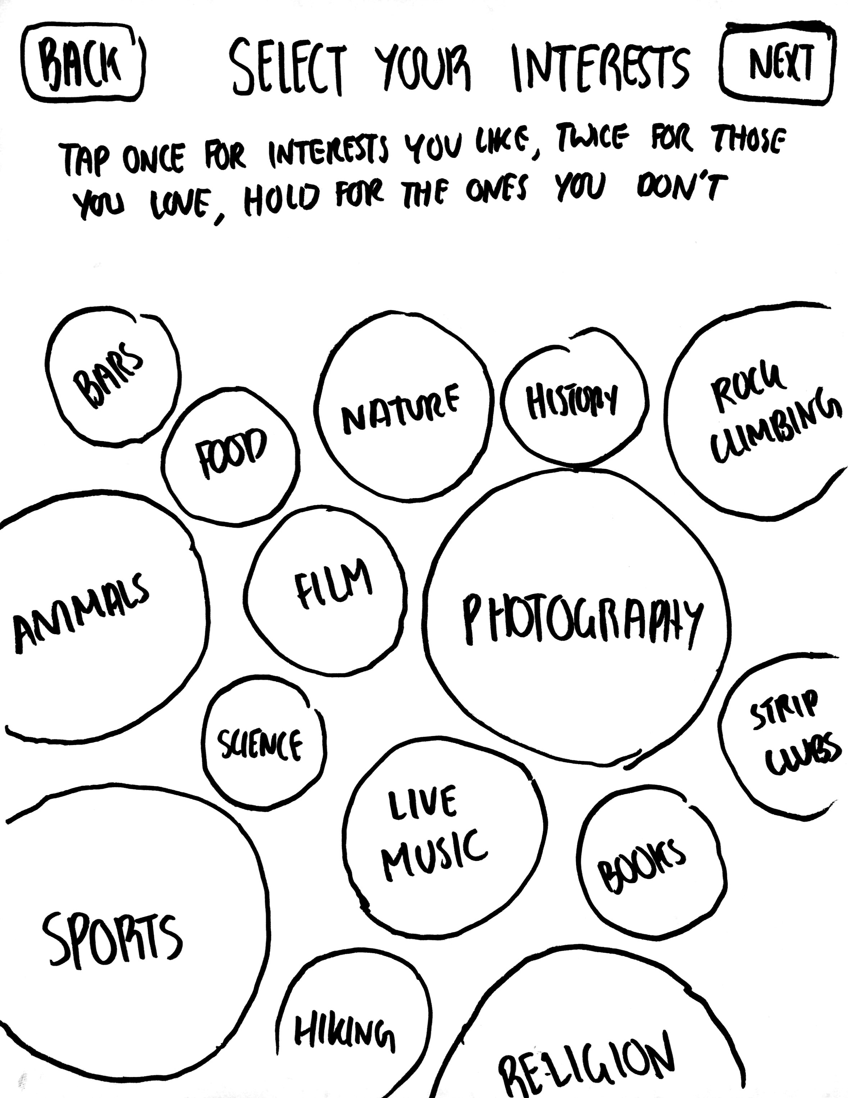
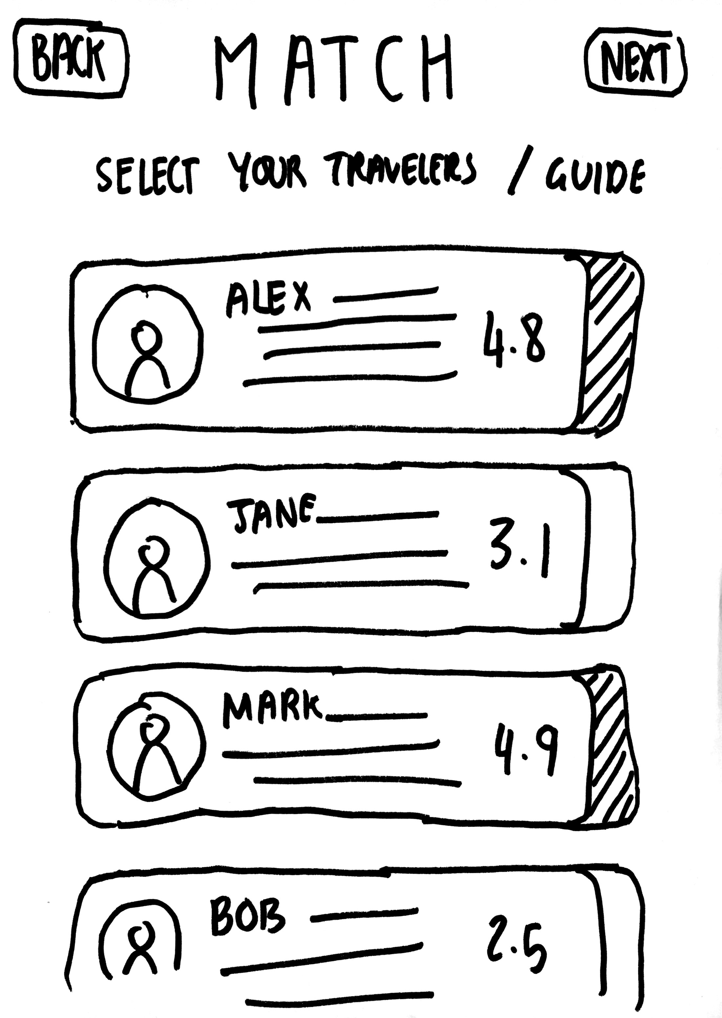
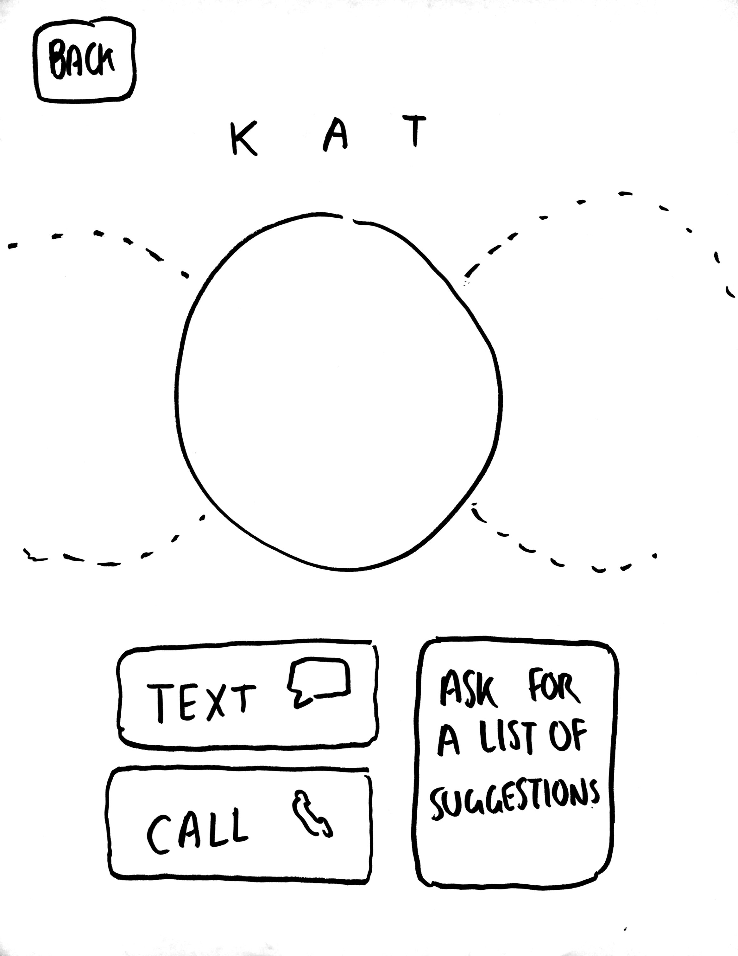
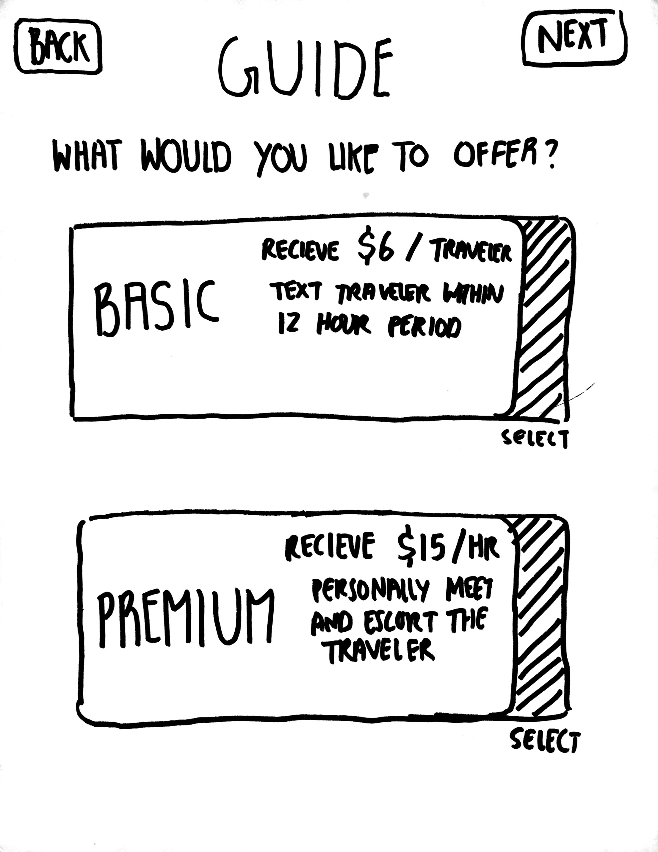
L O W – F I P R O T O T Y P E
T R A V E L E R
G U I D E

Slide 21
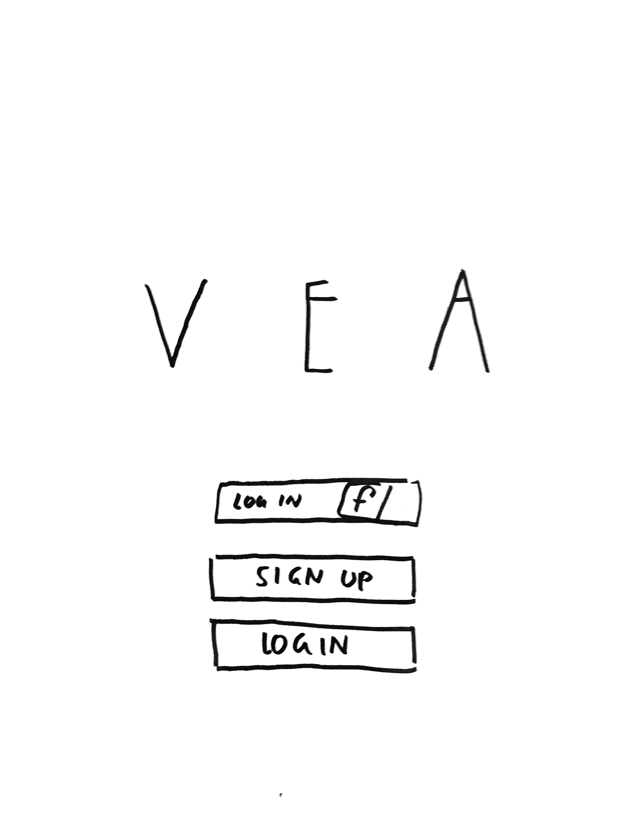
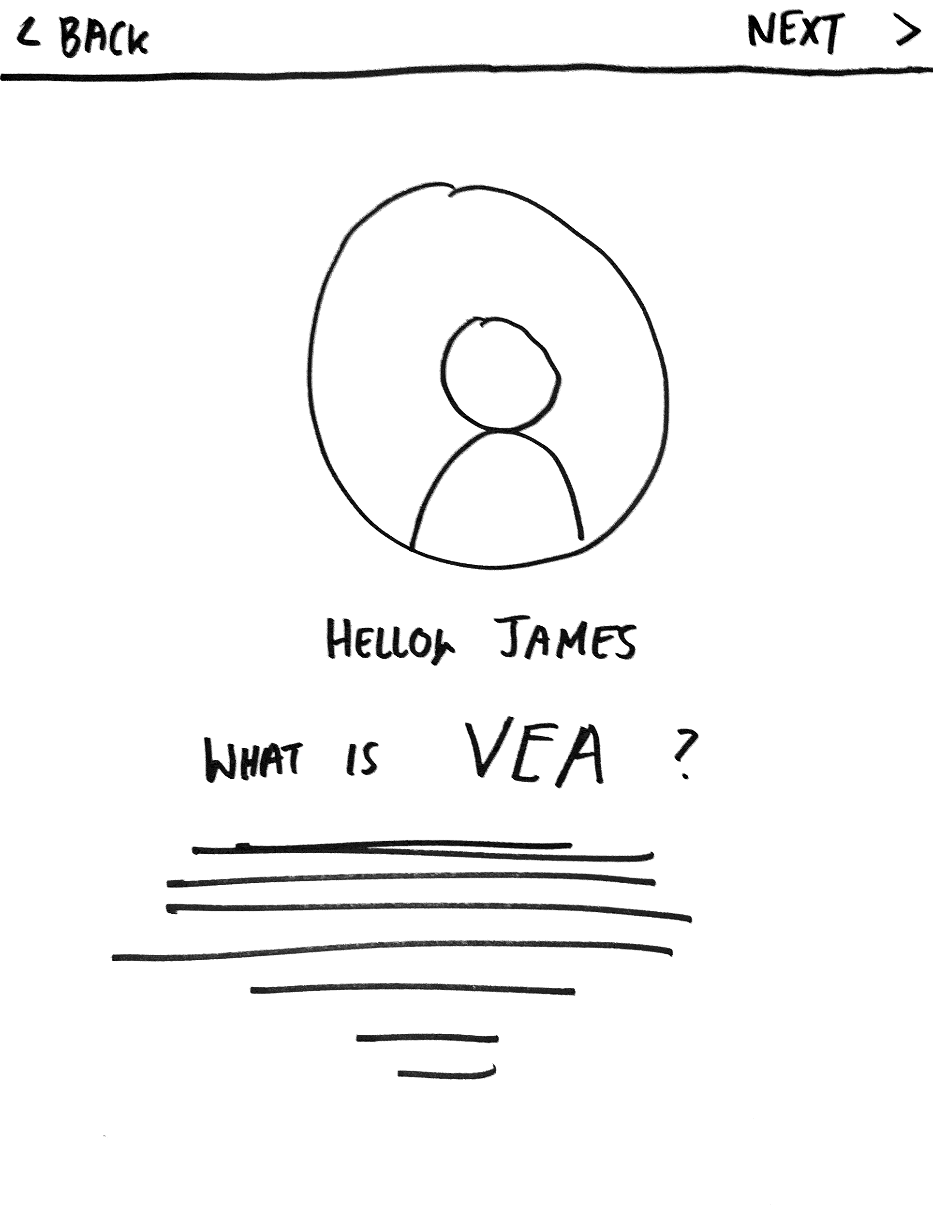
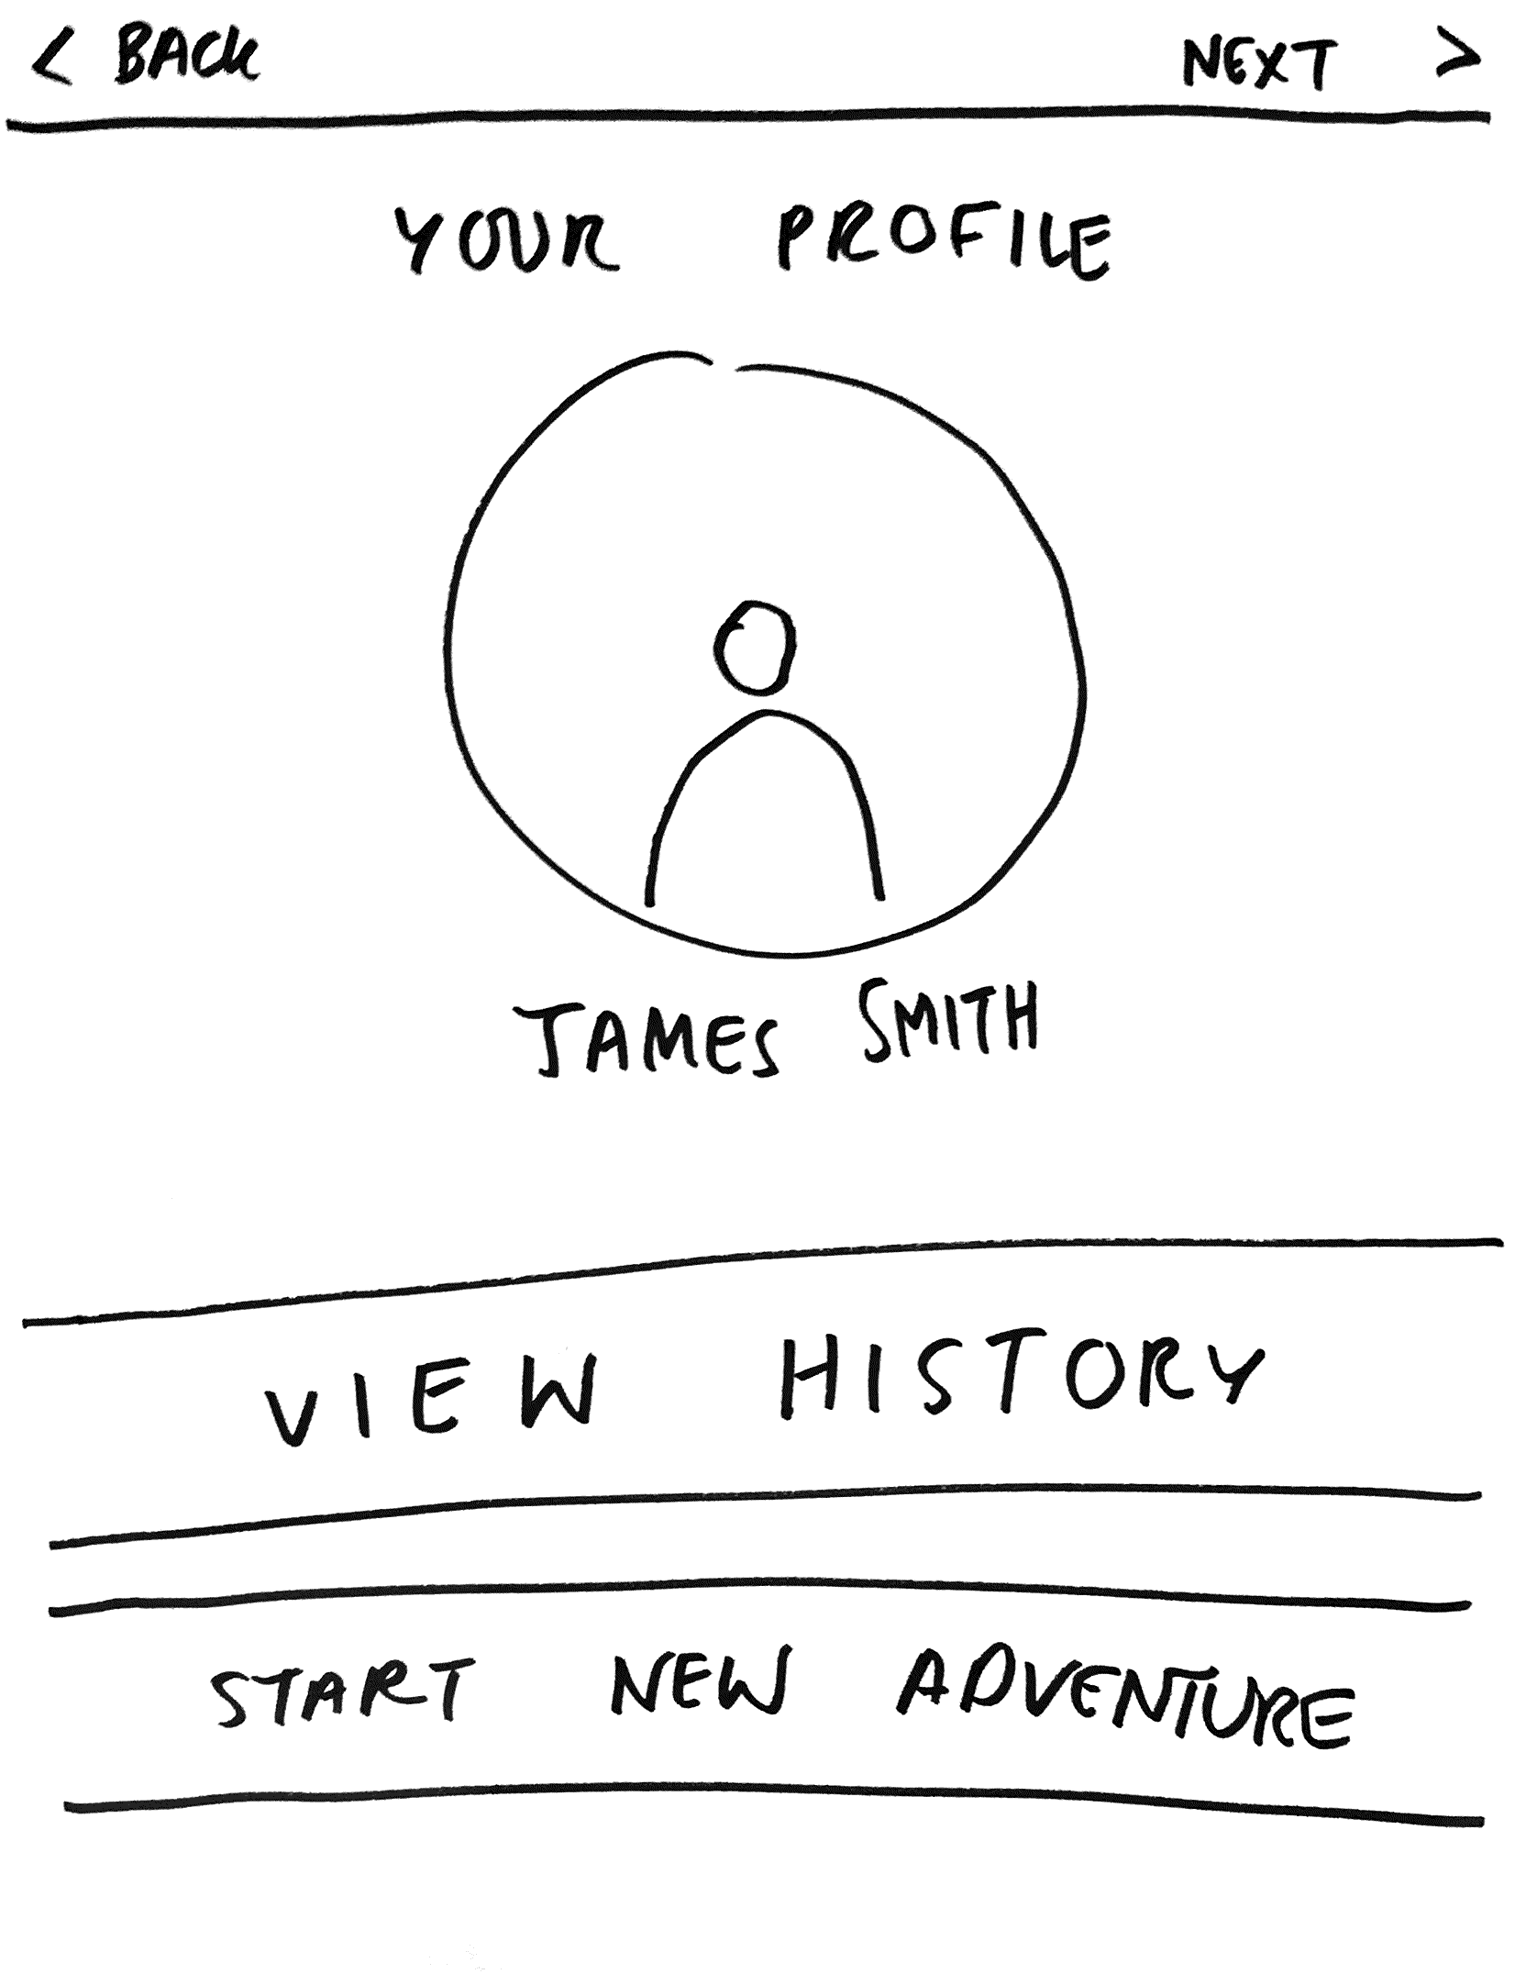
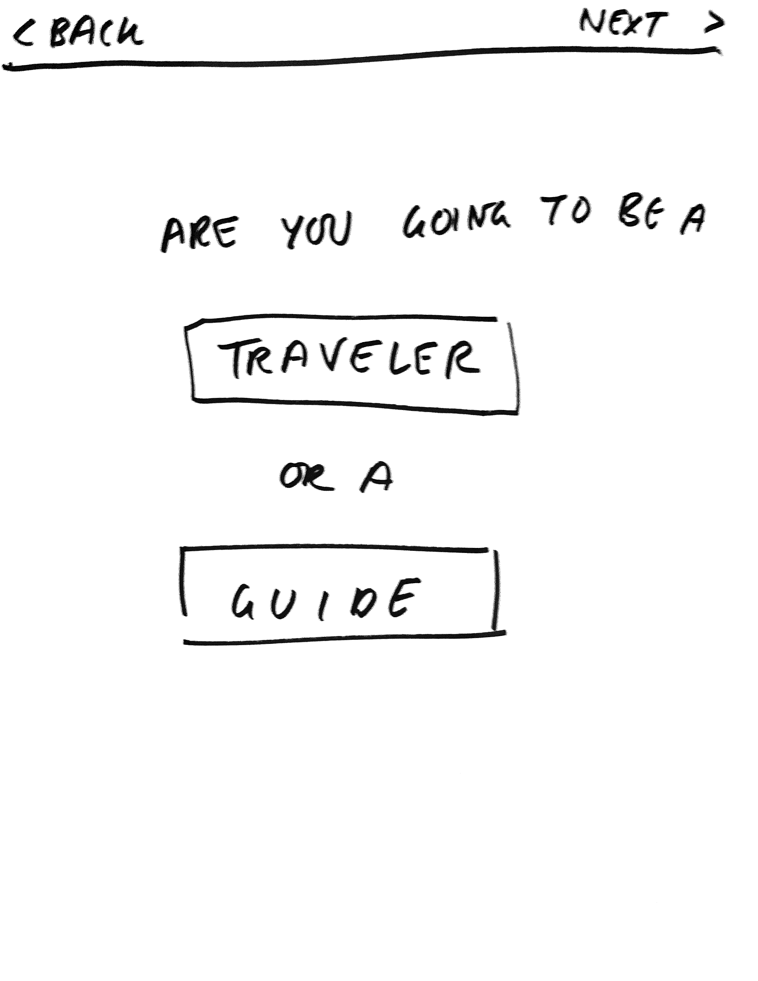
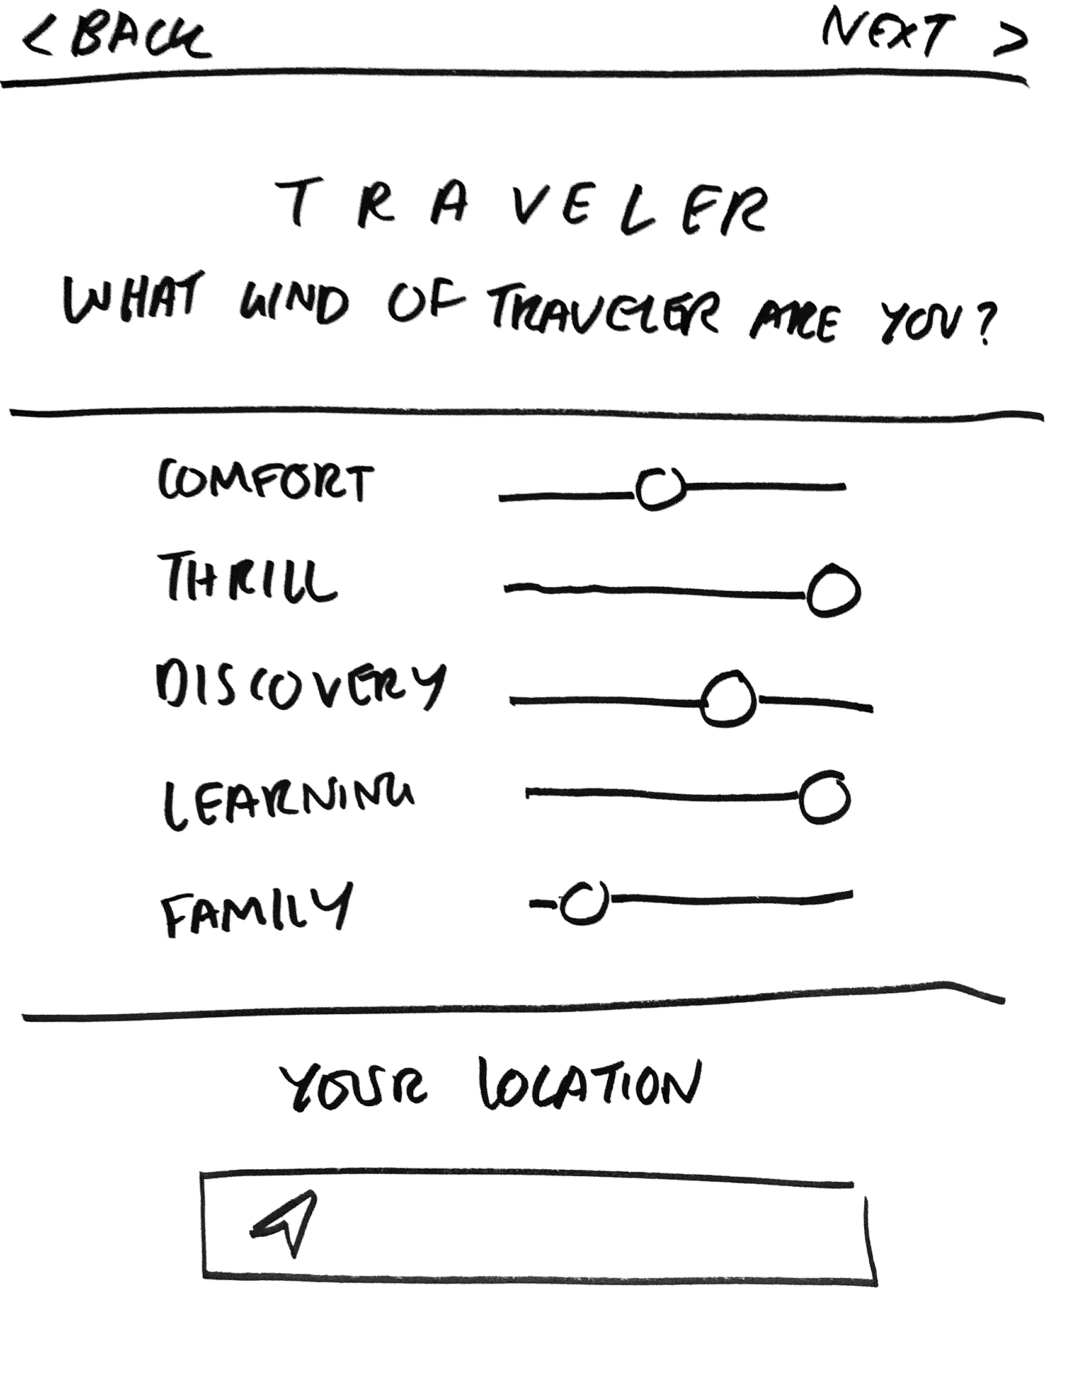
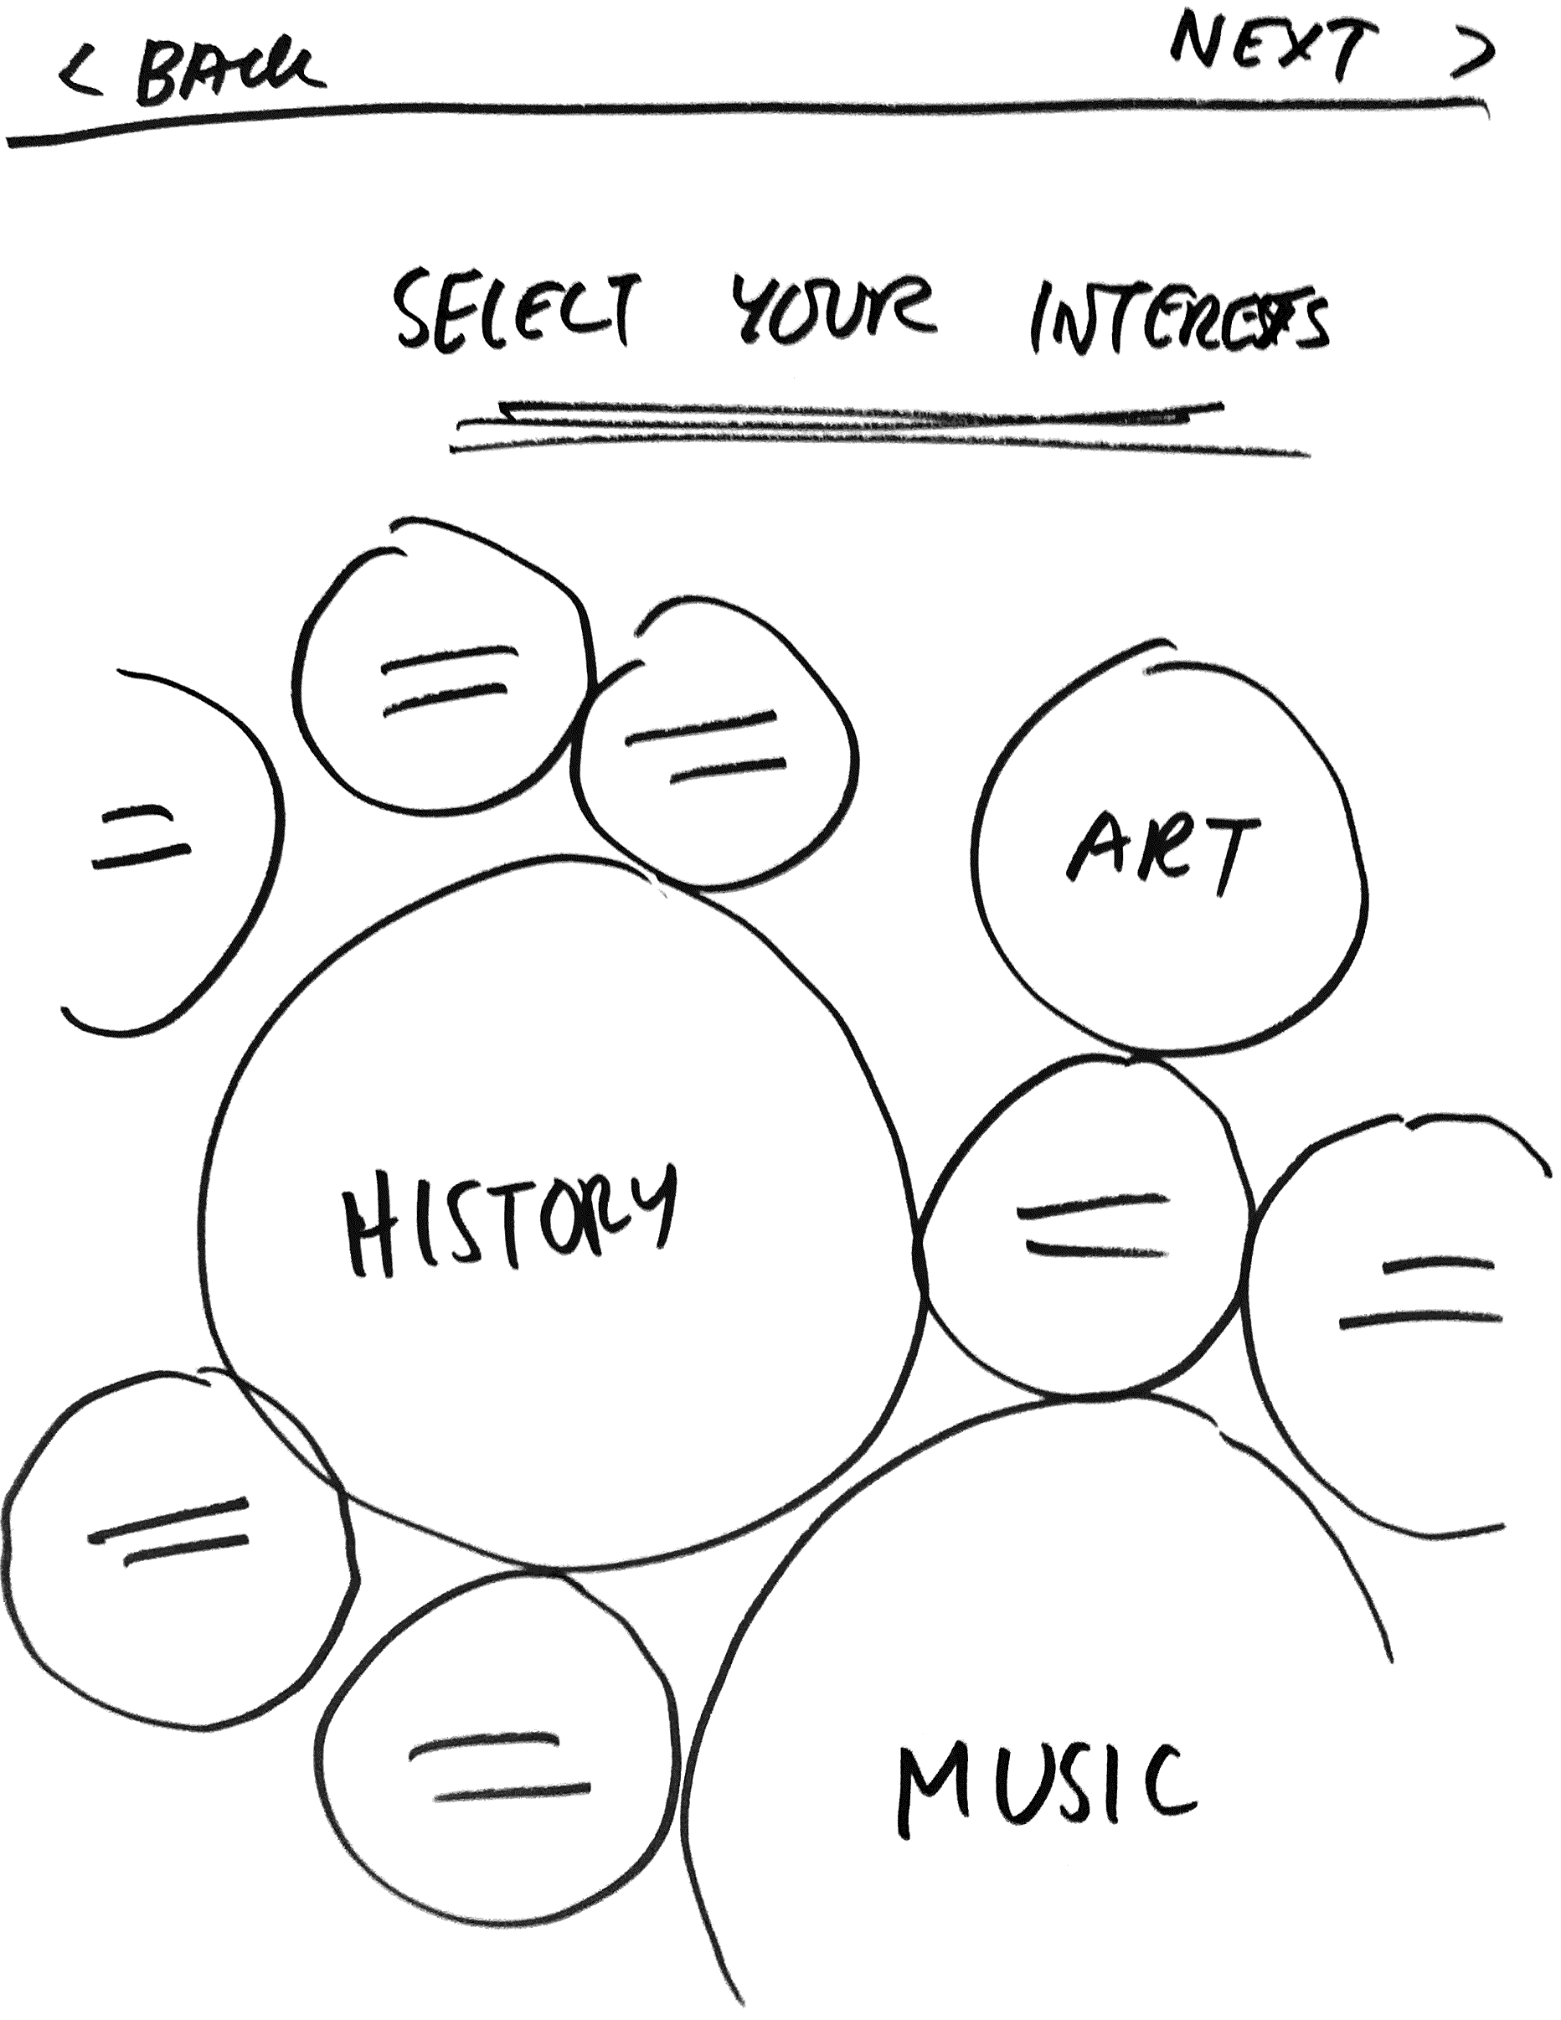
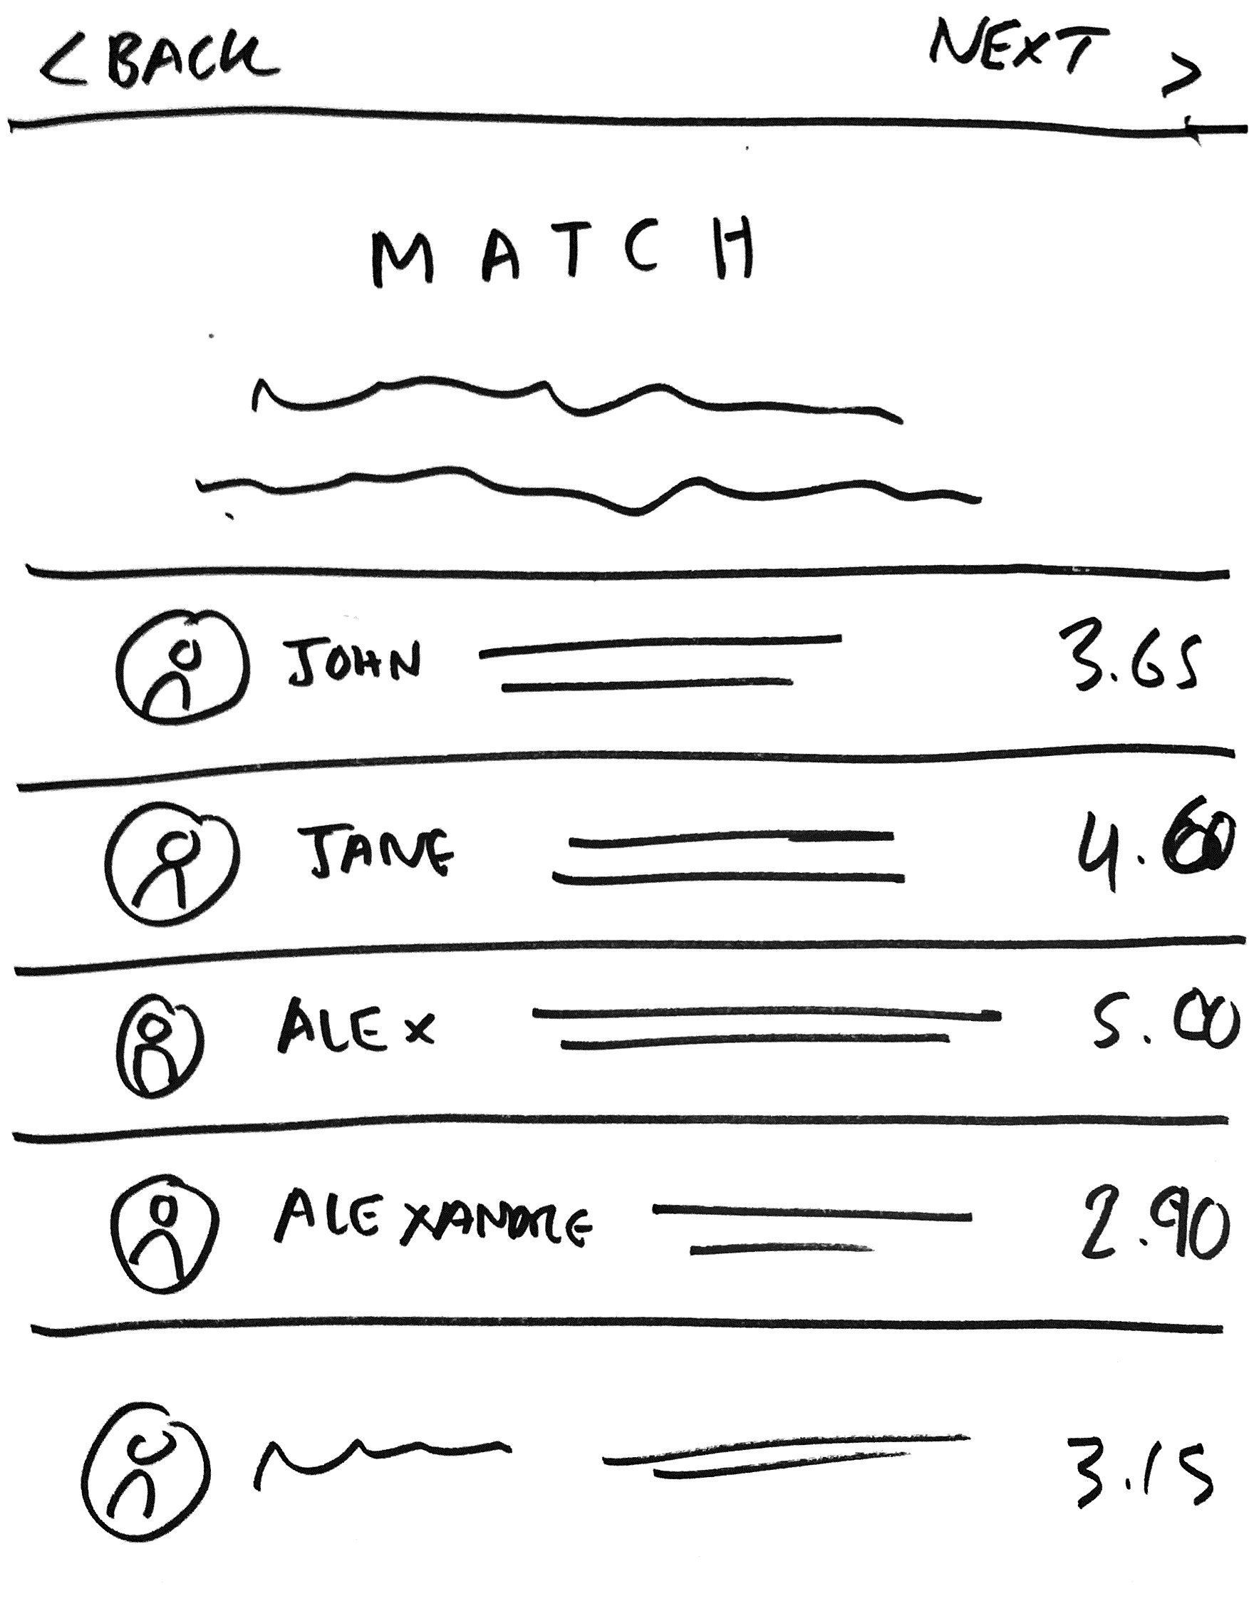
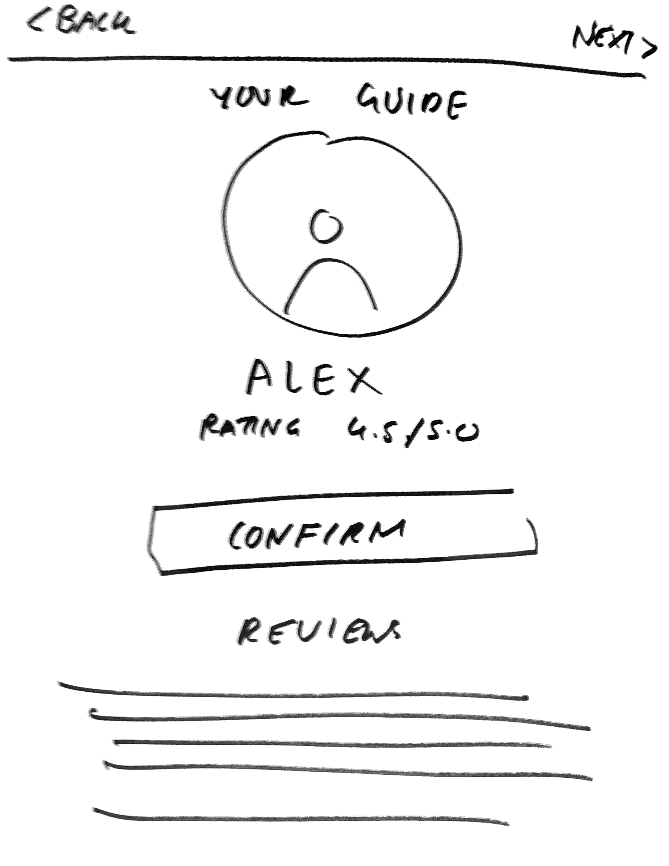
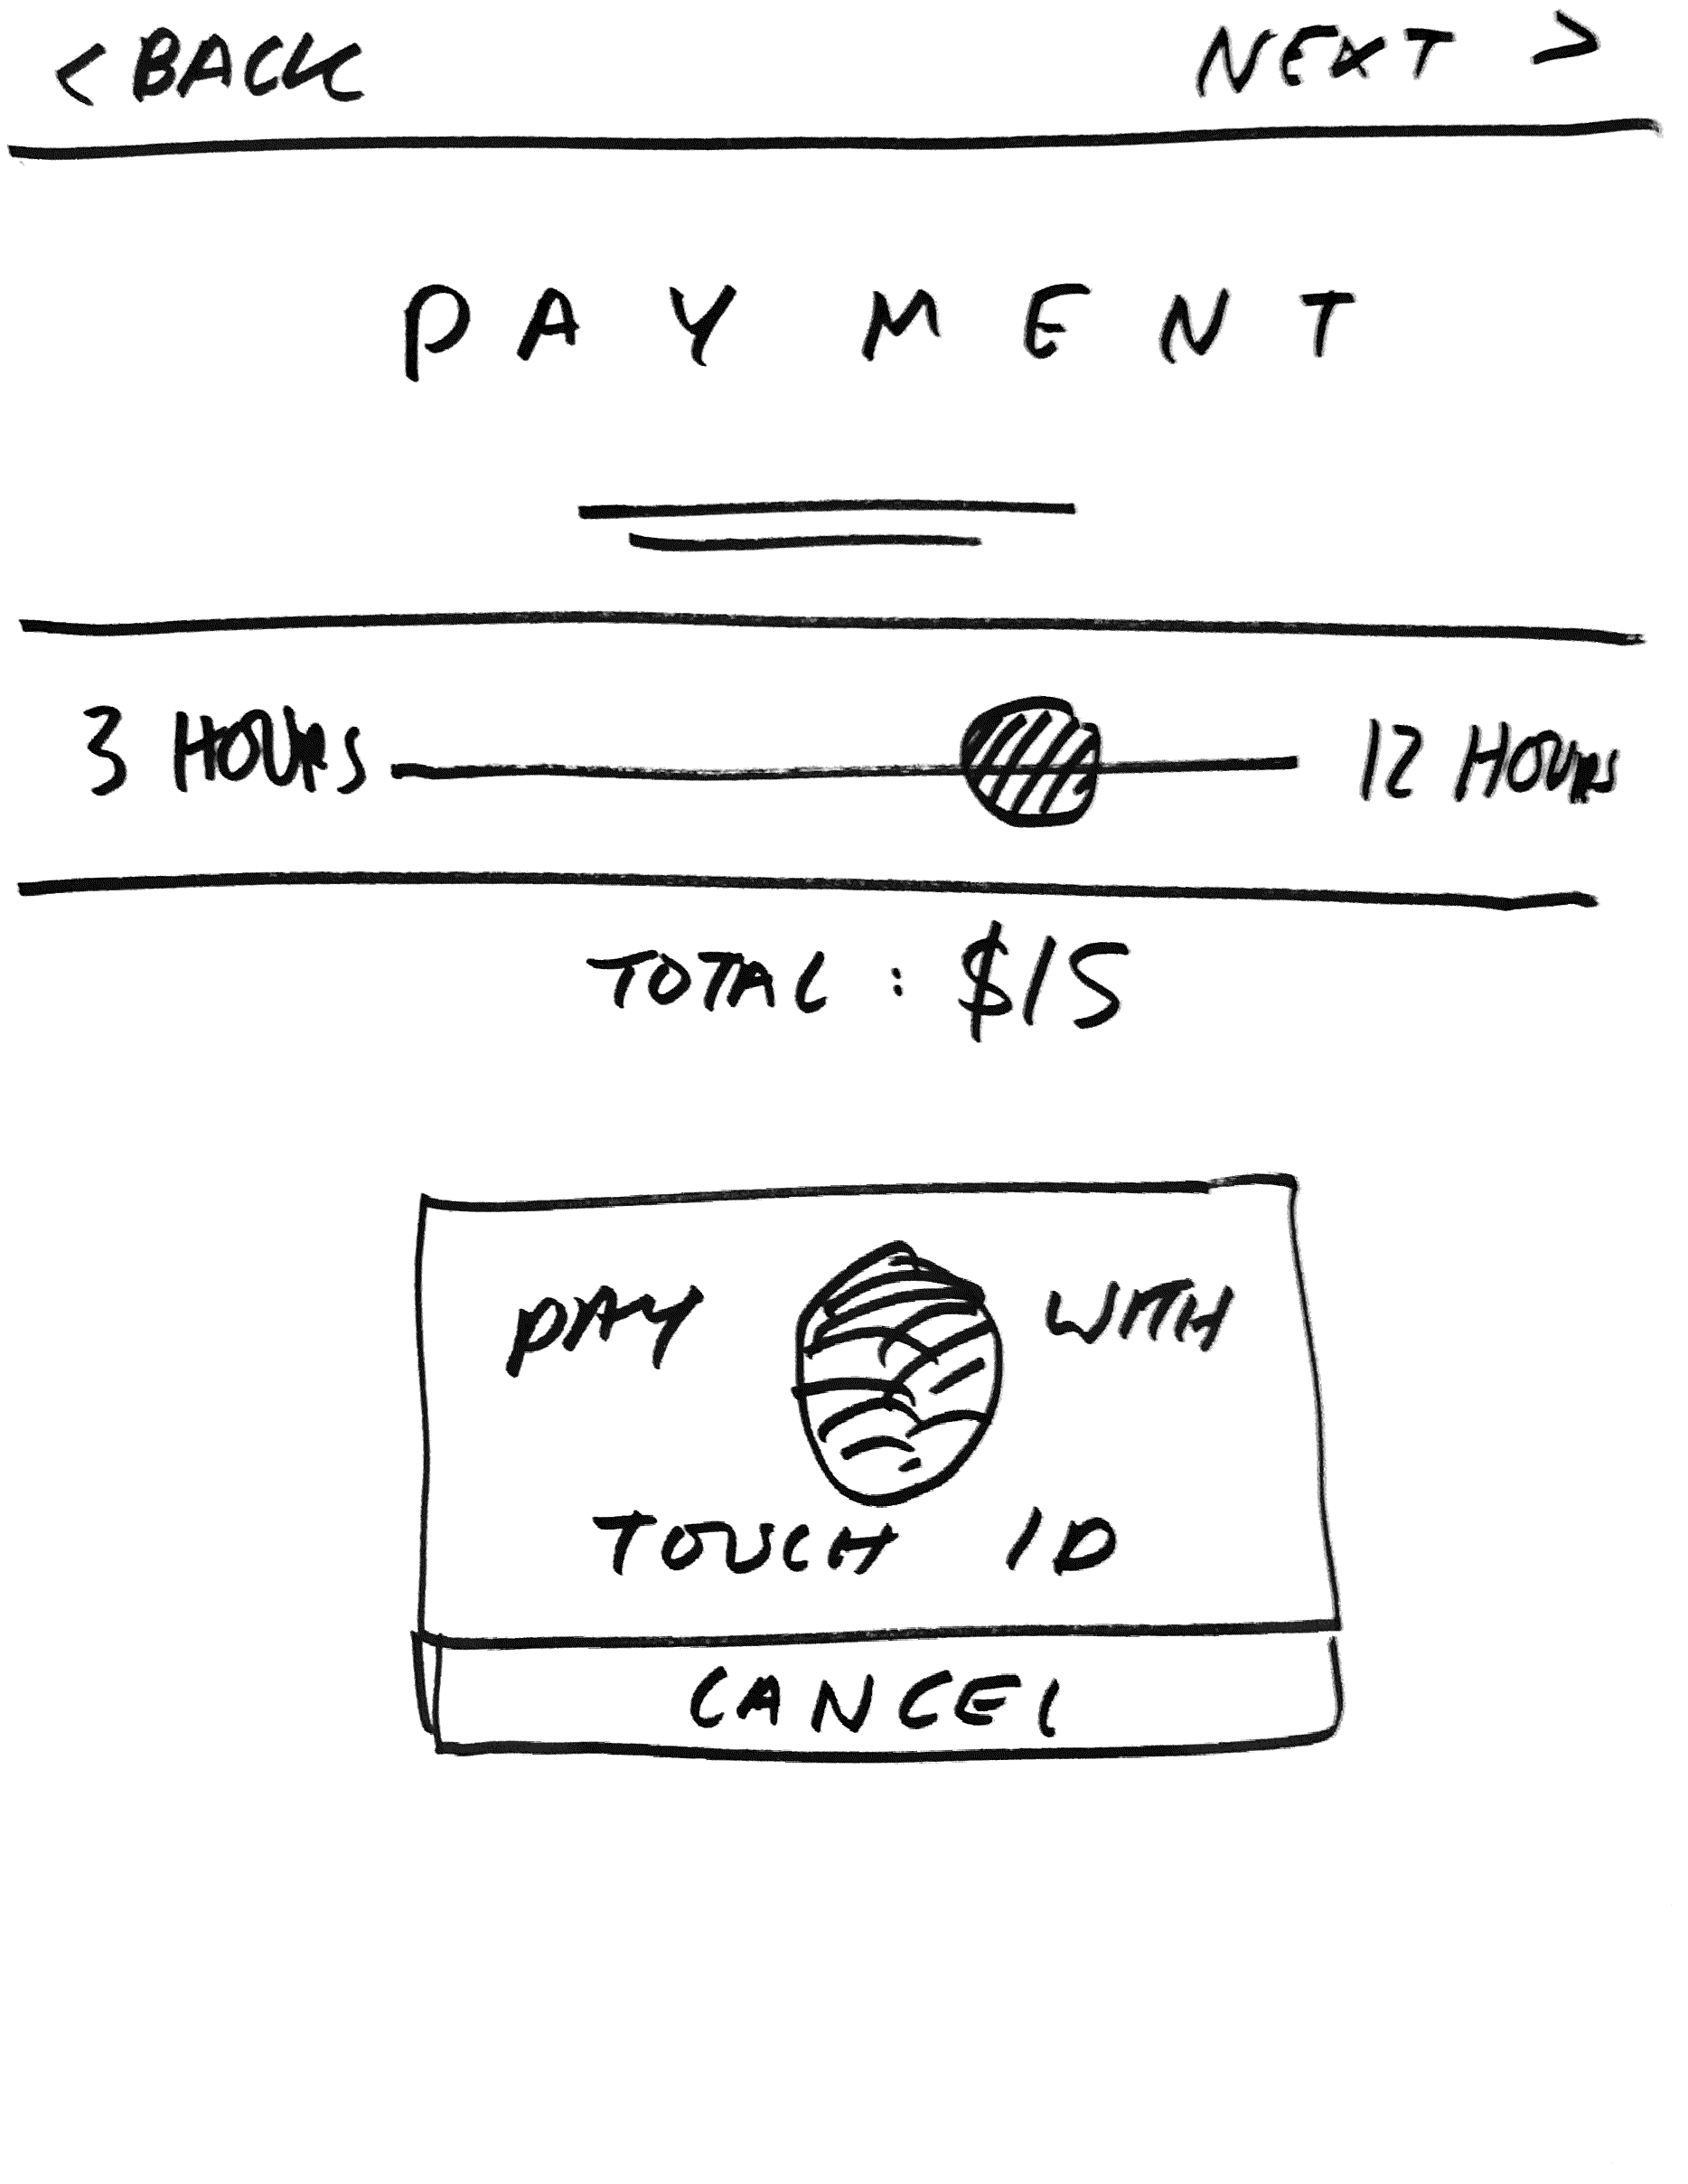
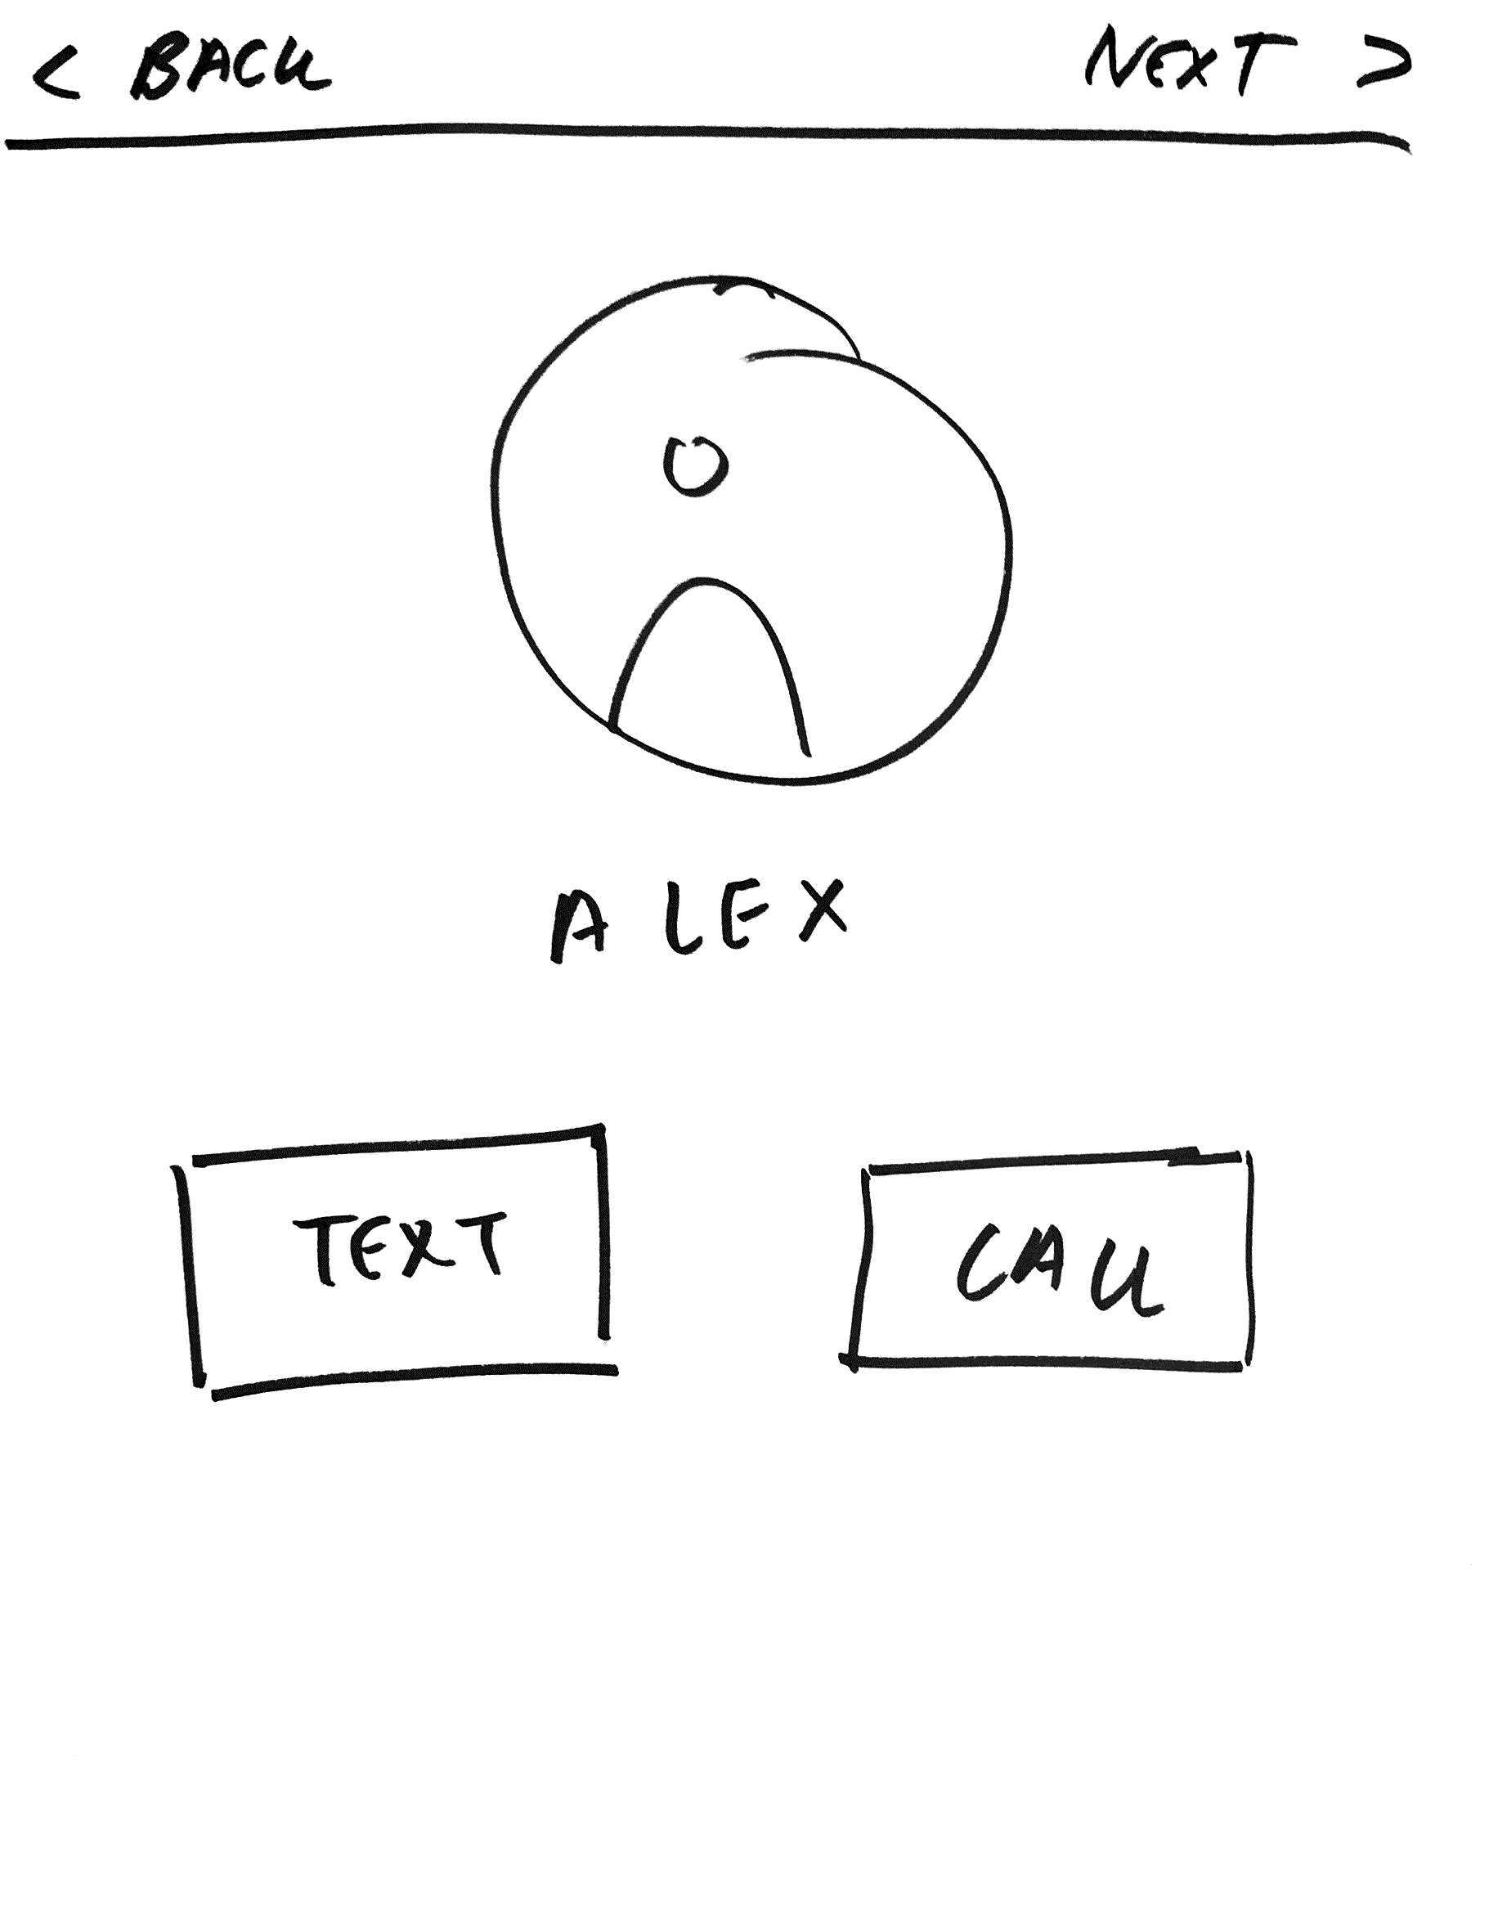
R E V I S E D S K E T C H E S

Slide 32
Introduction
Value Prop, Problem and Solution Overview
Tasks
Revised Interface Design
Medium-Fi Prototype Task Flows
Prototype Overview
Summary

Slide 33
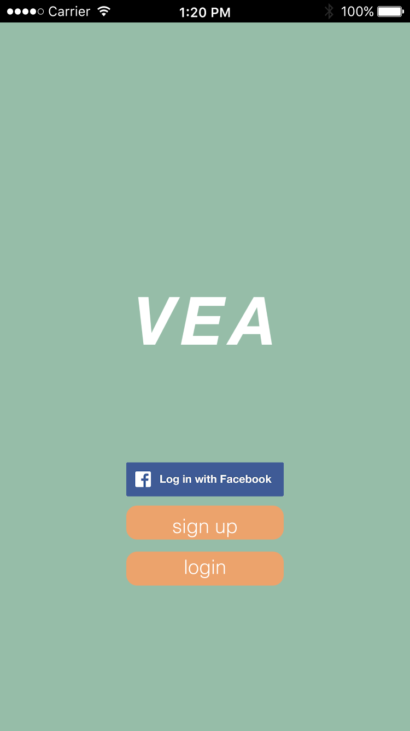
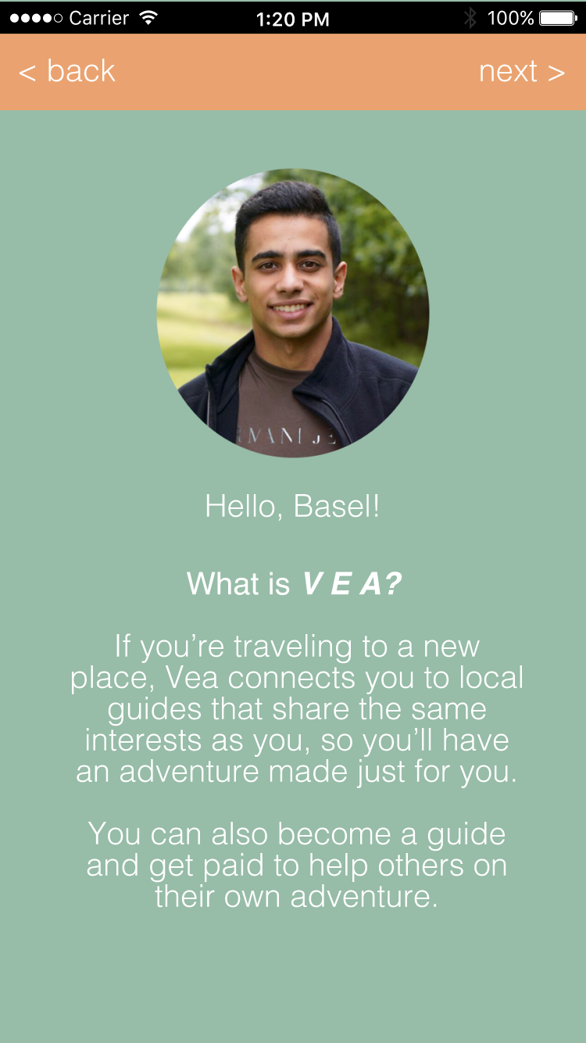
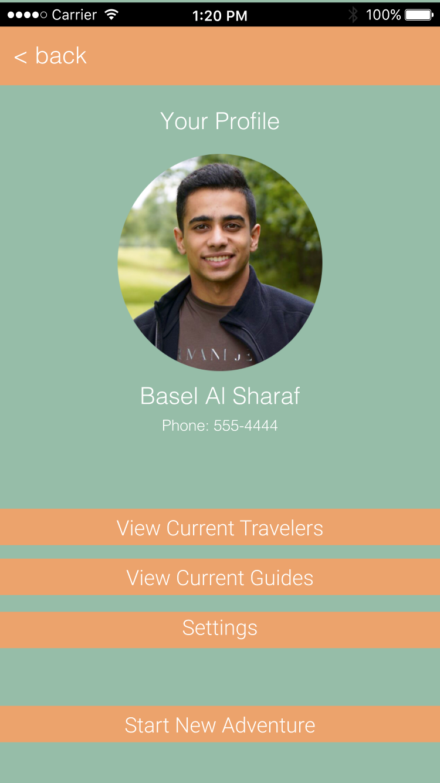
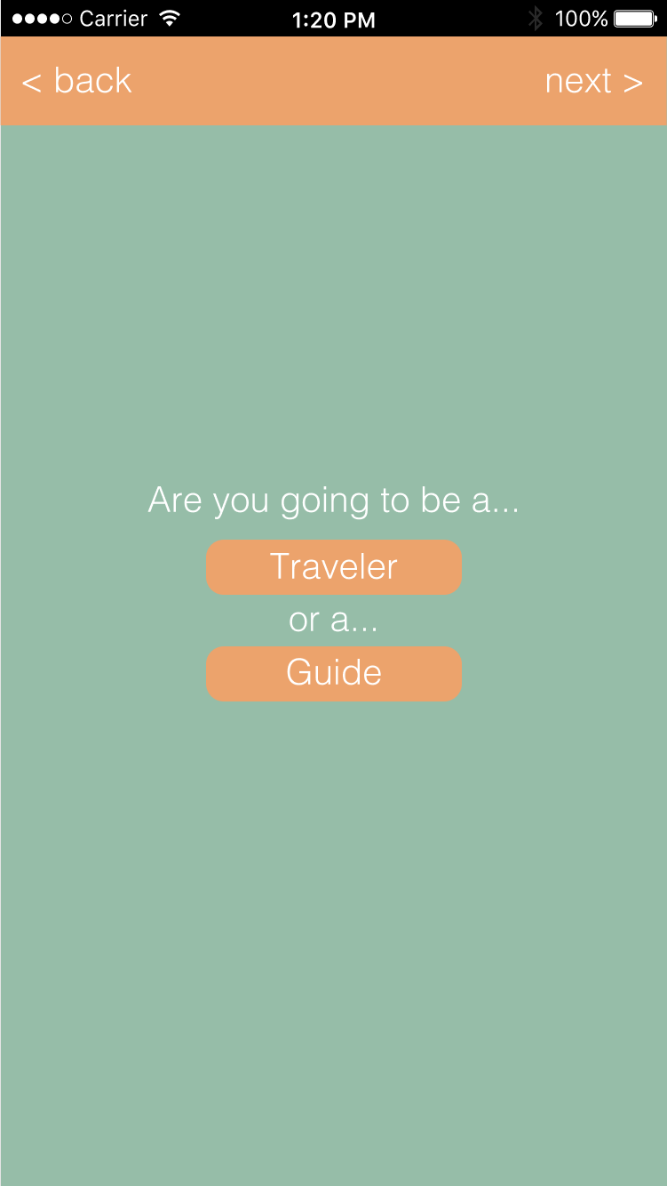
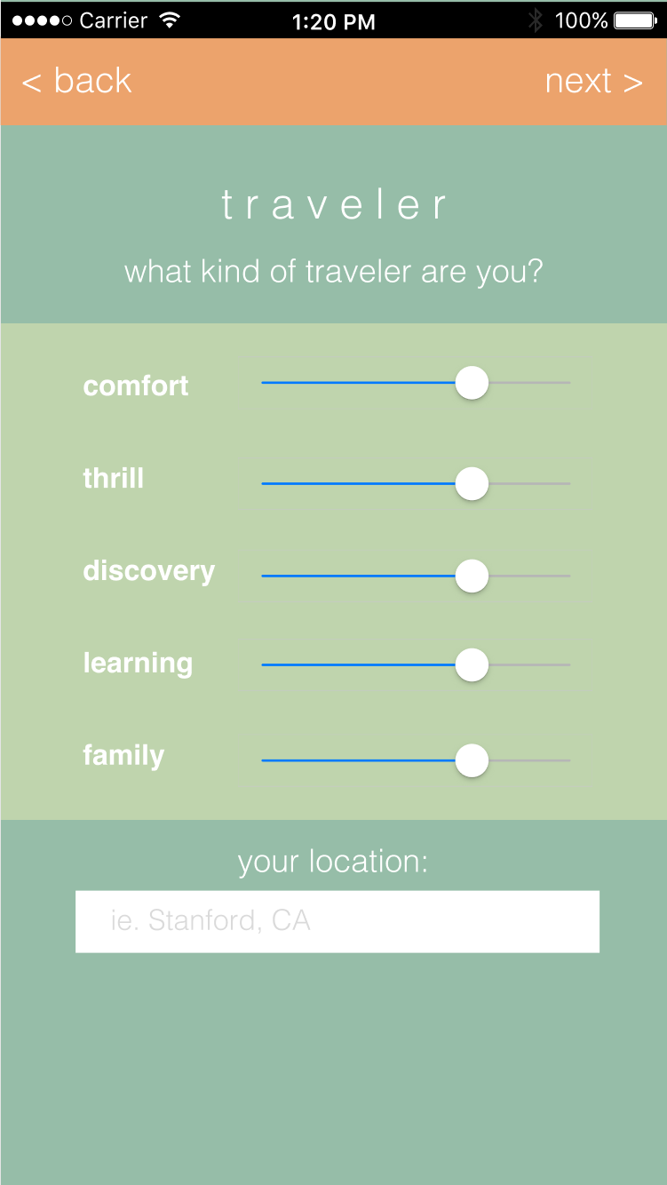
T A S K I

Slide 34
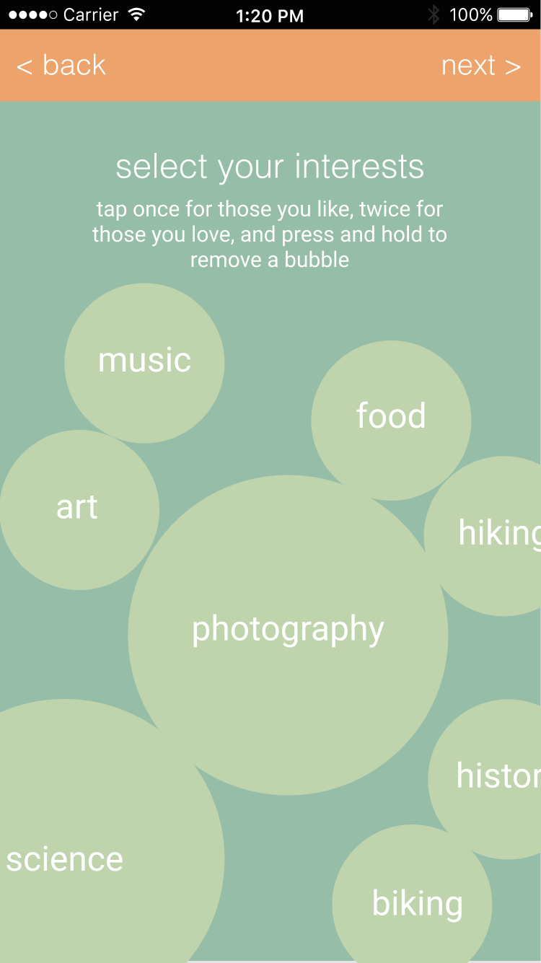
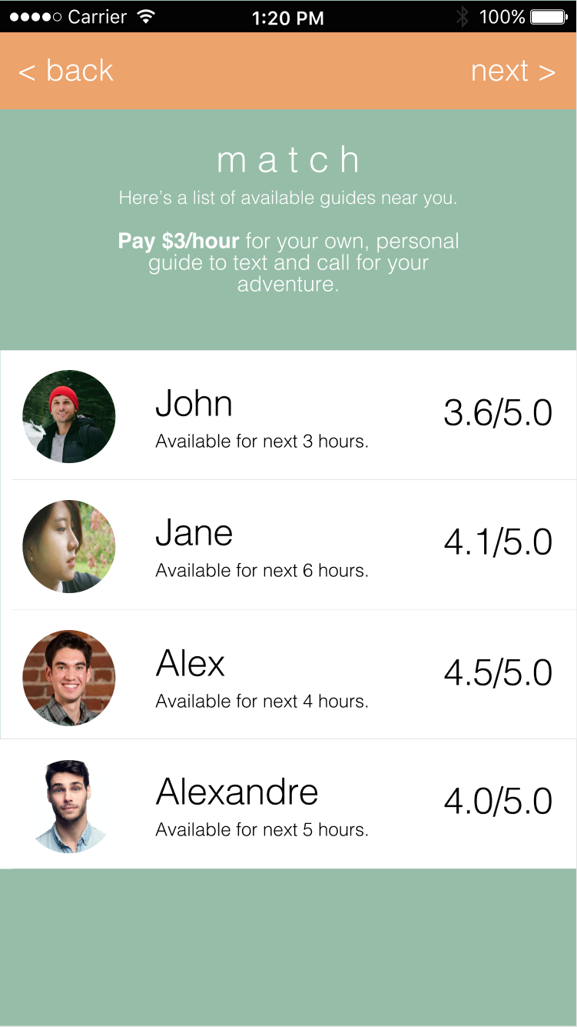
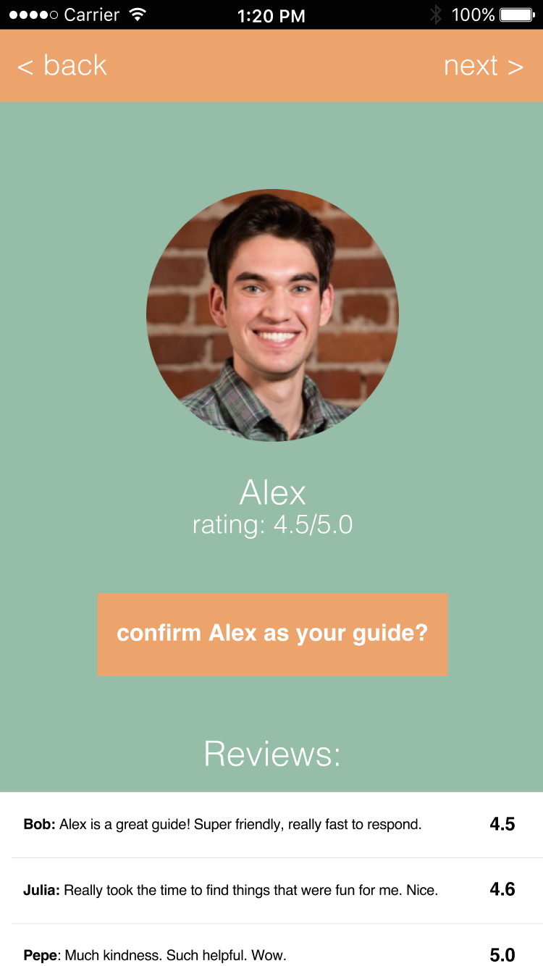
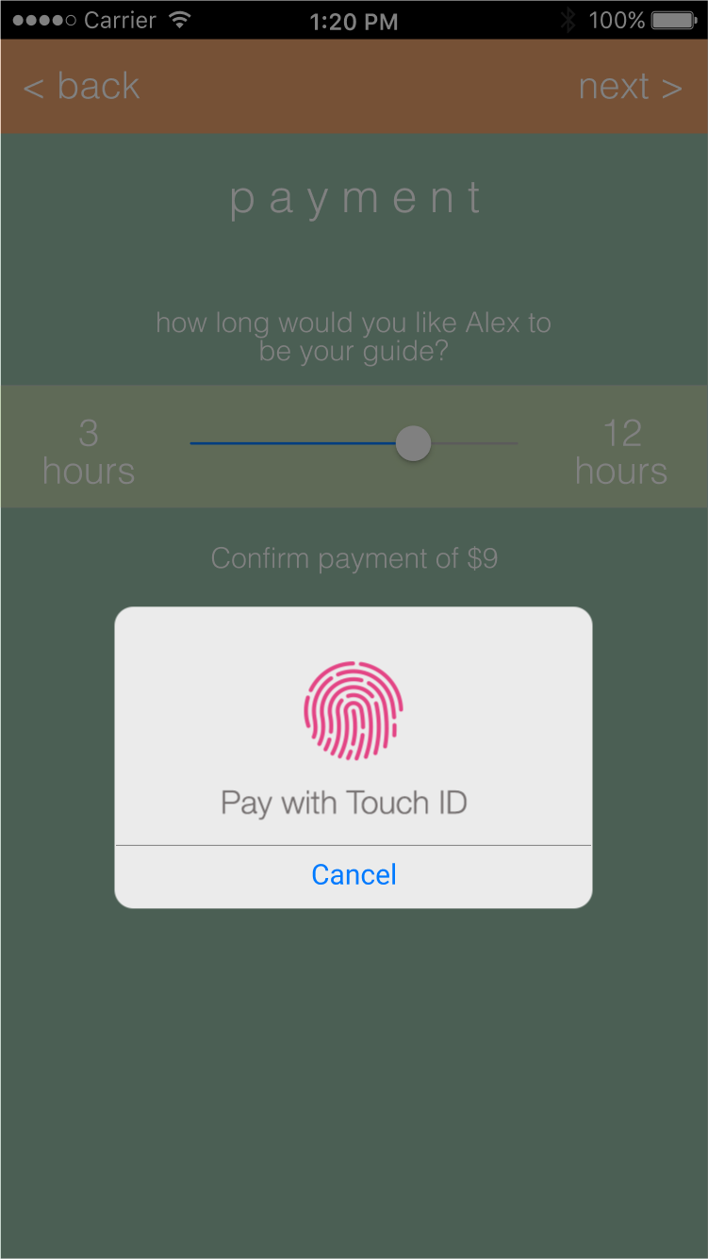
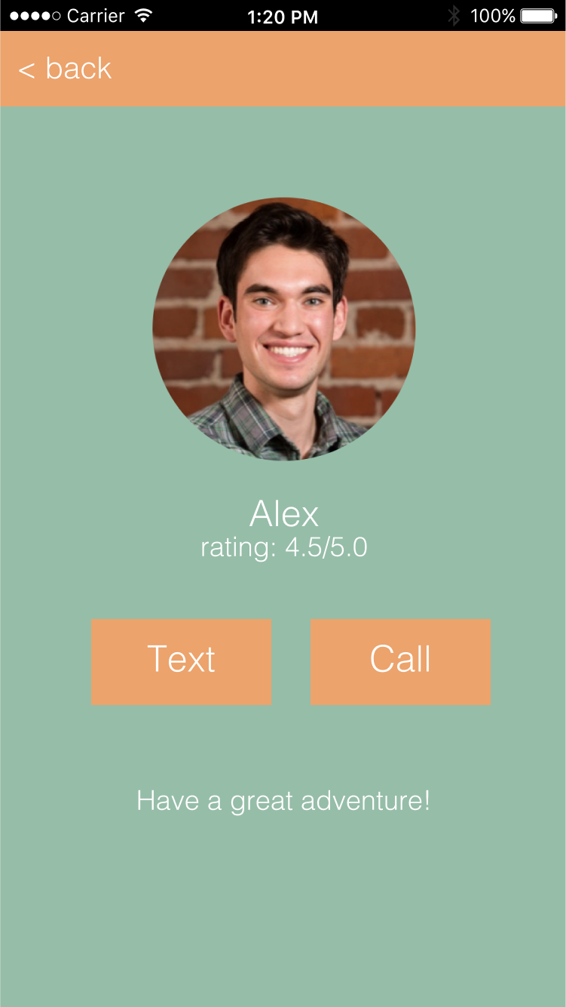
T A S K I

Slide 35
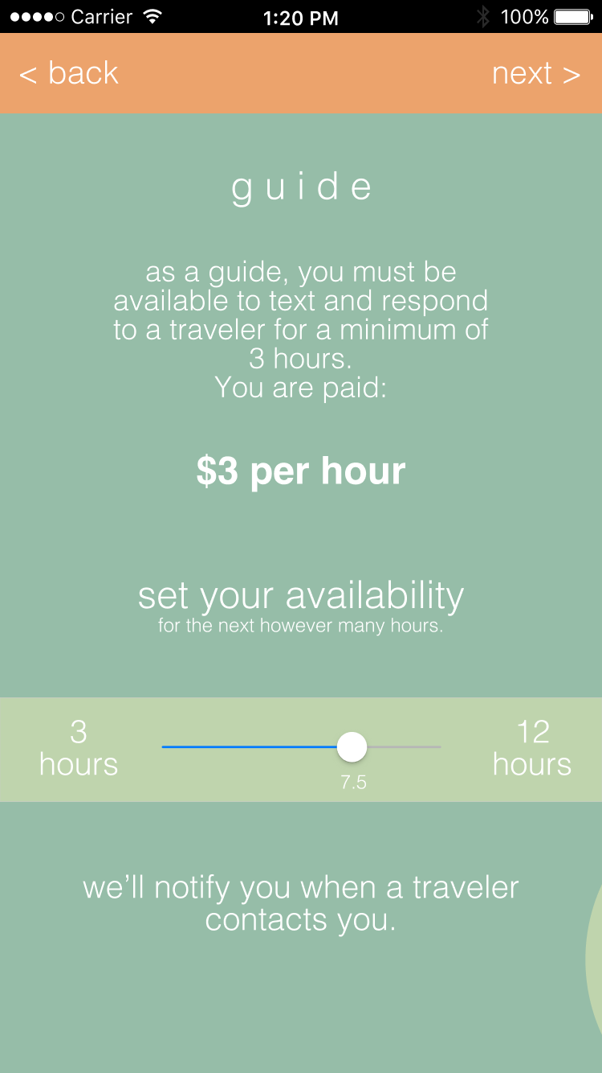
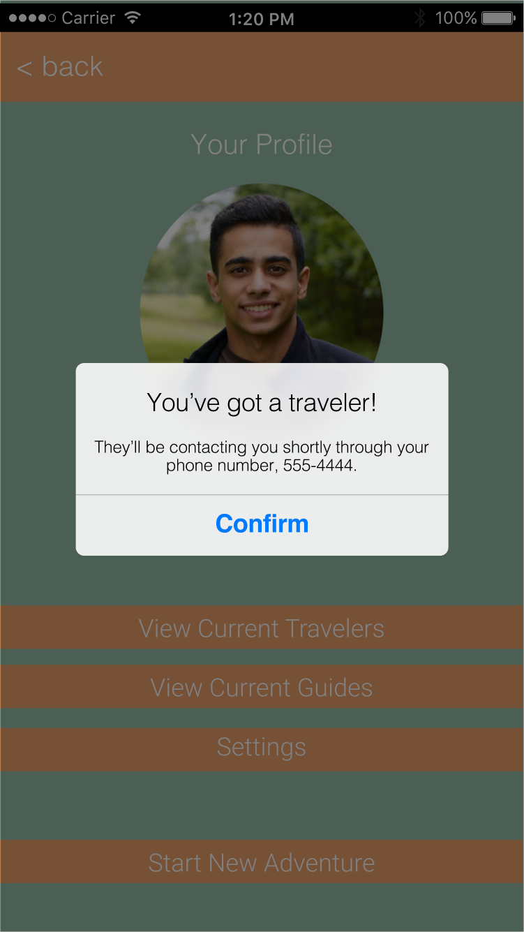
T A S K II

Slide 36
T A S K III
We depend on communication between the traveler and the guide to facilitate this
Like Uber, we provide phone number of guide and use money incentives and ratings for guides to help travelers

Slide 37
M E D I U M – F I P R O T O T Y P E

Slide 38


P R O T O T Y P I N G T O O L S
+
Helped with collaborative planning & prototyping
Helped to pull the app together cohesively

Slide 39
L I M I T A T I O N S
Figma seems limited in that you can’t crop objects within, requiring post-processing cropping of images. Lack of fonts make it difficult to work on iOS interfaces on Windows. Required constant internet connection to maintain changes, and WebGL would crash occasionally from bulk copying/pasting/resizing.
Left out proper sign-in sequence, actual messaging between traveler & guide. We place trust in the guide to help the traveler.

Slide 40
W I Z A R D O F O Z T E C H N I Q U E S
Match-making process based on interests, payment options for user. Both require a more in-depth behind the scenes work to actually function.

Slide 41
H A R D – C O D E D F E A T U R E S
Match-making process, getting alert that a traveler is connected to you, payment processing. All are a little too complex to show in a task flow, but are integral to each task.

Slide 42
Introduction
Value Prop, Problem and Solution Overview
Tasks
Revised Interface Design
Medium-Fi Prototype Task Flows
Prototype Overview
Summary

Slide 43
S U M M A R Y
Realized the tradeoffs between our low-fi and med-fi prototyping
Improved our UI based on feedback from last week
Looking forward to building our complete app!

Slide 45
Q U E S T I O N S

