Slide 1

L O W – F I P R O T O T Y P E
[ M I C R O ] A D V E N T U R E

Slide 2

Overview
Team Mission Statement
Selected Interface & Rationale
Low-fi Prototype Structure
Task Flows
Experimental Method
Experimental Results
Suggested UI Changes
Summary

Slide 3
Overview
Team Mission Statement
Selected Interface & Rationale
Low-fi Prototype Structure
Task Flows
Experimental Method
Experimental Results
Suggested UI Changes
Summary

Slide 4
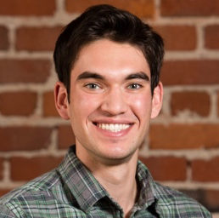


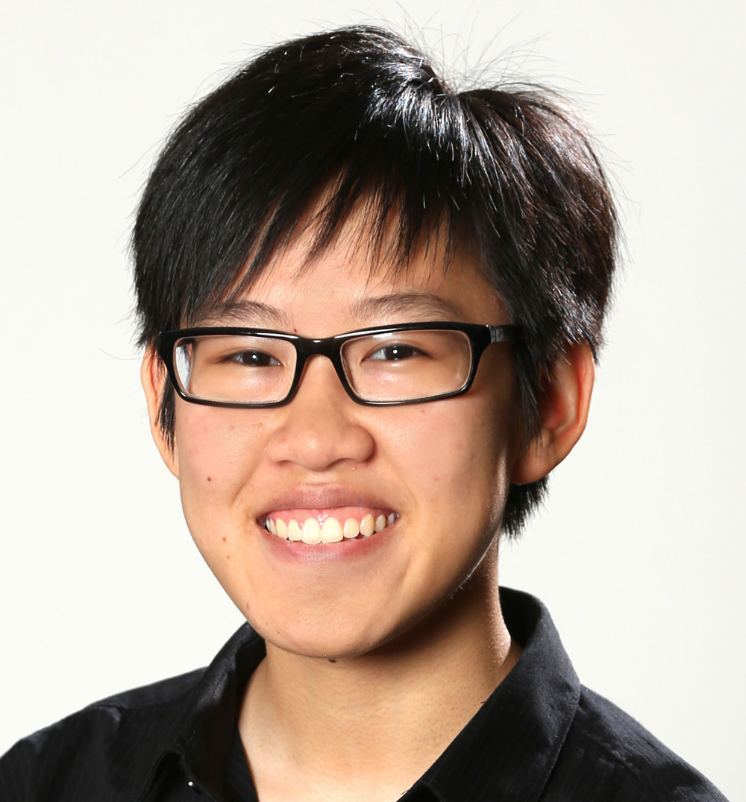
O U R T E A M
Alex Alexandre Basel Kim
Usability Testing
Software Engineering
Design
Team Manager

Slide 5
O V E R V I E W
Identified problem
Proposed solution
Testing
Improvements
Repeat

Slide 6
Overview
Team Mission Statement
Selected Interface & Rationale
Low-fi Prototype Structure
Task Flows
Experimental Method
Experimental Results
Suggested UI Changes
Summary

Slide 7

Planning a fun adventure takes too much time and effort

Slide 8
T E A M M I S S I O N S T A T E M E N T
Notes:
Adventurers enjoy spontaneity & new things; those aspects of traveling get taken away when they must plan every detail and activity of their trip.

Slide 9
T E A M M I S S I O N S T A T E M E N T
We want to help travelers
make the most out of their adventures

Slide 11
Noun {ˈβe.a } Latin | way, sail
Notes:
Our app relieves the stress of constant planning and connects the adventurer to a local guide who helps assist the adventurer in exploring a new area.

Slide 12
Overview
Team Mission Statement
Selected Interface & Rationale
Low-fi Prototype Structure
Task Flows
Experimental Method
Experimental Results
Suggested UI Changes
Summary

Slide 13
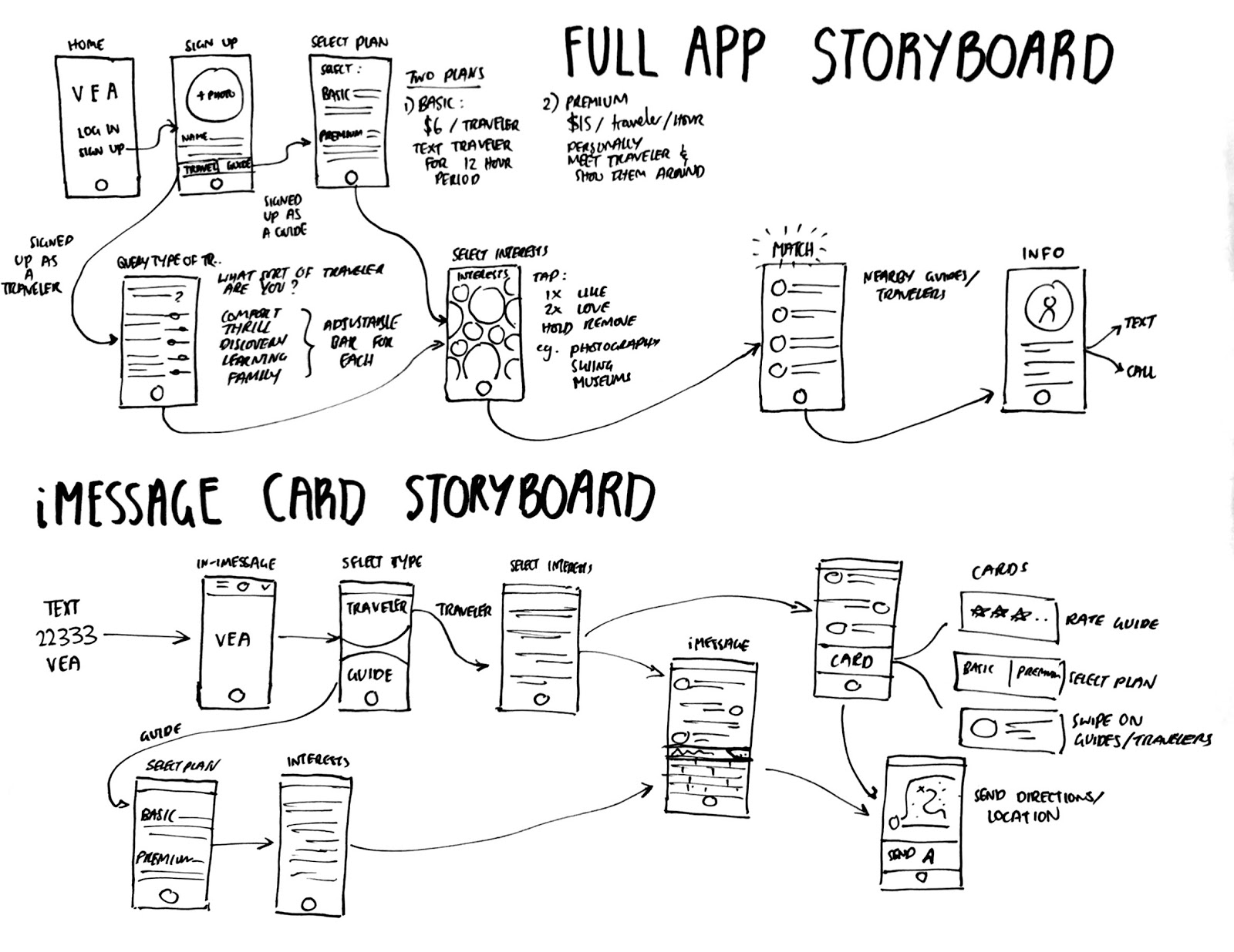
T O P C A N D I D A T E S

Slide 14
S E L E C T E D I N T E R F A C E

Slide 15
R A T I O N A L E
More control over the UI
Get analytics from our own app
Bigger opportunity to develop UI
iMessage card interface still relatively new and untested
More experience with full mobile apps
Recognizable app & icon for users

Slide 16
Overview
Team Mission Statement
Selected Interface & Rationale
Low-fi Prototype Structure
Task Flows
Experimental Method
Experimental Results
Suggested UI Changes
Summary

Slide 17
P R O T O T Y P E

Slide 18
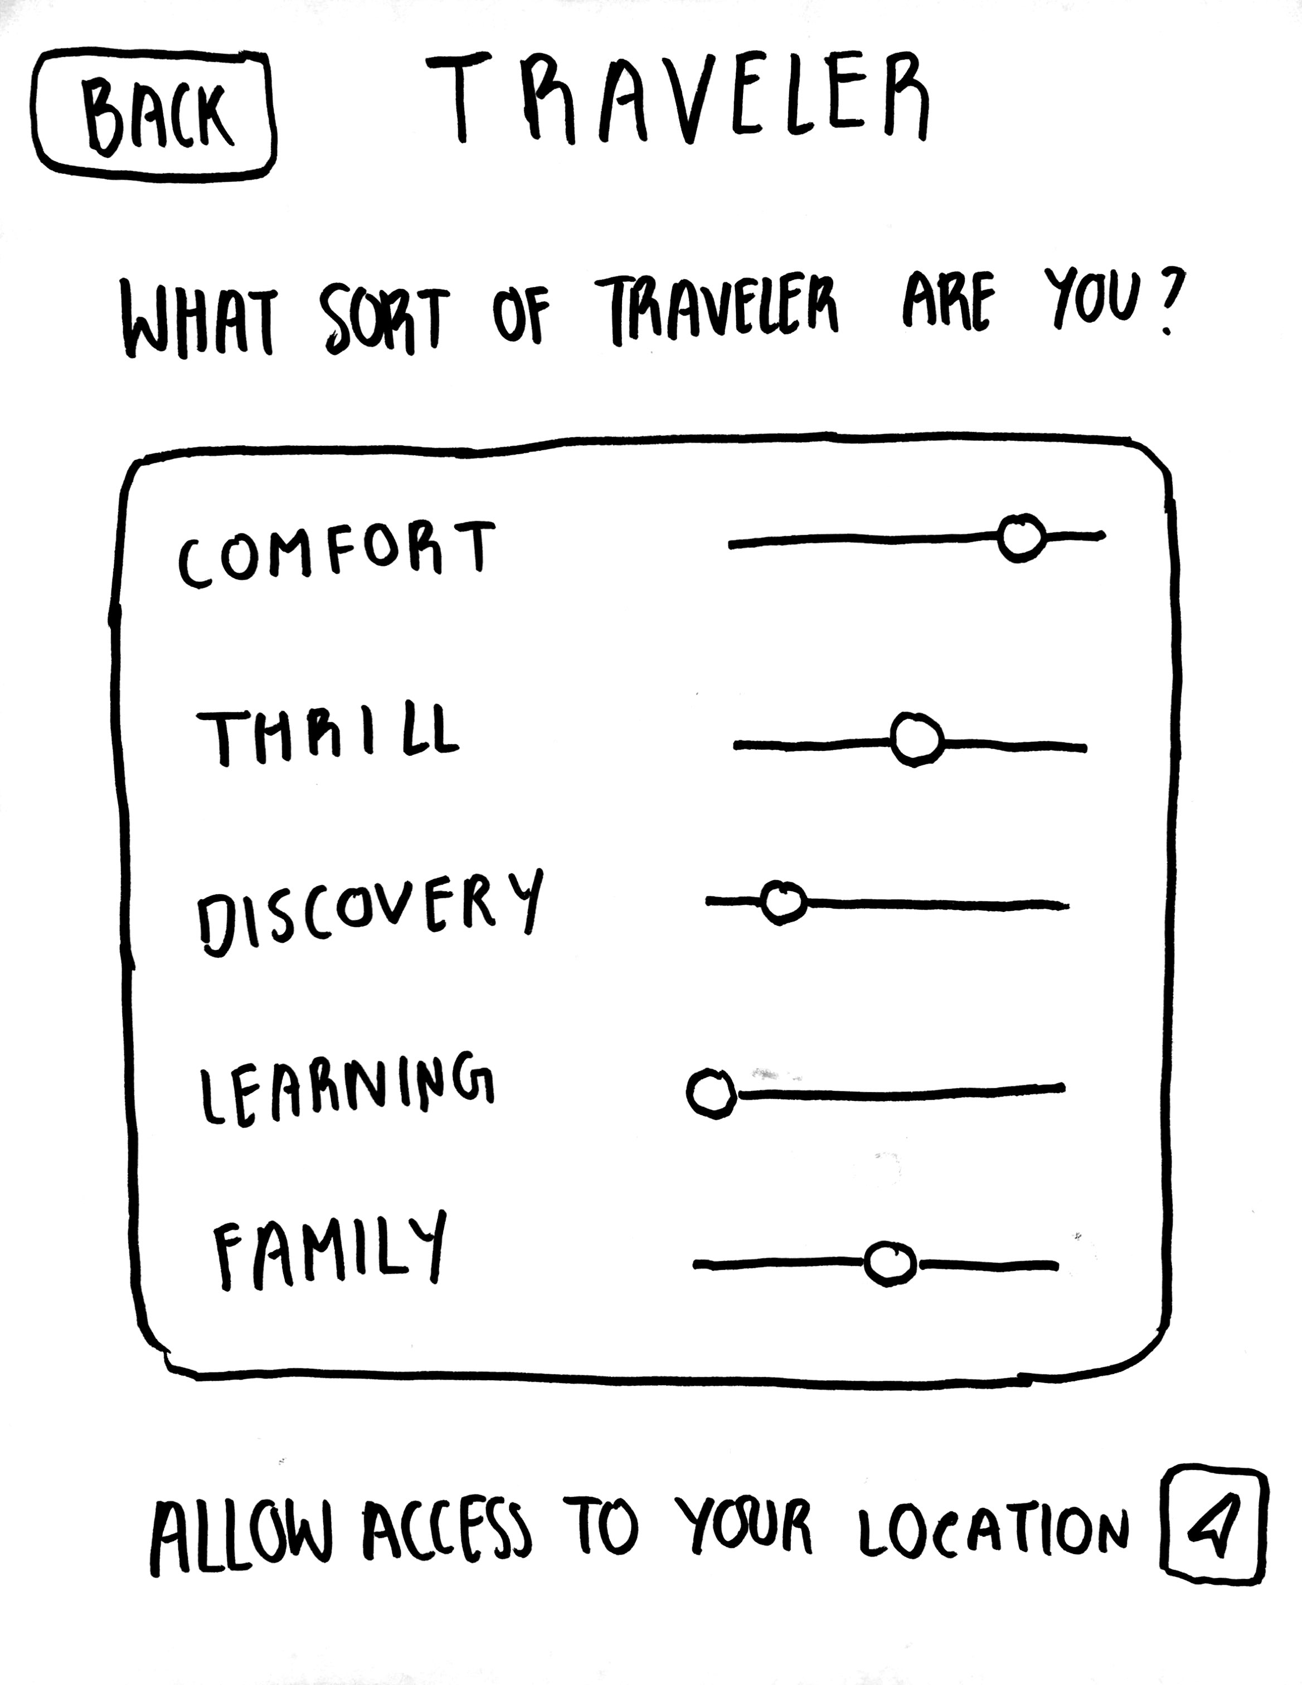
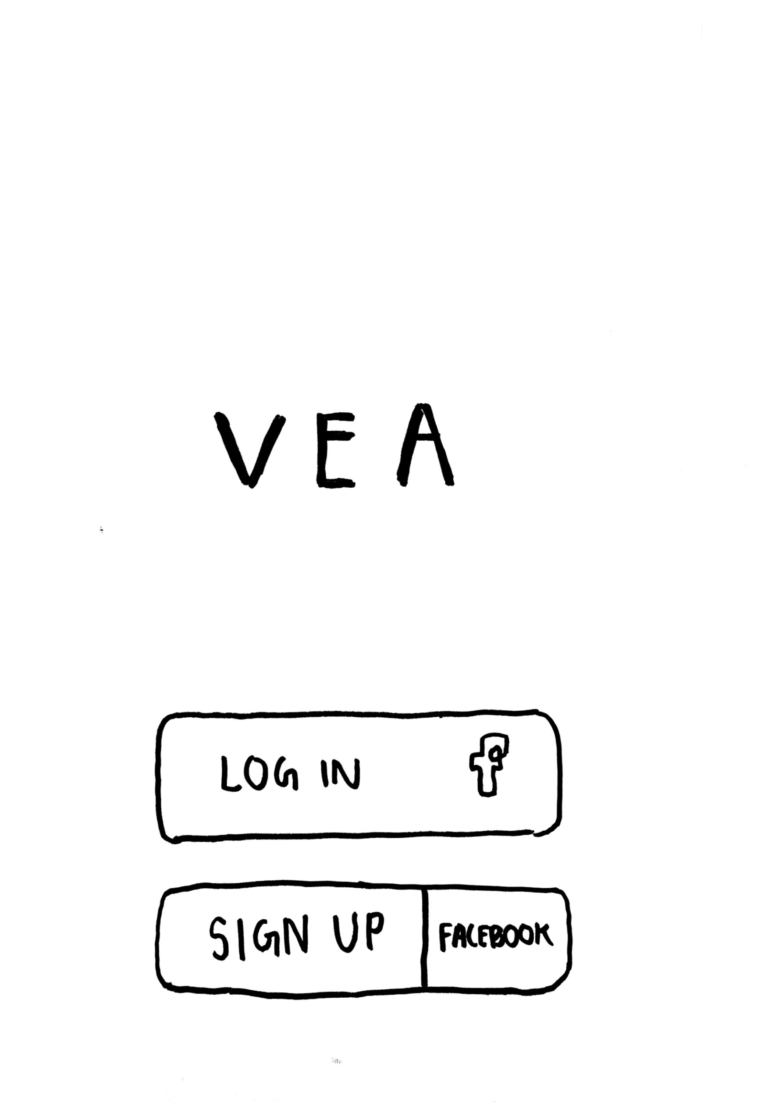
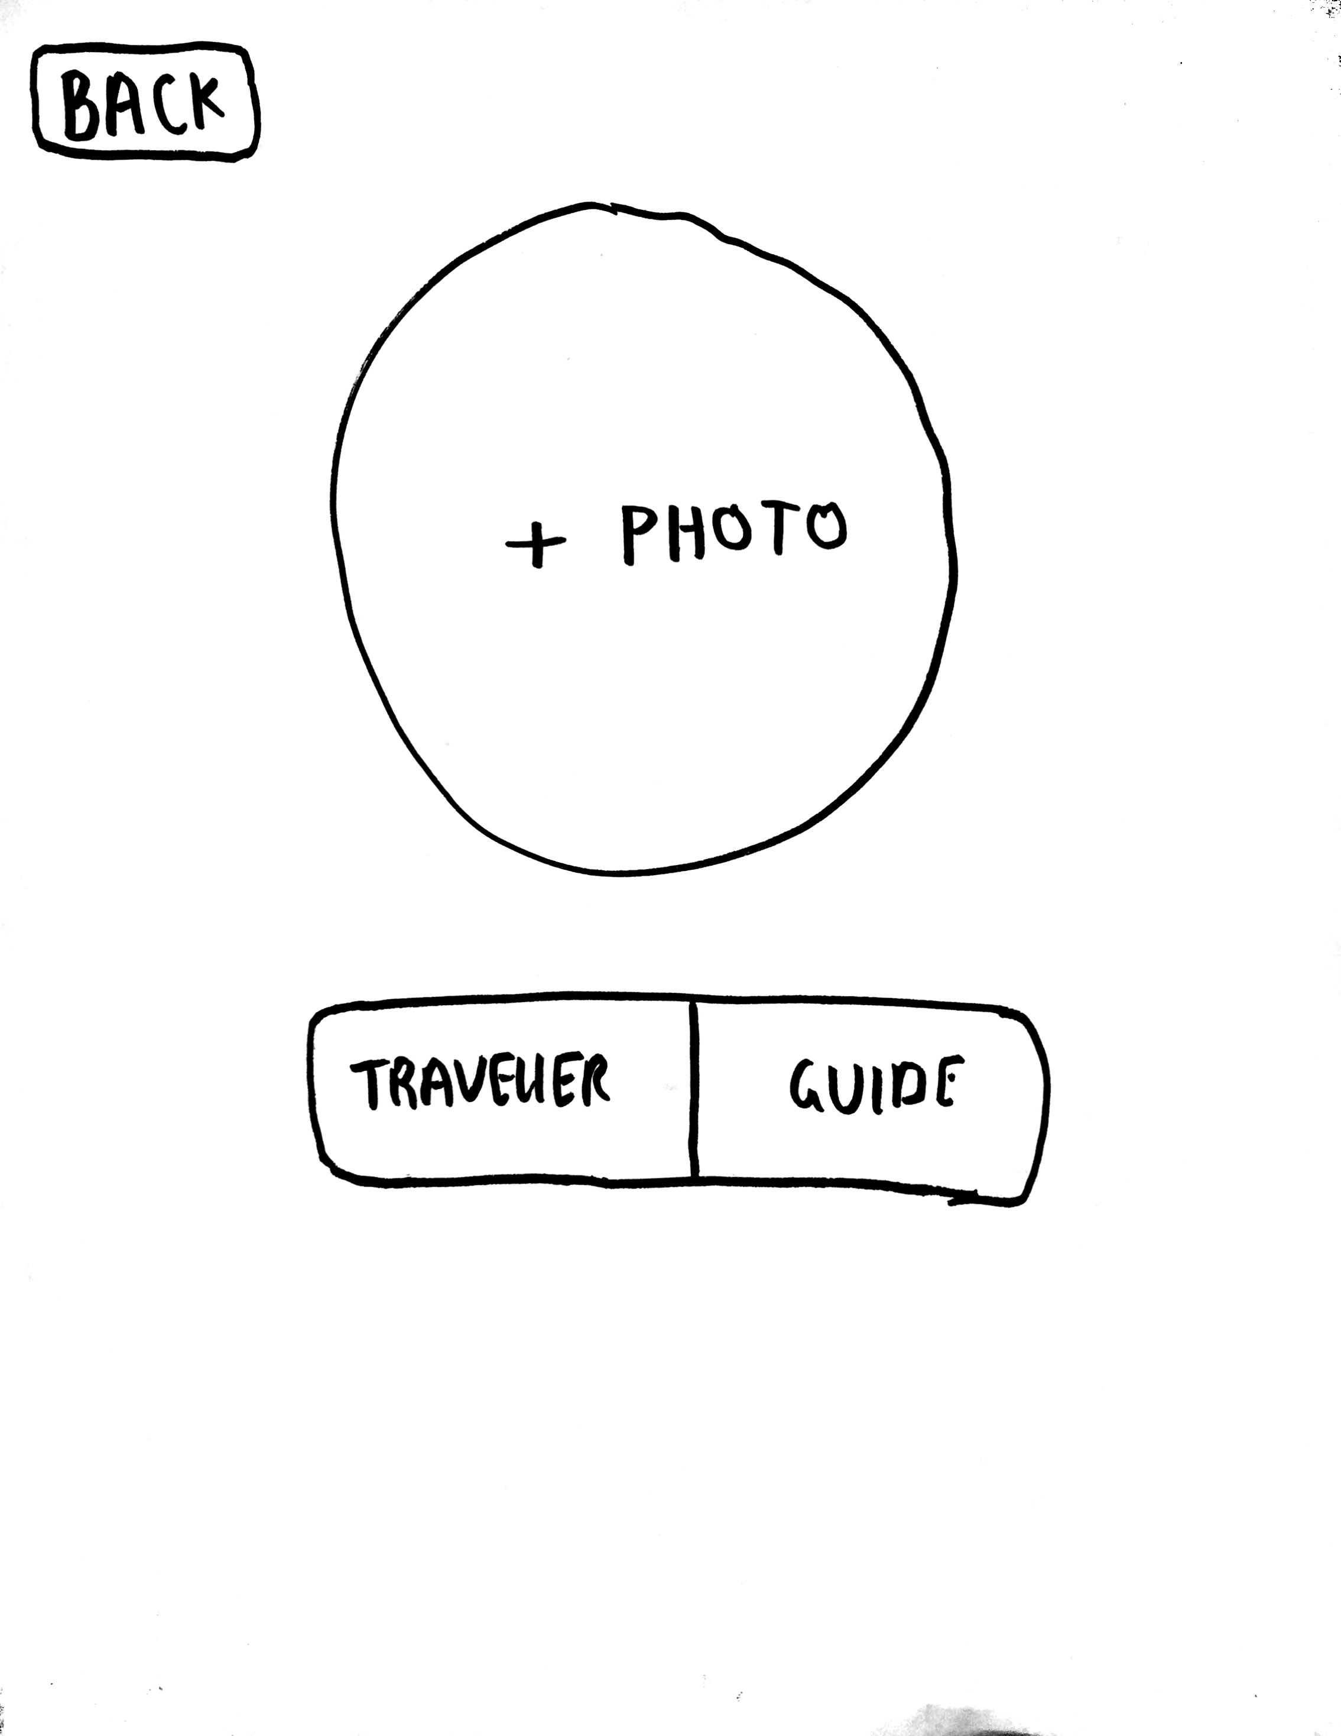
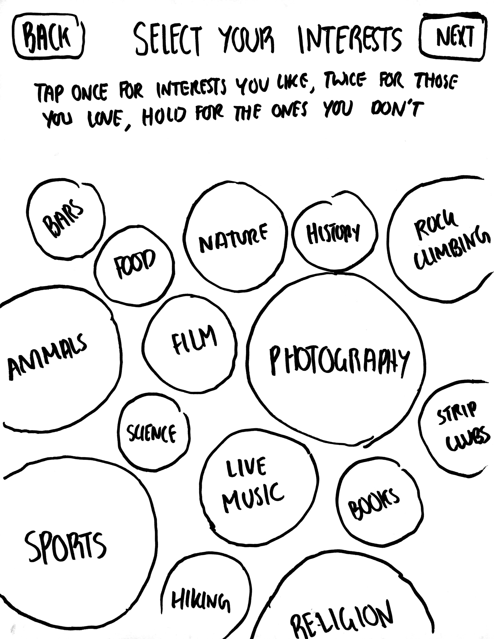
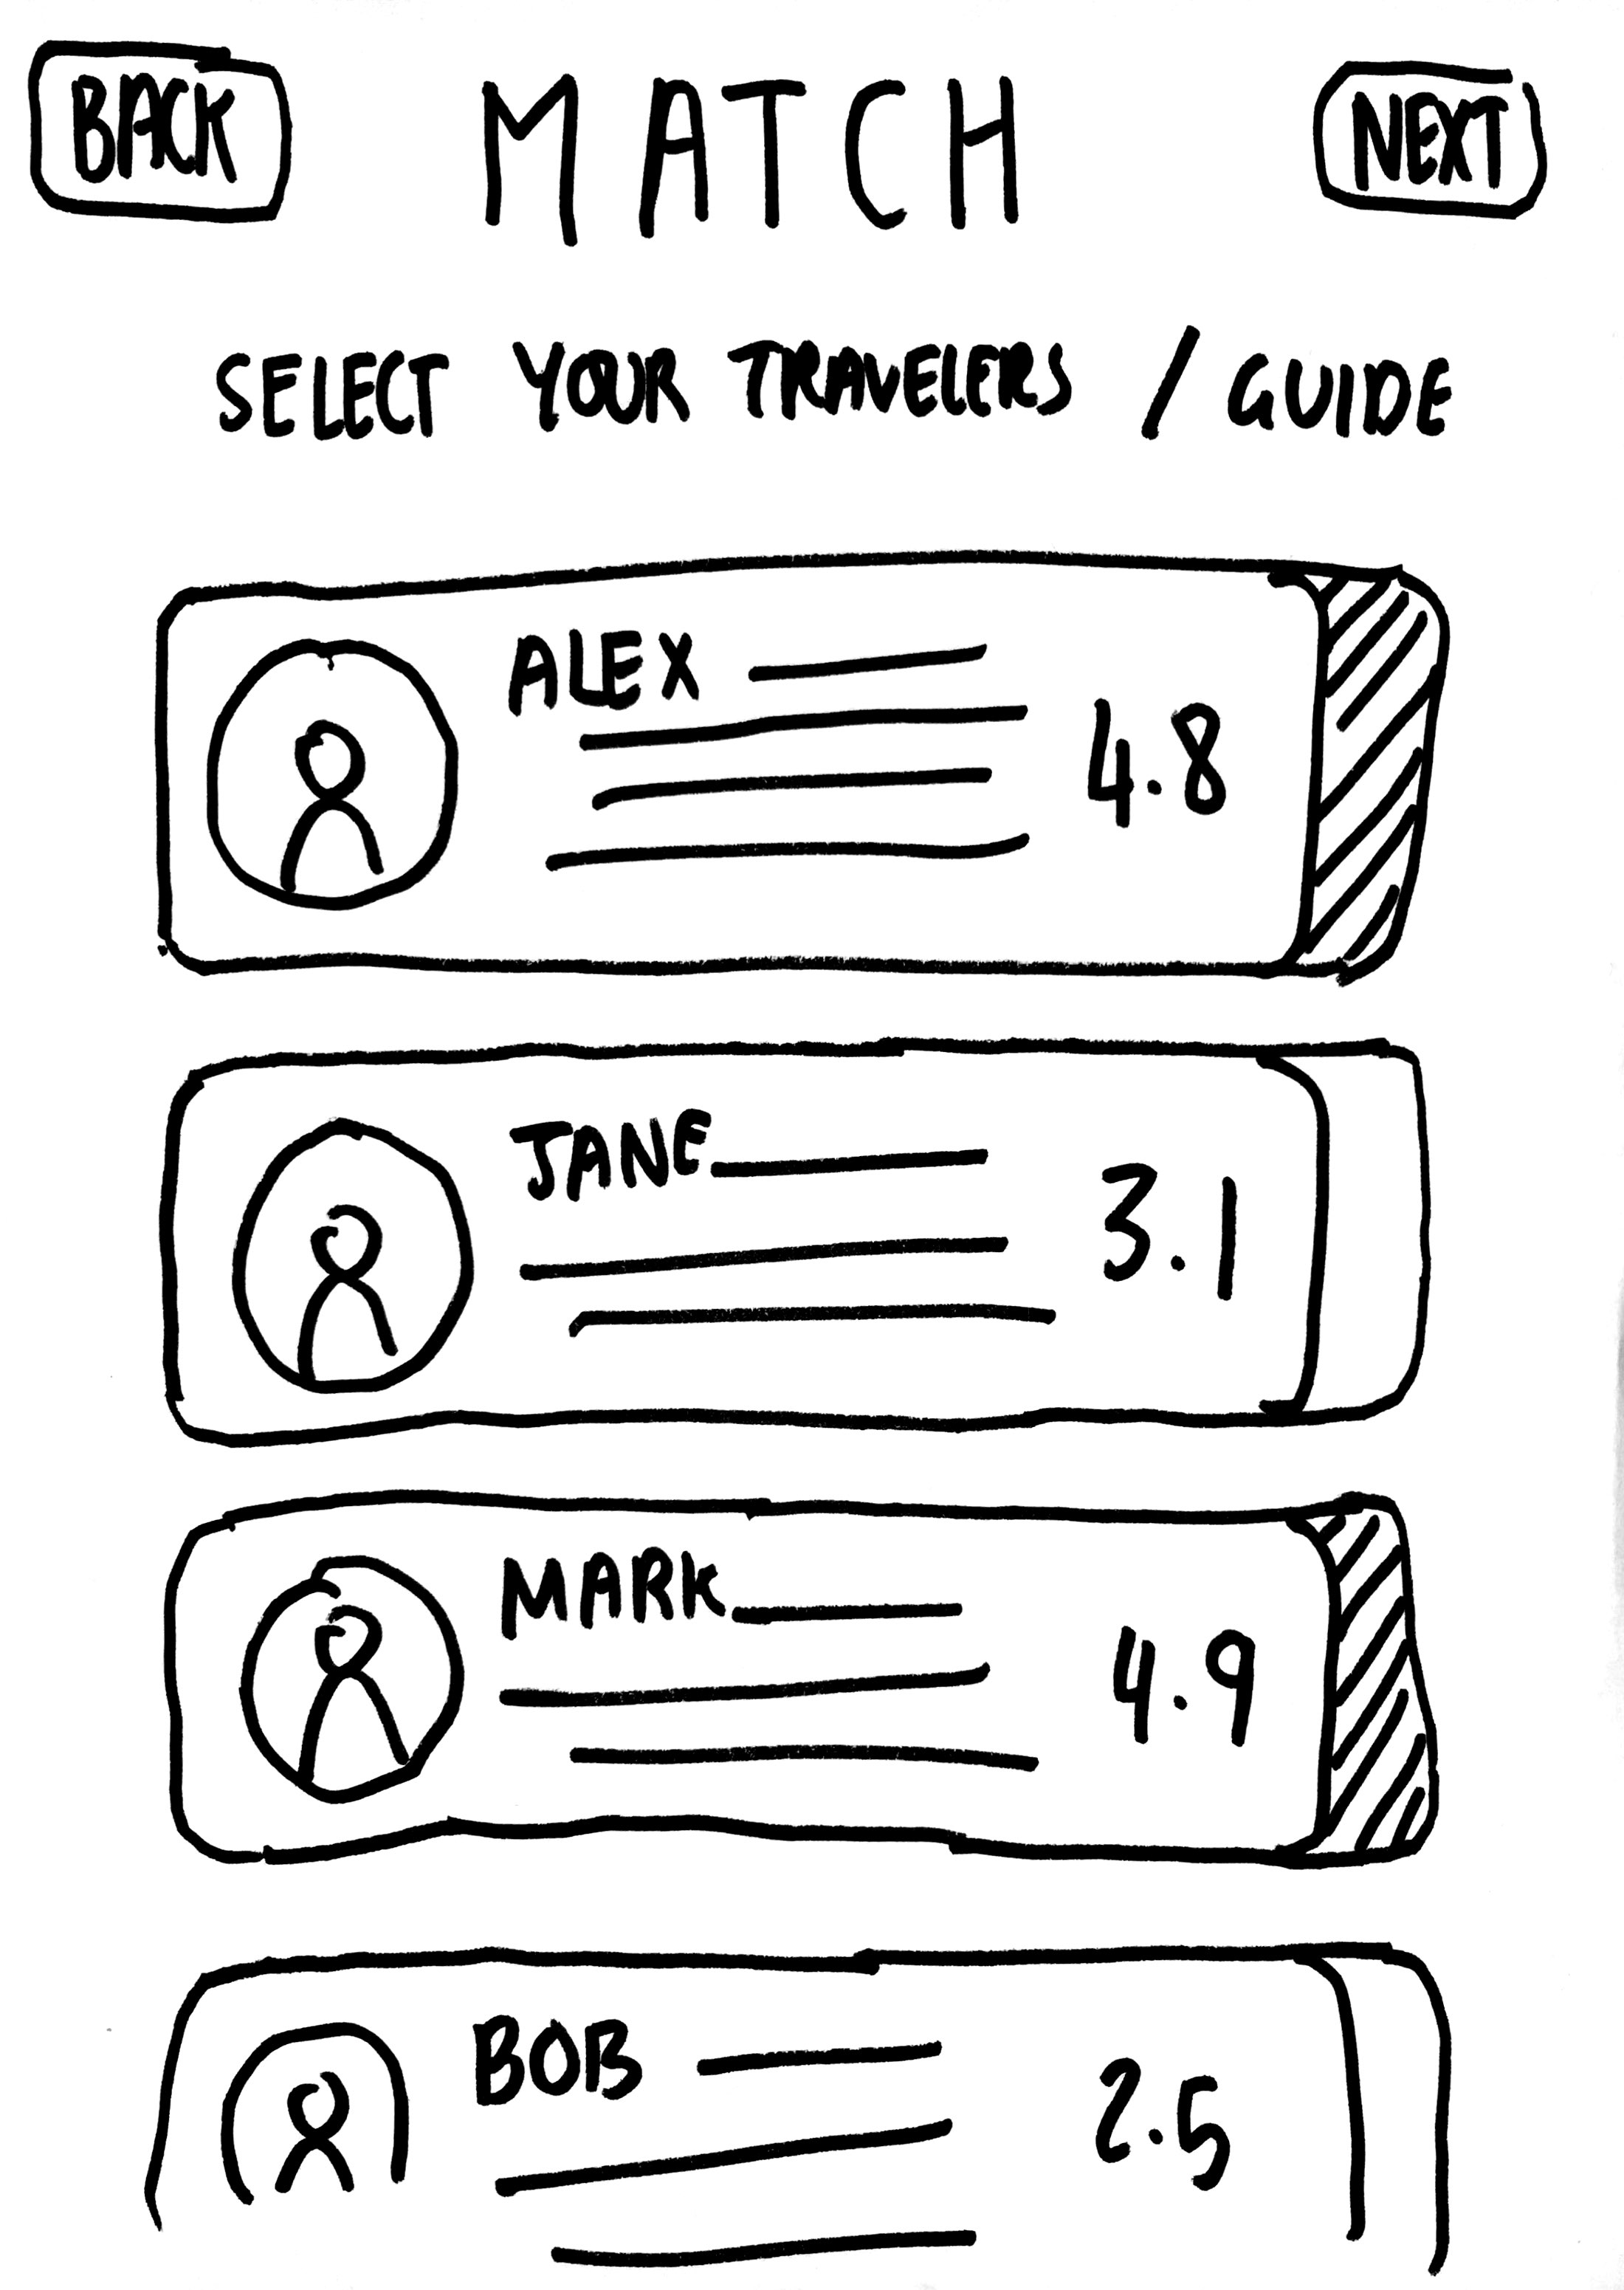
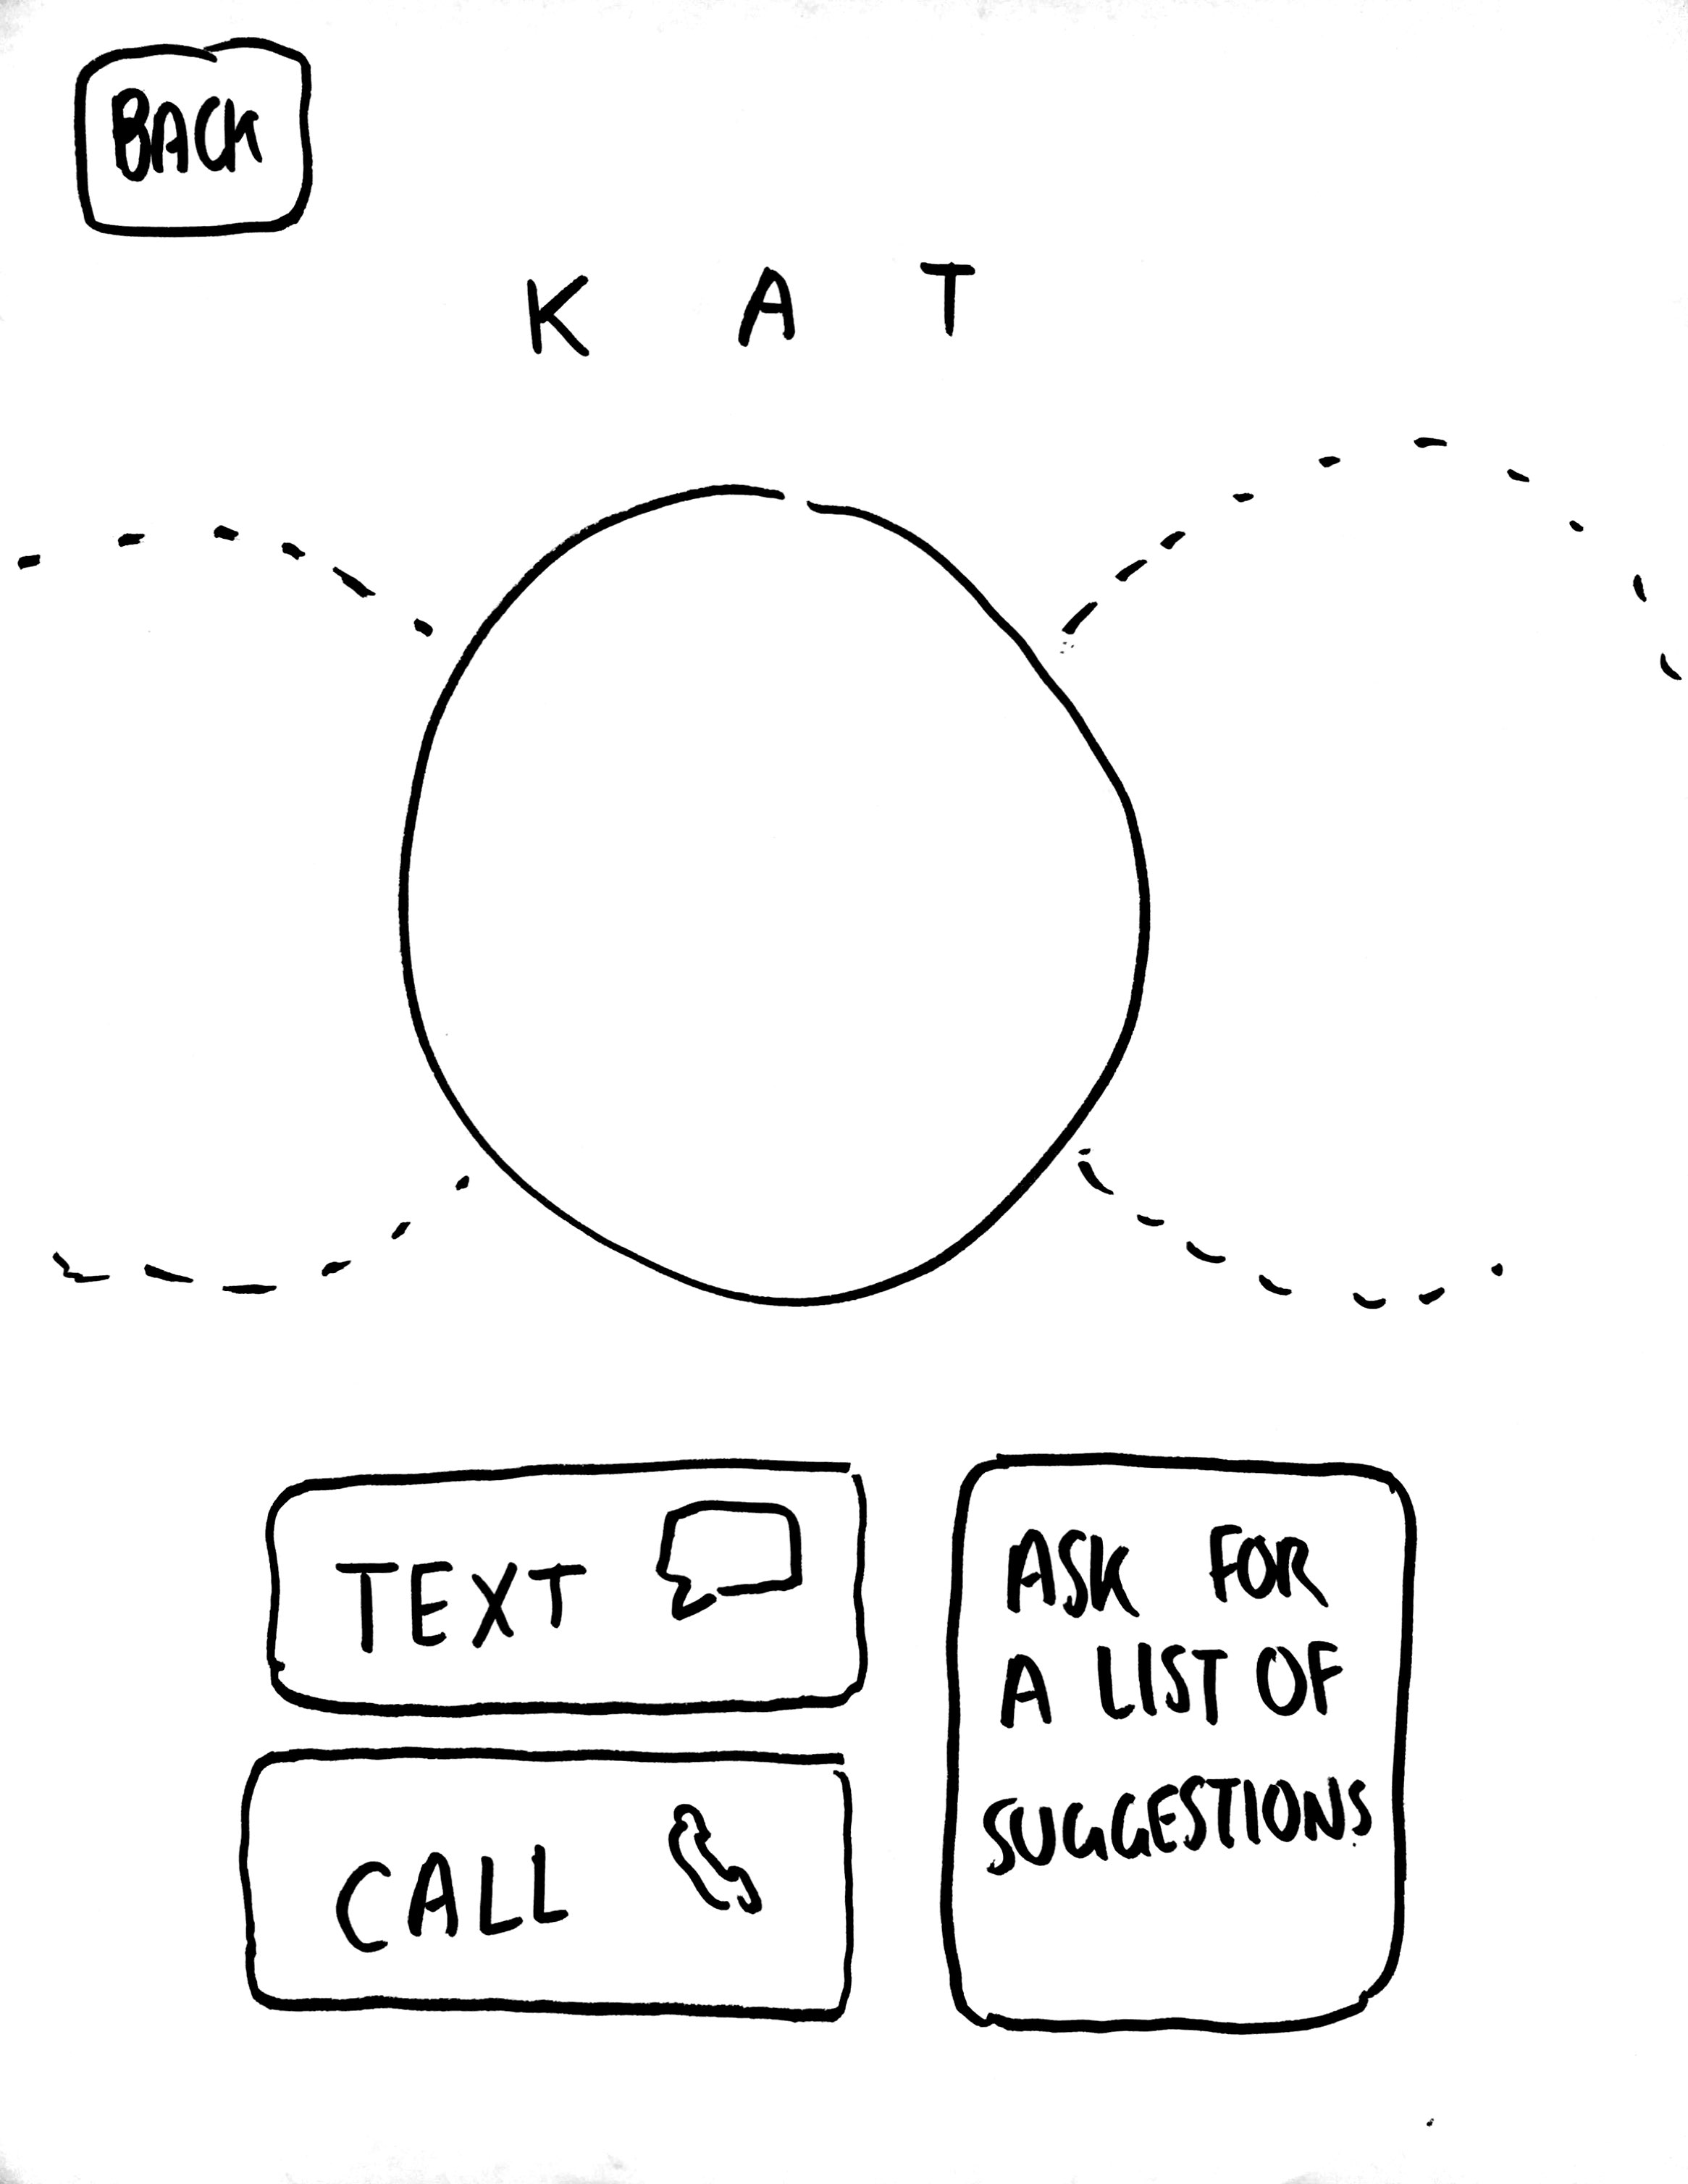
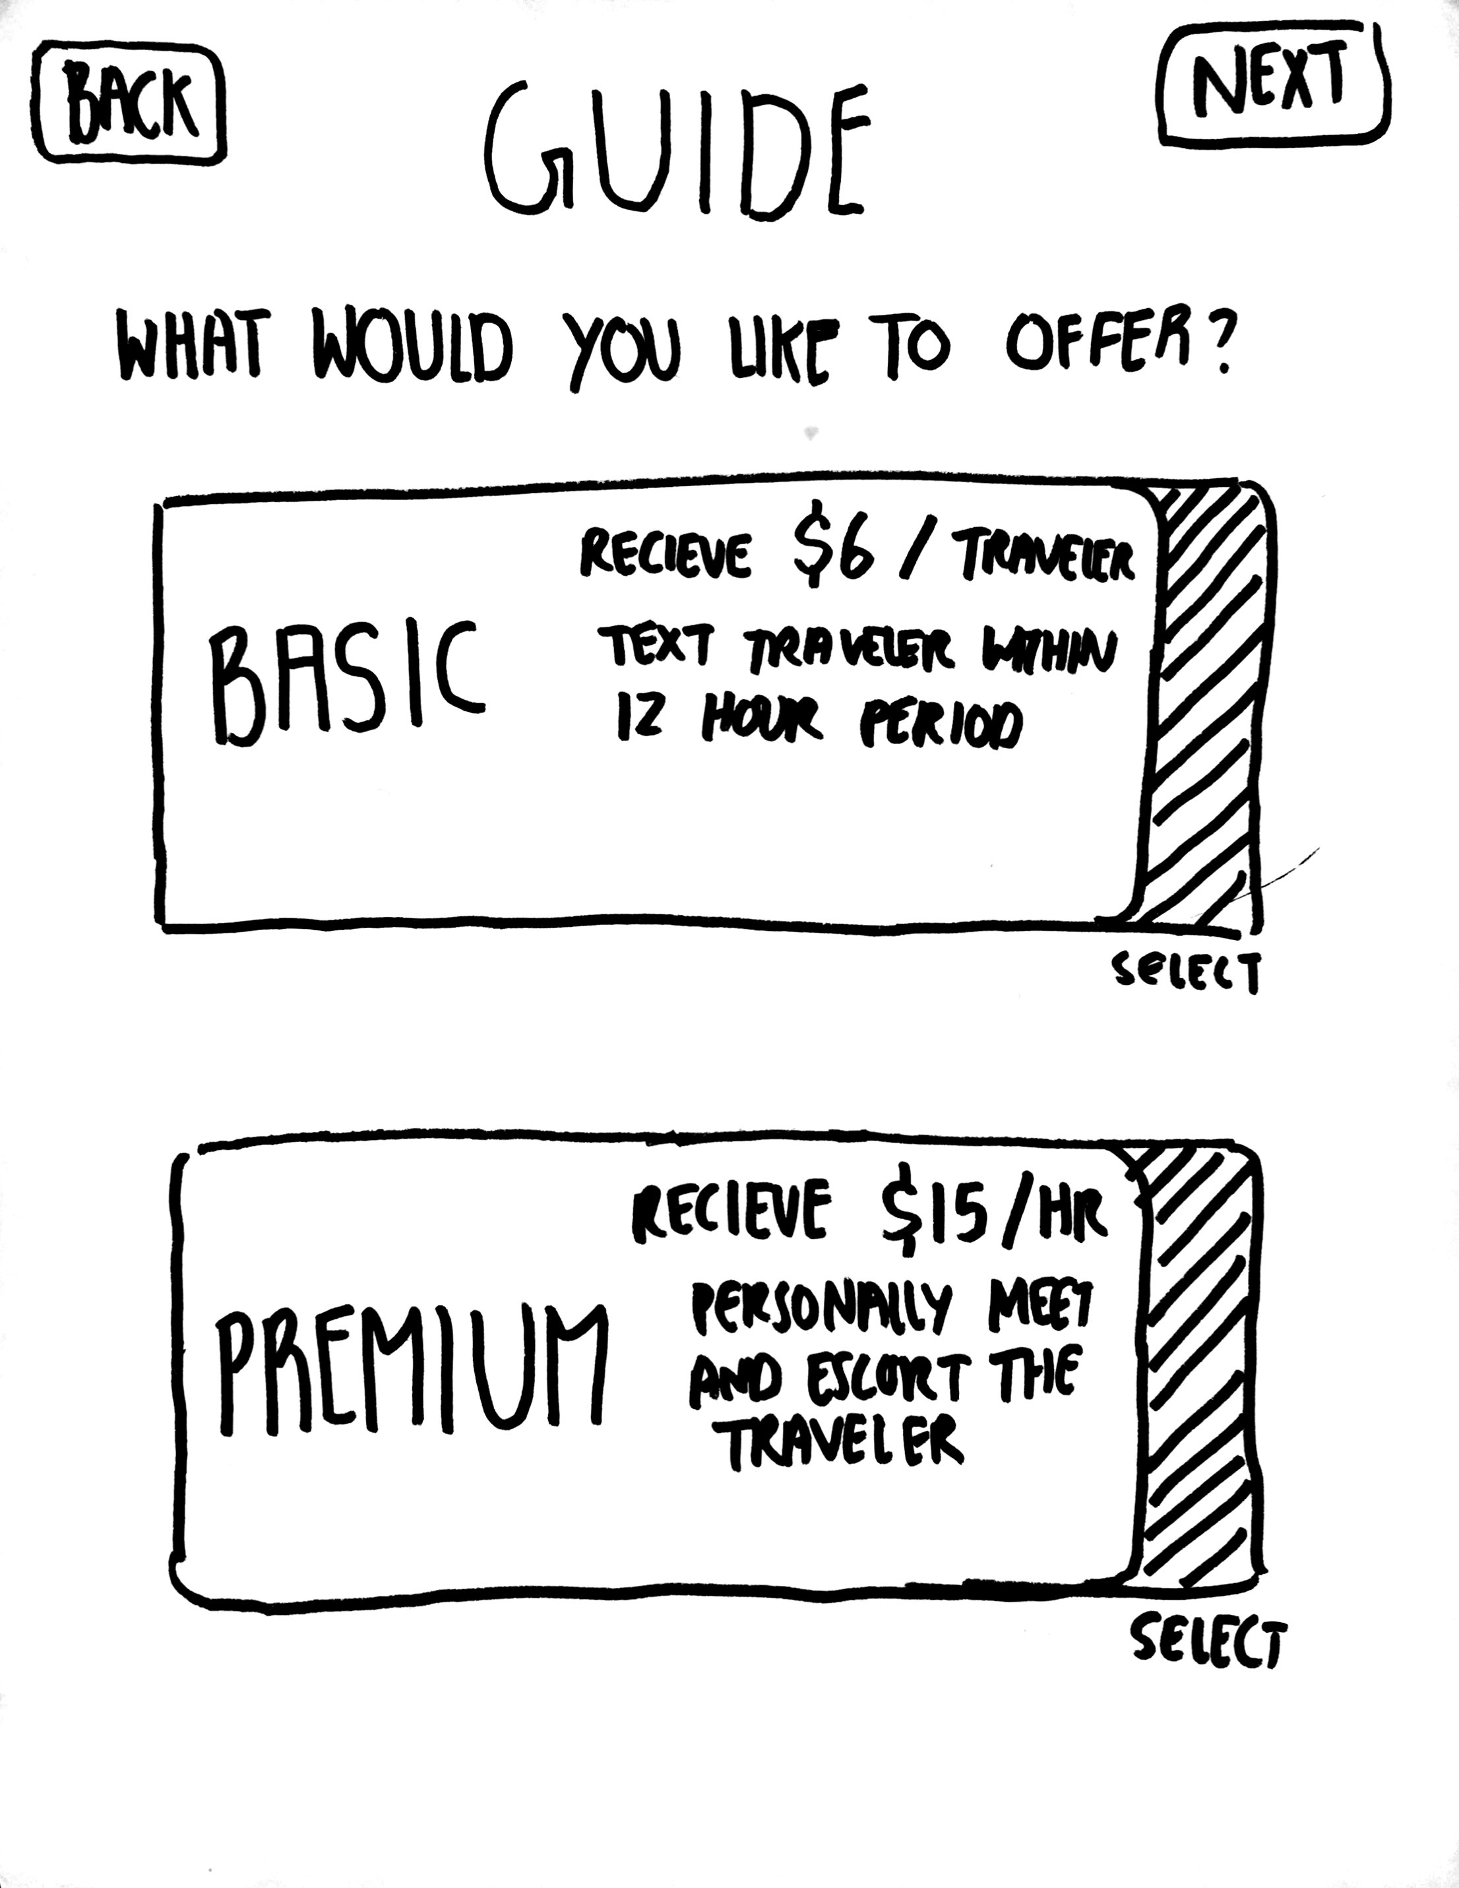
P R O T O T Y P E
T R A V E L E R
G U I D E

Slide 24
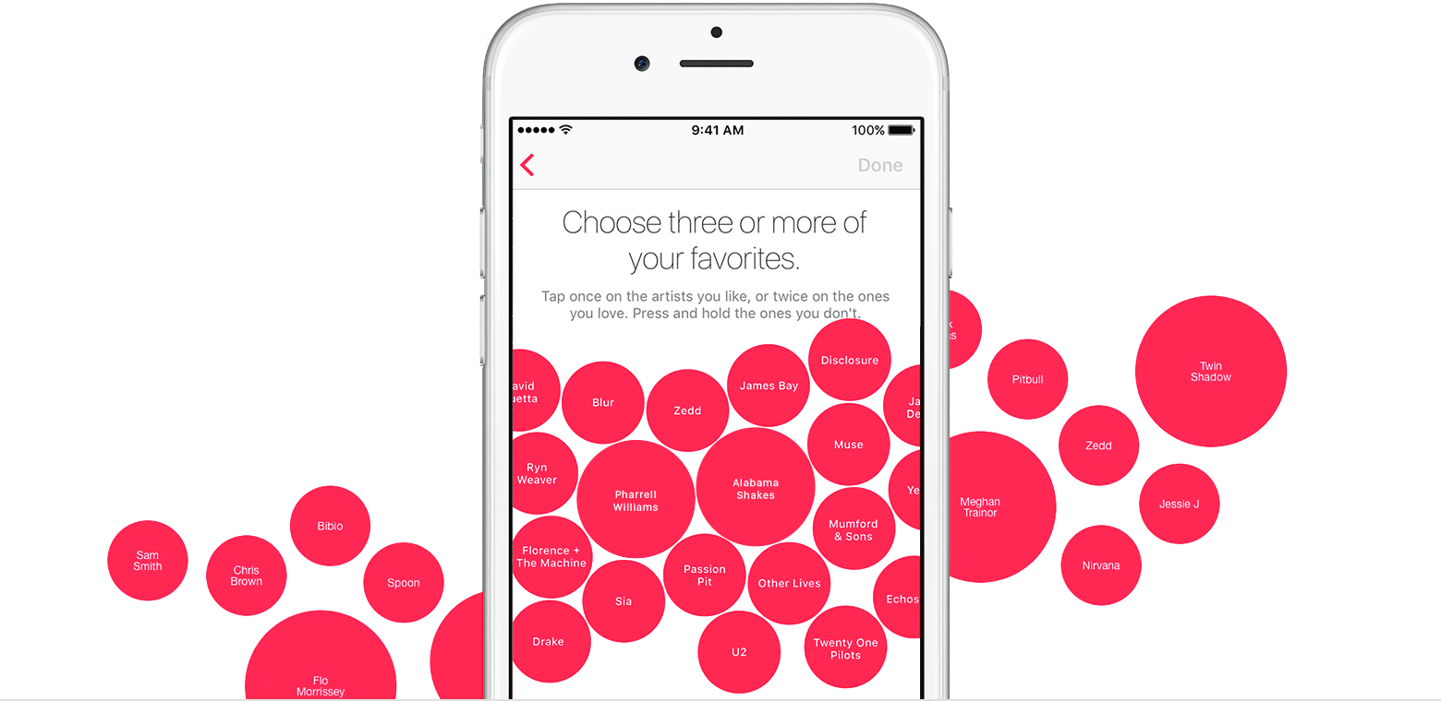

Slide 27
Overview
Team Mission Statement
Selected Interface & Rationale
Low-fi Prototype Structure
Task Flows
Experimental Method
Experimental Results
Suggested UI Changes
Summary

Slide 28
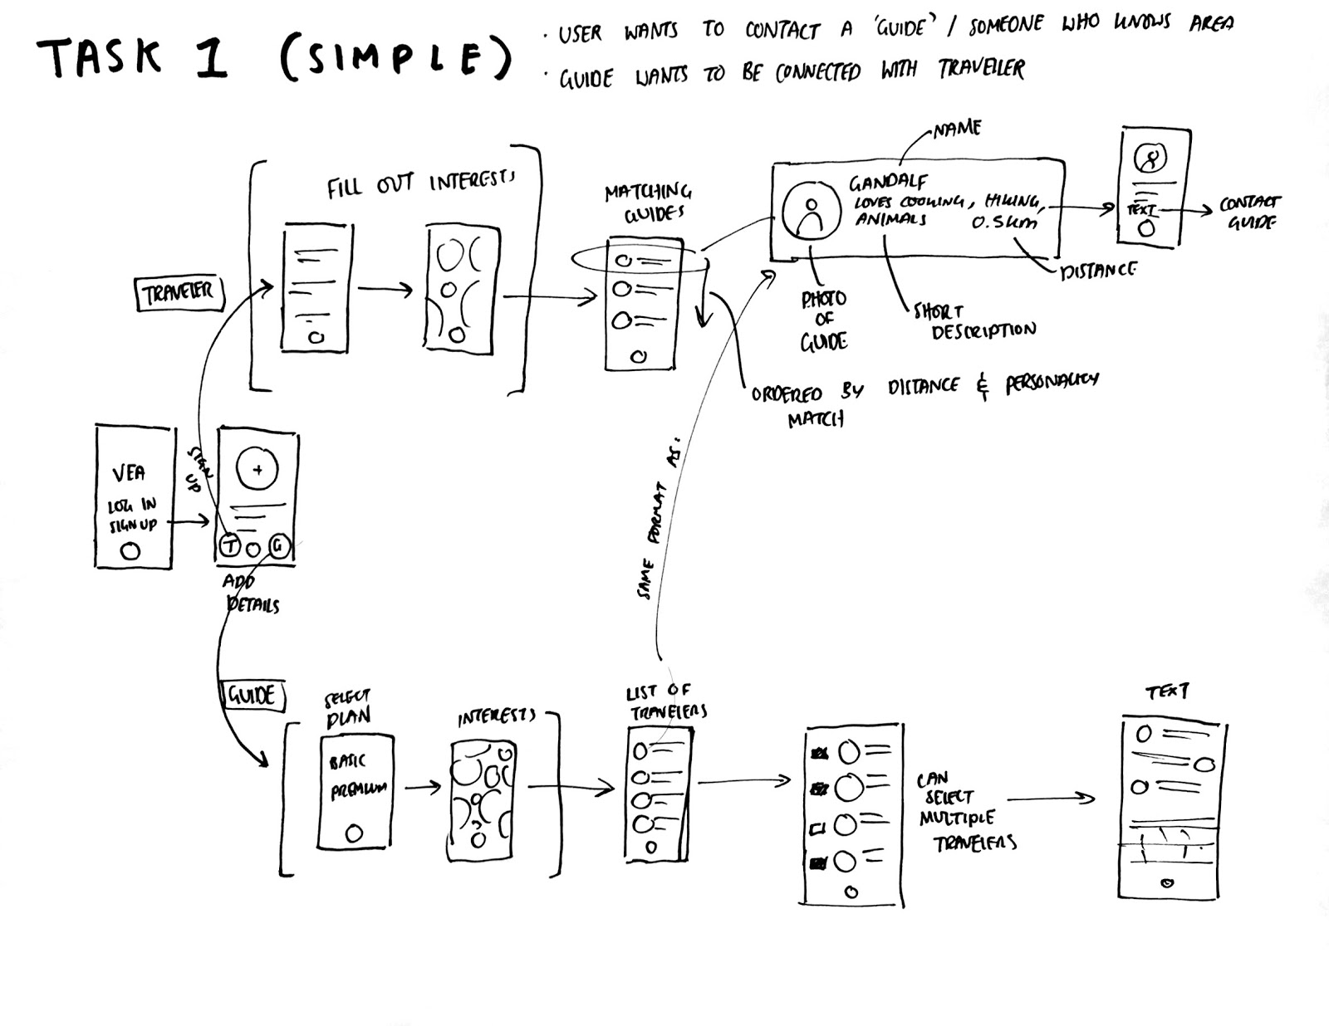
T A S K I

Slide 29
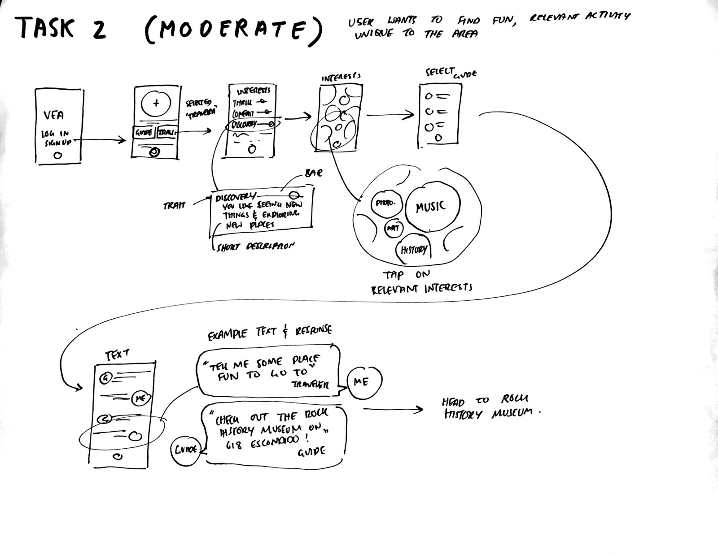
T A S K II

Slide 30
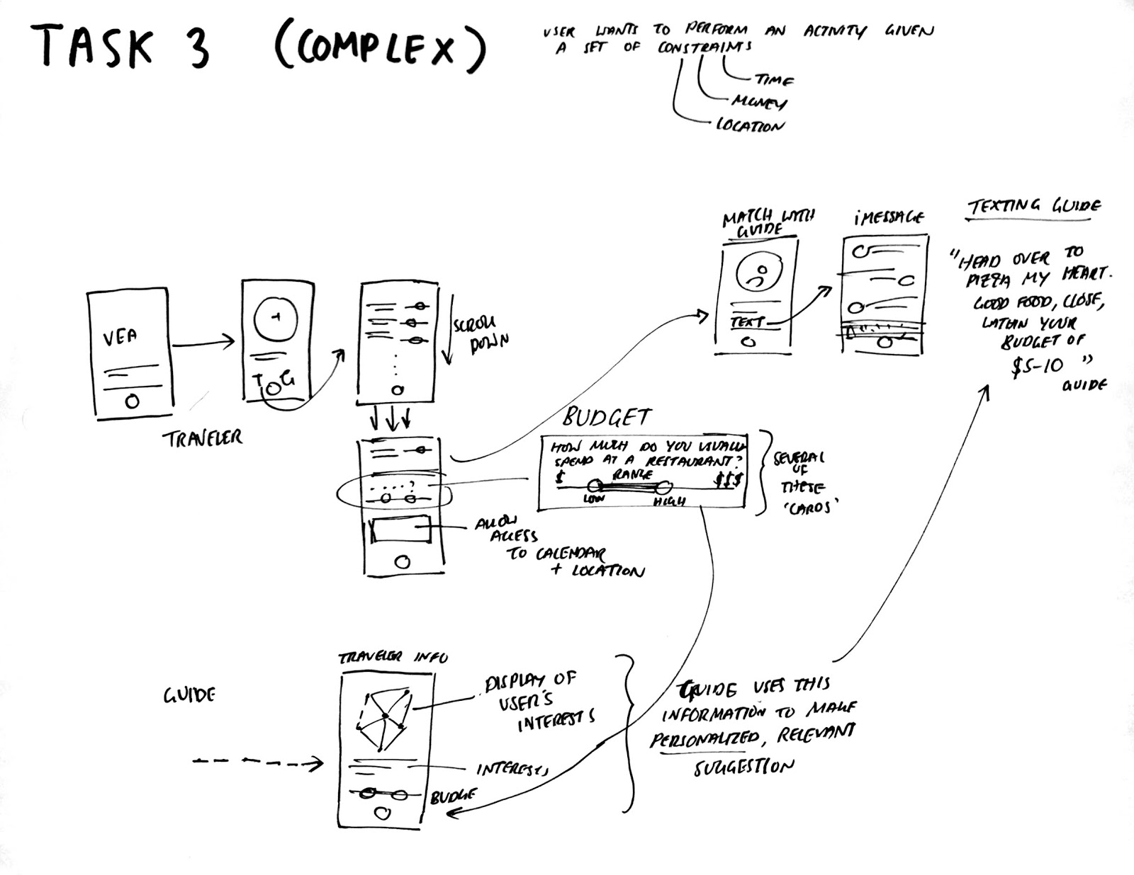
T A S K III

Slide 31
Overview
Team Mission Statement
Selected Interface & Rationale
Low-fi Prototype Structure
Task Flows
Experimental Method
Experimental Results
Suggested UI Changes
Summary

Slide 32
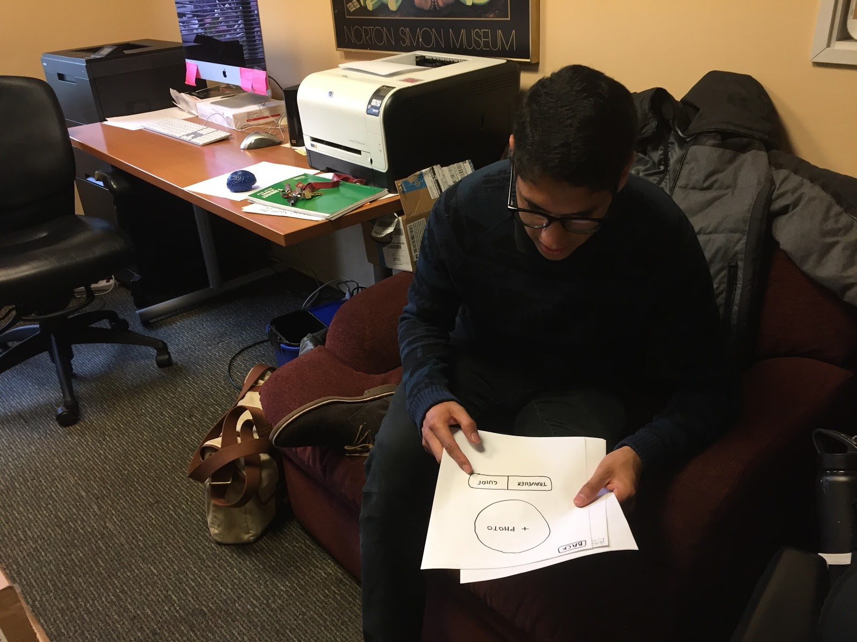

Slide 33
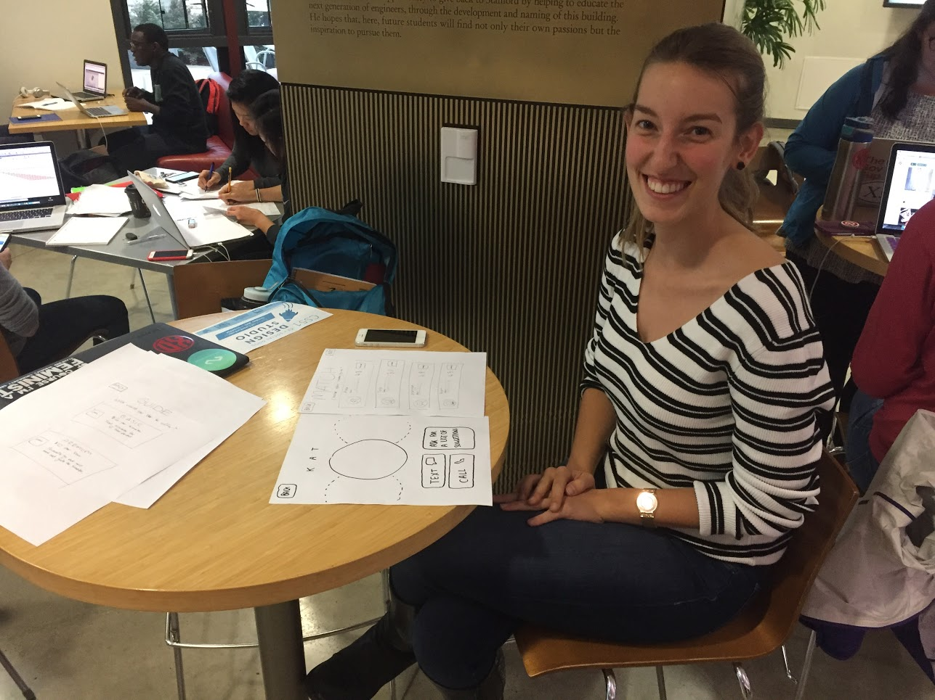

Slide 34
M E T H O D
ENVIRONMENT Participants recruited at various locations to get a very diverse sample.
PROCEDURE Paper prototype as iPhone ‘screen’. Participants were told to go about trying to achieve the three tasks. One of the participants also served as a Guide instead of a Traveler.
MEASURES See if user can achieve tasks without direction. Studied facial expressions, hesitations, time taken, etc.
Notes:
The participants in our study were recruited and interviewed at various locations on campus in order to get a diverse sample of users and environments in which they may use the application.

Slide 35
Overview
Team Mission Statement
Selected Interface & Rationale
Low-fi Prototype Structure
Task Flows
Experimental Method
Experimental Results
Suggested UI Changes
Summary

Slide 36
R E S U L T S

Slide 37
P A R T I C I P A N T I
BIO Stanford tour guide. Familiar with showing people around. Compensation: 1 boba tea.
GOOD Found the UI to be incredibly easy to understand, followed tasks smoothly. Loved the ‘interest bubbles.’
IMPROVE Confused with the Basic/Premium plans screen. Wanted to be able to set shifts for himself.

Slide 38
P A R T I C I P A N T II
BIO Seasoned traveler from Turkey.
GOOD Lots of feedback!
IMPROVE Had significant problems with our prototype. Confused by the interface, was especially confused by figuring how to move to the next screen. ‘Next’ button felt out of place in the top-right. Wanted more information about guides and payment plans.

Slide 39
P A R T I C I P A N T III
BIO Traveling French entrepreneur.
GOOD Found the UI to be easy to understand, did not need much assistance.
IMPROVE Felt that the payment system needed to be reconfigured. Suggested rewarding guides for good ratings, partnerships with local museums/attractions, etc.

Slide 40
Overview
Team Mission Statement
Selected Interface & Rationale
Low-fi Prototype Structure
Task Flows
Experimental Method
Experimental Results
Suggested UI Changes
Summary

Slide 41
S U G G E S T E D U I C H A N G E S
Rework screen navigation and placement of buttons
Simplifying ‘interests’ page – bubble interface a little confusing
Adding a ‘help’ page to explain how the app should work
Using Facebook for sign up information and verification

Slide 42
Overview
Team Mission Statement
Selected Interface & Rationale
Low-fi Prototype Structure
Task Flows
Experimental Method
Experimental Results
Suggested UI Changes
Summary

Slide 43
S U M M A R Y
we learnt a great deal about how users expect to navigate our app
our prototype highlighted the app’s strengths and weaknesses
we’re excited to work on implementing the improvements to our app!

Slide 45
Q U E S T I O N S

