Slide 1

H I – F I P R O T O T Y P E
[ M I C R O ] A D V E N T U R E

Slide 2

Introduction
Value Prop, Problem and Solution Overview
Heuristic Evaluation Results
Revised Design
Prototype Implementation Status
Demonstration of Prototype
Summary

Slide 3
Introduction
Value Prop, Problem and Solution Overview
Heuristic Evaluation Results
Revised Design
Prototype Implementation Status
Demonstration of Prototype
Summary

Slide 4



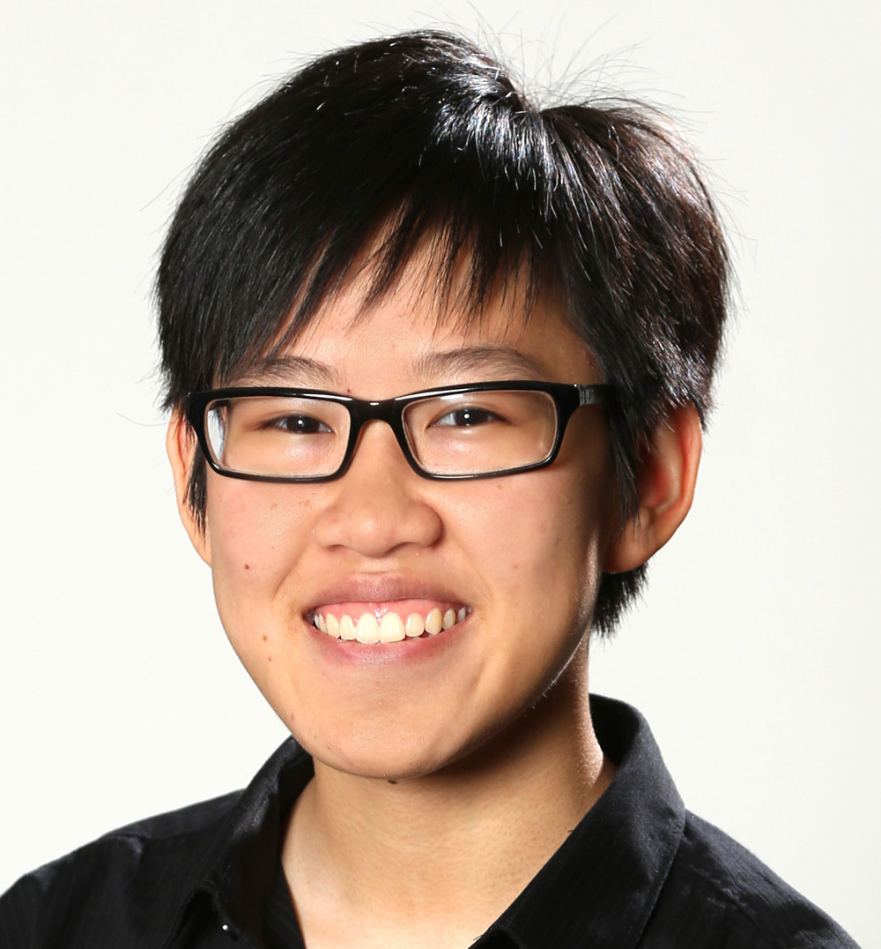
O U R T E A M
Alex Alexandre Basel Kim
Usability Testing
Software Engineering
Design
Team Manager

Slide 6
Introduction
Value Prop, Problem and Solution Overview
Heuristic Evaluation Results
Revised Design
Prototype Implementation Status
Demonstration of Prototype
Summary

Slide 7
V A L U E P R O P O S I T I O N
We want to help travelers
make the most out of their adventures
Let a personal guide help you plan your adventure

Slide 8

P R O B L E M
Planning a fun adventure takes too much time and effort

Slide 9
S O L U T I O N O V E R V I E W
We’ll connect you with a local guide,
on-demand wherever you go

Slide 10
Introduction
Value Prop, Problem and Solution Overview
Heuristic Evaluation Results
Revised Design
Prototype Implementation Status
Demonstration of Prototype
Summary

Slide 11
Introduction
Value Prop, Problem and Solution Overview
Heuristic Evaluation Results
Revised Design
Prototype Implementation Status
Demonstration of Prototype
Summary

Slide 12
R E V I S E D D E S I G N

Slide 13
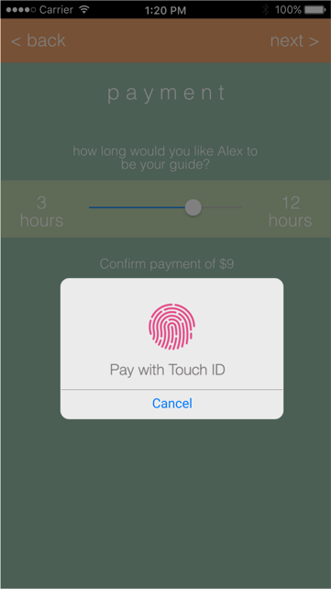
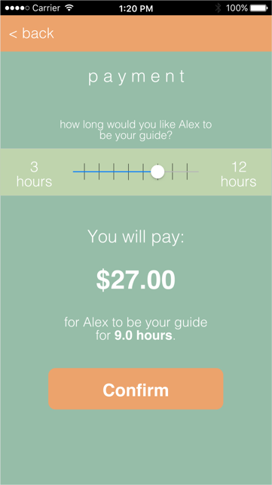
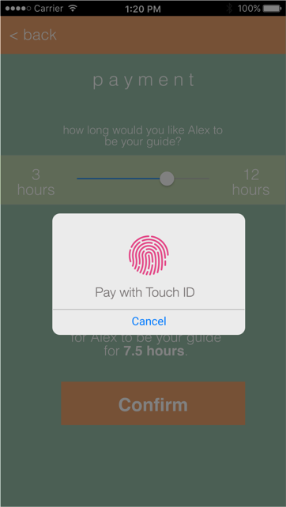
When a user has selected to pay for a guide’s services they are prompted to pay “with touch id” however the user is not given the cost of the services.
O R I G I N A L
R E V I S E D

Slide 14
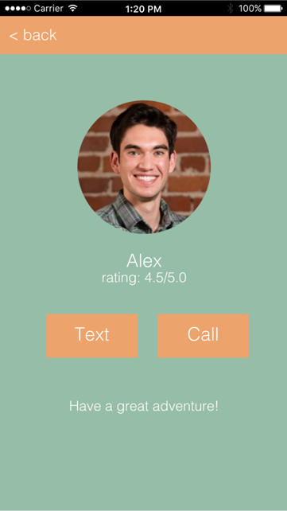
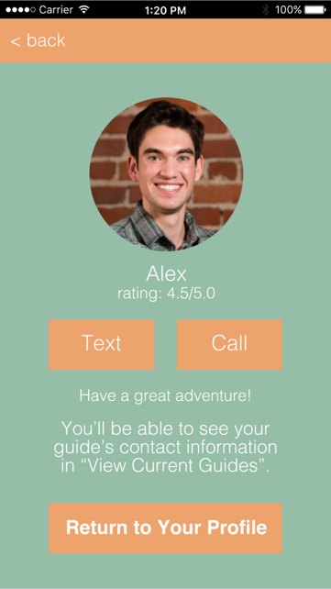
Added button to return to ‘Home’ after getting connected with a guide.
O R I G I N A L
R E V I S E D

Slide 15
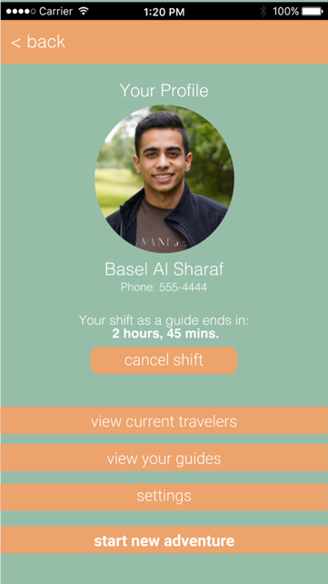
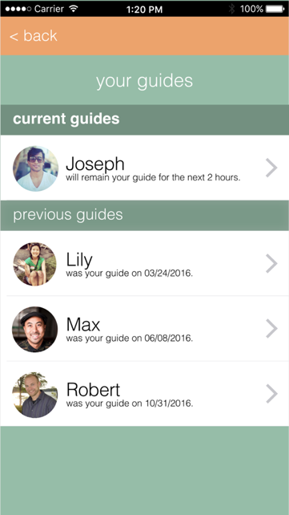
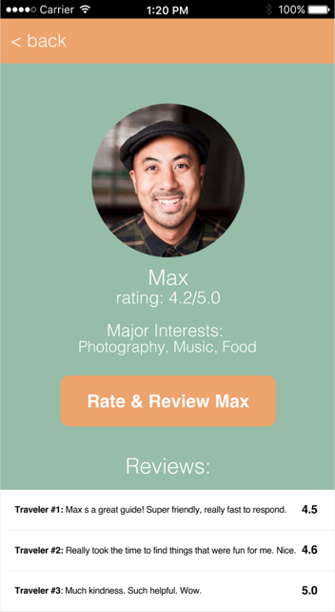
There does not appear to be any way for travelers to rate their previous
tour guides.
N E W A D D I T I O N

Slide 16
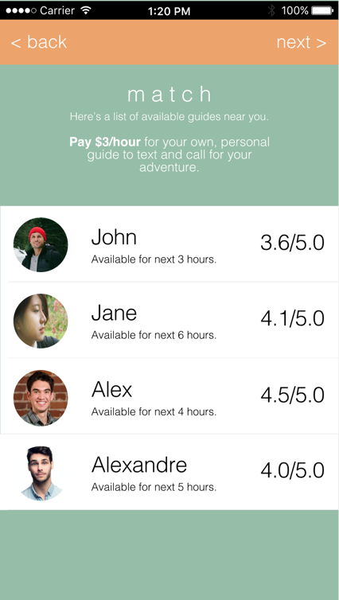

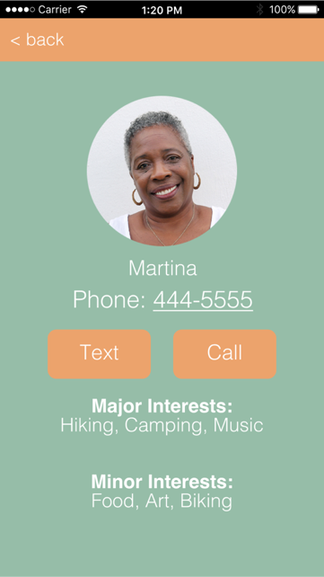
The traveler selects their interests but information does not appear to be used anywhere else in the app. The guide user interface does not have any indication of the interests of a given traveler that selects them.
O R I G I N A L
R E V I S I O N

Slide 17

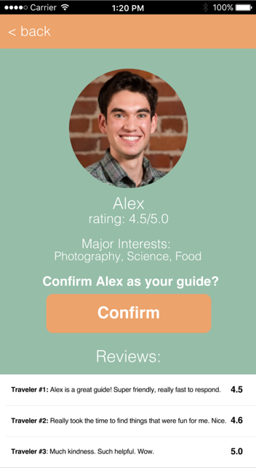
Additional ‘Revised’ pages where we added in the interests of Guide & Traveler.
N E W A D D I T I O N

Slide 18
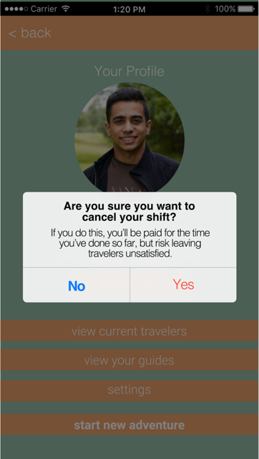
After the guide selects his hours of availability there does not appear to be a way for them to modify the hours or even see that they are currently “active”. There should be a way for guides to see that they are active and modify their hours of availability.
R E V I S E D

Slide 19
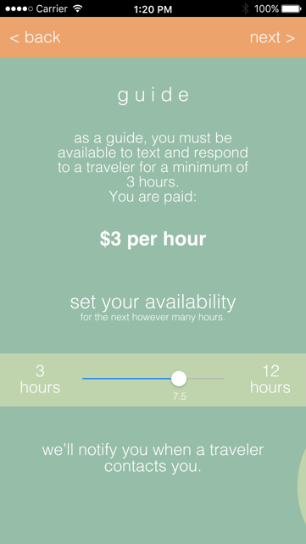
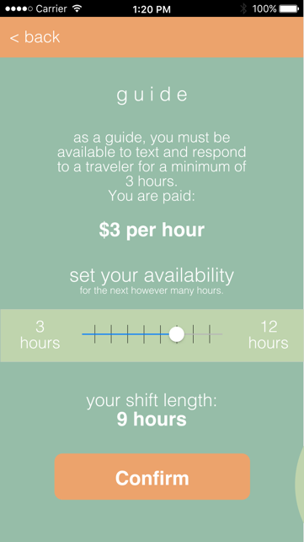
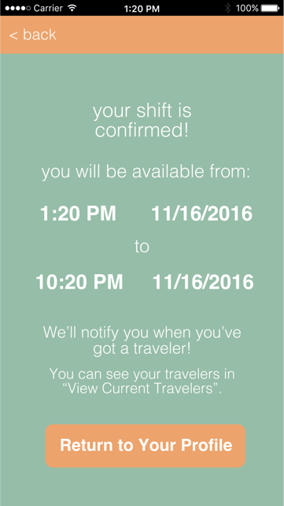
As a user sets his/her preferences for how much time they want to be a guide they enter the amount of time they are free with a slider (which is less exact than typing in a number) and then are not asked to confirm the amount of time they can guide.
O R I G I N A L
R E V I S E D

Slide 20

When the traveler is going through the list of guides, they are unable to see what interests the guides had listed and are thus unable to make the most informed decision of who they want to hire.
O R I G I N A L
R E V I S E D

Slide 21
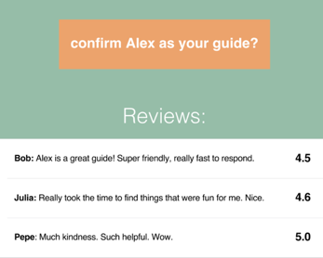
On the guide profile screen, the reviews are posted with the name of the traveler that wrote it. This could be a security concern for certain the travelers that wrote an unflattering review of a guide since the guide knows the user’s phone number and name.
O R I G I N A L
R E V I S E D

Slide 22
Introduction
Value Prop, Problem and Solution Overview
Heuristic Evaluation Results
Revised Design
Prototype Implementation Status
Demonstration of Prototype
Summary

Slide 23
P R O T O T Y P E I M P L E M E N T A T I O N S T A T U S

Slide 24

T O O L S
+

Slide 25
F E A T U R E S
I M P L E M E N T E D
U N I M P L E M E N T E D
Guide Task Flow
Rating Guides
Traveler Task Flow
Improved Interests Page

Slide 26
W I Z A R D O F O Z T E C H N I Q U E S
We’re assuming we’ve already gone through a ‘vetting’ process for guides.
The ‘Matchmaking’ process isn’t implemented.
Payment process already confirmed.
Messaging between users just done through porting phone number into iMessage or external message app.
Location services isn’t truly implemented either.

Slide 27
H A R D – C O D E D
User profiles, we assume payment options have already been confirmed by users.

Slide 28
I S S U E S / Q U E S T I O N S
The initial ‘Bubble’ interest page; we’ll make something more creative later, if we have time.
‘Porting’ a number from the final ‘Text/Call’ page to a messaging app - we might just do a screenshot of iMessage.

Slide 29
Introduction
Value Prop, Problem and Solution Overview
Heuristic Evaluation Results
Revised Design
Prototype Implementation Status
Demonstration of Prototype
Summary

Slide 30
D E M O N S T R A T I O N

Slide 31
Introduction
Value Prop, Problem and Solution Overview
Heuristic Evaluation Results
Revised Design
Prototype Implementation Status
Demonstration of Prototype
Summary

Slide 32
S U M M A R Y
Realized the tradeoff between our med-fi and final prototyping
Improved our whole structure and UI based on our colleagues’ feedback
Almost done building our complete app
Website online

Slide 34
Q U E S T I O N S

