Slide 1
Concept Video
Kat, Matt, Tyler
https://vimeo.com/188353287

Slide 2
Value Proposition
UpQuest: The student data that keeps on giving
Problem/Solution Overview
Teachers often have a hard time tracking their students’ progress. Our solution allows teachers to provide rewarding mini-assessments to students and track their progress over time.

Slide 3
Simple Task: Teachers
Have students answer assessment questions
Goal: Know where all students’ current knowledge lies
Medium Task: Students
Get rewards for answering questions
Goal: Feel rewarded for learning + demonstrating knowledge
Complex Task: Teachers
Track student progress over time
Goal: Help students continuously learn what they don’t know

Slide 4
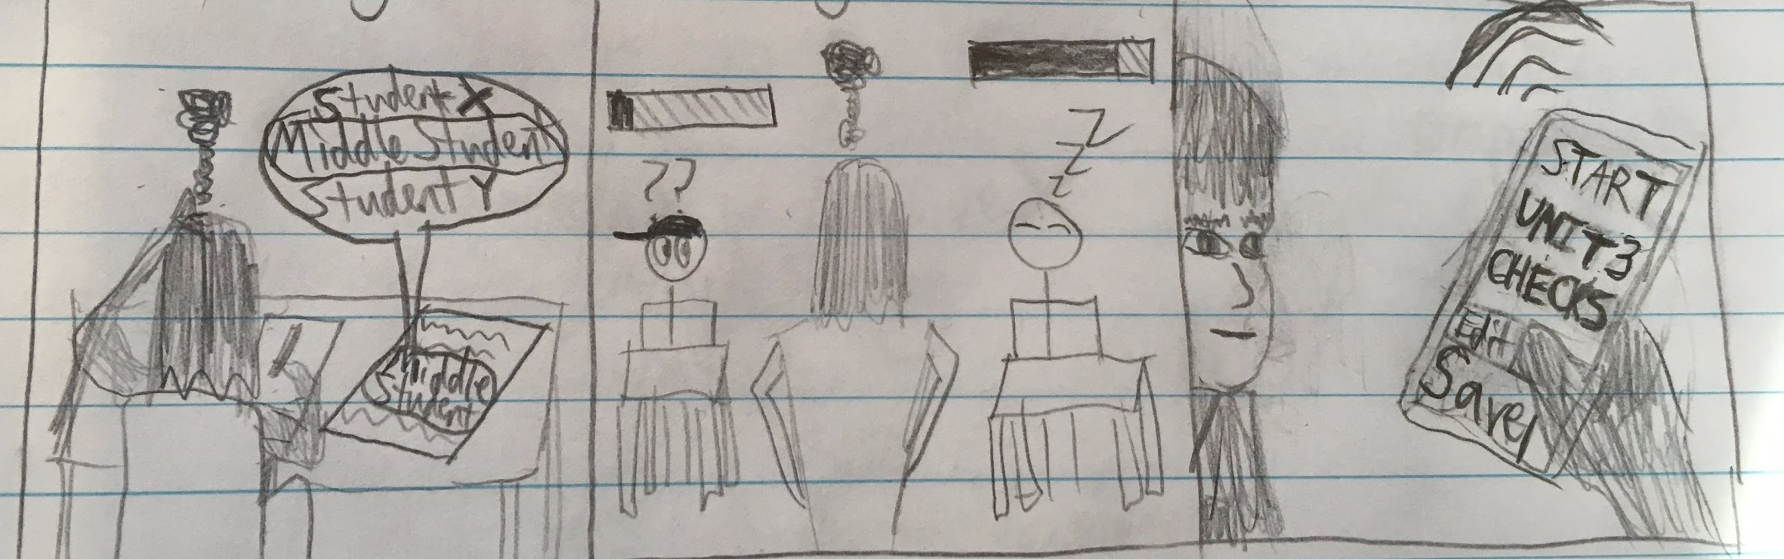
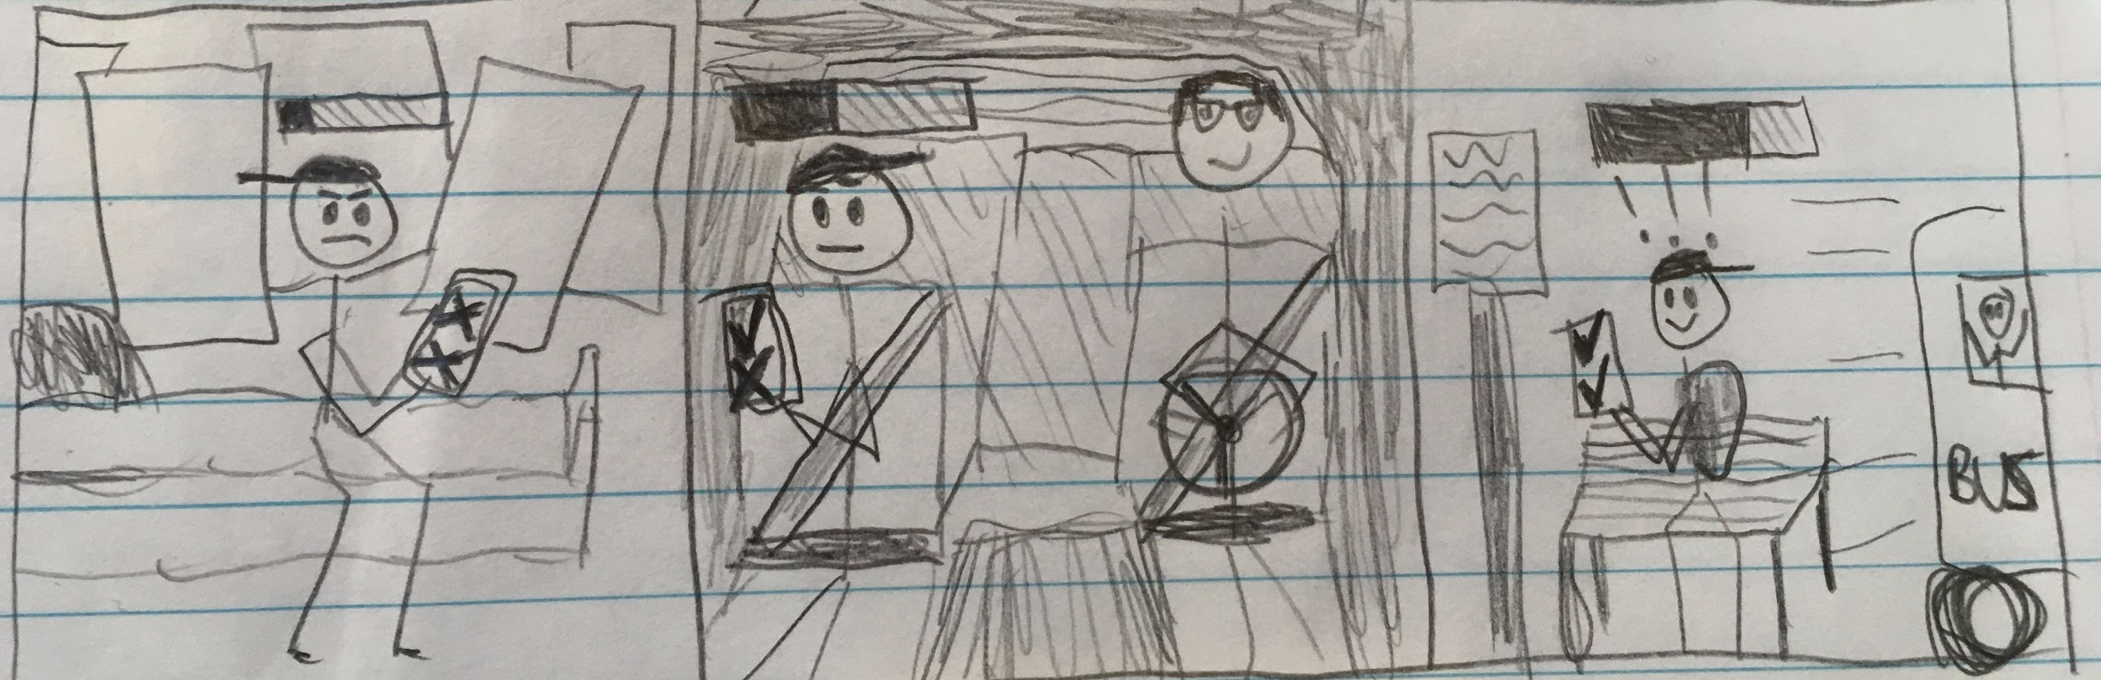
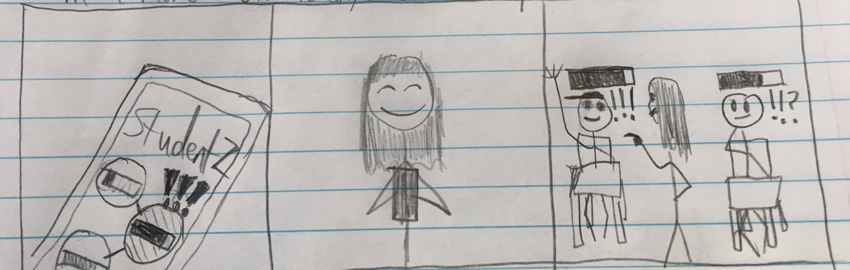
Scene 1
Lacking a simple way to pin down individual students’ knowledge, a teacher is forced to teach to the “middle student” with bad results, then starts using UpQuest.
Scene 2
A student receives individual questions at random times throughout the day (uses spacing effect + variable ratio rewards!) which builds his motivation to show off knowledge and helps him learn
Scene 3
The teacher now has high-level insights about her students’ knowledge. We show her feeling proud and putting these insights to good use at school. The student is making progress and feel excited.

