Slide 1
Video
CS 147 - Learning Studio - Fall 2016
Jack Swiggett
Serena Wong
Connie Li

Slide 2
Value Proposition

Slide 3
Feel at home in a new place.

Slide 4
Problem

Slide 5
Newcomers:
Are uncomfortable going out of comfort zone to interact in new environment
Find it hard to meet fellow newcomers easily and establish a lasting connection

Slide 6
Solution

Slide 7
Pelican helps newcomers:
Get used to going out into their new environment by having fun
Complete challenges in groups to form lasting friendships

Slide 8
Tasks

Slide 9
Complex
Become more comfortable approaching strangers

Slide 10
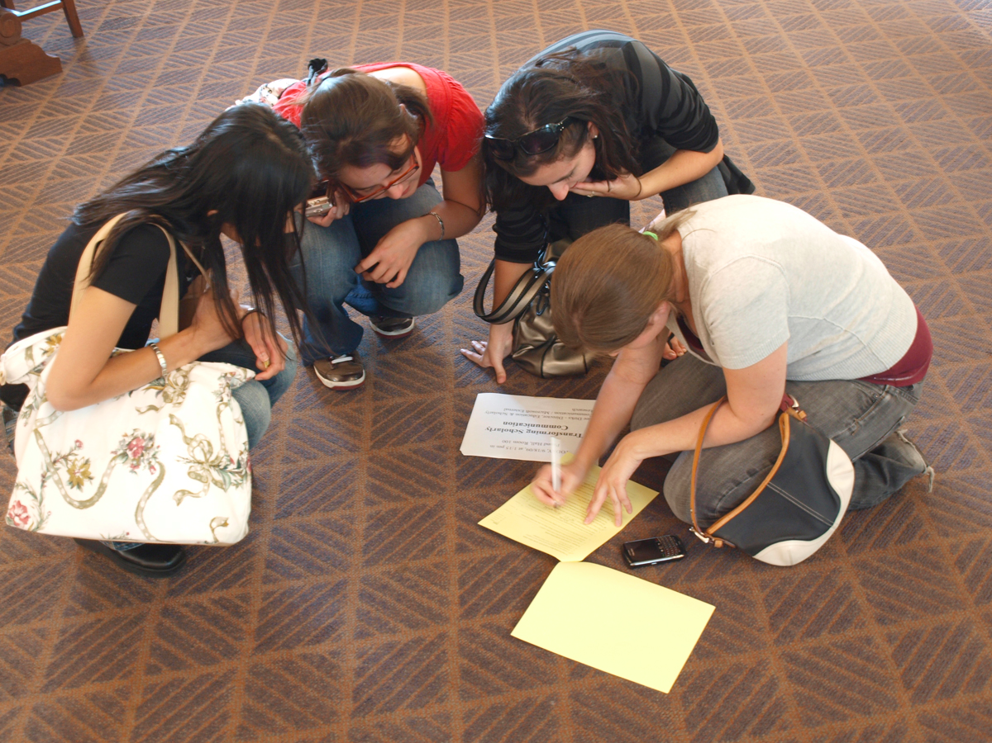
Medium
Find other newcomers and complete challenges with them

Slide 11
Simple
Complete challenges to get points and compete with your friends
Notes:
You just completed a challenge!

Slide 12
Storyboards

Slide 13
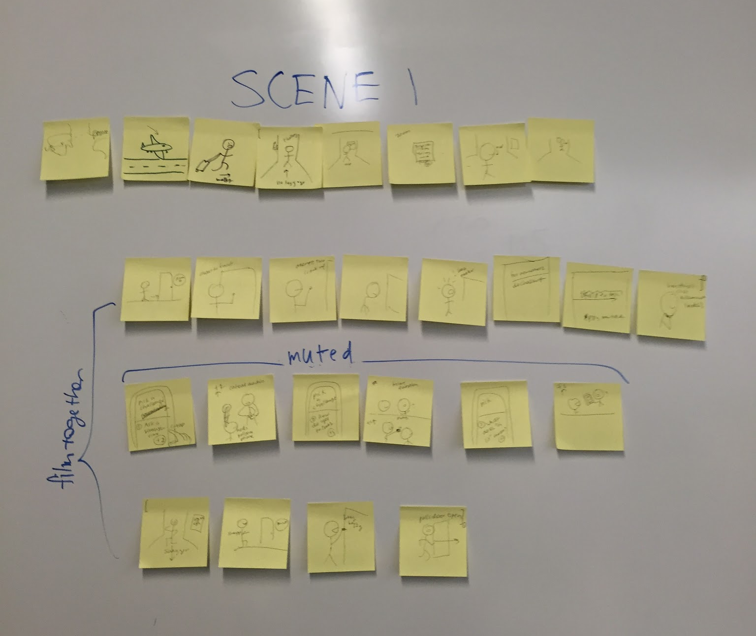
Complex
26 stickies

Slide 14
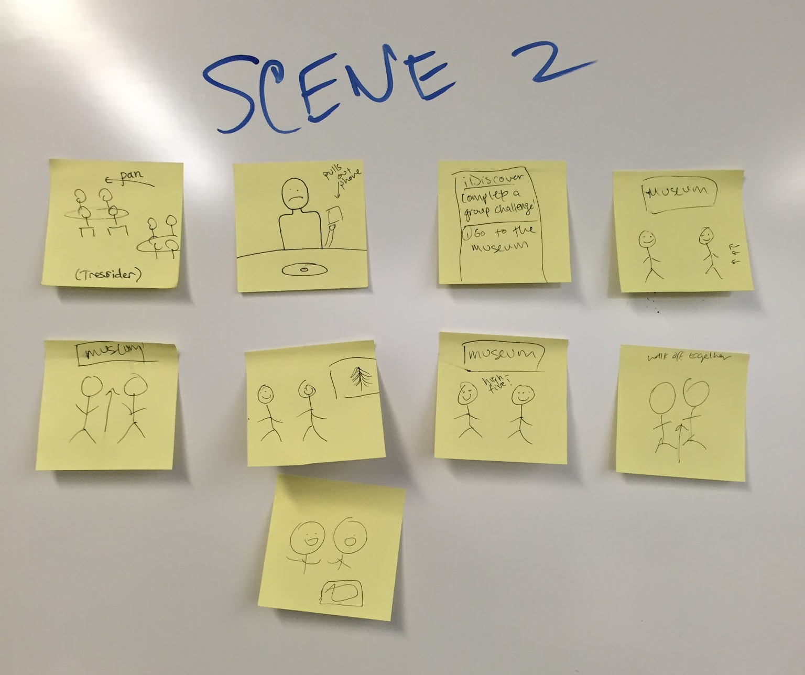
Medium
9 stickies

Slide 15
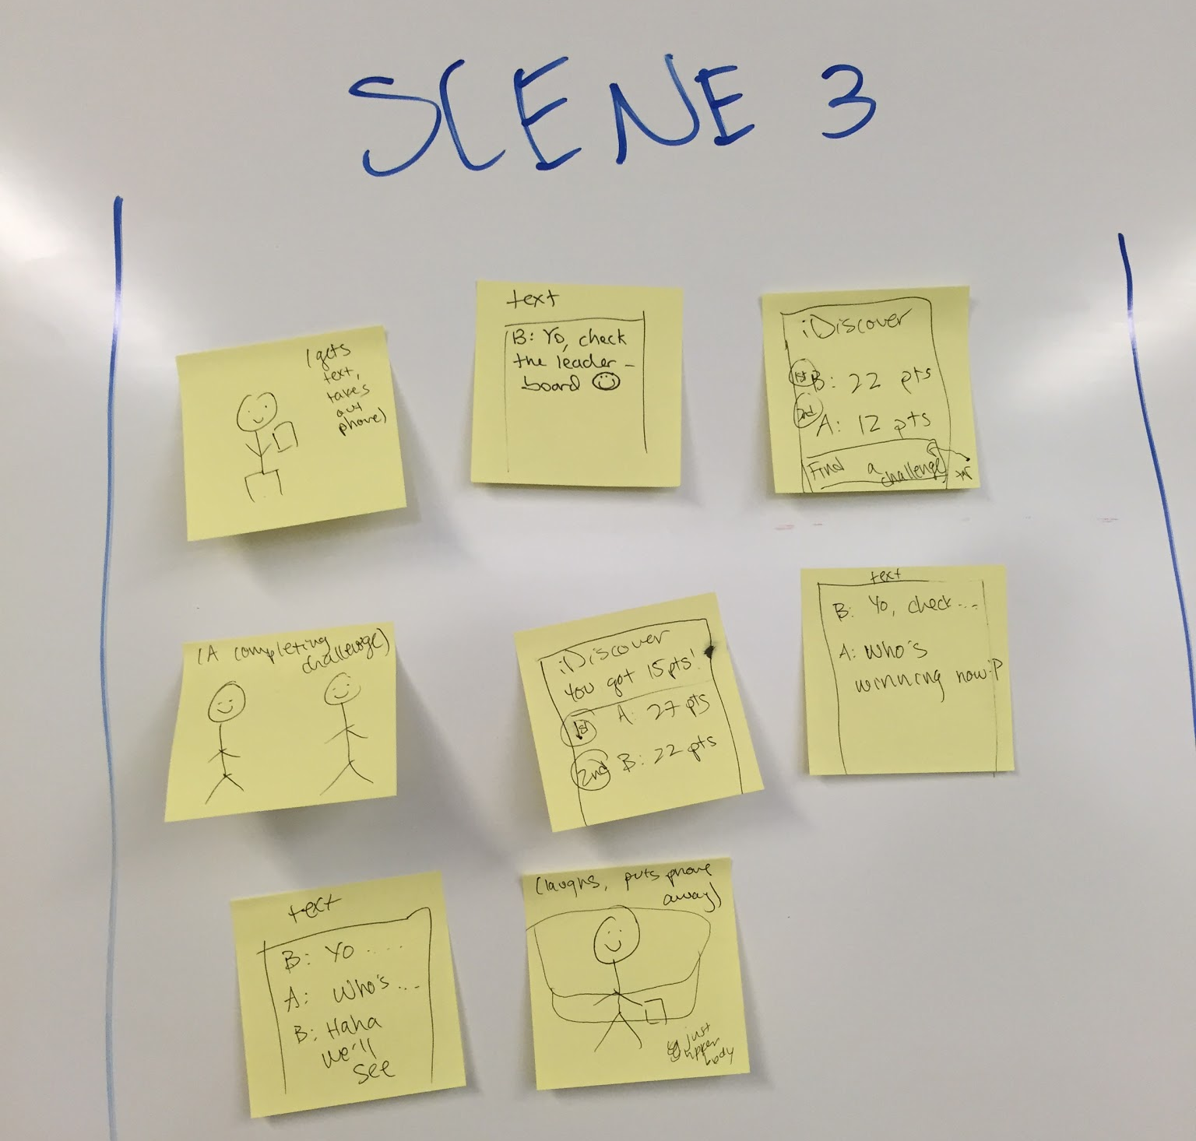
Simple
7 stickies

Slide 16
Video Link: https://www.youtube.com/watch?v=8Jzbz2pbqII

Slide 17
Thank you!

Slide 18
Image Sources
http://az616578.vo.msecnd.net/files/2016/06/29/636028043798068323-2046823592_How-To-Step-Out-Of-Your-Comfort-Zone.jpg
http://www.superhero-therapy.com/wp-content/uploads/2014/04/lonely.jpg
https://media.licdn.com/mpr/mpr/AAEAAQAAAAAAAAZdAAAAJDhkMGI2ODE1LWVlNDktNDYzYy04MTFiLTJjYmIzZDEwMzZmZQ.jpg
http://1.bp.blogspot.com/-9c_F2olAbmk/VaN4yfeIkiI/AAAAAAAAHdE/foIc6QfIM4k/s1600/20363760-MISSION-COMPLETE-Rubber-Stamp-over-a-white-background--Stock-Photo.jpg
http://pad2.whstatic.com/images/thumb/c/cc/Talk-to-Strangers-Step-8-Version-3.jpg/670px-Talk-to-Strangers-Step-8-Version-3.jpg
https://upload.wikimedia.org/wikipedia/commons/e/ec/1L-LLM_Scavenger_Hunt_(3952858025).jpg
http://www.pintarmandarin.com/qa/wp-content/uploads/2016/01/leaderboard2.png
https://redditupvoted.files.wordpress.com/2015/10/immigrant.png?w=1000&h=500&crop=1

