Slide 1
Prototype Testing
CS 147 - Fall 2016
Jack Swiggett
Serena Wong
Connie Li

Slide 2

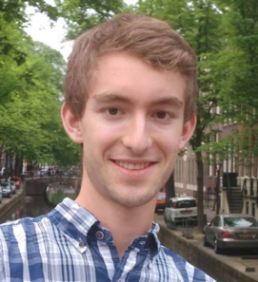
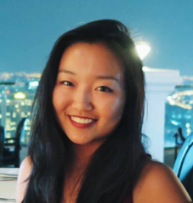
The Team
Serena Wong
Jack Swiggett
Connie Li

Slide 3


Our Problem
Education
+
Newcomers to a country

Slide 4
Points of View

Slide 5
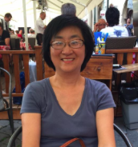
Initial POV
We met Leeno, a woman who grew up in China, went to undergrad in Japan, and came to the US for graduate school.
We were amazed to realize that she felt way more comfortable in Japan than in the US, despite knowing nothing about either culture.
It would be game changing to eliminate the discomfort in interacting with unfamiliar people/backgrounds/races.

Slide 6
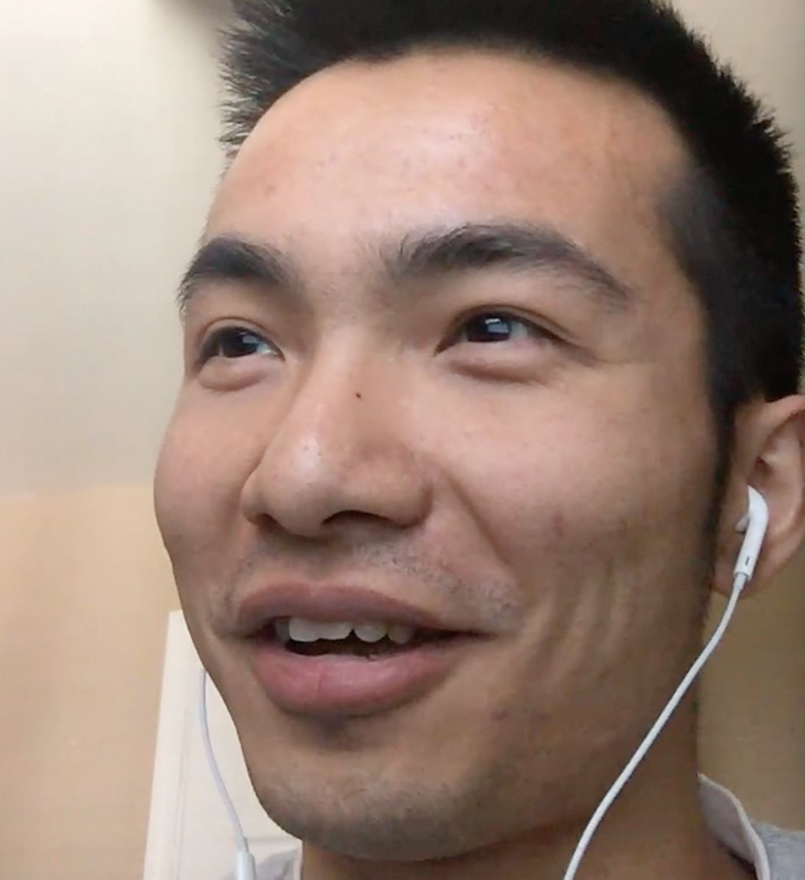

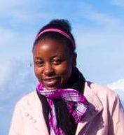
Additional Needfinding
Derry
27, China
Caro
21, Mexico
Vimbai
19, Zimbabwe
Notes:
Derry, a software engineer who immigrated from China 7 years ago
Caro, a 21 year old Stanford student from Mexico
Vimbai, a Stanford junior from Zimbabwe who came to the United States for the first time two years ago
Derry - struggled with stepping out of his comfort zone, asking strangers questions. Story of how he had trouble registering for classes.
Vimbai - what helped her get through the first couple months. “Excitement” of NSO and first times. Otherwise she wouldn’t have made it.

Slide 7
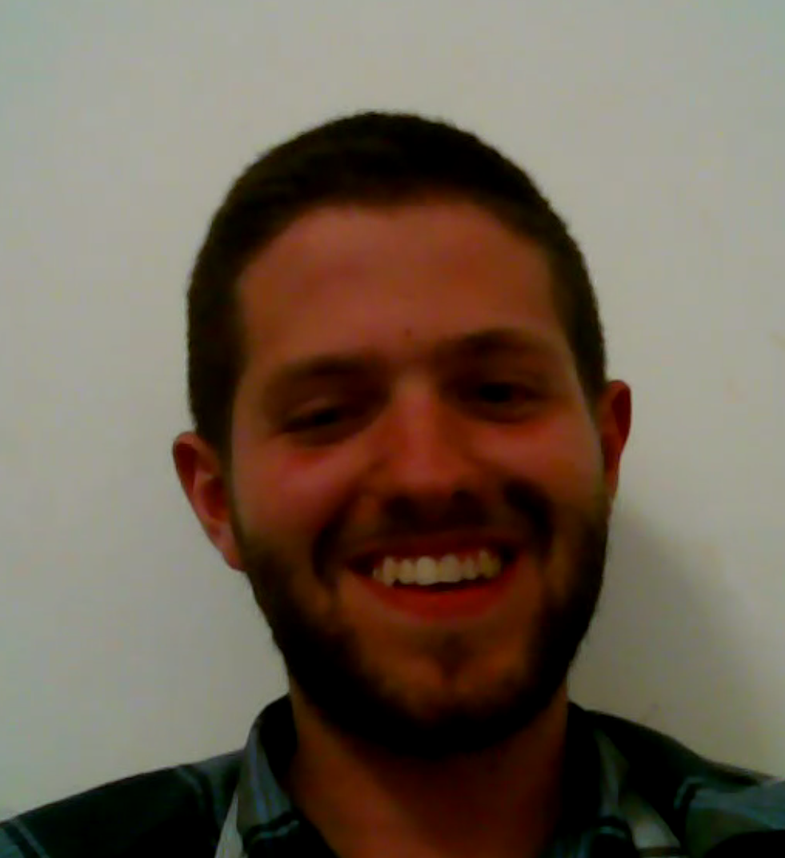
Additional Needfinding
Micah
20, US to Israel
Nelda
54, US
Clif
56, US
Notes:
Micah, a junior who goes to Carlton and is abroad in Israel
Nelda & Clif, a well-traveled couple from Seattle who run a well-frequented Airbnb
Micah - Story of an awkward situation where he tried to shake a woman’s hand, but she was not allowed to touch men. Would have loved a resource with “everything you need to know about Israeli culture.”

Slide 8
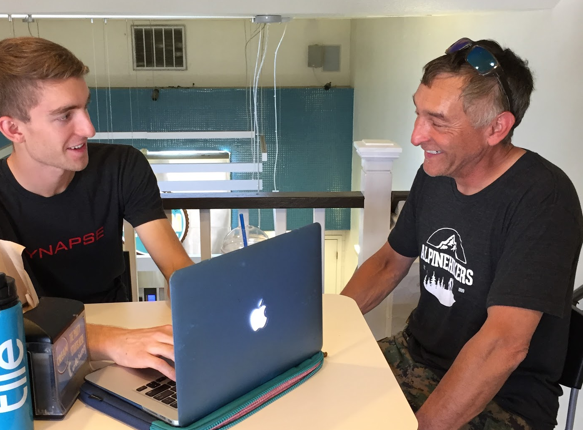
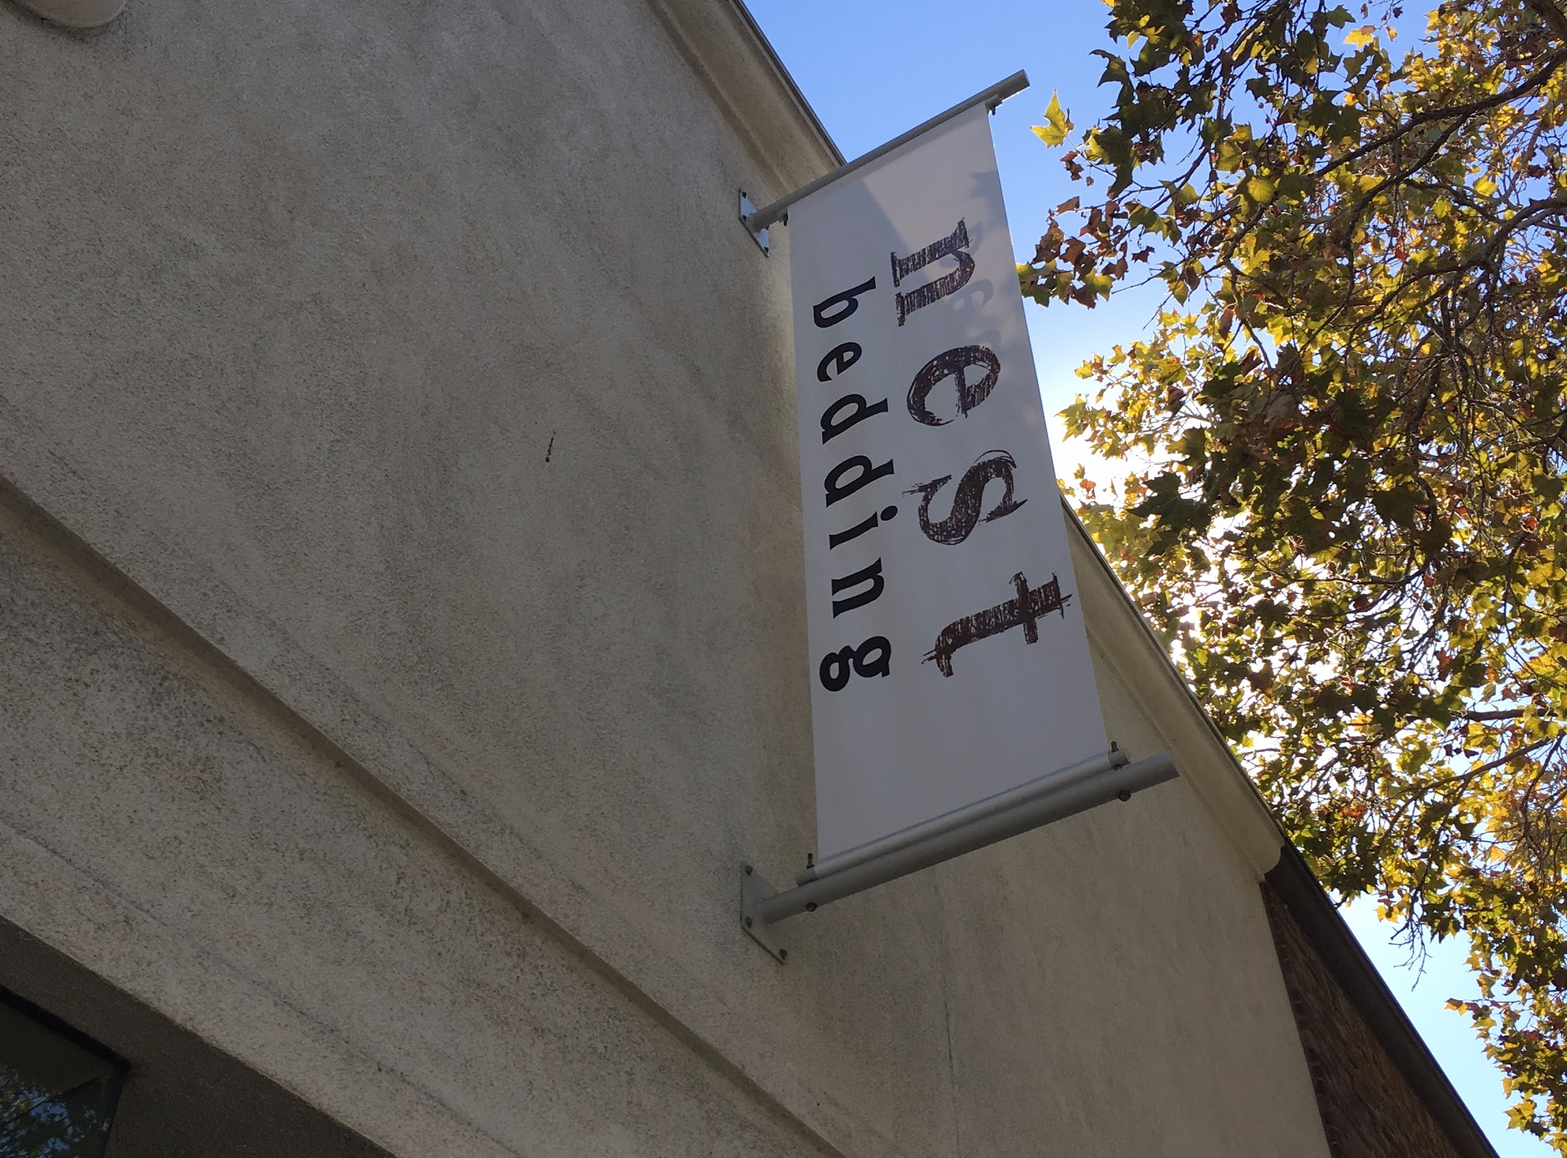
Additional Needfinding
Tony
Jeffrey
(camera-shy)
Notes:
Tony, a handyman from the bay area, but his mother is Spanish, and he has travelled internationally
Jeffrey, a salesman at Nest Bedding on University Avenue
Tony - considered himself culturally aware as a result of living in such a diverse area. Had a positive view of tourists, and the added diversity they bring with them.

Slide 9
How Might We’s

Slide 10
Revised POV #1
We met Derry, a young 20-something engineer who immigrated from China seven years ago.
We were amazed to realize that he was afraid to ask questions when he first arrived because he was afraid of bothering people.
It would be game changing if Derry wasn’t afraid of approaching others and asking for help.

Slide 11
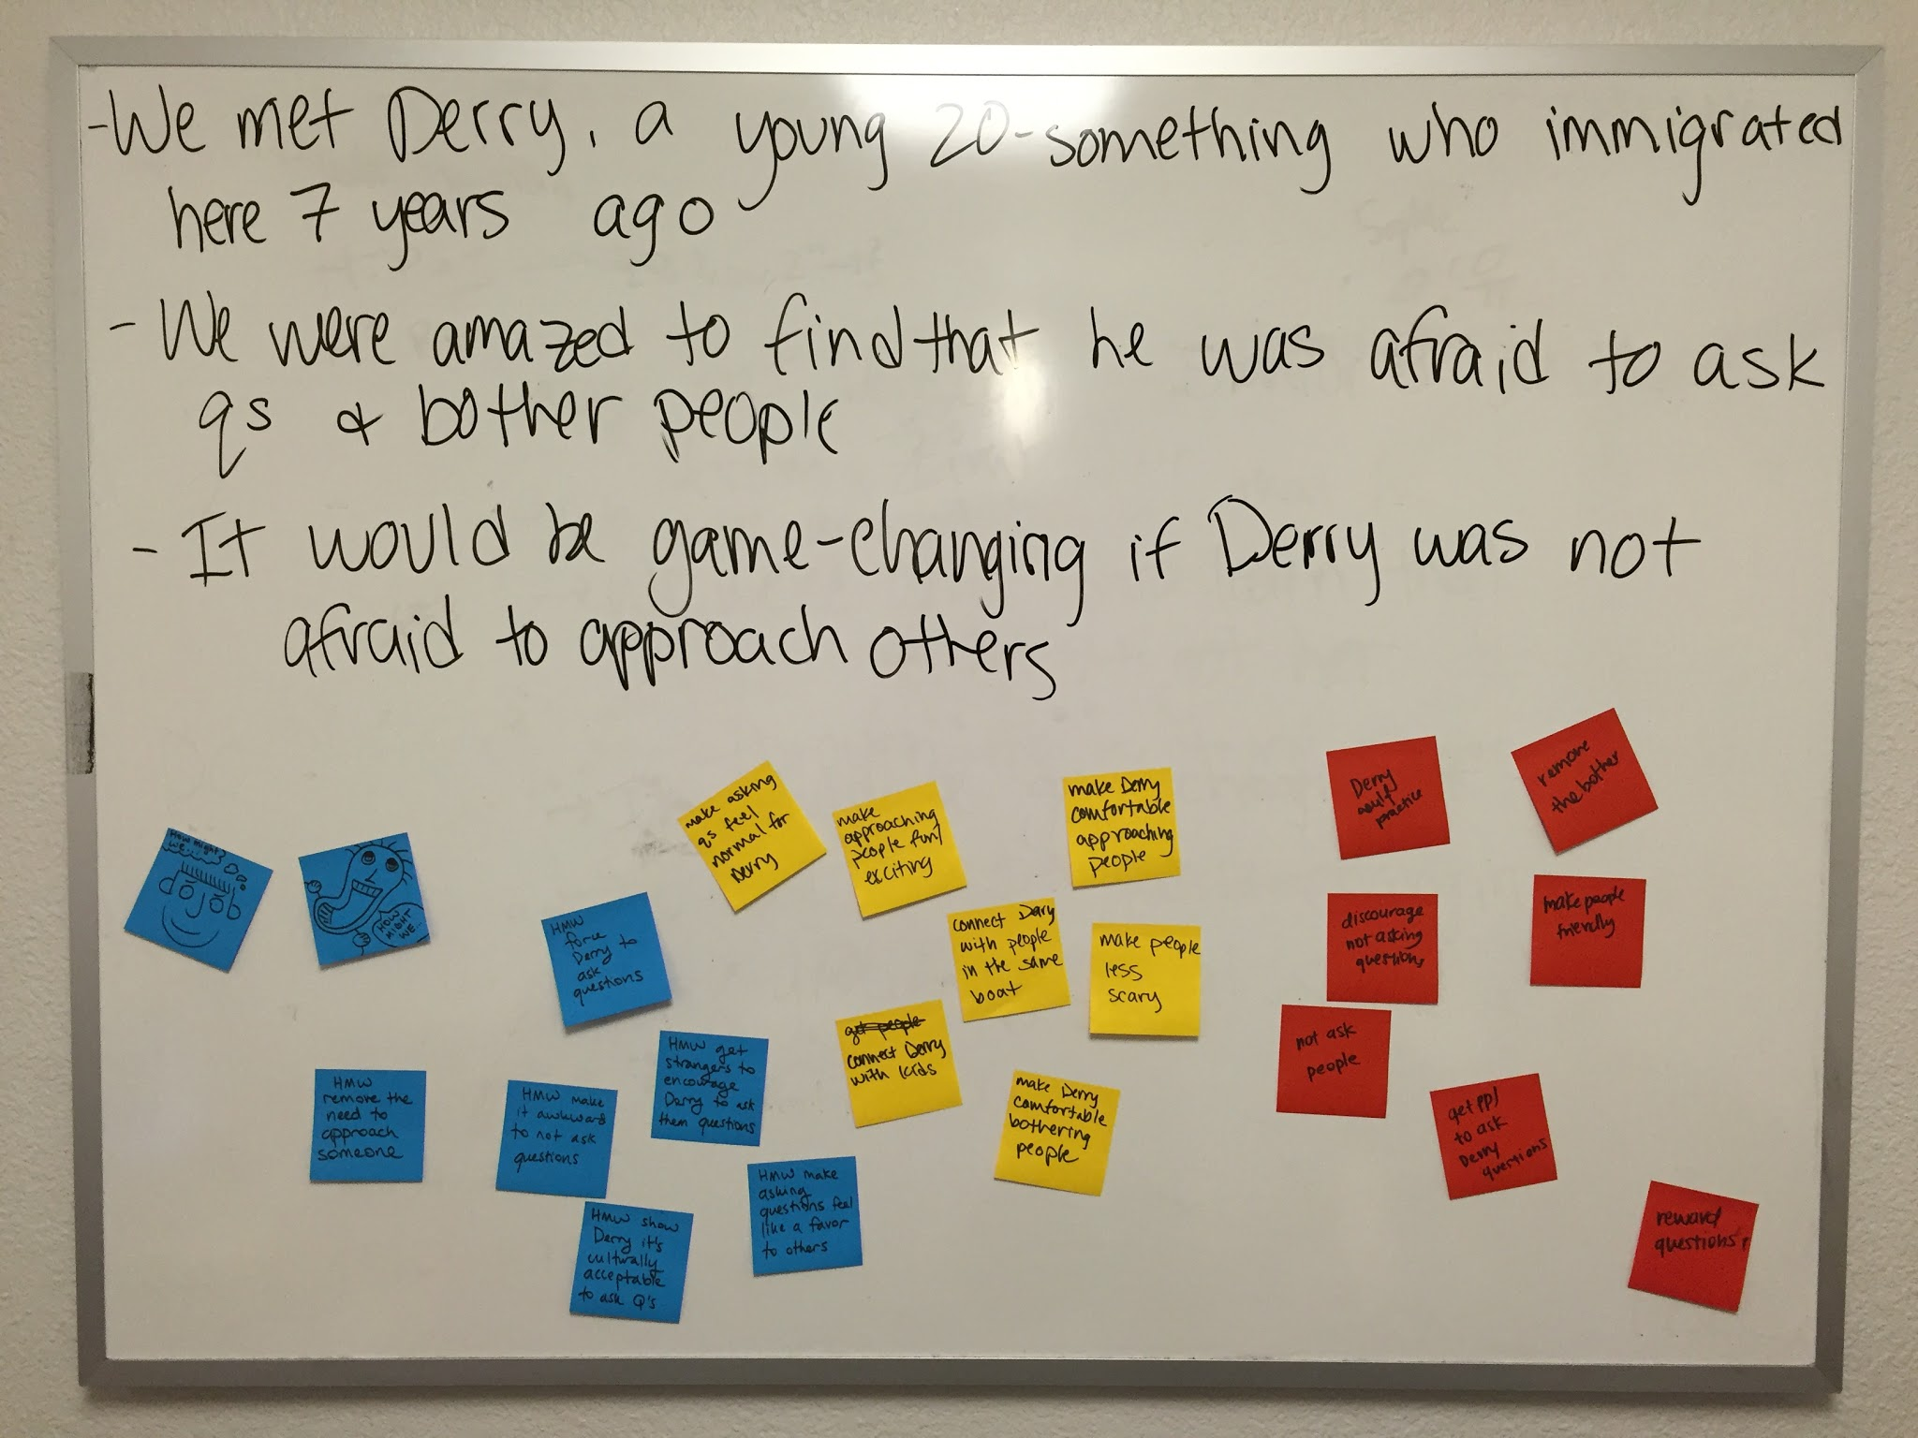
make approaching people fun and exciting?
connect Derry with people in the same boat?
make asking questions feel normal for Derry?
get strangers to encourage Derry to ask them questions?
make asking questions feel like a favor for others?
get people to ask Derry questions?
remove the bother?
discourage not asking questions?
How might we...

Slide 12
Revised POV #2
We met Vimbai, a Stanford junior who grew up in Zimbabwe and came to the United States for the first time two years ago.
We were amazed to realize that the only way she made it through the stress and culture shock of moving was the overpowering excitement of embarking on a new adventure.
It would be game changing to give other newcomers to the country that same excitement to help them get out, interact, and adapt to their new environment.

Slide 13
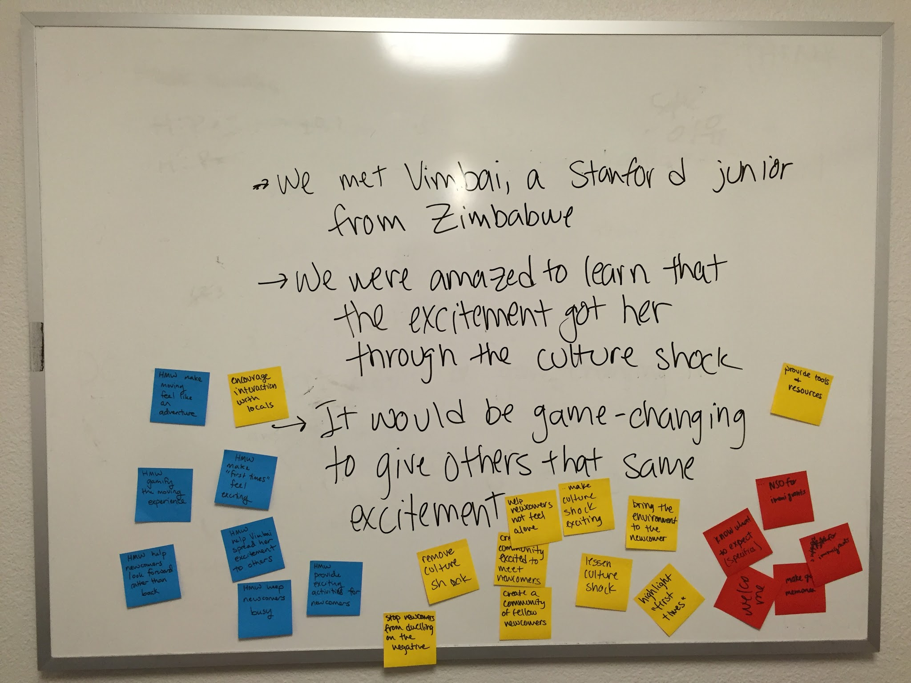
help newcomers know what to expect?
create a community excited to meet newcomers?
keep newcomers busy?
make culture shock exciting?
create a community of fellow newcomers?
help Vimbai spread her excitement to others?
encourage interaction with locals?
gamify the moving experience?
provide exciting activities for newcomers?
remove culture shock?
How might we...

Slide 14
{
HMW make approaching people fun and exciting?
Derry
{
HMW help newcomers know what to expect?
Vimbai
HMW create a community excited to meet newcomers?

Slide 15
Solutions & Prototypes

Slide 16
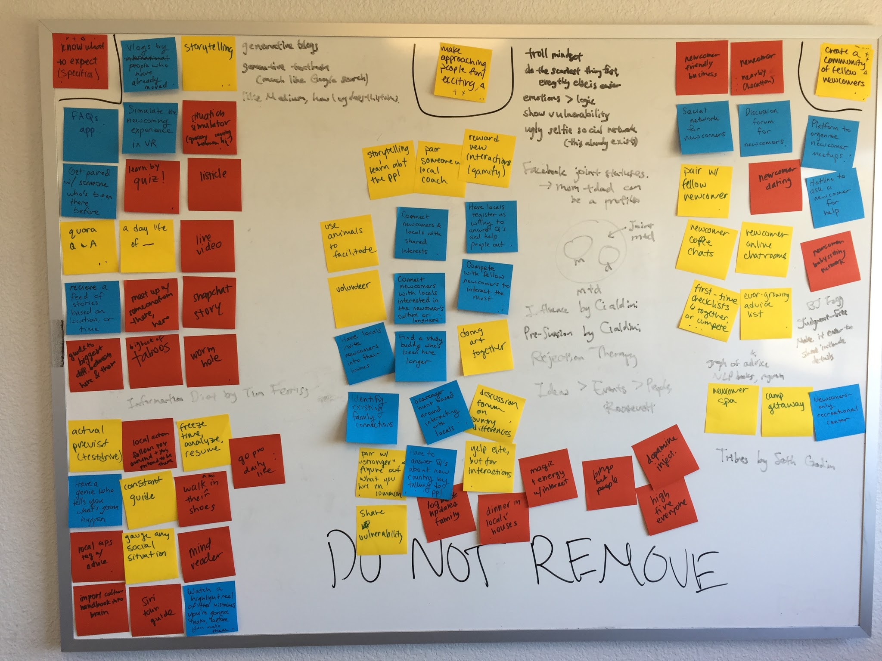

Slide 17
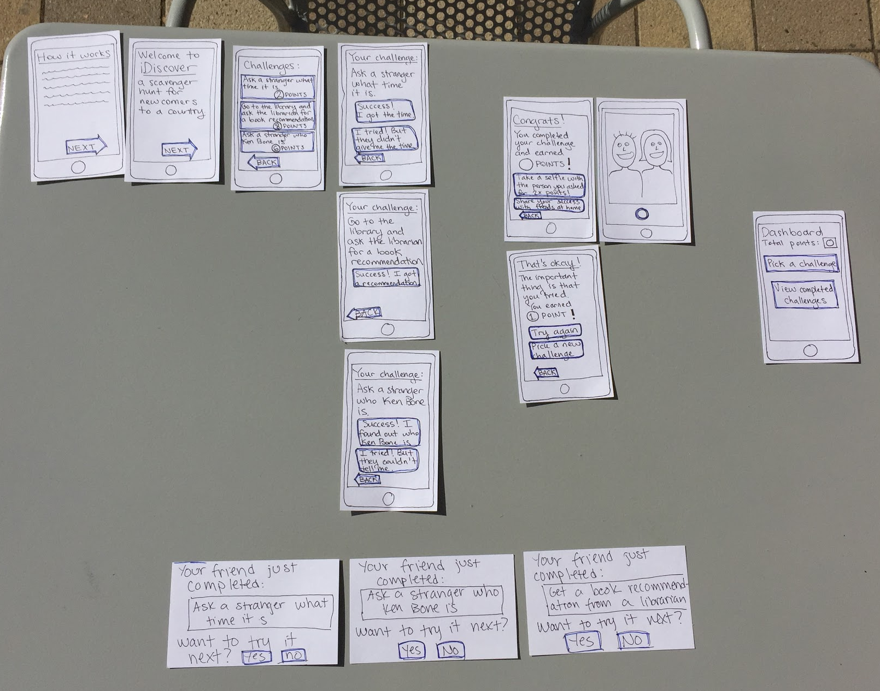
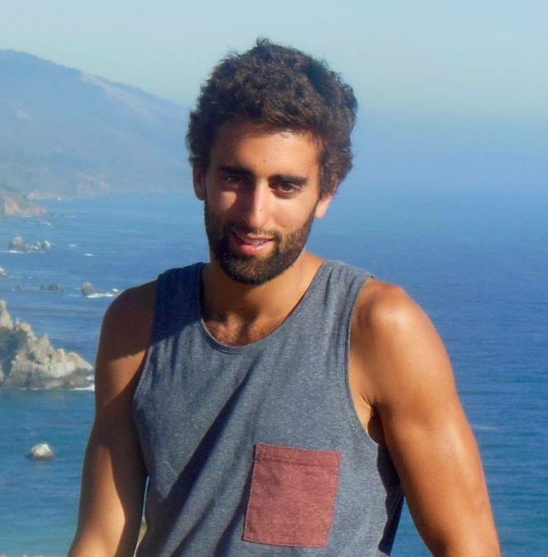
Experience Prototype 1:
iDiscover
A scavenger hunt where a newcomer has to ask questions, interact with locals, and explore their new environment.
Prototype
Bertrand
Notes:
Stems from “HMW: make approaching people fun and exciting?”
Bertrand - French graduate student, just arrived

Slide 18
Results:
iDiscover
Assumptions
Valid | Invalid
Gamification makes the app more exciting to use | It is difficult to speak to strangers
Bertrand wanted...
To participate/compete with other newcomers
To eventually meet local people in a less superficial way

Slide 19
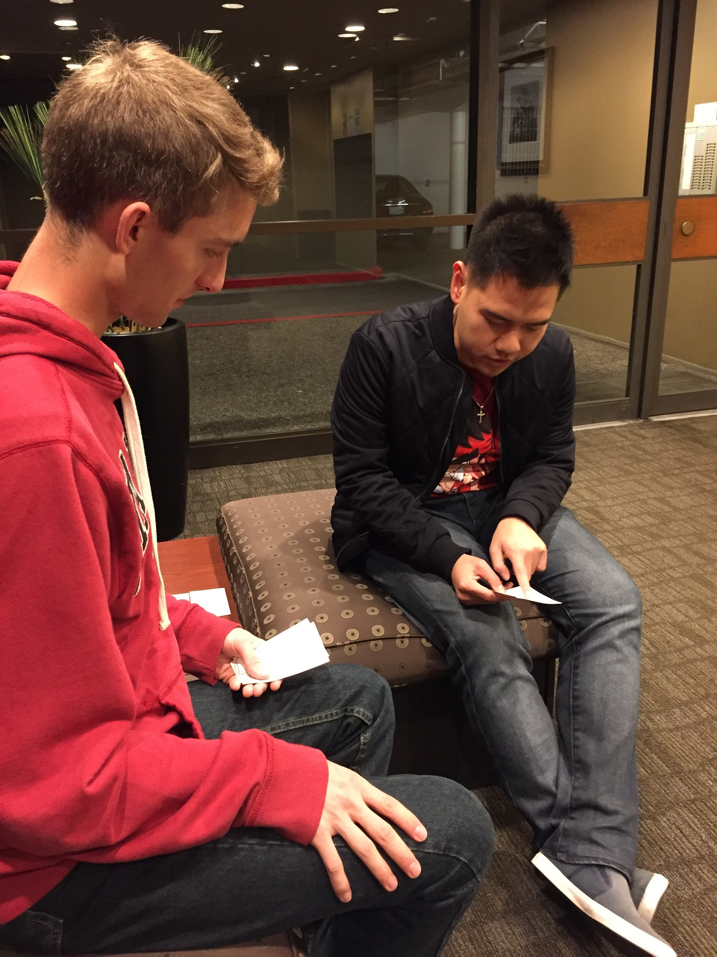
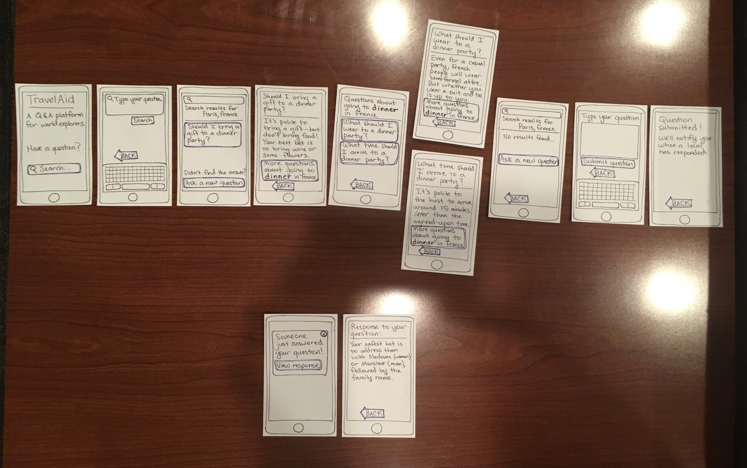
Experience Prototype 2:
TravelAid
A Q & A platform for newcomers to ask specific questions and get quick answers from knowledgeable locals.
Prototype
Bao
Notes:
Stems from “HMW: help the newcomer know what to expect?”
Bao - mid-twenties, born and raised here

Slide 20
Results:
TravelAid
Assumptions
Valid | Questionable
It is more interesting to get answers from locals than impersonal Google results | A local will respond quickly enough for their answer to be useful
Bao thought...
We should initially focus on one country or region to make sure we had enough question/answer pairs for the app to be useful
The general format of the Q & A platform worked well

Slide 21
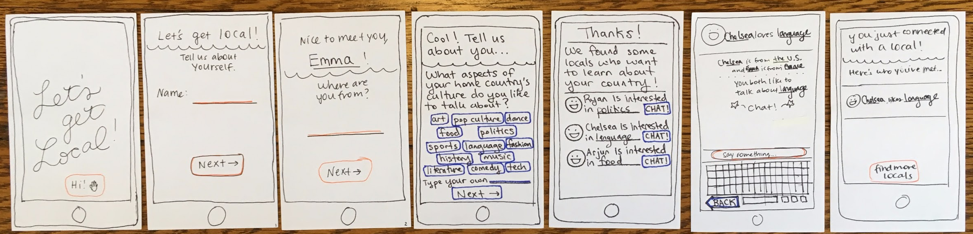
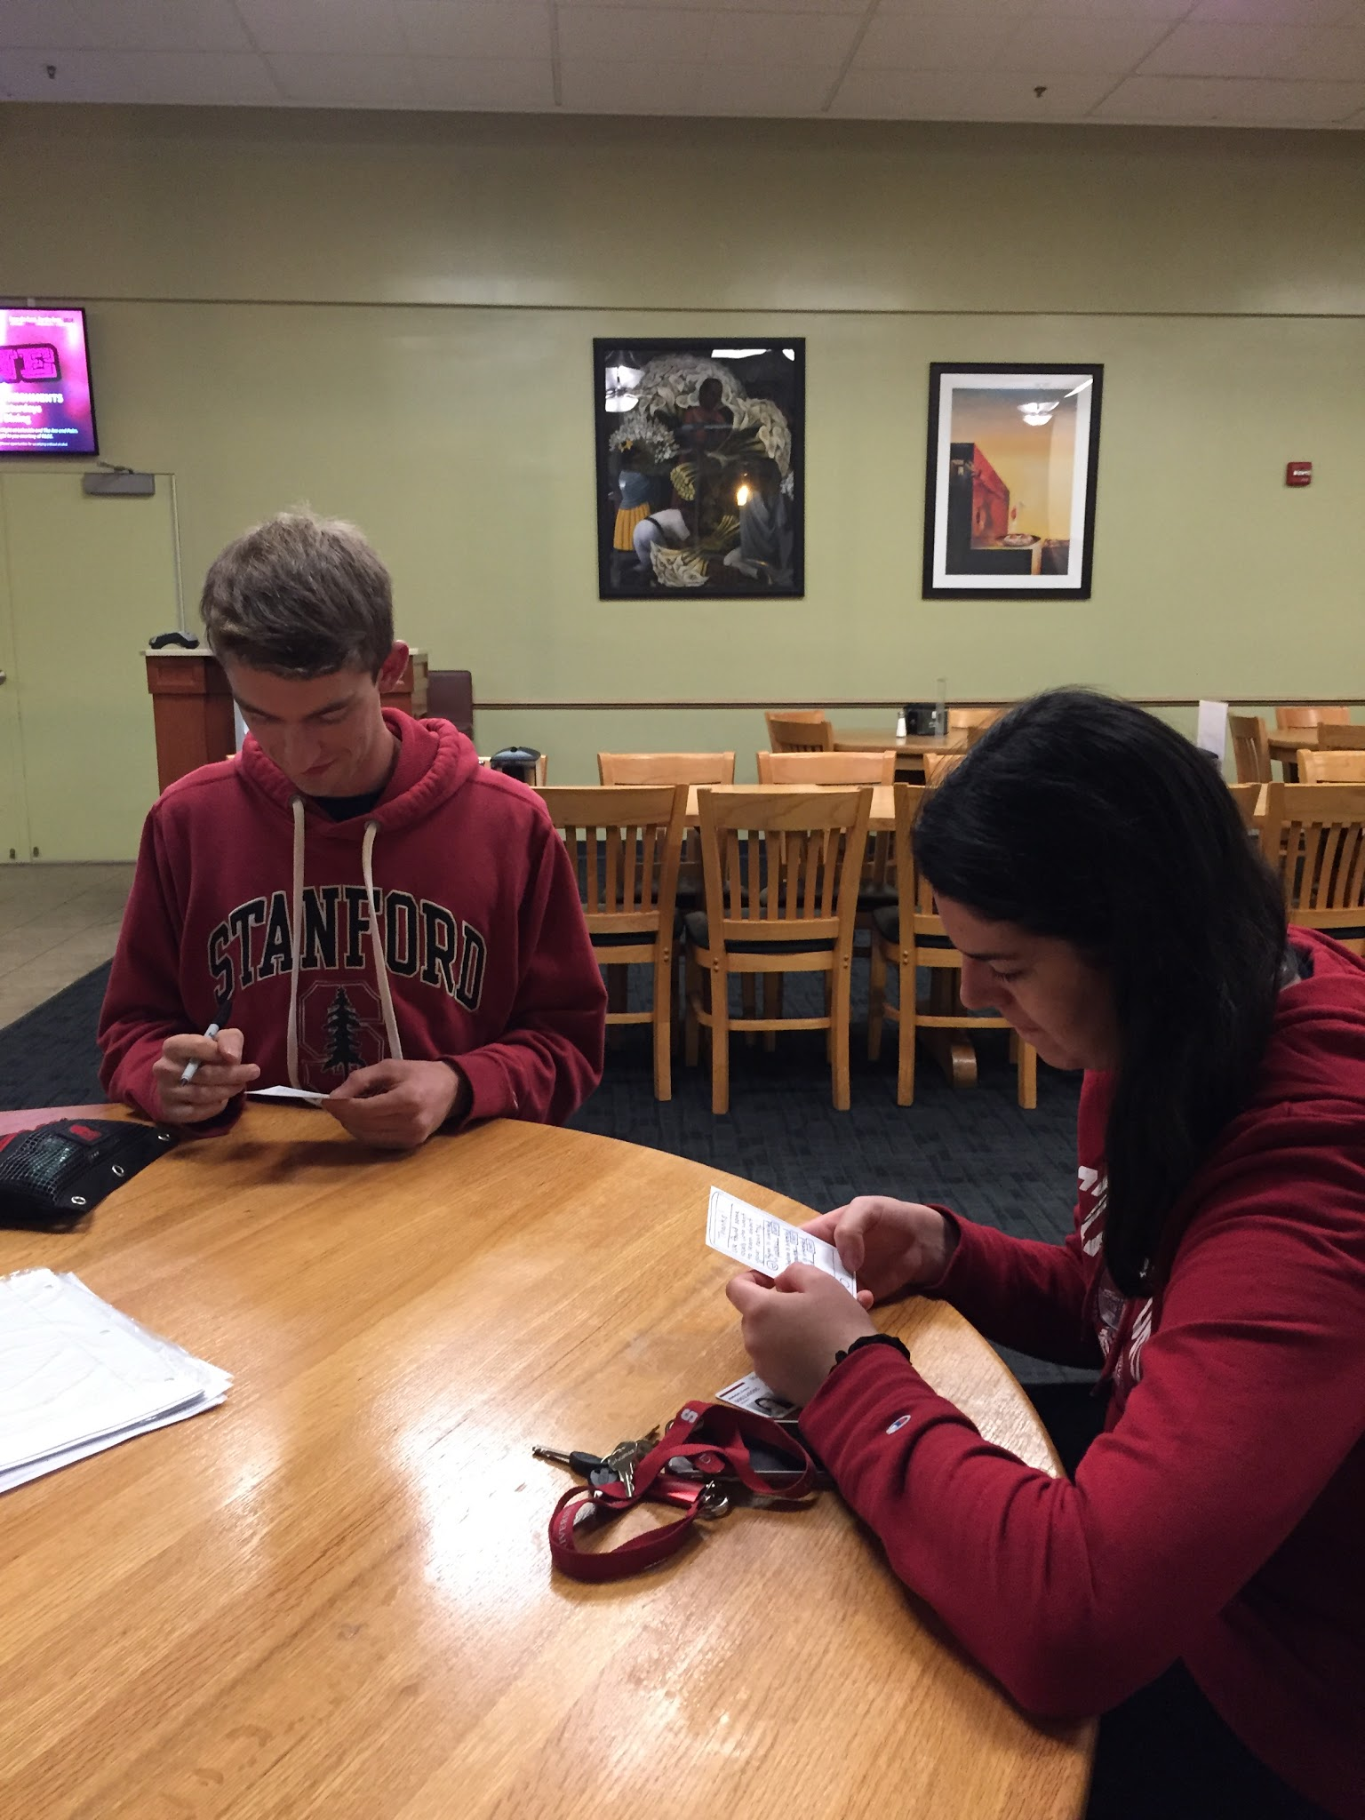
Experience Prototype 3:
Let’s Get Local
A platform to connect newcomers and locals with shared interests beyond a superficial level.
Prototype
Emma
Notes:
Stems from “HMW: create a community excited to meet newcomers?”
Emma - French freshman, just arrived

Slide 22
Results:
Let’s Get Local
Assumptions
Valid | Invalid
Newcomers want to meet locals and would be excited to chat with them | We should search for locals nearby based on newcomer’s location
Emma thought...
The format for selecting interests worked well
It would be nice to start a conversation with a local while she was still at home, and already have a friendship established before arriving in the U.S.

Slide 23
Thank you!

Slide 24
Image Sources
http://www.nationofchange.org/wp-content/uploads/2016/05/education.jpg
http://www.wahbexchange.org/wp-content/uploads/2015/08/immigrant_customs-300x300.png

