Slide 1
[Re-]Entry Education
Connie Li
Jack Swiggett
Serena Wong
Notes:
-introduce self, teammates
Talk about domain: re-entry education

Slide 2
Our Team
Serena Wong
Jack Swiggett
Connie Li
Notes:
-able to interview people from both demographics; one newcomer to the states, two people involved in inmate education

Slide 3
Newcomers to a country
Former prison/jail inmates
Both groups need to navigate society.
Notes:
-two types of “re-entry” education
-newcomers to the US; unfamiliar with culture and customs; language barrier
-released inmates: potentially spent years in jail, unfamiliar with advances in technology; potential language barrier;
-commonalities: find themselves in an unfamiliar landscape, unsure how to navigate and find the resources they need

Slide 4
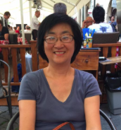
Leeno Wong
Chad Martens
Jarrod Mock
Notes:
-first participant: Mrs. Wong, my mom--chose to interview her because she is an extreme user; two major moves: china -> japan, japan -> US

Slide 5
What was your experience?
How did it make you feel?
Unexpected difficulties?
Unexpected ease?
Story about meeting someone new
Notes:
Questions were general to avoid leading to answers, but specific in types of feelings
Found it easiest to start general, then probe with follow up questions about what interviewee said
Like the “story” question form section, helpful in getting a concrete story, and one that was memorable for interviewee

Slide 6
“I should’ve tried harder to mix into society, instead of looking for comfort and staying with people like me”
Notes:
Most striking quote here; for context, when Mrs. Wong came to the US, she stayed with her brother, who also spoke Shanghainese; throughout college, stayed mostly with other foreign students; did go to one year of international school to learn english, just as she did in Japan

Slide 7
“I want to learn, I just don’t know how”
vs
Resignedness
Notes:
Interesting tension present-day; been in US since 1983, but still not entirely comfortable with English. Mrs. Wong expressed strong desire to learn English, but also a sense of resignedness; at this point, English is definitely good enough for work/navigating American society

Slide 8
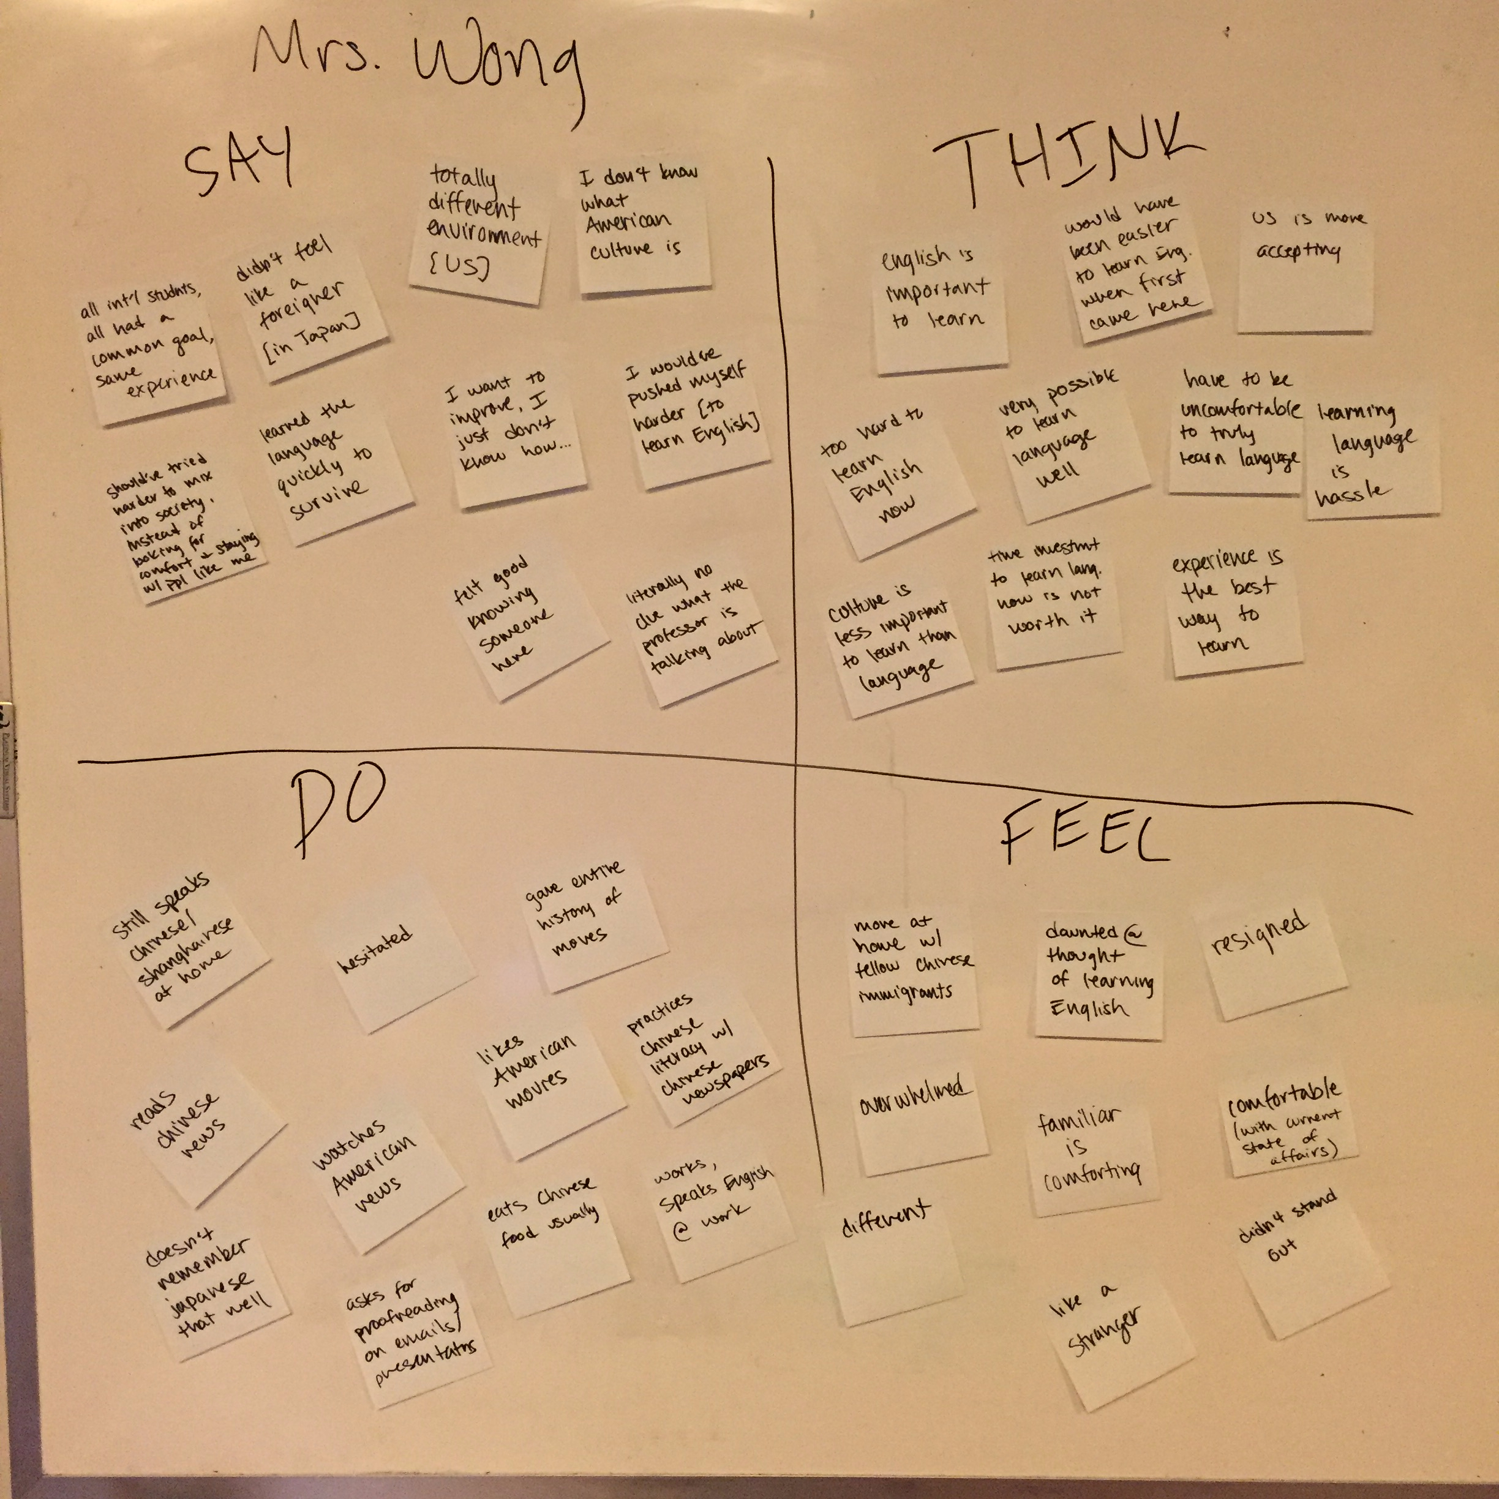
Notes:
Preliminary Empath map

Slide 9
SAY
Experience is the best way to learn
THINK
Felt good knowing someone here
Have to be uncomfortable to learn language
Culture is less important to learn than language
Common goal
Totally different environment
Watches English news/movies
Familiar is comforting
Daunted
Speaks Chinese at home
Resigned
Overwhelmed
Speaks English at work
DO
FEEL
Notes:
Distilled to this;

Slide 10
NEEDS:
Be comfortable
being uncomfortable
when learning a
new language

Slide 11
NEEDS:
See learning language in
positive light

Slide 12
Leeno Wong
Chad Martens
Jarrod Mock
Notes:
-Prison interviewees:
-Chad Martens, senior analyst with the Elmwood Complex
-domain expert; interned at the Elmwood Facility

Slide 13
Leeno Wong
Chad Martens
Jarrod Mock
Notes:
-Prison interviewees:
-Jarrod Mock, current Stanford student
-domain expert; worked with Elmwood, specifically the inmate education teachers

Slide 14
What types of educational programs already exist? What works/doesn’t work?
What differences do you see between teaching prison inmates and teaching students in a traditional classroom?
What impact do these programs have on the lives of prisoners who complete them?
Tell us about a time when a teacher did something unexpected.
Tell us about a time when a course was particularly helpful for an inmate.
Logistical questions
Notes:
-Needed to get more familiar with this space, so a lot of informational questions
-Wanted to explore how prison education is different from education in schools
-Also needed to explore logistics of working with inmates

Slide 15
“It’s a cage we need to expand”
Notes:
Quote from chad; very poetic, and captures the urgency of the situation--shouldn’t have cages in modern day, especially with regards to education in a first-world country

Slide 16
Efficiency in the classroom
vs
Inefficiency in learning
Notes:
Interesting tension present-day; been in US since 1983, but still not entirely comfortable with English. Mrs. Wong expressed strong desire to learn English, but also a sense of resignedness; at this point, English is definitely good enough for work/navigating American society

Slide 17
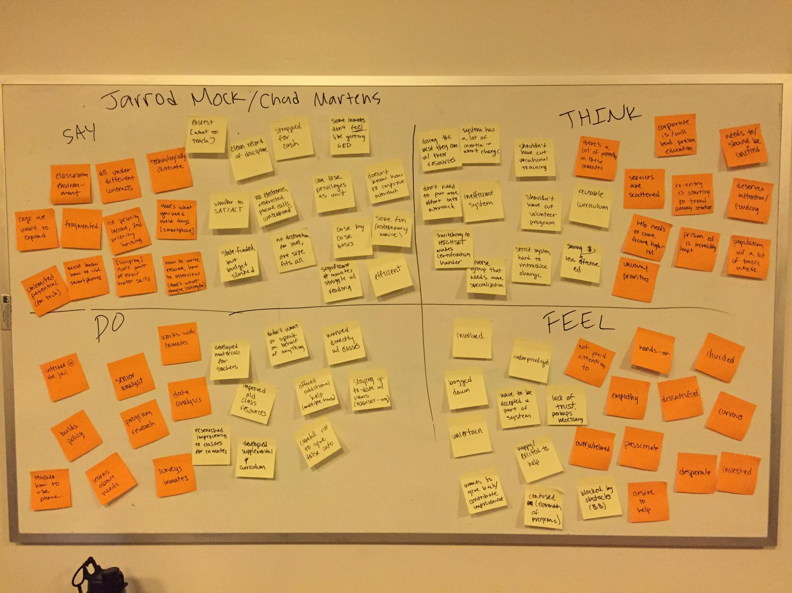
Notes:
Empathy map for both Jarrod and Chad

Slide 18
SAY
Strapped for cash
Resistant to change
THINK
One size fits all; efficient
Lots of potential in inmates
Inefficient
Fragmented programs
Deserves more funding
Classroom environment
Needs more specialization
No electronics
Invested
Empathy
Develops materials for teachers
Works with inmates
Lack of trust
Overwhelmed
DO
FEEL
Notes:
Distilled to this
-one size fits all: classroom curriculum; no distinction of education level within class of 30 inmates; can imagine single teacher struggles
-lots of programs exist, but very fragmented, and all under different umbrellas
-can attest to this; our team placed 15 calls; often went to voicemail, but when did speak to someone, redirected all over the place
-biggest need is that these programs are super underfunded, but we were able to narrow that very broad need into a more specific one:

Slide 19
NEED:
Tailored approach
to education

Slide 20
NEED:
Unification of resources to increase accessibility

Slide 21
Summary
Newcomers
Change attitude toward learning
Former inmates
Get access to what we take for granted
Notes:
Target demographics took us in somewhat different directions
Change attitude toward learning: currently, viewed as a necessary burden; can’t learn in a comfortable environment and actually know the language
Former inmates: can’t look at inmate education from same perspective as education in schools; they have more basic needs: e.g. knowledge of where to find resources, and a more tailored approach to education

Slide 22
Thank you

Slide 23
Images Sources
http://www.123rf.com/photo_10503690_fork-in-the-road-or-highway-business-metaphor-representing-the-concept-of-a-strategic-dilemma-choosi.html
http://ometz.summit-tech.ca/blog/wp-content/uploads/2012/04/shutterstock_60289846.jpg
http://www.santamonicalanguage.com/uploads/3/4/1/3/3413829/1022382_orig.jpg
http://www.returnofkings.com/wp-content/uploads/2014/06/learning-a-language.jpg
http://how-to-teach-english.ontesol.com/wp-content/uploads/2014/07/iStock_000023334394Small.jpg
http://www.topeducationdegrees.org/wp-content/uploads/2016/01/6357758756001800821152486765_State-Education-Generic-jpg.jpg
http://awakentherebel.com/wp-content/uploads/2013/09/r-PEOPLE-APPLYING-FOR-A-JOB-large570.jpg

