Slide 1
Medium-fi Prototype
Connie Li ● Serena Wong ● Jack Swiggett
CS 147, Fall 2016

Slide 2
Pelican
explore your new home

Slide 3
Value Proposition:
Confidence and familiarity in a new environment

Slide 4
The Problem
Newcomers to a country are uncomfortable getting out of their comfort zone and interacting with strangers.
They also find it hard to meet new people and establish lasting social connections.

Slide 5
Our solution
Newcomers get used to interacting with locals in their new environment by completing challenges.
Group challenges allow fellow newcomers to meet and form lasting friendships.

Slide 6
Tasks

Slide 7
Complex task:
Become more comfortable approaching strangers
Pick a solo challenge and complete it

Slide 8
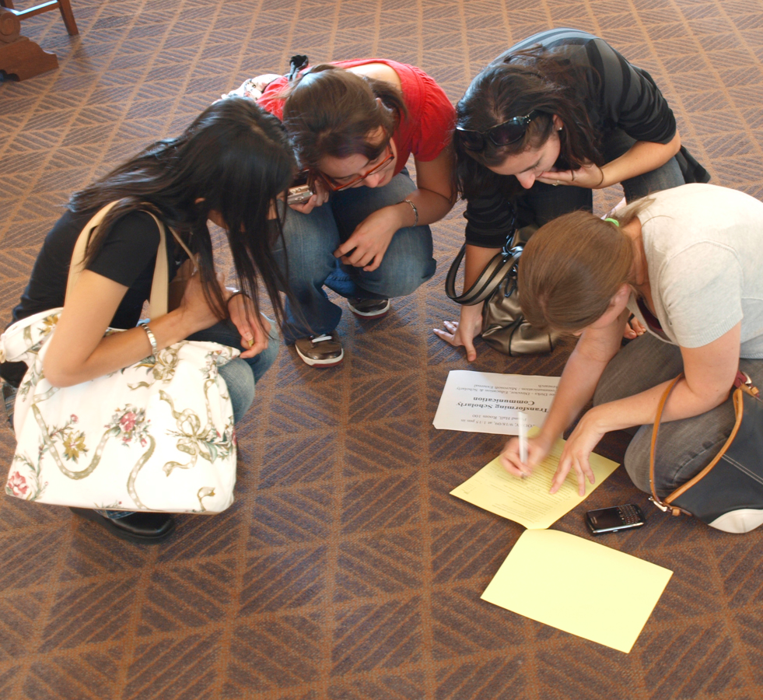
Medium task:
Find other newcomers and complete challenges with them
Pick a group challenge and complete it

Slide 9
Simple task:
Earn points and compete with friends
Check the leaderboard

Slide 10
Additional task:
Figure out what challenges you have recently completed

Slide 11
Revised Interface:
Design Changes

Slide 12
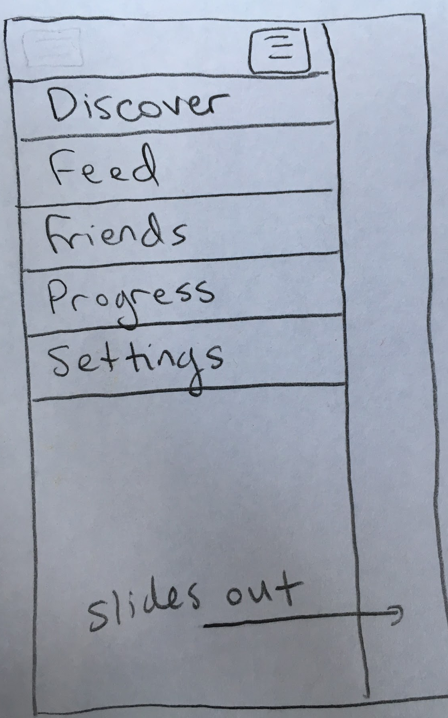
We replaced the navigation bar with an expanding menu
1.
Rationale
Navigation icons were confusing and unintuitive
Reduces clutter in the UI
Provides an easy way to add new features over time

Slide 13
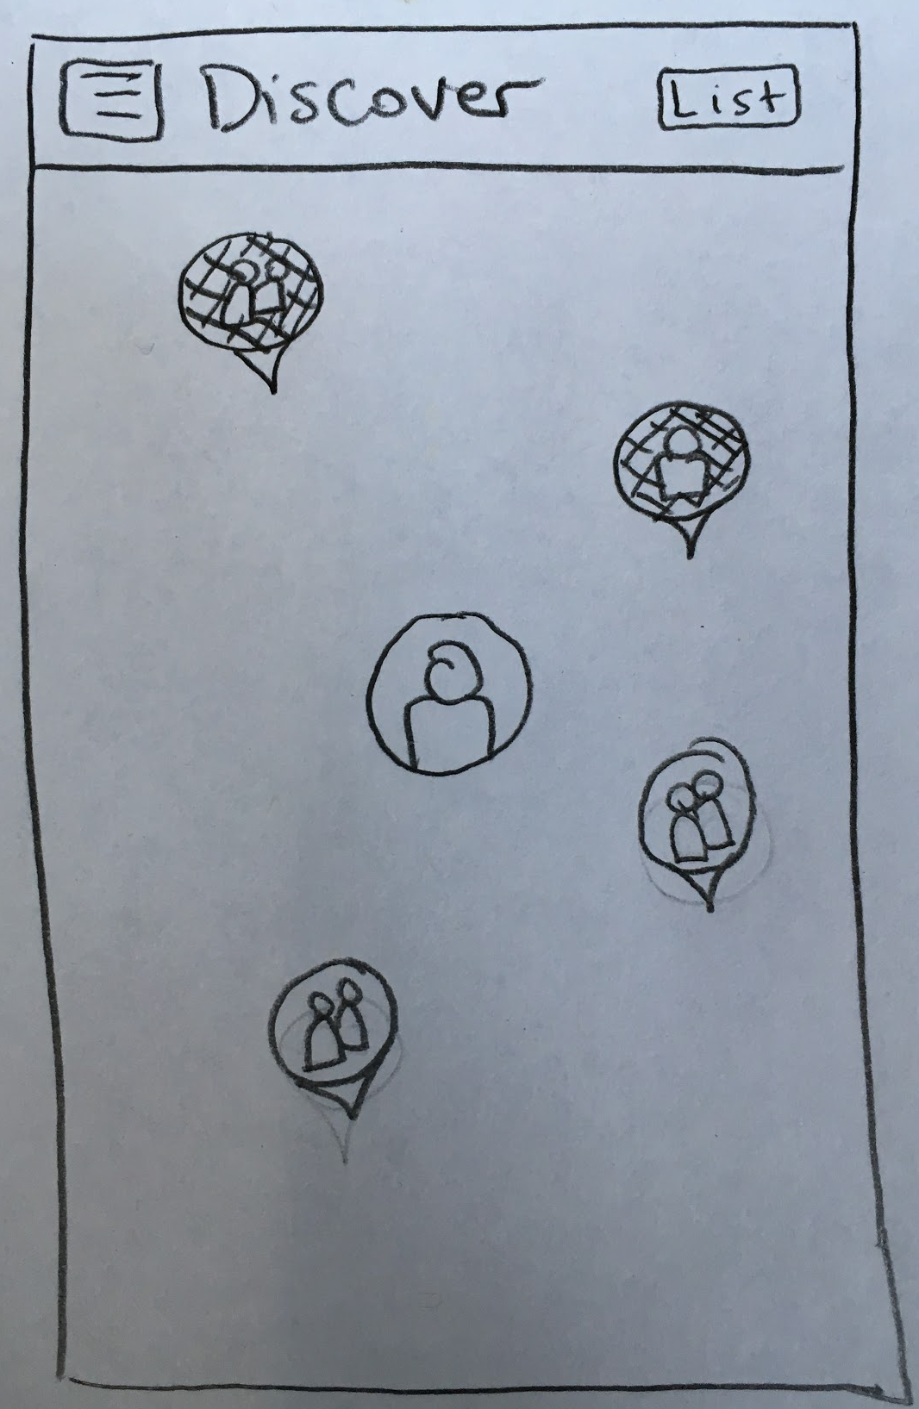
We combined the discover map and the feed map
2.
Rationale
Difference between the two maps was unintuitive
Testers wanted to see challenges their friends had completed while looking for new challenges
Feed is separate and easier to understand

Slide 14
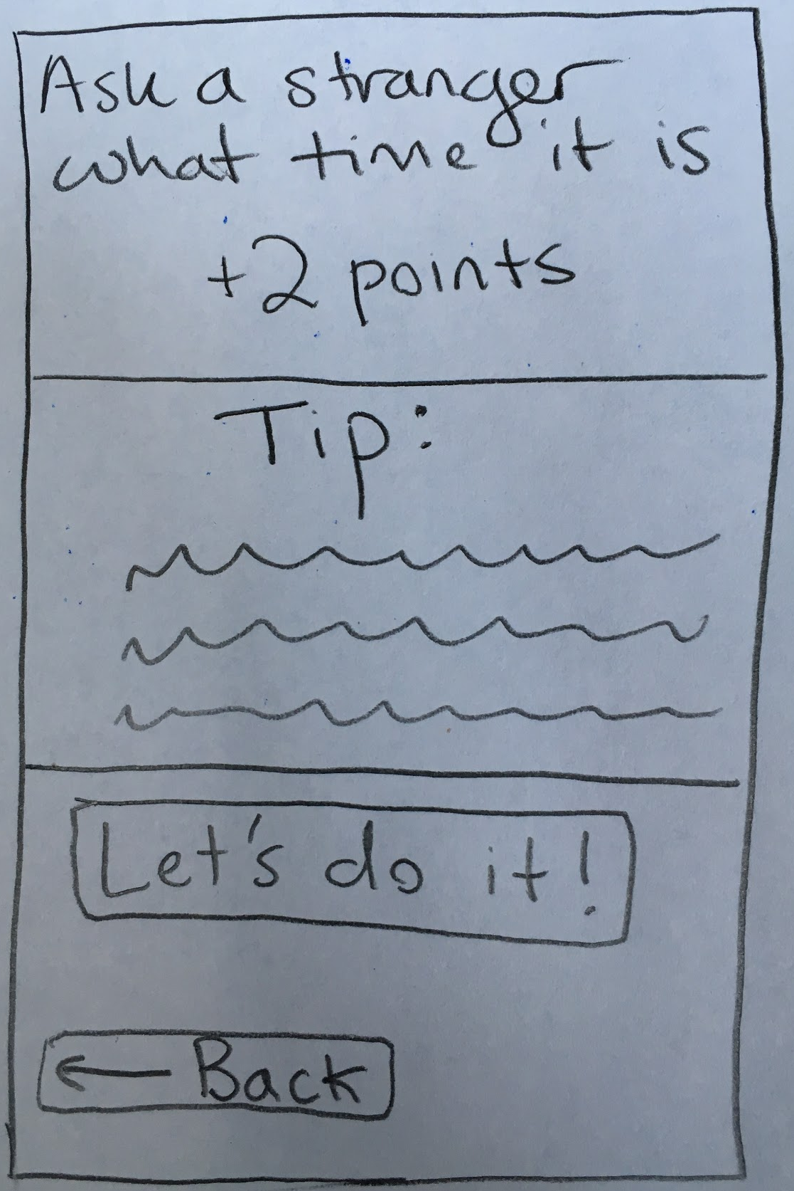
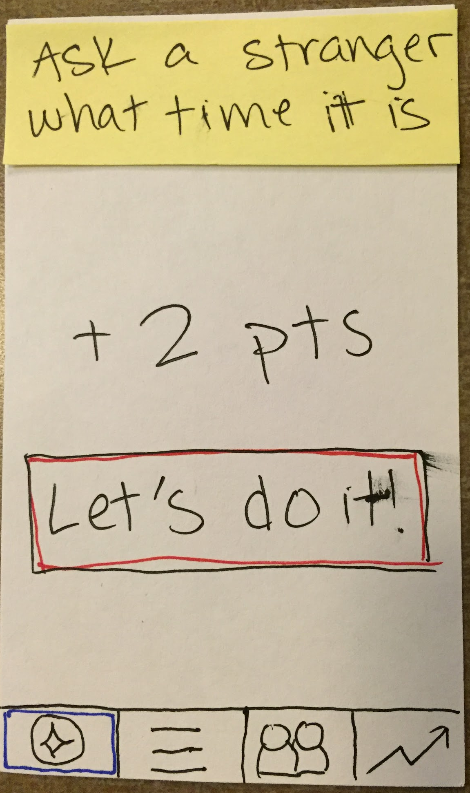
We added tips to each of the challenges to guide our users
3.
Rationale
Testers wanted guidance on how to approach strangers
Allows us to clarify challenges and address common problems

Slide 15
Revised Interface:
Task Flows

Slide 16
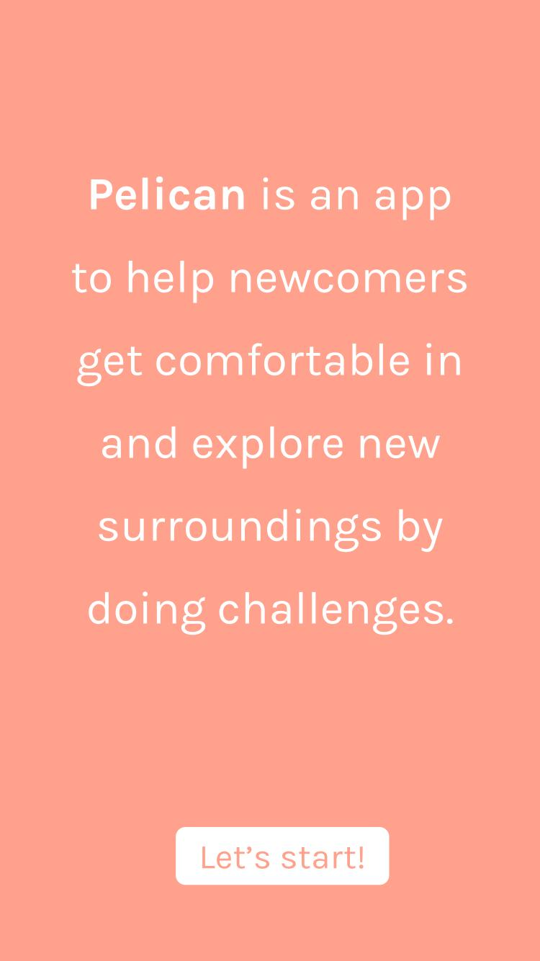
Startup screens…

Slide 17
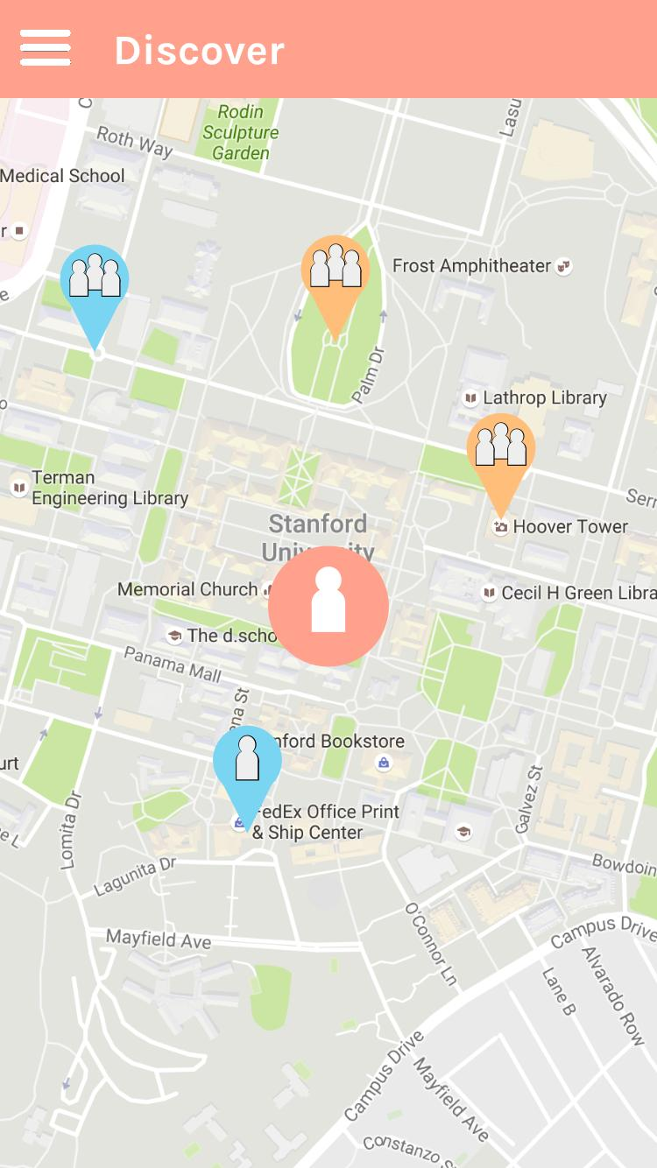
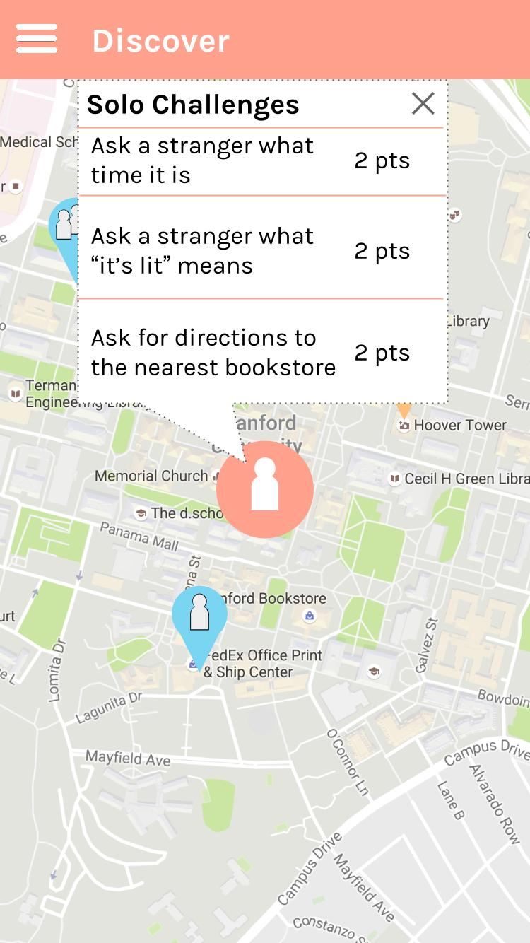
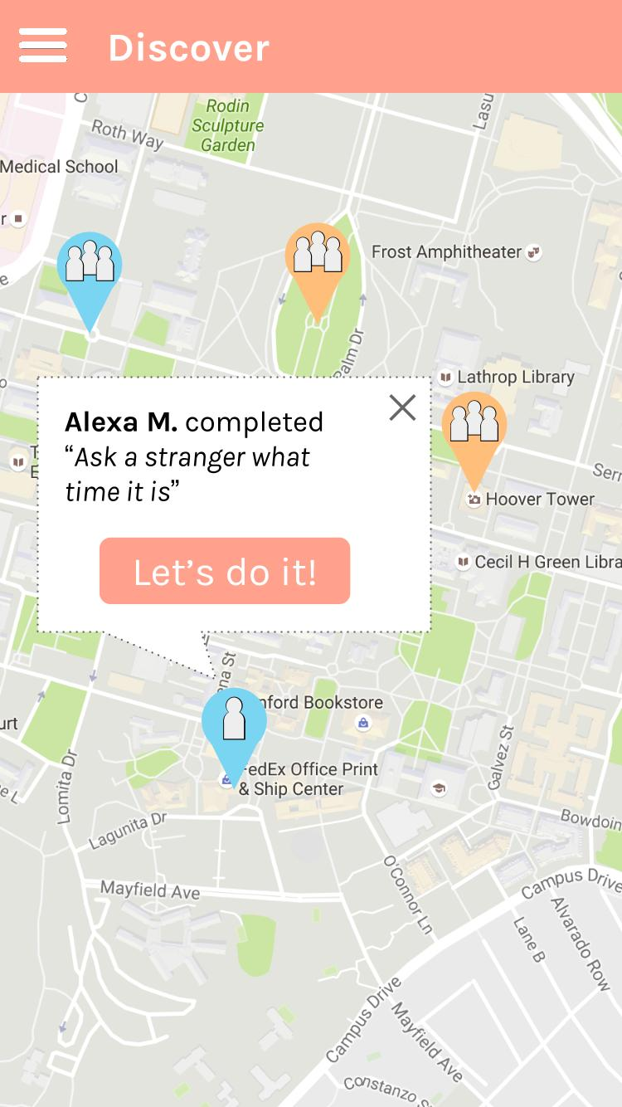
Pick a solo challenge and complete it

Slide 18
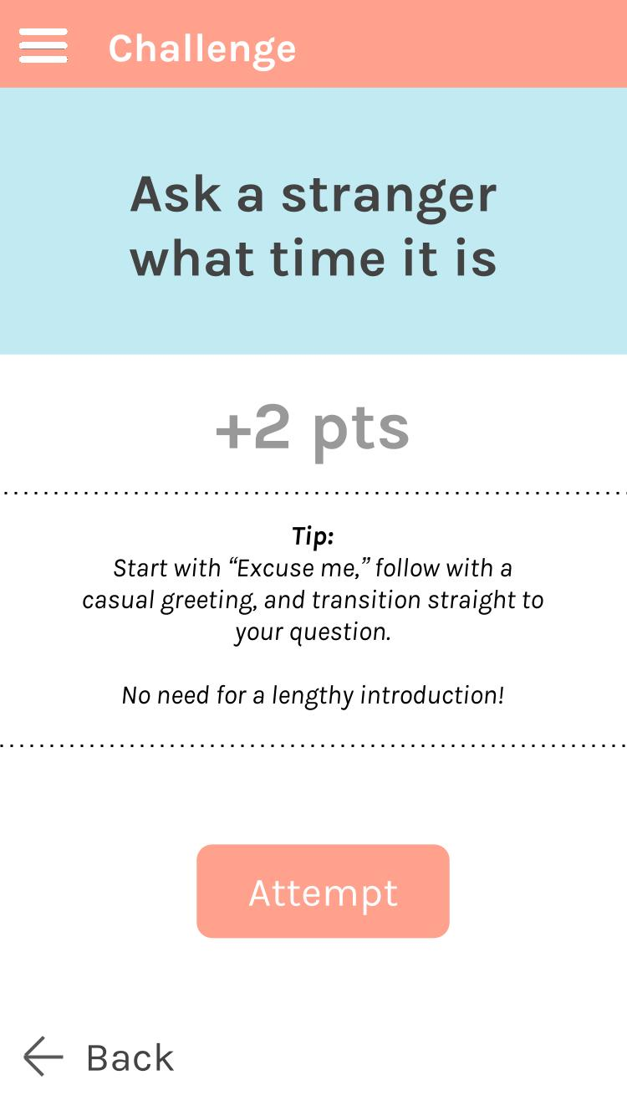
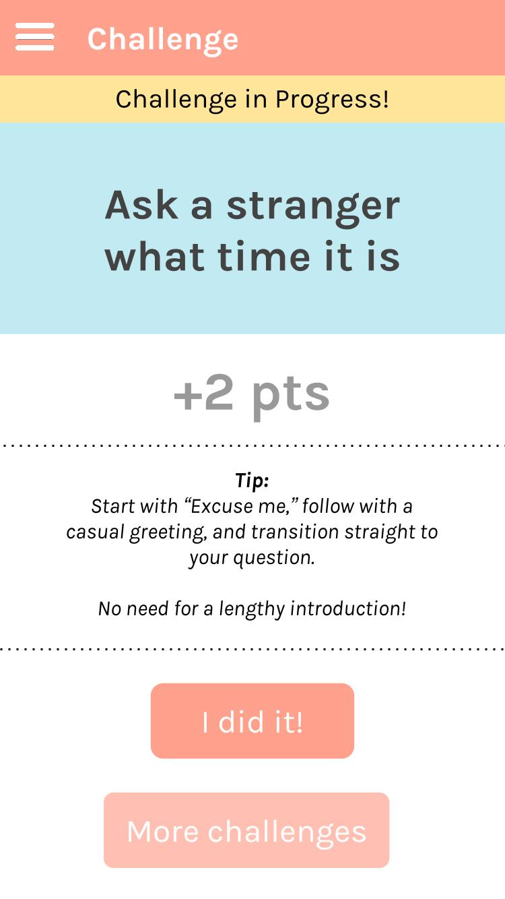
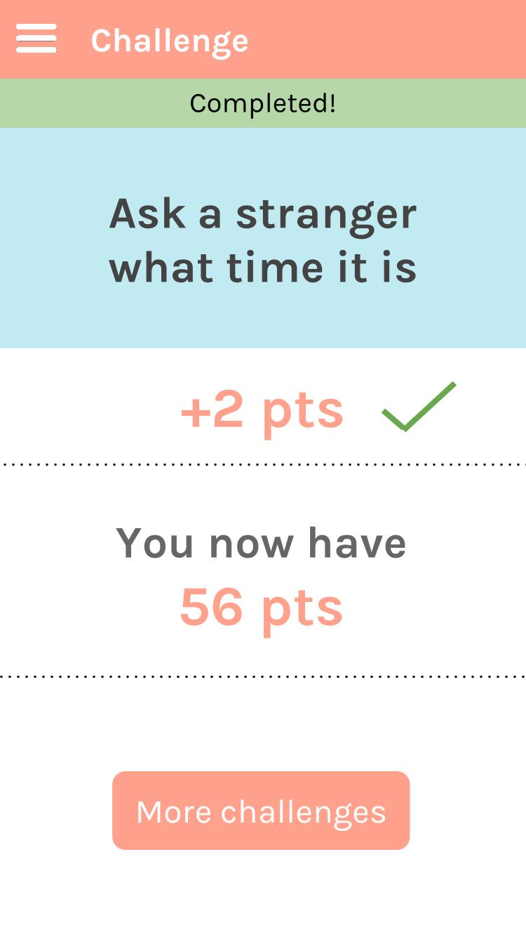
Pick a solo challenge and complete it

Slide 19
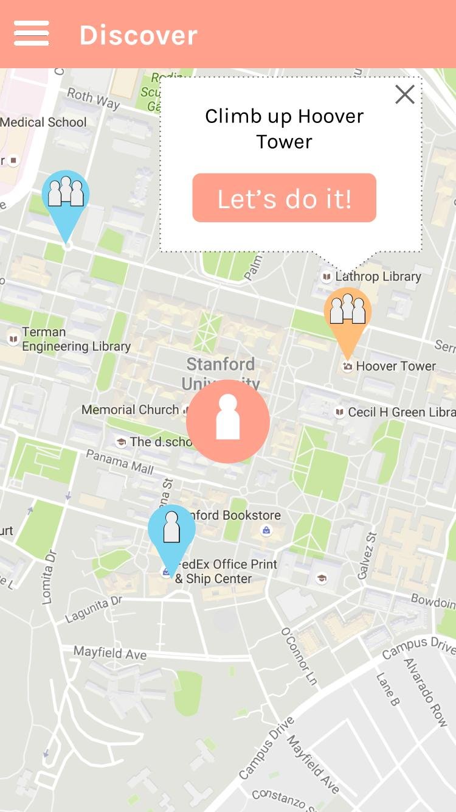
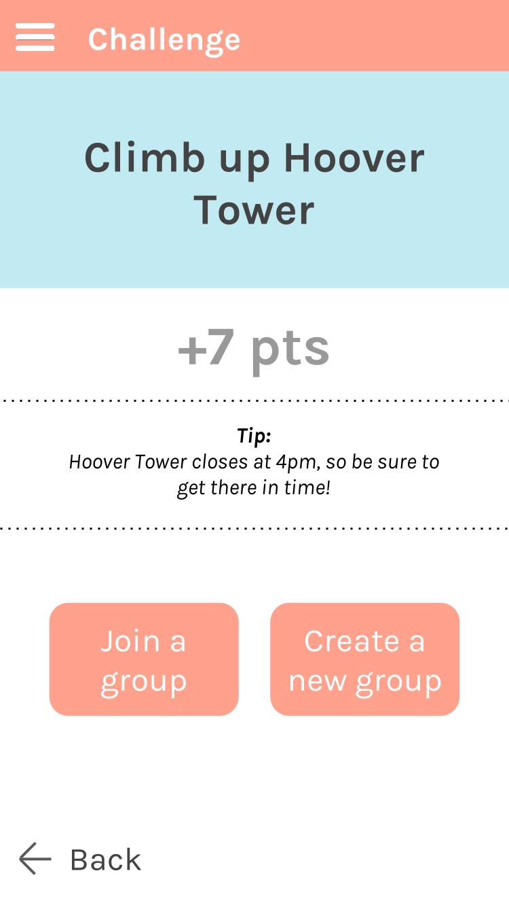
Pick a group challenge and complete it

Slide 20
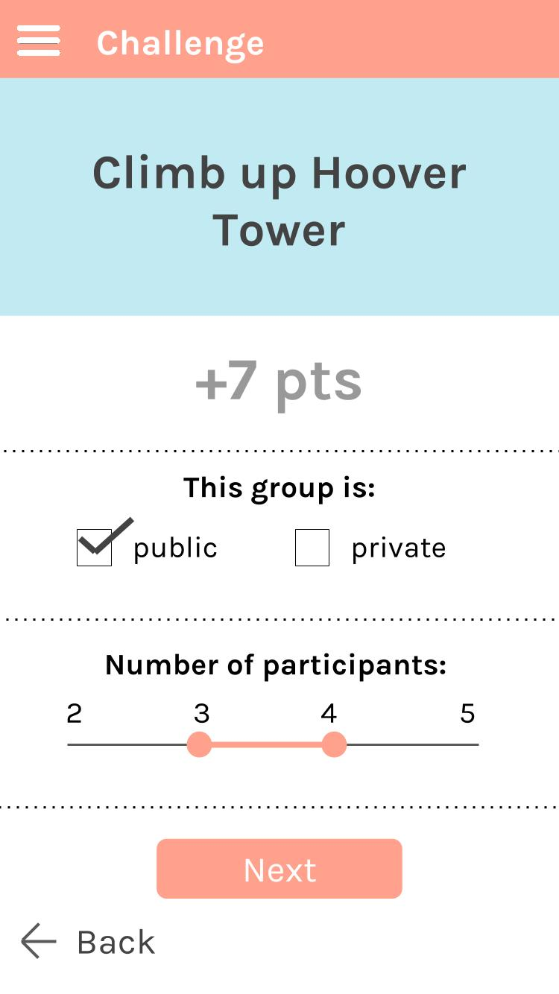
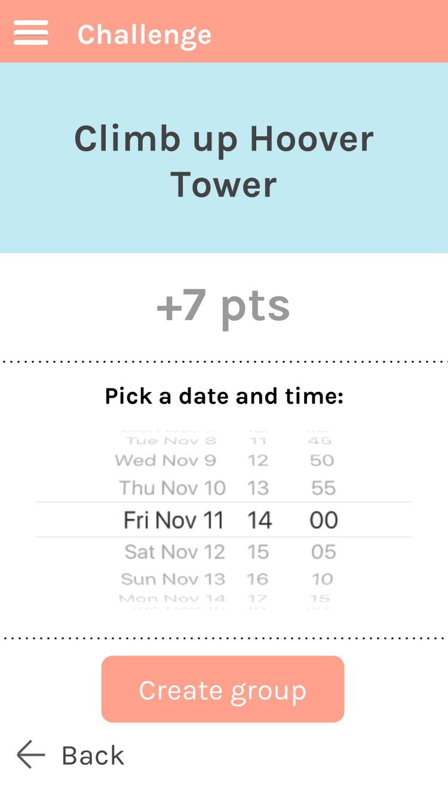
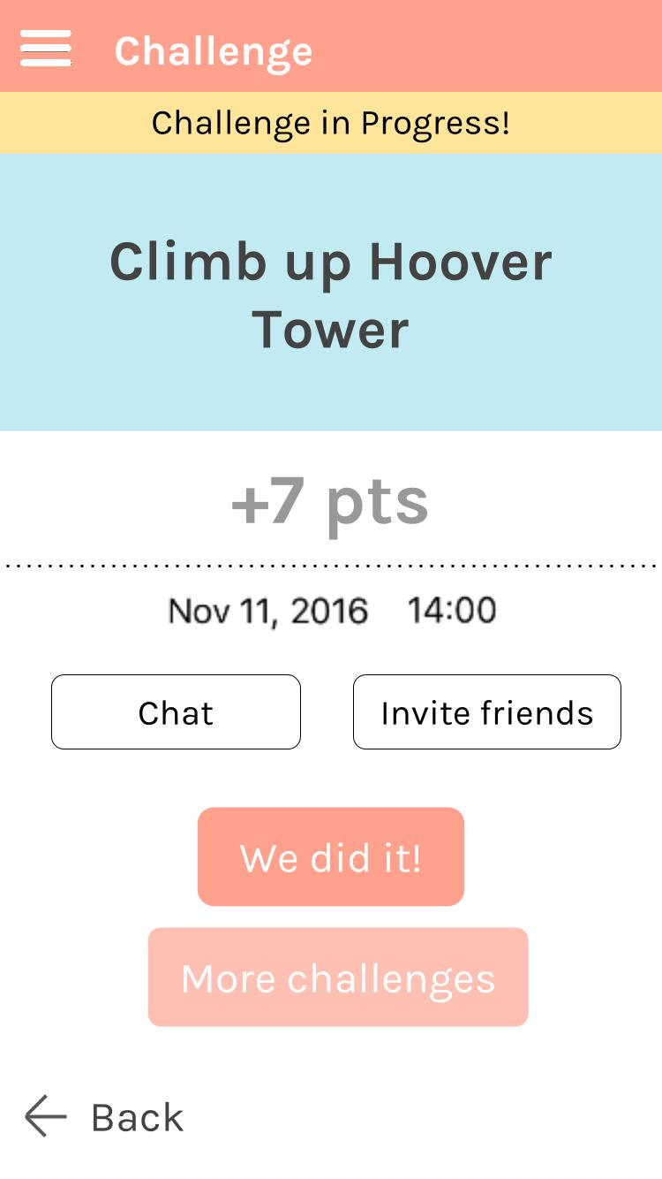
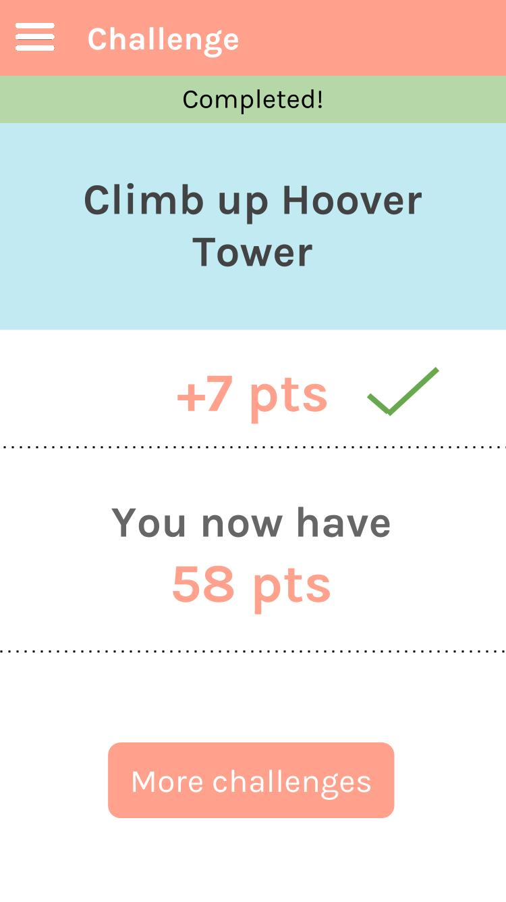
Pick a group challenge and complete it

Slide 21
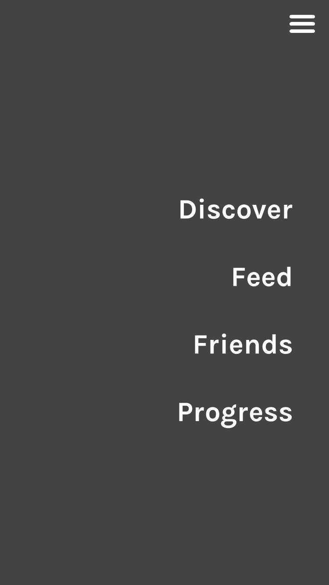
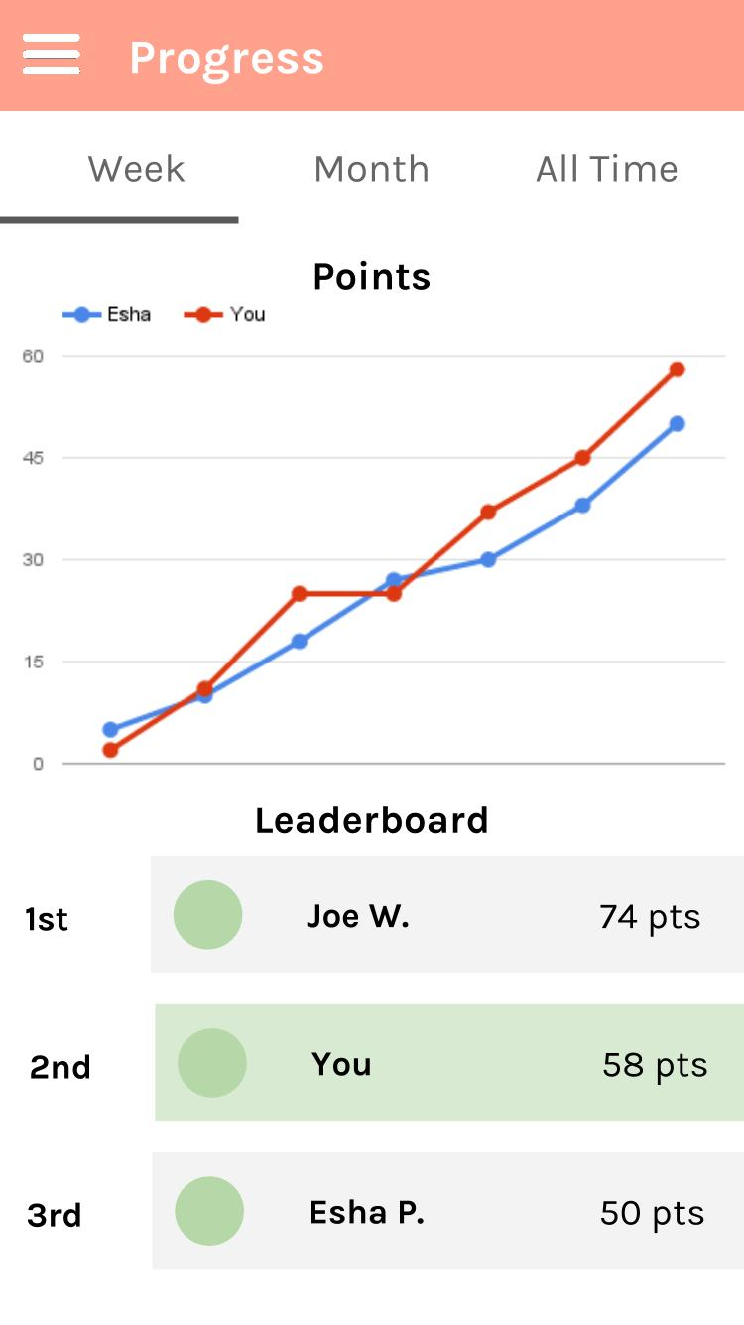
Check the leaderboard

Slide 22
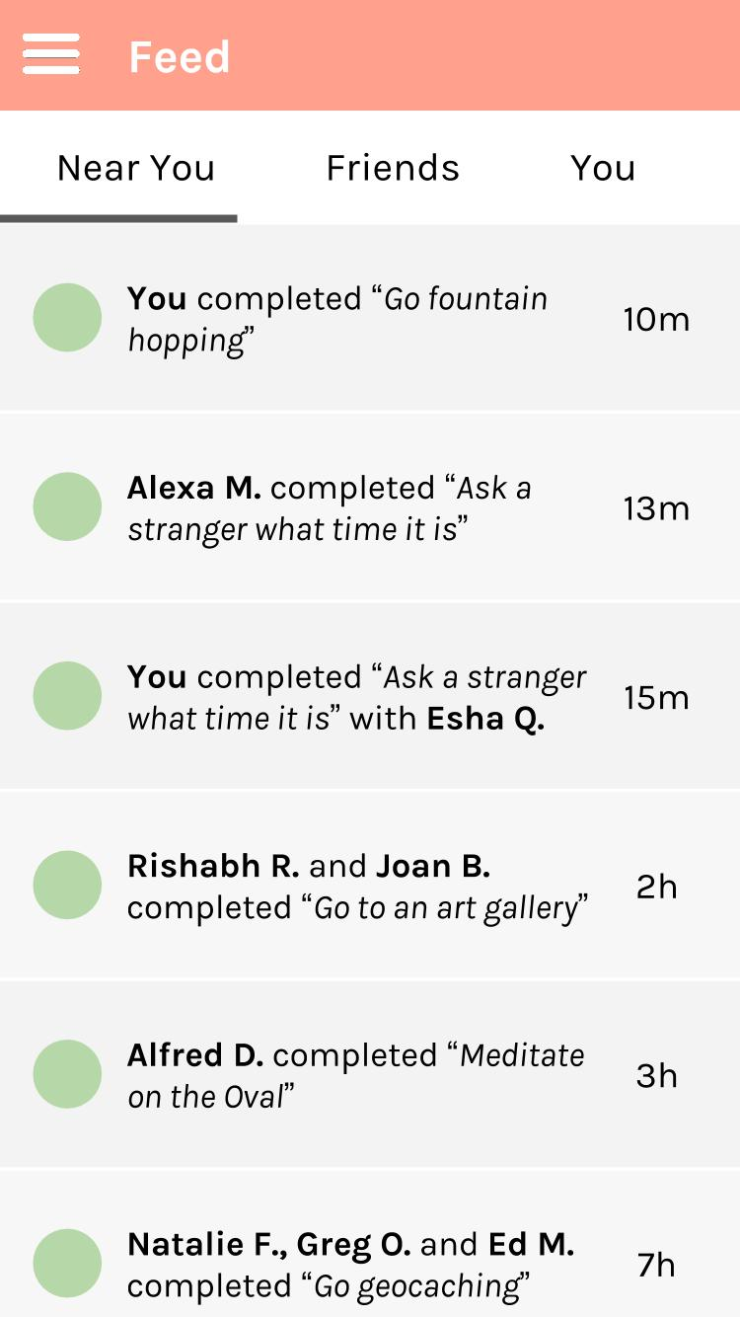
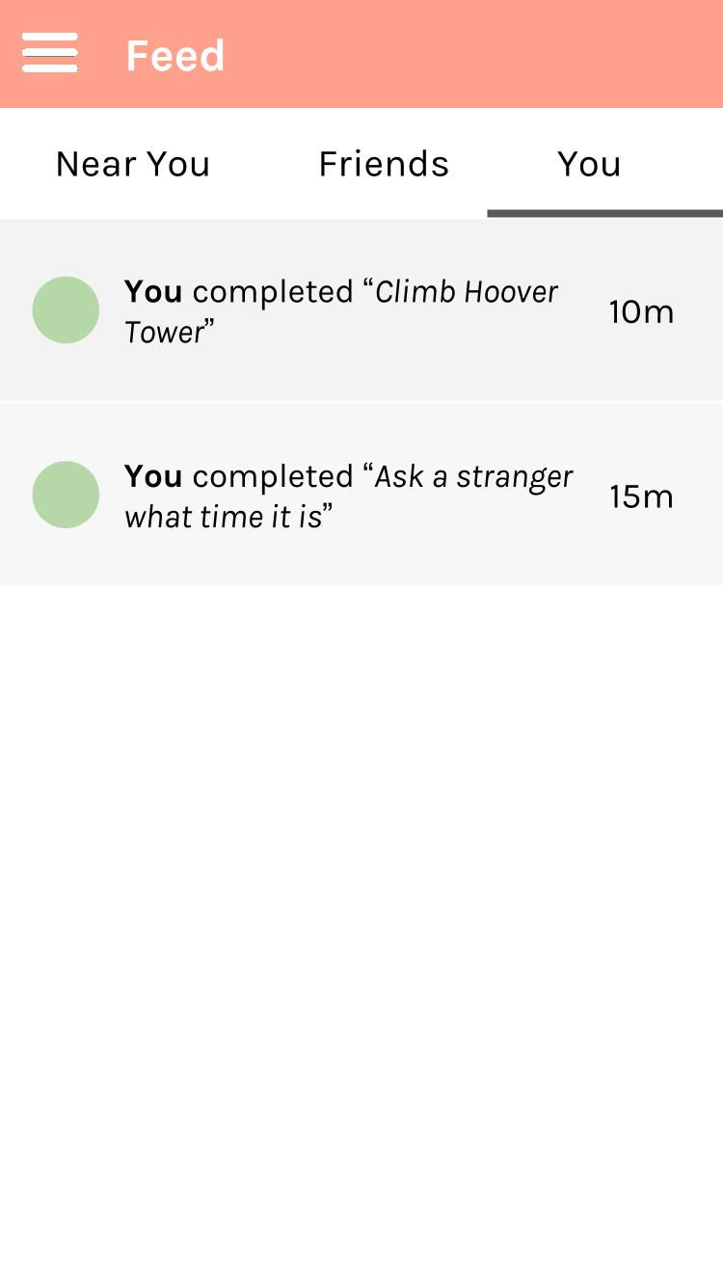
Figure out what challenges you have recently completed

Slide 23
Prototyping Tools

Slide 24
Google Slides to create images for the app screens
Pros
Easy to create simple graphics
Easy to work collaboratively in real time
Can set slides to be the right screen size
Cons
Difficult to create complex graphics or charts
Need to export slides one at a time

Slide 25
Marvel to create the interactive prototype
Pros
Easy to import images and create simple interactions
Easy to embed in our website
Cons
Unable to implement complex logic like earning points or navigating in the map

Slide 26
Prototype Limitations

Slide 27
What we left out
Challenge verification to prevent cheating
Couldn't find a simple way to do this
Since users will mostly compete with themselves or friends, they are likely to be honest
Tutorial
Didn’t want to display tutorial every time someone launched the app
Changing tutorial to as-needed basis

Slide 28
Hard-coded features
Feed of recently completed challenges
Points and graph of progress
Leaderboard
Current location on the map
Implementing these would require a database or reading information from the Internet, which we could not do in Marvel

Slide 29
Thank you!

