Slide 1
Lo-Fi Prototyping and Testing
CS 147 - Fall 2016
Jack Swiggett
Serena Wong
Connie Li

Slide 2
Value Proposition:
Confidence and familiarity in a new environment

Slide 3
Selected Interface Design

Slide 4
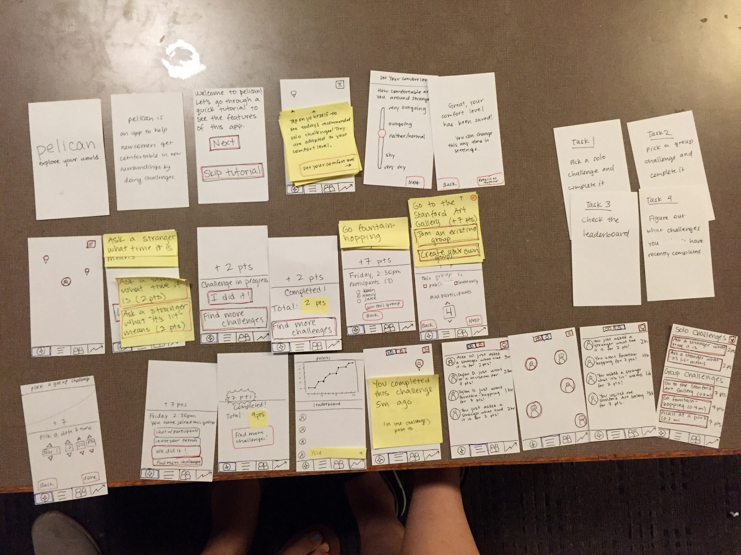

Slide 5
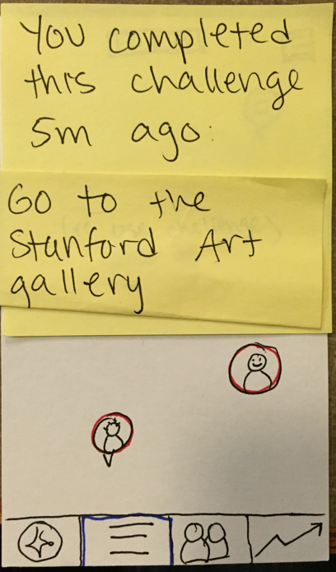
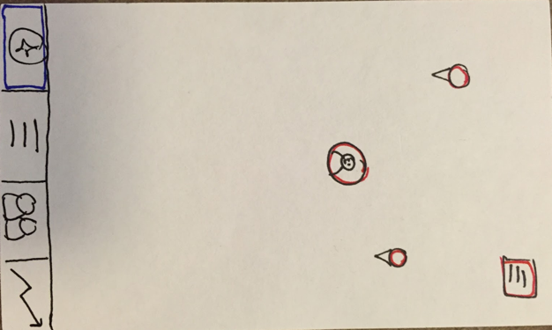
Big Idea:
Map-
Based
Interface
Help users explore their surroundings

Slide 6
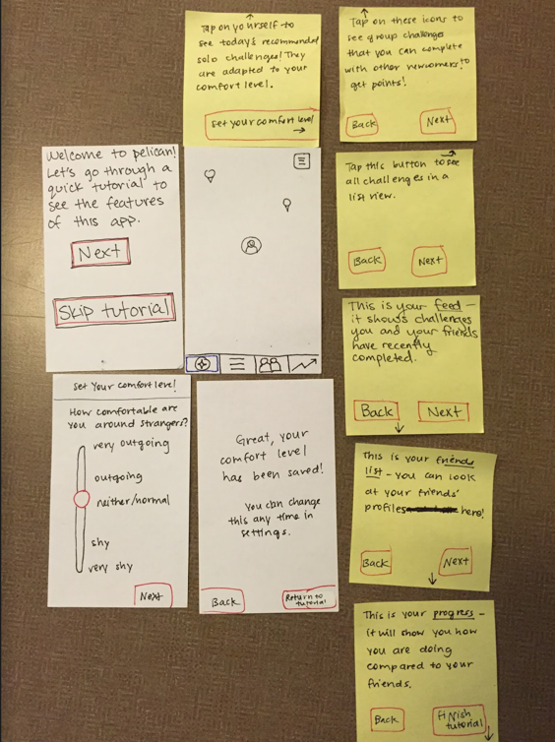
Tutorial
Help users understand how to navigate the app

Slide 7
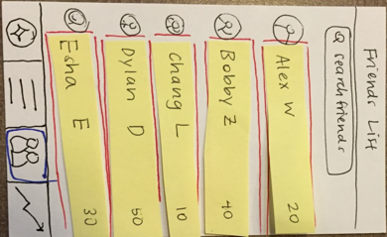
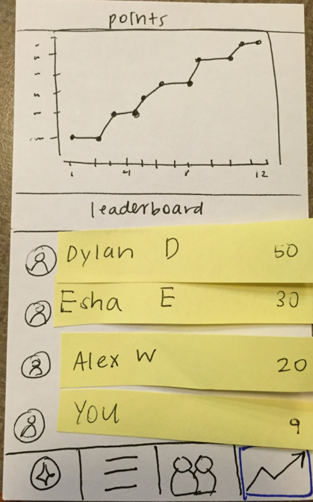
Four Tabs
Discover
Feed
Friends
Leaderboard

Slide 8
Paper Prototype UI
Stickies as modals/popups
Red for tappable buttons
Blue for selected buttons

Slide 9
Tasks

Slide 10
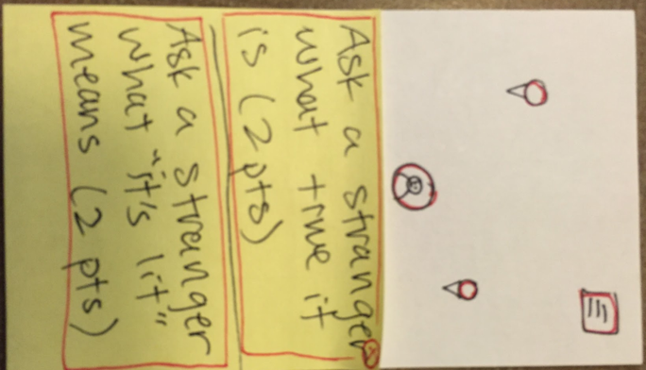
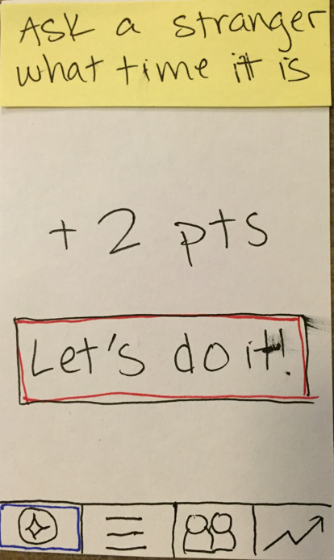
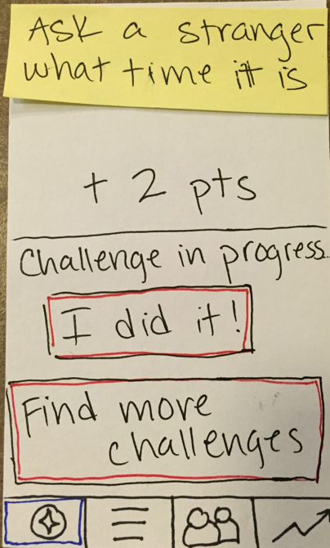
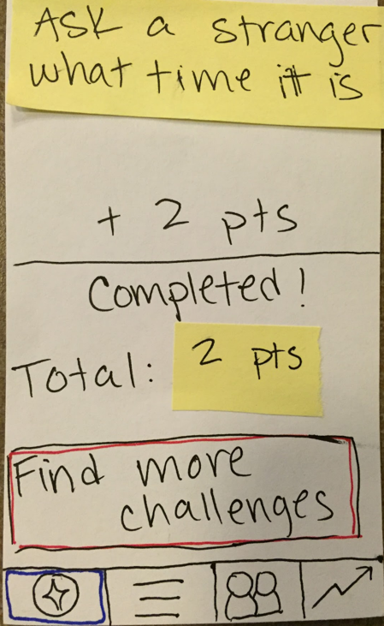
Complex:
Become more comfortable approaching strangers

Slide 11
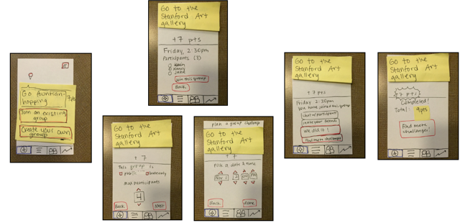
Medium:
Find other newcomers and complete challenges with them
Join existing group
Create new group

Slide 12
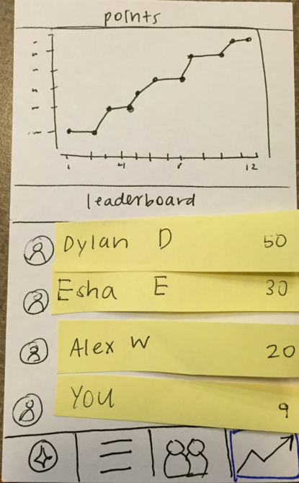
Simple:
Get points by completing challenges to compete with friends

Slide 13
The Experiment

Slide 14
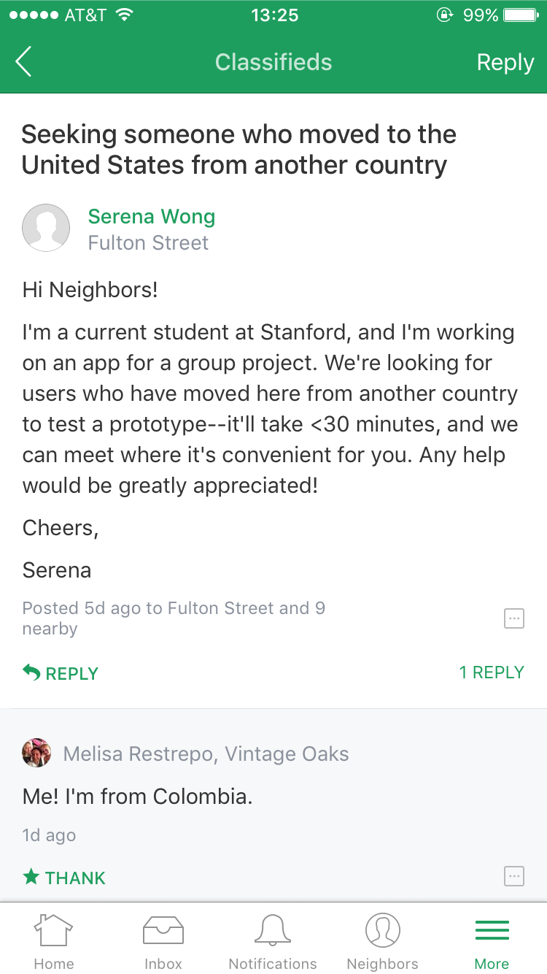
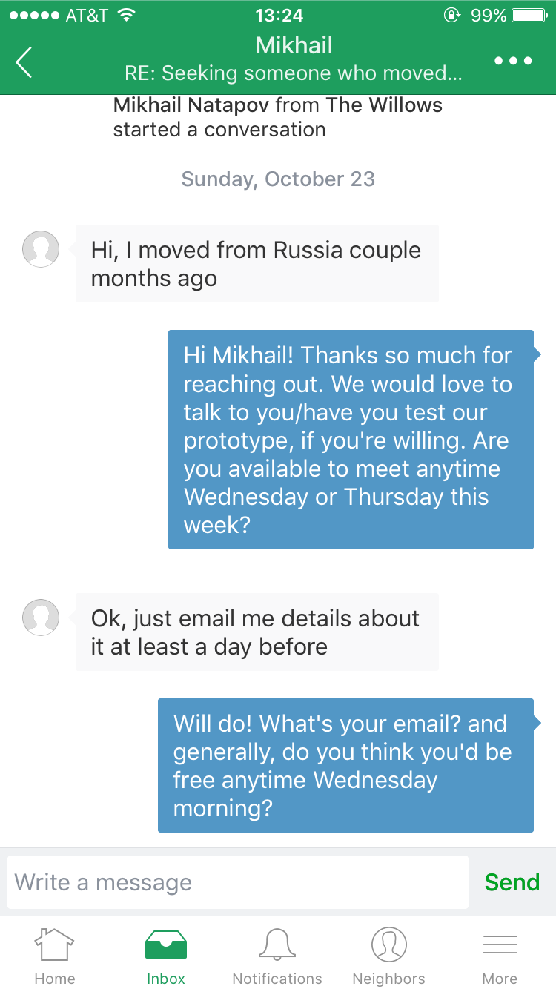
Experimental Method: Participants
A 40-yo man from Russia (found on Nextdoor)
A 21-yo Chinese undergraduate student (personal)
A 23-yo man who lived in Japan for 6 months (personal)

Slide 15
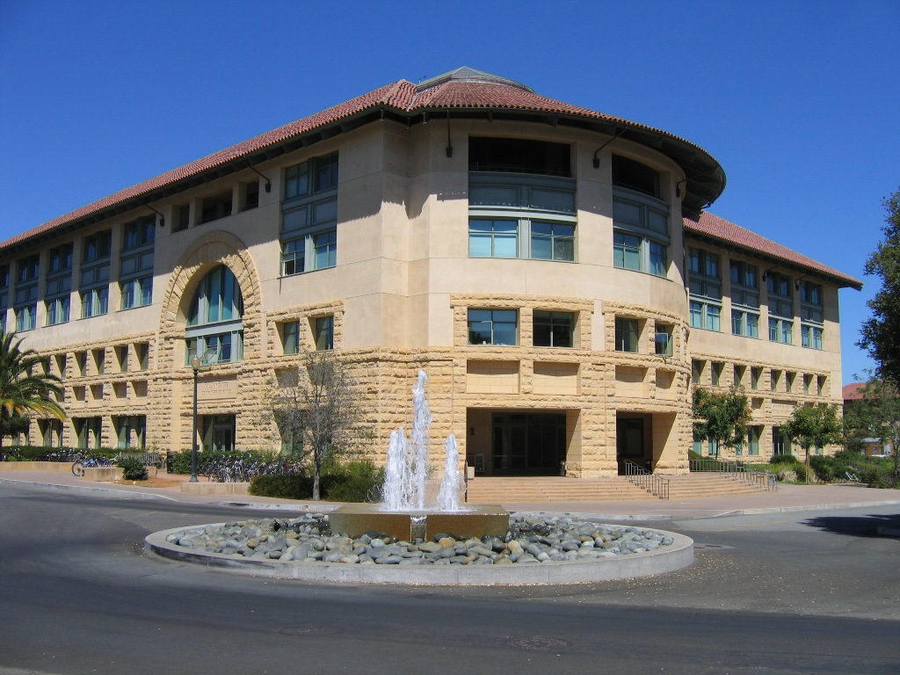
Experimental Method
Locations varied from Lathrop Library, to Storey Lounge, to Gates Lobby
Serena was computer, Jack was note-taker, Connie was facilitator
Filmed interactions on Photobooth
Mostly recorded high level pain points, mistakes, comments

Slide 16
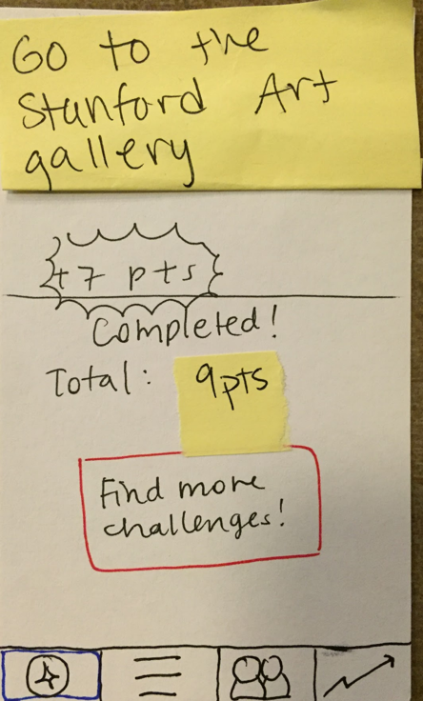
Experimental Results: The Good
Delight
“Yay, I did it!”
upon completing a task
“Oooooooh”
Upon toggling between list and map view
Completing the leaderboard task was very straightforward

Slide 17
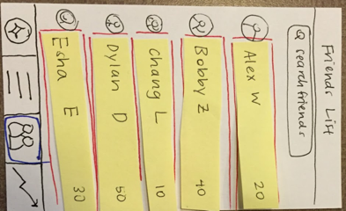
Experimental Results: The Bad
Confusion!
“Who the hell is Bobby? Bobby has 40 points. Oh my god.”
“What do these points mean and why do I care about it?”

Slide 18
Experimental Results: The Bad
Confusion!
“What does this graph mean?”
Someone didn’t really read the tutorial and fundamentally didn’t know how to use the app.
Comfort level in tutorial unclear
Wanted tips for how to complete challenge
Wanted to add group members as friends
Didn’t understand what feed tab was for
Forgot how to find solo challenges
Felt it was too text heavy

Slide 19
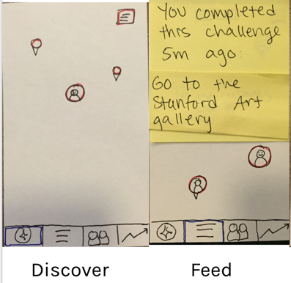
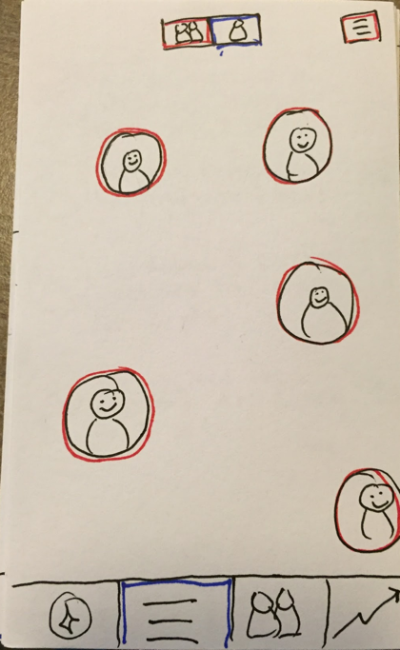
Suggested UI Changes
Merge two map views (discover and feed tabs) - too similar
Show users around you, not just friends
Feed tab icon and list view icon were identical - need to be switched
Reorganize information hierarchy
Overall: Eliminate confusion!

Slide 20
Summary
Map-based interface - makes sense for location-based activities and local discovery
Three tasks: solo challenge, group challenge, and leaderboard
Overall users liked map idea, but were confused by small inconsistencies/overlaps/complicated information hierarchy
Next steps: Streamline and simplify

Slide 21
Thank you!

