Slide 1
Medium-Fi Prototype

Slide 2
Presentation Overview
About Feast
Task Updates
Interface Design Changes
Overview of Prototype
Prototype Techniques, Limitations and Tradeoffs

Slide 3
Feast
“Alive without compromise”
The goal of Feast is to reduce the hassle surrounding food for diabetics to help them prevent their dietary and health goals from interfering with them living the life they want to live.

Slide 4
THE FEAST TEAM
Dan Shiferaw
Software Engineering Lead
Megan Wilson
Senior Product and Team Manager
Peter Lowe
Design and Usability Testing Lead

Slide 5
TASK REVIEW
Task #1
Checking carbohydrate and other nutritional information about a food to determine how much insulin to take.
Task #2
Keep track of health statistics over time, including information about blood sugar trends and the effects of certain foods on blood sugar.
Task #3
Sharing food with others and socializing around food.
note: these tasks were not modified from the low-fi prototype stage.

Slide 6
LOW-FI → MEDIUM-FI : REVISION GOALS
figure out what “sharing” means for task #3
make task #1 more intuitive
flesh out log details for task #2

Slide 7
Back to the Drawing Board:
Task Flow Updates & Revisions

Slide 8
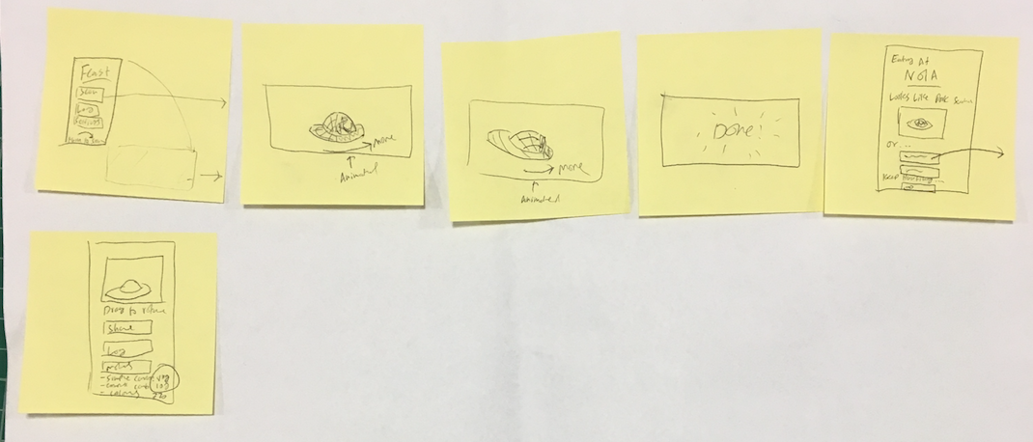
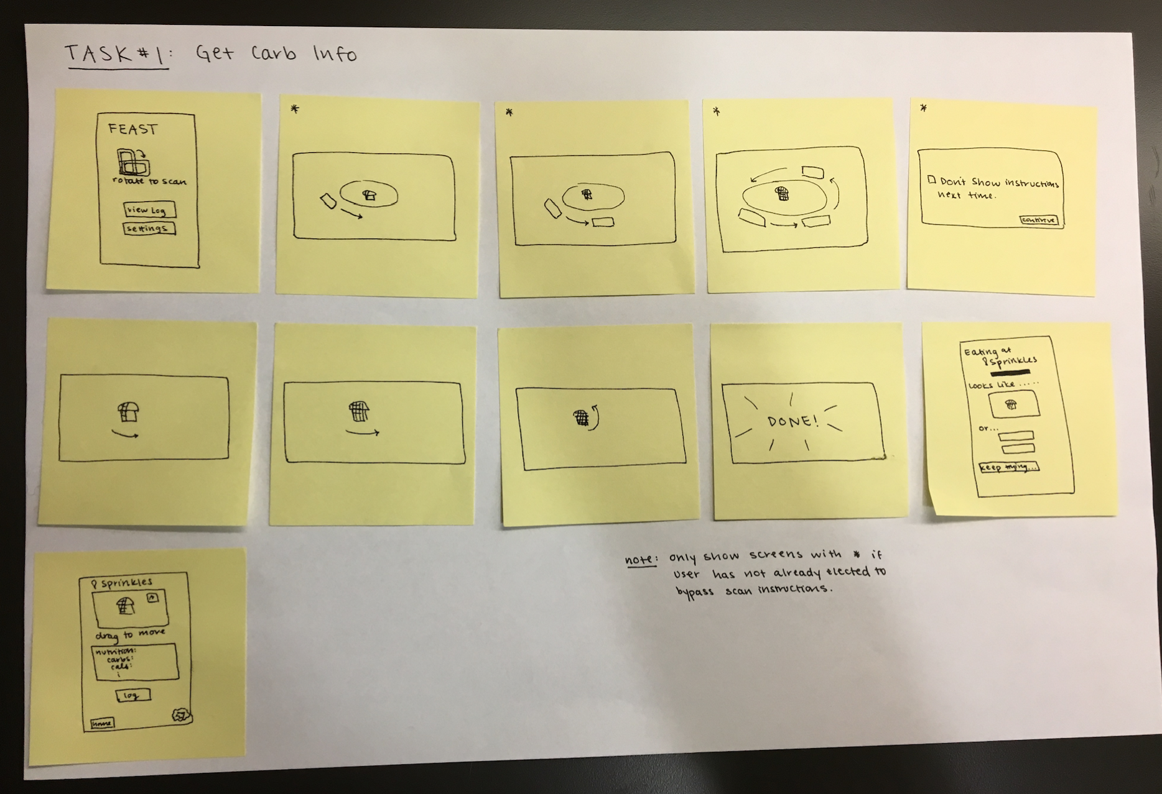
Notes:
Flow of the app the same as before, but we fleshed things out and added a sequence of screens to give the user instructions on how to properly scan food.
This change in the task flow was to address the fact that many of our low-fi prototype testers had a difficult time understanding that they needed to orbit their food to complete the scan.

Slide 9
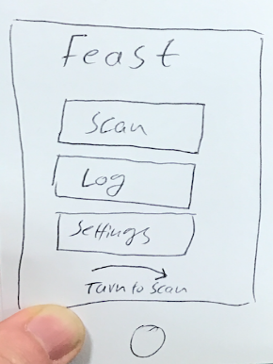
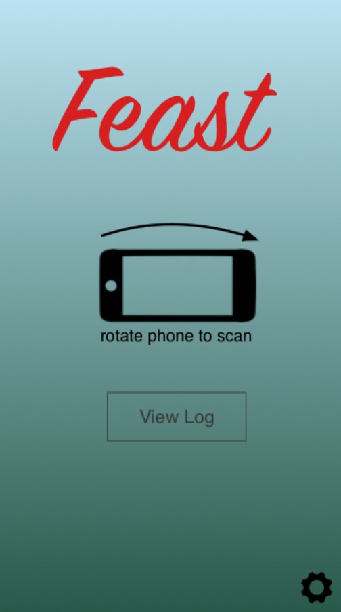
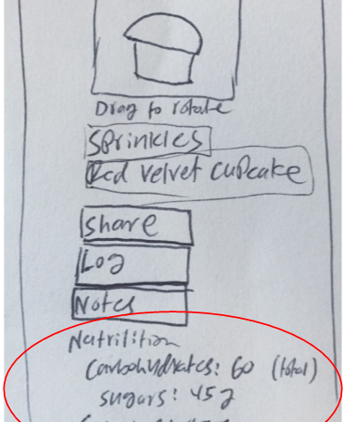
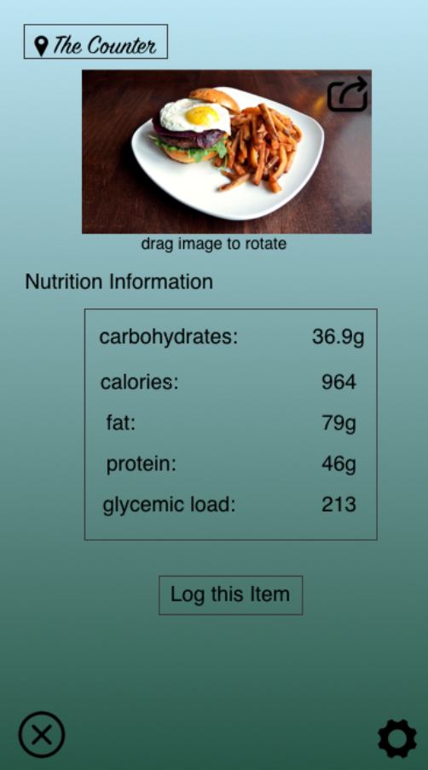
Notes:
Talk about the following 3 changes:
“Rotate to scan” with landscape icon
Nutrition information front and center rather than at the bottom of the screen

Slide 10
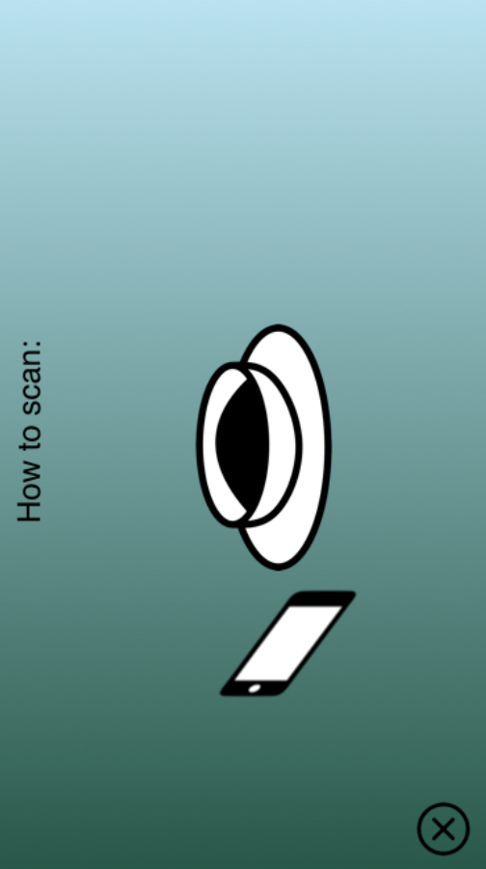
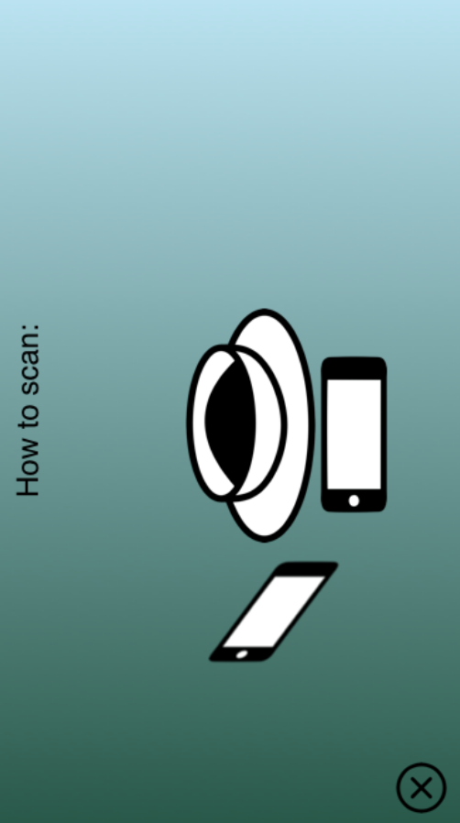
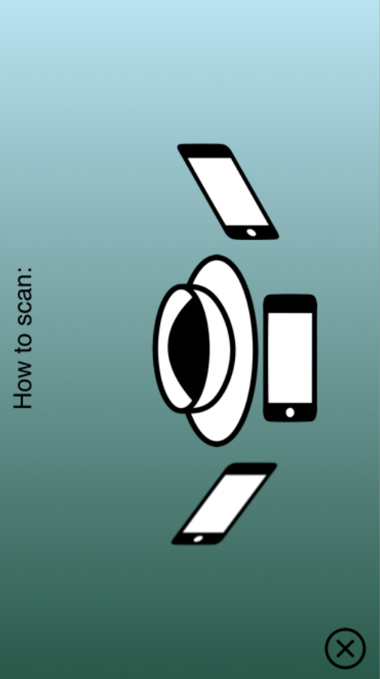
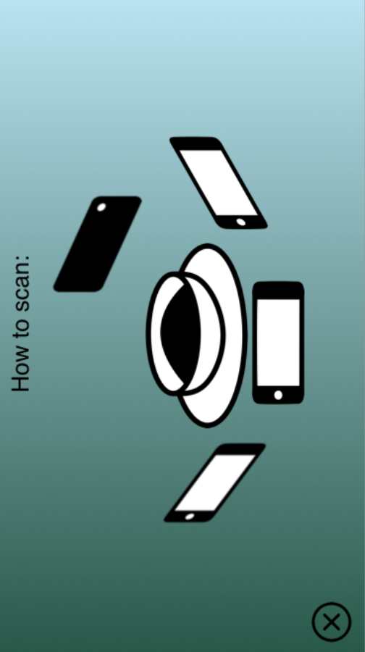
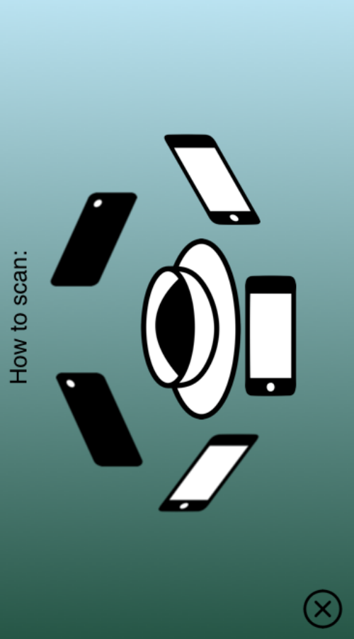
ADDITIONAL INSTRUCTIONS TO CLARIFY TASK #1
Notes:
Also wanted to show the instructions screens, which we didn’t have in our low-fi prototype but, seeing as many of our testers had difficulty scanning, we decided to add in the medium-fi prototype

Slide 11
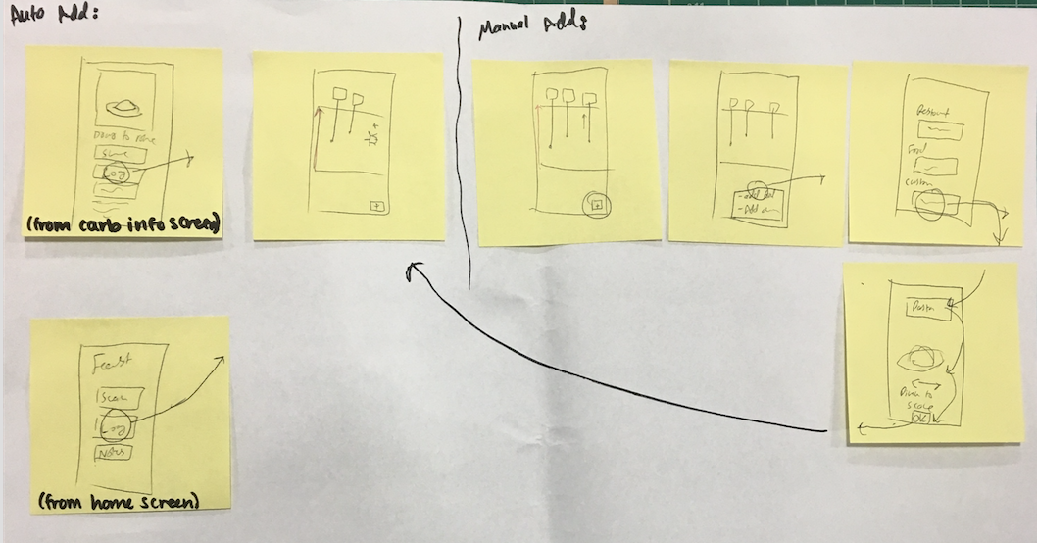
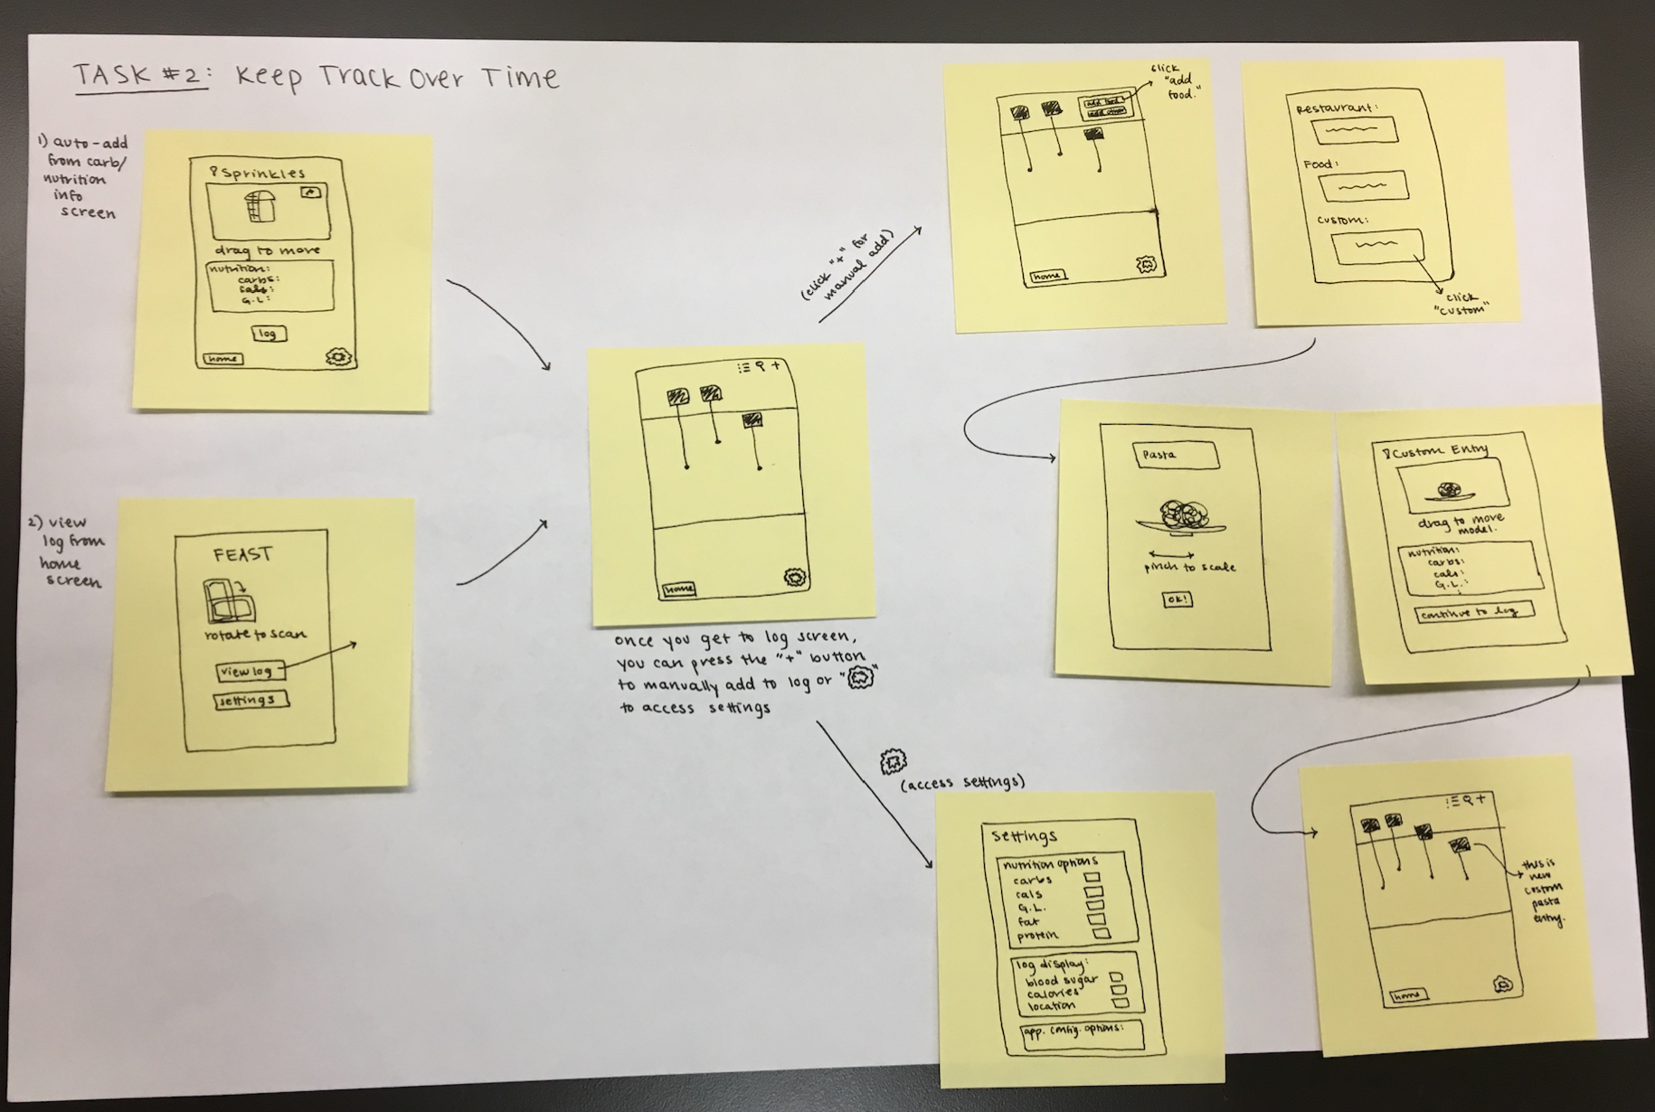
Notes:
Manual add fleshed out a bit more → specifically, we worked on making sure that our custom add will give accurate nutrition information by allowing the user to search an item they would like to add and having them indicate their serving size on an example scan of that food.

Slide 12
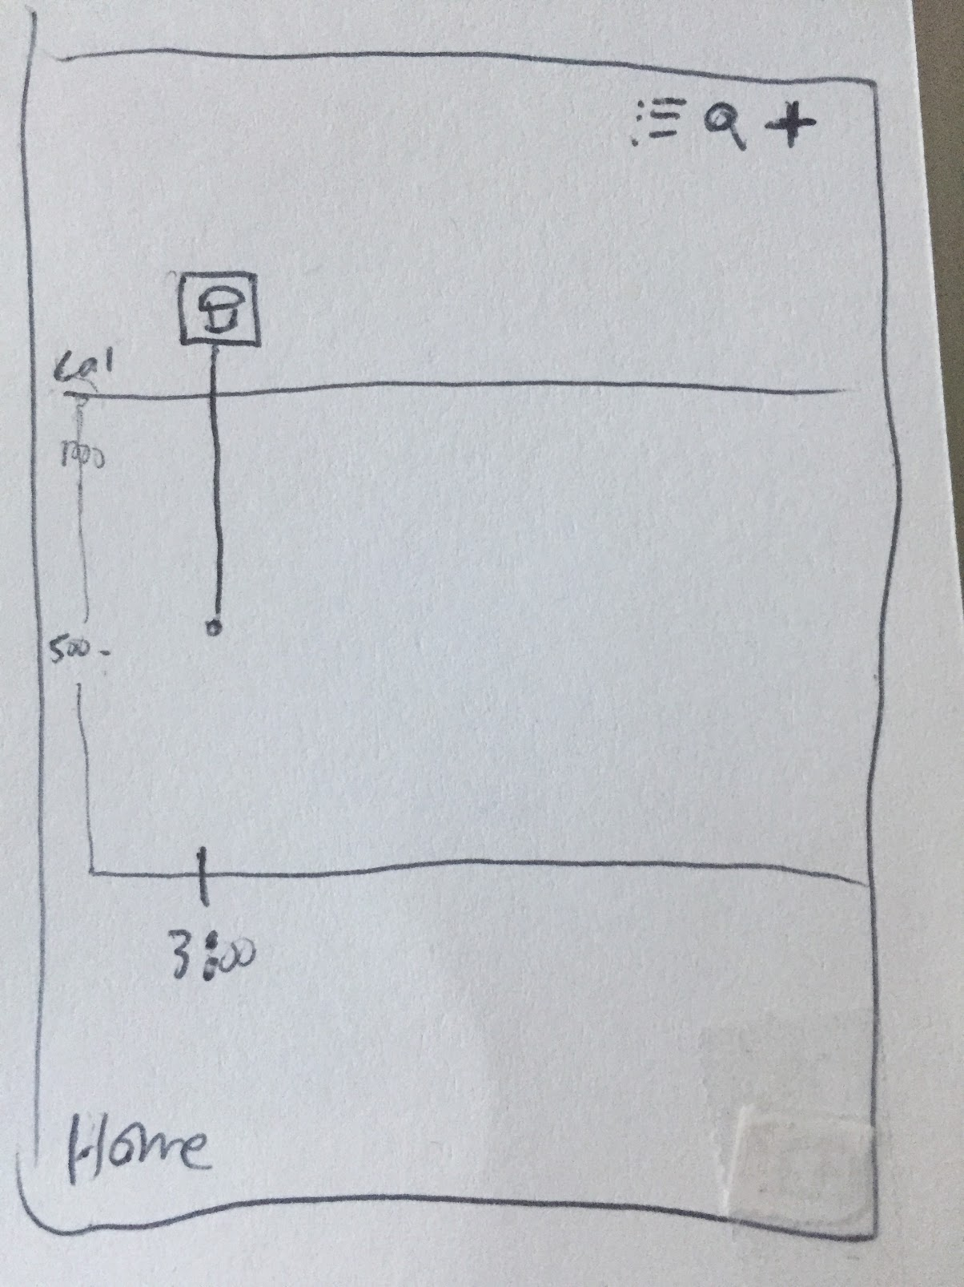
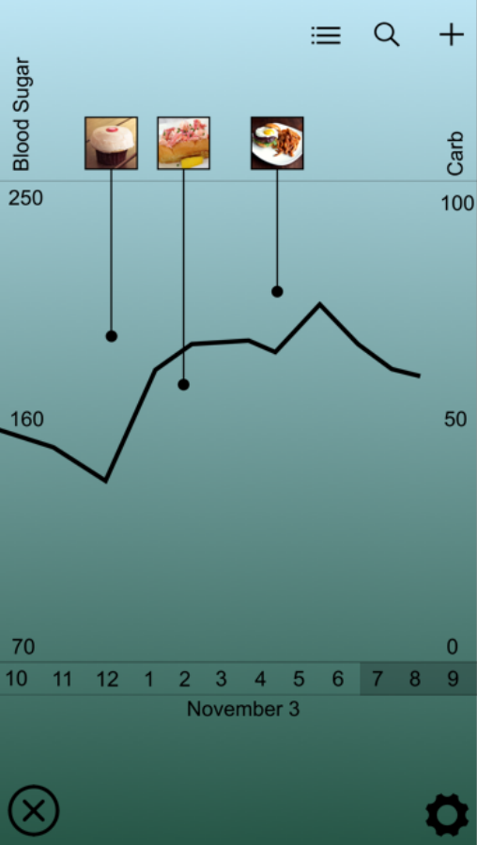
Log Display

Slide 13
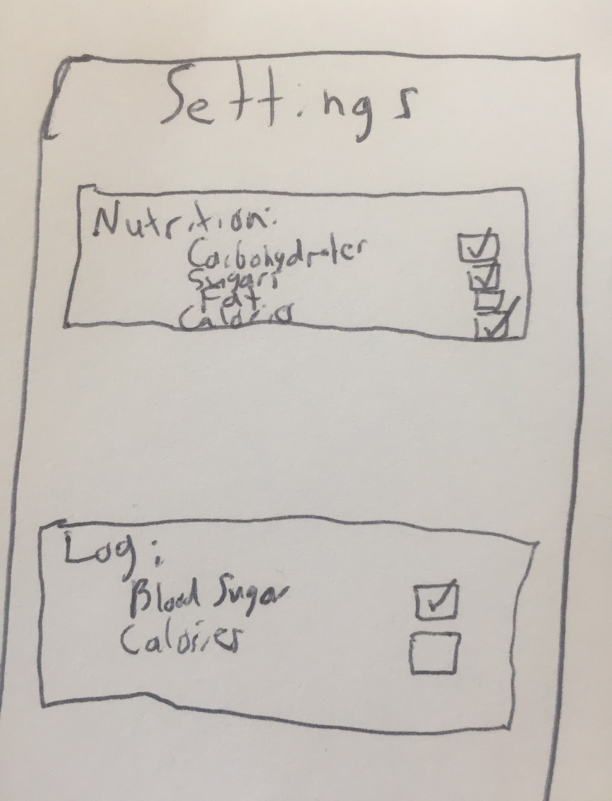
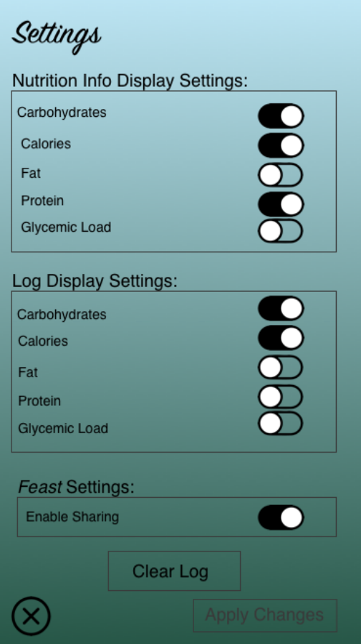
Settings Options
Notes:
Talk about the following 2 changes:
Fleshed out settings options given the feedback we heard from low-fi prototype testers (especially Ben and Max)
Streamlined access to home screen and settings screen throughout the app, which will likely be particularly helpful accessing and updating the log as part of task #2

Slide 14
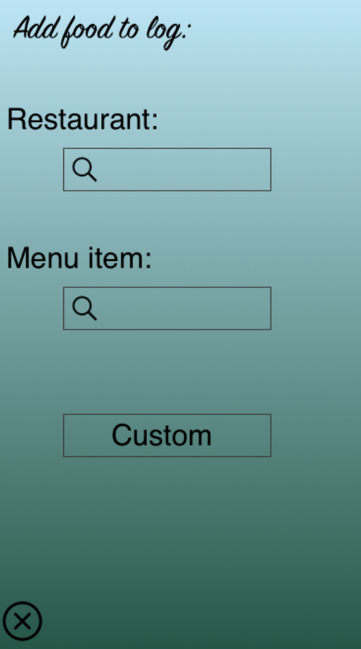
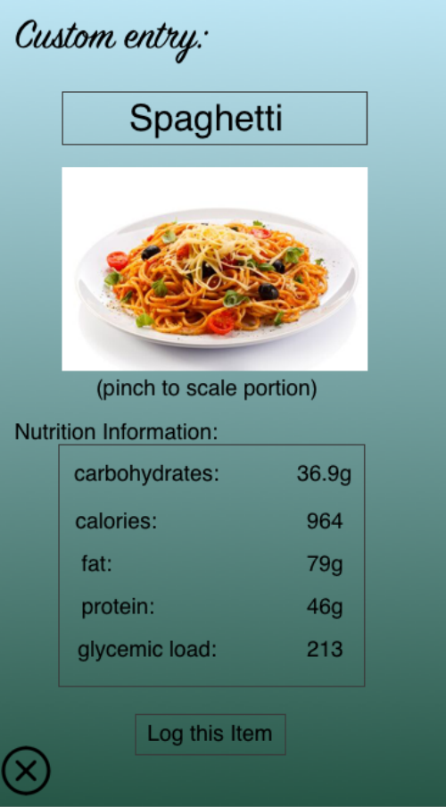
Manual Add

Slide 15
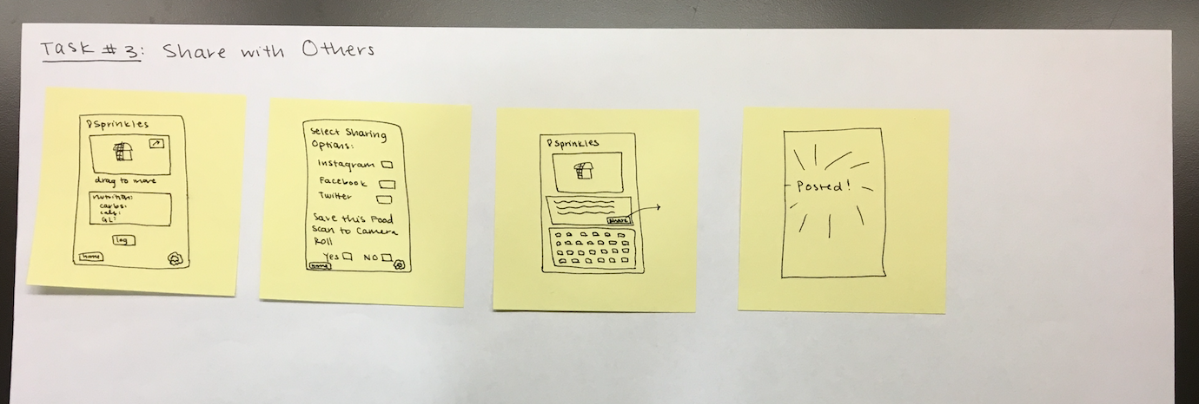

Slide 16
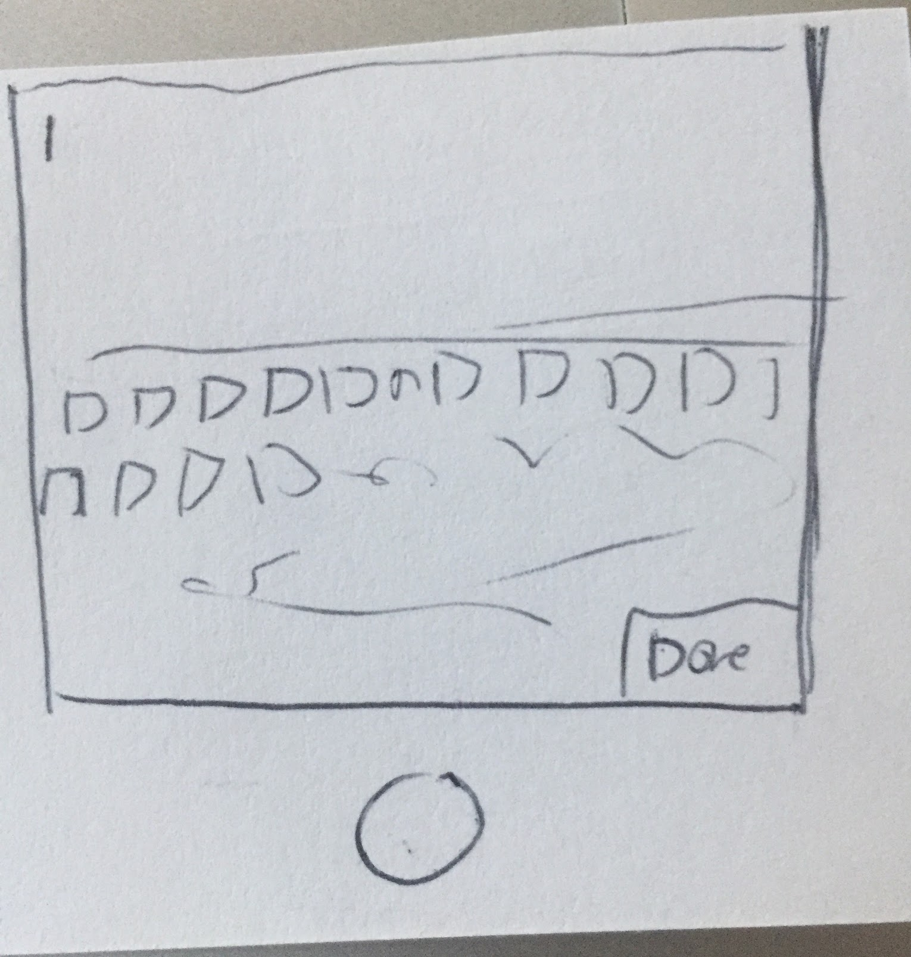
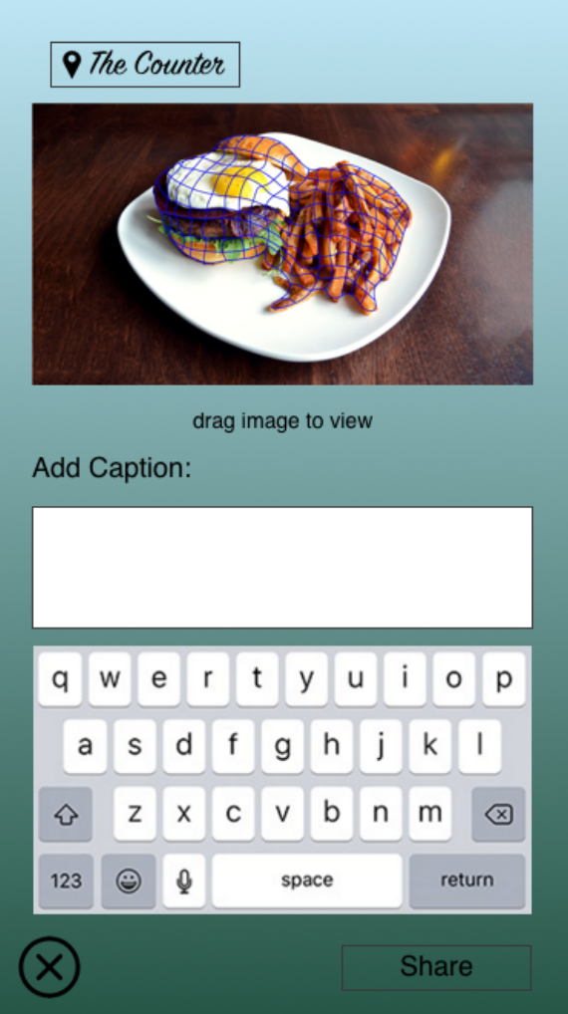
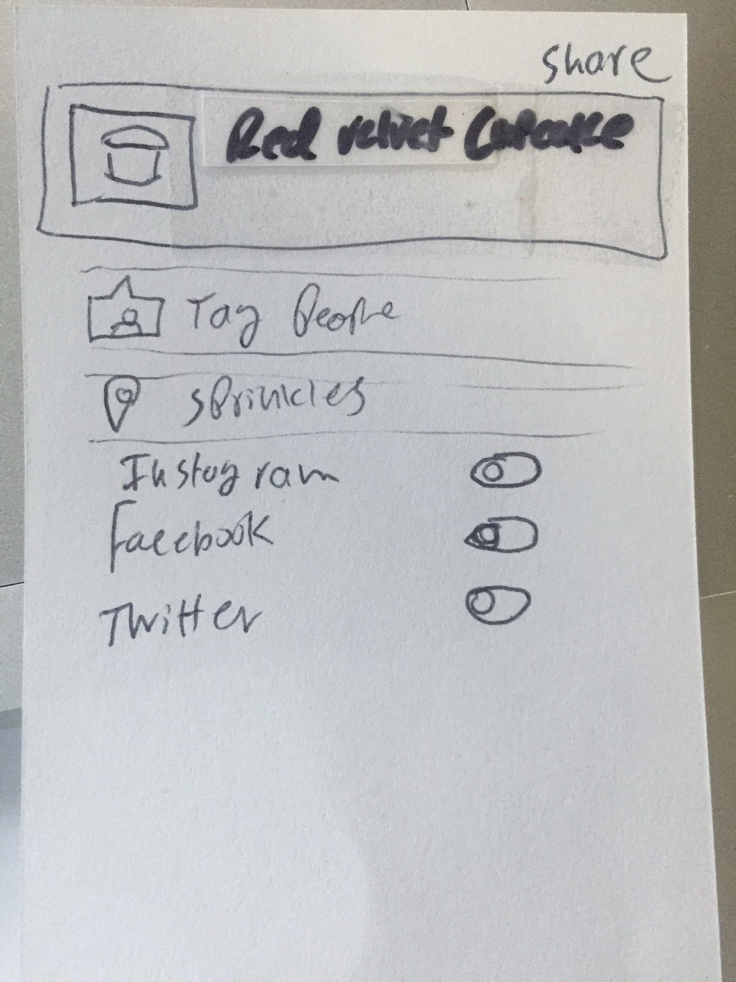
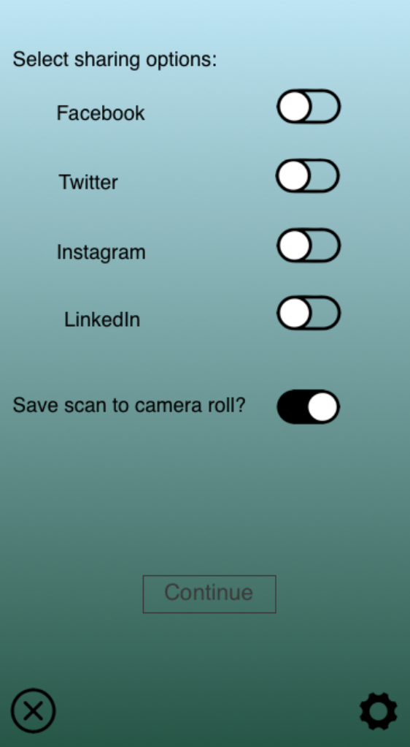
Notes:
Rationale for how we developed the share screens/sharing functionality:
Heard last week that sharing may not be important for diabetics in a variety of different ways:
Ben: focus on making it a health app or a social media based app, not both
Mothers: “what my children eat is no one else’s business”
Max: “funeral” remarks → does not want to have what he eats scrutinized by others
Went on social media this week to check out whether we were just missing the diabetics who are into food sharing and found a decent number of diabetic foodie accounts
Influenced our decision to keep the sharing aspect of our app
Also decided to have a “save to camera roll” option because some of the people we met last week mentioned they know diabetics who keep photos of their meals and wanted them to have the option to save photos to look at later without having all of their food photos associated with their log
Example use: they could show a friend how great their cake looked without having their friend see the full nutritional breakdown of what they are eating
We view this as allowing for both large-scale sharing and small-scale sharing → appeals to all different types of users

Slide 17
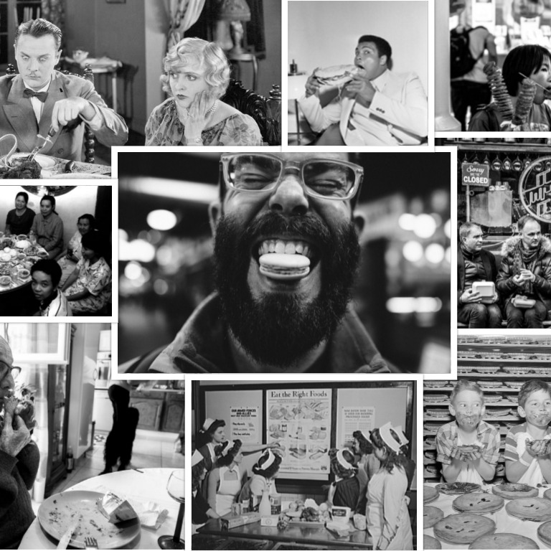
Let’s view these revised tasks in action!

Slide 18
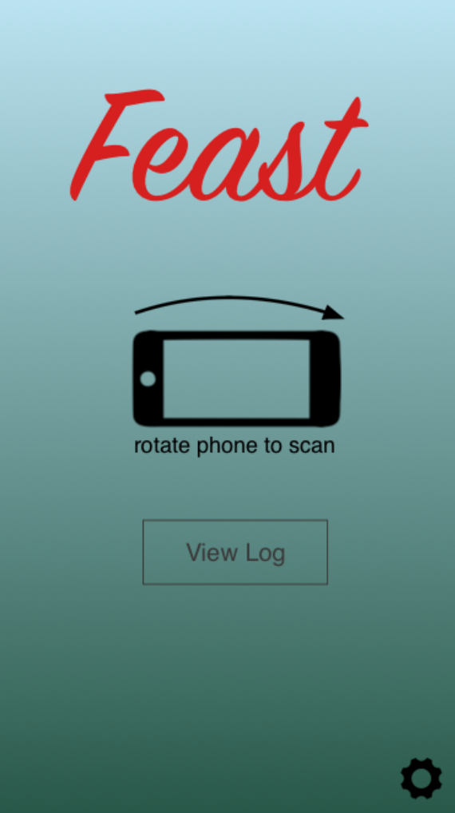
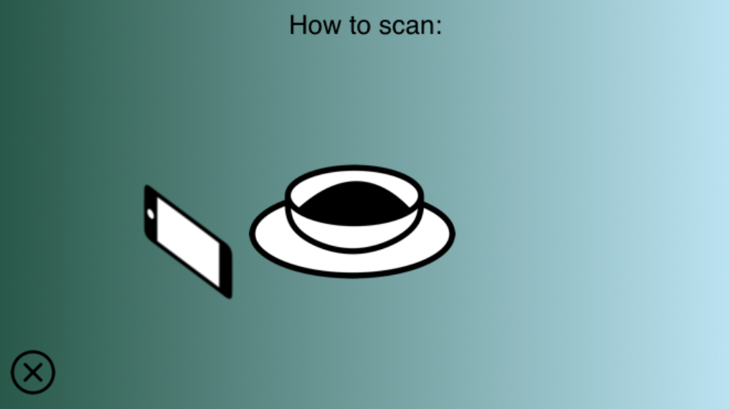
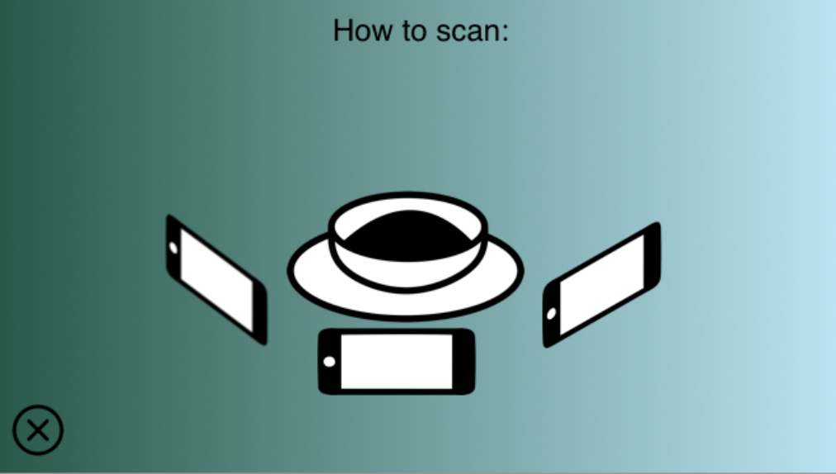
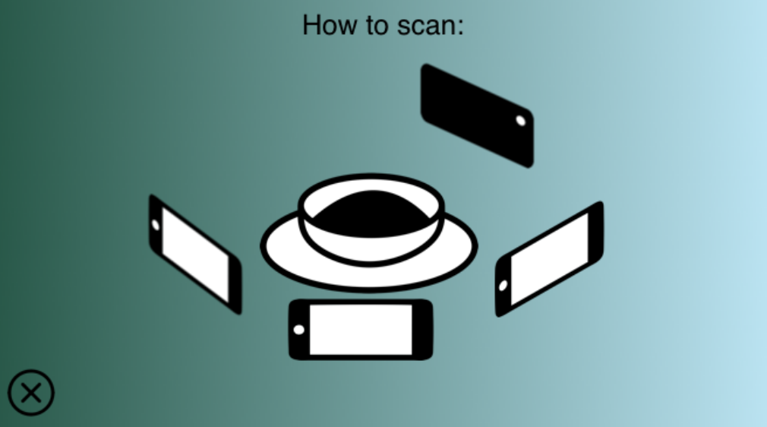
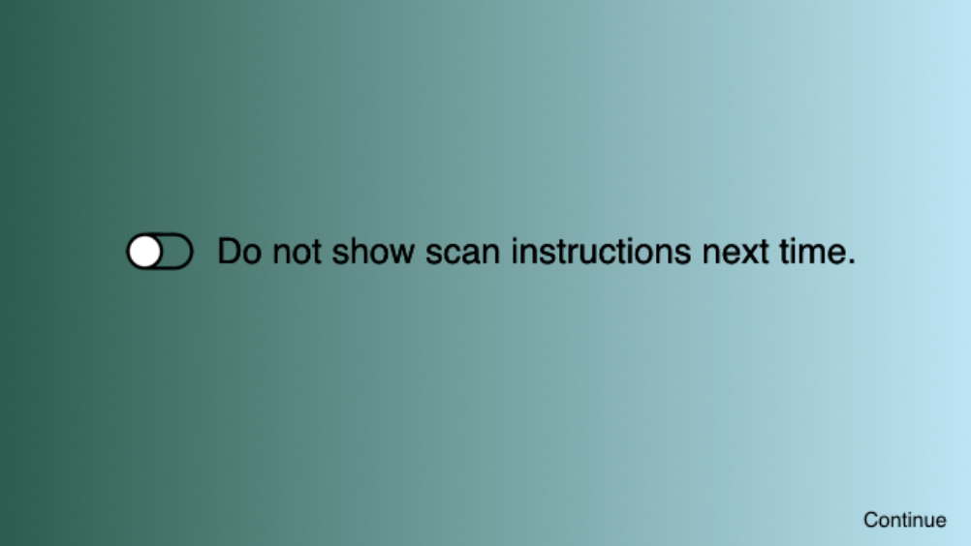
TASK #1: Get Nutrition Information
Notes:
Insert Video of Task #1 flow in iPhone screen

Slide 19
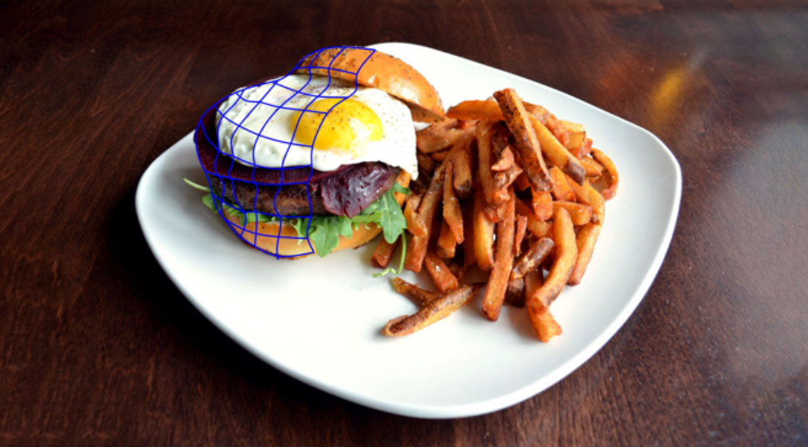
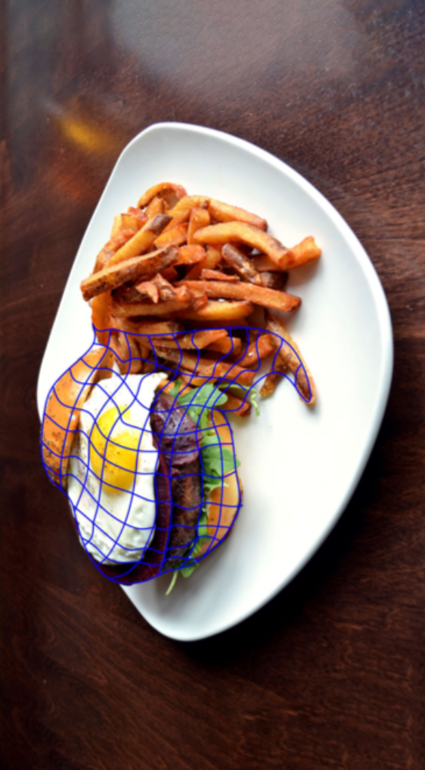
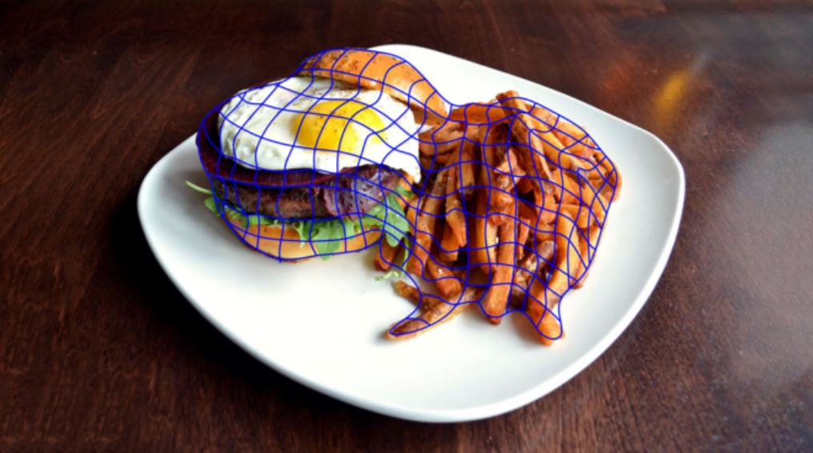
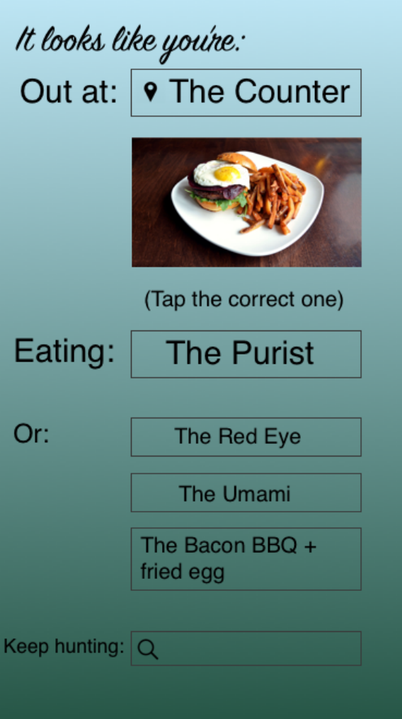
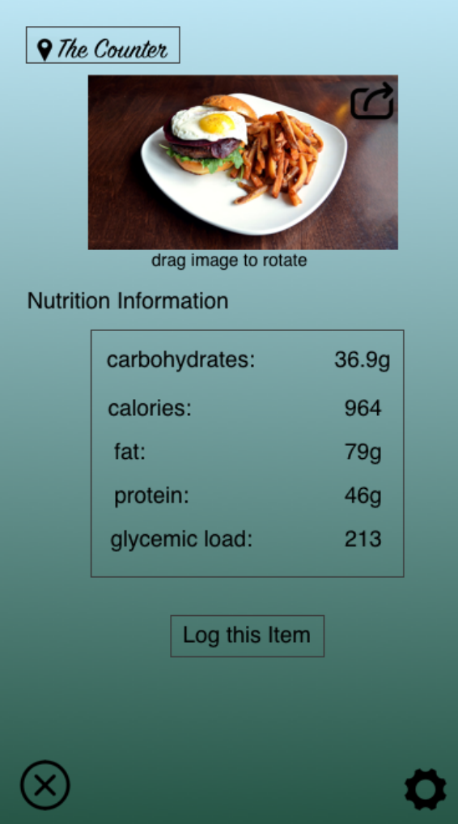
1-2-3...

Slide 20
TASK #2: Keep Track of Health Info Over Time
Auto Add:
Notes:
Insert Video of Task #2 flow in iPhone screen

Slide 21
View Log without Add:
Notes:
Insert Video of Task #2 flow in iPhone screen

Slide 22
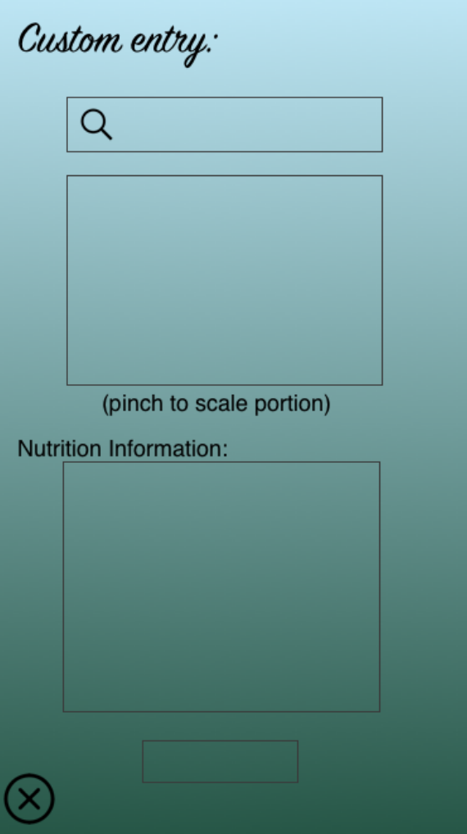
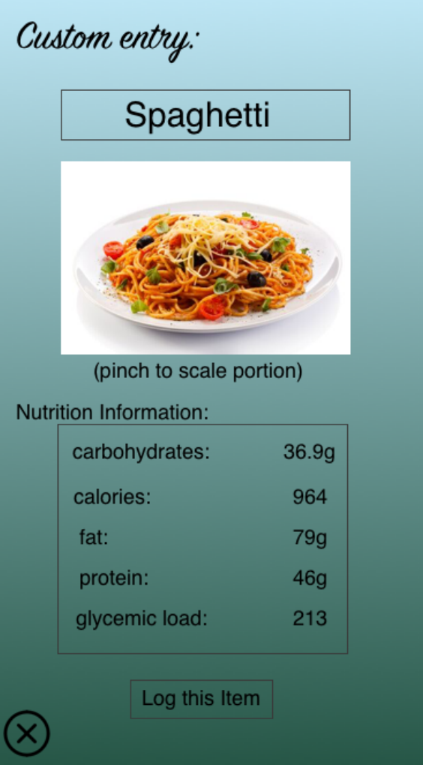
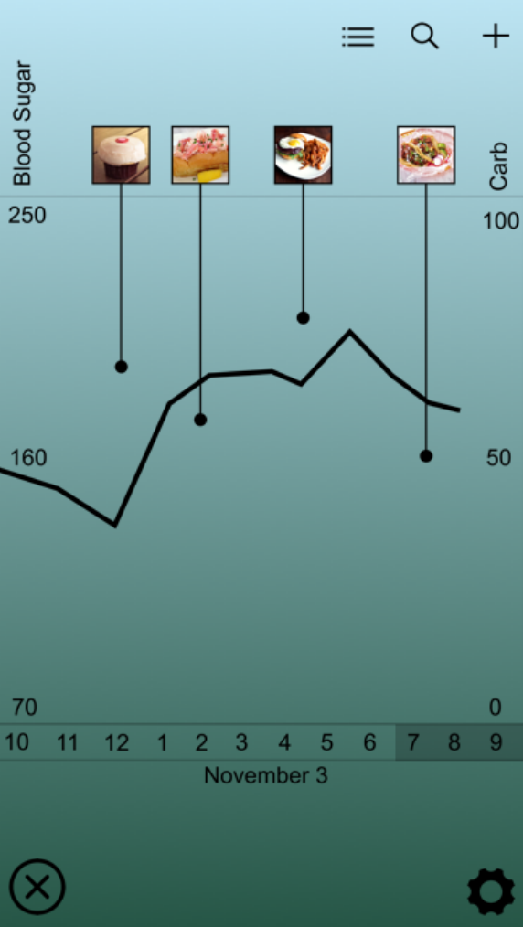
Manual/Custom Add:
Notes:
Insert Video of Task #2 flow in iPhone screen

Slide 23
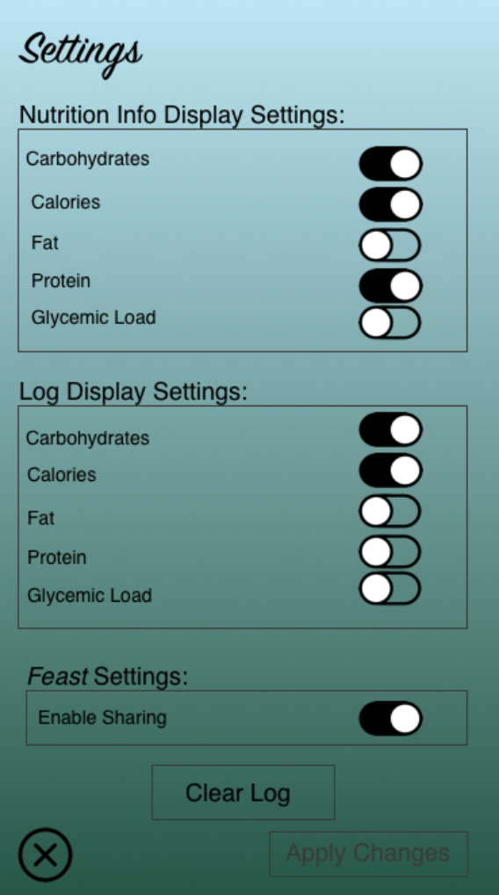
Adjust Log Settings:
Notes:
Insert Video of Task #2 flow in iPhone screen

Slide 24
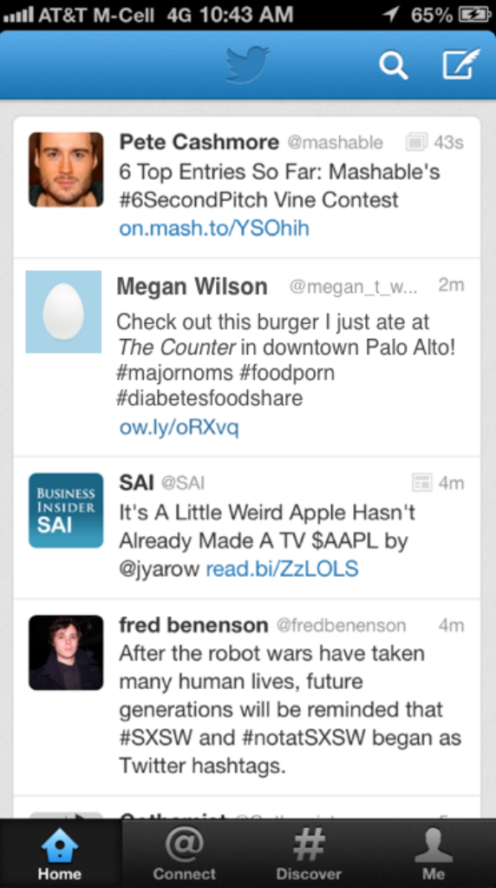
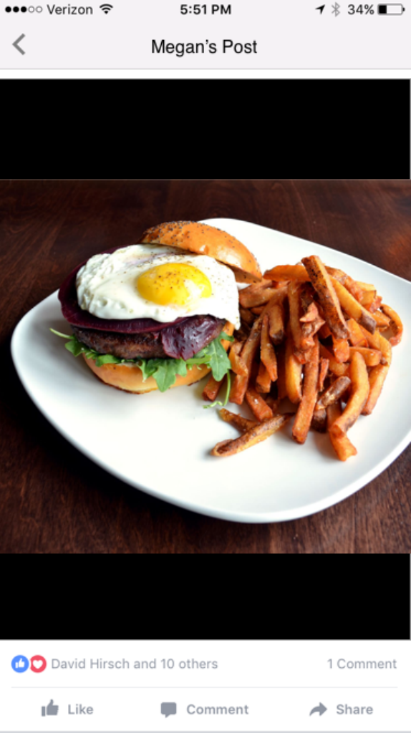
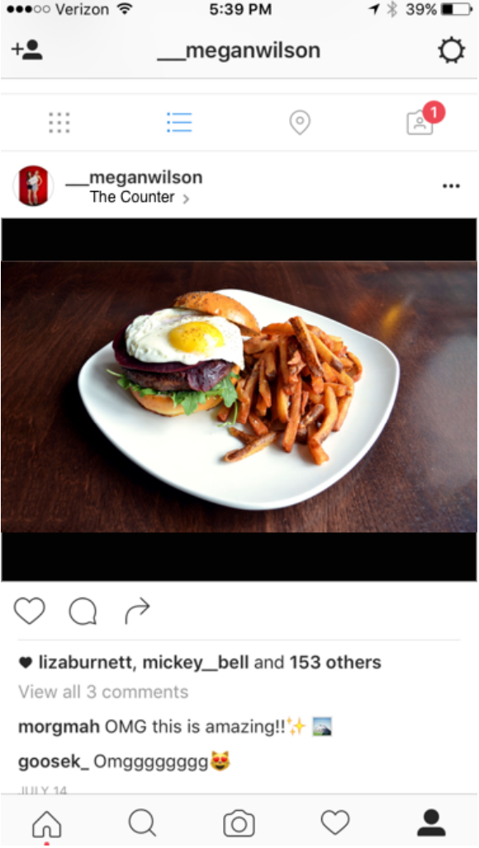
TASK #3: Share!
Notes:
Insert Video of Task #1 flow in iPhone screen

Slide 25
PROTOTYPE DETAILS

Slide 26
SKETCH
INVISION
prototyping tools
create individual screens
link individual screens to simulate app functionality

Slide 27
Limitations & Tradeoffs
in Creating our Medium-Fi Prototype

Slide 28
SKETCH
Pros: facilitates consistent design elements and themes across tasks, straightforward to use
Cons: difficult to prototype dynamic aspects including 3D scanning

Slide 29
INVISION
Pros: Fast and very straightforward: like building a branching powerpoint
Cons: unable to register orientation as input or use phone camera, so “turn to scan” and scanning must be Wizard of Oz

Slide 30
LINK TO OUR PROTOTYPE:
invis.io/TJ96VOPU9
Notes:
Include final link here

Slide 31
Questions?
Comments?
Suggestions?
About our prototype
About our process
About how to move forward

Slide 32
Thank You!

Slide 33
CLOSING CREDITS
Special thanks to all the people who made and released these awesome resources for free:
Presentation template by SlidesCarnival
Photographs by Death to the Stock Photo (license)
The Noun Project

