Slide 1
Health: Chronic Illnesses
Peter Lowe, Dan Shiferaw, and Megan Wilson

Slide 2
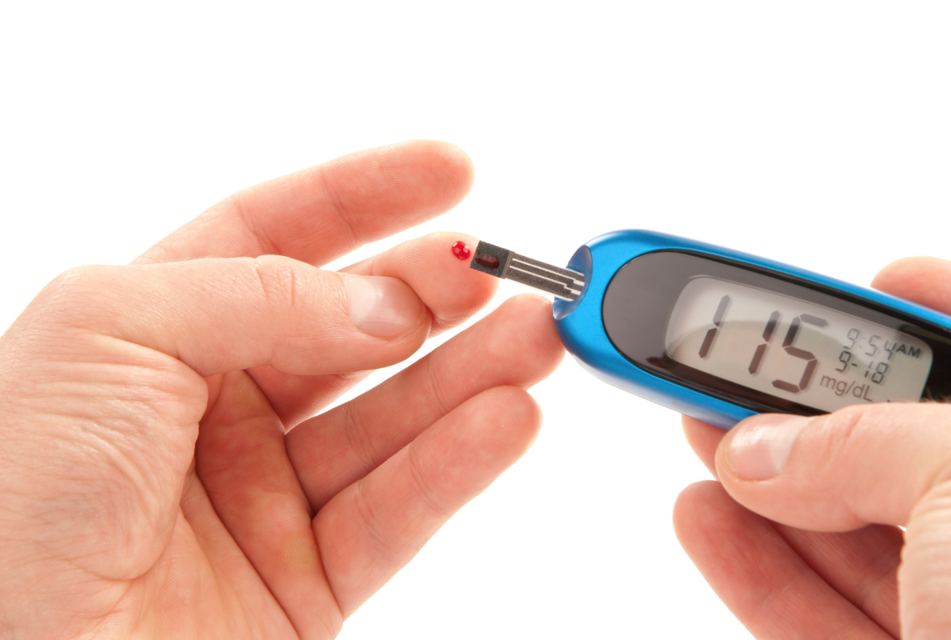
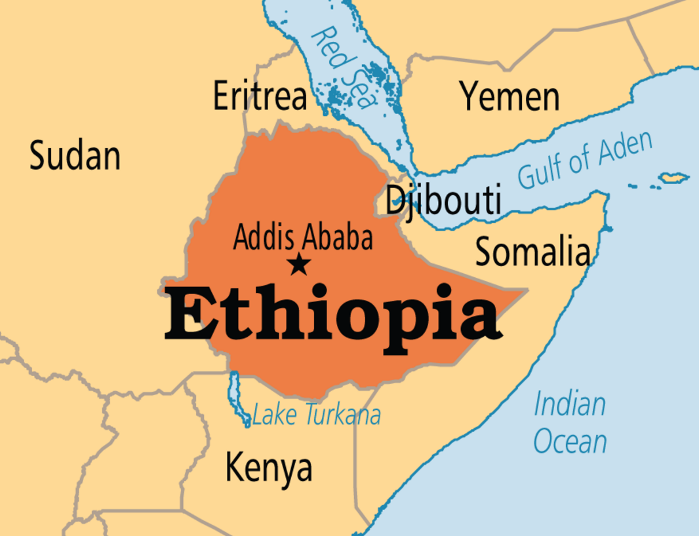
Step #1: Initial Brainstorm
Peter’s List +
Megan’s List +
Dan’s List →
Team List
Notes:
Basically just combined all of our individual brainstorms of who we wanted to talk to into a single list in a Google Doc
Thought that throwing all of our interests out there and discussing them would be the most organic way to draw out our common interests.
Before we started interviewing, we had a rough sense that we were all interested in chronic illnesses and learning more about how people with chronic illnesses deal with their treatment and lifestyle requirements on a day-to-day basis.

Slide 3
Step #2: Casting a Wide Net
anyone & everyone we could think of
“extreme” interview candidates
proposed interviews in comfortable spaces for interviewees
Notes:
Took the approach of reaching out to as many people as possible and hoping that they would say yes.
Sent out lots of emails, made tons of phone calls, and visited a few places in person to ask if they would be interested in talking to us.

Slide 4
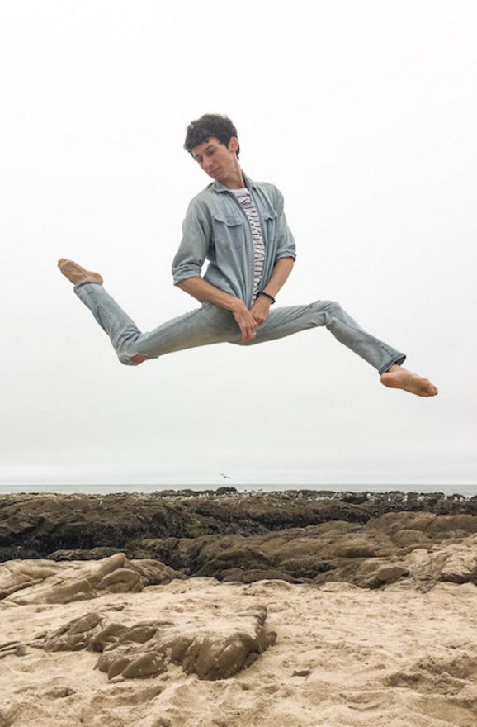
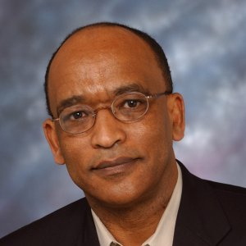
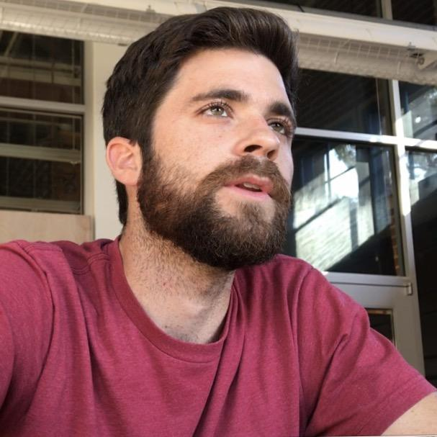
Participants
Student Athlete
Yoga
Guru
Prediabetic Retired Researcher
Young Professional

Slide 5
Step #3: Conducting Interviews
Establish consent and comfort
Develop context around problem; encourage open-ended storytelling
Explore and elaborate on surprising information, deeply emotional experiences, and confusion
Informally discuss problems and potential solutions
Notes:
Conducted most of our interviews Monday, Tuesday, and Wednesday this week.
In-person interviews with 3 of our subjects (Stanford student-athlete, local yoga studio owner, young engineer) and phone/FaceTime(?) interviews with our other two subjects, who aren’t from the Bay Area.
We wanted to make sure that our interviews weren’t too Stanford-focused, and it was interesting to hear thoughts from people living with diabetes in other parts of the country, because lifestyles are vary from region to region, and we want to make sure that we have a collection of stories with people from different backgrounds.

Slide 6
Interview #1: Riley Spain
19-year-old female
Varsity rower
Recently diagnosed with PCOS & Insulin Resistance
“a balanced, healthy diet’ isn’t healthy or balanced for me.”

Slide 7
Interview #2: Steve Farmer
Mid-fifties
Yoga Studio Owner, Health Researcher
Suffered from Ulcerative Colitis in 30s
“It’s all poison in there anyway.”
“I didn’t find the idea of dying appealing from a young age.”

Slide 8
Interview # 3: Dr. Shiferaw
Retired medical researcher residing in NJ
Pre-diabetic
Logs diet and blood sugar levels but struggles to easily summarize data and determine correlations
Wishes high blood sugar was detected sooner
“I was scared after I found out”
“worried I won’t be there for my family”

Slide 9
Interview # 4: Patrick Harrington
Young engineering professional
Type I diabetes for 2 years
“It was kind of like a cool challenge, but then it just got kind of tiring”
Defiant that disease won’t hold him back, but giving up sports unnecessarily
Doesn’t want to admit how much disease constrains him
“I don’t want people to see me as sick, because sick means helpless”

Slide 10
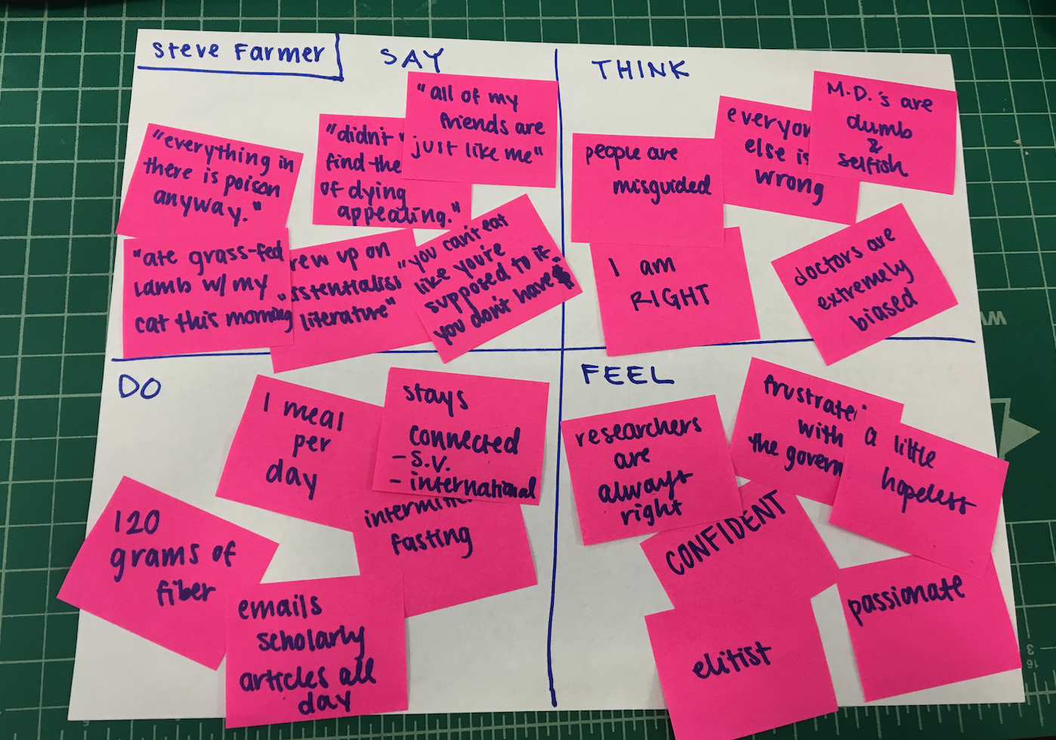
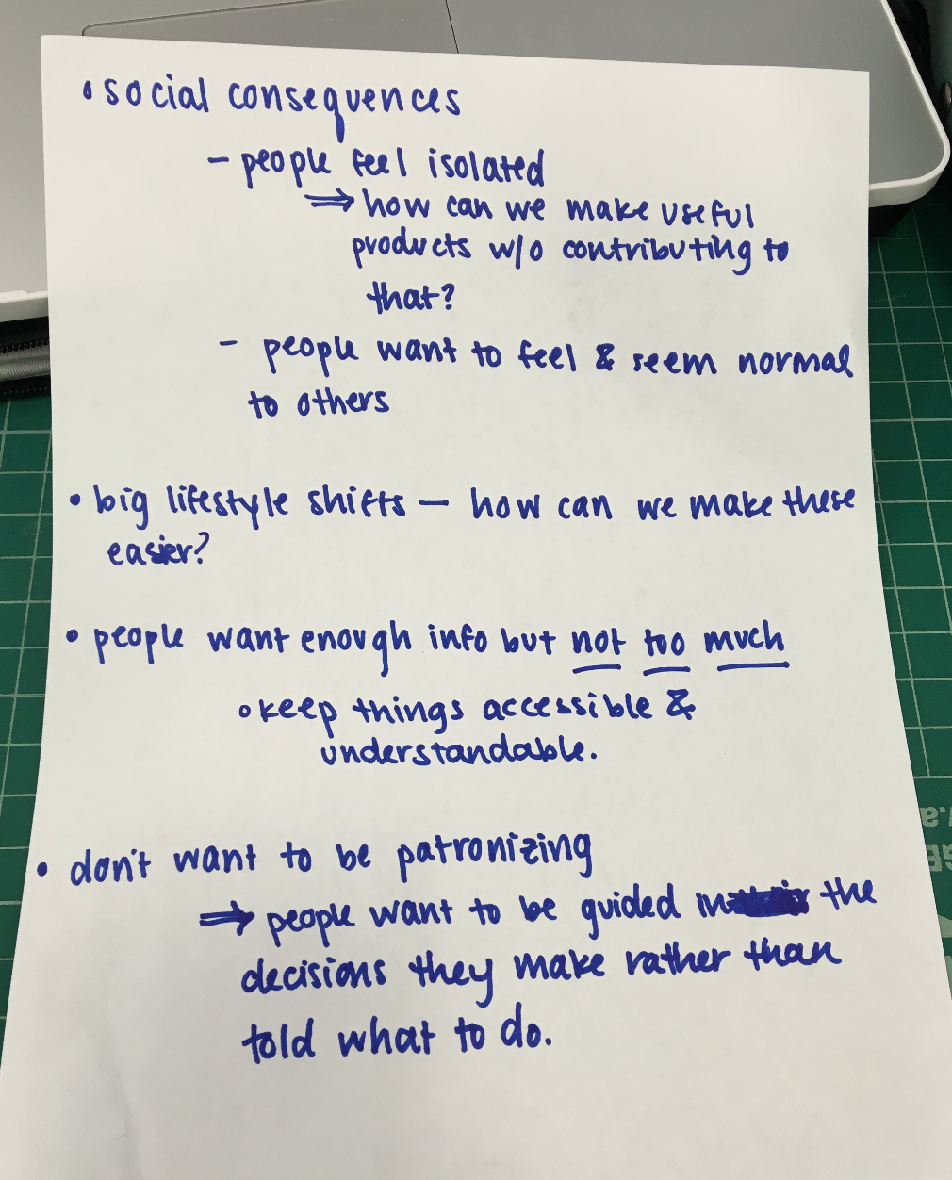
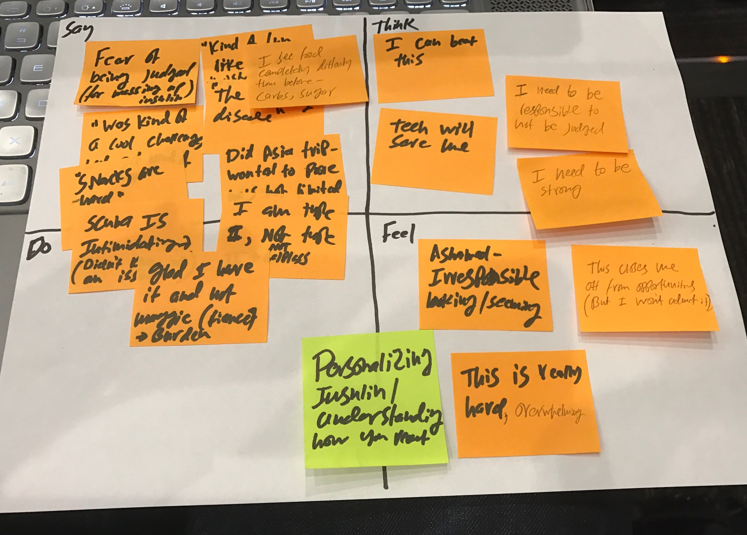
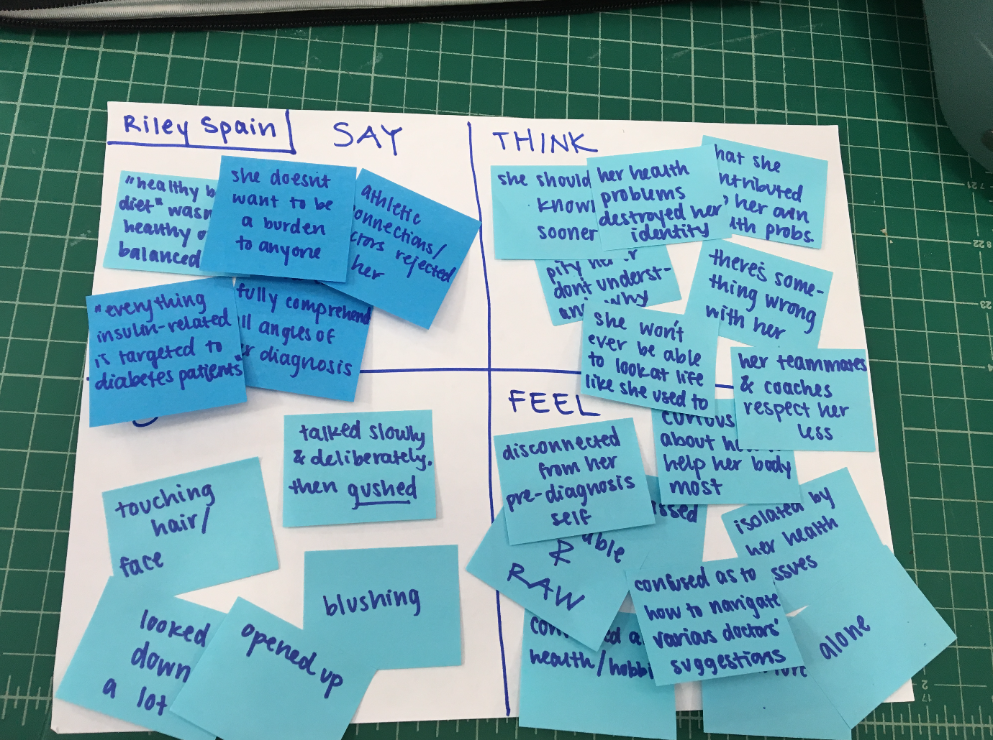
Step #4: Bringing It Back Together
Rough List of Discussion Themes:
Mini Empathy Maps:
Notes:
Spent an hour or two Wednesday afternoon discussing our interviews.
We made mini empathy maps for each person we interviewed, but we tried to let our conversation about our work so far develop naturally. We threw crazy ideas out (some involving lots of VR) and tried to see if bouncing ideas off of each other would help us recognize some of the common needs we found.

Slide 11
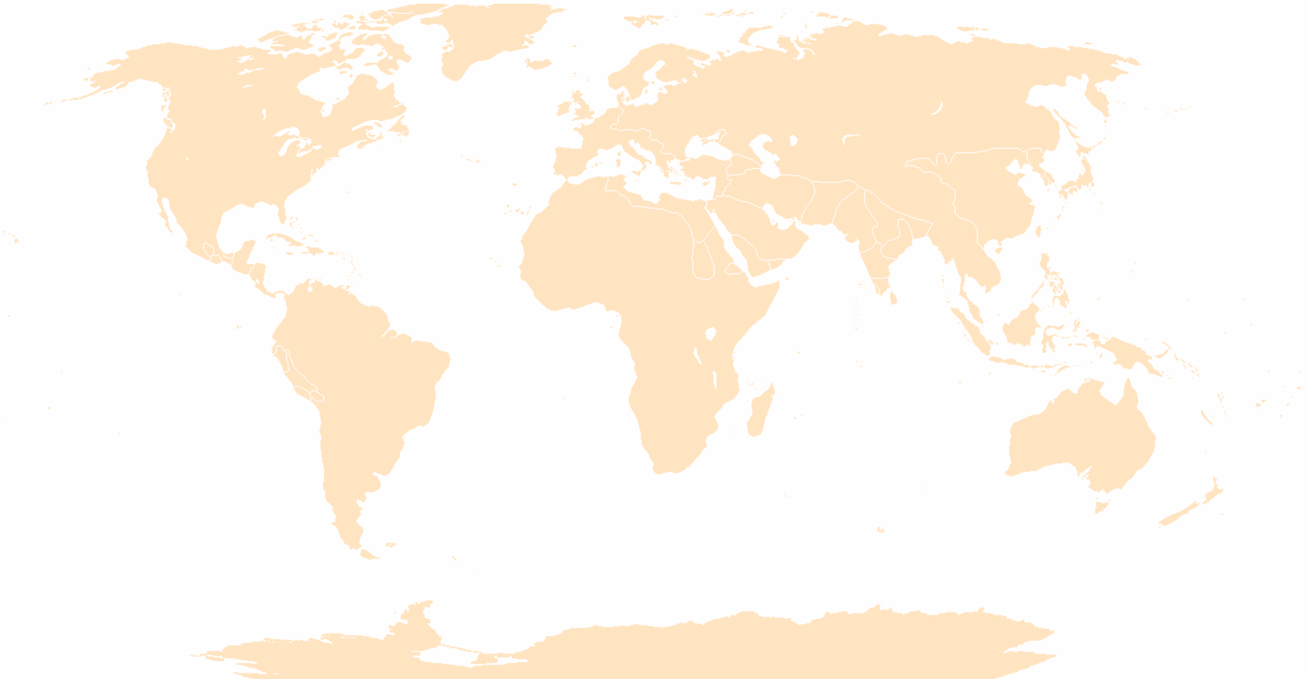
mapping it out
SAY
it will be okay
it will not be okay
identity is lost
life forever changed
need to be more careful
I’m glad it was me, not maggie
THINK
people are misguided
doctors are wrong, inconsistent
her own fault
less respect from others
System needs to change
I need to be strong
DO
blush
get defensive
laugh it off
confide
voice chokes
FEEL
isolated
misunderstood
confused
overwhelmed
frustrated
worried
helpless

Slide 12
How can we help?
→ reduce isolation
→ streamline information
→ provide personalized analysis
→ dispel health myths
→ increase convenience

Slide 13
Summing it up:
people with chronic conditions want their lifestyles to fit in with those of their friends and family
people want health information that is easy to understand and easy to act on
we want to find convenient, streamlined and personalized solutions for people living with chronic illnesses
people want personalized information about how to manage their symptoms

