Slide 1
Flourish
Rhea Pokorny, Elizabeth Yao, Jeffrey Yu

Slide 2

Value Proposition:
For parents, for kids.
Problem/solution overview:
Targeted towards parents who don’t know what developmental milestones their kids should be achieving and when. We want this app to create a community to encourage and educate parents and draw away from those insecurities to focus on the tender memories associated with reaching childhood milestones.
Notes:
Developmental milestones
Create community
Focus on memories associated with developmental milestones

Slide 3

Three Tasks
View developmental goals
Find resources for meeting goals
Store memories related to goals
(simple)
(medium)
(complex)
Notes:
Listed in order of complexity → simple, medium, complex
All tasks are simple by construction, but could see lightest users just using it to view goals, medium users just trying to find resources to meet goals, and power users storing memories in the form of pictures and videos.
Be able to view goals by age
Be able to keep track of more than one kid
Resources include network of other parents

Slide 4
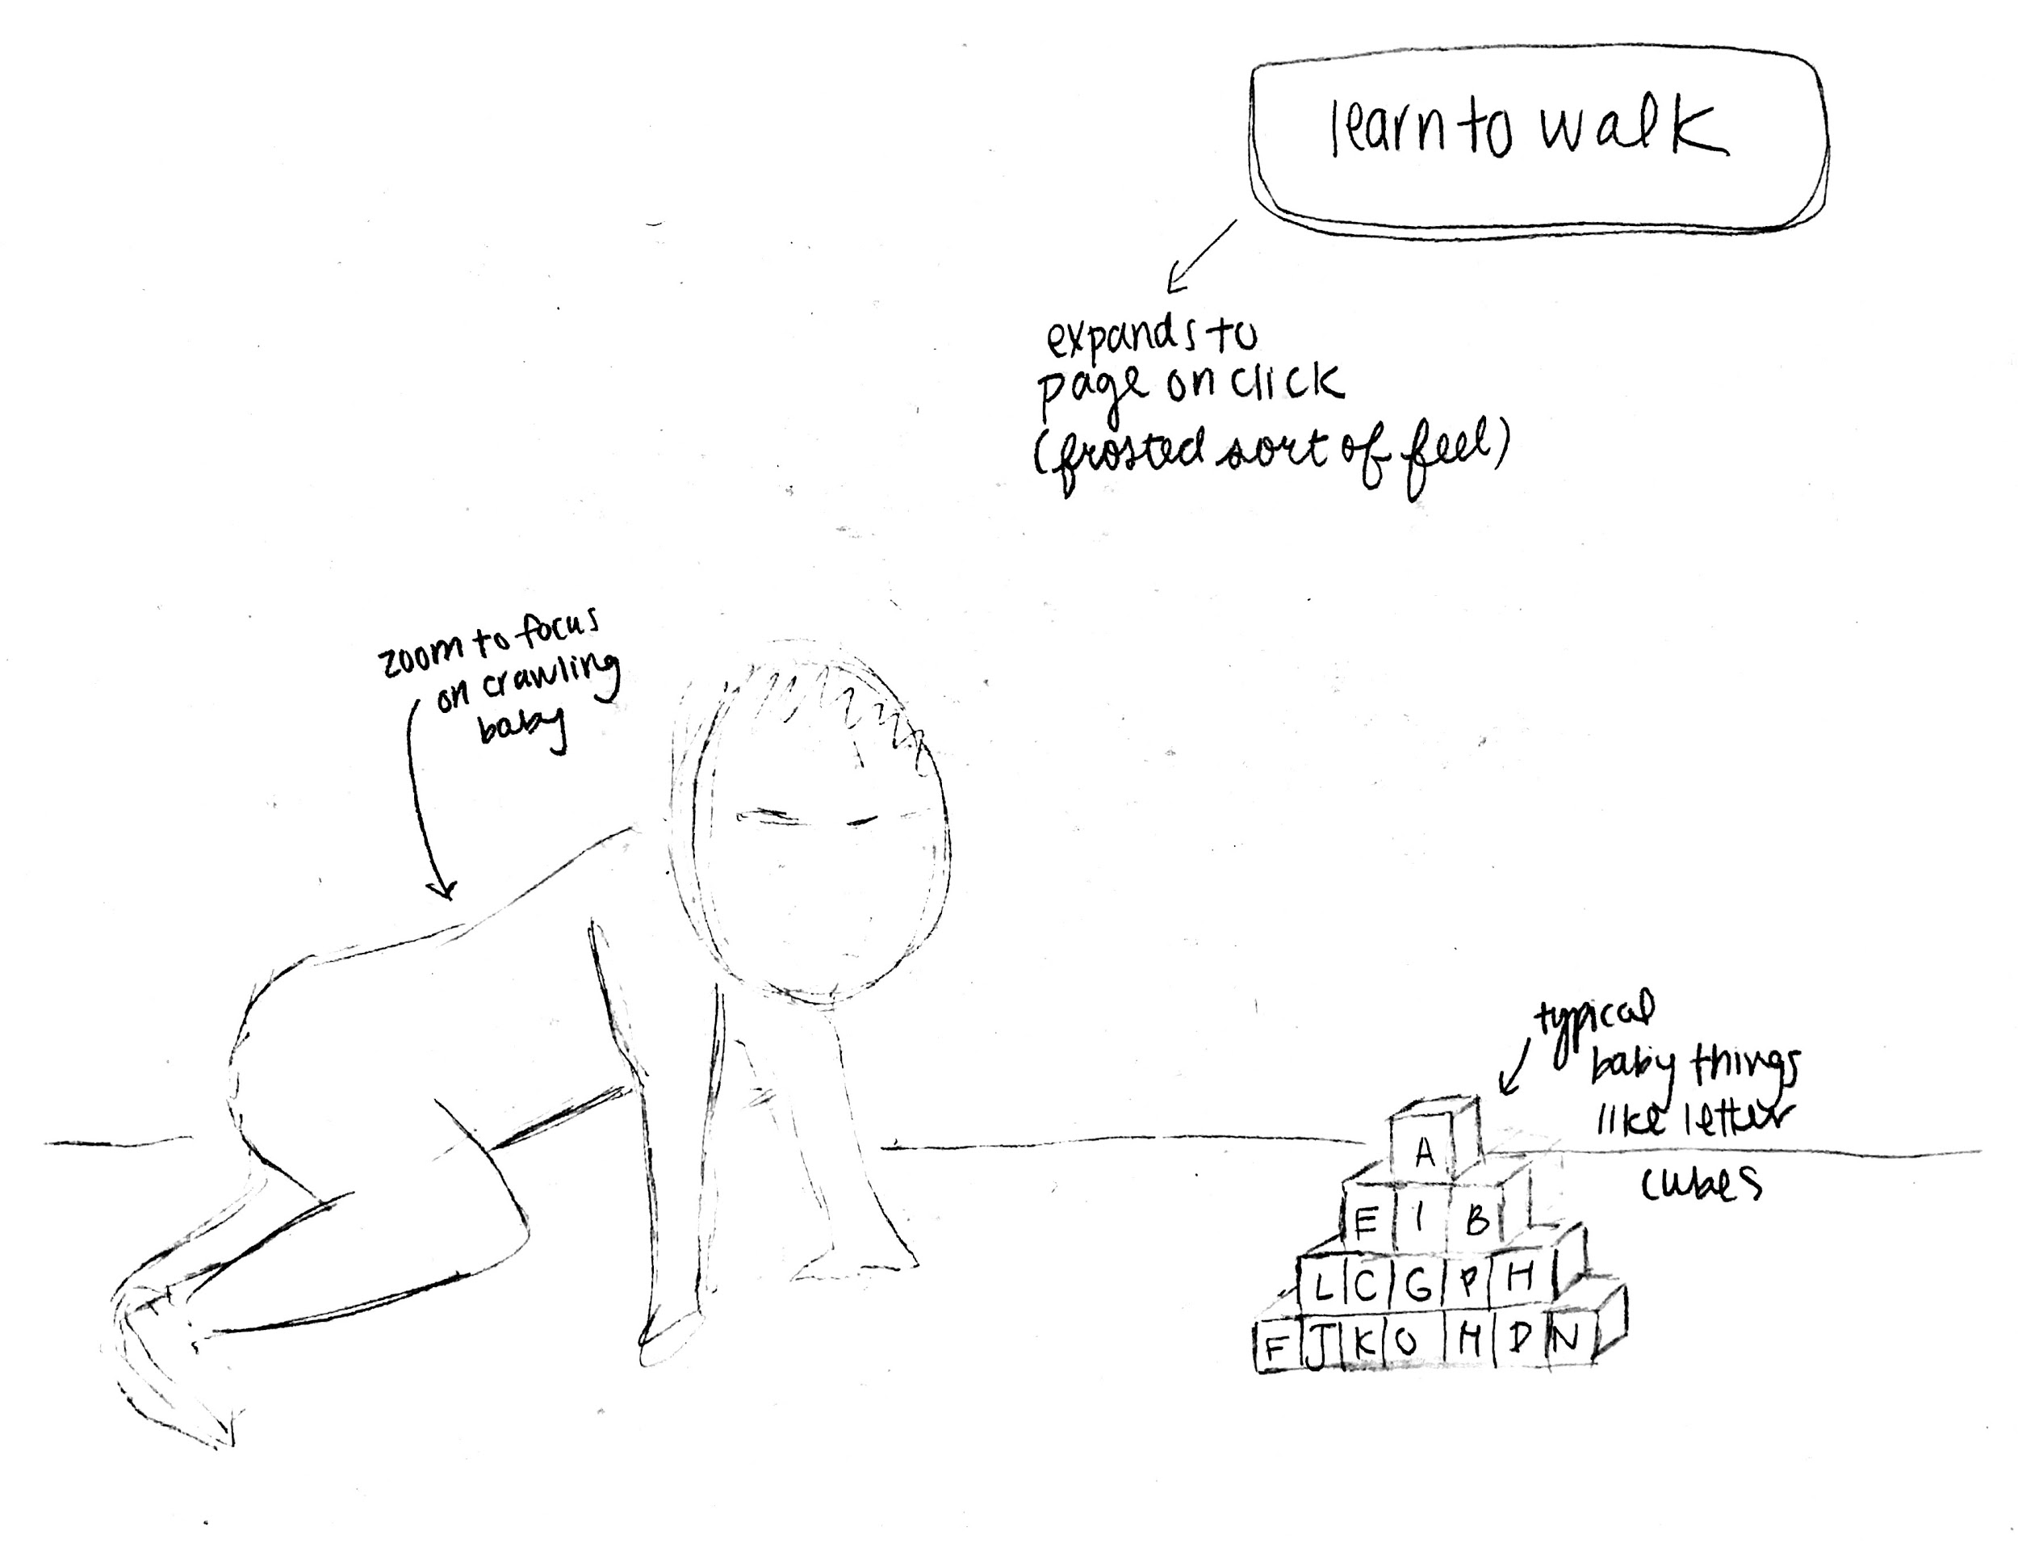
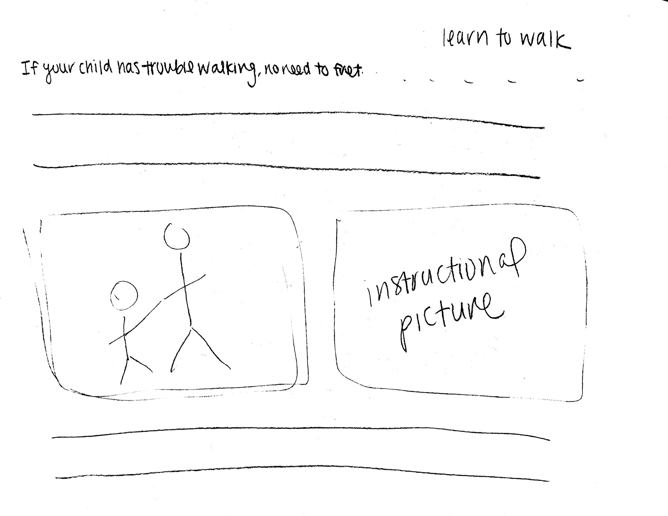
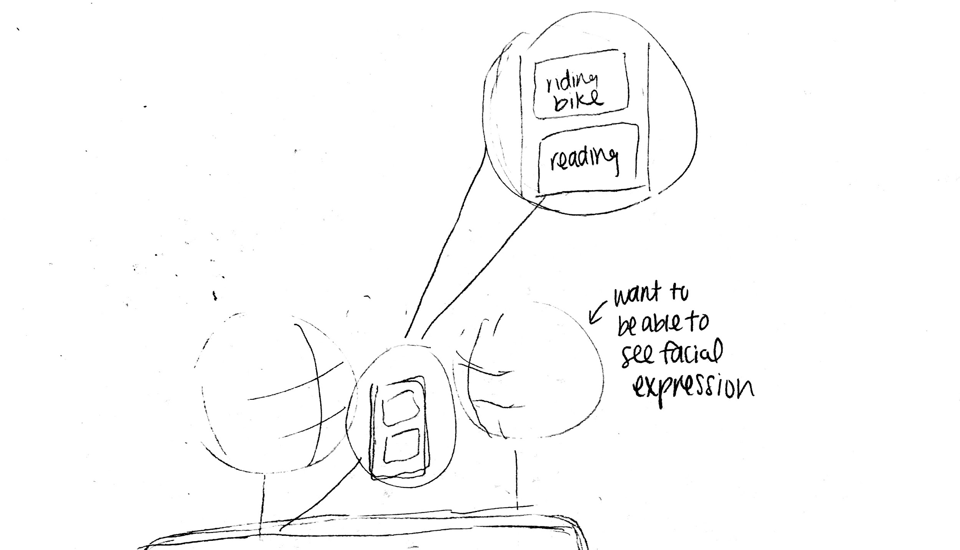
Storyboards

Slide 5
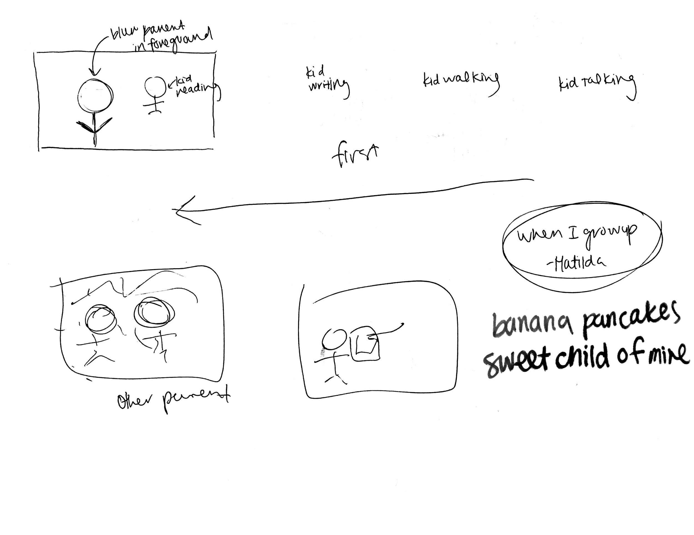
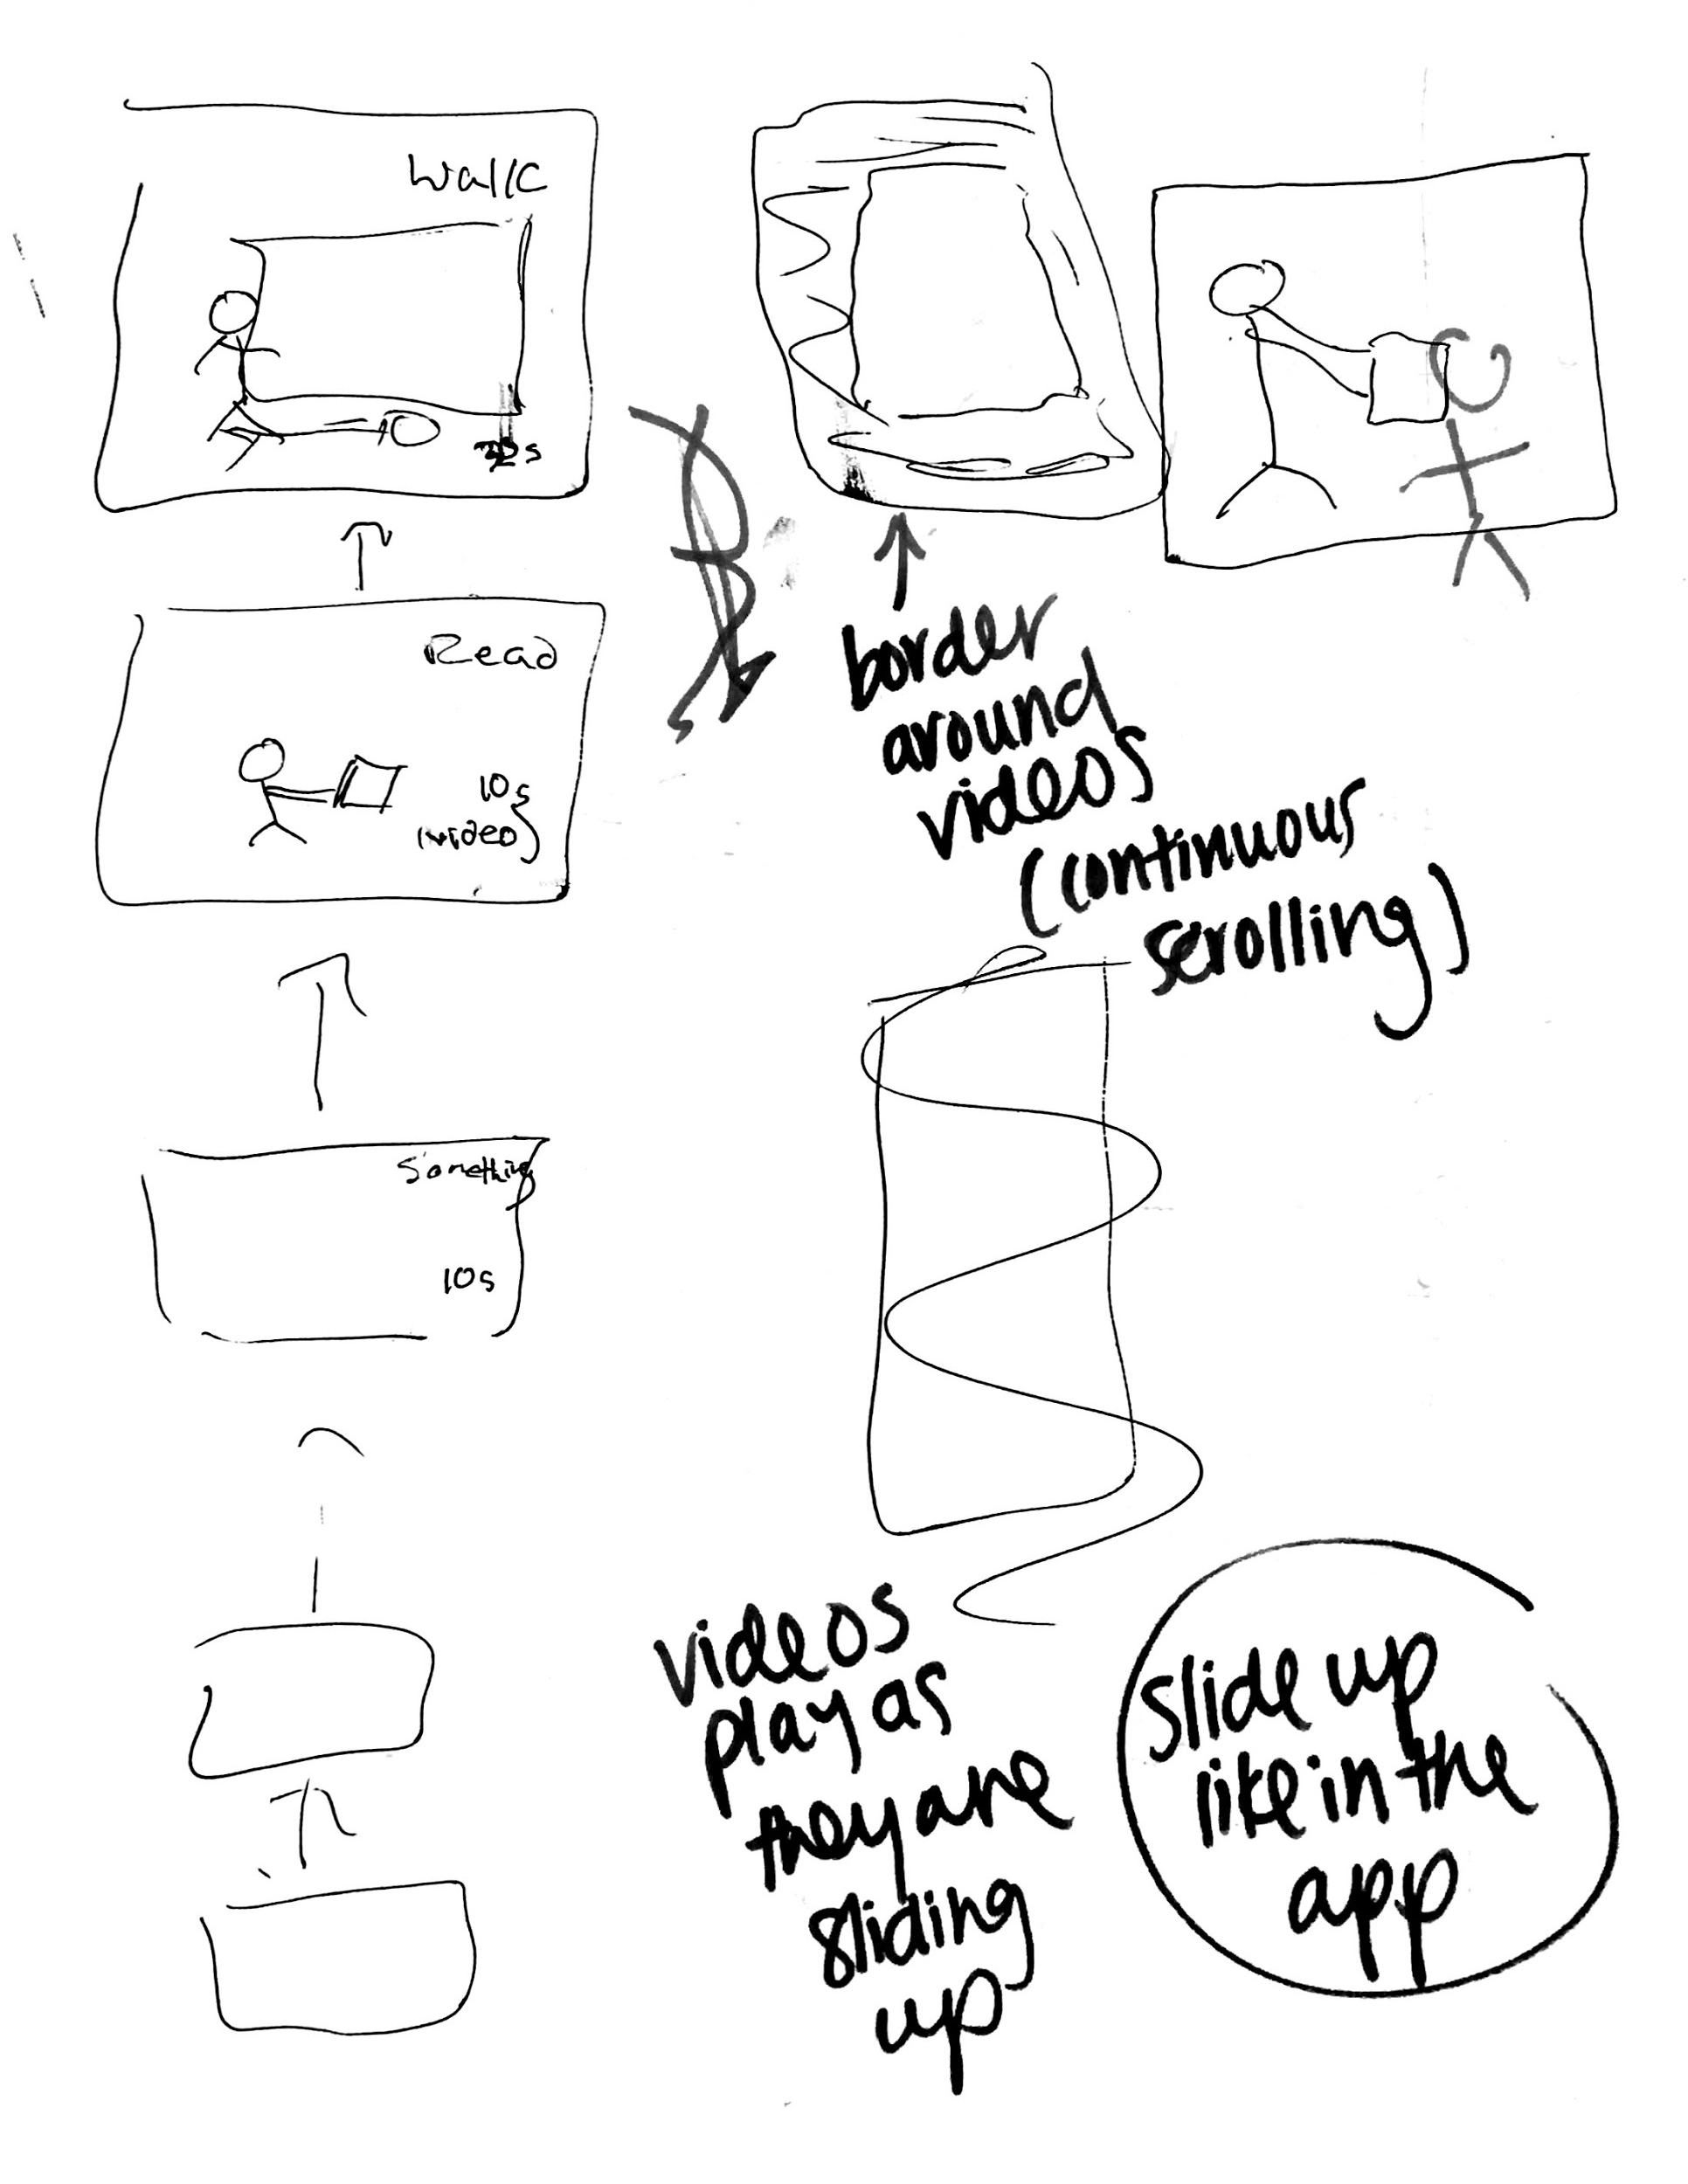


Slide 6


