Slide 2
end food waste. locally.
40% of all food grown in America is wasted. 1 in 7 Americans are food insecure. My Neighbor’s Kitchen tackles food waste at the source: local communities. No longer throw out excess food, but instead make it available to hungry people around you. Don’t go hungry yourself when you leverage the resource you have just a few feet away - the kitchen next door.

Slide 3
Lo-Fi Prototype Testing

Slide 4
Roadmap:
High Level Goals
Initial Sketches
Distilling and Selecting Prototype
Prototype
Task Flows
Method
Results
UI Changes

Slide 5
High Level Goals
Ensure users could quickly and easily post & pickup food waste
Normalize usage of leftover food

Slide 6
Roadmap:
High Level Goals
Initial Sketches
Distilling and Selecting Prototype
Prototype
Task Flows
Method
Results
UI Changes

Slide 7
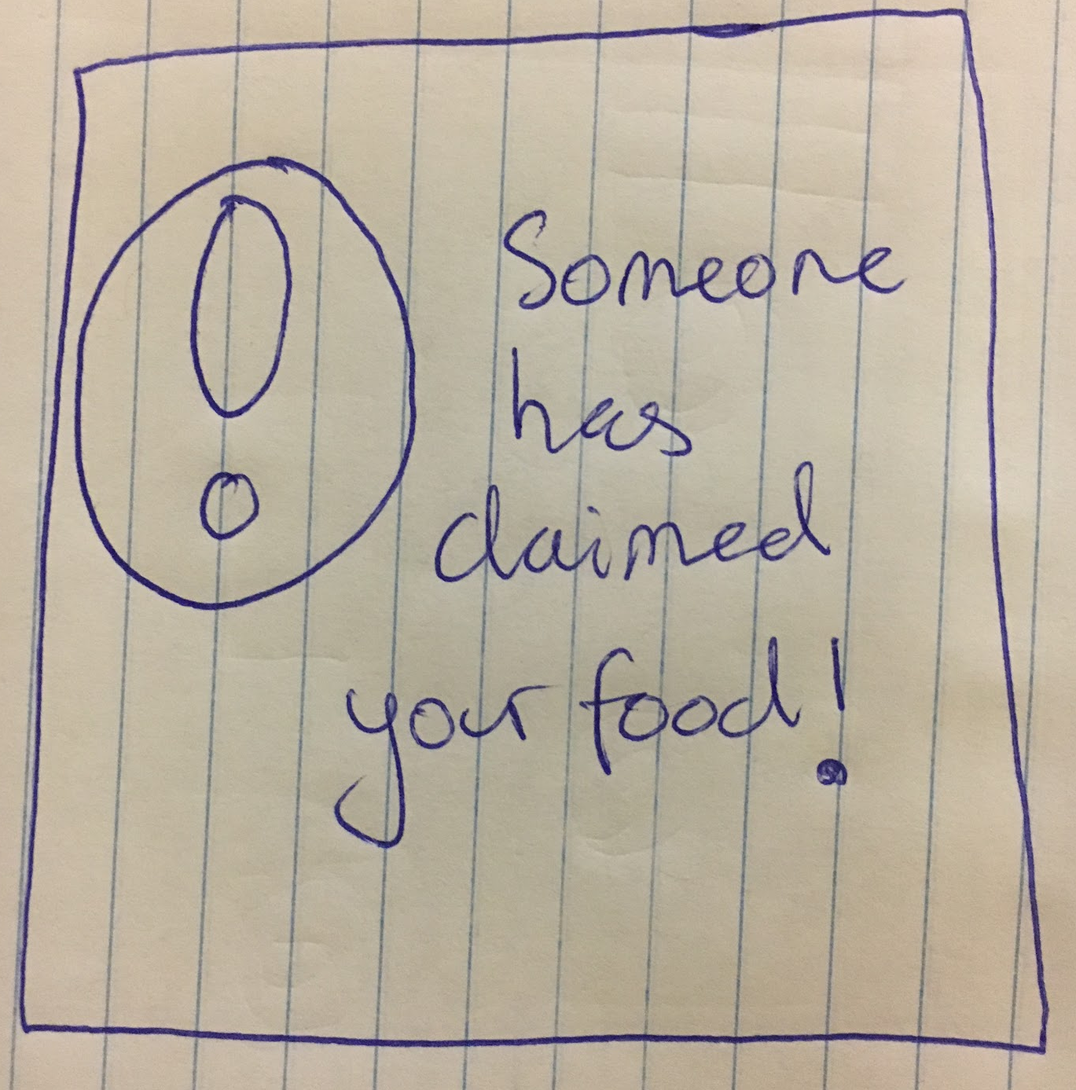
Initial Sketches
Voice Controlled Trash Can
Mobile App #1
Mobile App #2
Smart Watch App

Slide 8
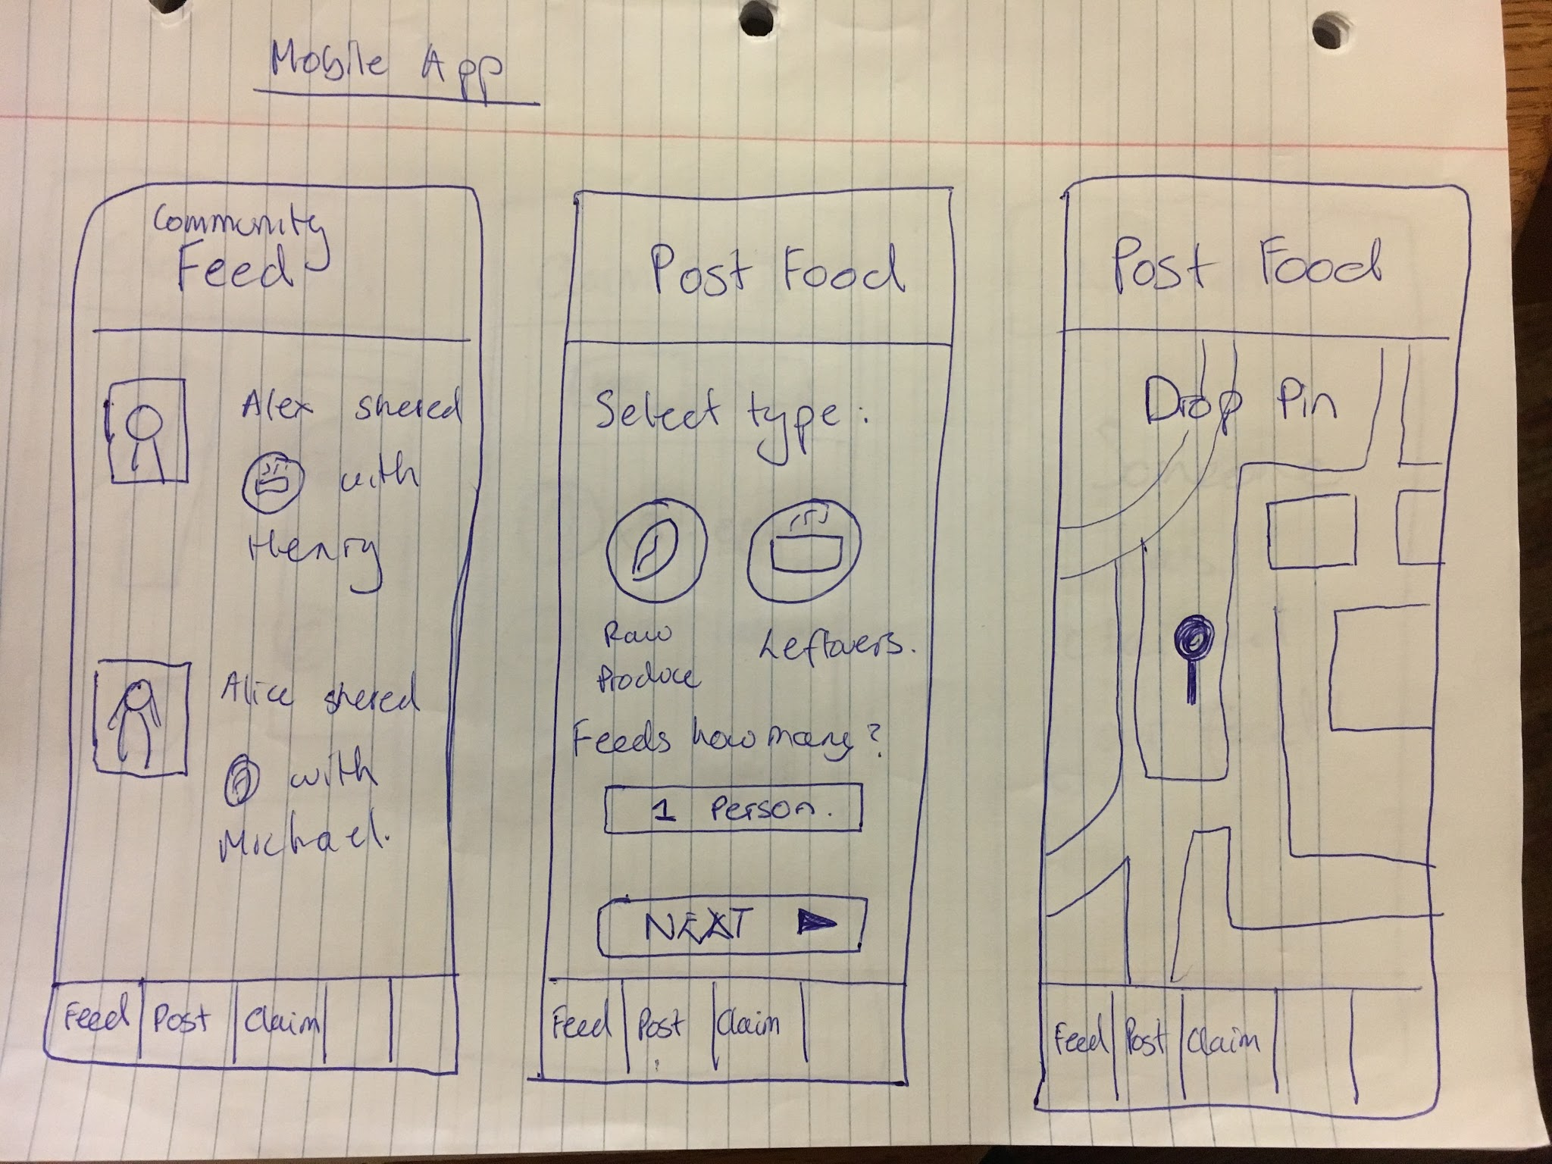
Distilling & Selecting Prototype
Mobile App #1
Mobile App #2

Slide 9
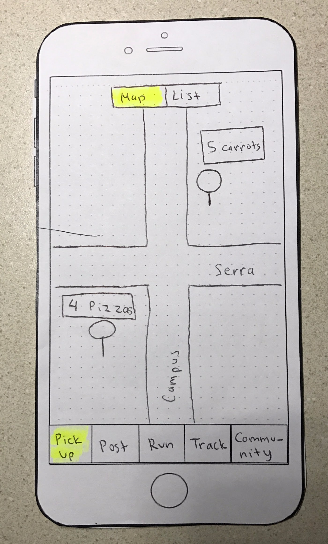
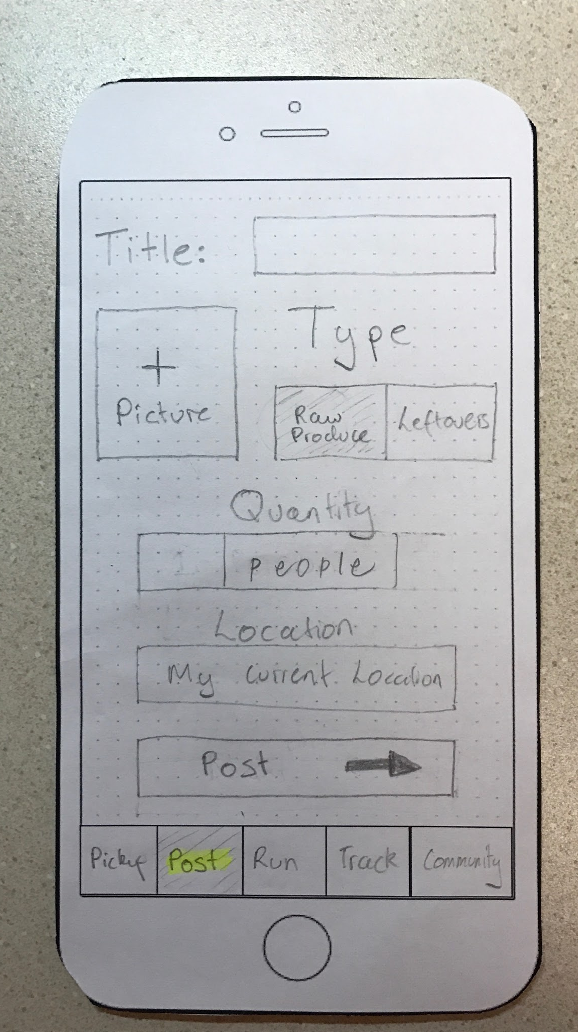
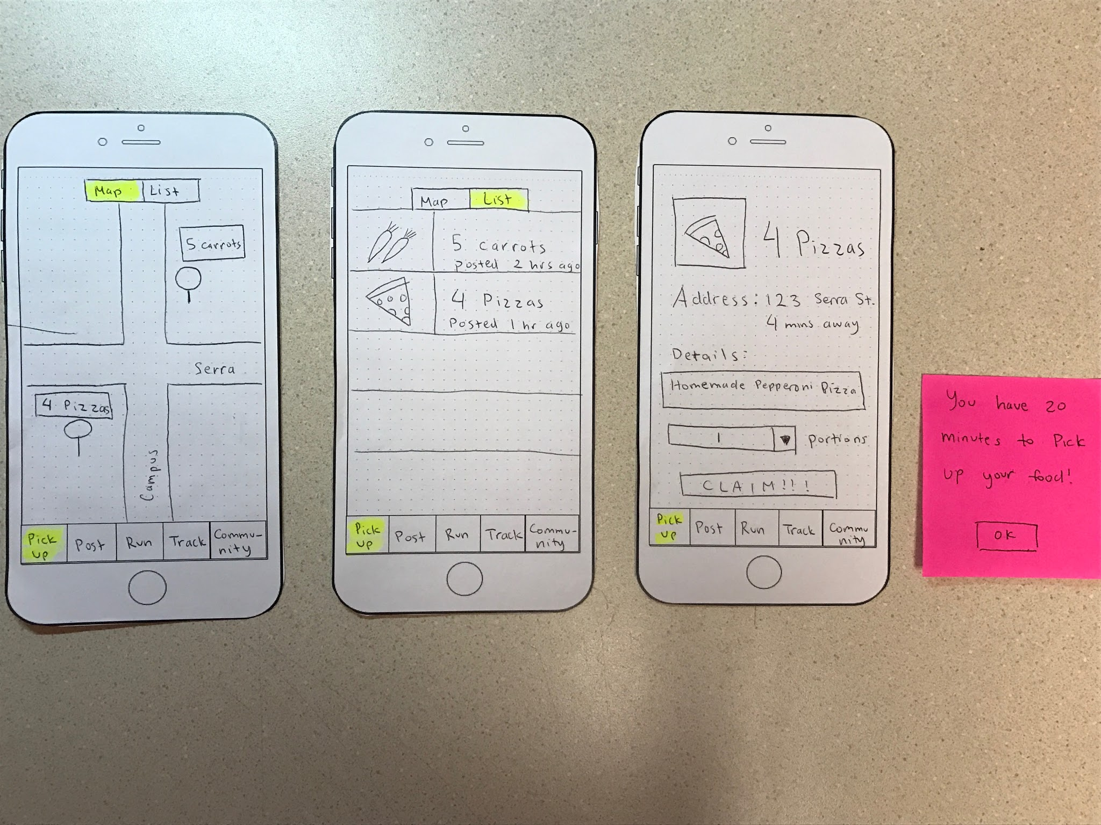
Lo-Fi
Prototype
Structure
-Pickup/Post

Slide 10
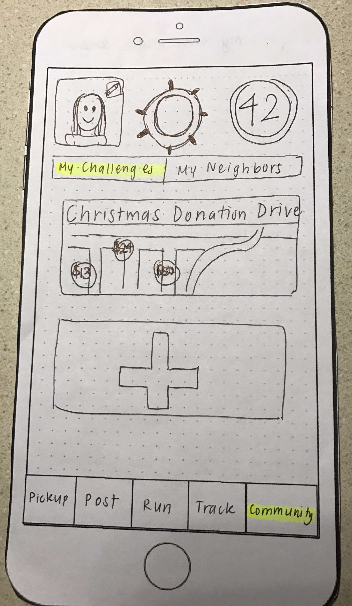
Lo-Fi
Prototype
Structure
-Community

Slide 11
Tasks
Map the app’s main functions to the chosen tasks.

Slide 12
Task 1: Post Leftover Food

Slide 13
Task 2: Pickup Someone’s Leftover Food

Slide 14
Task 3: Start a Community Challenge

Slide 15
Experimental Method
Participants | 3 Stanford Resident Fellows Greg Watkins Lydia Tan John Barton
Location | Households/Kitchens
Procedure | Introduced concept and area of research Gave a demo of Food Run feature Asked a series of three tasks Asked participant to explain their thought process as they carried out task Asked for feedback on each task Asked for general feedback

Slide 16
Experimental Results
Positive | Negative
Food Post | Uncertainty over Community Tab
Food Pickup | Uncertainty over how to initiate the community challenges, what they were
Familiar design, sticks to proven principles | Portion Sizes
Initial Screen | Pickup status of the food

Slide 17
Experimental Results
In General:
Stronger and clearer line of communication between poster and pickup receiver of food
Pickup status, questions about food etc.
Better communication of known solutions
Mutual Facebook friends
20min pickup to prevent food from going bad
More details over the quality of the food

Slide 18
Suggested UI Changes
Badges/Icons
Mark potential allergy causing food
Give-to-take ratio displayed on food claimer
Standardized food portions
Review system: numbers of meals posted per user

Slide 19
Suggested UI Changes
General
Message interface between poster and claimer to enable questions about the food.
Smoother transitions once food has been posted - where do we redirect to?
Reminders about picking food up in the allotted time limit.
Selecting who the food would be posted to

Slide 20
Summary
Overall structure of app solid
Community tab needs work
Greater connection between the donor and the receiver

