Slide 1
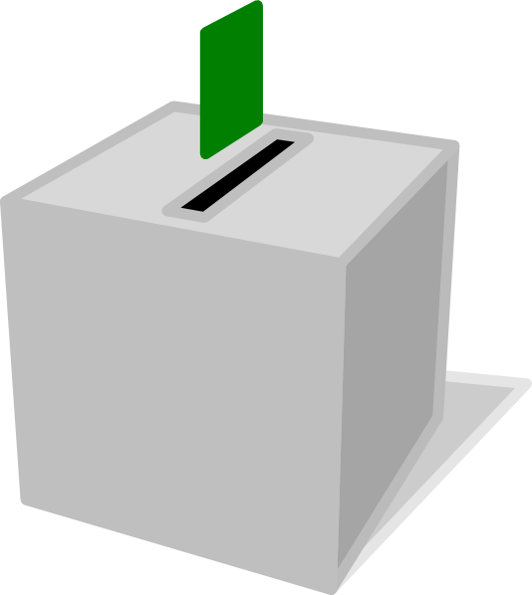
Voting:
It’s not only presidential.
Digital Democracy
Ana C Mexia, Trina Sarkar, Alex Gill, Katy Shi

Slide 2




Team
Katy Shi
Alex Gill
Trina Sarkar
Ana Carolina Mexia
Columbia, MO
Junior
Computer Science
Portland, OR
Junior
Symbolic Systems
Irvine, CA
Junior
Computer Science
Mexico City
Junior
Computer Science

Slide 3



DIGITAL DEMOCRACY
Young Voters and Local Governments
Notes:
Our problem domain with Digital Democracy is local governments, and more specifically civic engagement of new voters with their local governments. Right now, many young adults know nothing about their local governments and care only about the presidential elections, despite local governments having a massive impact on quality of life and issues like education and infrastructure.

Slide 4


Initial Pov
We met Auden and Ashley, two college students. We were amazed to learn that two students with similar backgrounds had such differing amounts of knowledge about their local governments. It would game changing if there were an easy way for Ashley to have the same amount of knowledge as Auden.

Slide 5





Additional Needfinding College Students.
Notes:
Sergio, Christina, Connie, Mark, Connor, Anna, Chris

Slide 6
We met Connie
Connie wonders how she is “allowed to vote” given that she knows so little about local gvt.
It would be game-changing if Connie had an easy, low-commitment way to learn more about local government before the election
Connie Li , 20
Junior
San Jose CA

Slide 7
We met Sergio
Sergio is voting absentee this election, and is only preparing for the Presidential vote, since he feels disconnected from home.
It would be game changing if Sergio had an easy way to keep up with his local government while he is away in college.
Sergio Rebeles 21
Biology
Senior
Visalia

Slide 8
We met Christina
Christina cares a lot about policy, including local government, but none of her friends do. Christina needs a way to discuss local issues because sometimes she is unsure of how she’ll vote.
It would be game changing if she had a way to connect and share information with other voters.
Christina Gill, 21
Recent graduate
Portland, OR

Slide 9
Top 3 HMWs
How might we educate new voters about local government?
How might we help college students navigate engaging in up to two local governments?
How might we help engaged voters teach and connect with non-engaged voters?

Slide 10
HOW MIGHT WE ...
...educate new voters about their local government?
Connie

Slide 11
HOW MIGHT WE ...
...help college students navigate engaging in up to two local governments?
- Sergio

Slide 12
HOW MIGHT WE ...
....help engaged voters teach and connect with non-engaged voters?
-Christina

Slide 13
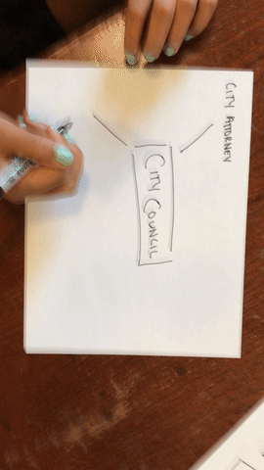
Educating new voters about local government
Khan Academy-style explainer videos on important local government topics Explain exactly what local gov does
You-tube series on local government issues Demonstrate how impactful local government actually is
Notes:
Assumption: people want to learn about local government, but do not want to put in the effort to learn more about their local governments.

Slide 14
Educating new voters about local government
Good: People found it easy to understand
Bad: Local governments don’t make interesting videos
Surprises & New Learnings: No one cares enough to actively subscribe
Notes:
Valid assumption, but even a video is too much effort

Slide 15

“If I felt if like local government actually did something important like abortion policy, then I’d vote.”
-- Chris Lucas, 20
Finding:
There is a clear misunderstanding among students about what local government actually does for them

Slide 16

Educating new voters about local government
App that shows a user’s ballot and allows them to click on measures to learn more about them Interactive way to learn about local government Voters can use while waiting in line to vote
Notes:
We assume that most people are seeing the ballot for the first time in the voting booth.

Slide 17
Educating new voters about local government
Good: Replicates the actual ballot
Bad: Not very intuitive
Crowded
Surprises & New Learnings People need more guidance on how to navigate a ballot, like what info can be found on a ballot
Notes:
Assumption valid, Most people had not seen this year's ballot and were completely unfamiliar with the layout of the ballot.

Slide 18
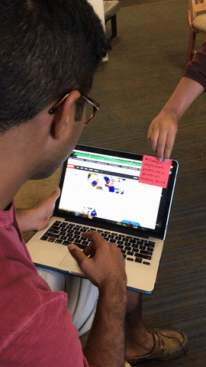
Navigating local government away from home
Chrome extension that notifies students of major votes/developments from hometowns Keep students engaged with their home politics Notifications mean they don’t have to go out of their way to stay updated
Notes:
Assumption: most college students have a difficult time keeping up with news about their local government from their home towns or home states.

Slide 19
Navigating local government away from home
Good: Simple, no maintenance
Bad: Distracting
Irritating if too frequent
Surprises & New Learnings: People ignore a lot of notifications
Notes:
Valid assumption

Slide 20
Questions?
Notes:
Extra interviews
Mark
We interviewed Mark Ibanez, a Junior Student from Danville, CA, Majoring in Communications. We decided to interview him because we wanted to hear more from the general young college-aged population. We learned that Mark has no knowledge of local government and no interest in learning about it, which is a trend we have been finding in college-aged voters. He said he would want a way to be connected to his local government that would require little to no effort from him, because he would rather exert effort on the myriad of activities he is interested in. Towards the end of the interview, he remarked that he has never been a politically inclined person, and has had no incentive to change that mindset.
Chris
We interviewed Chris Lucas, a junior from Rolling Hills, California, majoring in Computer Science. Chris only decided a week ago that he would vote in this year’s election and does not generally stay engaged in politics. Chris’s interview was incredibly enlightening due to his perspective on local government. He thinks local government mainly controls HOA boundaries and which neighborhoods connect to certain schools. He said if local government decided on important things like abortion, he would care about voting on it. Chris’s ignorance unawareness of local governments’ influence on abortion indicates a general unawareness by young voters of how impactful local government really is.
Anna
We interviewed Anna McCaffrey, a Junior Student who attends Tulane University, Majoring in Public Health. Anna has never been interested in politics, either local or federal, but this recent fascinating presidential election has elevated her interest in all levels of government. She wants to begin the process of learning more about government, both on the federal and state level, but is overwhelmed by the amount of information present and wants a streamlined process to go about this educational endeavour.

