Slide 1
Needfinding
Cheenar Banerjee, Travis Geis, Guhan Venkataraman

Slide 2
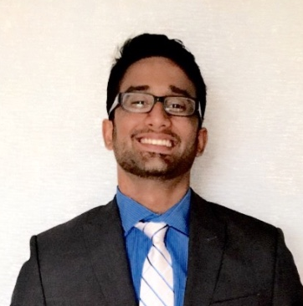

How do people view democracy and their role in it?
Digital Democracy
Cheenar Banerjee
Guhan Venkataraman
Travis Geis

Slide 3
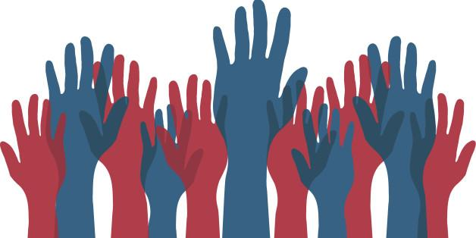
Methodology: Average Users
Educated middle-aged voter
Student who has recently voted
Notes:
9 people total
Some at work, some on street, one on phone
30-something software engineer with master’s degree
Recent grad working as a product manager who voted in the last pres election
Ages skewed young

Slide 4





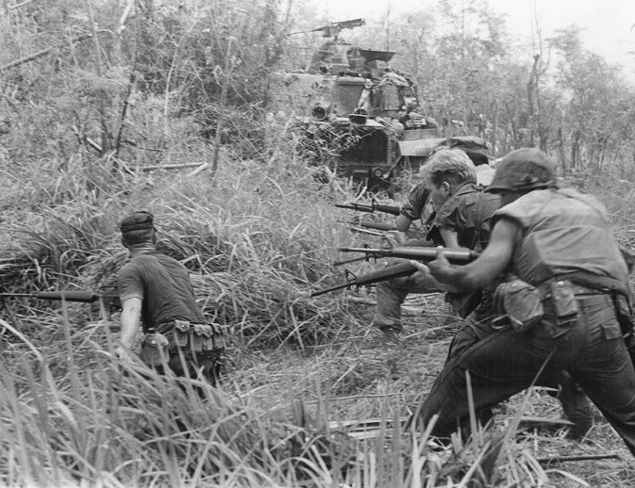


Methodology: Extreme Users
Notes:
No political orientation -- young professional w/ master’s from CMU
Campaign worker -- several who volunteered for Hillary campaign: one a software engineer at Google, the other at Facebook
Senior citizen & veteran -- older painter, vet of Vietnam war
Citizen of another country -- pro dancer & Indian citizen
Government Employee -- police officer (Palo ALto head of PR), two Palo Alto city performance auditors

Slide 5
Methodology: Interview Themes
What do you think of when you hear the word ‘democracy?’
How do you participate in <your definition of democracy>?
What is your responsibility towards <your definition of democracy>?
Notes:
Start with what/how:
Where do you get news and information?
How do you discuss issues with others?
Move to feelings:
How do you feel about your impact?
General interview trend, from what & how to broader feelings about
Things about democracy that make people happy, proud, fulfilled
Things that make people sad, upset, disappointed
Asked for stories of when people felt involved, proud, fulfilled

Slide 6
“It’s not just political”
What do you think of when you hear the word ‘democracy?’
Notes:
“Sometimes individual”
“The voice of the people”
“One man one vote”
“We don’t live in one”
“Mostly political”
“Free to do what they like, with a responsibility to come together”

Slide 7
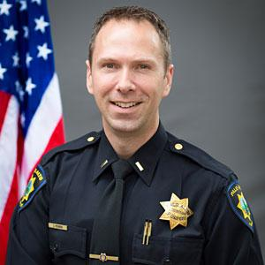
“I stay engaged”
How do you participate in <your definition of democracy>?
Notes:
“I’m pro-government, but I’m always questioning the government”
“I think critically about what I would do as a Congressperson or Senator”
“I reach out to people”
“There’s a lot I’m unaware of”
“I vote, even if it doesn’t mean anything”

Slide 8

“Citizenship is a job… Most people don’t view it that way”
What is your responsibility towards <your definition of democracy>?
Notes:
“I take the time to be educated and to read up on the issues of the day”
“Help those that have fallen down”

Slide 9
“This job is fulfilling because...you really make change”
“[Our bubbles] are homogeneous”
“I’m sad that my vote doesn’t count”
“The Internet is really good at [...] having people come together for a very short time, like for an election [...] it’s not good at facilitating long-term, committed work”

Slide 10
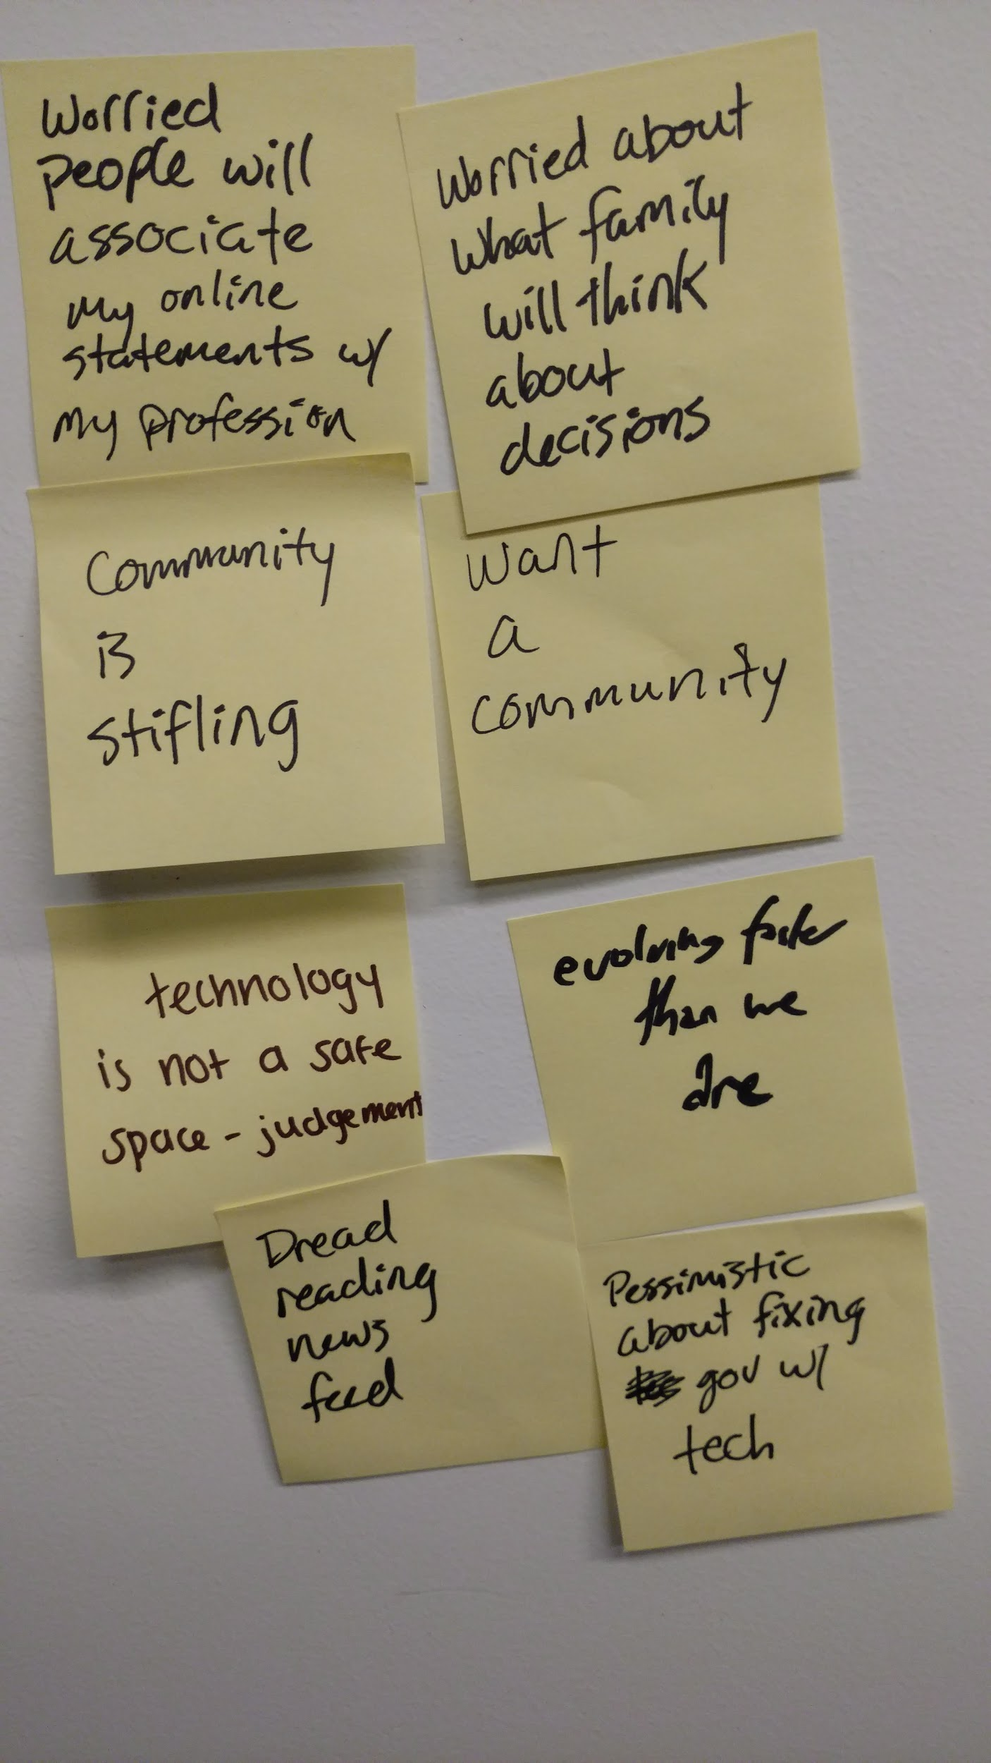
Skepticism
Dissatisfaction
Personal freedom
SAY
Notes:
Skepticism:
“Government always forces their will”
We can do better; our society can work “smarter”
I love helping people

Slide 11
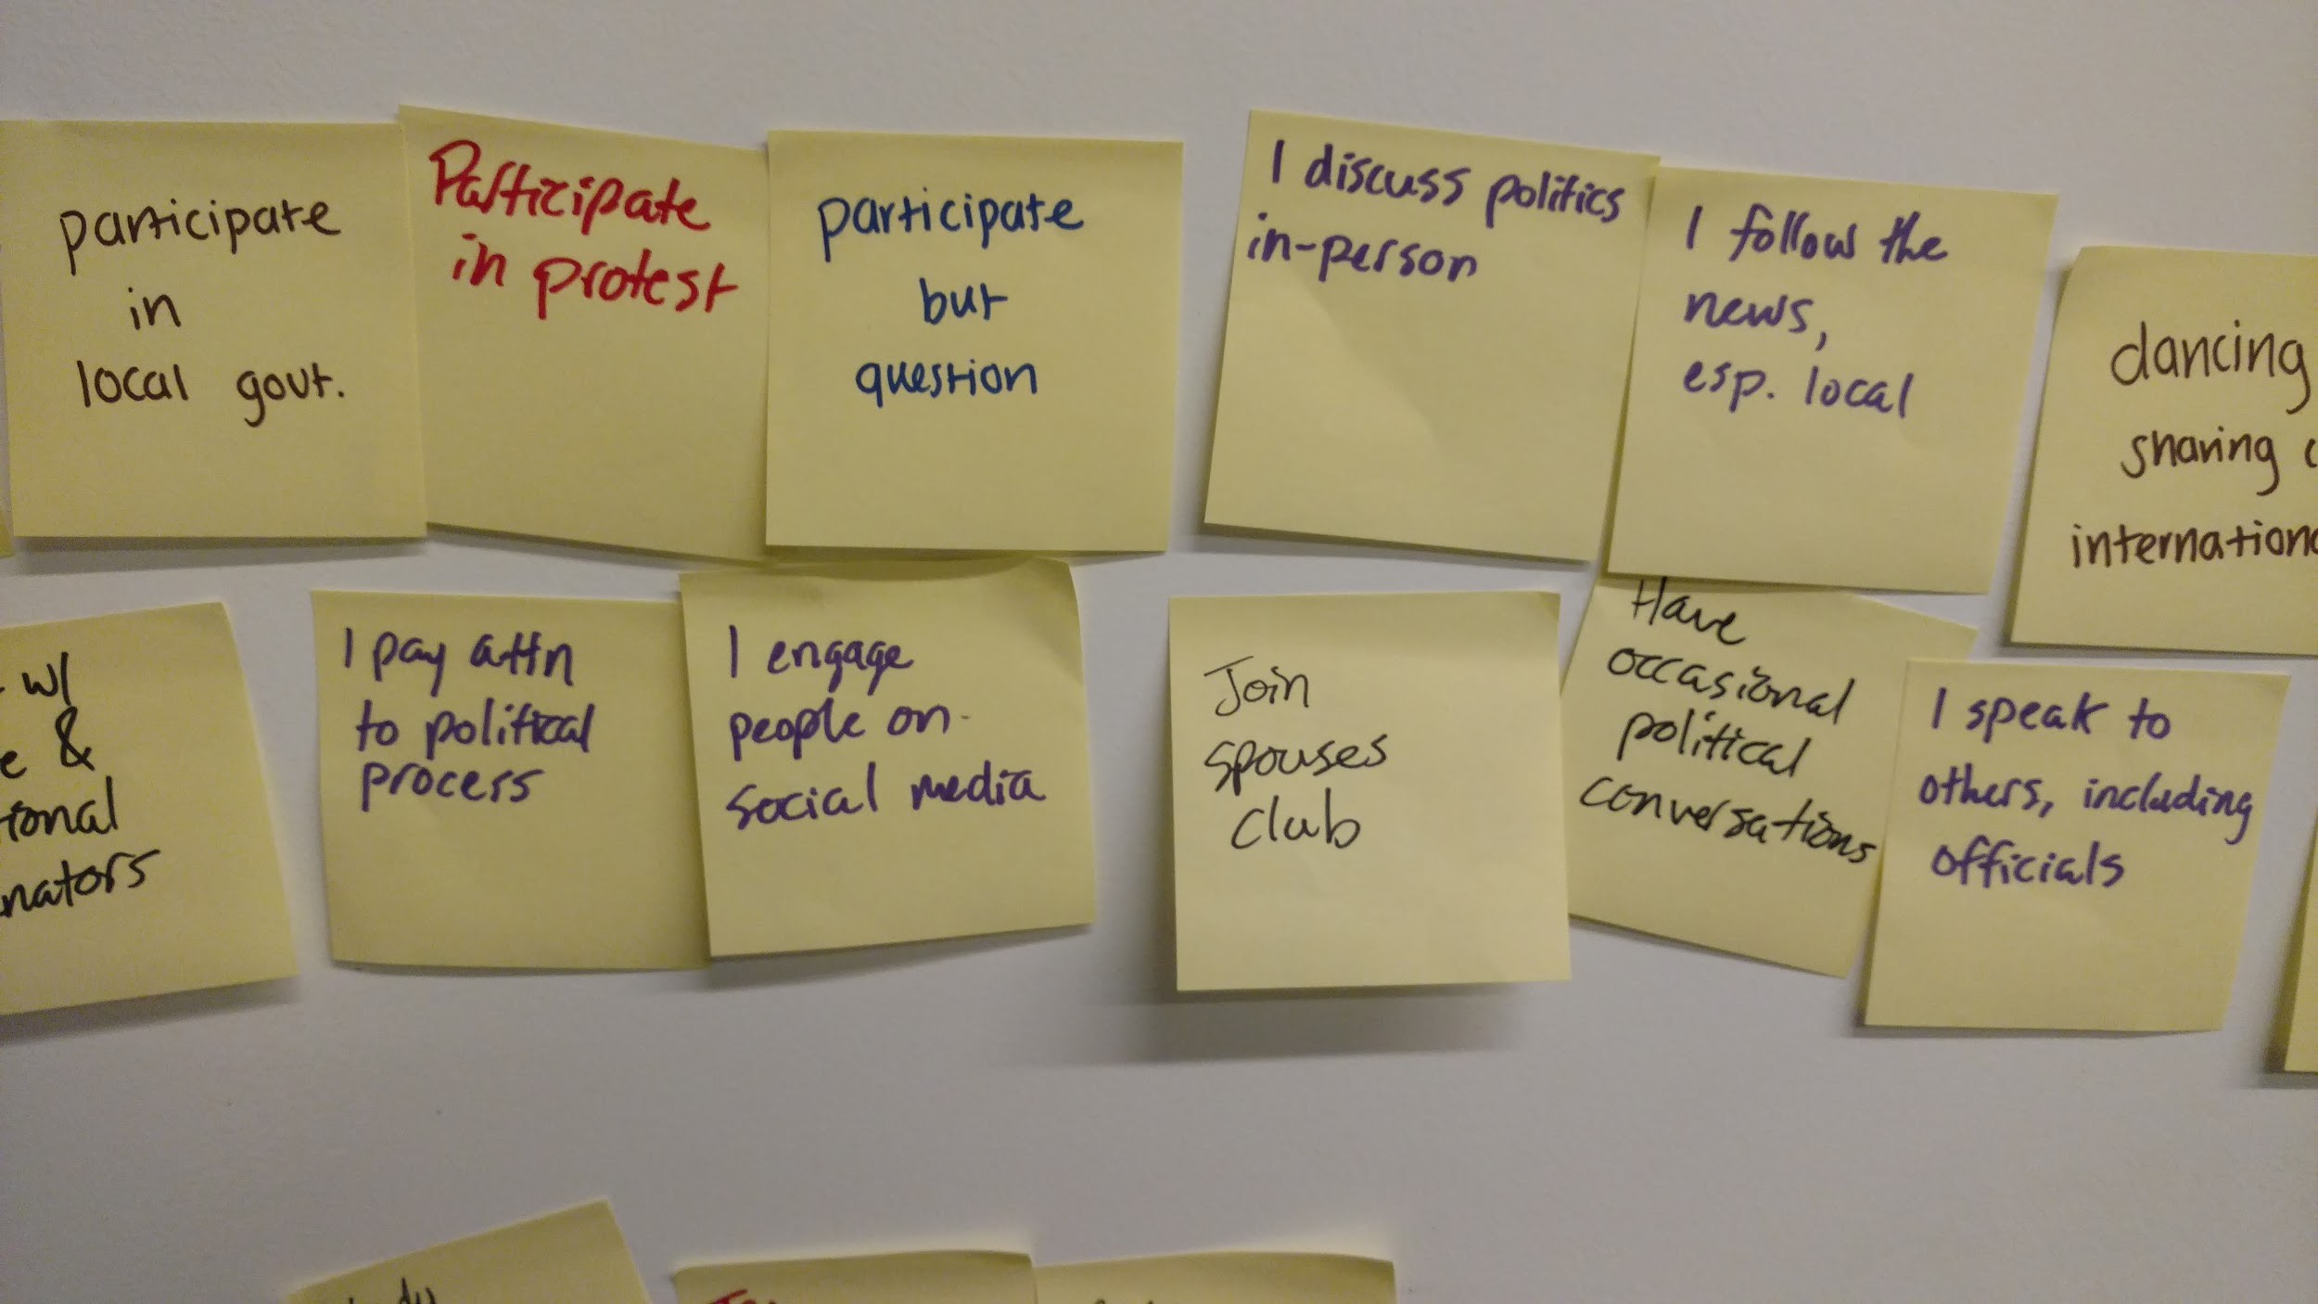
Participate
Stay informed
DO
Notes:
Vote
Campaign
Read news
Go to official meetings / town halls
Discuss in-person and online with friends and family

Slide 12
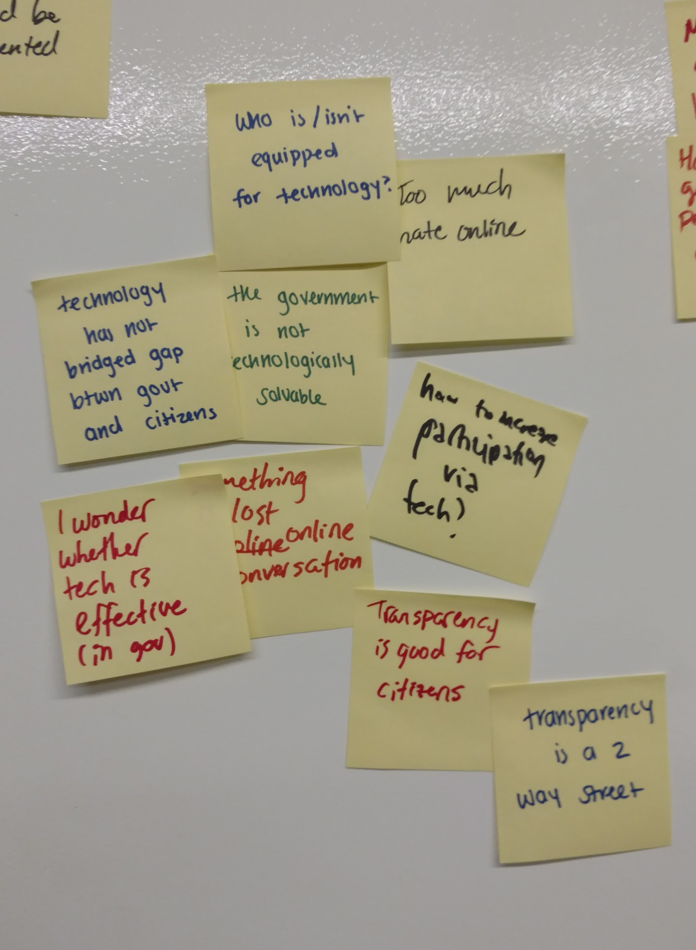
What can technology do?
Citizenship is a job
Politics are too opaque
THINK
Notes:
Need diverse perspectives
A lot about impact of vote or participation
Transparency is better

Slide 13
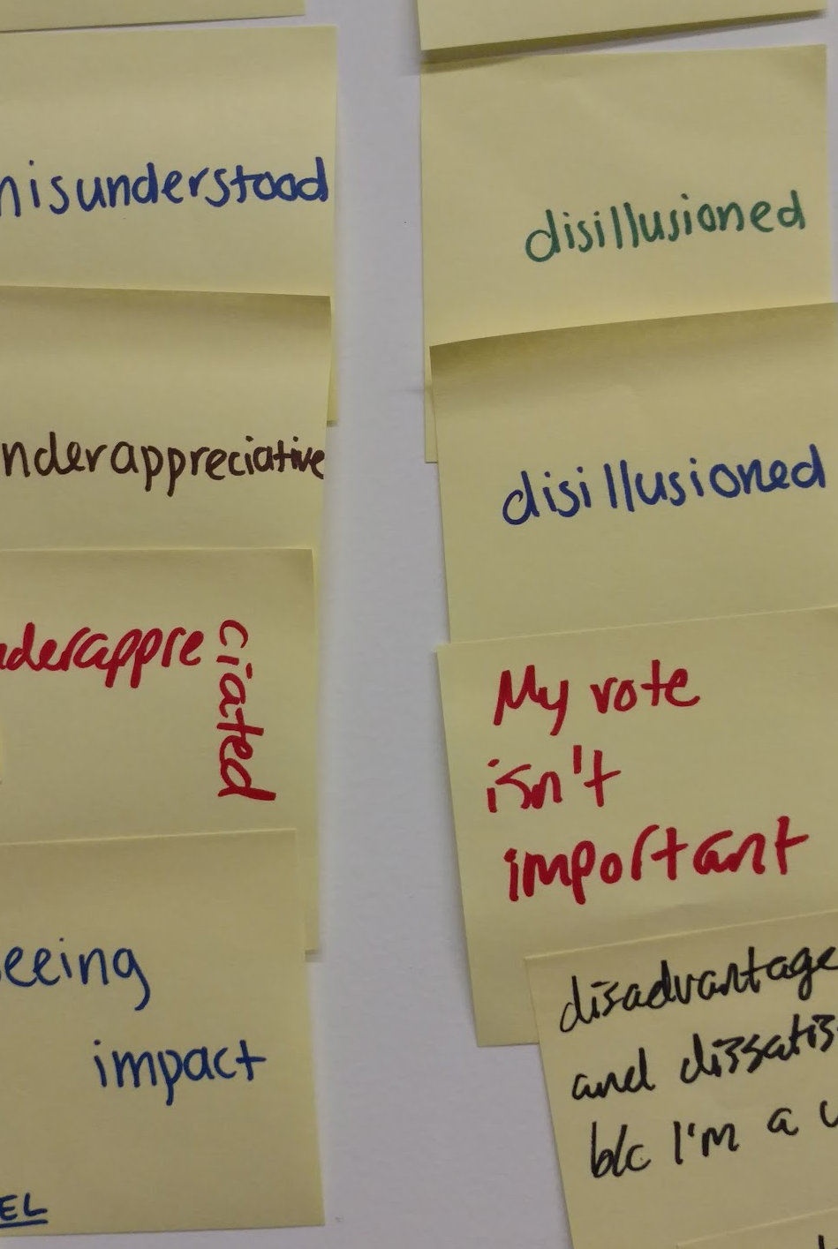
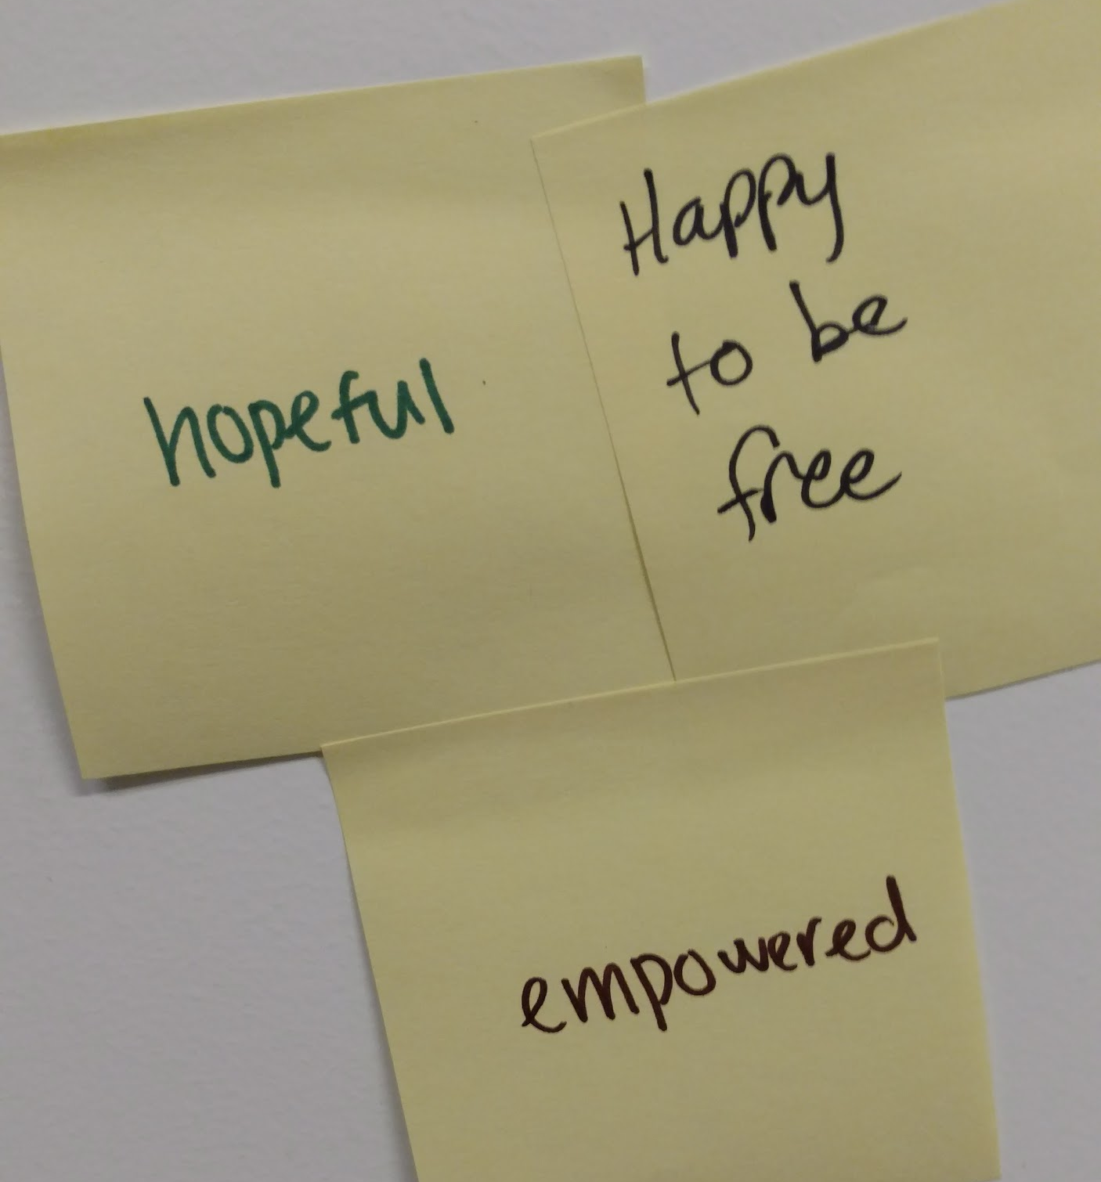
Disillusionment
Disappointment
Empathy
Hope
Empowerment
FEEL

Slide 14
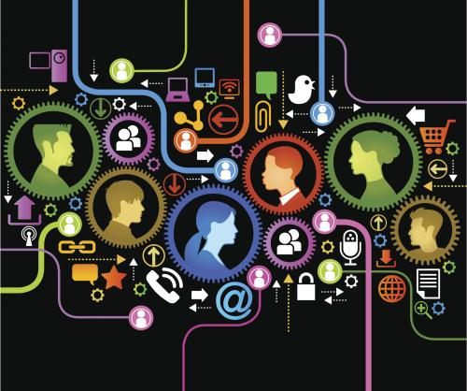
Tensions, contradictions, and surprises
Technology connects and isolates
Community is comforting and stifling
People are unaware of their impact
Notes:
Diverse perspectives online, but it isn’t safe to talk there
Tradeoff between individual liberty and community cohesion
People are afraid of being seen negatively by peers
Many people think of voting
“Voting is symbolic” vs. “To make a difference, I must vote”
Other ways to be involved

Slide 15
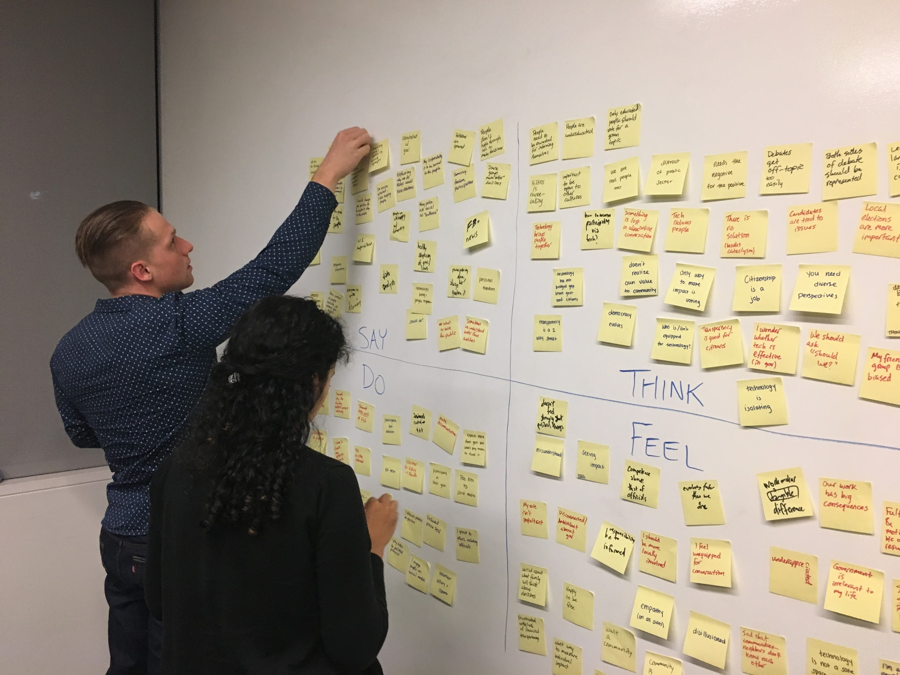
Needs and Insights

Slide 16
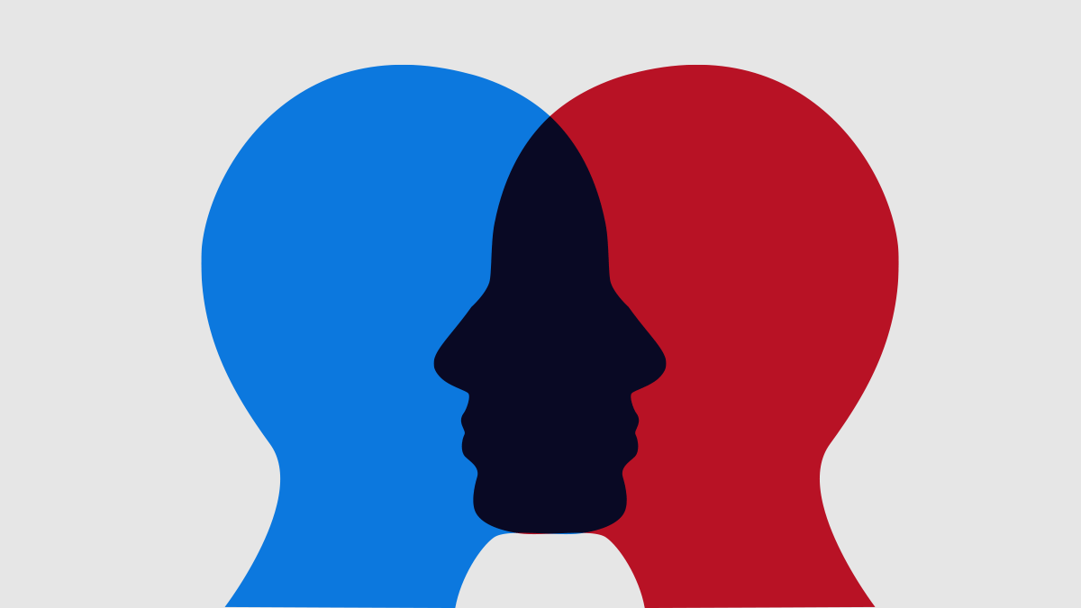
Need: Empathy & Safe Space
People feel misunderstood, disillusioned, underappreciated
insight

Slide 17
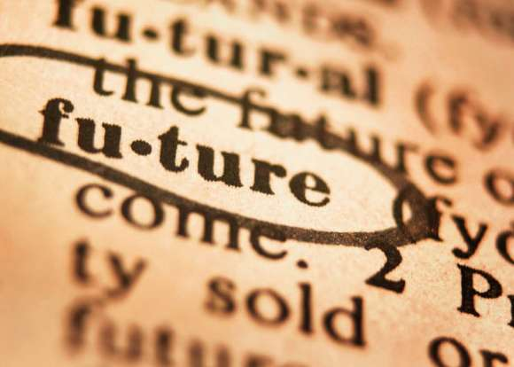
Need: Long-Term Engagement
Have technological advances improved our democracy?
insight

Slide 18

Need: Face Time
It’s hard to feel truly connected and find diverse perspectives online
insight

Slide 19
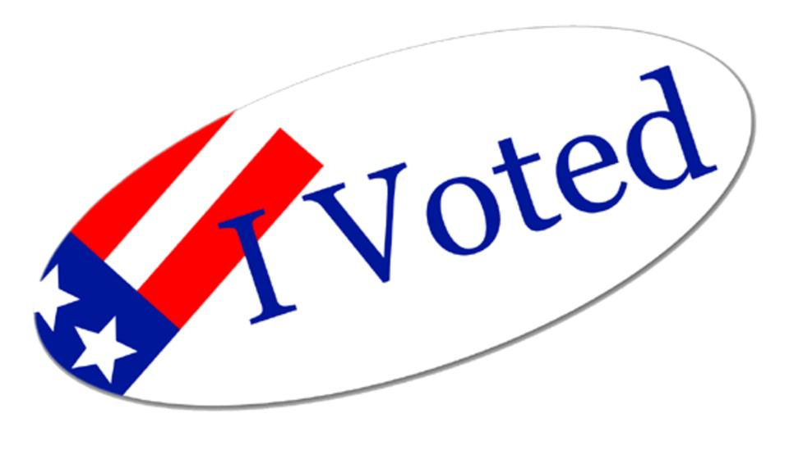
Need: Visible Impact & Validation
I am compelled to participate if I know I am making a difference
insight

Slide 20
Summary
Notes:
Heard from “extreme” and “average” users
Heard from both government and non-government
Concerns on both sides were similar: people feel misunderstood, and they want to give or receive more insight into how the country operates
People are hopeful and worried about how tech is changing society

Slide 21
Overflow Slides

Slide 22
Empathy Map

Slide 23
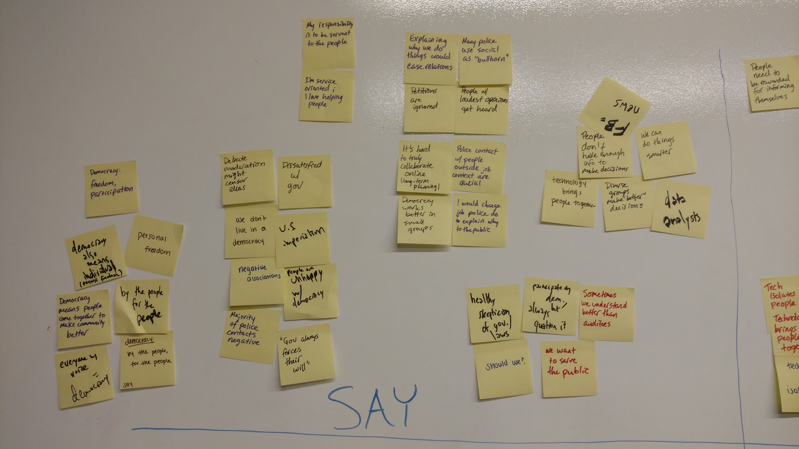
Empathy Map: SAY

Slide 24
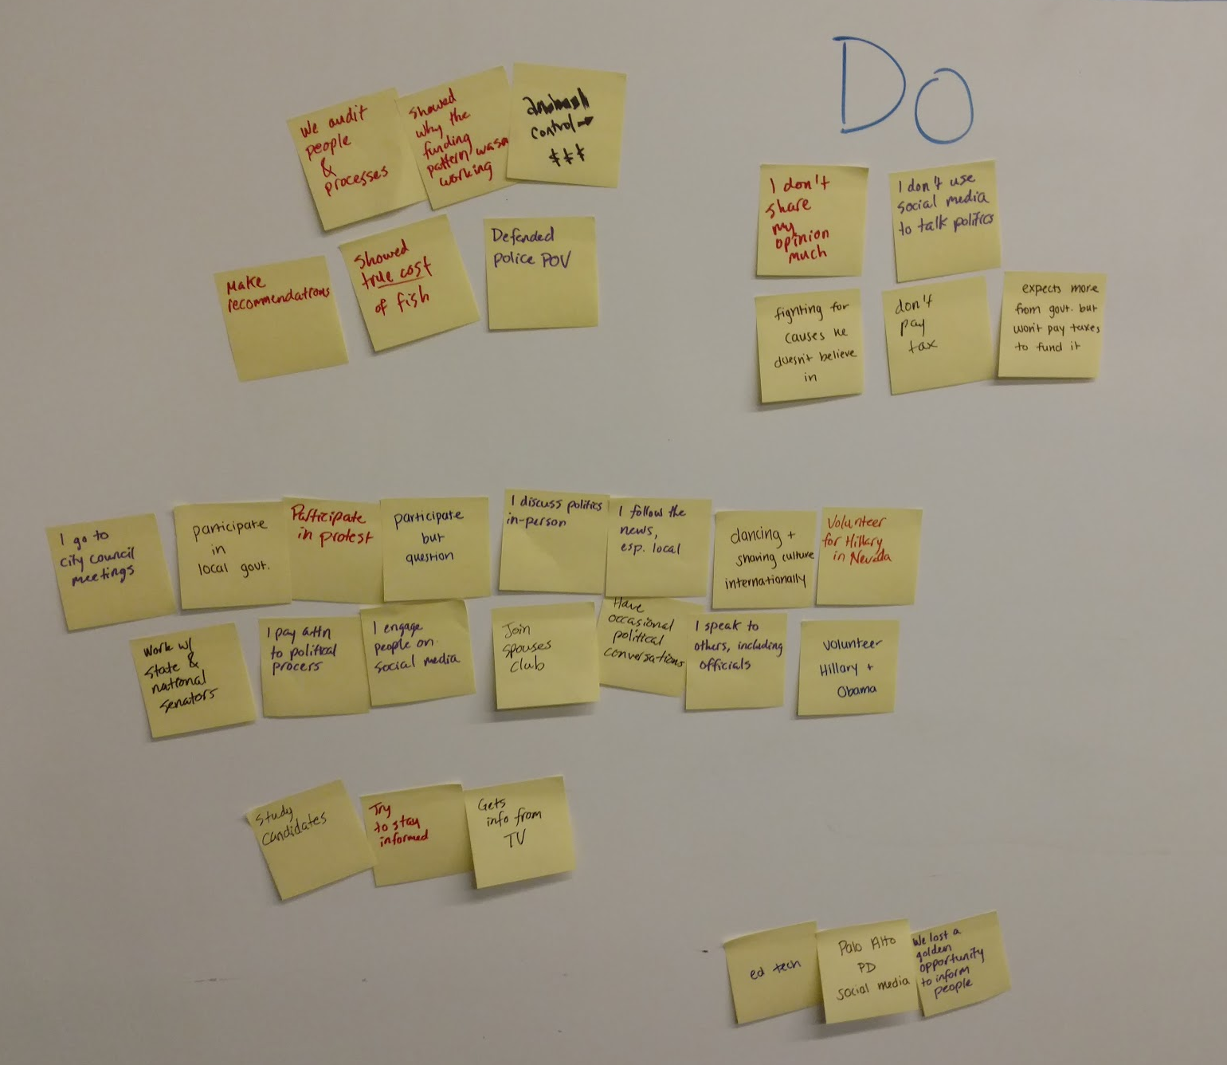
Empathy Map: DO

Slide 25
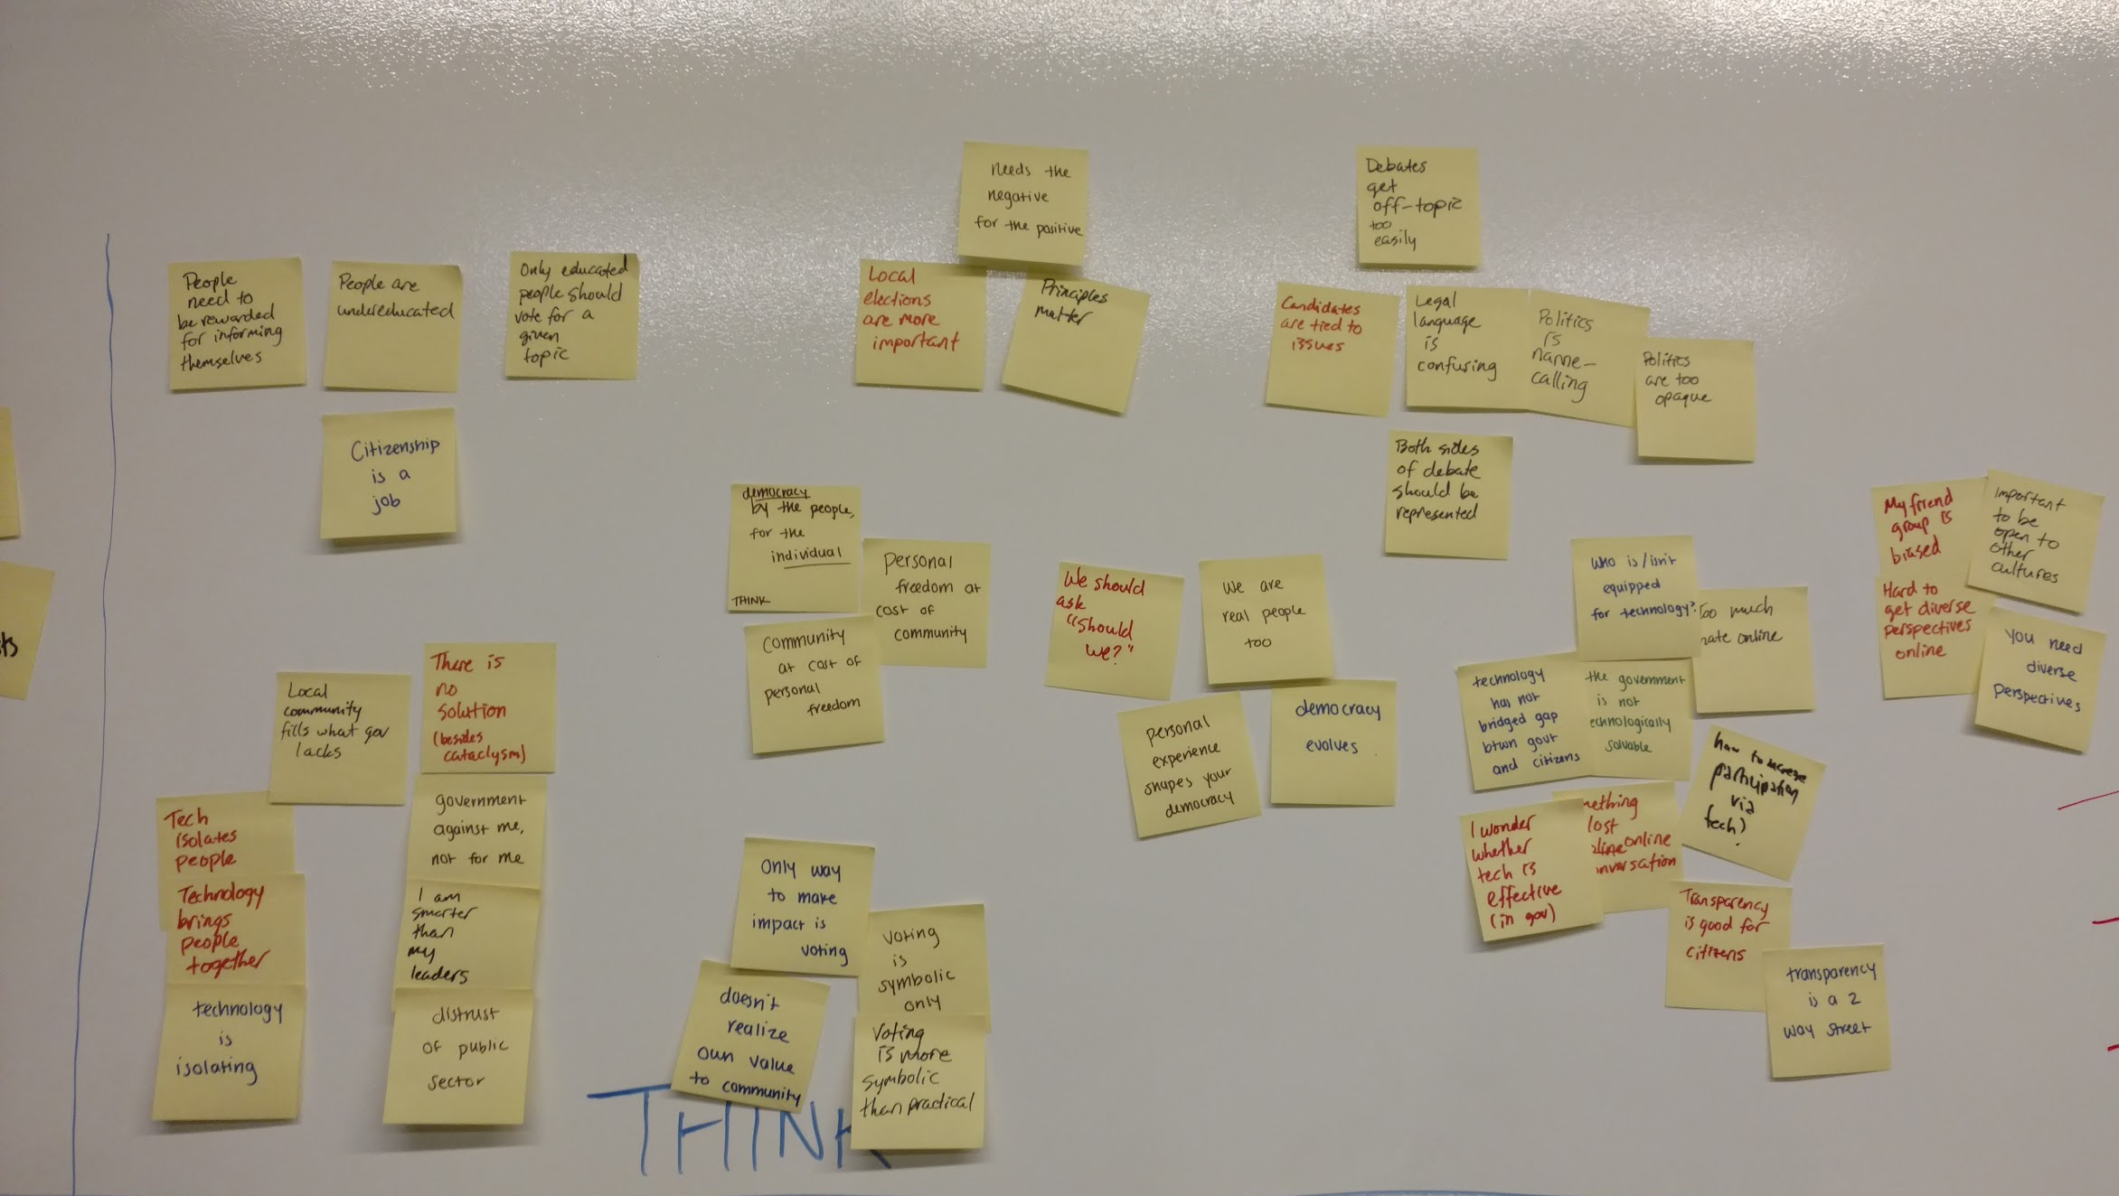
Empathy Map: THINK

Slide 26
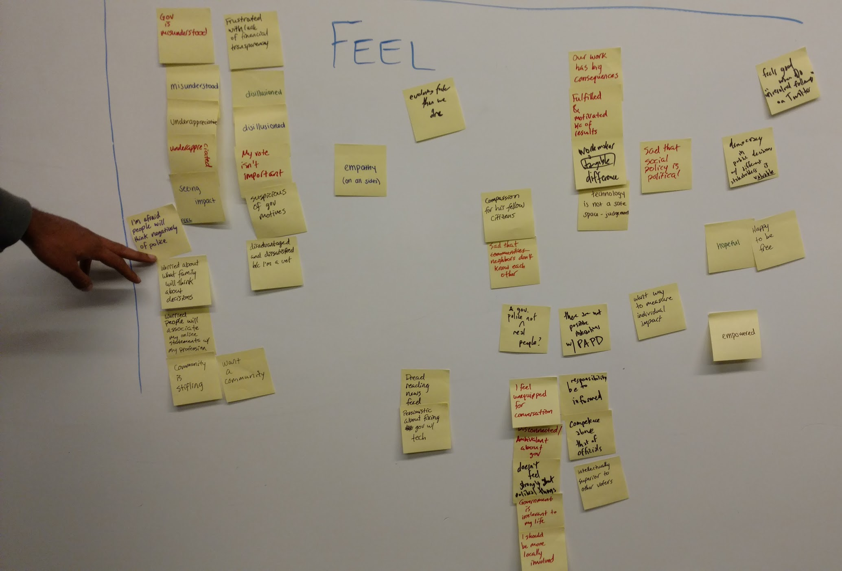
Empathy Map: FEEL

Slide 27
Interview summaries

Slide 28
User 1
Political definition
Democracy “doesn’t work”
Not many opportunities to engage in democracy
Democracy problem = people that aren’t educated about a topic are voting for that topic
Maybe something similar to the peer review process in science?
Educated, middle-aged adult
Notes:
Production Engineer
32
M
Master’s in Computer Science, CMU
White
Atheist
No political orientation
Political underpinnings come to mind immediately
Democracy should enable everyone to have hand in designing political system, but “it doesn’t work that way”
“The fact that advertising is so strong and that you can map the amount of money to the sway it has makes it clear that people don’t have enough information to make perfect decisions”
Democracy works better in smaller groups
Study where two groups were asked to make democratic decisions - one of experts, one of random people (random people made better decisions because of less biases and more diversity)
Doesn’t see signed petitions (i.e. change.org) being effective because they’re ignored
Votes, but since election electoral process doesn’t count raw votes, “hard to tell how much impact my vote has”
Has political conversations to small extent with friends and family, but not incentivized
Feels there are not many opportunities to engage in democracy and that it is hard to measure individual impact
Would want a way to measure individual impact
Australia requires voting censuses - registered to vote door to door. This introduces big problem
Democracy problem = people that aren’t educated about a topic are voting for that topic
How to weed out uneducated people, or at the very least stall their voting until they are educated?
Gamify their education?
Ex. bills are worded funny (supporting or not supporting bill? Who knows?) [i.e. Brexit]
Interested in a way to share ideas so that they can change the way policies are made
“During this election, we’ve heard things that are ridiculous. But what use is it to go on some random discussion forum where 5 people upvote your answer?”
Instead of voting for a person, some kind of voting process for ideas
“I want ideas subjected to critique in way that cant be ignored. Each critique should be vetted, and if you have a valid objection to some idea, someone should have to refute it.”
“Unresolved followups” in Piazza kind of thing
One of problem with piazza is that moderators want to post something like “this is already posted, don’t post it”, but that loses info
If a user sees an idea, they should be required to agree or disagree with it, and then the service should use some kind of classification algorithm to help the user see related responses (“supporting arguments and objecting arguments grouped and enumerated”)
Similar to the peer review process in science, but applied to politics, in order to preserve the Democratic process in an intellectually honest way
Both sides would want all objections to be addressed
To the extent that that’s not happening is how the average voter is persuaded by marketing
Financial contributions are good if every dollar mapped to what it went towards - “I donated $10 to Bernie’s campaign, but what happened to that money, that’s anyone’s guess.”
Whatever service it is, needs to be “crowdsourced to be scalable”

Slide 29
User 2
Democracy is “the voice and representation of the people, and how multiple viewpoints are incorporated into one”
“I take the time to be educated and to read up on the issues of the day”
Problem with community cohesiveness
“Citizenship is a job - it’s not clear to some people that it is”
Recent college grad
Notes:
Software Engineer
24
M
Master’s in Computer Science, Stanford
Indian
Hindu
Moderate political affiliation
Democracy is “the voice and representation of the people, and how multiple viewpoints are incorporated into one”
“I take the time to be educated and to read up on the issues of the day”
Volunteered for Hillary campaign through website, went to Nevada stop trump
Bused for free to Reno, spent 6 hours registering door to door, 50/60 votees
Gratifying experience
“What struck me is that none of these people knew anything about their neighbors. There was no community cohesiveness. I honestly think that in my short time there, I learned more about their community than they did. They have no idea what kind of neighborhood ethnic, social, or political backgrounds their direct neighbors have.”
“A problem I see is the prevalent misconception that everything happens at the top”
Believes local elections are “way more impactful on daily life”
Participating local elections big thing
“Citizenship is a job - it’s not clear to some people that it is”
Most people choose not to educate themselves = biggest problem
Another, secondary problem is not getting too biased by your viewpoints or blinded by the candidate that you prefer
Until the system crashes, and people realize how much they took for granted, there is no solution to the problem.
Argument: so many needs can be taken care of from laptop that people don’t need to see neighbors
Stranger Things, other old TV shows were about neighborhoods (nonexistent now)
Rise of internet, automation of groceries, etc. is now 90% Google
Human-human interaction is gone because “you see who you live with and work with, noone else”
Online dependency leads to the fracturing of the human element
How do you tie a knot? Online is a good thing
Subjective things, like who should I vote for, internet only helps those that want to learn
Views used to be disseminated casually, but human perspective is now gone and the bubble is homogenous
How to incentivize the bubble to heterogeneity?
The Great Depression: people were stratified socioeconomically, but WW2 brought everyone together
Some big event like that is what is required - drastic changes that highlight “how bad things can get”
How do you get people to stop looking at their cell phones?
Political tinder?
Spending leisure time interacting with different people is the need
Dramatic - spend two years in military where everyone has to get to know each other
Incentivize volunteerism; pick up skills and perspective
Radical idea: people are lonely in today’s society, isolated
Always wondered: in todays society where everything is monetized, would people be willing to pay for social interaction?

Slide 30
User 3
“Nonmaterialistic professional artist” (freelance oil painter)
Served in Vietnam for two years
“Took the two best years of my life and wasted them”
One year he made $36,000 and paid $8000 taxes - then, he quit paying taxes
Been on Social Security for nine years
Believes he has done what he set out to do
Senior citizen +
Vietnam war veteran
Notes:
Oil Painter
71
M
Bachelor’s Degree in Fine Art, University of Puget Sound
Russian Jewish ancestry (white)
“Here now” religious affiliation
No political orientation
Parents kept him pretty naive and sheltered
“Nonmaterialistic professional artist” (freelance oil painter)
Served in Vietnam for two years, hated being in the army (took orders from people he thought were dumber than him)
“Took the two best years of my life and wasted them”
US “fought for a lot of greedy land grabbing”
Married for 5 years
GI benefits (never had to pay for health insurance)
When he came back from the war, he “had a stereo set when all of [his] friends had houses”
Painted in Vietnam - murals, sign painting, bulletin board, mainly propoganda
Except one mural in the barracks, surreal abstract expressionism that he did for “morale”
One year he made $36,000 and paid $8000 taxes - then, he quit paying taxes
Only paid taxes for 8 years in his life, when in high school and when in the army
Been on Social Security for nine years
Believes he has done what he set out to do
Democracy is “pretty simple really - one man one vote”
Believes we don’t live in a democracy
Too much “grey eminence” (French term - power behind the throne) in politicians
Manipulation/corruption (gerrymandering, ballot-stuffing propoganda, false information)
Admitted that the information he gets is “just what he sees on television”
If they want more people to enlist in the army, then “they” create a regional depression to drive out jobs to force army
“University Ave used to be just drunks and pot smokers”
“Someone got in office and moved them all out - that’s bullshit, government always forces their will”
Freedom in this country to probably do more than in other countries, but still not enough
Lawyers, police, courts “not his thing”
Started voting because “even if it doesn’t count, it lets them know what you stand for”
“They’re gonna have their way, whoever ‘they’ are”
Used to believe government worked for the people - that changed when he was in college
“Government is not here to take care of us - we are here to take care of each other. Do the right thing, act appropriate to the situation you’re in. Help someone up if they’ve fallen down”

Slide 31
User 4
Democracy isn’t just political; it’s also personal
Politics here are same as they are in India: mud-slinging and name calling
America lacks the strong sense of community found in India
In America, you have more personal freedom than you do in India
Indian citizen; professional dancer

Slide 32
User 5
Used to hold a naive view that government was solvable with technology -- disillusioned
Technology is a segmented megaphone -- the loudest voices get amplified the most
Doesn’t read Facebook news feed because of vitriol
Despite disillusionment, still convinced that government can do good and make positive impact
Google software engineer;
Campaign worker;
Former government volunteer

Slide 33
Users 6 & 7
This job is fulfilling because you make real change
Government employees are misunderstood and underappreciated
Participate in government, but constantly question it
Democracy evolves and is shaped by personal experience
Empathy is crucial from both inside and outside the government
Without citizen participation, how is government different from any other company?
City of Palo Alto performance auditors

Slide 34
User 8
Doesn’t have strong opinions about government or political topics -- “it’s just there”
Uninformed and doesn’t feel qualified to engage in political discourse
Thinks that vote doesn’t count
Gets information from friends; aware that friends are biased
Recent college grad;
software engineer

Slide 35
User 9
Wishes encounters with law enforcement weren’t mostly negative in public’s mind
Always wanted to do something where he couldn’t stop learning
Important: engagement with local community
Afraid to express candid political opinions on social media
Palo Alto police department;
Manages Palo Alto PD social media presence

