Slide 1
Impromptu - Lo-Fi Prototype
Qingping He, John Carlo Buenaflor, Chen Luo, Diego Hernandez
Notes:
Hello, today I will be presenting on our Lo-Fi prototype for Impromptu

Slide 2
Value Proposition
Notes:
During our needfinding, we found that many musicians wanted better ways to be able to leave their comfort zone. So our value proposition is that

Slide 3
We present challenges in a fun social setting to help musicians break out of their comfort zone

Slide 4
Prototypes
Notes:
Prototypes. Although it was suggested to perhaps sketch out different form factors like watch, mobile, or AR versions of the app, we felt that our solution would fit best in a mobile app as mobile phones are a widely avaliable video recording device. Instead, we tried out different ways to share the videos users created.

Slide 5
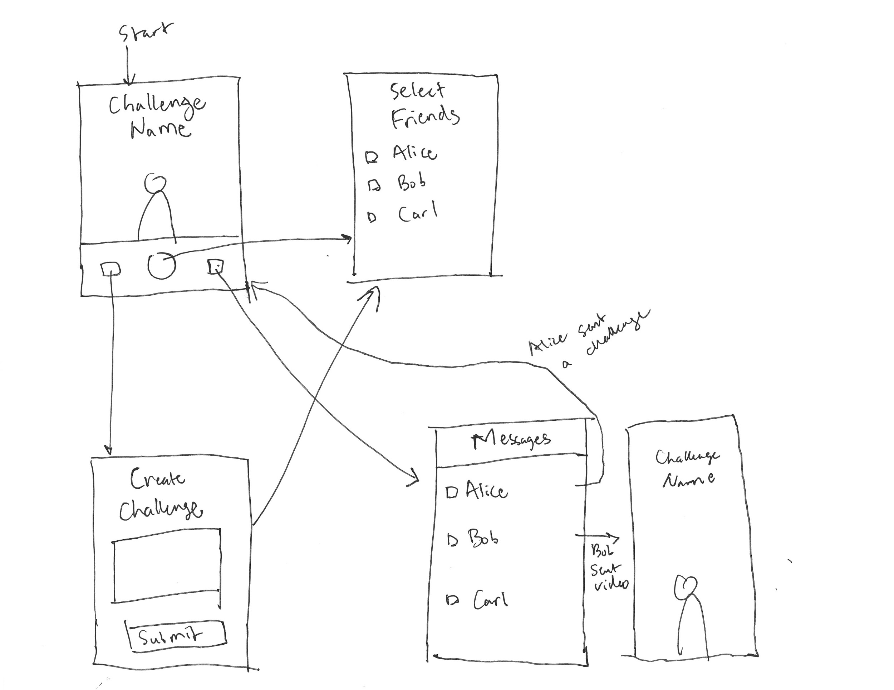
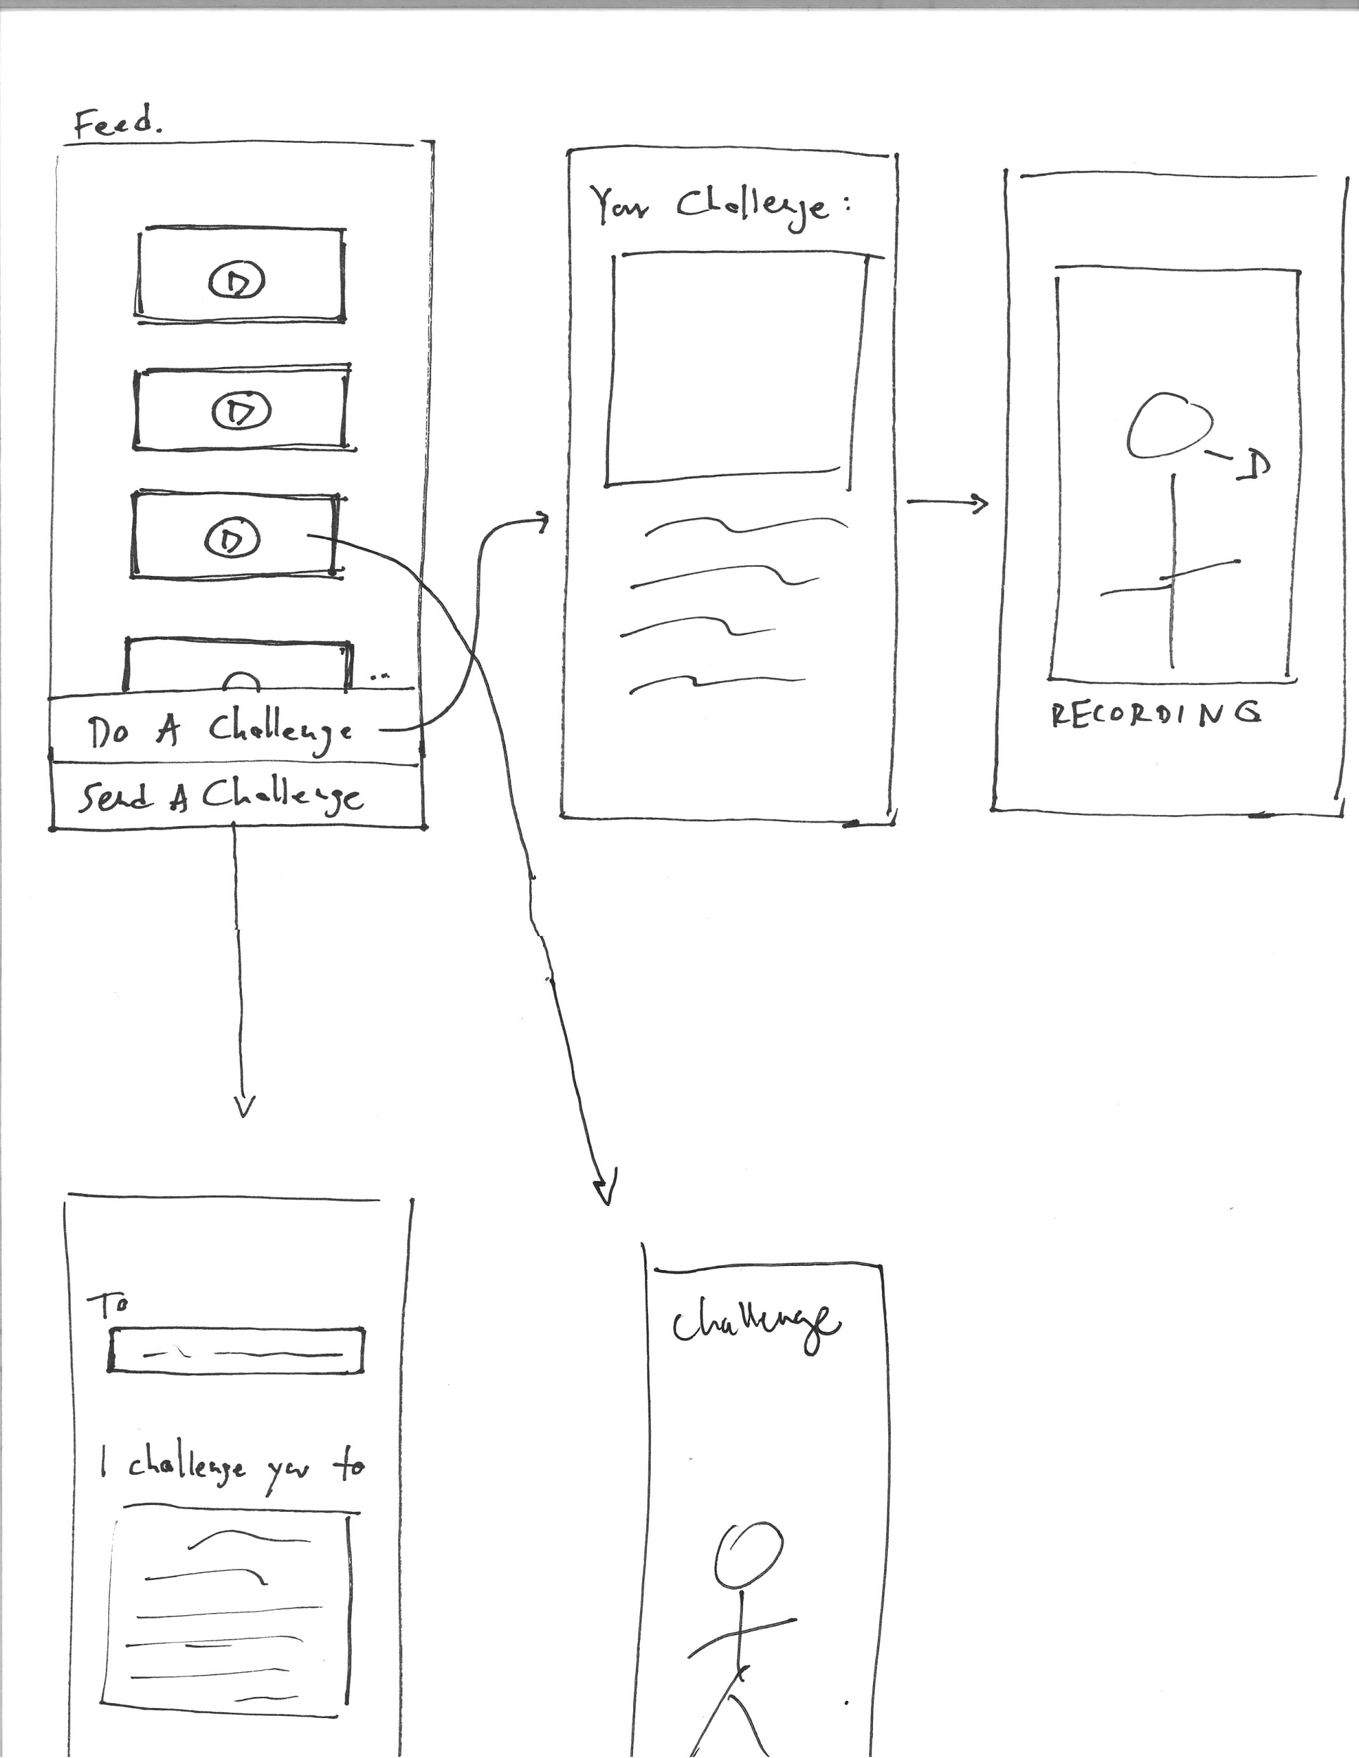
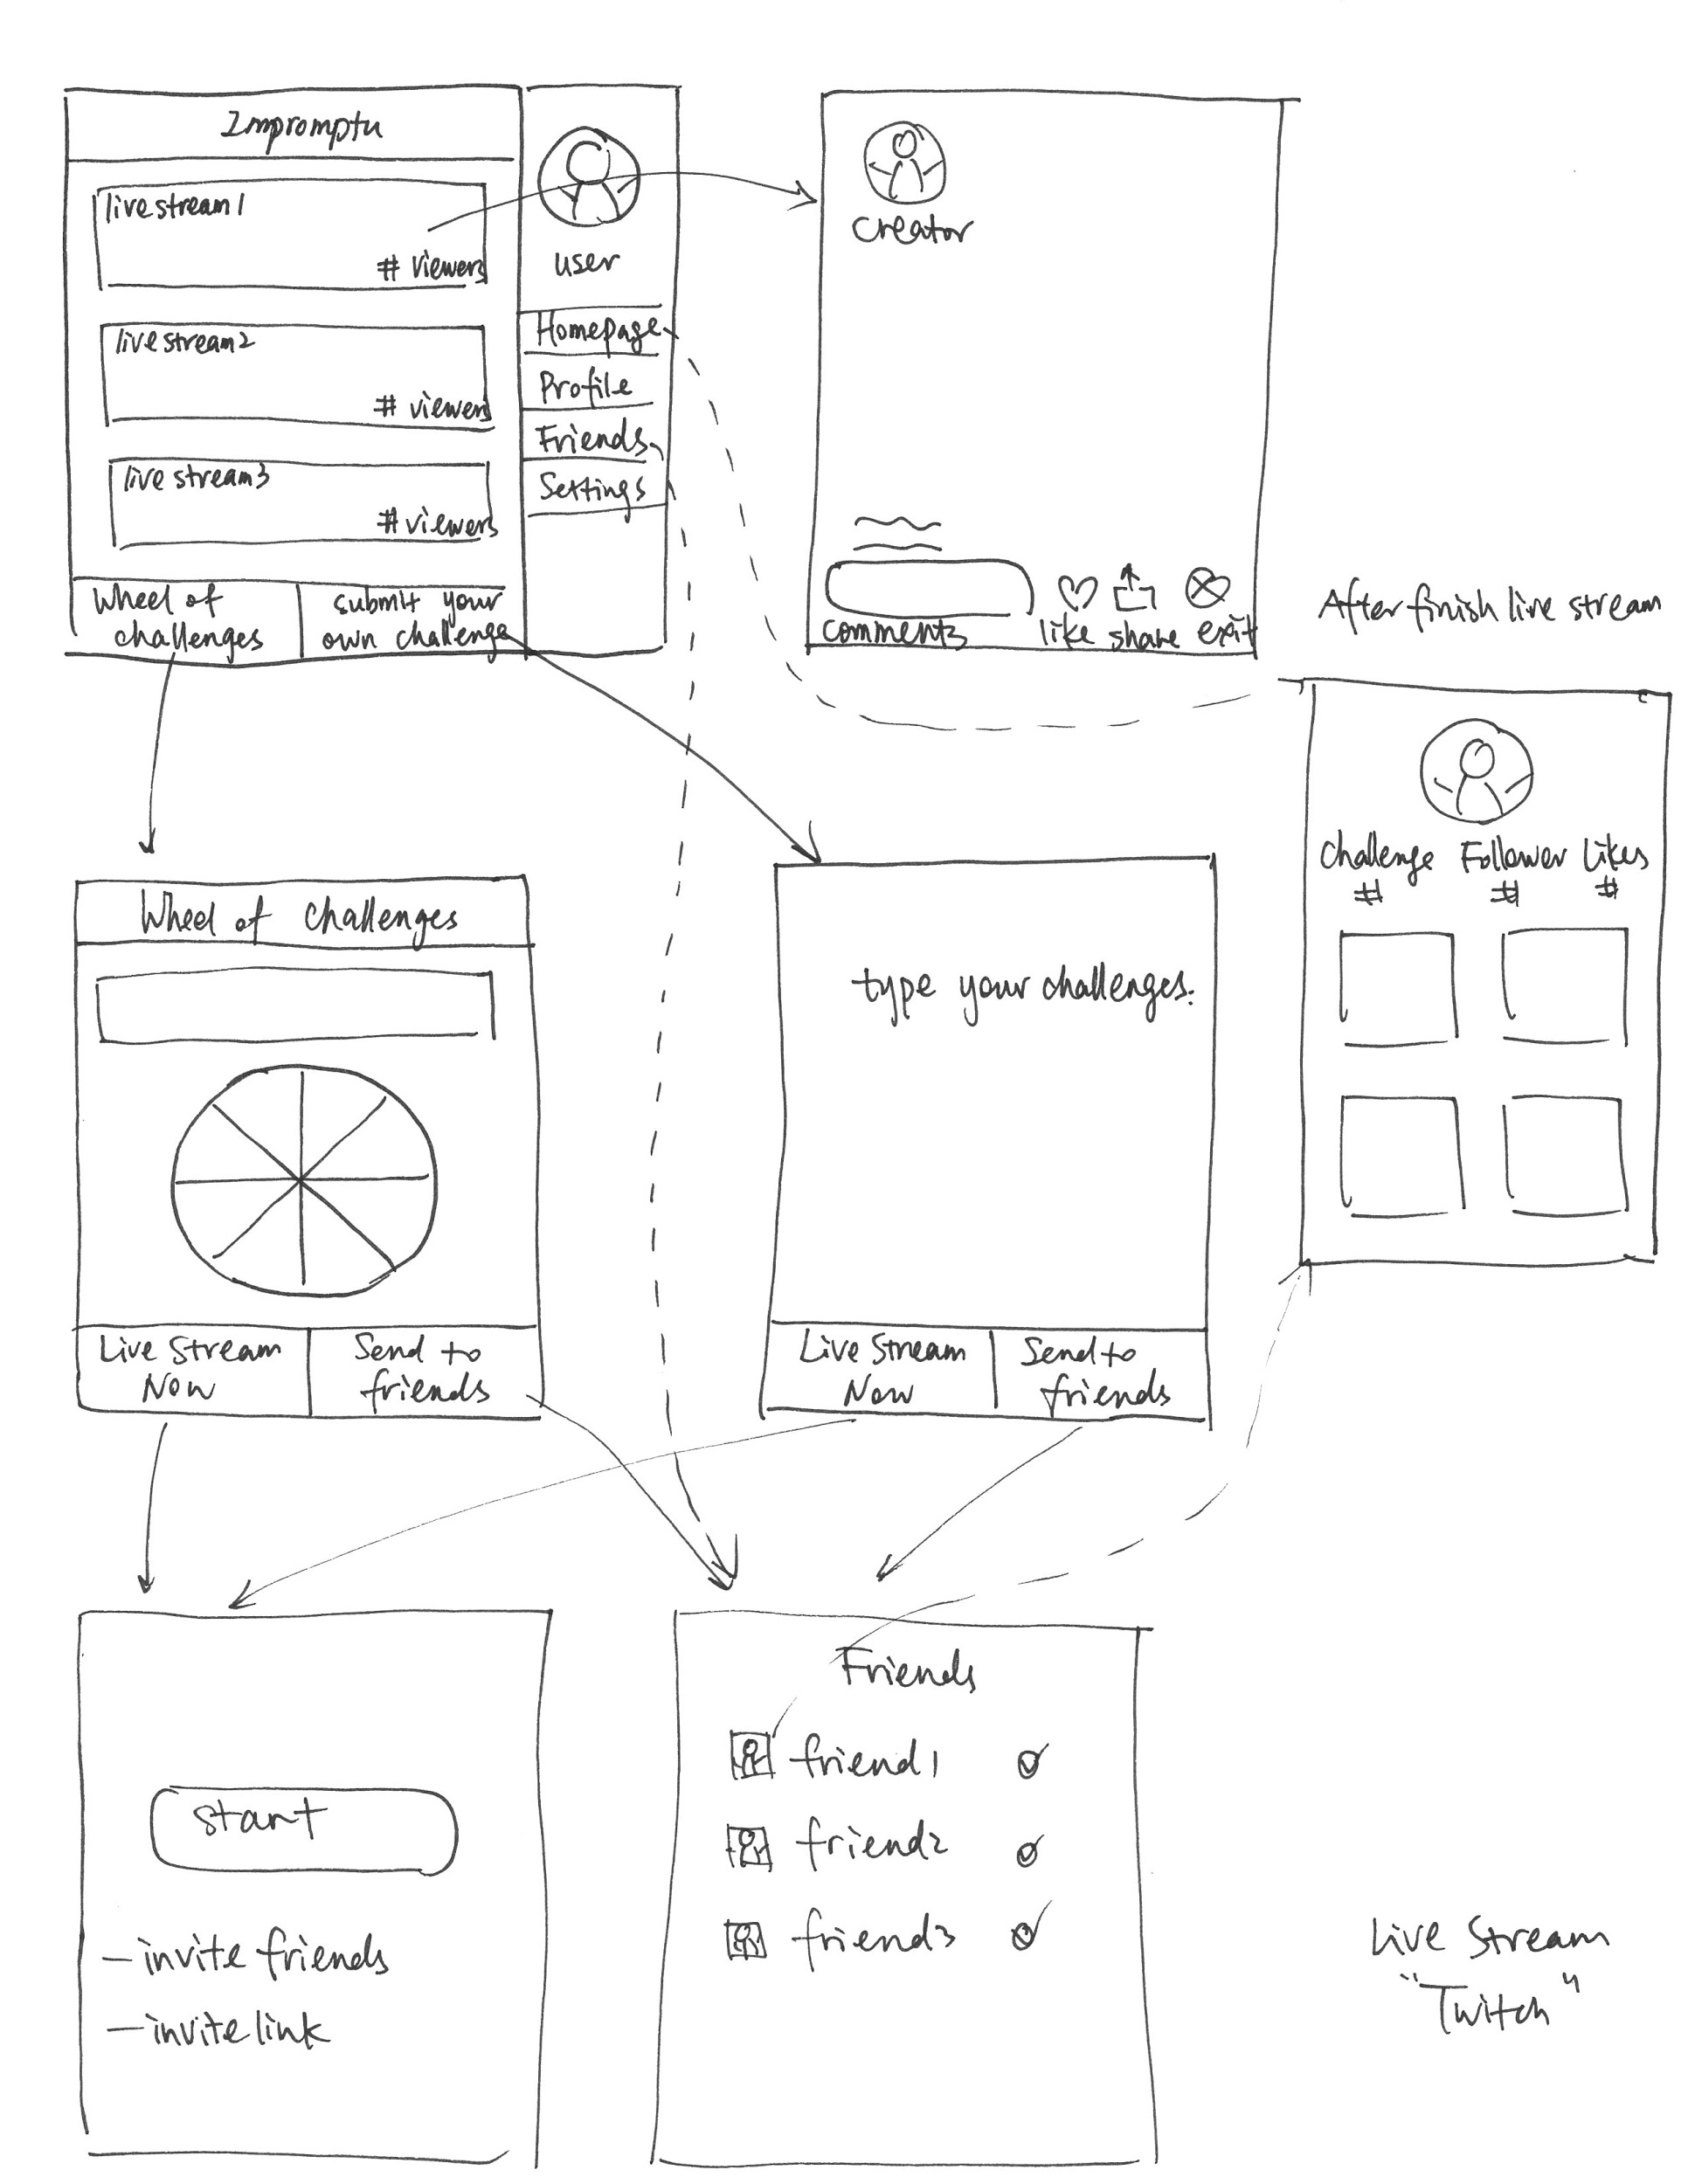
Three rough prototypes
Notes:
Here are the three initial storyboards for our prototype. In the first one, the videos users created would be visible to all the friends the user had on a semi-public feed, which could perhaps be imported from Facebook. In the second prototype, we explored explicitly specifying the friends each video would be sent to, and in the final prototype, we explored doing challenges in real time with a live interactive audience. Out of the three we felt that the weakest was real time sharing. This is because if each challenge is short, it was extremely unlikely that audience members would be online at the same time as the performer.

Slide 6
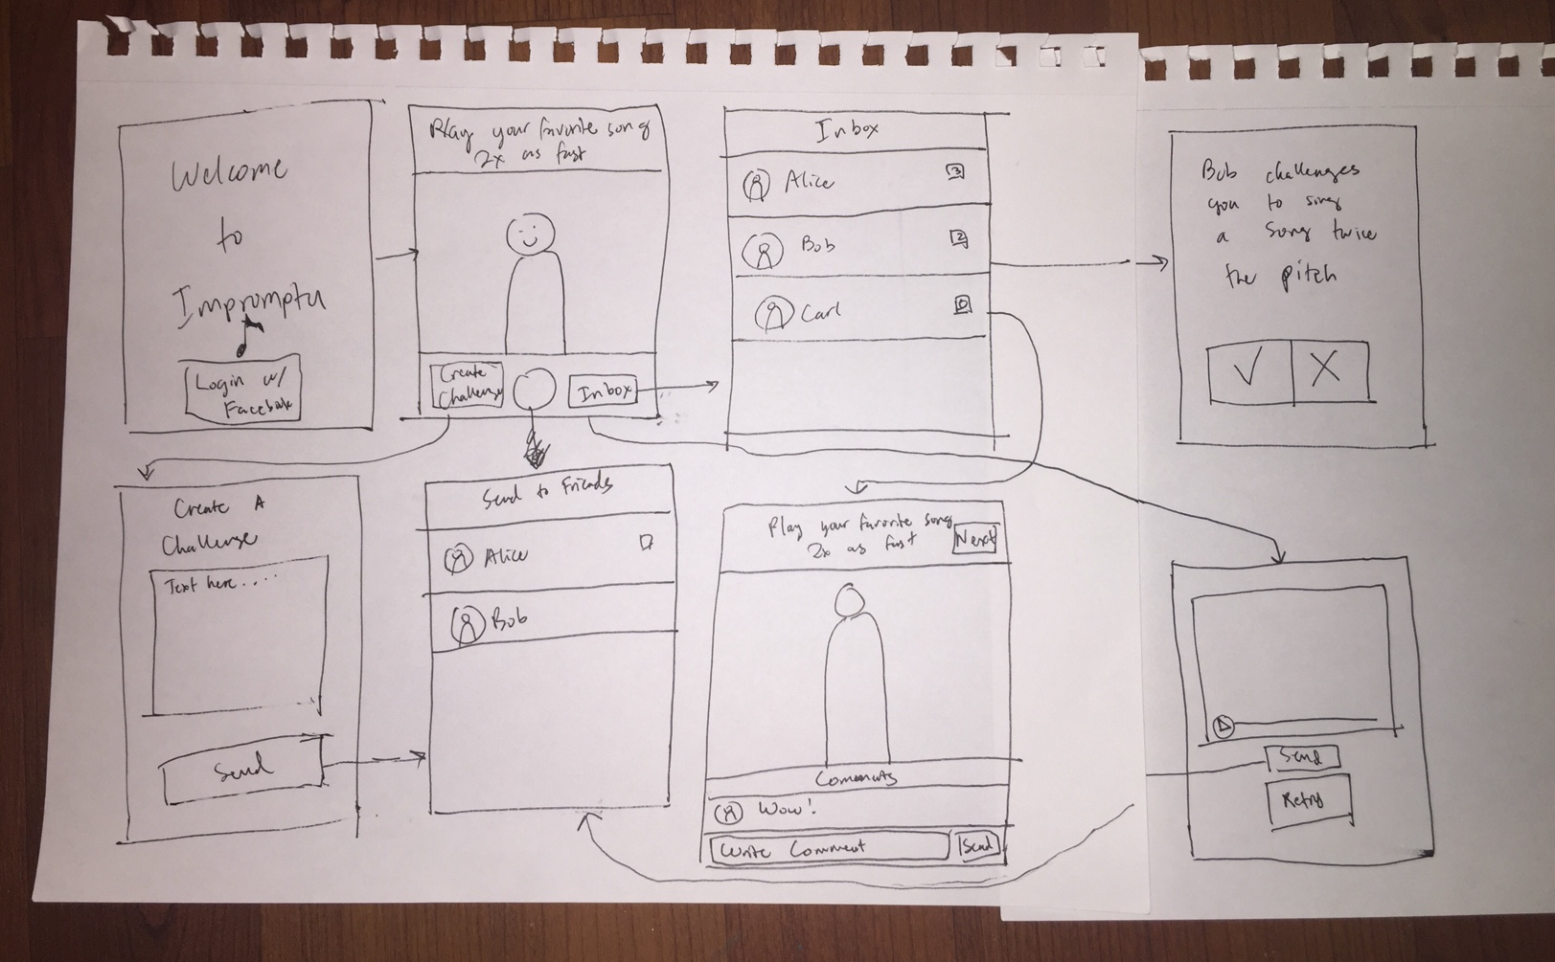
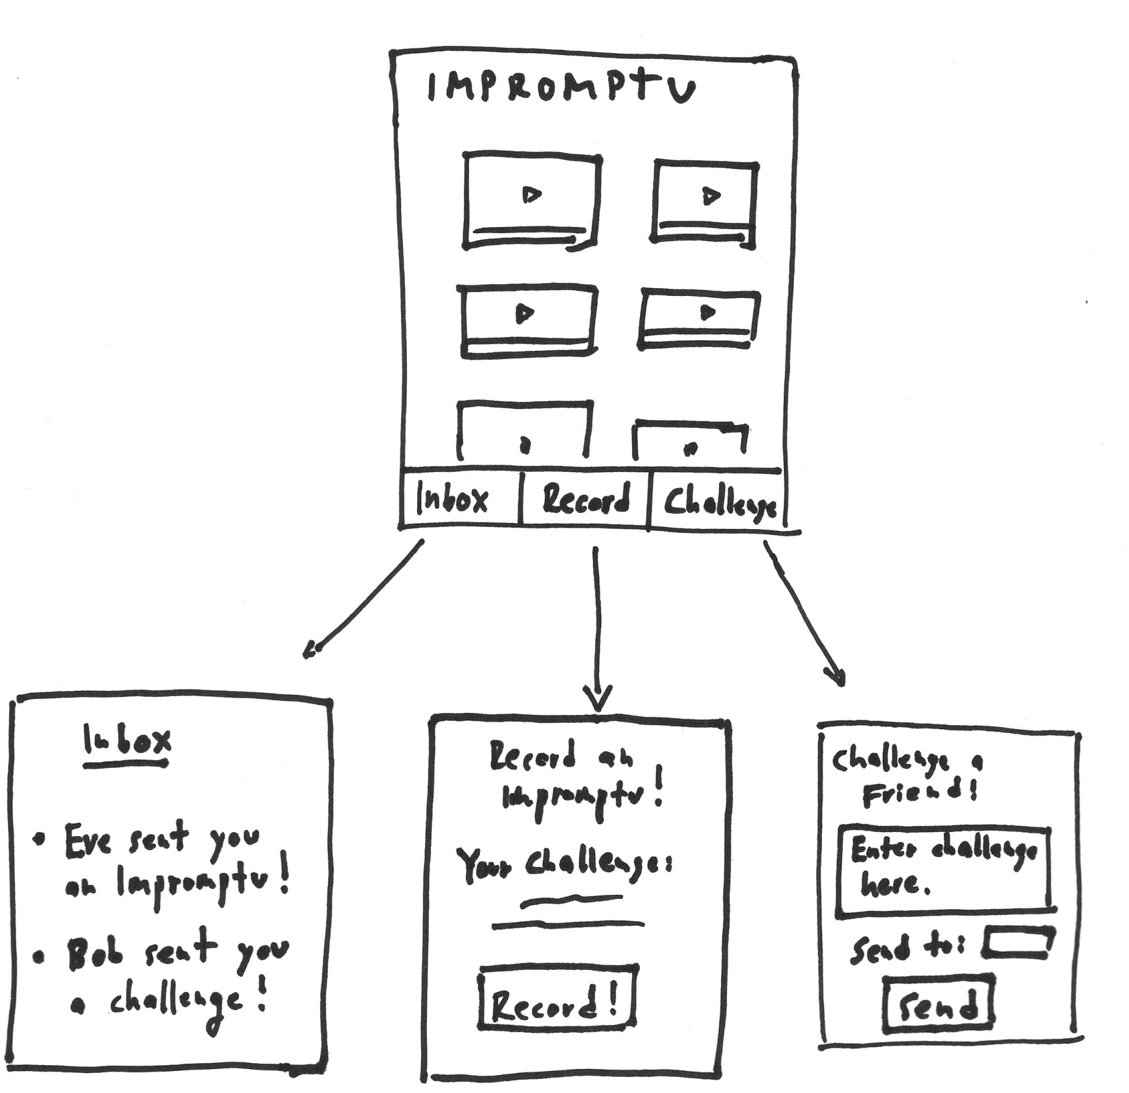
Two refined prototypes
Notes:
Here are our two more refined prototypes. Ultimately we combined aspects of both designs, as we felt that it was important to present the content in an approachable manner with a main feed, but that it was also important to provide users a way to share vulnerable moments in a safe way.

Slide 7
Three Tasks

Slide 8
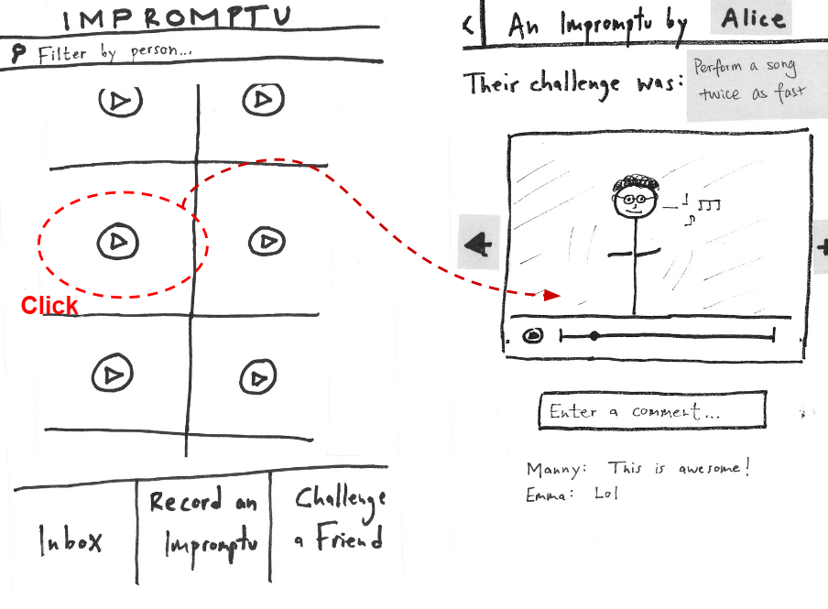
Watching a challenge
Watching a challenge
Notes:
The first task was watching a challenge. It’s pretty simple, just tap on a video on the feed and it brings you to the video. The video has a description of the challenge, and you can also comment on the video as well

Slide 9
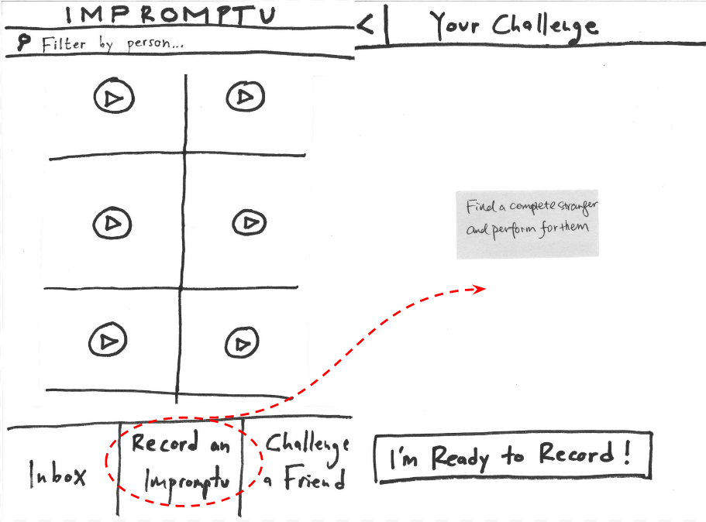
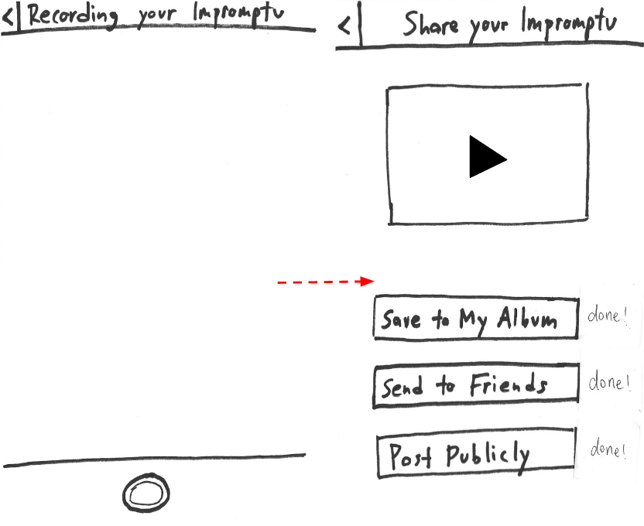
Doing a challenge
Doing a challenge
Notes:
The next task was doing a challenge. First you press the Record an Impromptu button, which brings you to a description of the challenge. You can go back if you don’t like the challenge, or continue, which brings you to the camera, where you record the video. After recording the video, you can see a preview,of the video you recorded. You also have the option to save to your album, which is a list of the videos you have recorded, or you can send to a selected group of friends or post it to your public Impromptu Feed

Slide 10
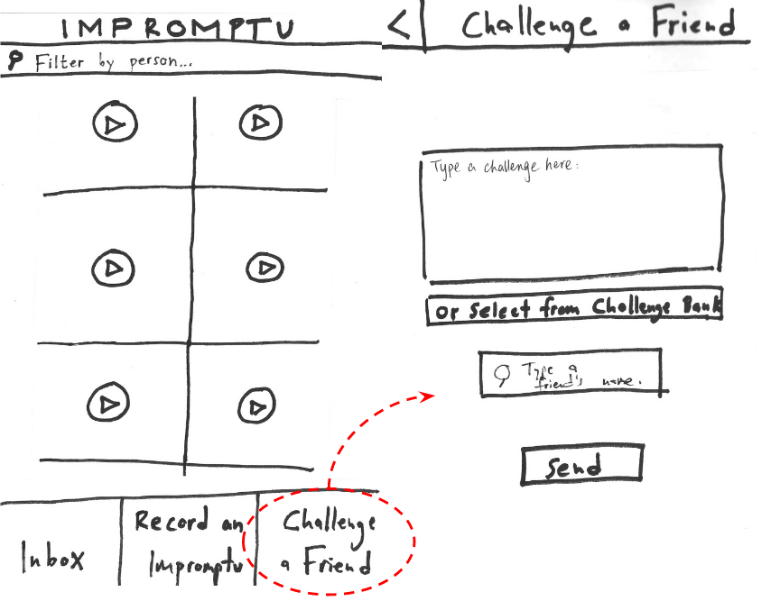
Sharing a custom challenge
Notes:
The final task is sharing a challenge with another user. First you click on the challenge a friend task, which lets you write a t

Slide 11
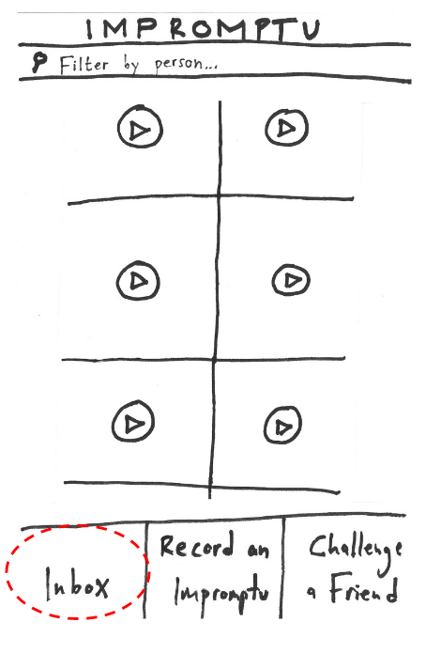
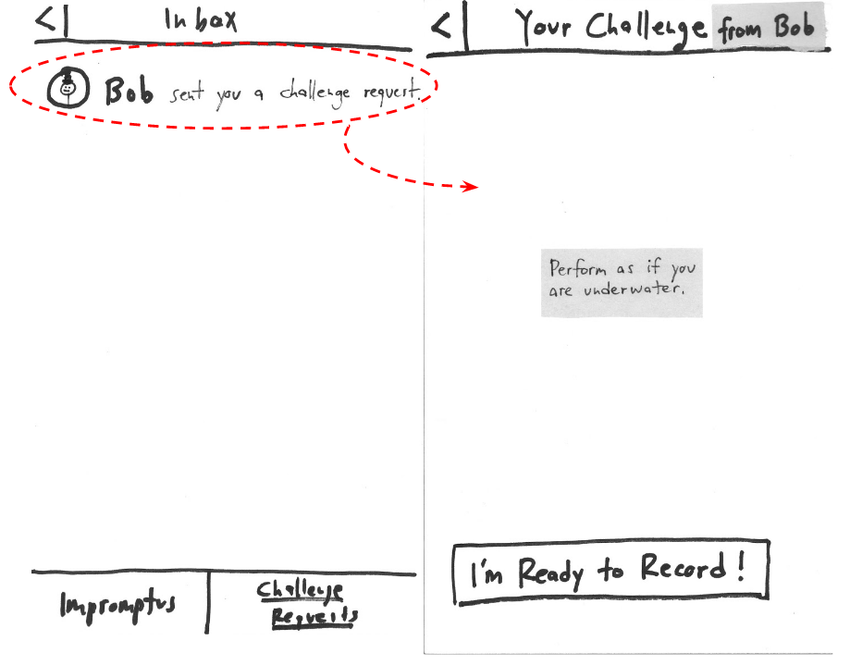
Sharing a custom challenge

Slide 12
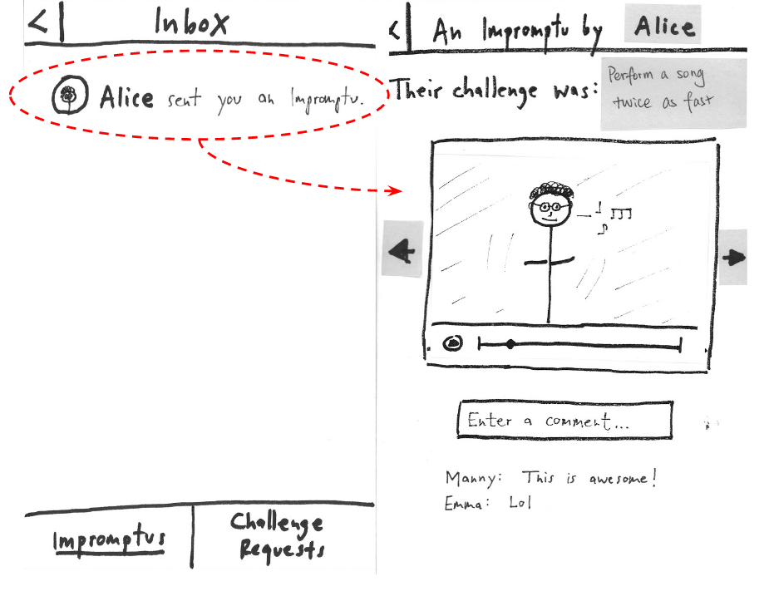
Sharing a custom challenge

Slide 13
Experimental Method

Slide 14
Experimental Method
Participants were mostly musicians
Interviewed in their natural habitat
Looked mainly for confusion

Slide 15
Results/Discussion/Changes

Slide 16
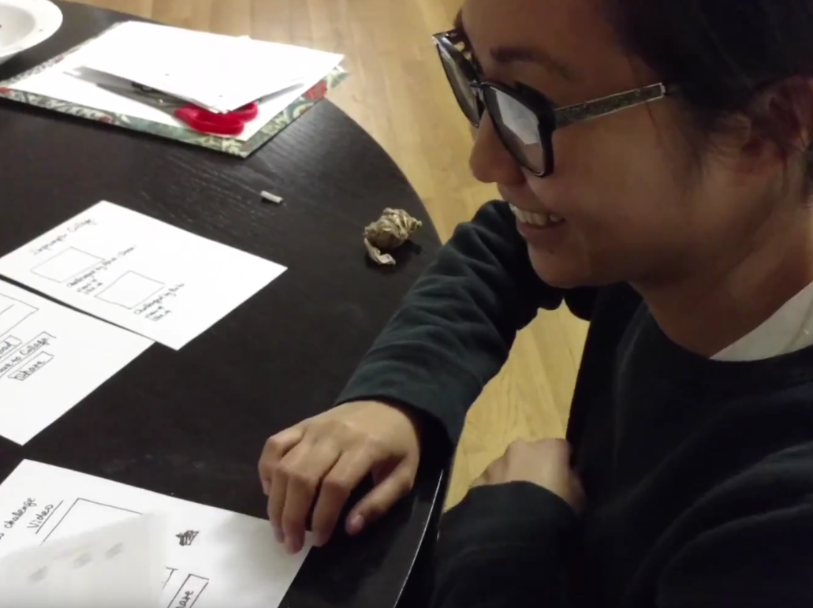
Participant #1
Did not understand onboarding process
Confused by the wording on several buttons
Inbox vs Album
Submit vs Share
Notes:
Participant 1 had difficulties with the original language and the feed screen. Some action words were ambiguous such as the instructions during onboarding, sharing to friends versus public posting, and sending a challenge versus submitting a challenge to the challenge bank. They also had trouble distinguishing between the Inbox and the Album as well as their purposes. It was unclear to them what the words “submit” and “share” meant on the Create Your Challenge Screen -- do I submit challenges to friends or share them to the Challenge Bank? She would have liked better onboarding in describing what each button does on the Impromptu Feed.

Slide 17
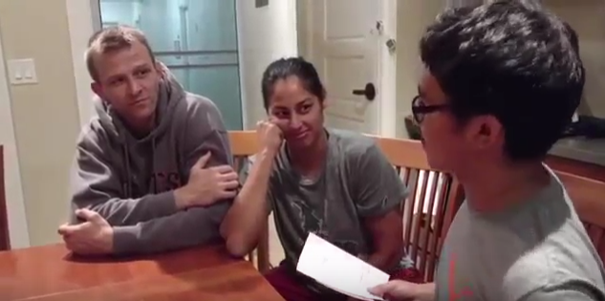
Participant #2
Did not understand onboarding process
Confused by wording in the challenge description
Concerned about the difficulty of actually doing a challenge
Wanted a way to ignore challenge requests
Notes:
Participant 2 also had trouble understanding the language choices for user actions, similar to Participant 1. There was some confusion on how to navigate back and forth within the app, as well as difficulty understanding the wording for challenges. Participant 2 thought that the challenge “Play a song 2x as fast” meant to pull up a song on iTunes and have the playback be 2x as fast, rather than performing or singing a song 2x as fast. One difficulty they foresaw was the amount of time it would take to record a “perfect” Impromptu, which may require lighting, makeup, and props and would impede on the fun of the app. Participant 2 was unclear about whether upload or share meant sharing with friends, or posting to the Impromptu Feed. They were curious about how messages and challenge requests were stored, and if there was a simple way to ignore challenge requests from friends. They were also confused when first viewing an Impromptu, and thought that it was a challenge request.

Slide 18
Discussion/Changes
Redrew the onboarding images
Added explanations to empty pages
Changed wording on several buttons
Added the ability to ignore challenges

Slide 19
Participant #3
Was still confused by the onboarding process
Was not confused by the wording on several buttons
Confused by Impromptu Feed vs Facebook Feed
Wanted to see a challenge history
Notes:
Participant 3 found our final revised prototype to be easier to interact with, but language choices for interactions could still use some tweaking. Participant 3 was mostly confused about the lack of interactivity in the onboarding screens, which may mean the onboarding screens were not intuitive enough or may require more textual instructions. Participant 3 wanted to see their “challenge history,” i.e., who challenged them and whom they challenged; they were unable to do so since that feature was not implemented. There was also ambiguity between the option to post to the Impromptu Feed and also to the participant’s actual Facebook timeline since the button was labeled “Post Publicly.”

Slide 20
Discussion/Changes
Insert the onboarding images into a “fake” iPhone
Change “Post to Public Feed” to “Post to My Impromptu Feed”
Add a history of challenges (?)

Slide 21
Thanks

Slide 22
Overview
Value Proposition
Prototypes
Three Tasks
Experimental Method
Results
Discussion
Notes:
Before we begin, I’d like to first give an overview of the entire presentation. First, I will cover the value proposition of our app. Then I will cover our prototyping process and how we refined our intial sketches into our final prototype. Afterwards, I will discuss the three tasks flows for our prototype. Then I will cover the experimental method for testing our prototype. Finally I will cover the results of our testing and discuss future changes.

