Slide 1
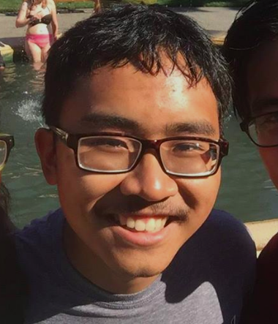
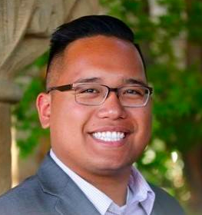
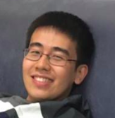
CS 147 Assignment 4
Concept Video
Team: ♪mprov
Chen Luo
Diego Hernandez
John Carlo Buenaflor
Qingping He

Slide 2
Value Proposition
1

Slide 3
Impromptu
Share music. Share surprises.

Slide 4
Problem/Solution Overview
Impromptu is a fun social platform for performing artists to expand their comfort zones.
It addresses artists’ need to practice, perform, and share their creative experiences.
Musical
Challenges
Impromptu
Social
Interaction

Slide 5
Tasks
2

Slide 6
Tasks
2

Slide 7
Tasks
Welcome to
Impromptu: D
Simple:
Watch someone else doing a challenge
Browse challenge videos
Medium:
Record yourself doing challenge
Share your challenge video
Complex:
Do a challenge in a group
Submit your own customized challenge to someone else

Slide 8
Storyboard
3
Video link: https://youtu.be/HbQkMYXqkcA

Slide 9
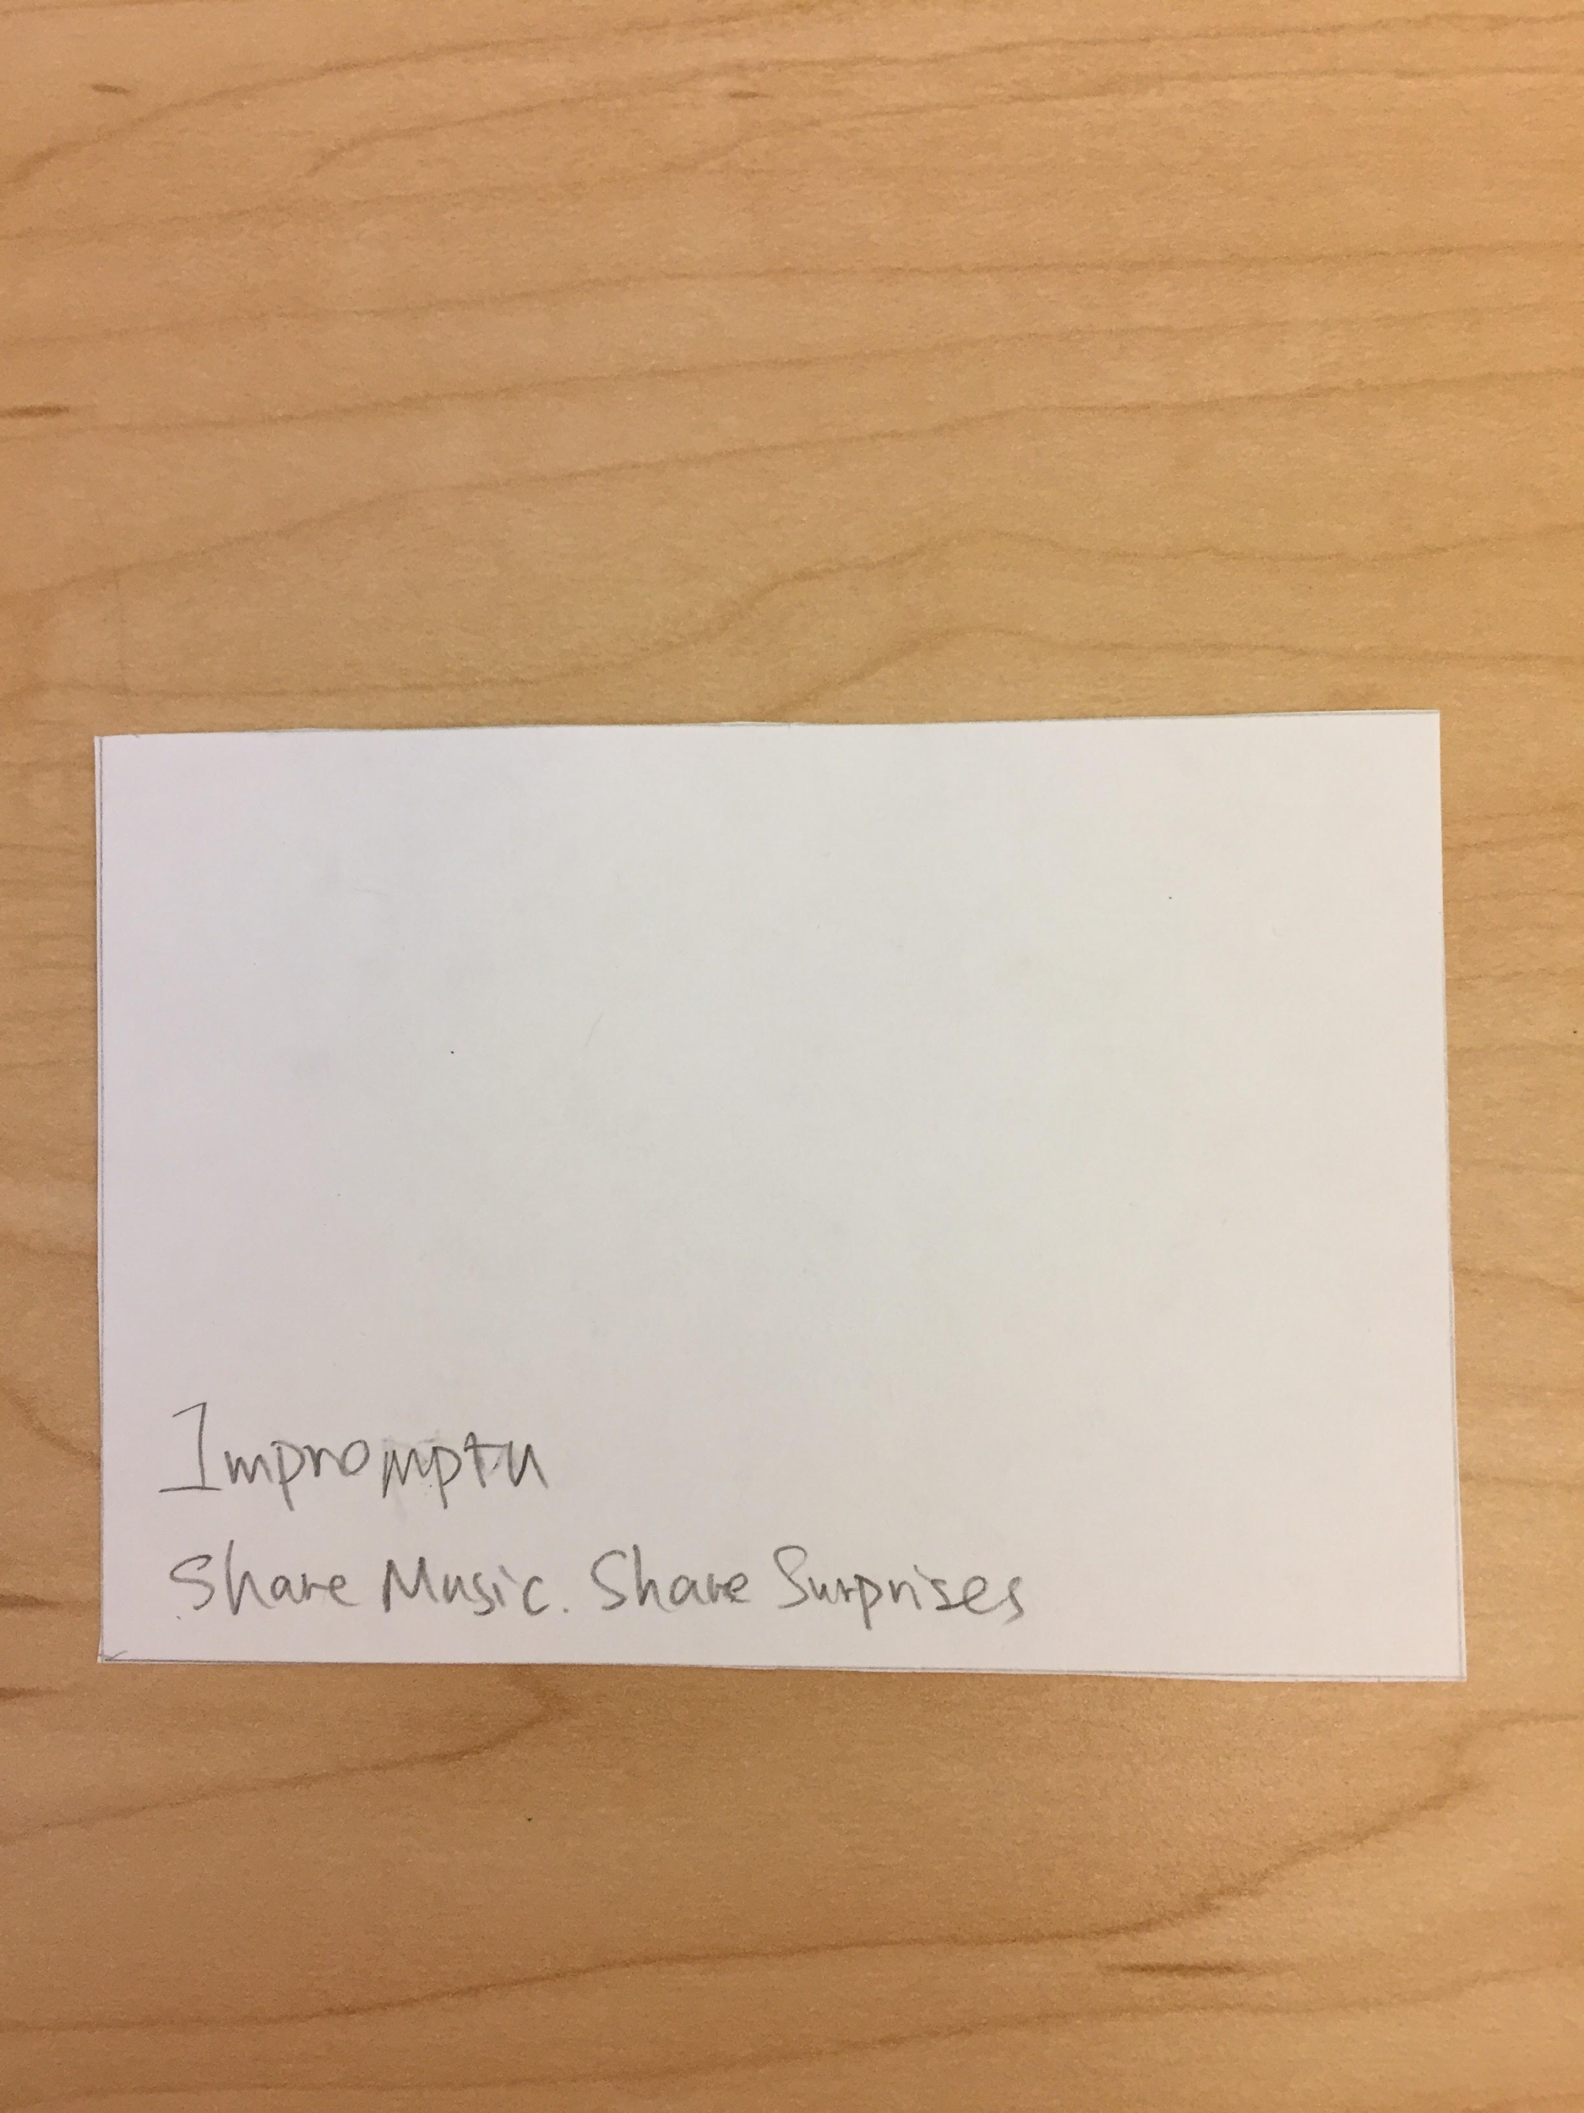
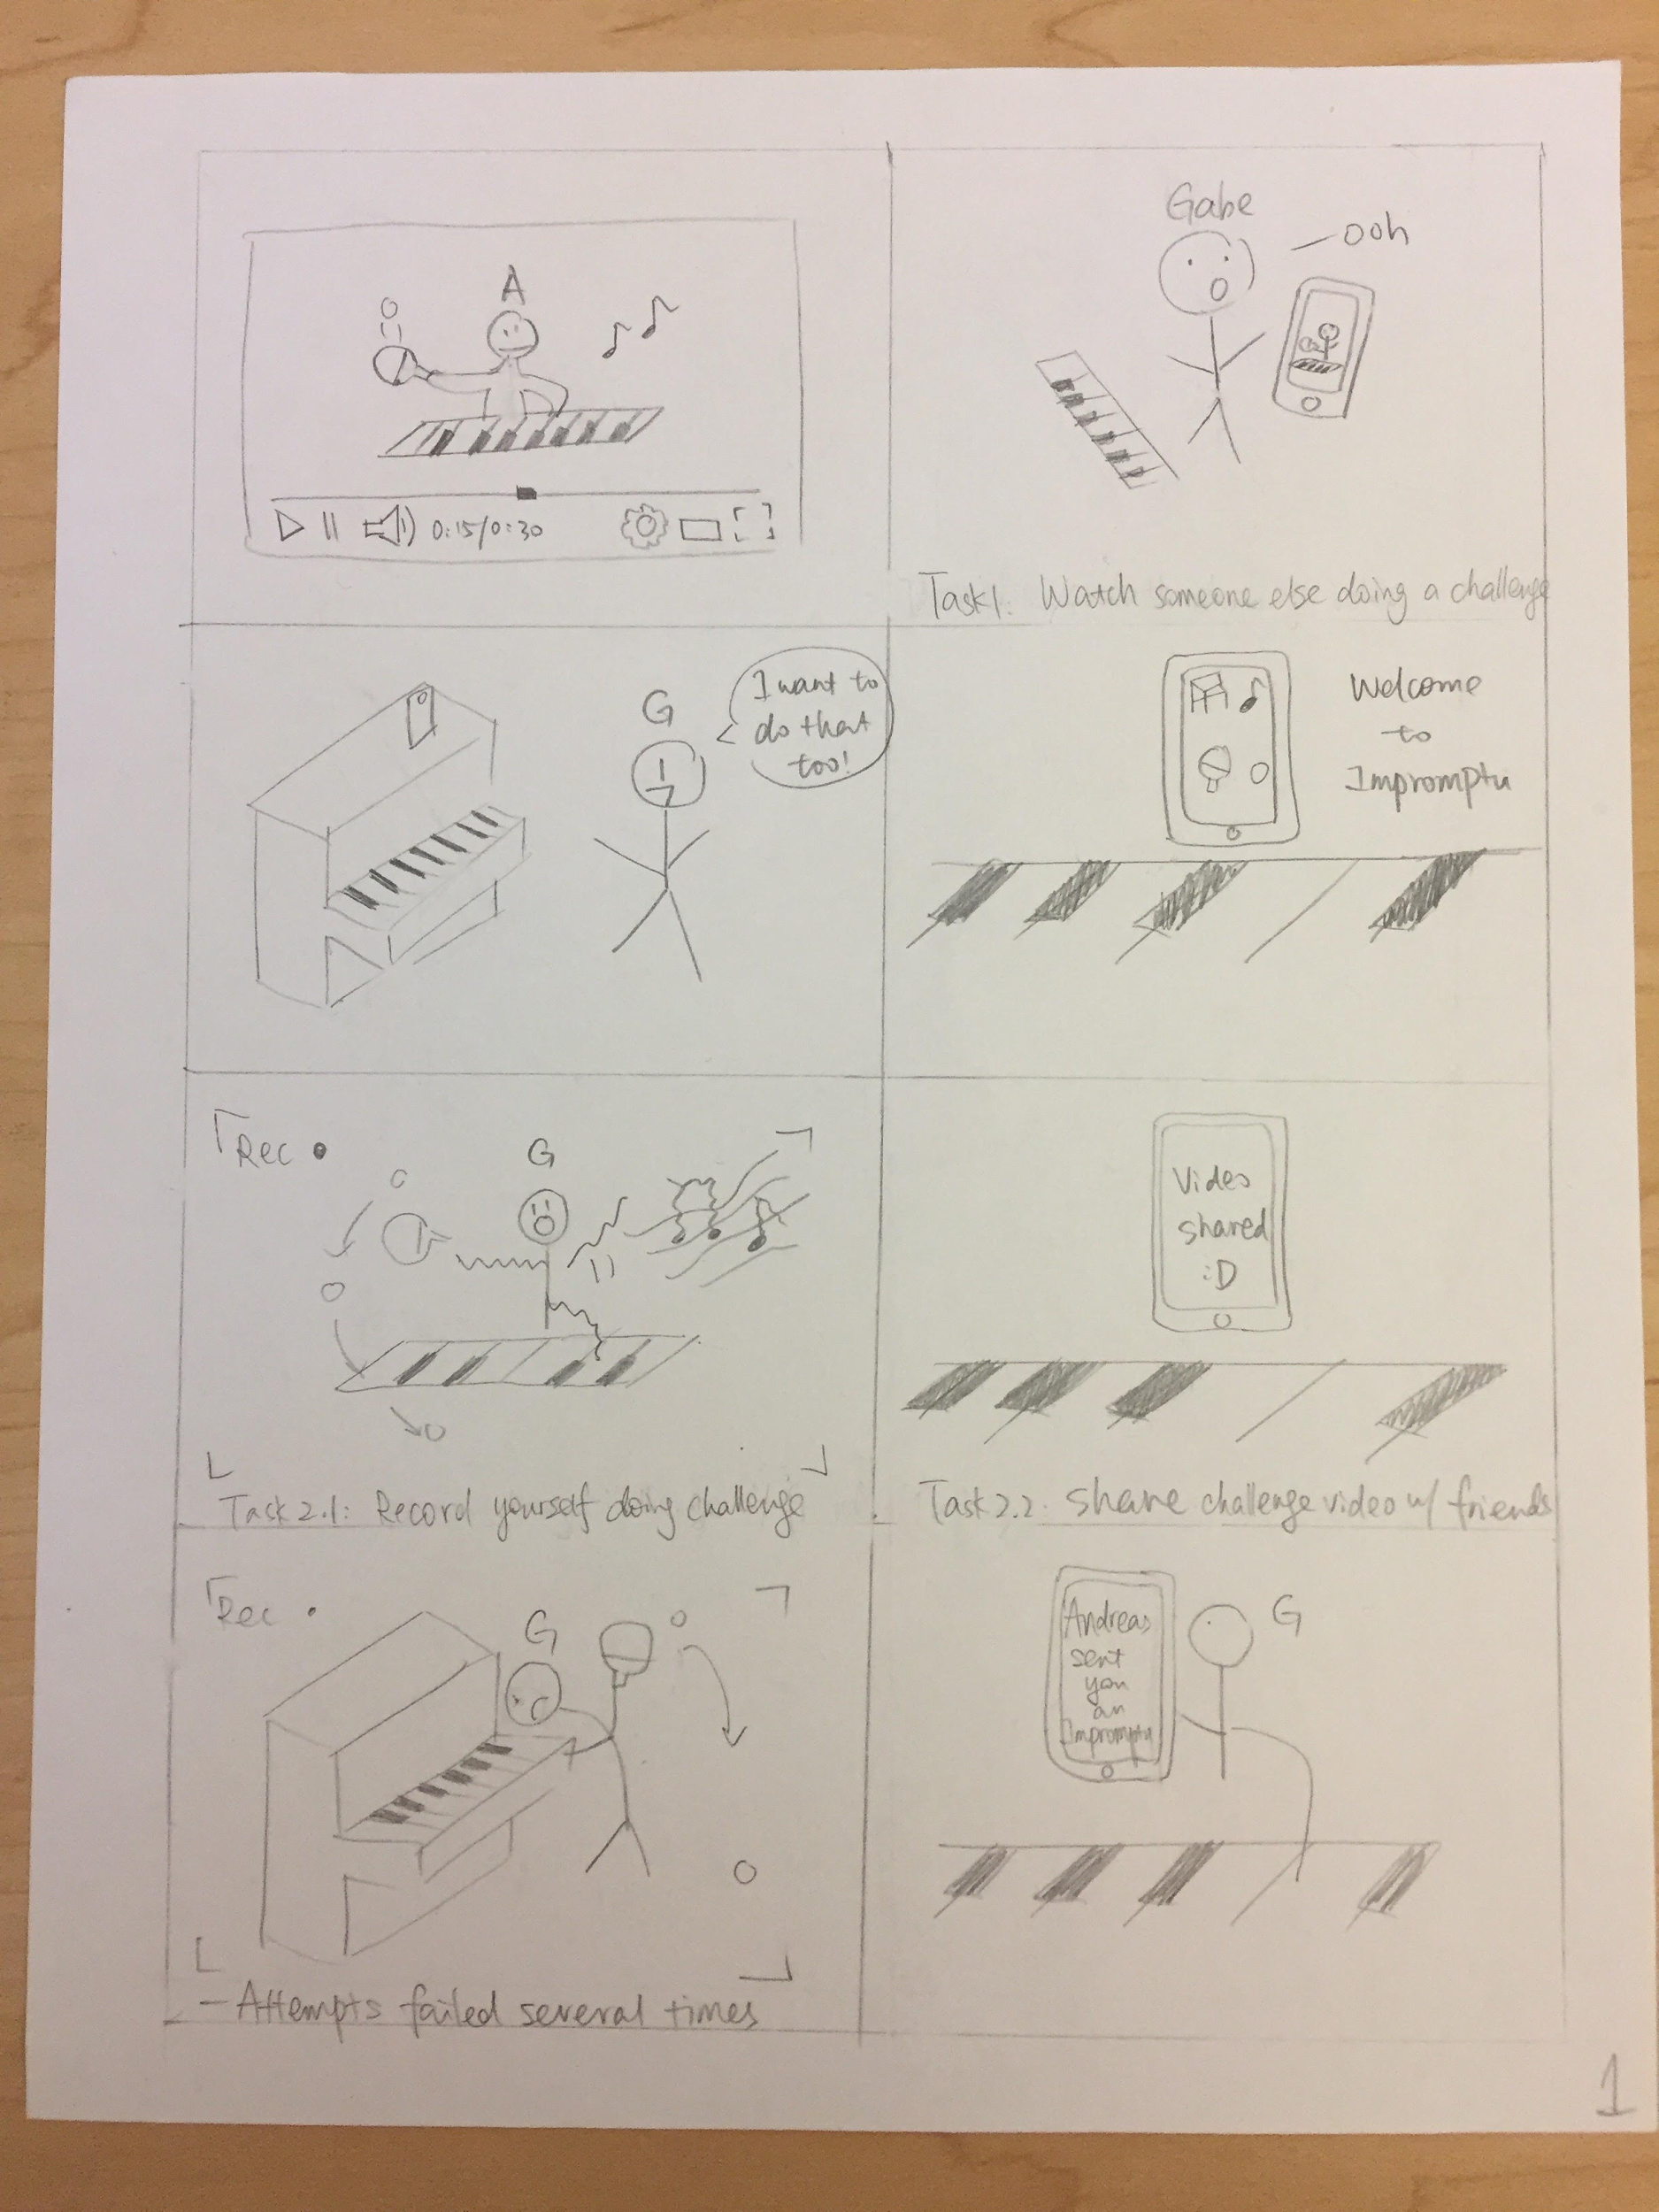

Slide 10
