Slide 1

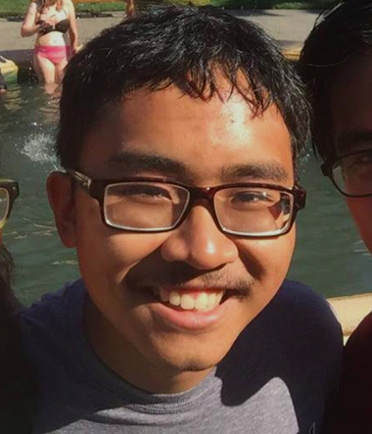
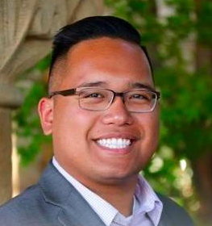
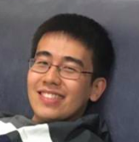
♪mprov
Chen Luo
Diego Hernandez
John Carlo Buenaflor
Qingping He

Slide 2
Andreas Our Initial POV
Composer
Enjoys spontaneous social situations
Encourage more social musical experiences
Notes:
In order to refine this POV, we conducted additional needfinding interviews. During our interviews, we found that people all have strong feelings about the social aspect of music in terms of practice, communication and performing. We found that social interaction was central to creating experiences that our interviewees learned from and enjoyed.

Slide 3
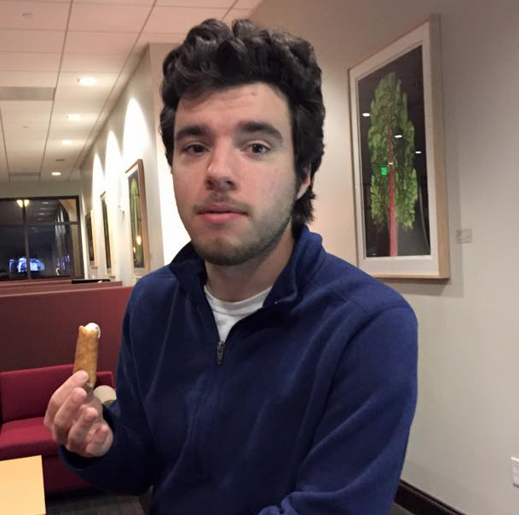
Gabe Needfinding #1
Jazz Musician
Takes risks in practice, not performance
Support enables him to take risks and to become better
Notes:
Gabe is a jazz musician who plays saxophone, flute, and piano. Although his performances appear to be completely improvised, Gabe only plays things that he has tried out to some extent in his practice sessions. In his practice sessions, Gabe tries to take as many risks as possible so that he is prepared for a good performance.
This planned risk taking also carried over to his experiences trying street performance. Going outside his usual domain was intimidating at first. By performing with a friend, Gabe received musical and social support that allowed him to overcome this barrier. We were struck by his ability to manage the risk of trying new things.

Slide 4
Derek Needfinding #2
Google Employee
More free time to pursue music
Feels audience doesn’t appreciate technique of artists
Notes:
Derek is a Software Engineer at Google who is trying to get back into music due to the amount of free time he has. He used to play piano competitively, but is now more interested in the self-expressive aspects of music. He regrets not exploring music as a creative medium earlier, and feels that audiences need to appreciate the technical and artistic decisions of the performer.

Slide 5
Melissa Needfinding #3
10 year Violinist
Unable to find a place in Stanford music community
Loves to compete
Notes:
Melissa is a Stanford student and violinist who used to play competitively. In high school, she would derive most of her motivation from music competitions. At Stanford, she was unable to find a music community that challenged her in this way, so she drifted away from playing violin to study CS. One of her regrets was that she was unable to appreciate classical music as a creative pursuit without the competitive aspect.

Slide 6
Gabe Revised POV #1
Street Jazz Musician
Risk-taking is central to his music
Encourage musicians to try new things
Notes:
Gabe is a jazz musician who has occasionally tried street performance at home and abroad. We were amazed to find that risk-taking forms a central part of Gabe’s improvisation process. It would be game-changing to empower musicians to take more musical risks.

Slide 7
Make risk-taking in music like sky diving?
Notes:
Explain the metaphor and how they connect to the original pov

Slide 8
Derek Revised POV #2
SW Engineer & Musician
Personal technique is important
Convey enthusiasm to audiences in an accessible way
Notes:
Derek is a software engineer at Google who plays piano. We were surprised by the importance Derek ascribes to personal technique and the very act of performance. It would be game-changing to effectively convey this nuanced enthusiasm to audiences in a relatable, accessible way.

Slide 9
Help the audience appreciate the role of personal technique in performance?
Notes:
Explain the metaphor and how they connect to the original pov

Slide 10

Bo Revised POV #3
Hip-hop artist & Activist
Originally rapped for himself
Convey the message behind the music
Notes:
Bo is a hip hop artist who raps to promote social causes. We were amazed to learn that he grew up in a neighborhood that used rap to elevate the performer, rather than others. It would be game-changing to empower artists to share information about the social contexts surrounding the music they encounter in their everyday lives to audiences.

Slide 11
Illuminate the social issues behind music and facilitate the conversation between artist and audience?
Notes:
Specify this more!

Slide 12
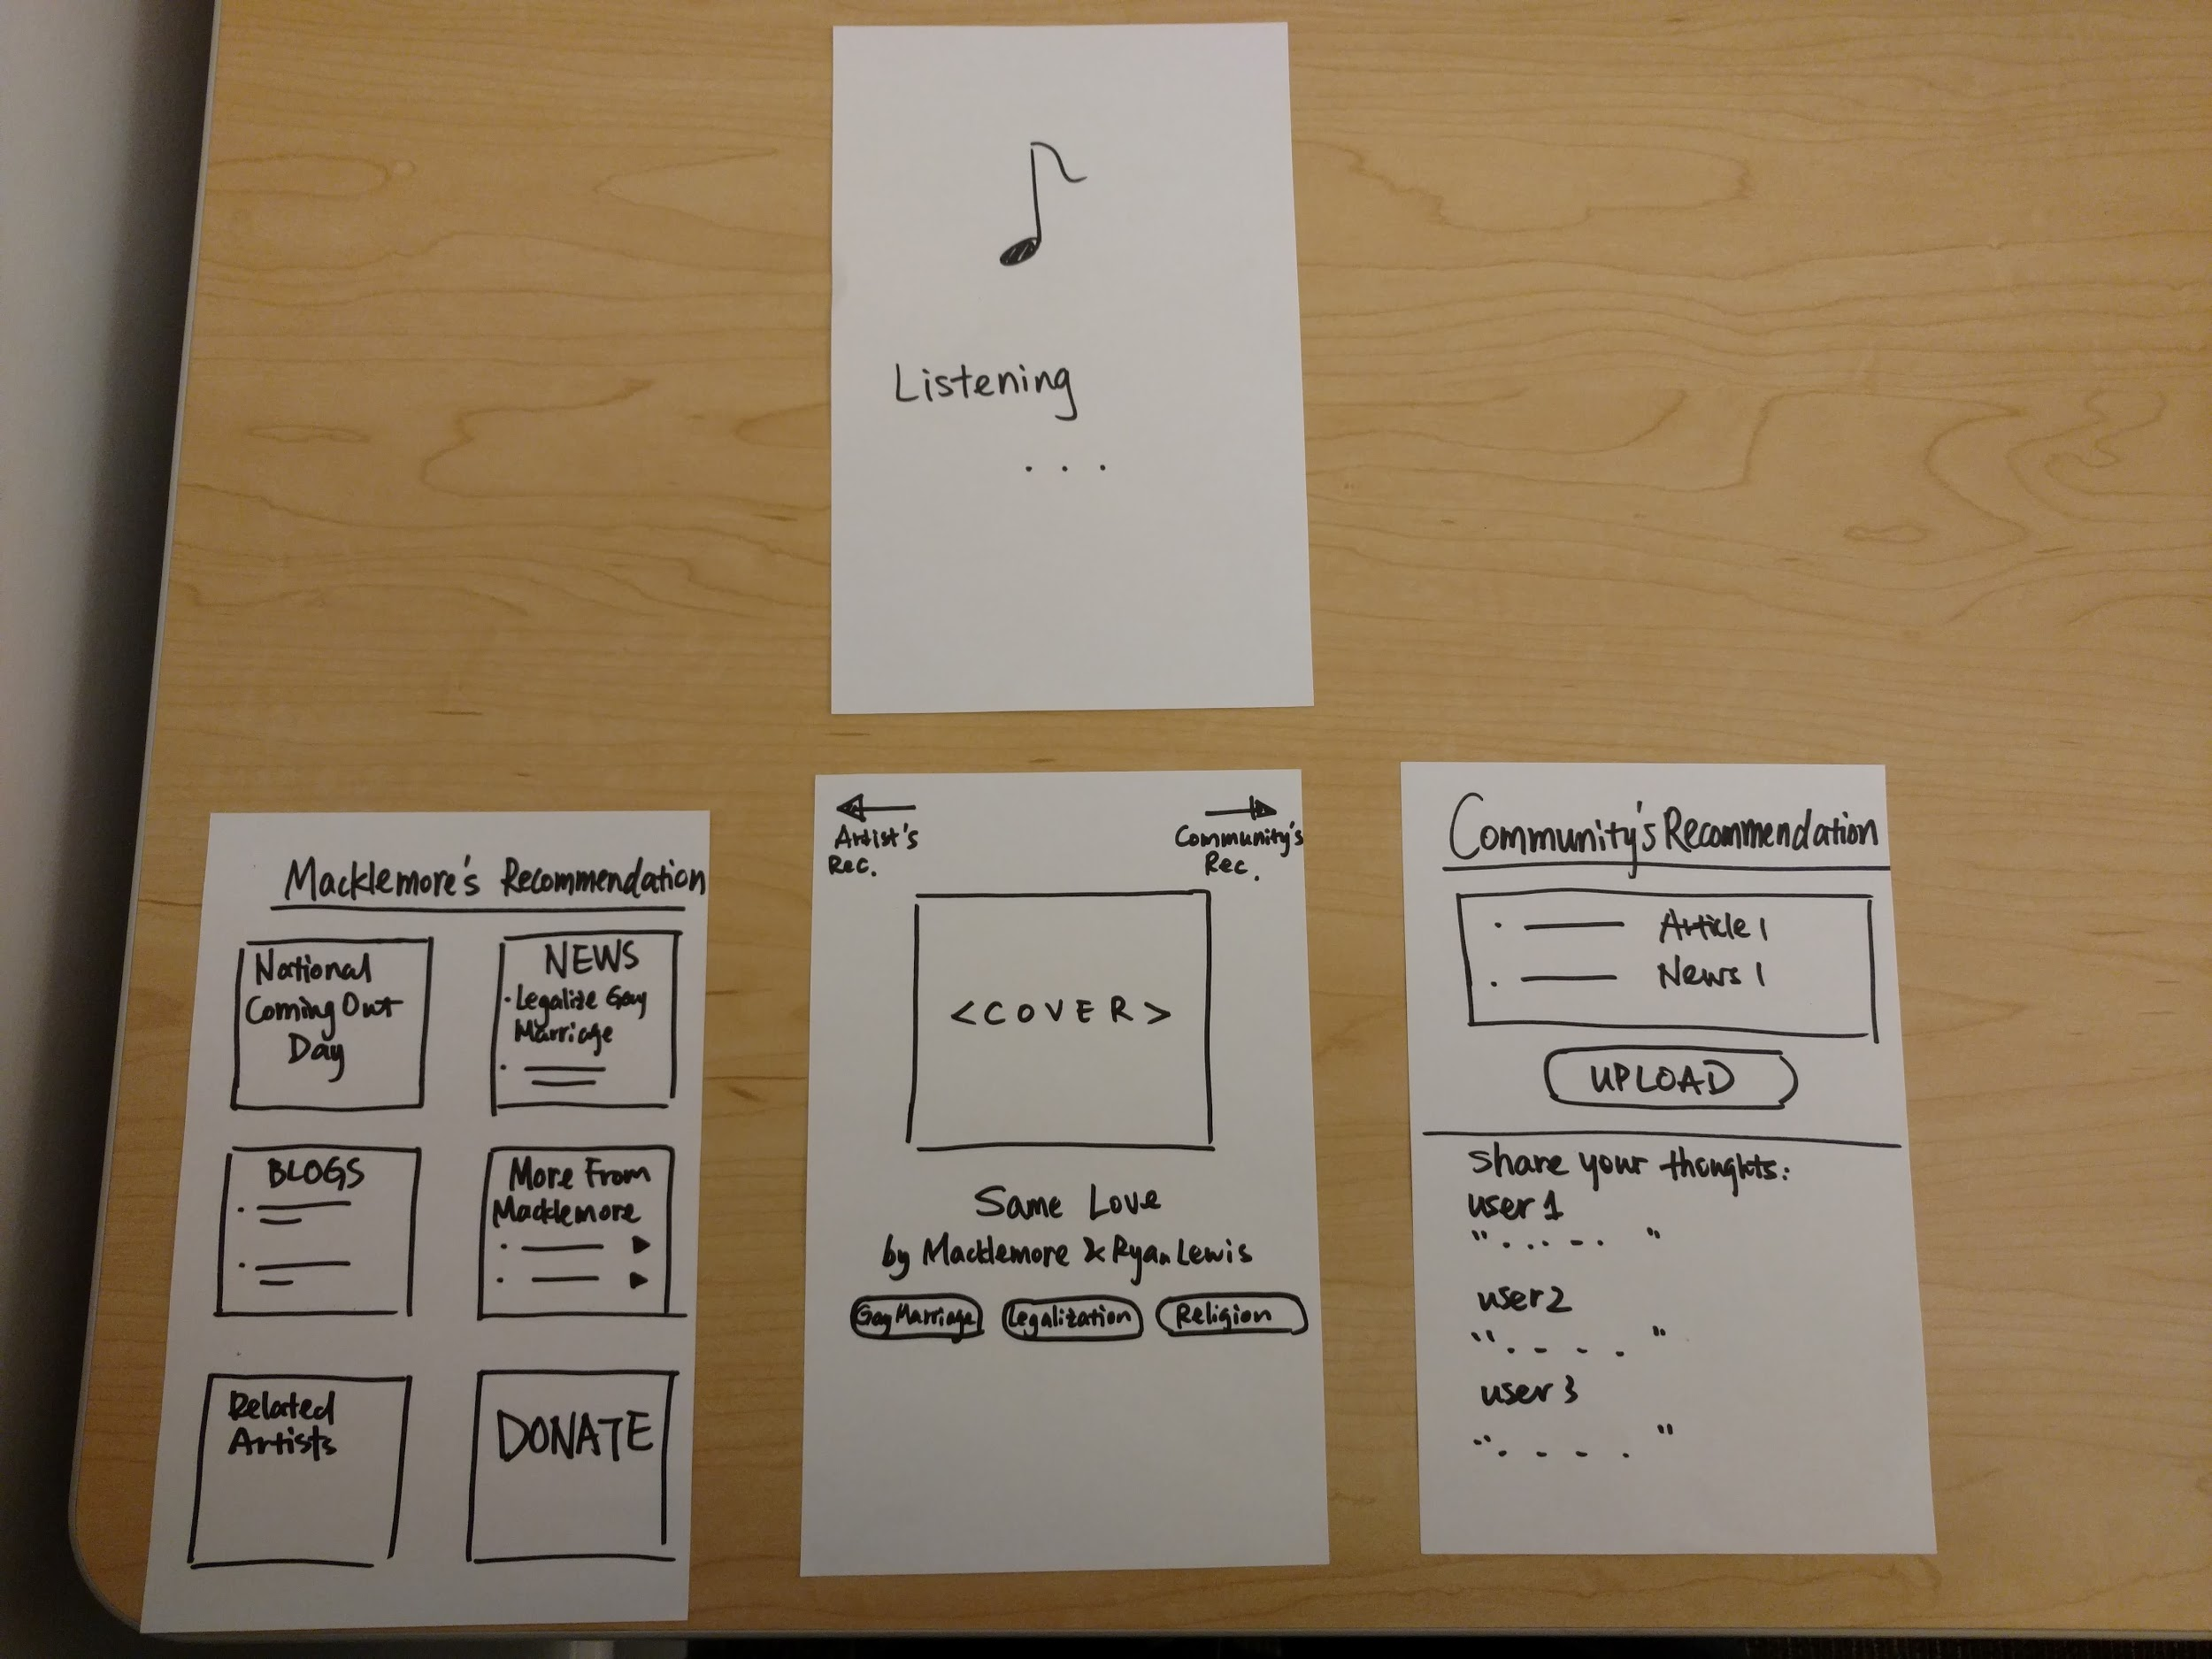
+ Discussion
+ Discovery
∆ Do you care?
∆ Controversial
Notes:
The second solution attempts to bring out the social context surrounding a song. Our solution captures the song, and then brings up a curated list of relevant news articles or personalized collections of similar songs by the artist or the community. The audience can also comment and discuss topics relevant to the music. Our assumptions were:
Listeners of music are interested in learning more about the social context surrounding a song
Listeners are unable to directly connect a song they like with the social context of message of the song
Maria liked that the prototype was an easy way for her to learn about the social issues surrounding a song, and said that it is also a good way to discover new artists and their stories. However, she feared that our app could unwittingly advance an unnecessarily narrow interpretation of a song. Moreover, she was concerned that users who don’t care about the issues won’t be compelled to use the app in the first place.
Sonja was less skeptical of the social issues aspect. She mentioned that social issues were the core reason she was interested in music. However, she didn’t seem to have any problem with finding more about the social context of the song and was actually quite familiar with the song we were playing. The problem is that people who would be interested in the app already know how to engage with the social issues, while everyone else won’t even download the app.

Slide 13
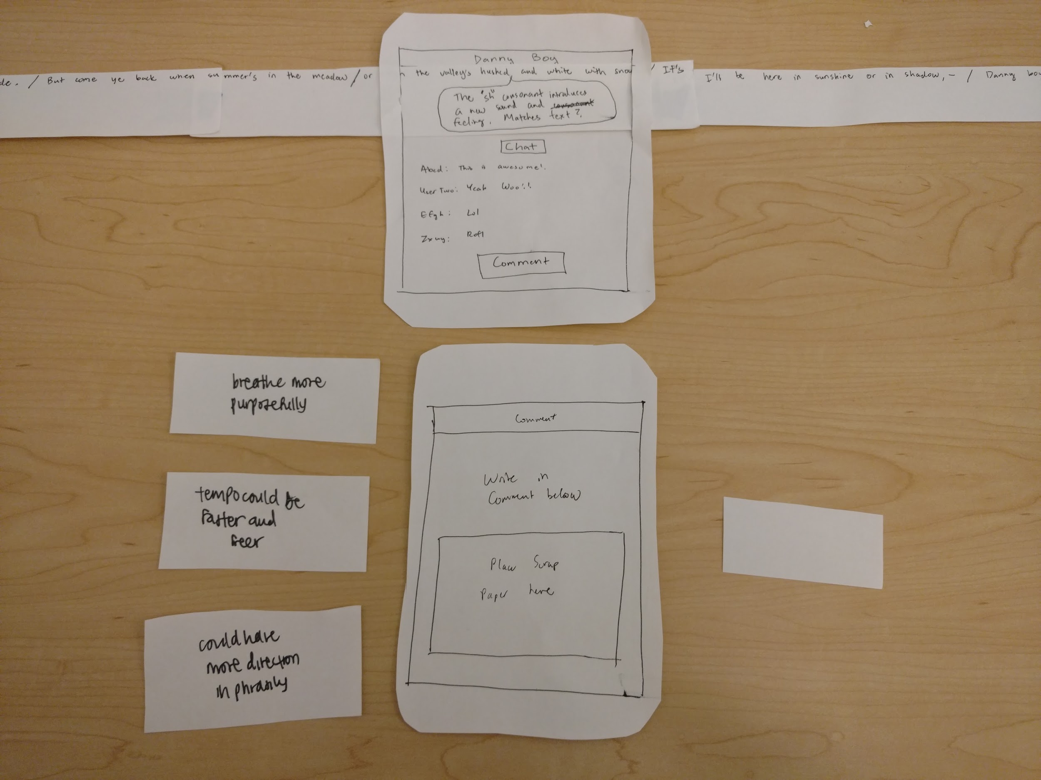
+ Have dialogue
+ Targeted
Feedback
∆ Distracting
∆ Low Quality
Feedback
Notes:
The third solution is to encourage audience participation during a performance. We have a paper prototype which has a window to allow scrolling a piece of paper with the lyrics as well as informative annotations from the performer. The paper is scrolled in time with the performance of the song. We also give the tester pieces of paper which they can write comments on. These comments are passed to the performer in real time during the performance to the performer. Our assumptions are
The audience wants to further understand the nuances behind a performance.
The performer is unable to tell if the audience has understood what they are trying to go for.
We invited Shu to Diego’s performance. Shu was given the paper scrolling prototype where she can see lyrics with Diego’s annotations. She was provided cards to comment on during Diego’s performance of “Danny Boy.”
Although Shu Chen enjoyed being able to send feedback during the performance, she was concerned that thinking about what to comment would distract her from the performance itself. She did feel that it would work in a learning environment where listeners were specifically listening and writing comments to help the performers. Furthermore, she thought that annotated lyrics would be useful to tell a music teacher what specific regions the performer was working on, which would guide the teacher to offer focused feedback. She also thought the comments would work well in an opera, where the lyrics are in a different language.
The problem with providing feedback is that the audience generally isn’t as informed as the performer. Therefore, the annotations aren’t particularly useful unless the information is fairly low level, like translations for an opera. Furthermore, due to the lack of musical knowledge of the audience, they can’t really provide more feedback than “I like” a section or “I don’t like” a different section. In a pop concert, this is essentially the crowd cheering, so there could be use for silent cheering in a classical music concert. In a teaching setting, this could be useful, as this knowledge asymmetry is not present or may even be reversed.

Slide 14
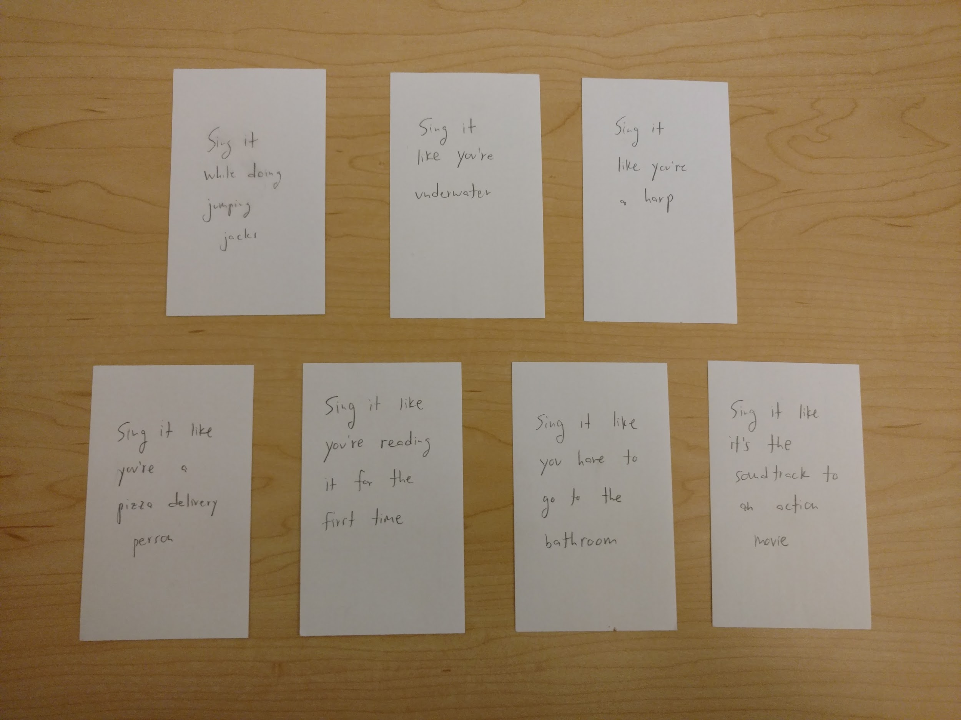
+ Natural
+ Enjoyable
∆ Limited scope
Notes:
We prototyped a solution for artists to take more risk in performing. The solution would present fun challenges for groups to participate in. Then the user would have a short amount of time to perform the challenge. The solution would record this performance and allow it to be shared on social media. Our assumptions were:
Thinking of new different things to try is challenging
Musicians will become better at taking musical risks if that activity is turned into a social game.
Other people would be interested in watching these performances
We tested this by creating a set of index cards with different challenges on them. A group of singers (Diego, and volunteers Sonja and Shu Chen) took turns trying out the different challenges on each card. The users seemed to really enjoy the interaction. Participants were smiling and having fun, and there were no awkward pauses or hiccups.
The initial reaction from Sonja was that this seemed more like something for an acting class, not a voice class. However, Shu Chen enjoyed the activity, and mentioned that her voice teacher sometimes uses similar techniques. The perceived suitability of the game, therefore, had more to do with the challenges we chose rather than a flaw in the concept. Our assumptions were confirmed as the singers immediately started trying different things out once given the cards and said that they had a fun time performing the activity. Furthermore, the testers did enjoy watching other people perform these silly challenges and laughed several times.

