Slide 1
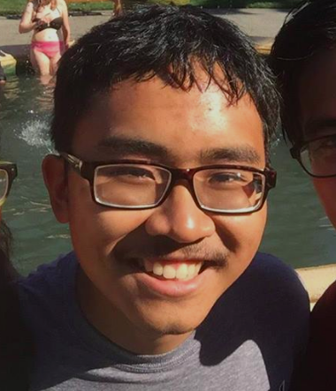
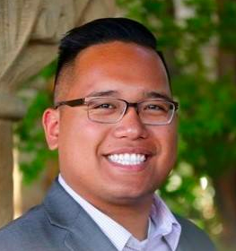
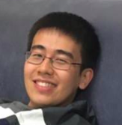
Needfinding
CS147 Studio: Arts & Culture Presenter: Diego Hernandez 7 October 2016
Chen Luo
Diego Hernandez
John Carlo Buenaflor
Qingping He

Slide 2
Domain of interest
Music
Image source: https://academichelp.net/samples/academics/essays/persuasive/inspiration-in-music.html
Notes:
Reasons
Ubiquitous, essentially human form of expression
Some of us are musicians
More than a hobby

Slide 3
Needfinding Methodology

Slide 4
I want to...
I do music because...
I like to...
Notes:
Chose interviewees that have diversity with respect to three things: Passion, pursuit, and preference, i.e. I do music because, I want to, and I like to.
Asked questions that relate to this: how did you get started, where are you going from here and why did you choose that path.

Slide 5
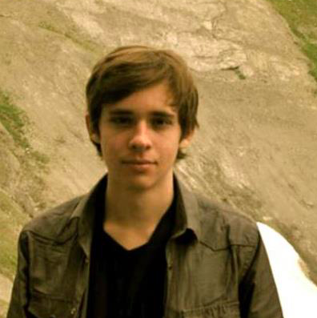
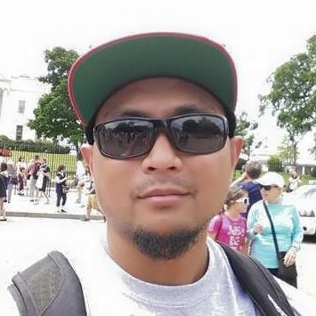
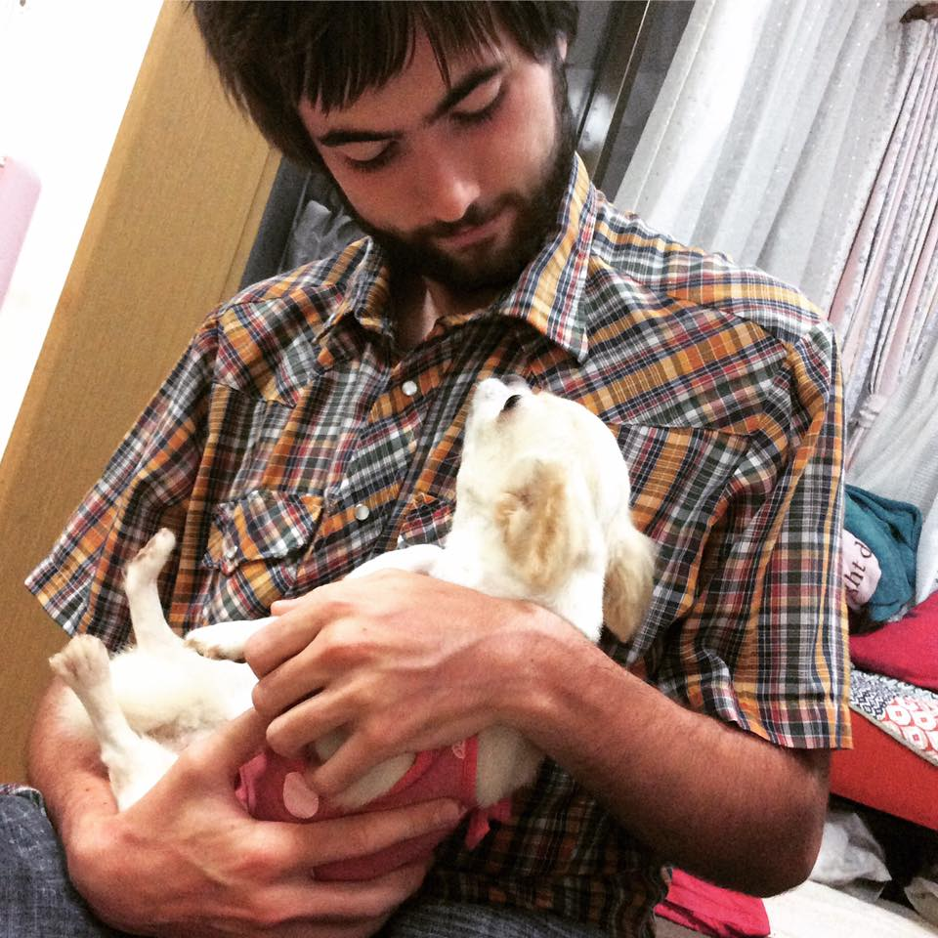
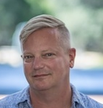
Interviewees
Justin White
Composition Student
Florida State Univ.
Bo Redondiez
Hip-Hop Artist & Activist
SF Bay Area
Andreas Garcia
Pianist & Composer
Stanford ‘17 (Math)
Ray Heigemeir
Public Services Librarian
Stanford Music Library
Notes:
Why chosen, how recruited:
These are all people we know
They come from very diverse backgrounds and do very different things with music
Where they were interviewed:
John Carlo interviewed Bo via Skype
Chen and Diego interviewed Ray at the Music Library (where he works)
Diego interviewed Justin via phone
Qingping interviewed Andreas at Lag Dining
What did you ask:
Tell me about how you started as a rapper? How do you see you influence your listeners? What is important to be able to influence others
What do you do as a librarian here at Music Library and who you engage with
What do you

Slide 6
Interview Results

Slide 7
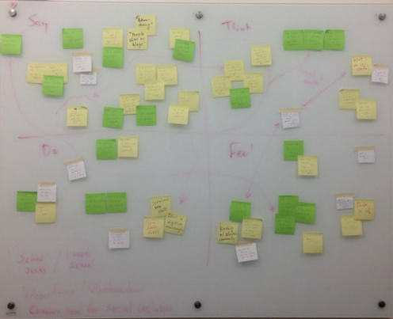

Slide 8
Say
Think
“Electronic music is cool, but playing in a group is cooler”
“If I meet some girl and we make a YouTube video,” I still need a comp. degree to be legit
“Don’t brag about fancy cars if you’re broke”
“Advertising” is impt; “people share my blogs”
Music as a “boost,” impt for “image”: multiple mentions of Pulitzer-winning comp. Teacher
“Thank God [the Kasamas] invited me!”
Good music: technique that taps into emotions
I can’t support myself with a musical career
You don’t need formal training to make something that gets people’s attention
Music school gets you taken seriously, gives you connections, expands your horizons.
Rap should be about your own experiences => people identify their craft => tell their story
What I do is useful. I’ve found my niche.
Do
Feel
Writes music, performs--preferably with friends, finds inspiration in friends’ music recs
Composes classical music, applying to Juilliard, has to play flute for requirements
Writes lyrics, records, performs for community
Spearheads new Music Library stuff (New Books shelf, digitizing manuscripts)
Social inclusion: kinship with community; need for external validation; connection to others
Desire to contribute to a higher cause: understanding heritage; classical music as an art form; pursuit of knowledge.
Self-assured; pride in job; aspirational desire to be remembered
Bo
Notes:
Question:
Asked him his story, how he started: Grew up in LA, where “image” was impt in rap => moved to SF, where he joined the Kasamas after attending one of their workshops, more about understanding oneself
Asked him how his music affects other people: Connecting with other people => empowering them tell their story
Music as a vehicle to explore and understand one’s heritage, grateful for opportunities
Staying humble: “Don’t brag about fancy cars if you’re broke”

Slide 9
Say
Think
“Electronic music is cool, but playing in a group is cooler”
“If I meet some girl and we make a YouTube video,” I still need a comp. degree to be legit
“Don’t brag about fancy cars if you’re broke”
“Advertising” is impt; “people share my blogs”
Music as a “boost,” impt for “image” -- multiple mentions of Pulitzer-winning comp teacher
“Thank God [the Kasamas] invited me!”
Good music: technique that taps into emotions
I can’t support myself with a musical career
You don’t need formal training to make something that gets people’s attention
Music school gets you taken seriously, gives you connections, expands your horizons.
Rap should be about your own experiences => people identify their craft => tell their story
What I do is useful. I’ve found my niche.
Do
Feel
Writes music, performs--preferably with friends, finds inspiration in friends’ music recs
Composes classical music, applying to Juilliard, has to play flute for requirements
Writes lyrics, records, performs for community
Spearheads new Music Library stuff (New Books shelf, digitizing manuscripts)
Social inclusion: kinship with community; need for external validation; connection to others
Desire to contribute to a higher cause: understanding heritage; classical music as an art form; pursuit of knowledge.
Self-assured; pride in job; aspirational desire to be remembered
Justin
Notes:
Contradiction: doesn’t like music school, too distracting - but feels that needs it
Question: Expand on that
Gets you taken seriously, gives you connections, and expands your horizons
Pursuit: Feels self-assured in his compositional ideas, and feels desire to advance classical music as an art form.

Slide 10
Say
Think
“Electronic music is cool, but playing in a group is cooler”
“If I meet some girl and we make a YouTube video,” I still need a comp. degree to be legit
“Don’t brag about fancy cars if you’re broke”
“Advertising” impt: “people share my blogs”
Music as a “boost,” impt for “image” -- multiple mentions of Pulitzer-winning comp. Teacher
“Thank God [the Kasamas] invited me!”
Good music: technique that taps into emotions
I can’t support myself with a musical career
You don’t need formal training to make something that gets people’s attention
Music school gets you taken seriously, gives you connections, expands your horizons.
Rap should be about your own experiences => people identify their craft => tell their story
What I do is useful. I’ve found my niche.
Do
Feel
Writes music, performs--preferably with friends, finds inspiration in friends’ music recs
Composes classical music, applying to Juilliard, has to play flute for requirements
Writes lyrics, records, performs for community
Spearheads new Music Library stuff (New Books shelf, digitizing manuscripts)
Social inclusion: kinship with community; need for external validation; connection to others
Desire to contribute to a higher cause: understanding heritage; classical music as an art form; pursuit of knowledge.
Self-assured; pride in job; aspirational desire to be remembered
Ray

Slide 11
Say
Think
“Electronic music is cool, but playing in a group is cooler”
“If I meet some girl and we make a YouTube video,” still need a comp. degree to be legit
“Don’t brag about fancy cars if you’re broke”
“Advertising” is impt; “people share my blogs”
Music as a “boost,” impt for “image” -- multiple mentions of Pulitzer-winning comp. Teacher
“Thank God [the Kasamas] invited me!”
Good music: technique that taps into emotions
I can’t support myself with a musical career
You don’t need formal training to make something that gets people’s attention
Music school gets you taken seriously, gives you connections, expands your horizons.
Rap should be about your own experiences => people identify their craft => tell their story
What I do is useful. I’ve found my niche.
Do
Feel
Writes music, performs--preferably with friends, finds inspiration in friends’ music recs
Composes classical music, applying to Juilliard, has to play flute for requirements
Writes lyrics, records, performs for community
Spearheads new Music Library stuff (New Books shelf, digitizing manuscripts)
Social inclusion: kinship with community; need for external validation; connection to others
Desire to contribute to a higher cause: understanding heritage; classical music as an art form; pursuit of knowledge.
Self-assured; pride in job; aspirational desire to be remembered
Andreas

Slide 12
Analysis

Slide 13
Tension
Independence
vs.
Interdependence
Notes:
Independence vs interdependence
Bo and Justin were polar opposites with in this regard (Bo wants to empower others, Justin wants to express himself first and foremost).
Andreas was somewhere in the middle.

Slide 14
Contradiction
“A lot of what they want you to know [in music school classes] is a load of crap…[Beethoven] had less distractions…”
“...my composition teacher, a Pulitzer Prize-winning composer...”

Slide 15
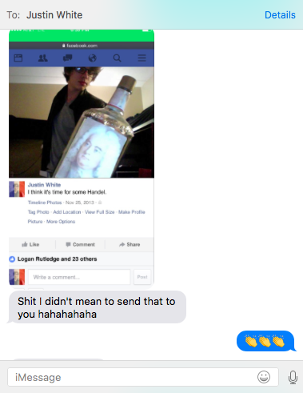
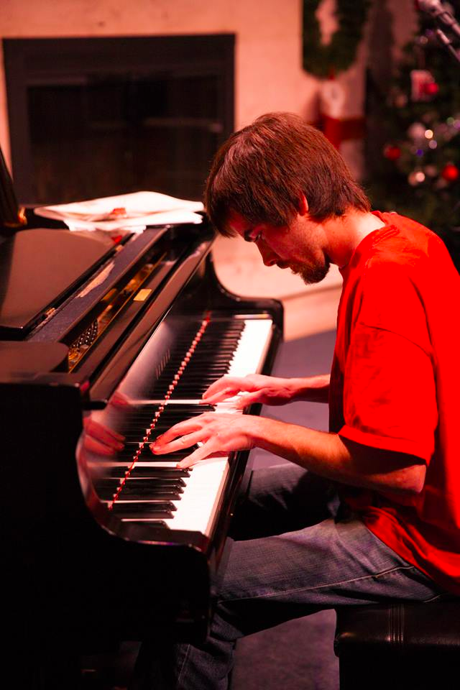
Insight
Nobody talked about having FUN
Source: Stanford Music Collective’s Facebook page

Slide 16
Needs
Question
Social inclusion
Convey deeper meaning to others
Can “fun” resolve tension and bring people together meaningfully? If not, what?

Slide 17
Thank you

Slide 18
Deleted slides (for now at least)

Slide 19
Our Team
Chen Luo
Diego Hernandez
John Carlo Buenaflor
Qingping He

Slide 20
Contradictions
“A lot of what they want you to know is a load of crap… [Beethoven] had less distractions… my composition teacher, who won a Pulitzer Prize...” (Justin)
Andreas wants to make music the main focus of his life, but he is afraid of not being able to support himself

Slide 21
Surprises
Music is social
Look at footnotes plz
Notes:
For Andreas, there is a social aspect to his composition process. He previously tried to compose for a string quartet as an outside composer, but the group only played it once and did not take it seriously. However, when he played together with a friend, they were much more successful at actually performing his pieces.
We also suggested that by creating electronic music, he could sidestep these problems of actual music production. However, he still maintained that performing with a group seemed “cooler”. This suggests that social bonds are an important part of his music composition process. ← this might be better in analysis

Slide 22
Say
Think
“The new book and score section attract a lot of people”
“Advertising becomes a big part of my job”
“People share my blogs on FB or via SNS”
It’s quite useful for visitors
It’s quite useful for visitors
It’s quite useful for visitors
“There are only 73 out of ~700
Do
Feel
Walk through the selected book/media in “new books and score” section
Proud
It’s quite useful for visitors
It’s quite useful for visitors

Slide 23
“No two people listen to the same song hear the same way”
Music provides the common ground for people speaking different languages to communicate.
Music is universal but also exclusive

Slide 24
Summary

Slide 25
Quotes
Bo
“Delivery of lyrics through rap was more digestible, especially to folks with less educational backgrounds”
“Thank god they invited me to join”
Ray
“Advertising becomes a big part of my job”
“I like how people share the blog via FB or other SNS”
Another quote
Another quote

Slide 26
Interviewees
Justin White
Composer
FL State Univ.
Bo Redondiez
Hip-Hop Artist & Activist
SF Bay Area
Andreas Garcia
Pianist & Composer
Stanford ‘17 (Math)
Ray Heigemeier
Public Services Librarian
Stanford Music Library

Slide 27
Domain of interest

