Slide 1
CS 147 Course Midterm Review
Design Thinking for User Experience Design, Prototyping & Evaluation
November 15, 2016
Notes:
50 minutes including questions at the end

Slide 2
Heuristic Evaluation Grades
Individual HE
  Avg. = 98, Std. Dev. = 4.3
Group HE
  Avg. = 97, Std. Dev. = 2.6

Slide 3

b a l a n c e
design
technology
Notes:
You need to find a balance between:
design & technology, human-centered approaches & CS approaches
Especially now HCI needs to find a balance between careful controlled experiments of existing technologies or minor tweaks on technology and building major new systems that can solve important world problems.
East: more family centric… west; individualistic… balance

Slide 4





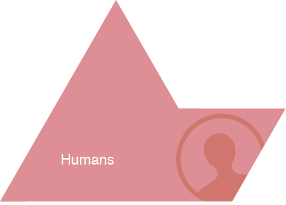
HCI Approach to UX Design
“People change their knowledge as they perform, i.e., they learn”
Notes:
Give Examples of Tasks/Activities:
activity:
learning history
high level taskl:
- writing a paper
- drawing a picture
low level task (operation):
- copying a word from one paragraph to another
- coloring a line

Slide 5

Why is HCI Important?
Major part of work for “real” programs
  approximately 50%
Bad user interfaces cost
  money
    5% satisfaction → up to 85%profits
    finding problems early makes them easier to fix
  reputation of organization (e.g., brand loyalty)
  lives (Therac-25)
User interfaces hard to get right
  people are unpredictable
  intuition of designers
  often wrong
Notes:
Studies have shown that the design, programming, and evaluation of the UI can take up to 50% of the project time and cost for a wide range of commercial and in-house software
Nearly 25% of all applications projects fail. Why?
overrun budgets & management pulls plug
others complete, but are too hard to learn/use
Solution is user-centered design. Why?
easier to learn & use products sell better
can help keep a product on schedule
finding problems early makes them easier to fix!
training costs reduced

Slide 6

Who Creates UIs?
A team of specialists (ideally)
  graphic designers
  interaction / interface designers
  information architects
  technical writers
  marketers
  program managers
  test engineers
  usability engineers
  researchers (ethnographers, etc.)
  software engineers
  hardware engineers
  industrial designers
  customers
Notes:
In this course you will wear the hats of many of these specialists.

Slide 7
How to Design and Build Good UIs
Iterative development process
Usability goals
User-centered design
Design discovery
Rapid prototyping
Evaluation
Programming

Slide 8



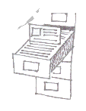



User Interface Development Process
Customers, Products,
Business, Marketing
Customers, Products,
Business, Marketing
Design
Discovery
Design
Exploration
Evaluate
Production
Customers:
- Roles (Who)
- Tasks (What)
- Context (Stories)
Marketing:
- Business Priorities
- Messages
Technology:
- Products
- Architecture
Design:
- Leading/competing
technologies
Work together to
realize the design
in detail
Evaluate with
Customers
Storyboard
Review & Iterate
Design Definition:
- Design Problem Statement
- Targeted User Roles (Who)
- Targeted User Tasks (What)
- Design Direction Statements
Proposal:
Demos/
Lo Fi Prototypes
(How)
Specification:
Hi Fidelity, Refined Design
- Based on customer feedback
- Foundation in product reality
- Refined Design description
based on slide by Sara Redpath, IBM & Thyra Trauch, Tivoli

Slide 9
Iteration
At every stage!
Design
Prototype
Evaluate
Sketch
Paper
Video
Tool
Program
Gut
Crit
Expert Eval
Lo-fi Test
User Study

Slide 10

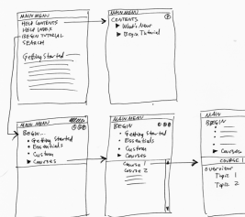
Design
Design is driven by requirements
  what the artifact is for
  not how it is to be implemented
  e.g., phone not as important as mobile app
A design represents the artifact
  for UIs these representations include (?)
    screen sketches or storyboards
    flow diagrams/outline showing
    task structure
    executable prototypes
  representations simplify

Slide 11
Usability(?)
According to the ISO:
The effectiveness, efficiency, and satisfaction
with which specified users achieve specified
goals in particular environments
This doesn’t mean you have to create a “dry” design
Notes:
or something that is only good for novices – it all depends on your goals

Slide 12
Usability/User Experience Goals
Set goals early & later use to measure progress
Goals often have tradeoffs, so prioritize
Example goals(?)
  Learnable
    faster the 2nd time & so on
  Memorable
    from session to session
  Flexible
    multiple ways to do tasks
  Efficient
    perform tasks quickly
  Robust
    minimal error rates
    good feedback so user can recover
  Discoverable
    learn new features over time
  Pleasing
    high user satisfaction
  Fun
Notes:
DO THIS ON THE BOARD!!!

Slide 13
Design Process: Discovery
Assess Needs
understand client’s expectations
determine scope
of project
characteristics of customers & tasks
evaluate existing practices & products
Discovery
Design Exploration
Design Refinement
Production

Slide 14
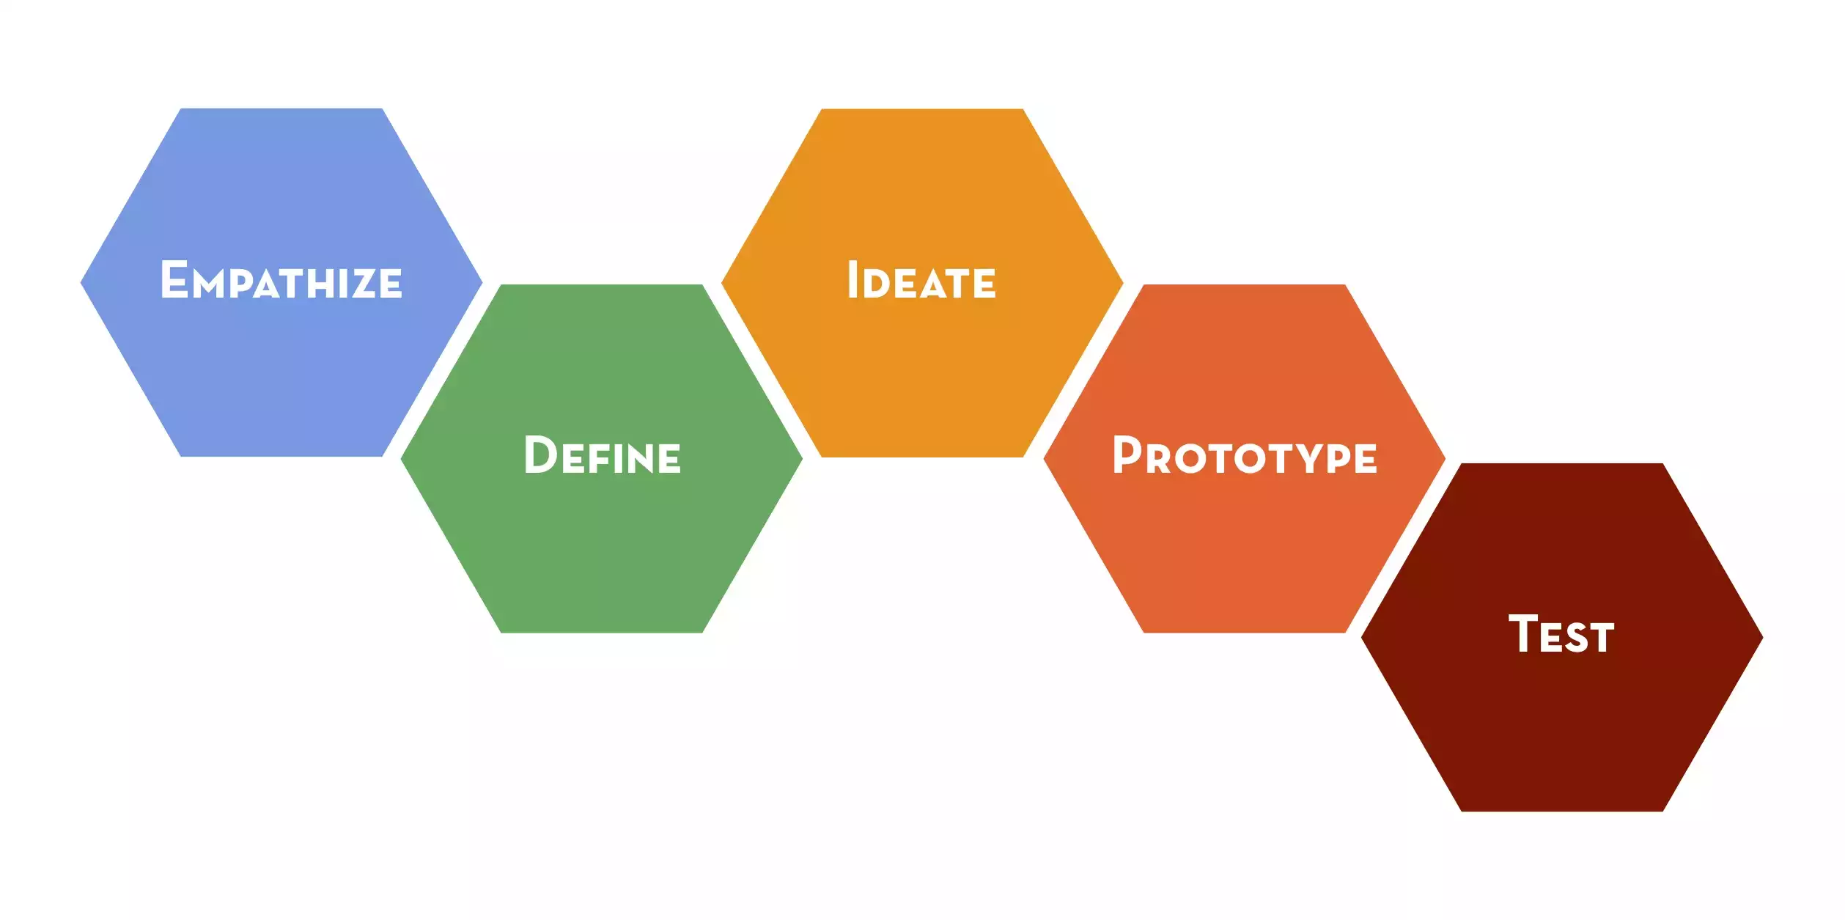
Design Thinking Process

Slide 15
User-centered Design
“Know thy User”
Cognitive abilities
  perception
  physical manipulation
  Memory
Organizational / educational job abilities
Keep users involved throughout
  developers working with target customers
  think of the world in users terms
Notes:
`

Slide 16
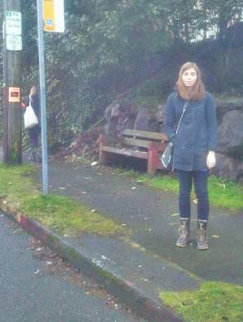
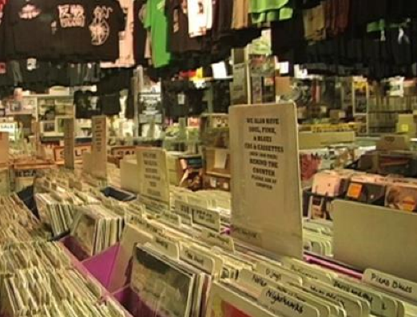
Design Discovery
Needfinding, Contextual Inquiry & Task Analysis
Observe existing practices for inspiration
Make sure key questions answered
Tuned CI participant
Tuned field work in record store
Notes:
Start with this CI design sketch, but required many examples (over 30 on 1st assignment) on each subsequent assignment from different folks on the team

Slide 17
Reframing the Problem as a Point of View
WE MET . . .
(user – possibly extreme – you are inspired by)
WE WERE AMAZED TO REALIZE . . .
(what did you learn that’s new?)
IT WOULD BE GAME-CHANGING TO . . .
(frame up an inspired challenge for your team.)
(don’t dictate the solution.)

Slide 18
Design Discovery Summary
Know thy user & involve them in design
Needfinding
  build empathy with customers
  listen to them to discover interesting insights
Contextual inquiry
  way to answer the task analysis questions
  interview & observe real customers in situ
  use what model to get them to teach you?
    the master-apprentice model
Notes:
CI is specific interviewing method used in needfinding

Slide 19
Ideate: From POV to How Might We
POV: Harried mother of 3, rushing through the airport only to wait hours at the gate, needs to entertain her playful children because “annoying little brats” only irritate already frustrated fellow passengers.
Break POV into pieces
Amp up the good/Remove the bad
Explore the opposite
Question an assumption
Go after adjectives
ID unexpected resources
Create an analogy from need or context
Change a status quo
http://dschool.stanford.edu/wp-content/uploads/2012/05/HMW-METHODCARD.pdf
Notes:
Use these to generate

Slide 20
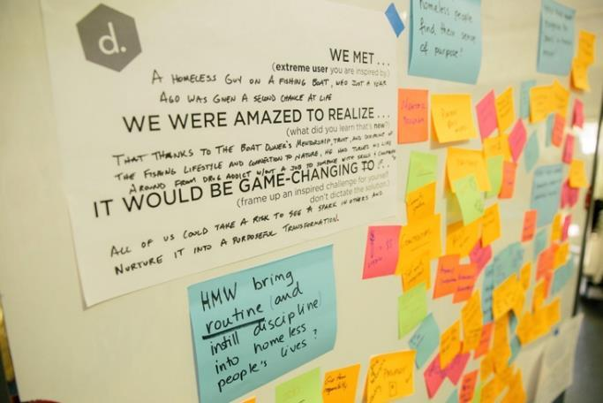
Brainstorm “How Might We”s Solutions
Notes:
We met a homeless guy on a fishing boat, who just a year ago was given a second chance at life
We were amazed to realize that thanks to the boat owner’s mentorship, trust, and display of the fishing lifestyle and connection to nature, he has turned around his life from drug addict without a job to someone with success and compassion
It would be game-changing if all of us could take a risk to see a spark in others and nurture it into a purposeful transformation.

Slide 21
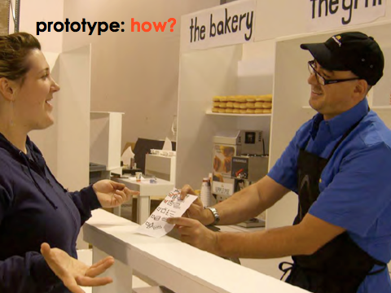
EXPERIENCE PROTOTYPE
Notes:
So how can we get from all the problem ideas we generated in our brainstorm to making a prototype that helps us learn from users

Slide 22
Design Process: Exploration
Expand Design Space
brainstorming
sketching
storyboarding
prototyping
Discovery
Design Exploration
Design Refinement
Production
Notes:
Expand design space:
brainstorming, sketching, storyboarding, prototyping

Slide 23
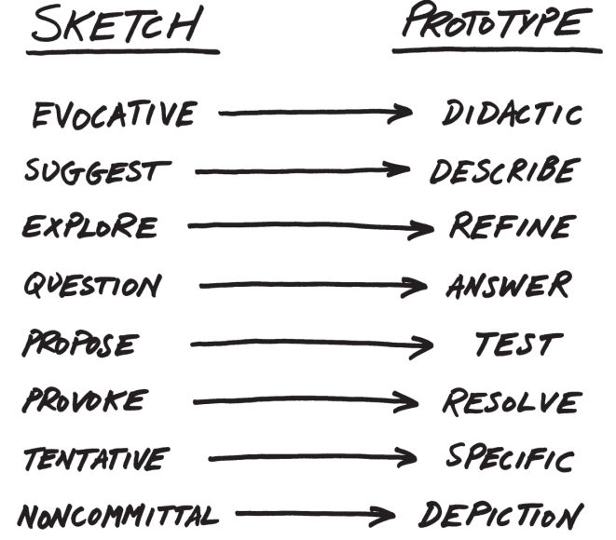
From Sketch to Prototype
Difference in intent rather than in form
Courtesy Bill Buxton
Notes:
This is a continuum, not an either/or proposition
The difference between the two is as much a contrast of purpose, or intent, as it is a contrast in form

Slide 24
Design Exploration Summary
Sketching allows exploration of many concepts in the very early stages of design
As investment goes up, need to use more and more formal criteria for evaluation
Experience prototyping allows us to try many ideas quickly & learn more about the problem & solution space (prototype to learn)

Slide 25
Concept Videos
Illustrate context of use rather than specific UI
Quick to build
Inexpensive
Forces designers to consider details of how users will react to the design
More important when context is not traditional work scenario

Slide 26
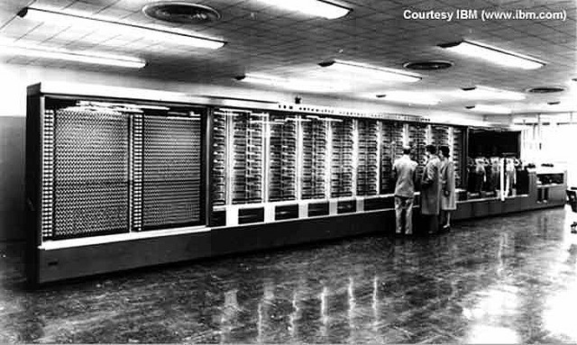
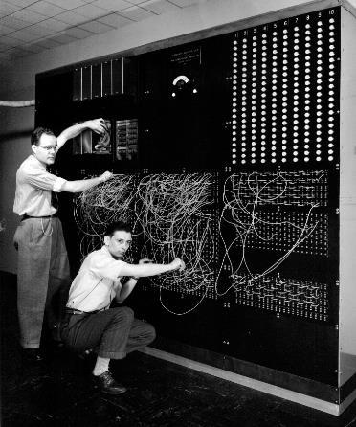
Context – Computing in 1945
Harvard Mark I : 55 feet long, 8 feet high, 5 tons
http://piano.dsi.uminho.pt/museuv/indexmark.htm
Notes:
This was the STATE OF THE ART!
Picture from http://piano.dsi.uminho.pt/museuv/indexmark.htm

Slide 27
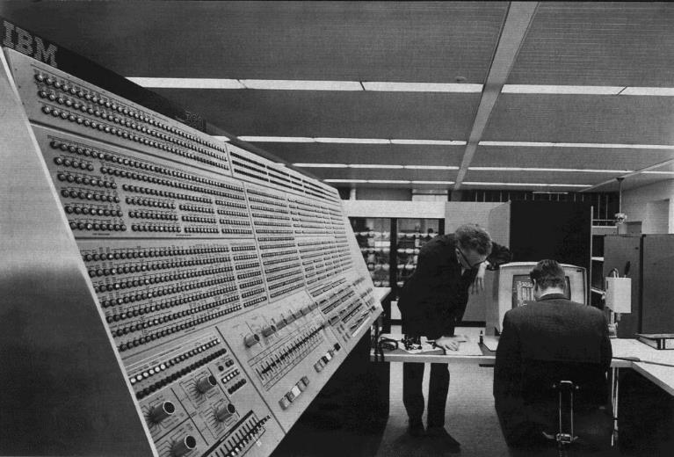
Computing in 1965
IBM System/360
360-91-panel. Licensed under Public Domain via Wikimedia Commons.
Notes:
This bigger model 360/91 at NASA a few years later had a much larger control panel and a CRT display (just text!)
the computer of the 1940s, 50s, and 60s, was essentially for manipulating math
A few pioneers had a different vision.

Slide 28
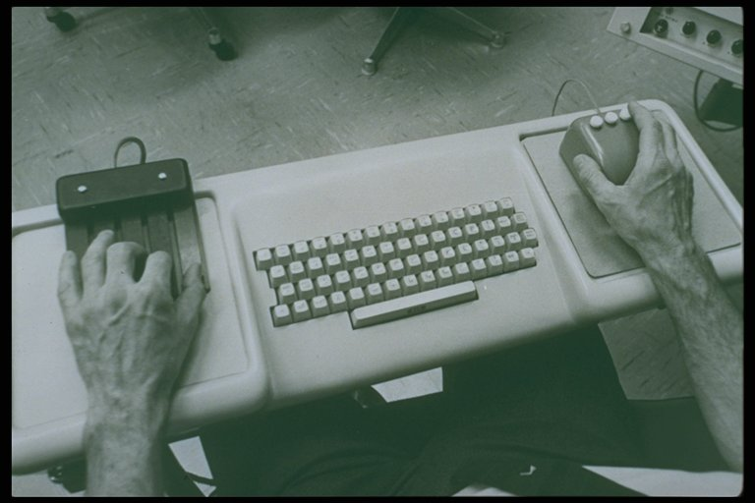
Augmenting Human Intellect
Notes:
NLS was for expert use! (two hands working at once!)

Slide 29
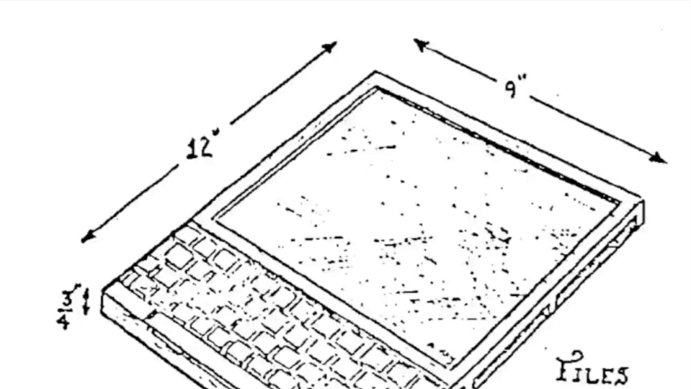
Dynabook – Kay (1974)
Notes:
What does it look like that you are familiar with today?
Invented 1968, over 40 years before the iPad, but wasn’t realizable

Slide 30
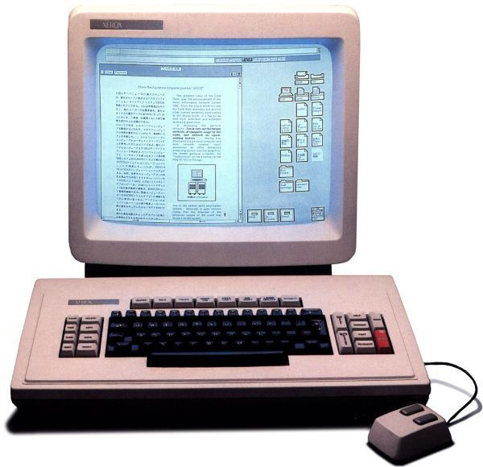
Xerox Star – 1st Commercial GUI (1981)
Notes:
The key computer that led to the Apple Macintosh in 1984 (Jobs saw the Alto – prototype of the Star)

Slide 31
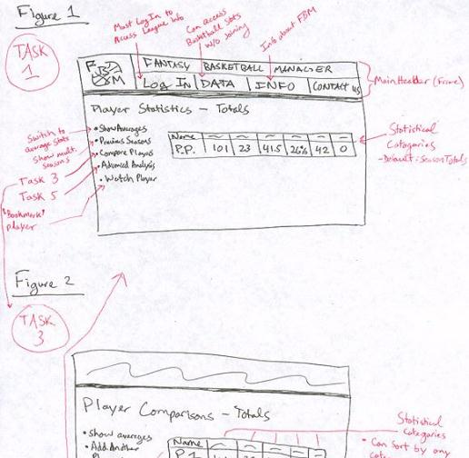
Rapid Prototyping
Fantasy Basketball
Build a mock-up of design
so you can test it
Low fidelity techniques
  paper sketches
  cut, copy, paste
  low-fi testing allows us to quickly iterate
  get feedback from users & change right away
Interactive prototyping tools
  HTML, SketchFlow, Balsamiq, Axure, proto.io, etc.
UI builders
  Expression Blend + Visual Studio, etc.

Slide 32
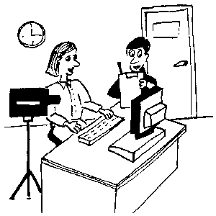
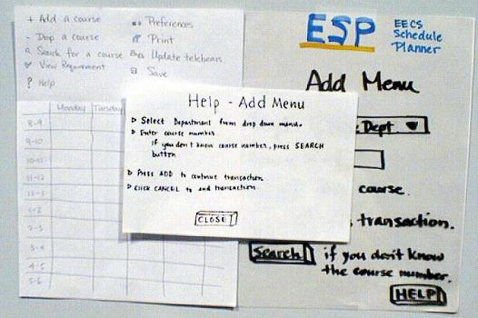
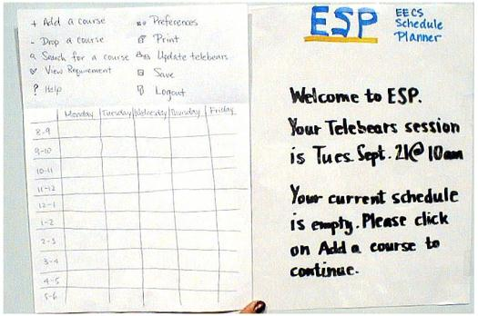
Evaluation
Test with real customers (participants)
  w/ interactive prototype
  low-fi with paper “computer”
Build models
  GOMS
Low-cost techniques
  expert evaluation
  walkthroughs
  online testing
ESP

Slide 33
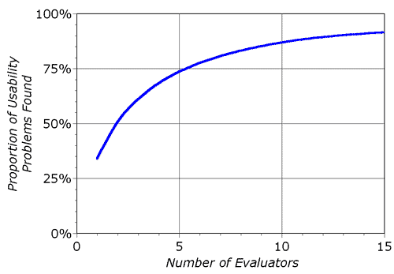
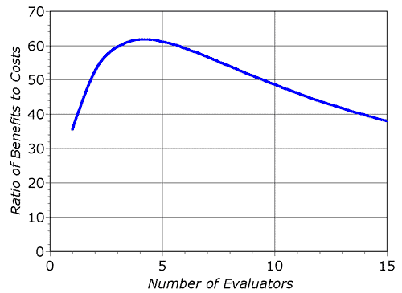
Heuristic Evaluation Decreasing Returns
problems found
benefits / cost
* Caveat: graphs for a specific example

Slide 34
Heuristic Evaluation Summary
Have evaluators go through the UI twice
Ask them to see if it complies with heuristics
  note where it doesn’t & say why
Combine the findings from 3 to 5 evaluators
Have evaluators independently rate severity
Alternate with user testing

Slide 35


User Testing Data
Process data
  observations of what users
  are doing & thinking
  qualitative
Bottom-line data
  summary of what happened
    time, errors, success
  i.e., the dependent variables
  quantitative
http://allazollers.com/discovery-research.php
http://www.fusionfarm.com/content/uploads/2012/10/analyzing-data.jpg

Slide 36
User Testing Summary
User testing is important, but takes time/effort
Use ????? tasks & ????? participants
  real tasks & representative participants
Be ethical & treat your participants well
Want to know what people are doing & why? collect
  process data
Bottom line data requires ???? to get statistically reliable results
  more participants
Difference between between & within groups?
  between groups: everyone participates in one condition
  within groups: everyone participates in multiple conditions

Slide 37
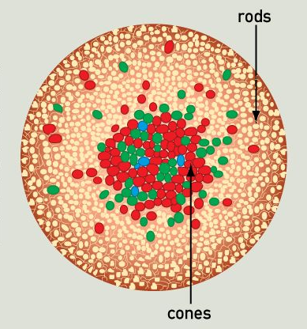
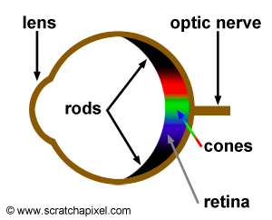
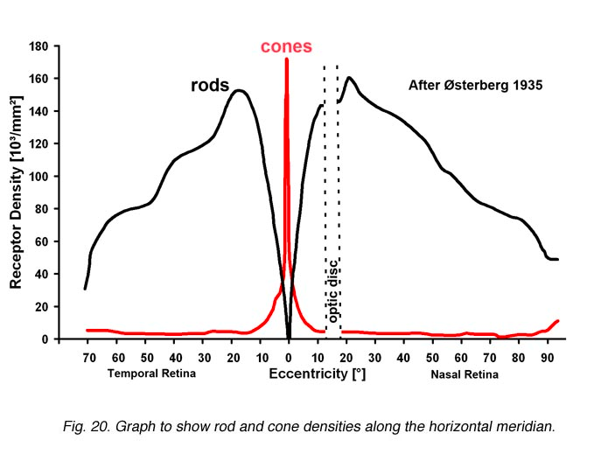
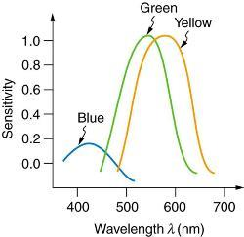
Human Abilities: Retina
Distribution of rods & types of cones has major impact on our visual abilities
http://www.webexhibits.org/causesofcolor/1G.html
http://webvision.med.utah.edu/imageswv/Ostergr.jpeg
http://archive.cnx.org/contents/d42c807d-a9fa-4e3d-83d0-0f7c745b51a0@4/color-and-color-vision#import-auto-id1844887

Slide 38
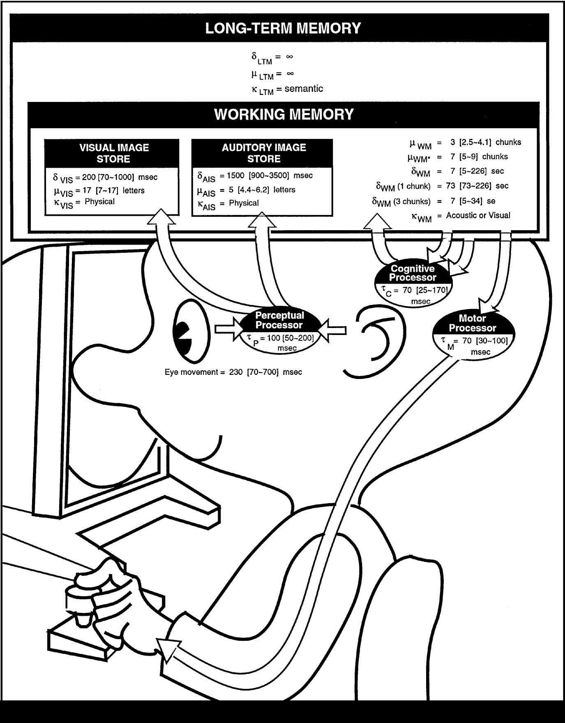
The Model Human Processor
Developed by Card,
Moran & Newell (’83)
  based on empirical data
Basic model underlies other HCI techniques
Allows us to make predictions w/o users
Know the processors, memories, cycle times, and decay times
  100ms!
Notes:
We model human performance to test understanding and
To predict the influence of new technology.
This is the classic image form the book “The Psychology of Human-Computer Interaction”

Slide 39
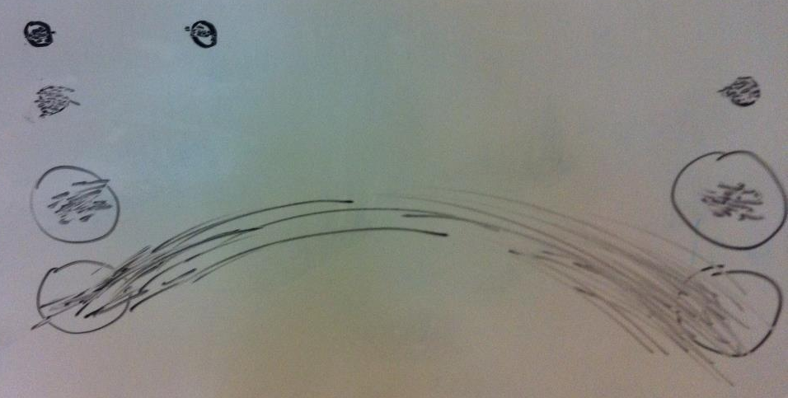
Fitts’ Law Experimental Results
Task:
Quickly tap each target 50 times accurately
  30 sec
  48 sec
  31 sec
  21 sec (lots of spread)
Notes:
Draw two circles on the board
both around 1/2 inches in diameter
1) distance of 6 inches
2) Repeat by extending the distance to 24 inches
Ask volunteer to put mark in circle 50 times each quickly, but accurately (outside of circle at most 4 times)
TURN to a partner and discuss what you think will happen and WHY????
ID=Log2(d/w+1) : try easy ID of 4 and hard of ID 8
log2 (13)=3.7
Log2 (49)=5.6
Now try it again with 24 inches but make the target 2 inches wide
3) log2 (13)=3.7
) Now try again asking the person to go as fast as they can independent of accuracy (should get more speed but see spread of circles outside)
Results:
30 sec
48 sec
31 sec (as predicted, almost the same as #1)
21 sec (lots of spread)

Slide 40
Fitts’ Law
Moving hand is a series of microcorrections
    correction takes T_{p +} T_{c +} T_{m} = 240 msec
Time T_{pos} to move the hand to target size S which is distance D away is given by:
    T_{pos} = a + b log₂ (D/S + 1)
Summary
  time to move the hand depends only on the relative precision required

Slide 41
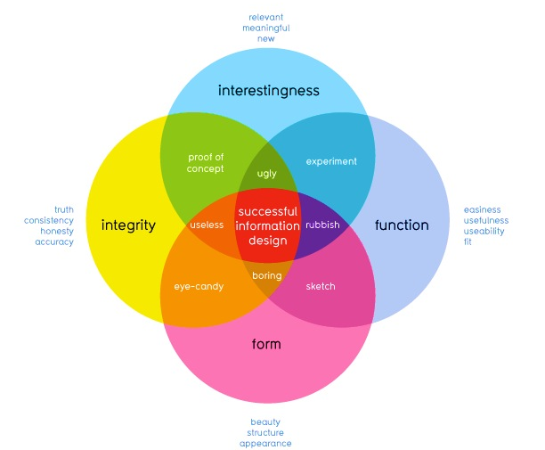
How well does it communicate?
How well does it work?
David McCandless
http://www.informationisbeautiful.net
Notes:
This graphic illustrates what should be balanced to achieve a design that can convey useful information to `its observers by creating desire in the information itself.
This part refers to the information itself, whether the data is accurate or useful. Arguably you are all rather talented at this part.
So today Im going to talk about the other two – some guidelines as to how to achieve designs that successfully allow the user to perform such functions without having to force themselves to do so

Slide 42
The Art of Balance
Promotion & demotion of important objects
First Question for any design
What are the most important things?
Information should be prioritized based on its importance to the user
Notes:
I’ve mentioned several times before that good design is about balance – visual design is no exception.
Information should be prioritized based on its importance or relationship to other information
: color, size, position and the other things we have discussed are methods to suggest this.
If we look at objects on a scale of importance, we can decide best how to use those techniques.
Scott Klemmer’s video gave you good examples of how Typograhpy, Layout, and Color give you a good idea of visual hierarchy

Slide 43
Using Proximity to Indicate Relationships
“The whole is greater than the sum of the parts.” – David Hothersall
Gestalt Psychology in information design
Information blocks should be grouped together if related, but unrelated elements should be located at some distance from each other.
Notes:
The principles of Gestalt psychology are based on the humans’ ability to perceive and generate visual forms.
One of the six Gestalt Principles, “The Proximity principle” is often used in information design.
We can use proximity to describe how elements are related to each other.

Slide 44
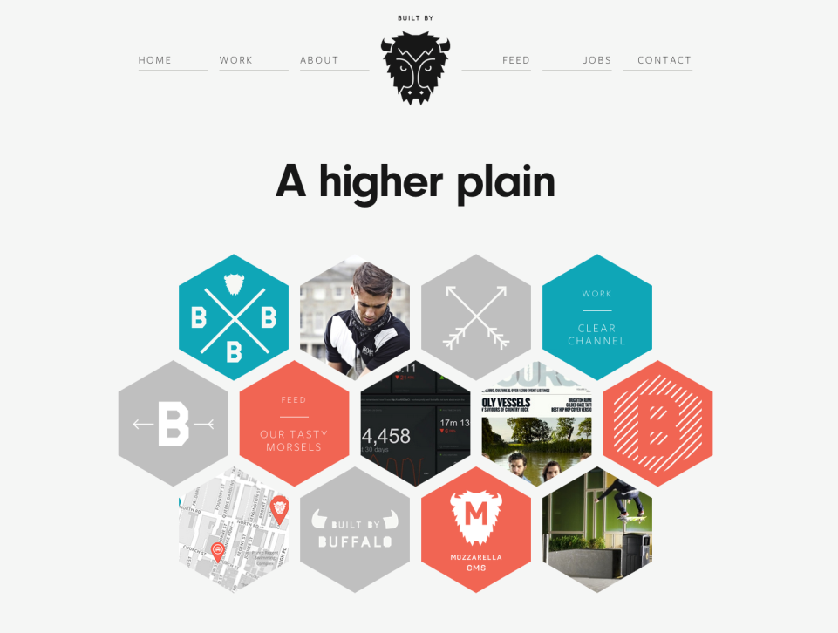
http://builtbybuffalo.com/
White Space = Value
Notes:
Using blank space as an object
Web design provides good examples of the proximity rule where good layouts will organize related items into groups such as seen here with the menu and project elements grouped together.

Slide 45
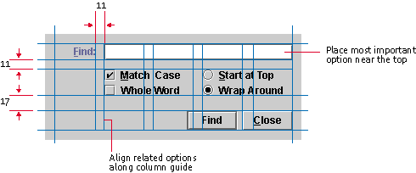
Grid Systems
A key pattern for implementing rationality, modernism, asymmetry
Note that no elements are “centered”
Java Look and Feel Design Guidelines
Notes:
One take-away on how to design a lot of information on a page, a grid system is a good place to start.
Using the grid gives you consistency and if you use someone else's grid, you get to take advantage of professional designed system.
Find is easy to see since it is in a column all by itself.
Space is consistent between the buttons.
Things that are similar are closer (i.e., radio buttons).
Bigger space to the buttons at the bottom – they are different.

Slide 46

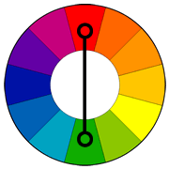
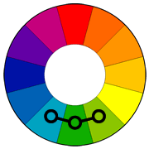
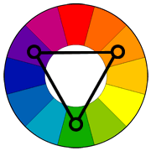
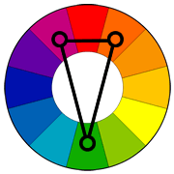
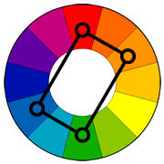
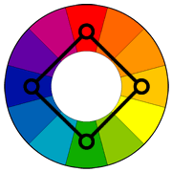
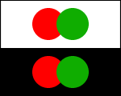
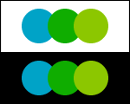
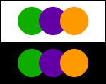
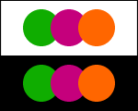
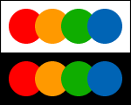
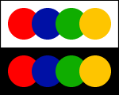
Using Appropriate Color “Harmonies”
Complementary
Analogous
Triad
Split
Complementary
Rectangle
(Tetradic)
Square
Notes:
So how to we pick the right colors?
While my suggestion for beginners is to stick to one color or “monochrome” pallets, there is the odd occasion where information must have multiple colors to be distinguishable, such as in graphs. In these cases, Color harmonies are particularly useful. They involve picking a primary color and using a color wheel to determine the best colors to go along with it.
For beginners, I suggest using these two (analogous and split-complimentary) as they are hard to get wrong and tend to work with lots of designs.
see: http://www.tigercolor.com/color-lab/color-theory/color-harmonies.htm

Slide 47
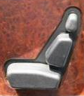
Conceptual Models Summary
Conceptual models ?
  mental representation of how the object works &
  how interface controls effect it
Design model should equal customer’s model ?
  mismatches lead to errors
  use customer’s likely conceptual model to design
Design guides ?
  make things visible
  map interface controls to
  customer’s model
  provide feedback
Design Model
Customer Model
System Image

