Slide 1
CS 147 Introduction & Course Overview
Design Thinking for User Experience Design, Prototyping & Evaluation
September 27, 2016
Notes:
[1:54 ] – 5 minute break
4 minutes over (don’t talk so much)

Slide 2

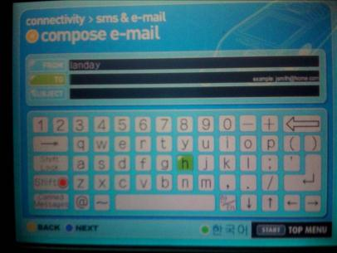
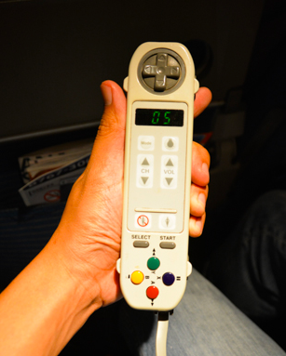
Hall of Fame or Shame?
Asiana Airlines interface for sending email or SMS from plane

Slide 3

Hall of Shame!
Asiana Airlines interface for sending email or SMS from plane
Cool, but
  text entry using this input device is tedious
  crashes often
Lost the strong brand value for me

Slide 4
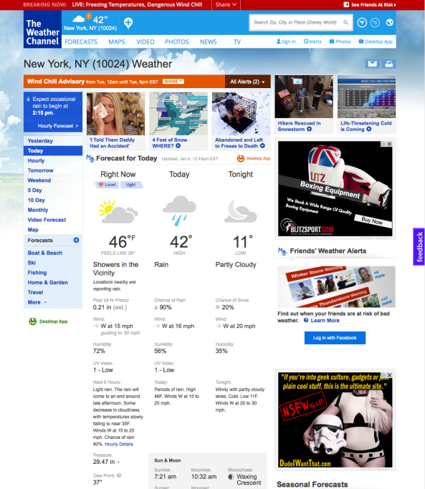
Hall of Fame or Shame?
weather.com
Notes:
Weather.com
What is the user trying to do (most commonly) when coming to this site?
What is the FIRST THINGS your eye is drawn to? (called the “first read”)

Slide 5
Hall of Shame!
weather.com
what is the “first read”?
  videos
  advertisements
  not weather!
Notes:
Weather.com
What is the user trying to do (most commonly) when coming to this site?
What is the FIRST THINGS your eye is drawn to? (called the “first read”)

Slide 6
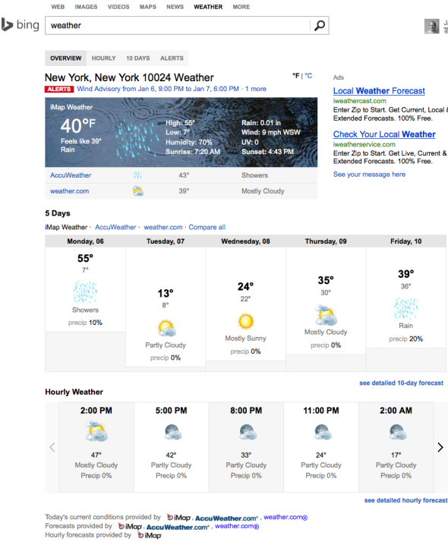
Hall of Fame or Shame?
bing.com/weather
Notes:
A friend from MS said, try the new Bing Weather!
Better… but?

Slide 7

Hall of Fame!
bing.com/weather
good!
  less clutter
  eye drawn to current weather
bad!
  feels boring
Notes:
A friend from MS said, try the new Bing Weather!
Better… but?

Slide 8
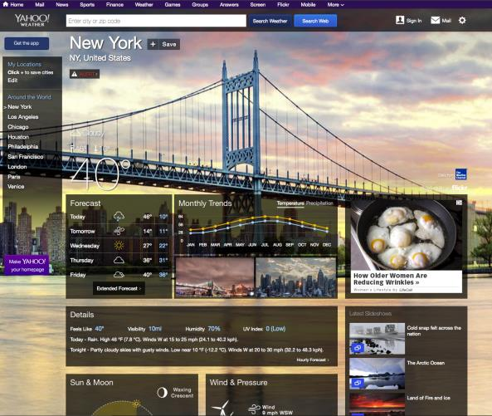
Hall of Fame or Shame?
weather.yahoo.com
Notes:
Better
How?
But still?

Slide 9
Hall of Fame!
weather.yahoo.com
good!
  aesthetic
  clean typography & icons
bad!
  image is 1st read
Notes:
A friend from MS said, try the new Bing Weather!
Better… but?

Slide 10
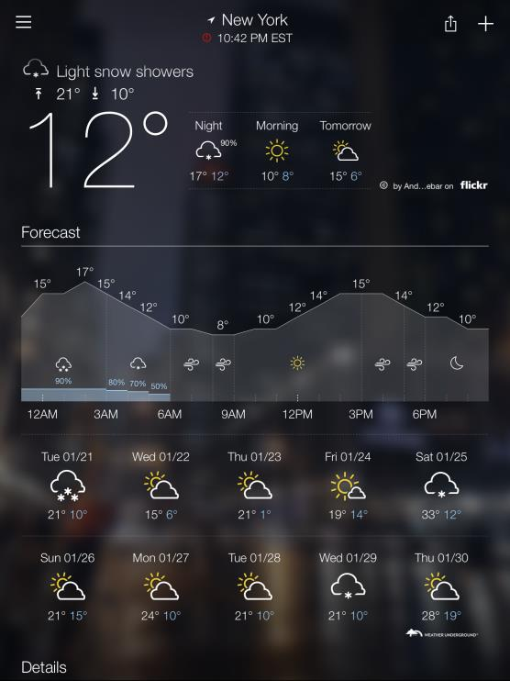
Hall of Fame!
iOS yahoo weather
good!
  aesthetic
  clean typography & icons
  image recedes to background w/ flick
Notes:
I think this one is the best
In this class you are going to learn to see these positives and negatives about user interfaces. You are going to learn how to design, prototype and test your ideas.
I want this to be interactive. We will do this hall of fame/shame exercise at the start of every lecture. Please participate.

Slide 11
CS 147 Introduction & Course Overview
Design Thinking for User Experience Design, Prototyping & Evaluation
September 27, 2016

Slide 12


Who are We?

Slide 13
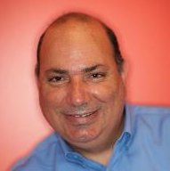
James Landay
Professor in Computer Science at Stanford
  formerly professor at Cornell Tech, University of Washington & Berkeley
  spent 3 years as Director of Intel Labs Seattle
  Dec 2011 finished 2.5 year sabbatical at Microsoft Research Asia
PhD in CS from Carnegie Mellon ’96
HCI w/ focus on informal input (pens, speech, etc.), crowdwork,
web design (tools, patterns, etc.) & Ubiquitous Computing
Founded NetRaker, 1st in web experience management (sold to Keynote)
Co-authored The Design of Sites with Doug van Duyne & Jason Hong
Office Hours: Tue. 4-5 PM / Thur 10-11 AM in 390 Gates (starting next week)
  we will also monitor CS147 Piazza site (signup @ piazza.com/stanford/fall2016/cs147)
Email: landay@[insert usual Stanford email domain]

Slide 14

Sherman Leung (Head CA)
CS Undergrad, CS/MS&E Masters
Interested in the intersection of healthcare and technology. Involved with digital health
I play jazz piano, ping pong, and basketball
Office Hours
  Tues 11-12pm @NVIDIA Lobby
  Weds 4:30-5:30pm @Old Union
Thurs 5PM-6:50PM @Gates 392

Slide 15
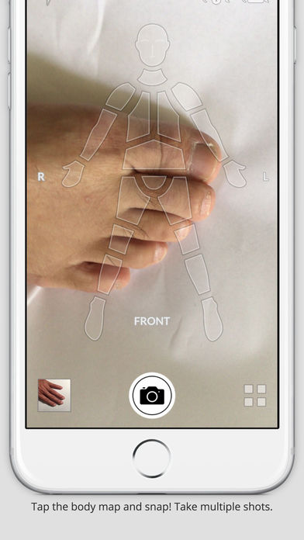
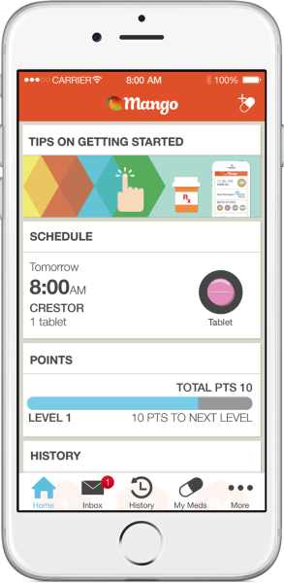
Health
Enable healthier lifestyles and outcomes
Digital and mobile health are some of the fastest growing industries of our day. As the gap between healthcare and technology is closing, patients and physicians alike are turning to technology-based products to enable more accessible and effective healthcare. From mobile apps that help patients manage their medications to tools that help resource-constrained clinics manage patient pipelines, this intersection of health and technology is ripe with opportunity!
Thurs 5PM-6:50PM

Slide 16
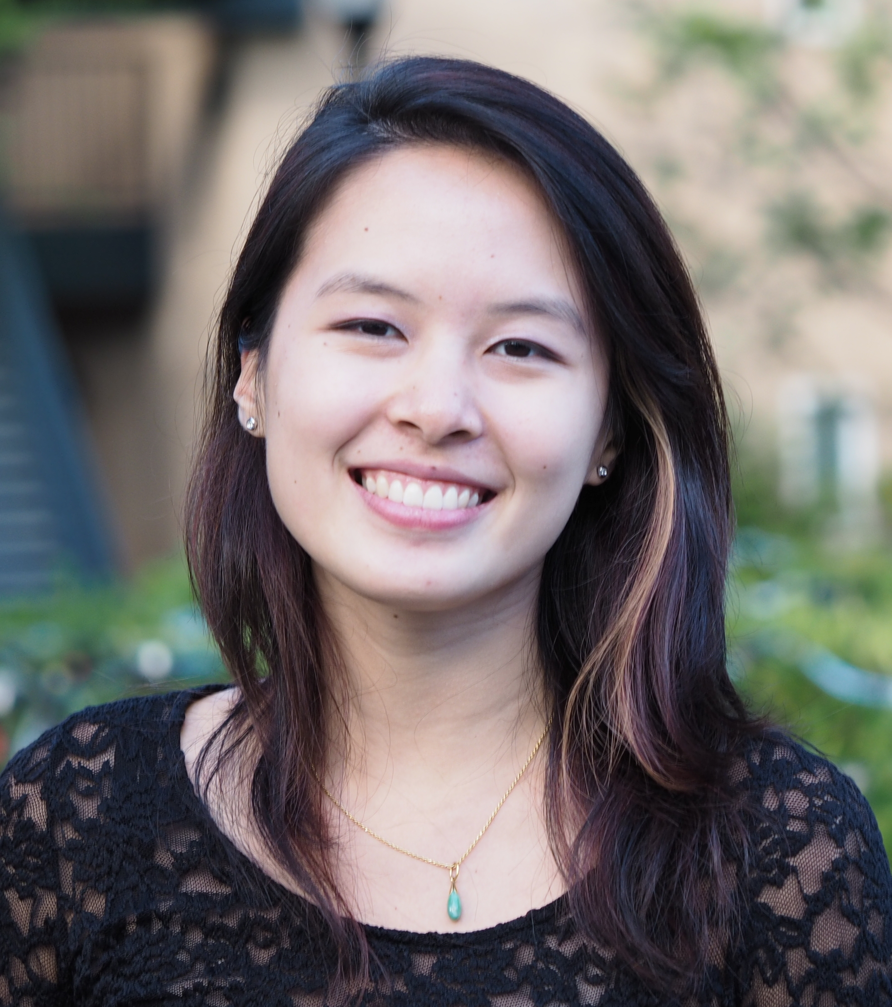
Emily Tang
CS & Psychology Undergrad, CS Masters
Interested in human behavior, educational equity, and diversity in STEM
I like corgis
Office Hours
  Wednesday 2:15-3:15pm @Lathrop Tech Lounge
  Thursday 4:30-5:30pm @NVIDIA Lobby
Friday 9:30AM-11:20AM @380-381T
Friday 1:30PM-3:20PM @160-319

Slide 17



Learning
Design next generation learning experiences
We are constantly learning by acquiring new skills, knowledge, and behaviors. In this studio, we will think about how technology can enable, supplement, or support learning. How can we use technology to support under-resourced demographics or accommodate different learning styles and needs? What kinds of challenges can we solve to help teachers focus on teaching? Feel free to look at and beyond your own learning environment for inspiration.
Friday 9:30AM-11:20AM, 1:30PM-3:20PM

Slide 18
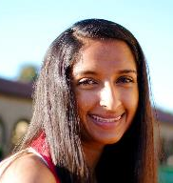
Shubha Raghvendra
HumBio Undergrad, CS Masters
Interested in product management, diversity and inclusion in STEM, computational biology
I like museums and ice cream
Office Hours:
  Monday 3:30-4:30pm @Huang Coupa
  Thursday 12:30-1:30pm @Lathrop Tech Lounge
Fri 8:30-10:20AM @160-317
Fri 10:30AM-12:20PM @200-124

Slide 19
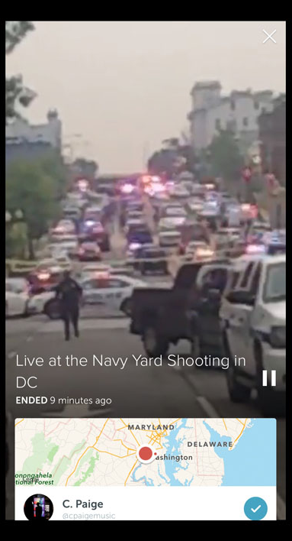
Digital Democracy
Technology-enabled democracy
Dialogue is the oxygen of democracy, and today, much of that dialogue dwells online. How might we leverage technological tools to broaden the reach of that dialogue to marginalized groups? To enrich the online conversation with fact-checking? To present complex information to our end-users -- voters -- in clear, meaningful ways? As the presidential election draws nearer, these questions are pressing and high-impact. Apart from the election cycle, we might also consider technology-enabled strategies to help citizens engage with local governments, or trawl the voting records of elected officials, for example.
Fri 8:30-10:20AM, 10:30AM-12:20PM

Slide 20
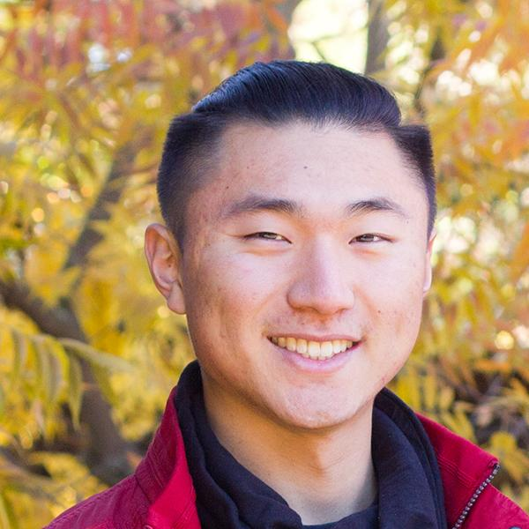
Kevin Zhai
Art Studio Undergrad, CS Masters
I like to make things
Office Hours
  Monday 4:30-5:30pm @Huang Coupa
  Thursday 3:00-4:00pm @GSB Coupa
Fri 12:30-2:20pm, 2:30-4:20pm

Slide 21
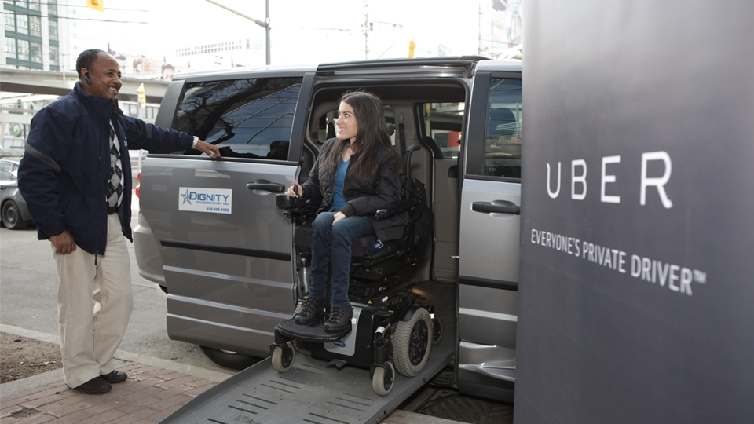
Inclusive Design
Products that benefit everyone
Gaining insights from communities and individuals that might be overlooked by the general population
  blind, deaf, dyslexic, etc
  under-represented individuals
  e.g., women & people of color
What can we learn when we
design specifically for a single
person instead of for the “average” person?
Hopefully, we can improve not only their lives but the lives of everyone around them
Fri 12:30-2:20pm, 2:30-4:20pm

Slide 22
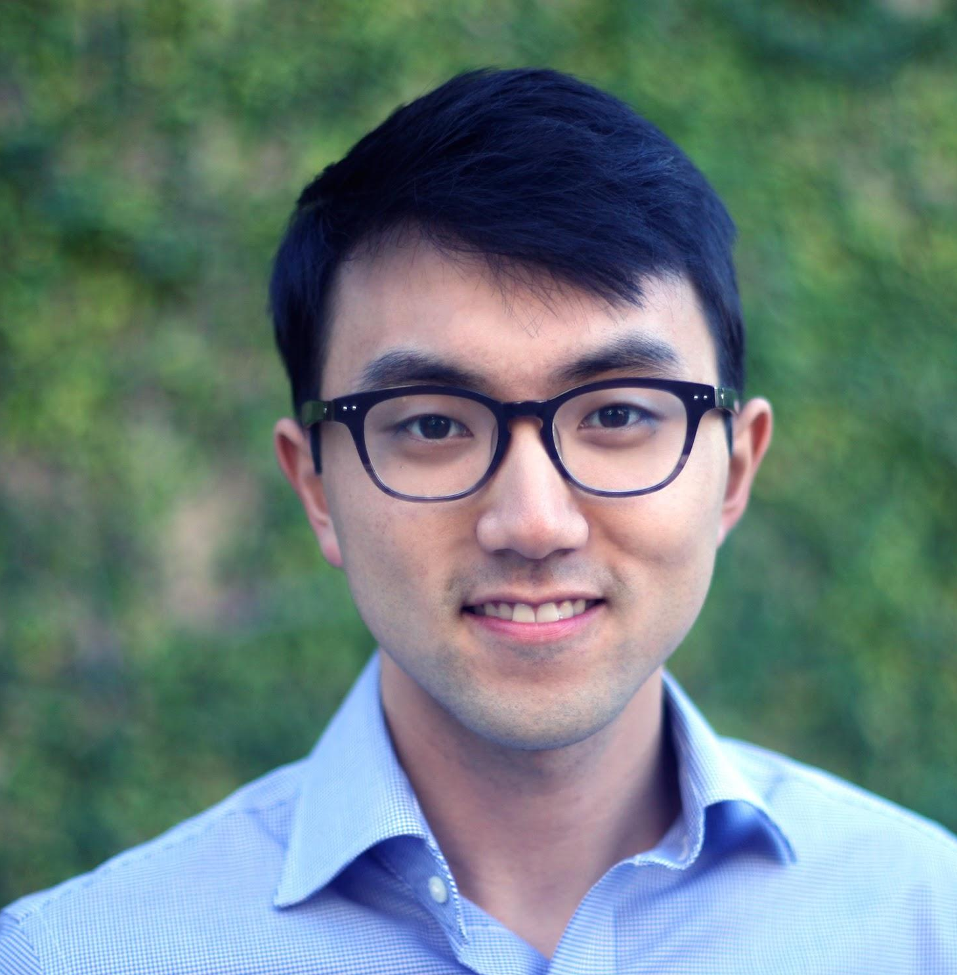

Will Kim
SymSys Undergrad, CS Masters
Interested in knowledge management
I like making pots
Office Hours:
  Monday 12:30-1:30pm @Lathrop Tech Lounge
  Friday 12:30-1:30pm @Lathrop Tech Lounge
Fri 10:30-12:20AM &
Fri 1:30PM-3:20PM @100-101K

Slide 23
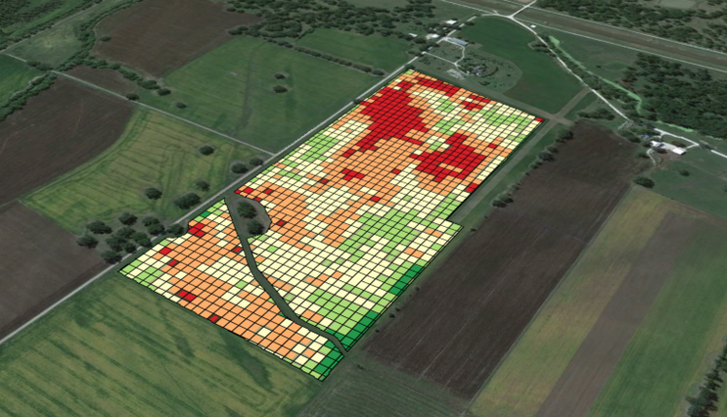

Food
Redesigning food, from the field to leftovers
How can we improve the experience around food?
Burgeoning ecosystem around “revolutionizing food”
  source (Hampton Creek, Beyond Meat)
  delivery (DoorDash, GoodEggs, etc.)
  consumption (Soylent)
  leftovers (Too Good To Go)
In this studio, students will focus on
learning from the producers to the
consumers and everyone in between
to cook up valuable ideas
Ripe with opportunity!
Fri 10:30-12:20AM &
Fri 1:30PM-3:20PM @100-101K

Slide 24

Edwin Park
CS Undergrad, CS Masters in AI & HCI
Interested in designing better user experiences for artificial intelligence
I like sports, especially speedskating
Office Hours
  Monday 2:30-3:30PM @Lathrop Tech Lounge
  Wednesday 4:30-5:30pm @Lathrop Tech Lounge
Friday 9:30-11:20AM @ 320-107
Friday 1:30-3:20PM @ 160-321

Slide 25
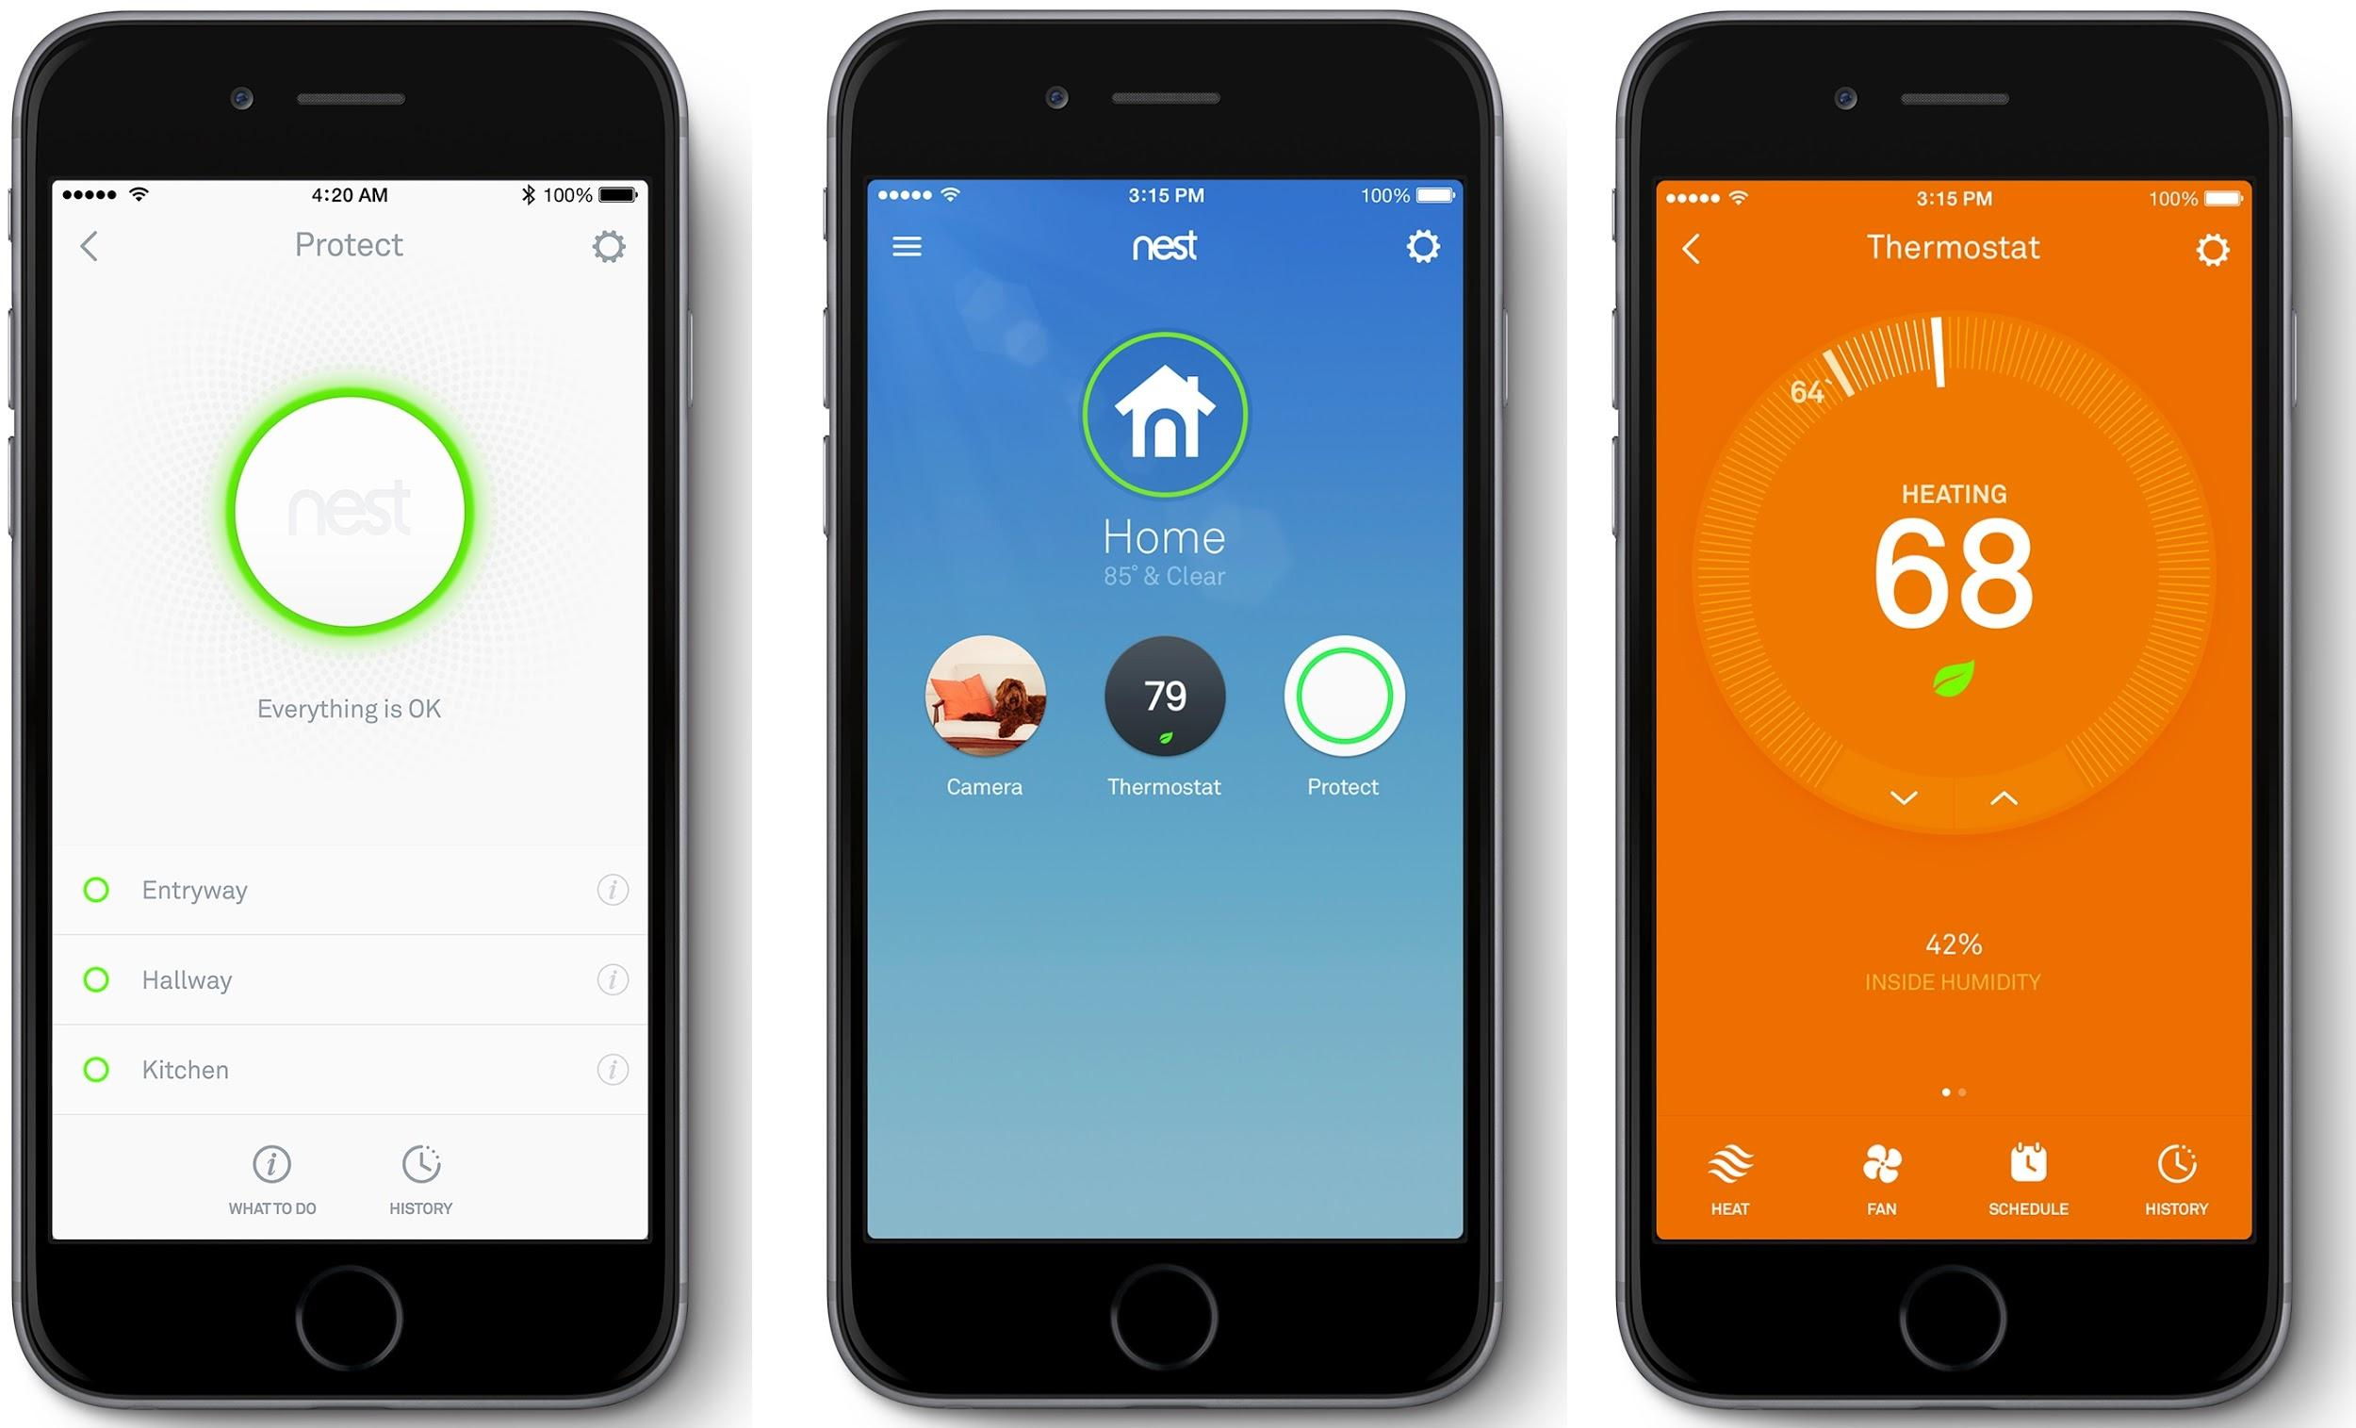
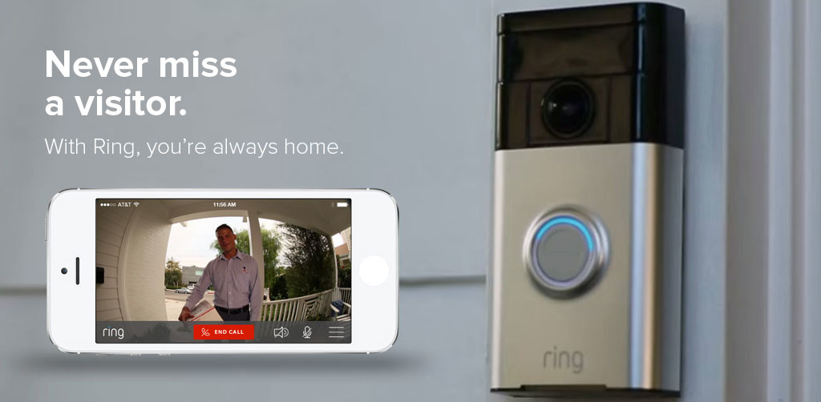
Home
Making homes accessible from anywhere
The Internet of Things (IoT) is starting to integrate into our everyday lives, allowing us to control many physical devices, such as thermostats, refrigerators, and even sprinklers from our wrists or phones. How can you use technology to make homes more accessible? What are some daily tasks at home that could be automated and more efficient?
Friday 9:30AM-11:20AM,
1:30PM-3:20PM

Slide 26
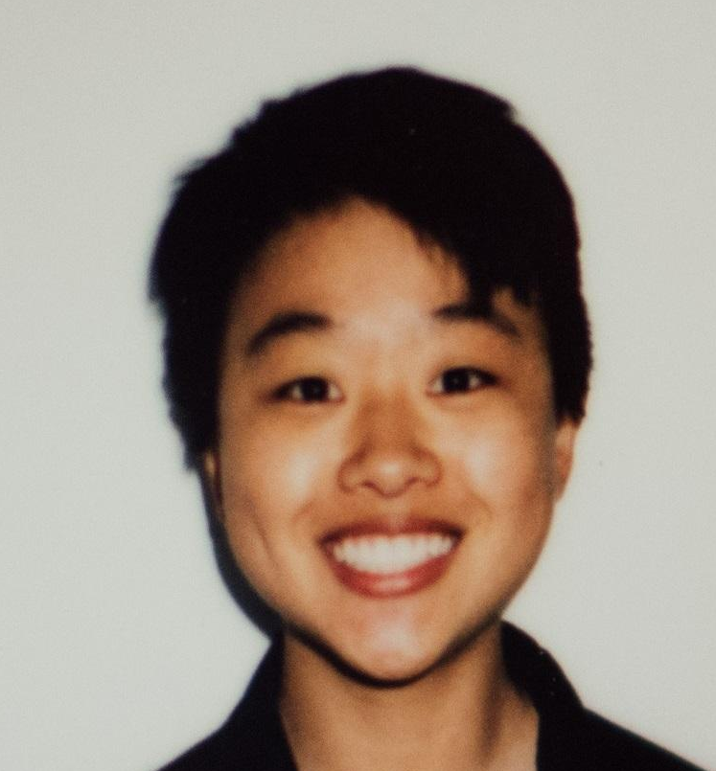
Ash Ngu
CS Undergrad + Art Studio Minor,
CS Masters in HCI
Interested in the intersection of art, media & technology
I take photographs and cut hair
Office Hours:
  Tues 4:30-5:30p @ Huang Basement
  Weds 3-4p @ Huang Basement
Friday 12:30p-2:20p & 2:30p-4p @ 160-321

Slide 27
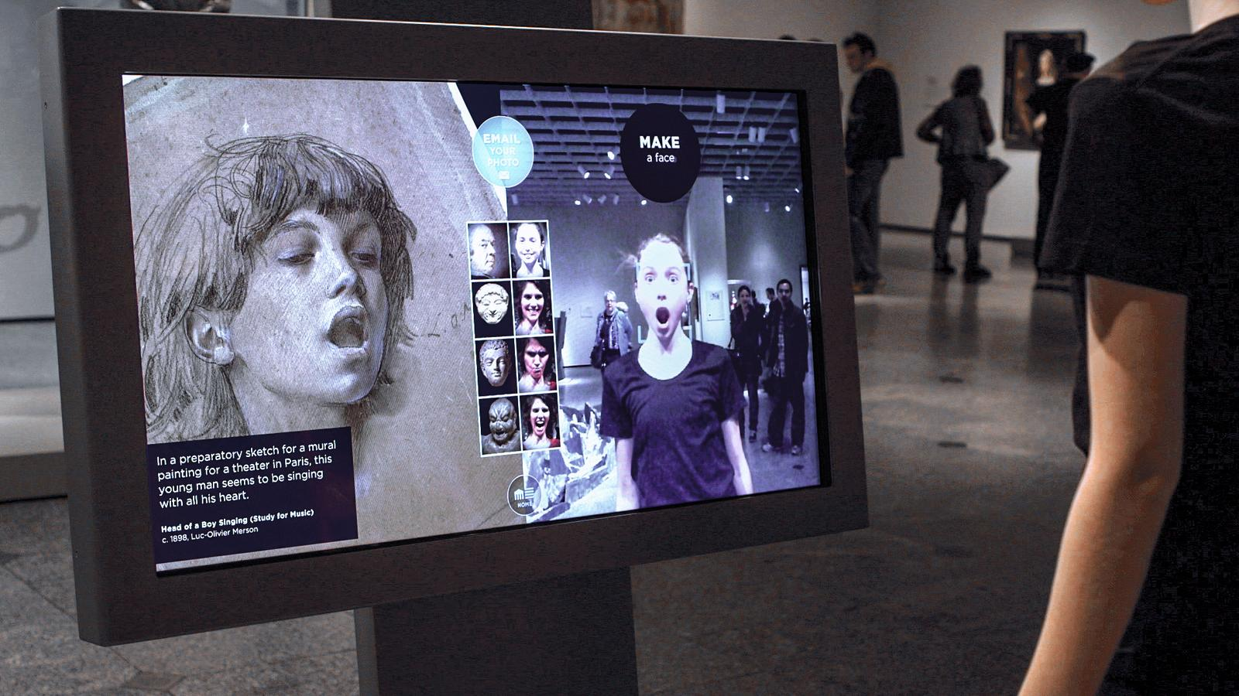
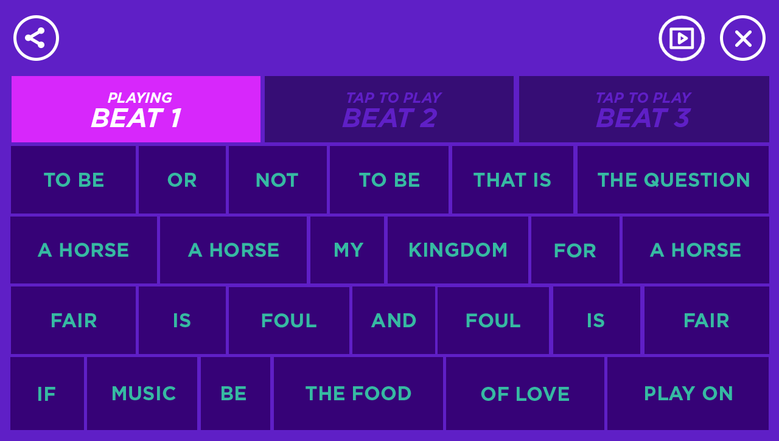
Art and Culture
Bringing creativity to our communities
Art and culture are integral to a vibrant, diverse, and cooperative community. Appreciation and engagement with art and culture spurs personal growth through self-expression and response, and brings people together over common values and shared experiences.
In this studio, we will build technology that enables people as creators, communicators, and empathetic citizens through engagement with arts and culture. We will seek opportunities where technology can complement our engagement with topics like literature, design, performance, music, journalism, visual arts, and with public spaces like community centers and organizations, libraries, museums, and historical sites.
Friday 12:30p-2:20p & 2:30p-4p @ 160-321

Slide 28

Kat Gregory
CS Undergrad + CS Masters in AI/HCI
Currently in a French Rural Village
I run marathons and love travelling!
Office Hours:
  Tu/Th 12:30-1:30pm @Lathrop
Friday 8:30-10:20p @ 160-314
Friday 10:30am-12:20pm @ 160-325

Slide 29
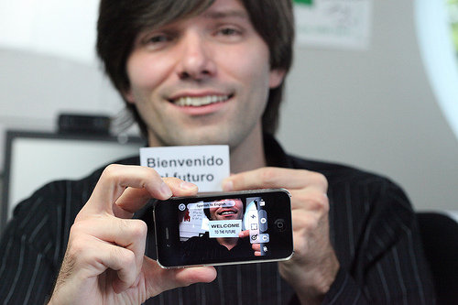
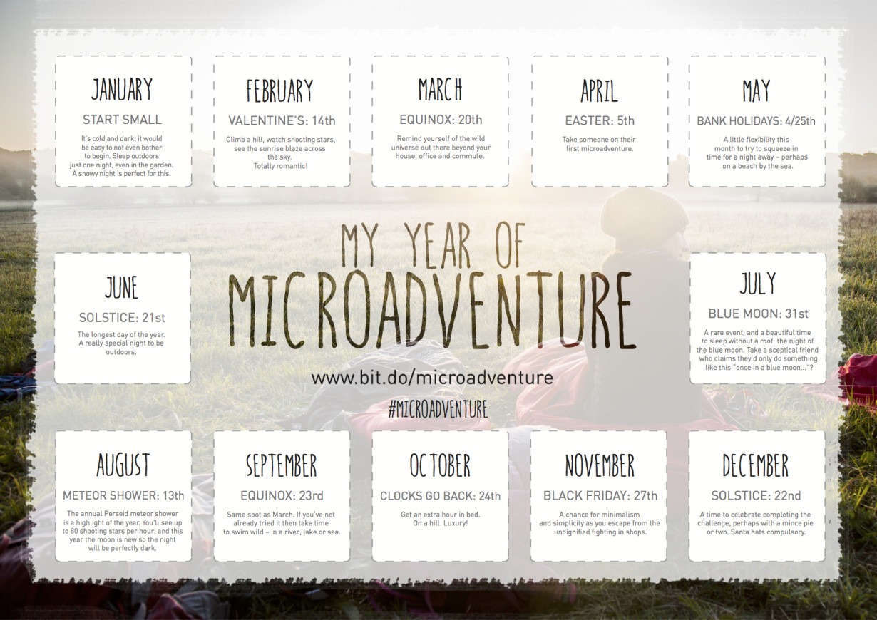
[Micro]Adventure
Help people get out there and adventure
Life’s about the journey, not the destination, yet too often the potential for adventure inherent in this journey is lost. The hunger to discover is easily forgotten in the clockwork tedium of commutes and errands that powers the hamster wheel of the every day. Even when actively pursued, the delight of exploring is often overwhelmed by a sea of stressful details regarding metro transfers and language barriers. How can we create opportunities for discovery and lower the barrier to exploration? The section seeks design solutions that rekindle playfulness, inspire wonder, and awaken wanderlust, both at home and abroad, to invite users to live more adventurously. "Get out there, take off your shoes, and Bilbo it up!”
Friday 8:30-10:20p @ 160-314
Friday 10:30am-12:20pm @ 160-325

Slide 30
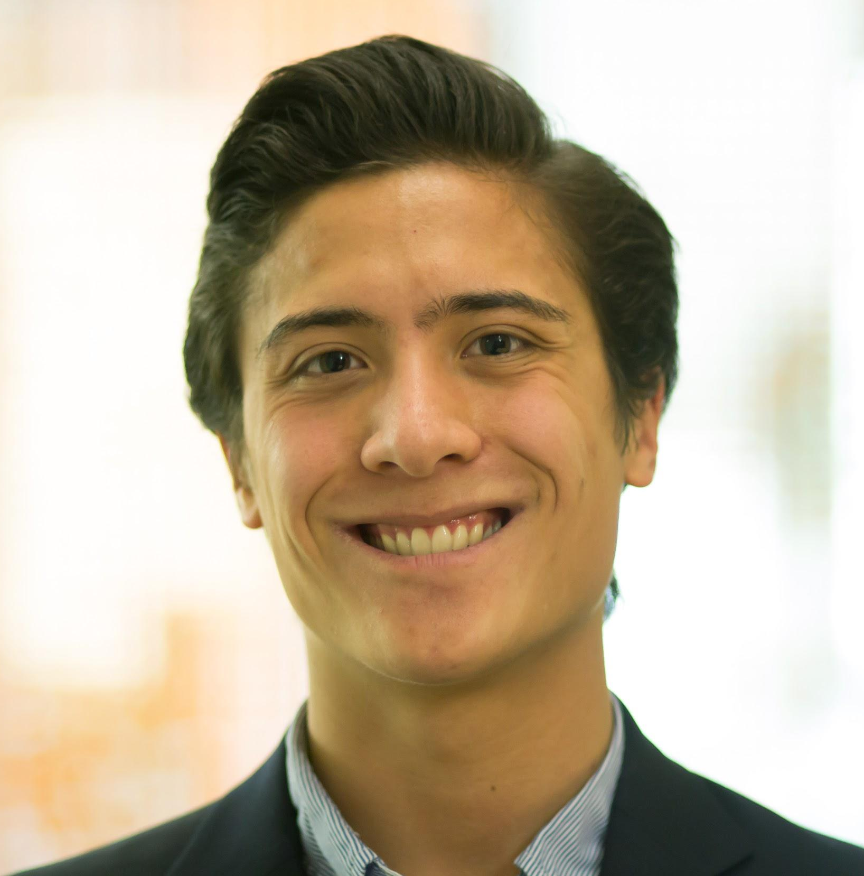
John Yang-Sammataro (YS)
BS CS Systems + MS CS HCI
Spent last year in Asia, a warzone, and an entourage
I like doing right, building teams, and exploring paths less traveled
Office Hours: (May change)
  Weds 3:00pm-4:00pm @ Huang Basement
  Thurs 12:30pm-1:30pm @ Lathrop Tech Lounge
Friday: 12:30pm-2:20pm @ 120-59
2:30pm-3:50pm @ 200-219

Slide 31
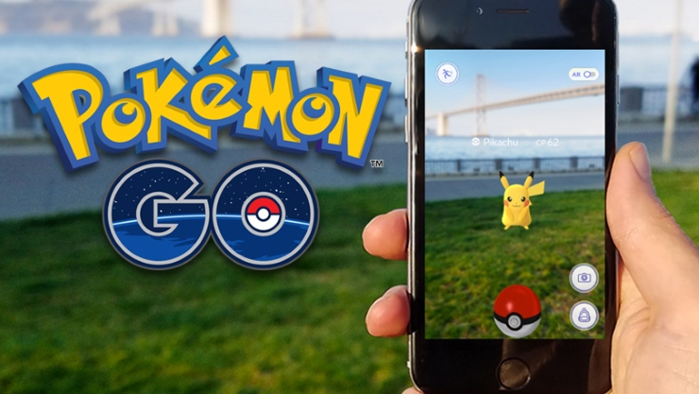
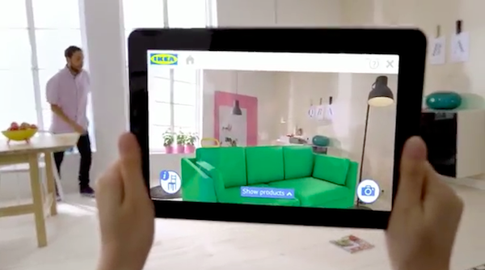
Mixed Reality
Merging Real and Digital Worlds
How can we leverage mixed reality - the merging of real and digital worlds through AR/VR to solve current needs? Pokemon Go took the world by storm this summer, but mixed reality spans far more than just games: Have you navigated with Waze recently? Did you know you can virtually try out your IKEA furniture? Mixed reality is even used to build houses. Have you used a Snapchat filter lately?
We will work at the bleeding edge of mixed reality in human computer interaction design. This will be an opportunity to use some of the latest software tools and hardware. It will also require focus and discipline to design and prototype solutions to real world problems and needs at a scope that can be accomplished within the quarter.
Friday: 12:30pm-2:20pm @ 120-59 2:30pm-3:50pm @ 200-219

Slide 32
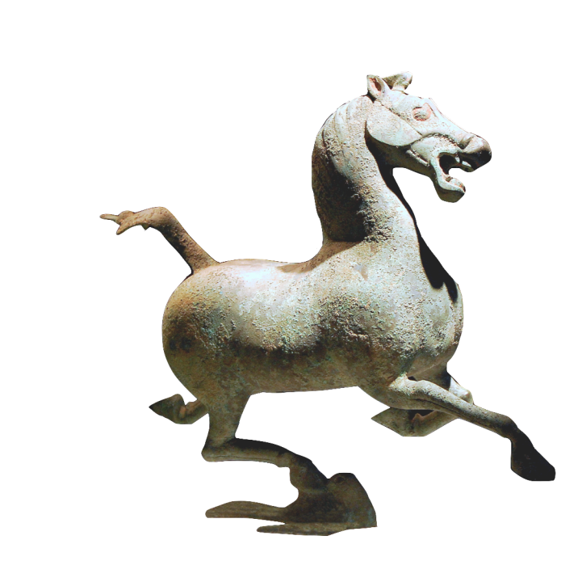
Notes:
For example, bronze galloping horse is 1 of most famous relics in China
from the Han dynasty. It is about 2000 years old
uncovered in 1969 in West of China. It shows a powerful horse that is so fast that it is literally flying. It treads on a small swallow that looks up in horror
This image doesn’t quite capture the liveliness & beauty of the original, which
baffled the experts who studied it for several years
Given technology of the day, couldn’t figure out how it was sculpted to maintain its balance

Slide 33

b a l a n c e
design
technology
Notes:
You need to find a balance between:
design & technology, human-centered approaches & CS approaches
Especially now HCI needs to find a balance between careful controlled experiments of existing technologies or minor tweaks on technology and building major new systems that can solve important world problems.

Slide 34


Human-Computer Interaction (HCI) Approach to UX Design
Human
  the end-user of a program
  the others they work or communicate with
Computer
  the machine the program runs on
  split between clients & servers
Interaction
  user tells the computer what they want
  computer communicates results
Notes:
So far you have probably studied lots about Computers, but
little about Humans and Interaction.
This course will concentrate on how these three areas come together.

Slide 35
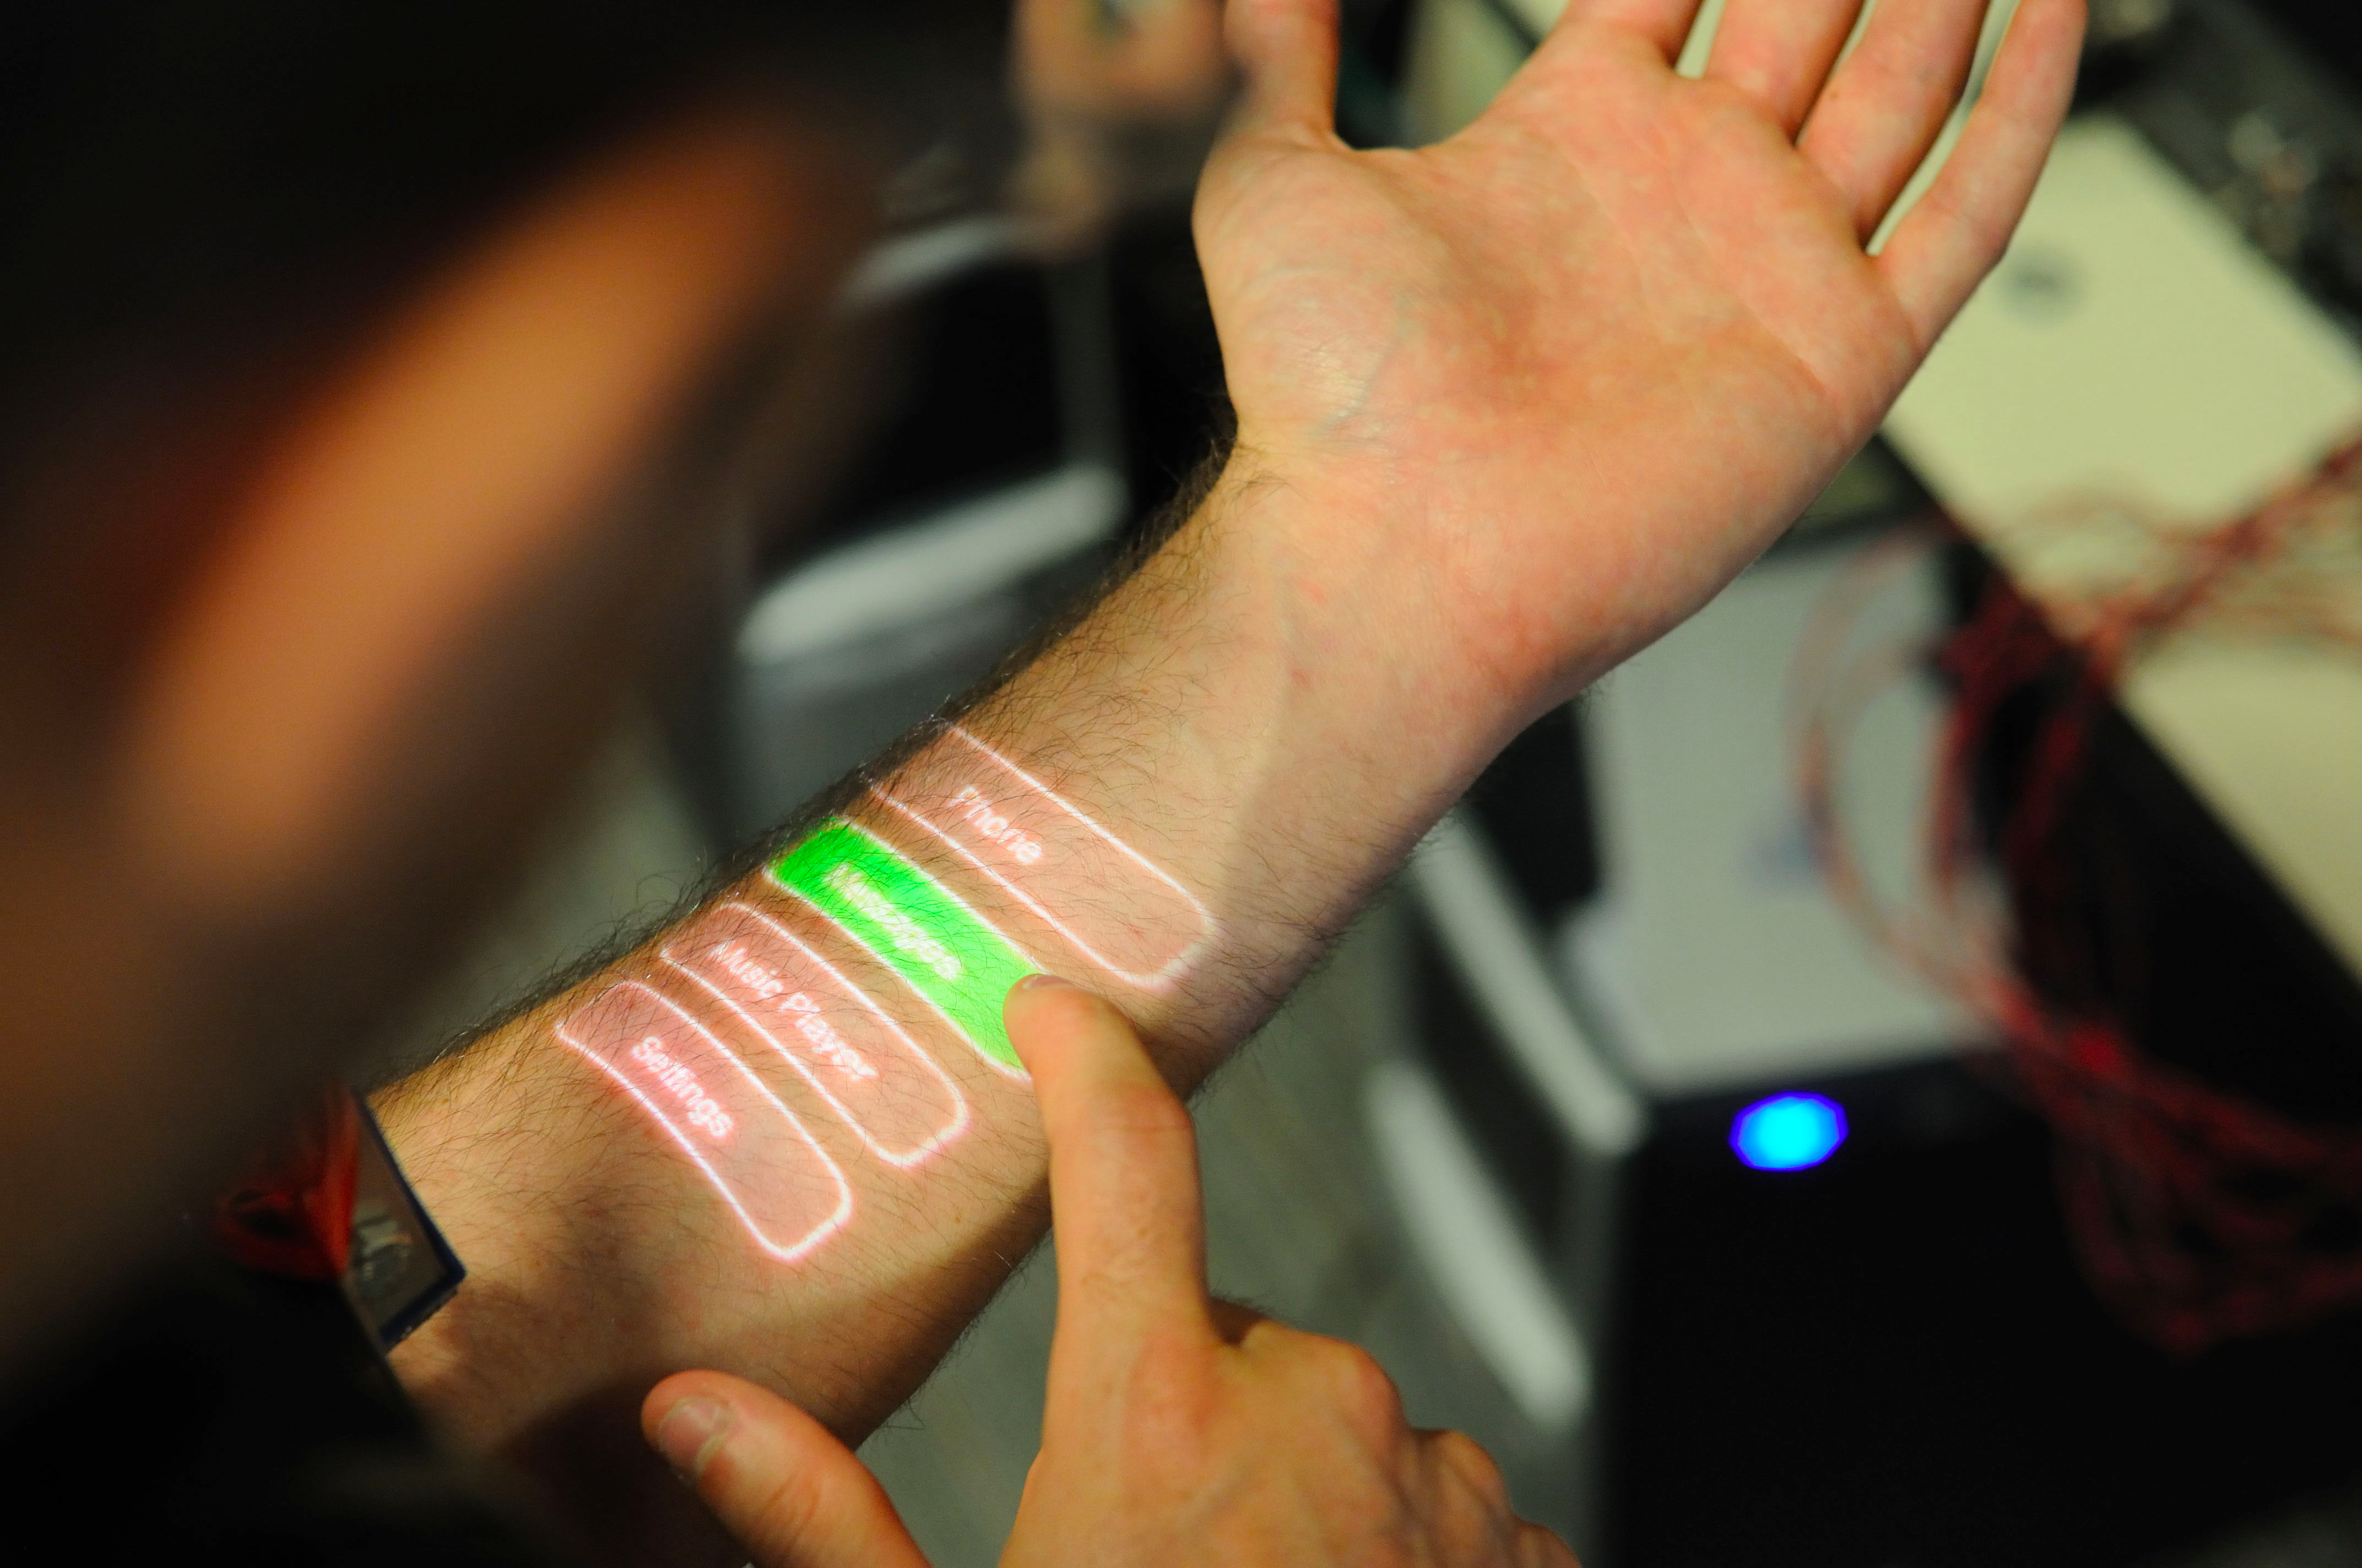
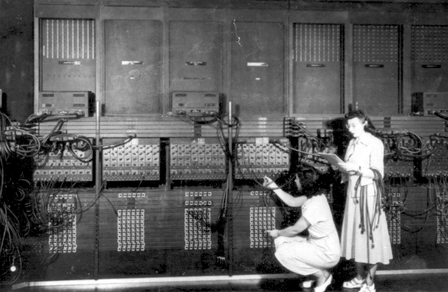
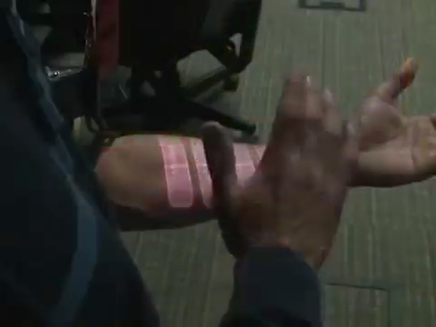
Notes:
Doesn’t just mean SCREENS (on laptop or phone)
Computers have changed significantly in the last 70 years and they will keep changing!

Slide 36





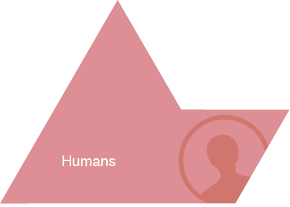
HCI Approach to UX Design
“People change their knowledge as they perform, i.e., they learn”
Notes:
Give Examples of Tasks/Activities:
activity:
learning history
high level taskl:
- writing a paper
- drawing a picture
low level task (operation):
- copying a word from one paragraph to another
- coloring a line

Slide 37

Why is HCI Important?
Major part of work for “real” programs
  approximately 50%
Bad user interfaces cost
  money
    5% satisfaction → up to 85%profits
    finding problems early makes them easier to fix
  reputation of organization (e.g., brand loyalty)
  lives (Therac-25)
User interfaces hard to get right
  people are unpredictable
  intuition of designers
  often wrong
Notes:
Solution is user-centered design. Why?
easier to learn & use products sell better
can help keep a product on schedule
finding problems early makes them easier to fix!
training costs reduced

Slide 38
Who Creates UIs?
A team of specialists (ideally)
  graphic designers
  interaction / interface designers
  information architects
  technical writers
  marketers
  program managers
  test engineers
  usability engineers
  researchers (ethnographers, etc.)
  software engineers
  hardware engineers
  industrial designers
  customers
Notes:
In this course you will wear the hats of many of these specialists.

Slide 39
How to Design and Build Good UIs
Iterative development process
Usability goals
User-centered design
Design discovery
Rapid prototyping
Evaluation
Programming
Notes:
These are the key steps we will go through in this course

Slide 40
break
Notes:
5-10 min

Slide 41



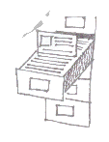



User Interface Development Process
Customers, Products,
Business, Marketing
Customers, Products,
Business, Marketing
Design
Discovery
Design
Exploration
Evaluate
Production
Customers:
- Roles (Who)
- Tasks (What)
- Context (Stories)
Marketing:
- Business Priorities
- Messages
Technology:
- Products
- Architecture
Design:
- Leading/competing
technologies
Work together to
realize the design
in detail
Evaluate with
Customers
Storyboard
Review & Iterate
Design Definition:
- Design Problem Statement
- Targeted User Roles (Who)
- Targeted User Tasks (What)
- Design Direction Statements
Proposal:
Demos/
Lo Fi Prototypes
(How)
Specification:
Hi Fidelity, Refined Design
- Based on customer feedback
- Foundation in product reality
- Refined Design description
based on slide by Sara Redpath, IBM & Thyra Trauch, Tivoli
Notes:
Our research found that almost all design organizations go through these key steps (sometimes with different names)

Slide 42
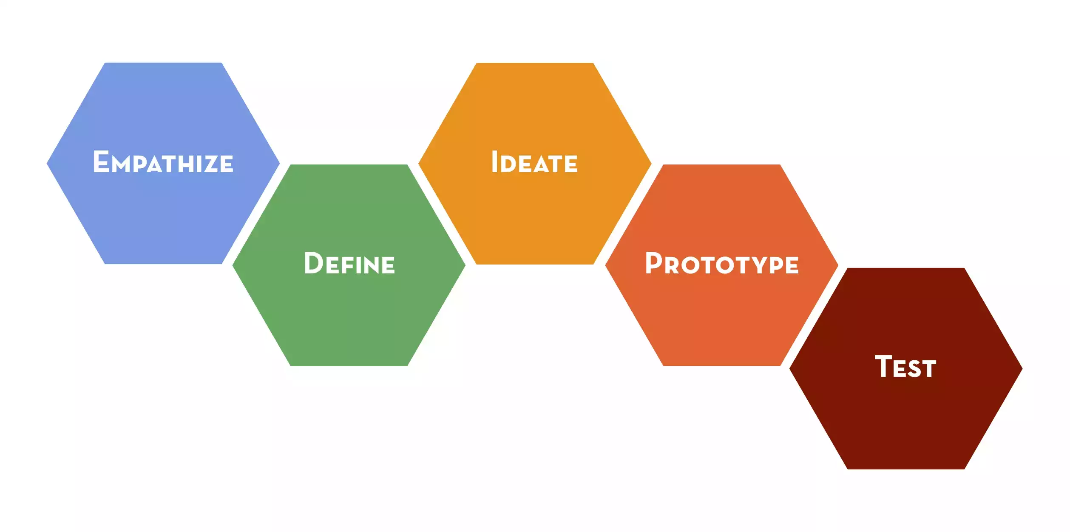
Design Thinking Process
Notes:
We will organize our work in CS147 with the Design Thinking Process popularized by ideo and the Stanford d.school

Slide 43
Iteration
At every stage!
Design
Prototype
Evaluate
Notes:
Iteration is a key at the high levels but also within each of these steps

Slide 44

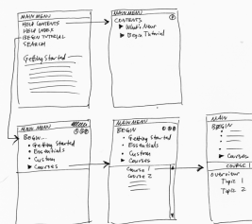
Design
Design is driven by requirements
  what the artifact is for
  not how it is to be implemented
  e.g., phone not as important as mobile app
A design represents the artifact
  for UIs these representations include (?)
    screen sketches or storyboards
    flow diagrams/outline showing
    task structure
    executable prototypes
  representations simplify
Notes:
So let's talk more about "design"

Slide 45
Usability(?)
According to the ISO:
The effectiveness, efficiency, and satisfaction
with which specified users achieve specified
goals in particular environments
This doesn’t mean you have to create a “dry” design
Notes:
or something that is only good for novices – it all depends on your goals

Slide 46
Usability/User Experience Goals
Set goals early & later use to measure progress
Goals often have tradeoffs, so prioritize
Example goals(?)
  Learnable
    faster the 2nd time & so on
  Memorable
    from session to session
  Flexible
    multiple ways to do tasks
  Efficient
    perform tasks quickly
  Robust
    minimal error rates
    good feedback so user can recover
  Discoverable
    learn new features over time
  Pleasing
    high user satisfaction
  Fun
Notes:
DO THIS ON THE BOARD!!!

Slide 47
User-centered Design
“Know thy User”
Cognitive abilities
  perception
  physical manipulation
  memory
Organizational / educational job abilities
Keep users involved throughout
  developers working with target customers
  think of the world in users’ terms
Notes:
`

Slide 48
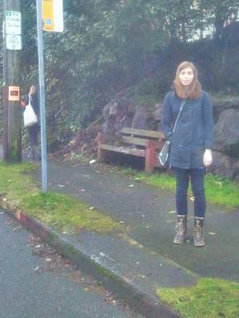
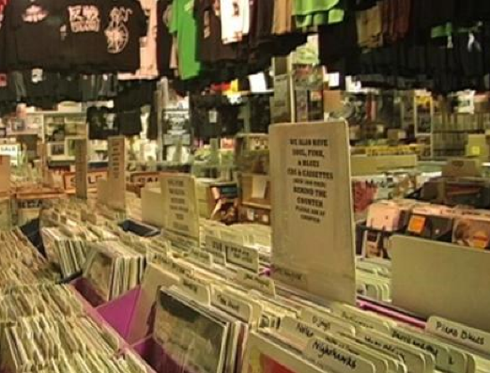
Design Discovery
Needfinding, Contextual Inquiry & Task Analysis
Observe existing practices for inspiration
Make sure key questions answered
Tuned CI participant
Tuned field work in record store
Notes:
Start with this CI design sketch, but required many examples (over 30 on 1st assignment) on each subsequent assignment from different folks on the team

Slide 49
Concept Videos
Illustrate context of use rather than specific UI
Quick to build
Inexpensive
Forces designers to consider details of how users will react to the design
More important when context is not traditional work scenario

Slide 50
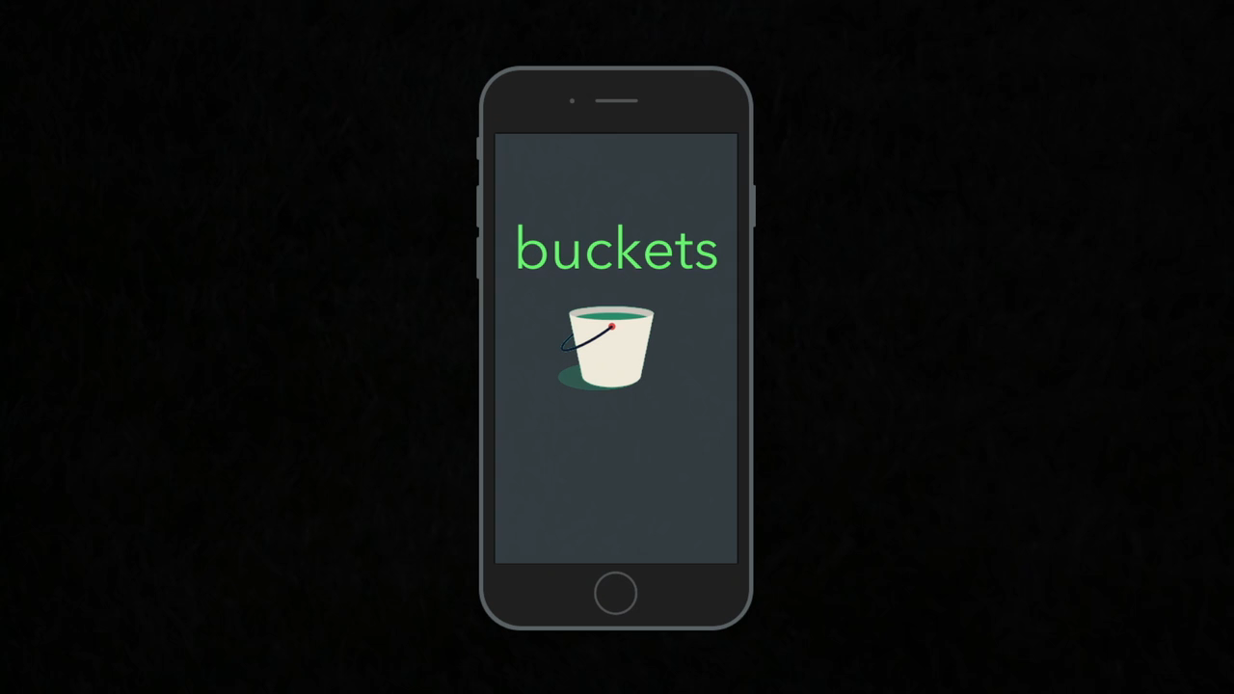
Notes:
There isn’t even technology shown in this video… it is telling the story of the idea

Slide 51
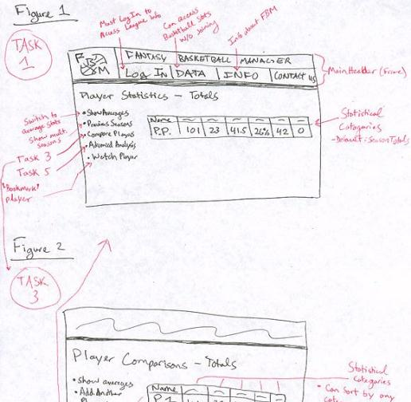
Rapid Prototyping
Fantasy Basketball
Build a mock-up of design
so you can test it
Low fidelity techniques
  paper sketches
  cut, copy, paste
Interactive prototyping tools
  HTML, SketchFlow, Balsamiq, Axure, proto.io, Sketch+Marvel, etc.
UI builders
  Expression Blend + Visual Studio, Xcode Interface Builder, etc.

Slide 52
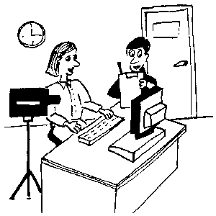
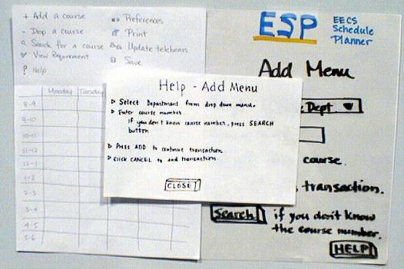
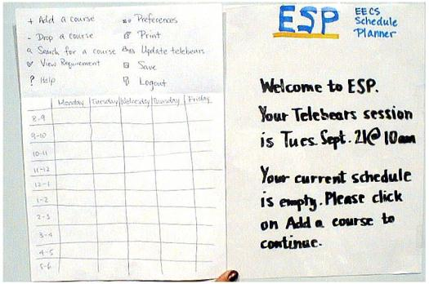
Evaluation
Test with real customers (participants)
  w/ interactive prototype
  low-fi with paper “computer”
Low-cost techniques
  expert evaluation
  walkthroughs
  online testing
ESP
Notes:
All about trying to measure what works and what does not

Slide 53
Goals of the Course
Learn to design, prototype, & evaluate UIs
  the needs & tasks of prospective customers
  cognitive/perceptual constraints that affect design
  technology & techniques used to prototype UIs
  techniques for evaluating a user interface design
  importance of iterative design for usability
  how to work together on a team project
  communicate your results to a group
      key to your future success
Understand where technology is going &
what UIs of the future might be like
Notes:
I WANT YOU TO PUSH THE LIMITS! Don’t just design what you KNOW can be easily created today.
Students in the past have LED many years ahead of industry

Slide 54
Course Format
Interactive lectures ➔ you speak!
Each week
  2 lectures on techniques & background
    reserved 20-30 minutes team meeting each lecture ➔
    you need to be here to work with your team
  1 studio hands-on activity or team presentation
Quarter-long project
Readings
Course material will be online
  slides, exercises, readings, schedule
  no lecture video (a few from 2014 you an watch if needed)
Have fun & participate!

Slide 55
How dt+UX Fits into CS Curriculum
Most courses for learning technology
  compilers, operating systems, databases, etc.
dt+UX concerned w/ design & evaluation
  technology as a tool to evaluate via prototyping
  skills will become very important upon graduation
    complex systems, large teams
    don’t look for large immediate impact in other CS courses

Slide 56
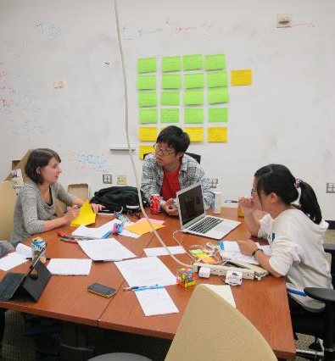
Projects
Each team will propose a UI-oriented project idea / team
  fixing something you don’t like or
  completely new idea
  based on team needfinding
Theme
  each Friday studio has a theme
  all projects mobile/wearable
Groups
  3-4 students to a group
  work with students w/ different skills/interests
  groups meet in class & studio weekly
Cumulative
  apply several HCI methods to one interface
Notes:
Team’s will be graded as a team, but individuals who let their team down will be graded appropriately at the end of the term
If you do NOT have the time to take this course and do the intense project, please drop it now.
Especially students who may be from other programs beyond engineering who aren’t used to the time commitment, please make sure you can do your share.

Slide 57
Project Process (10 weeks)
Break into teams (Fri)
Needfinding
  In studio presentations & critiques
Experience prototypes
  In studio presentations & project selection
Concept videos
  In studio viewing & critiques
Low fidelity prototyping & user tests
  In studio presentations & critiques

Slide 58
Project Process (10 weeks)
Medium-fi prototype (using tools)
  In studio presentations & critiques
Heuristic Evaluation of medium-fi prototype
  In studio group merge exercise
High-fi prototype (code on target platform)
  Half-way in studio presentations & critiques
Poster presentations & demos at
project fair with industry guests
  Friday 12/9 6-9 PM
  your participation is required

Slide 59
Project Process Timeline
Needfinding
Concept
Video
Medium-fi
Prototype
High-fi
Prototype
Experience
Prototypes &
Testing
Low-fi
Prototype
Heuristic
Evaluation
Project Fair
Week 2
Week 4
Week 5
Week 6
Week 7
…
Week 10
Week 3
Week 8

Slide 60
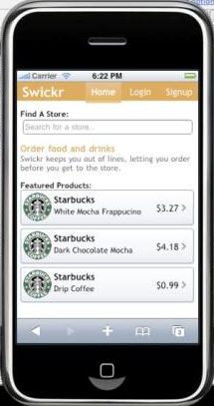
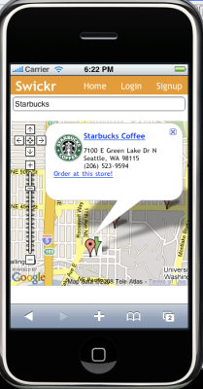
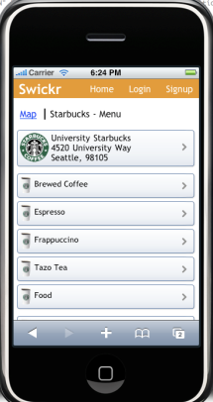
Swickr

Slide 61
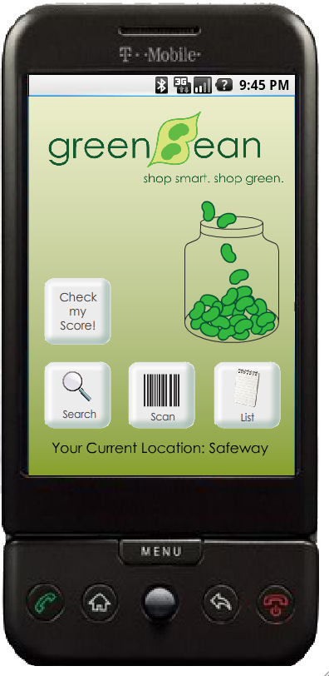
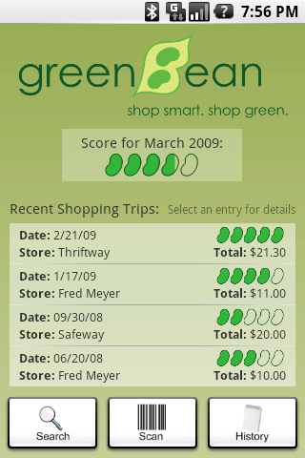
GreenBean

Slide 62
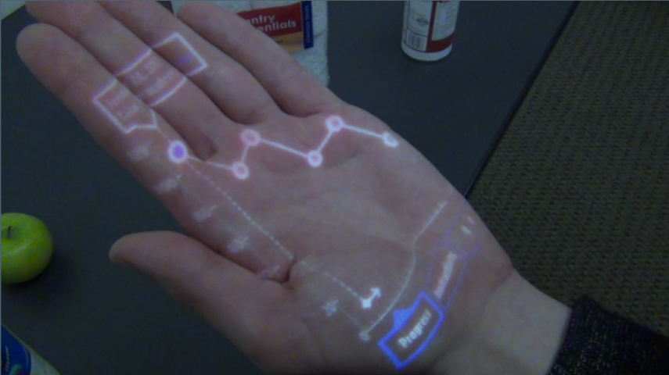
CarbonShopper

Slide 63
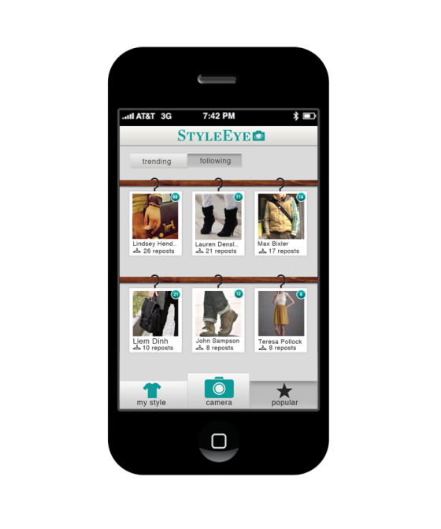
StyleEye

Slide 64
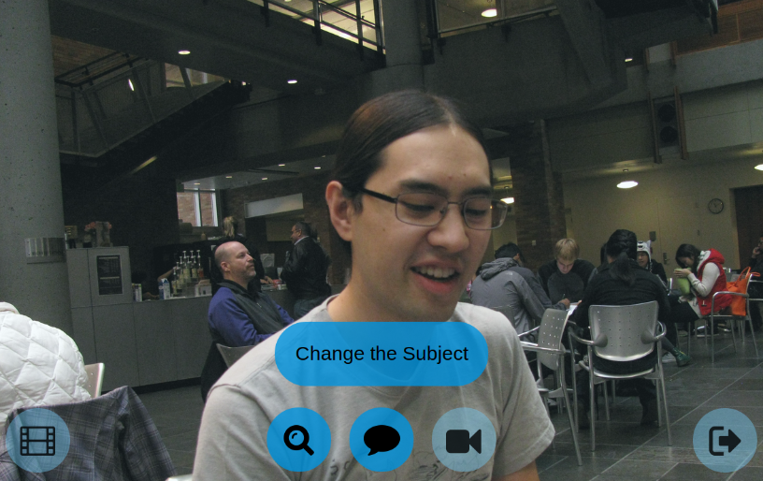
ProjectHarmony

Slide 65

Musistantat

Slide 66

Balancer

Slide 67




Food Dude

Slide 68





Cookable

Slide 69




Token

Slide 70







NightOwl

Slide 71
Books
The Design of Sites by van Duyne, Landay, & Hong
  online copies of the 3-4 chapters we will use
We will also hand out other papers, give you web links, & refer to lecture slides
Recommended textbook
  Designing the User Interface: Strategies for Effective Human-Computer Interaction by Shneiderman et. al, 6th edition (2016)

Slide 72
Assignments
Individual
  1-2 presentations each
  1-2 written (handed in online)
  class & studio participation (graded)
Group
  10 assignments
    5-6 presentations with 3 write-ups + video + poster
  all group work handed in online
    team web site & online submission site

Slide 73
Grading
A combination of
  individual assignments & presentation (10%)
  class/studio participation (10%)
  midterm (20%)
  group project (60%)
    presentations/poster (group component)
    project write-ups
No final
  must present at project fair on Fri., 12/9 instead

Slide 74
Tidbits
Late Policy
  no lates on group assignments
  individual assignments lose one letter grade/day
Course web site
  http://hci.stanford.edu/courses/cs147/2016/au/
Studio preferences & team signups
  https://goo.gl/RNKzJb
  due Wed at 5 PM

Slide 75
Summary
UX design is an important part of most of today’s software
Getting the interface right is hard, but…
Solution in Iterative Design including repeated cycles of
  Design
  Prototyping
  Evaluation
Notes:
You’ll be great at being able to do this after this course if you participate in your team’s work

Slide 76
Next Time
Design Discovery
Read
  Tom Kelley, The Perfect Brainstorm, Excerpt from The Art of Innovation (pw: hcid)
  Holtzblatt & Beyer, Ch. 3 from Contextual Design

