Slide 1
EcoKick
Medium-Fi Prototype
Eric Hermann
Jonny Leung
Ngoc Bui

Slide 2
HELP THE EARTH, PAY IT FORWARD
Notes:
Problem: How to get people to collectively invest in making a difference in the environment?

Slide 3
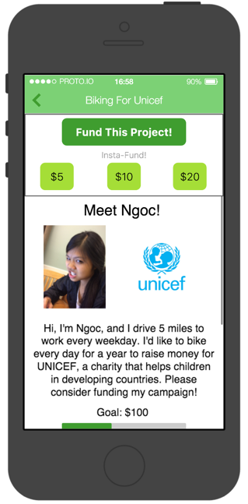
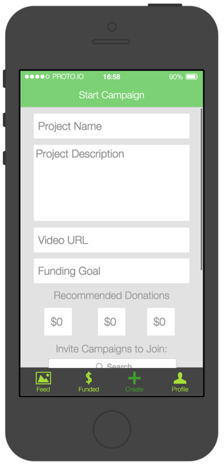
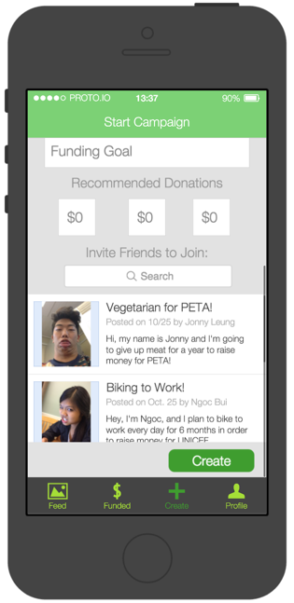
Tasks
Fund a Project
Start a Campaign
Start a Movement

Slide 4
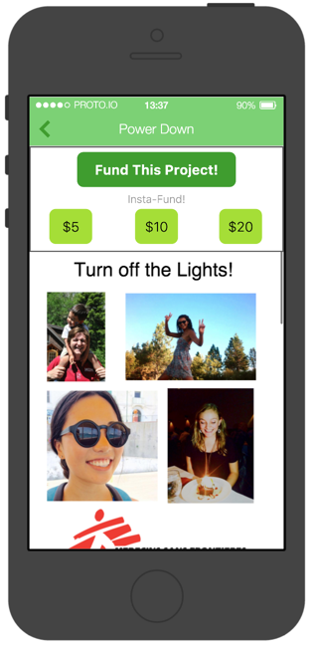
Task Change
Embedded creation of movements into starting a campaign

Slide 5
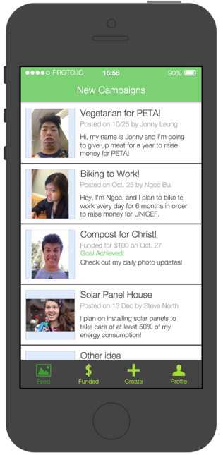
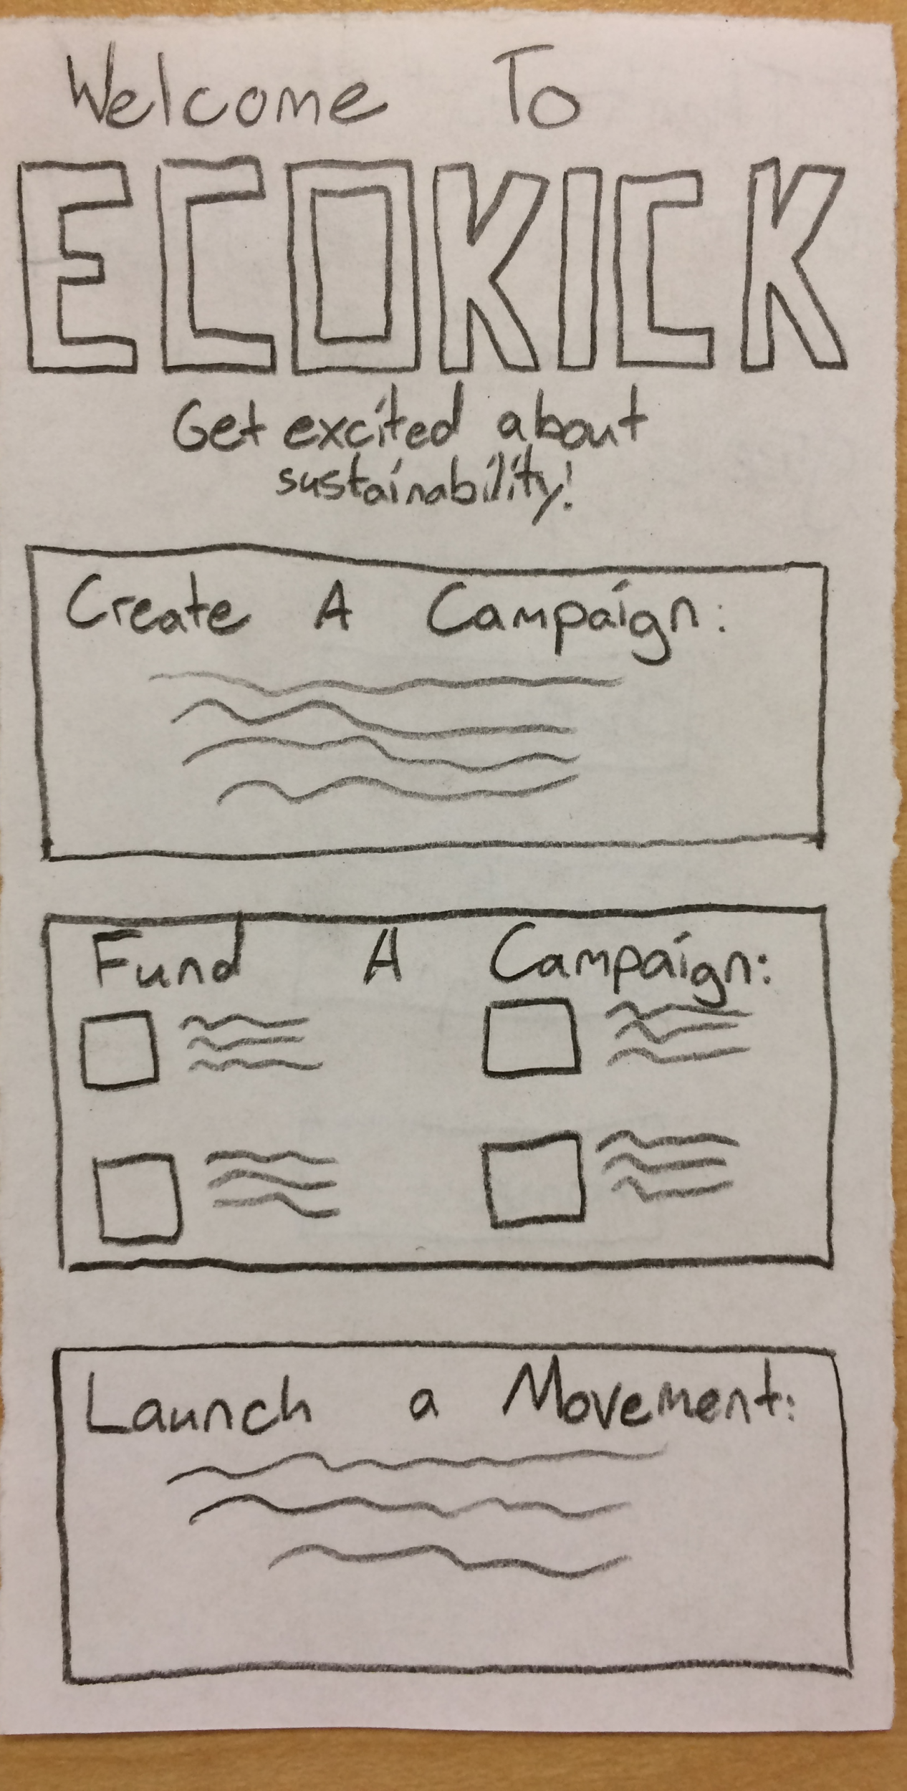
Page navigation made easy
Made it easier to navigate and move through options

Slide 6
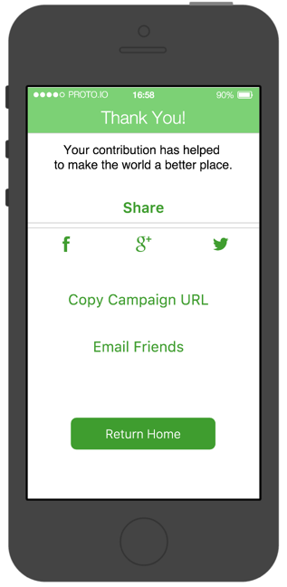
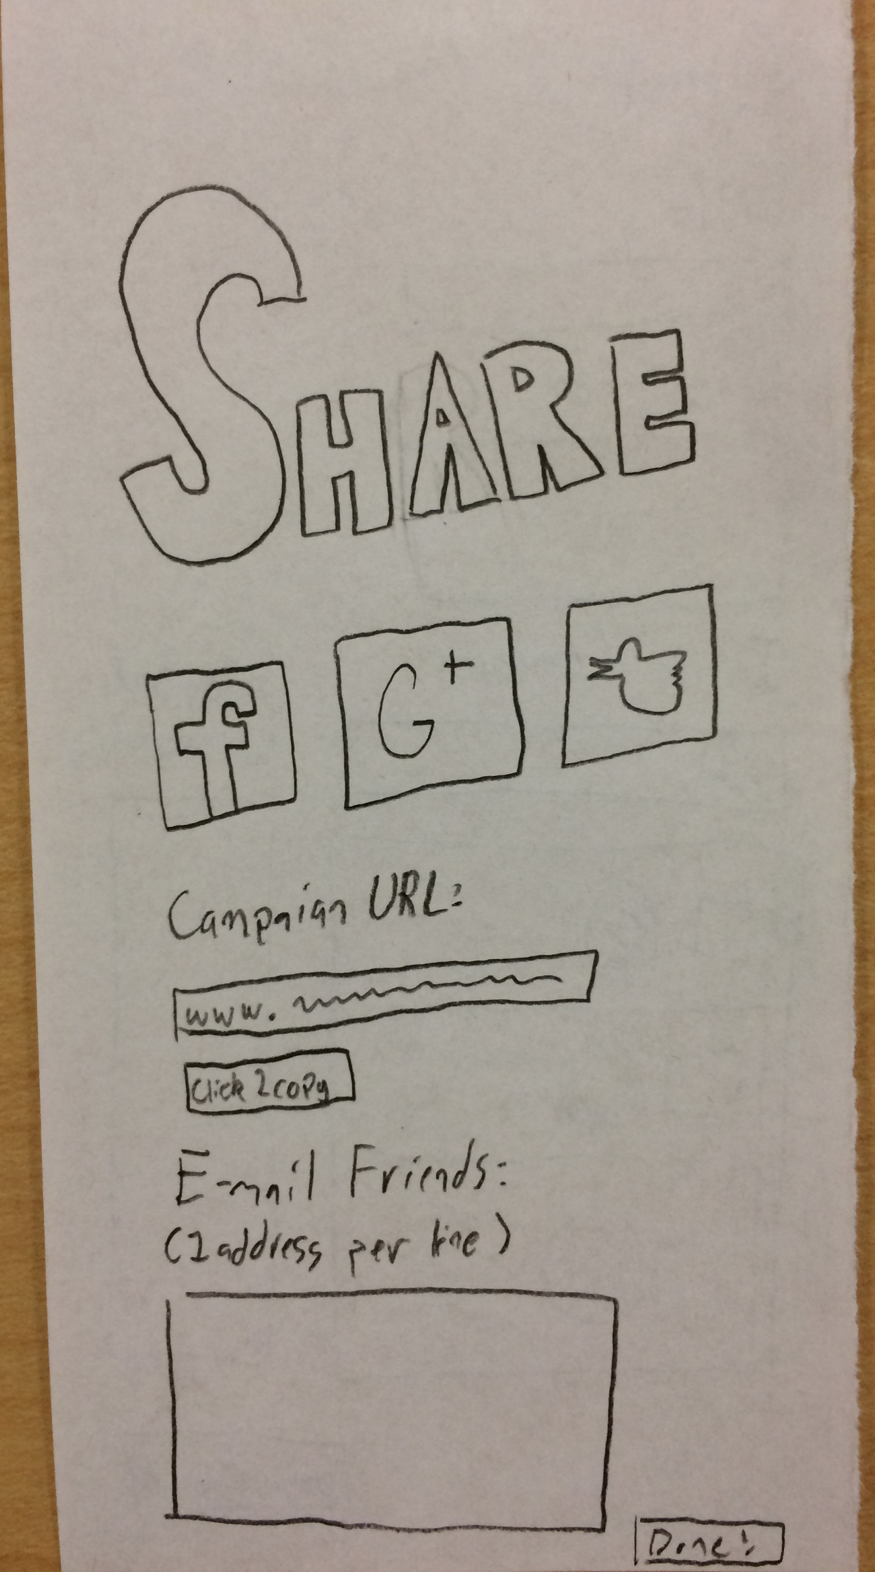
Simplified sharing
Sharing a project was made more intuitive and less messy

Slide 7
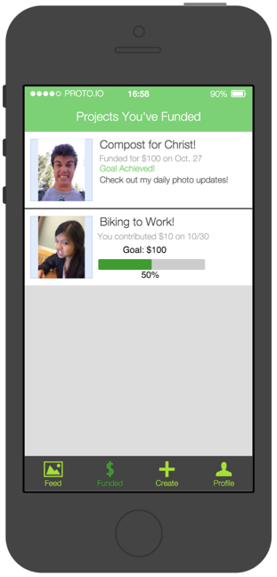
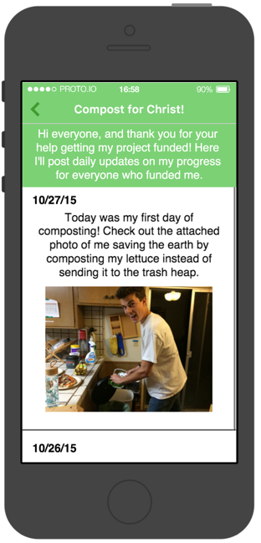
Get updates on projects
Check campaign or movement progress
Notes:
Can follow progress of your own or others’ campaigns and movements

Slide 8
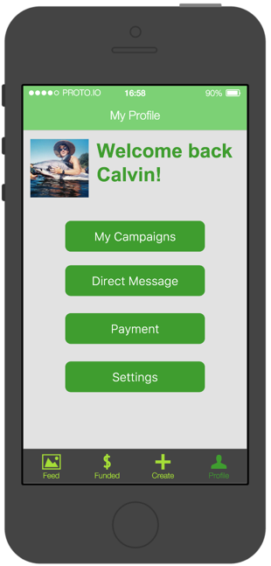
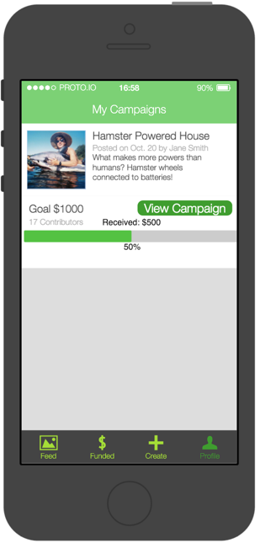
See how you’re doing
Check your progress on your own campaigns or movements

Slide 9
Task 1: Fund a Campaign

Slide 10
Task 2: Start a Campaign

Slide 11
Task 3: Start a Movement
Cleaner and easier to use
Will add new functionality for joining and starting movements for hi-fi prototype

Slide 12
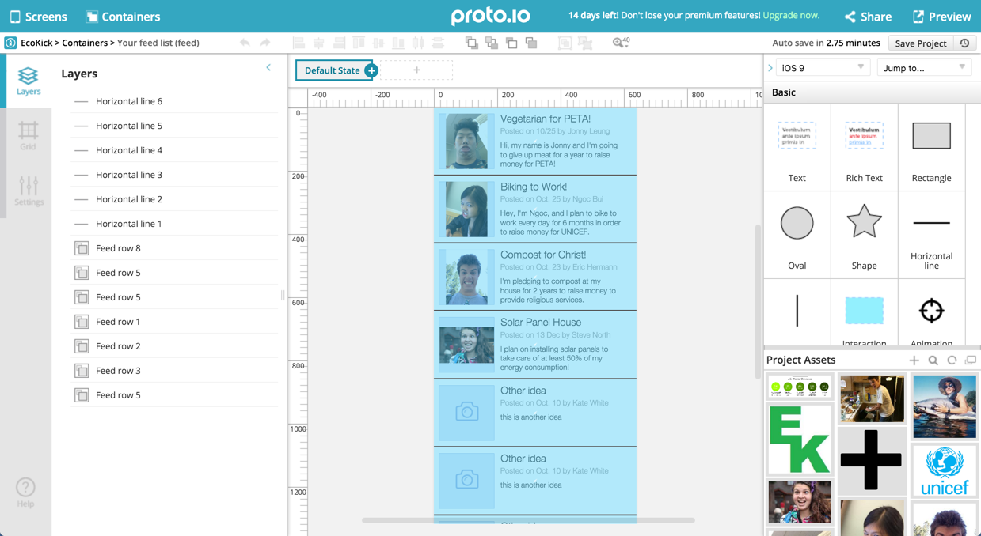
Prototyped with Proto.io
Online tool which allows you to create screens navigable with actions
Container use allows you to distribute changes easily
Lots of scaffolding, intuitive tools, very easy to use
Color schemes not easy to change or create

Slide 13
Prototype Limitations
Can’t show actual changes in system based on user actions
Users limited by screens we designed
Movement features not fully fleshed out
No dynamic content creation
Notes:
All of these were because our prototyping tool doesn’t allow dynamic creation of content. We tried to use Wizard of Oz techniques by coming up with campaigns for you and campaign ideas for you to use

Slide 14
Smoke and Mirrors
We designed our own campaigns for you to fund and browse

Slide 15
Thank You!
We encourage you to check out our website:
http://goo.gl/oPo8y9

