Slide 1
EcoKick
Low-Fi Testing
Eric Hermann
Jonny Leung
Ngoc Bui

Slide 2
Overview
Development
Testing
Findings
Notes:
How we went from sketches to prototype idea
How we tested the prototype
What we learned from testing

Slide 3
Individual Apathy
Collective Action
Notes:
The problem:
Our team wanted to address the lack of action amongst the normal person when it comes to the environment -- even when people express that they care a lot about the Earth. We found this stemmed from an inability to see the impact, a lack of information, or at times plain disinterest.
The solution:
EcoKick strives to promote environmental and social impact through a crowdfunding platform for sustainable actions that enables people to “pay it forward”.

Slide 4
PAY IT FORWARD
Notes:
Our value proposition is ‘pay it forward’. It reflects the mission of our app: to start a collective movement for sustainable living by encouraging individuals to make sustainable decisions through earning money for a social cause.

Slide 5
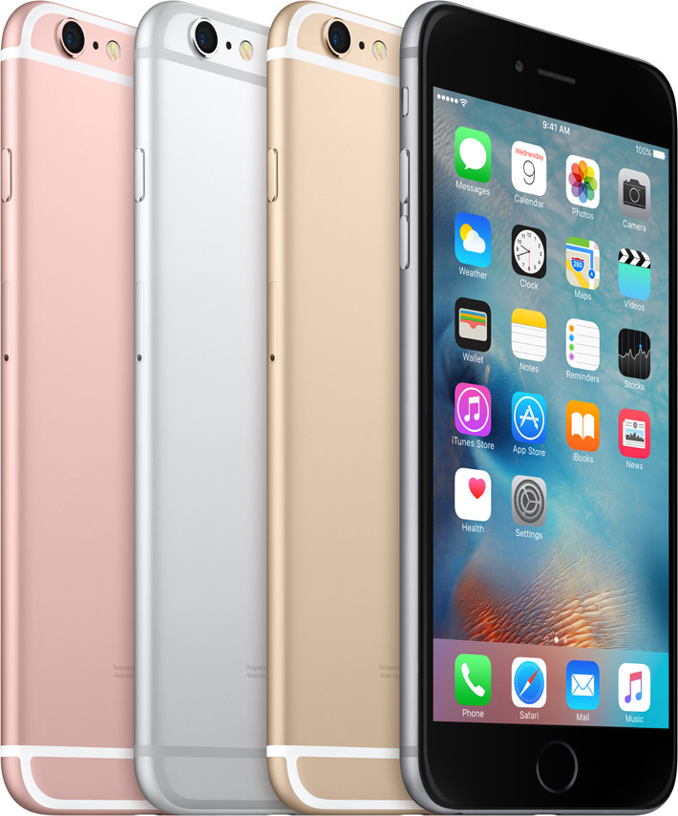
Selected Interface
Notes:
We sketched up 15-20 designs of a web platform, a mobile app, a Google Glass interface, and a wearable design with a watch.
After creating the designs, we discussed the limitations and advantages of each format.
We quickly decided against wearable because it wasn’t very easy to gather input. This is crucial in starting campaigns and movements.
Web: bigger pages, more room, more robust functionality; not as accessible all the time
Mobile app: easy to connect with social media (social sharing is fundamental to our app), people prefer mobile; smaller, harder to create something that transcends platforms (Android, iOS, etc)
We ended up choosing mobile -- people are always on their phone, it makes connecting with other social apps easy, and we wanted a simple interface which a mobile platform necessitates given the smaller screen.

Slide 6
Tasks
Simple Medium Complex
Fund a campaign
Create a campaign
Create a Movement
Notes:
The three tasks we created represent the core actions of EcoKick.
It lets people start campaigns to be sustainable, get money for it which they pay it forward to a social cause, and start movements around a shared action or cause.

Slide 7
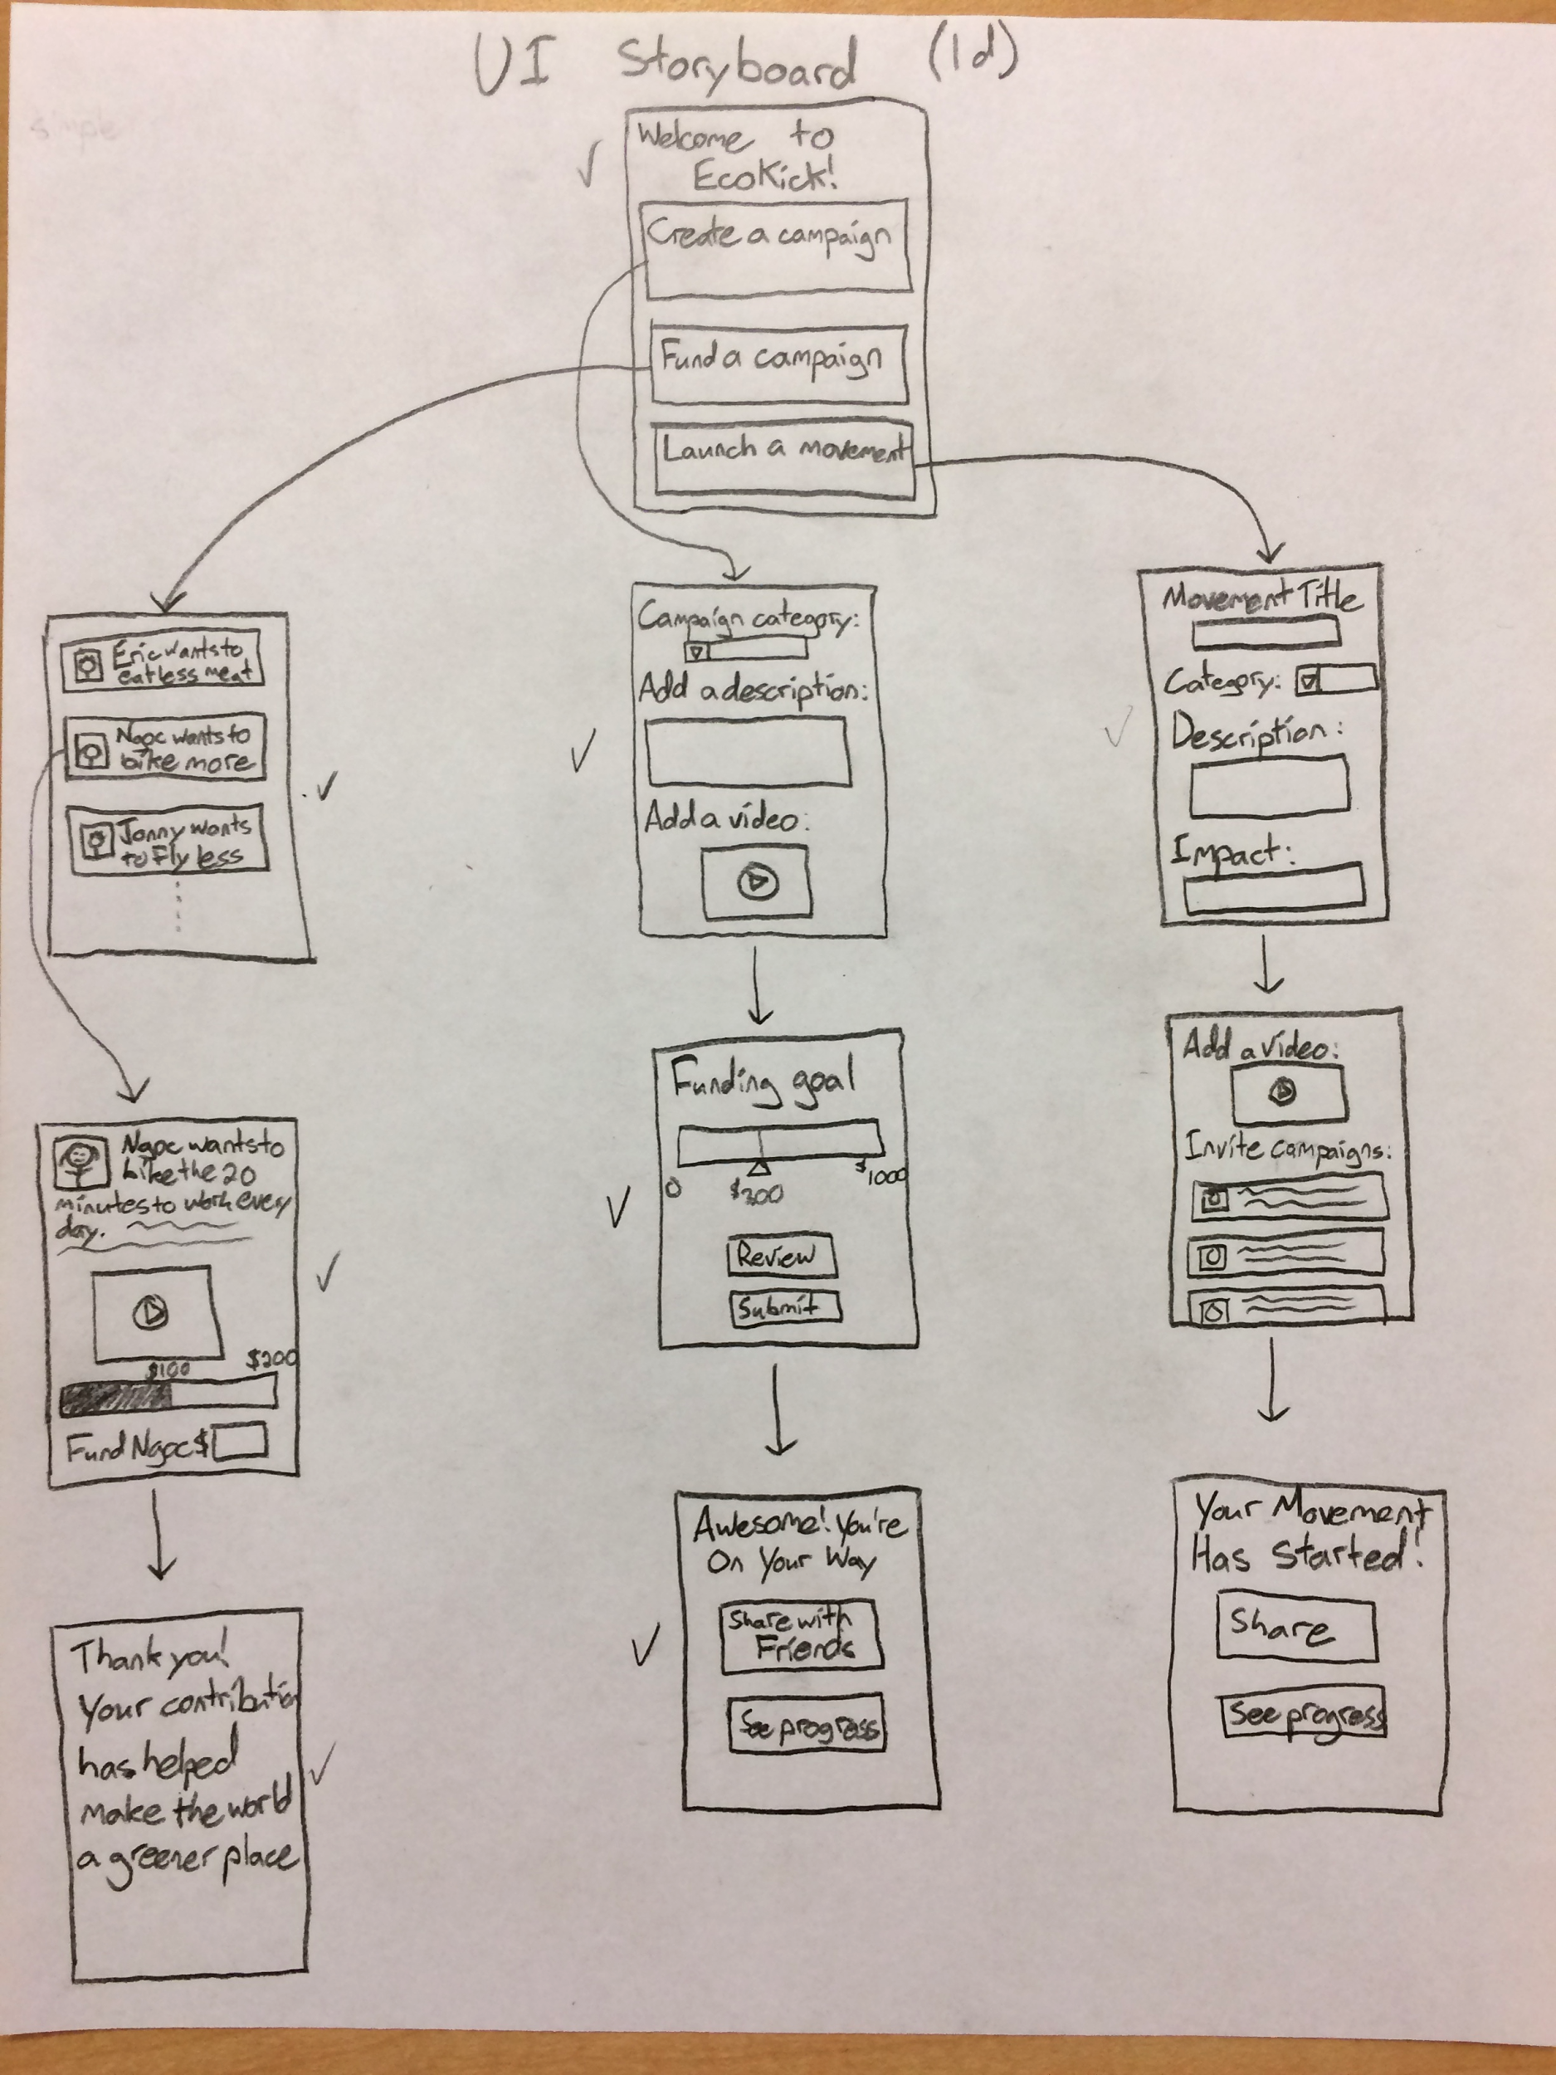
Task Flows

Slide 8
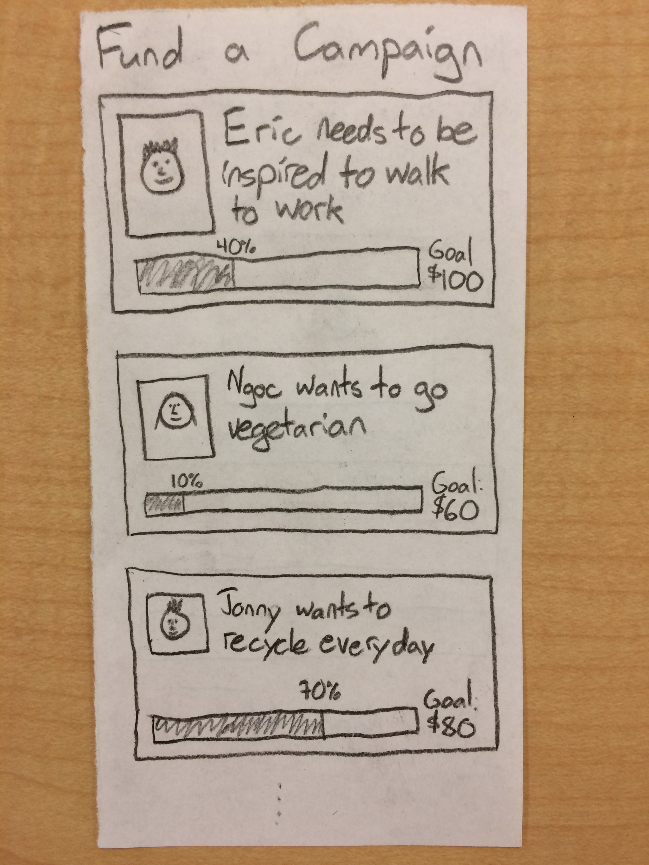
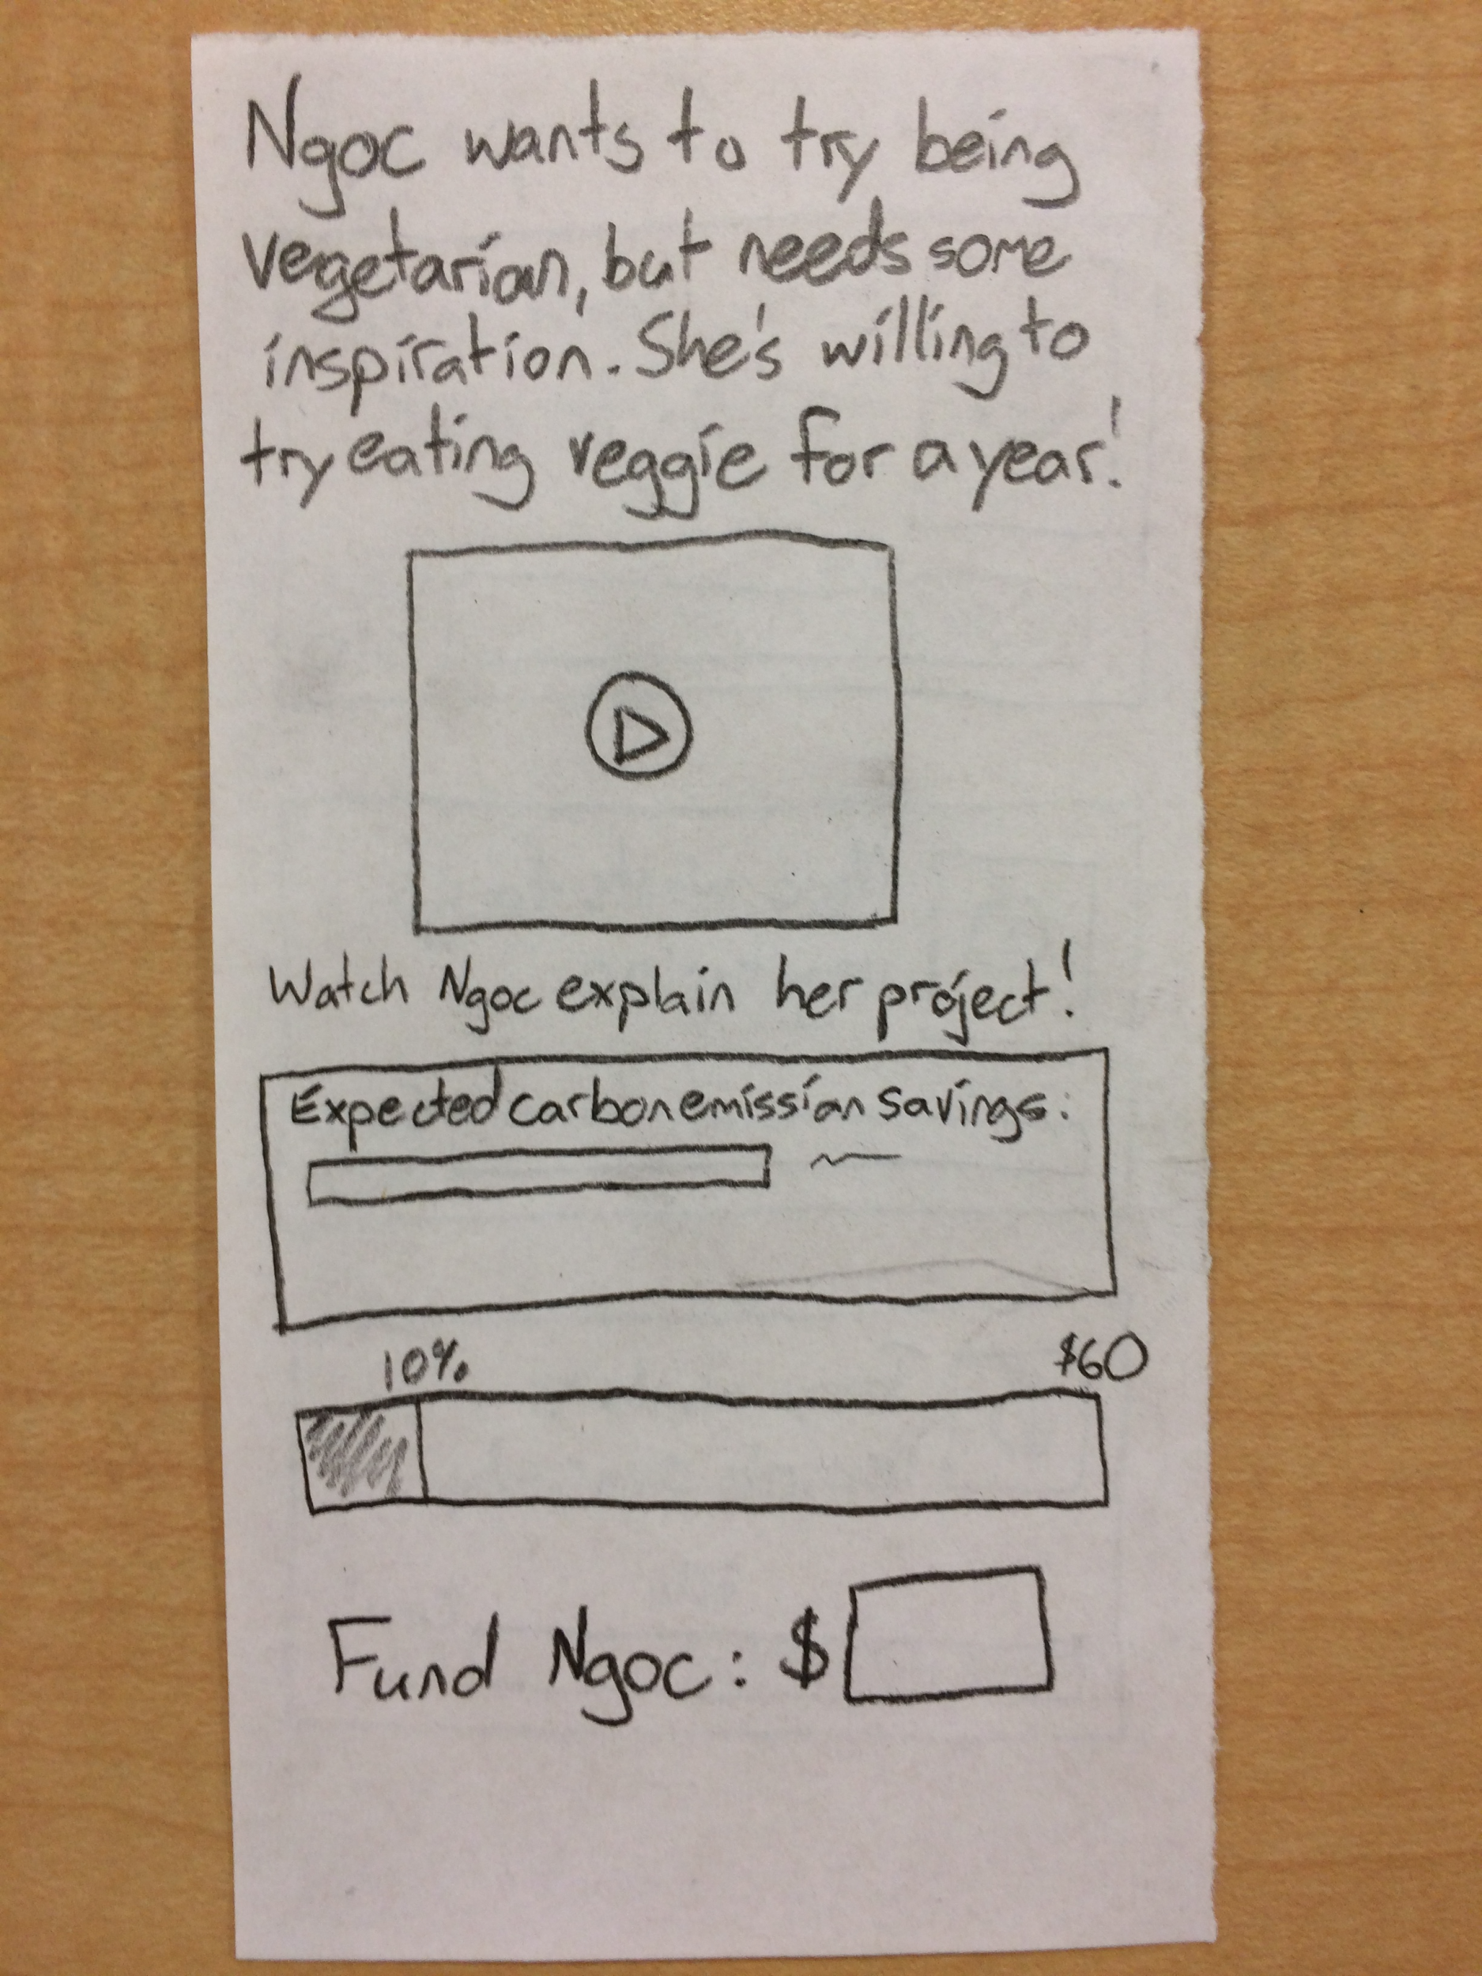
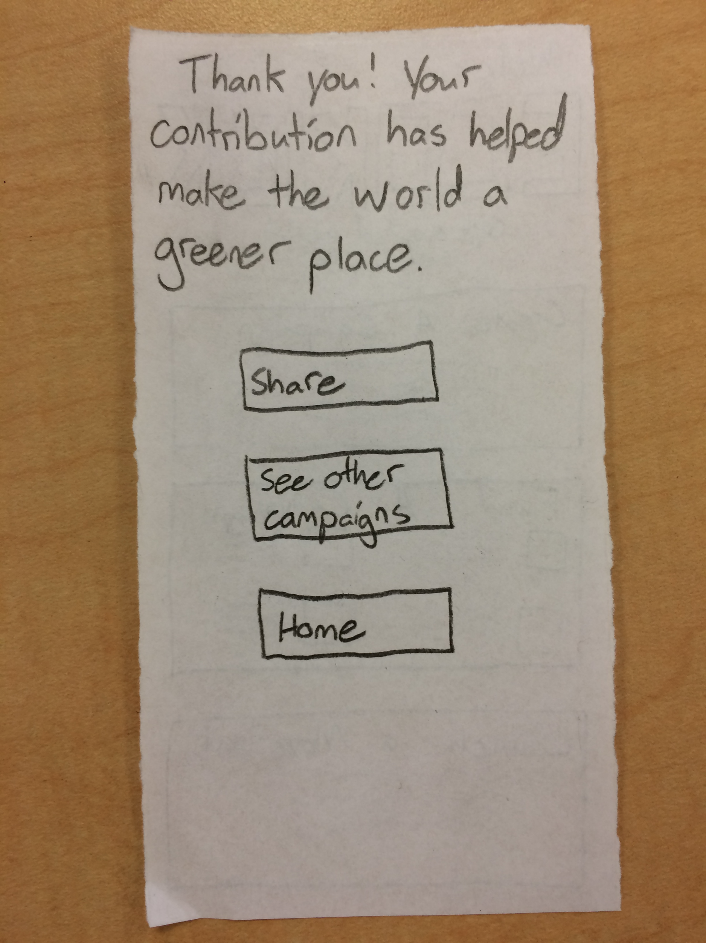
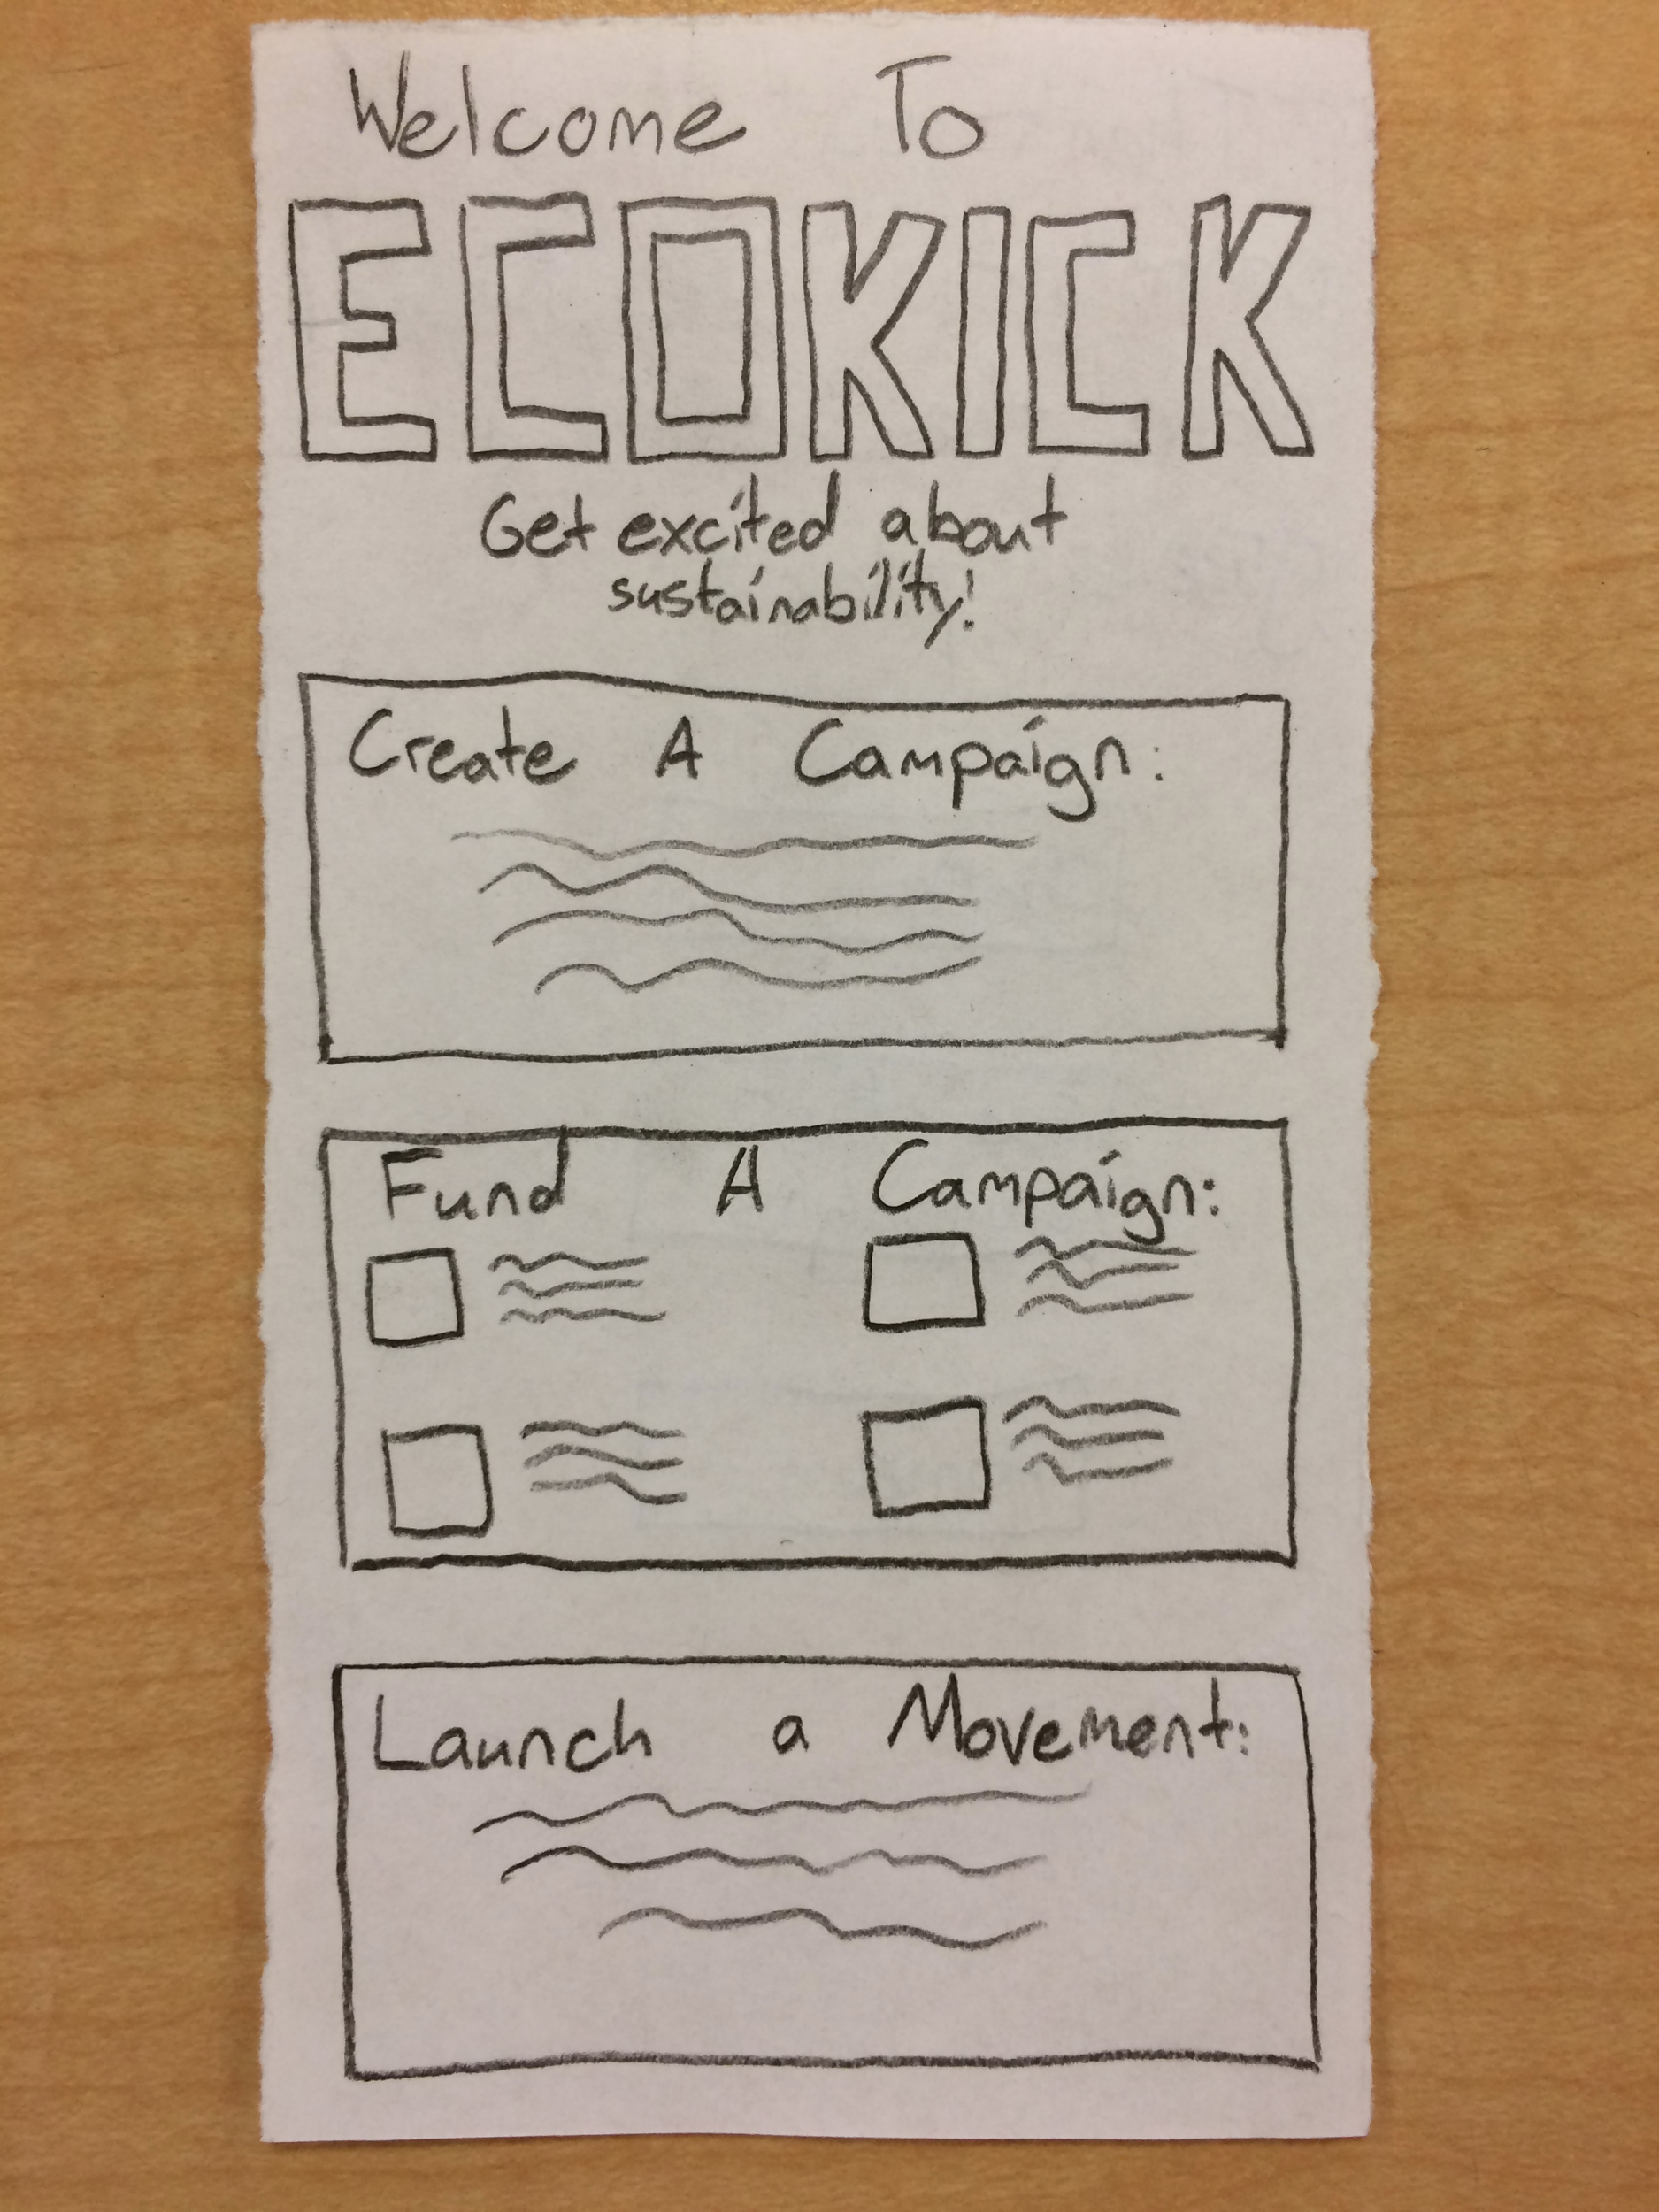
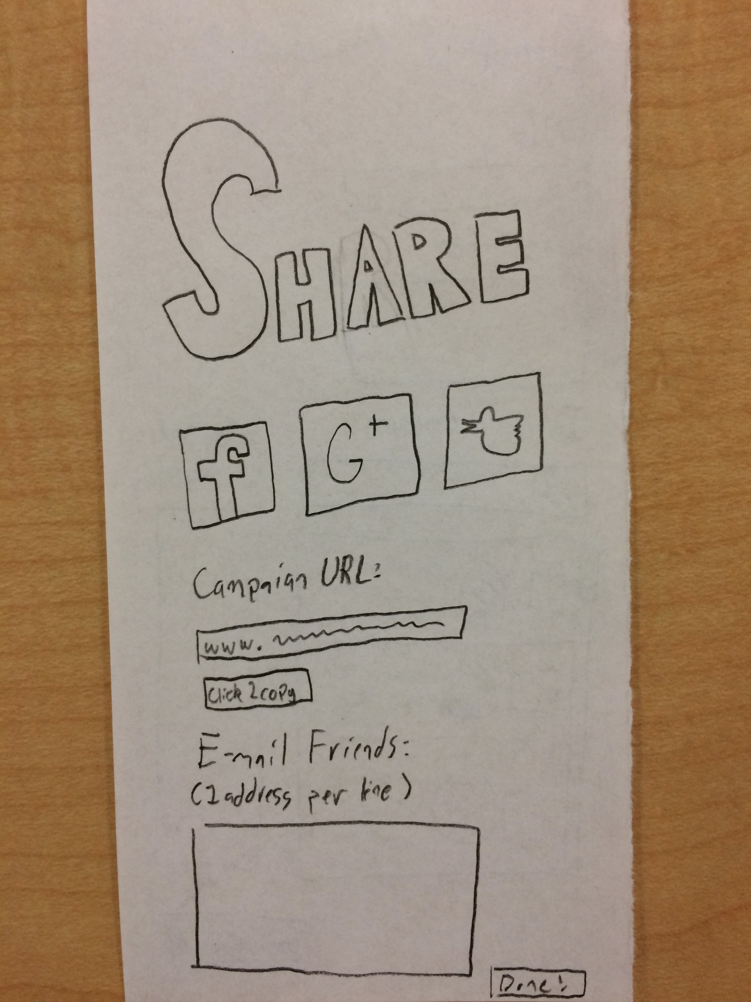
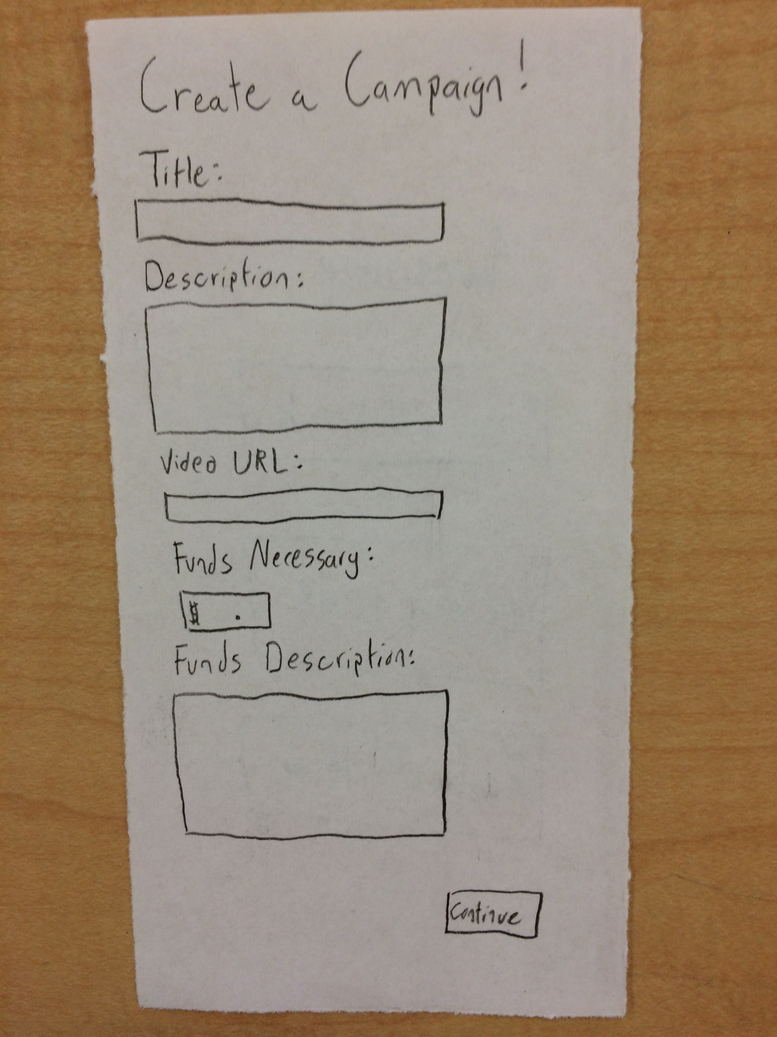
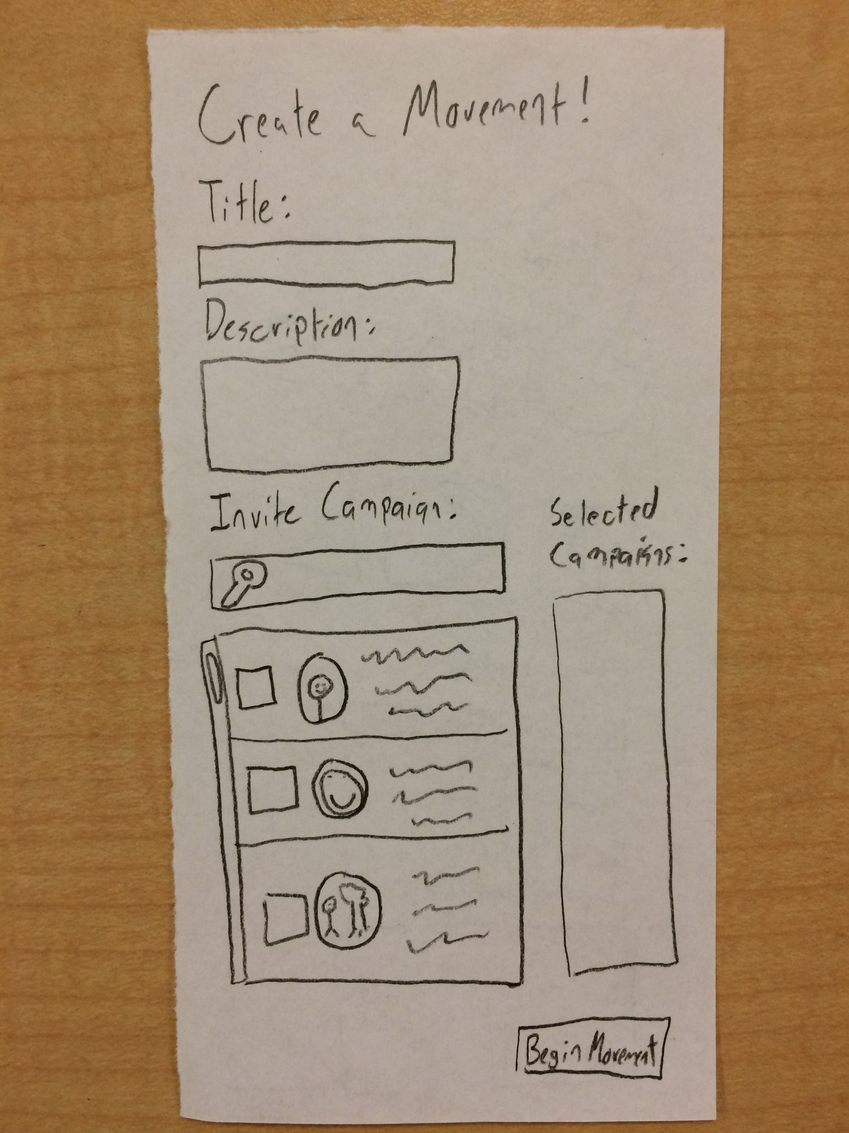
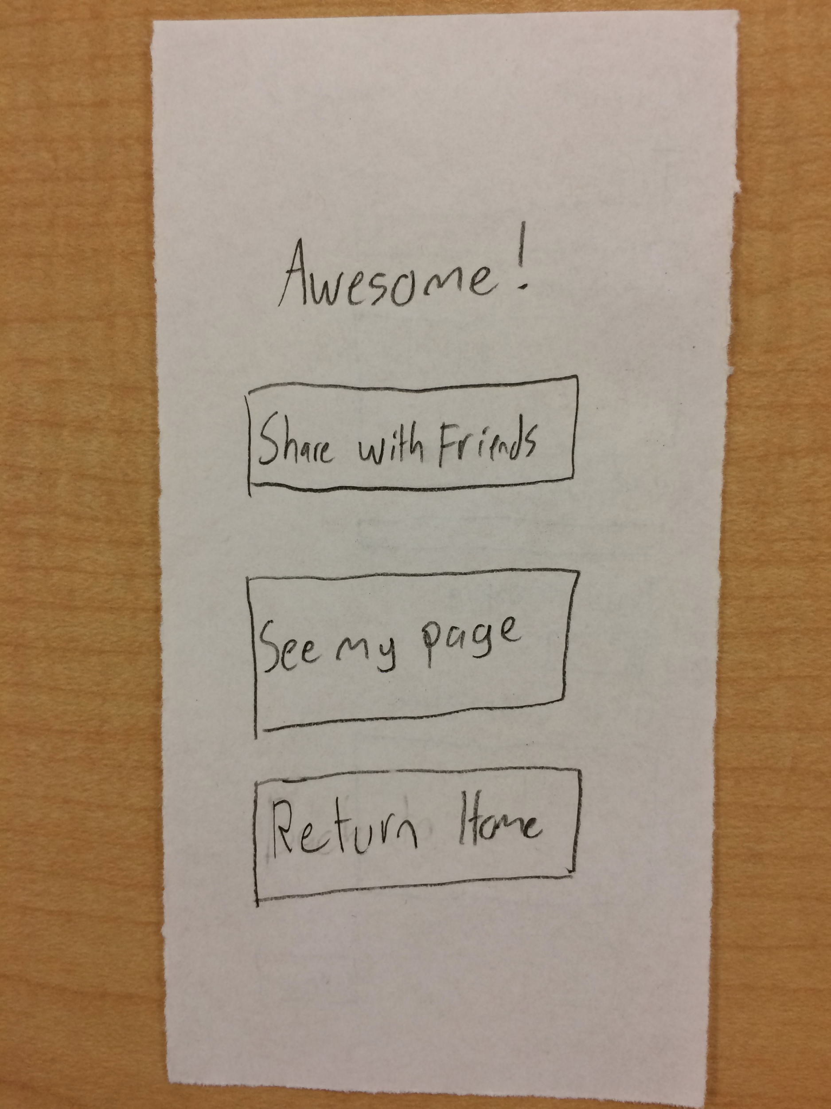
Low-Fi Prototype Structure
Notes:
We wanted the app to be very intuitive and straightforward so that people can immeidately accomplish what they want. This goes back to the problem we are looking to address: people don’t know how they can take action. Our app sought to make this as obvious and intuitive as possible to facilitate the process.
The landing page is shown on the far left in red. It allows users to carry out one of the three tasks by clicking on one of the buttons. Once they chose one of the tasks, they would be taken to the corresponding start screen for that task flow. Green screens are for funding. The start for this is a list of existing campaigns. They can then choose one to be taken to the campaign page to learn more and fund it if they choose. The final part is a thank you page that offers them options to share, see other campaigns, or go home.
The orange screen shows the page for starting a campaign and blue is create a movement -- a simple form. The create a movement lets users invite other campaigns to join and to select friends to join. This information is shown in a sidebar. Once they submit they get taken to the confirmation page in purple with the same three options. If they choose to share, the are taken to the far right page.
These screens encompass the three tasks and sharing functionality of the app. People give input by saying it aloud and click buttons by tapping the box on the paper. A person then changes the screen to the appropriate one.

Slide 9
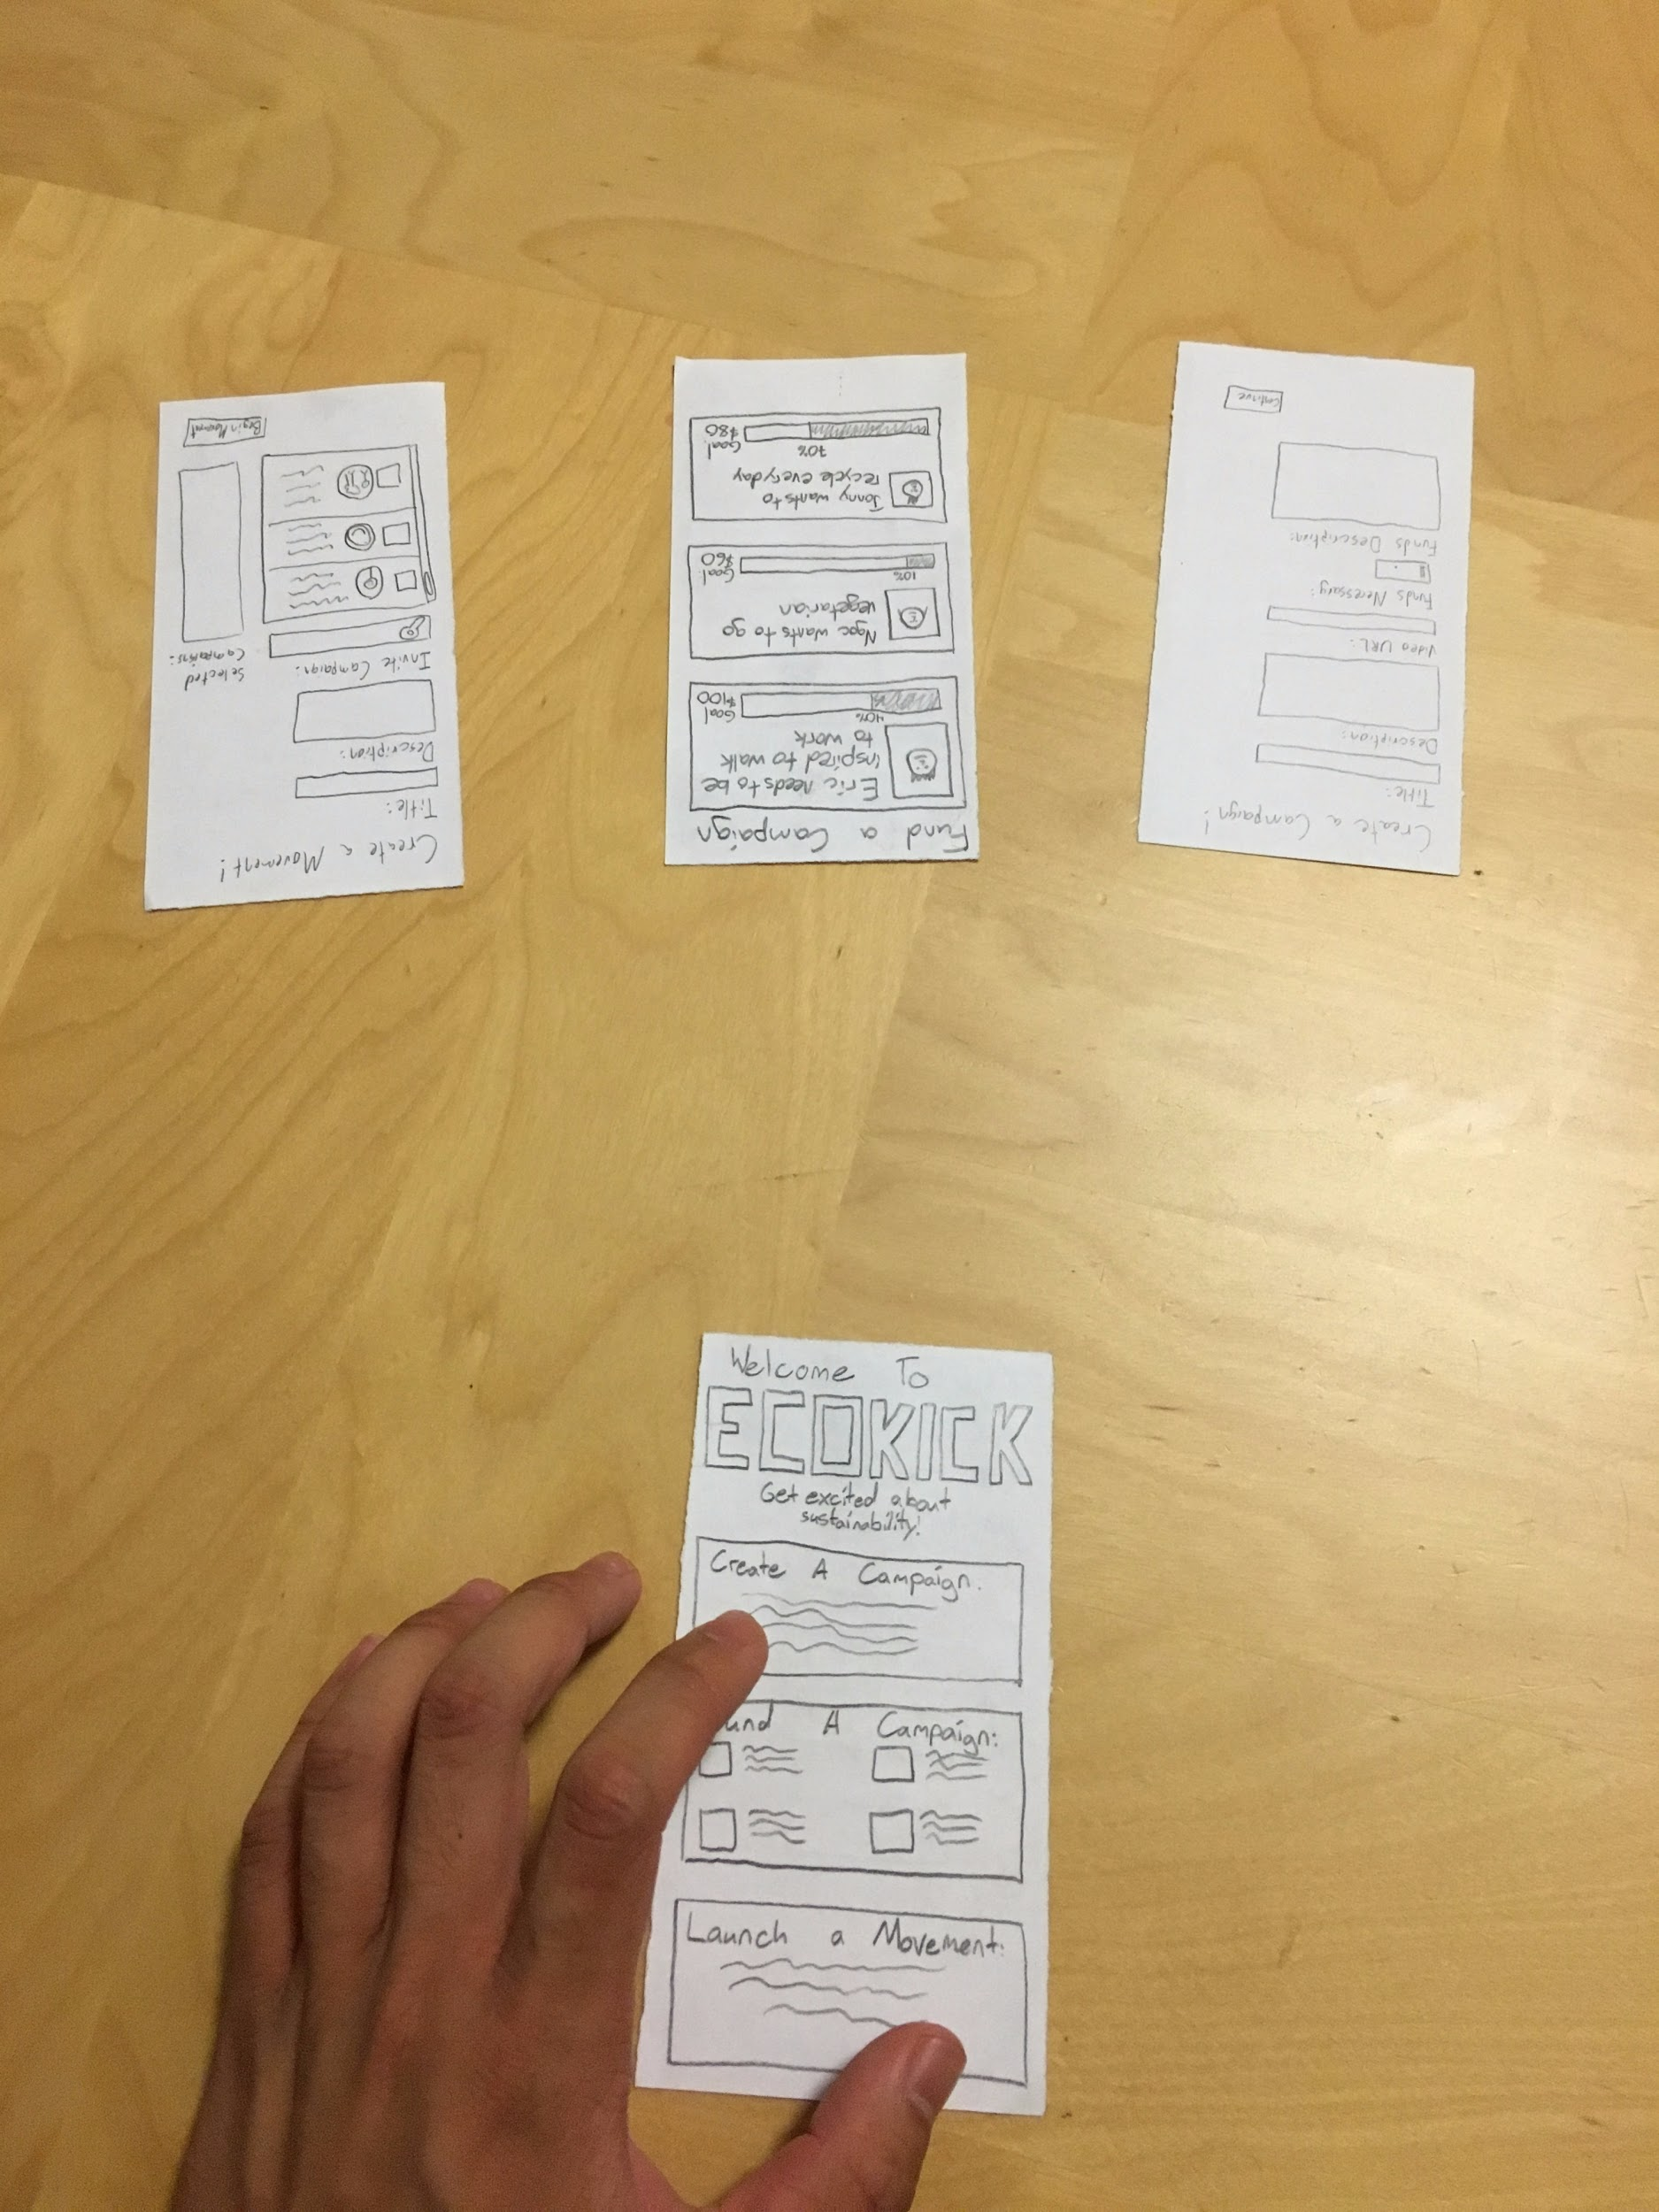
Experimental
Methods
Notes:
Created a script and list of questions, practiced the script and functioning the prototype, recruited people.
Diverse group of people at Tresidder in a comfortable, relaxed place. Assigned roles.
Noted things about usability, functionality, and visual appeal.

Slide 10
Experimental Results
Design was clean and well-liked
Wanted to clear confusion between feed and buttons
Too much text

Slide 11
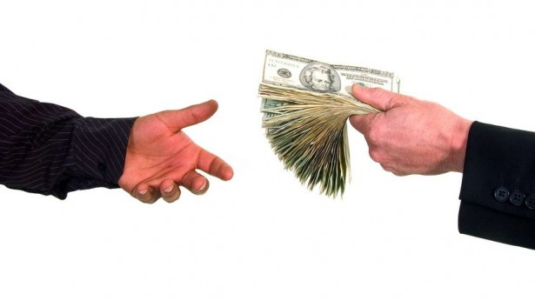
Experimental Results 2
People wanted to give money to causes, not individuals

Slide 12
Suggested Changes
Notes:
Wanted a greeting screen
More icons and incorporation of a feed instead of buttons/text
Funds description was confusing for people

Slide 13
Summary
Testing, Prototype, Findings
Notes:
More of a home page
Less text on campaign page and confirmation pages
More dynamic and visual display of information
Most importantly: incorporate social impact into the idea to make it about earning money for a cause instead of earning money for yourself.

