Slide 1
POV, HMW, & Experience Prototypes
Ngoc Bui, Eric Hermann, and Jonny Leung

Slide 2
Additional Need Finding

Slide 3
Participant:
Sarah
Late 40s
Psychiatrist and mother of 2 daughters
Lives in Carmel, Indiana
Chosen for midwestern perspective, age bracket
Interviewed over the phone

Slide 4
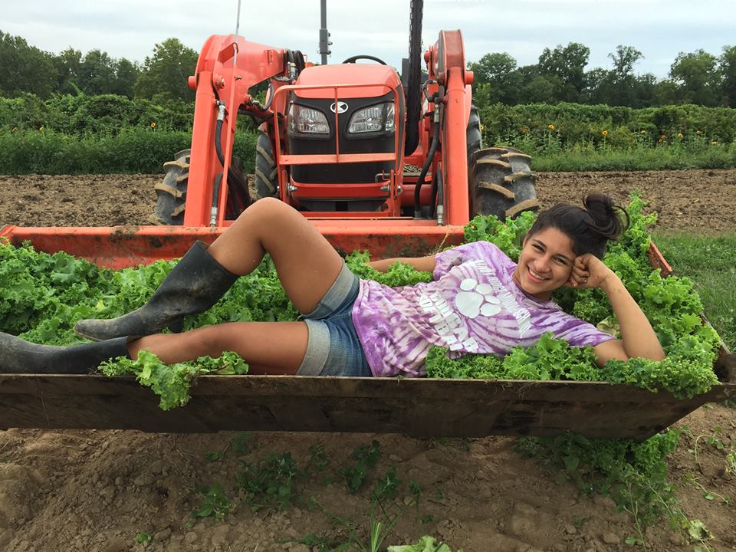
Participant:
Sofia
High Schooler
Previous work on a farm
Lives in Portland, Oregon
Chosen for farming experience
Interviewed at Town and Country

Slide 5
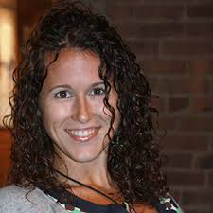
Participant:
Lauren
-Late 30s
-Works @ Office of Sustainability
-Chosen for her focus on motivating individuals
-Interviewed at CoHo

Slide 6
POV’s
-Sarah
-Amazed to realize how her actions are motivated by what makes her feel good, not quantifiable impact
-Game changing to leverage Sarah’s motivation to take further action
-Sofia
-Amazed to realize how individual gain can spur sustainable actions
-Game changing to show Sofia the monetary gain of her sustainable actions
-Sam
-Amazed to realize that he cares about the cause but has no idea of his quantifiable impact
-Game changing to provide an easy way for Sam to view the actual impact of his actions

Slide 7
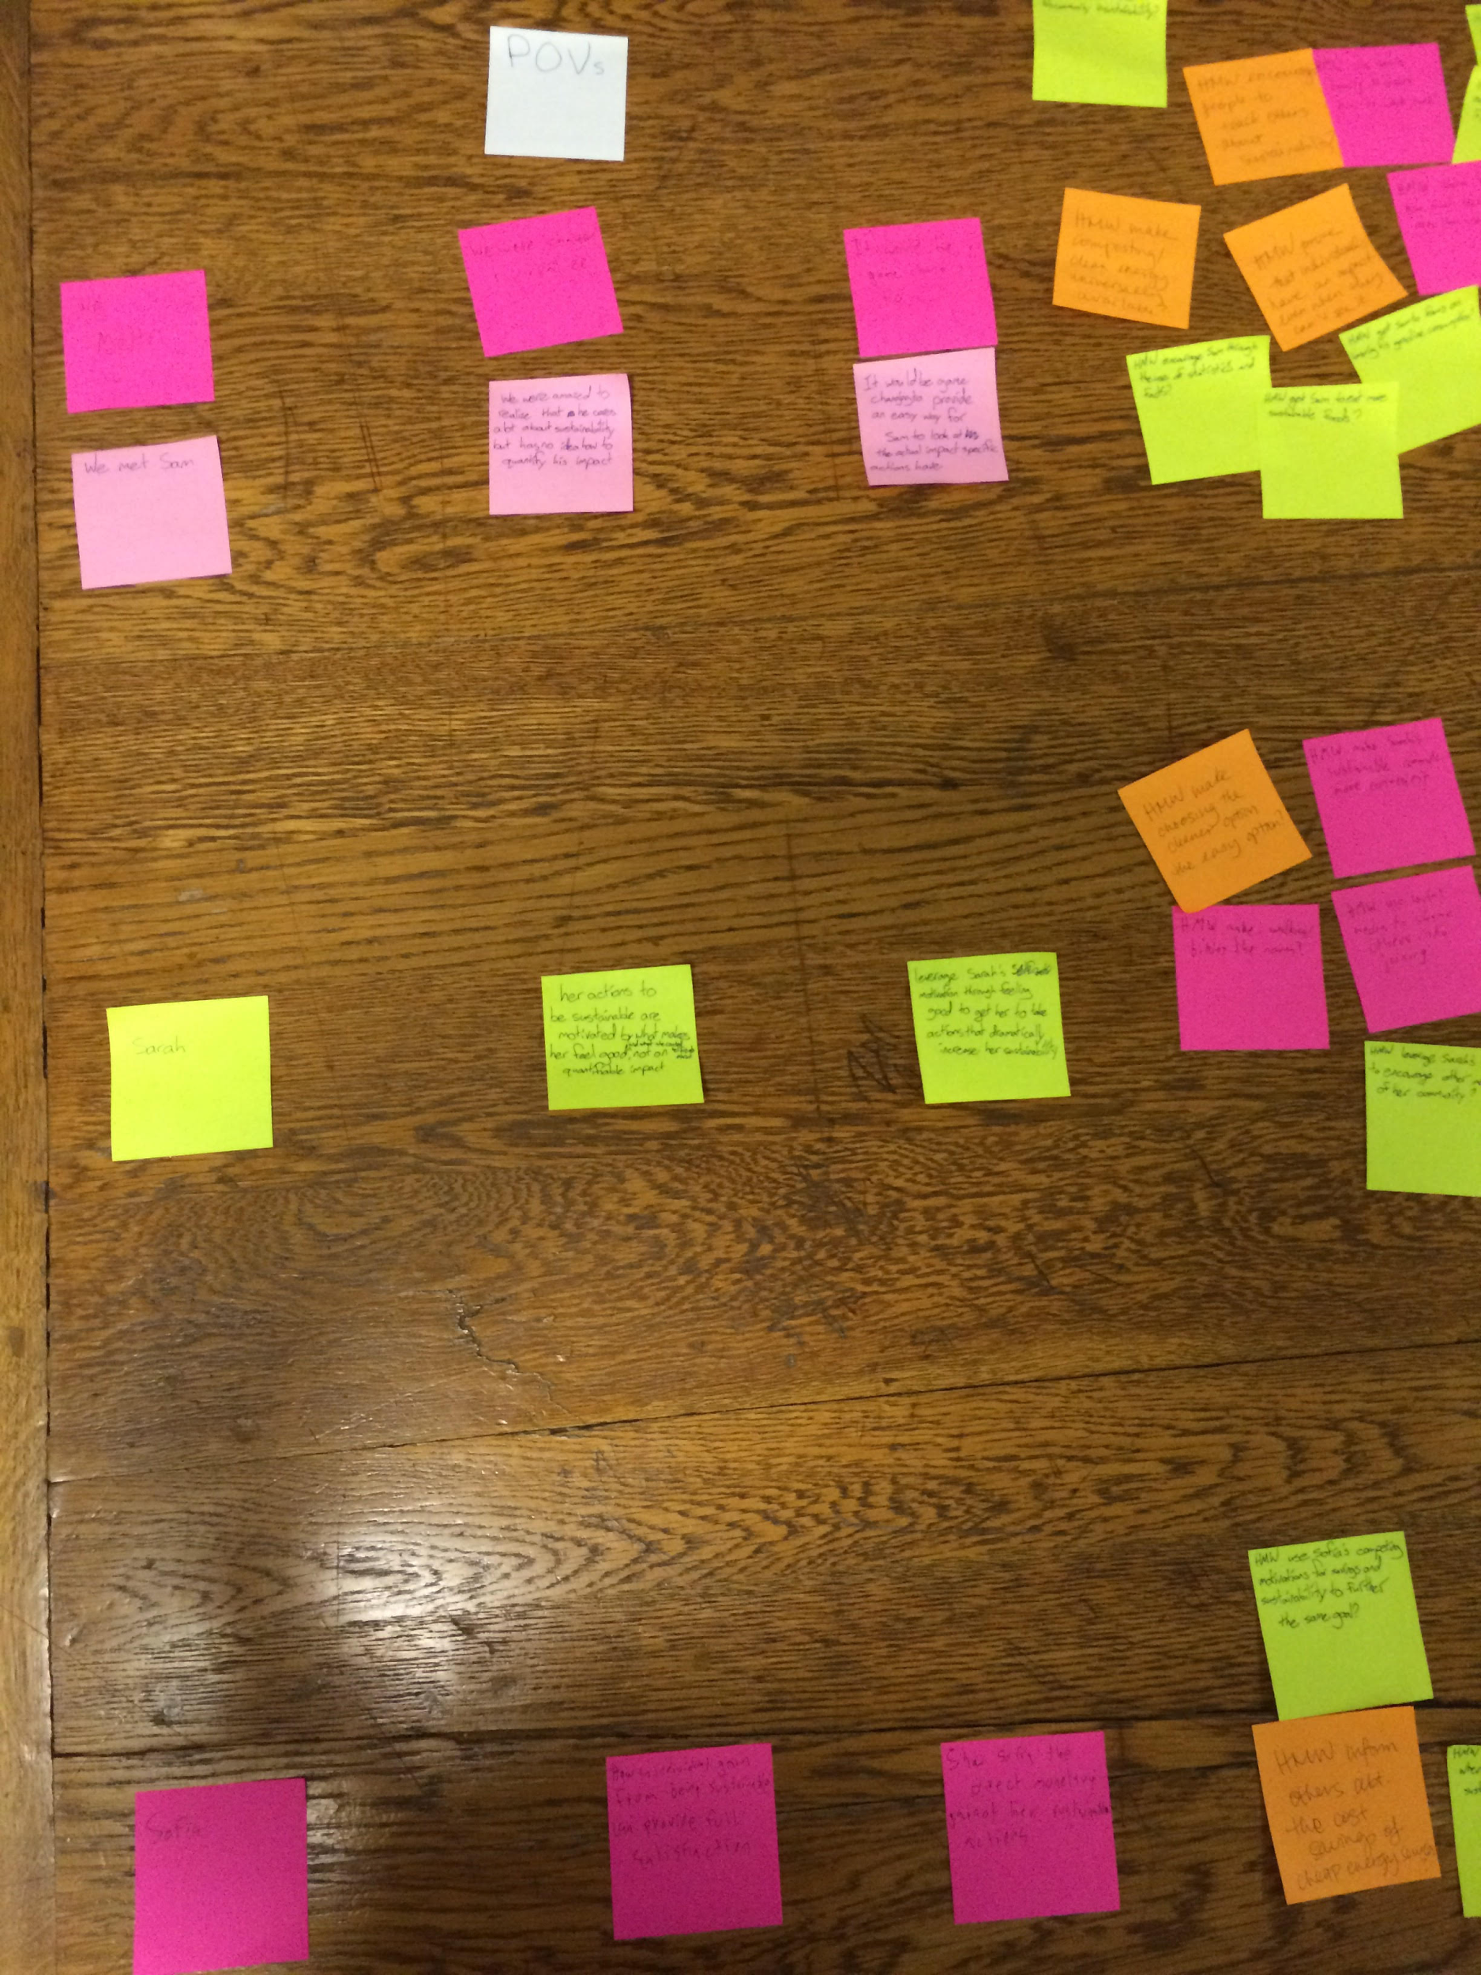
POV’s

Slide 8
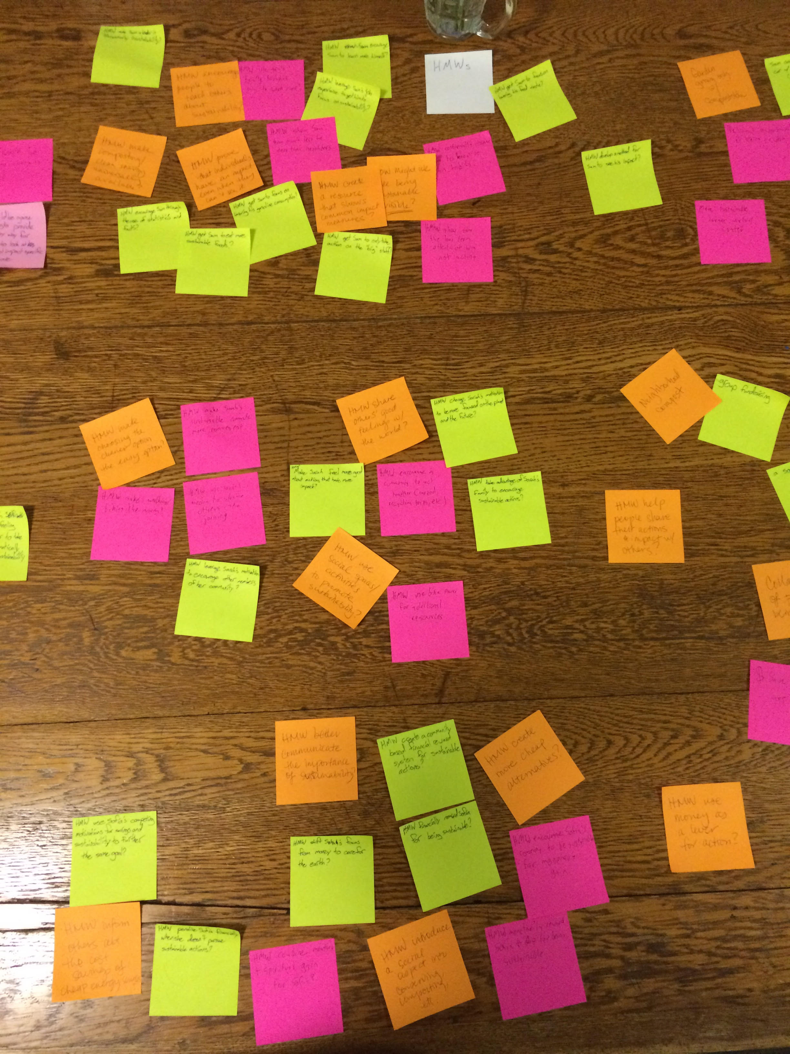
HMWs

Slide 9
HMW’s
-Sarah
-How Might we help people share their actions and impact with others?
-Sofia
-How Might We use money as a lever for action?
-Sam
-How Might We develop a method for Sam to see his daily impact?

Slide 10
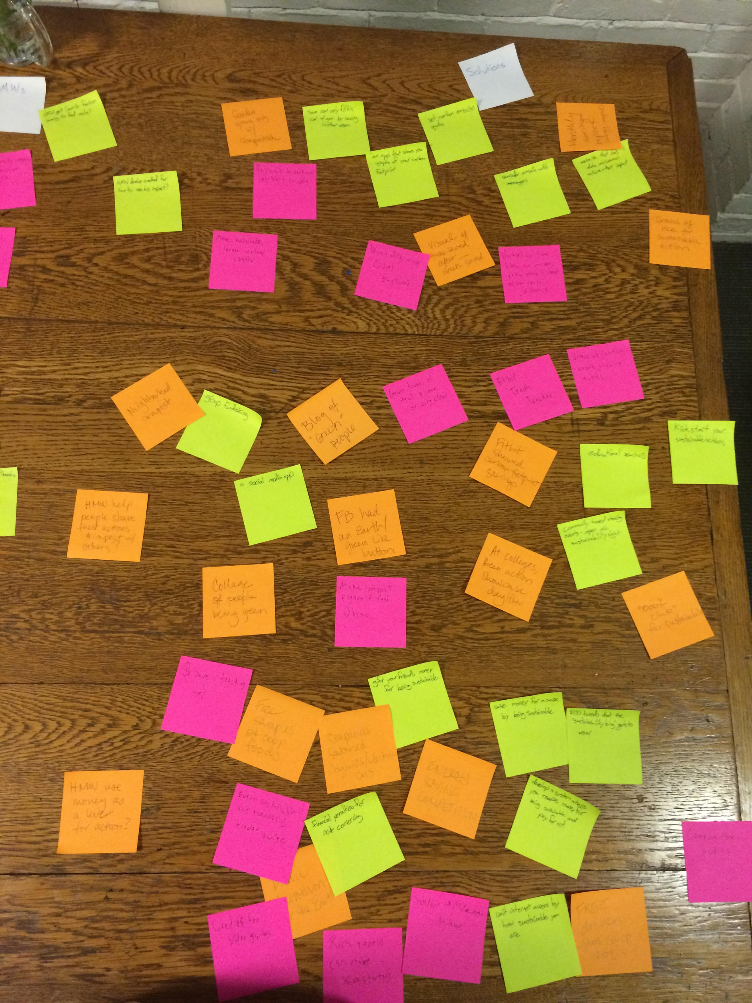
Solutions

Slide 11



Solutions
-Sarah
-Kickstart your own sustainable action!
-Sofia
-Coupons for action
-Sam
-Use grains of rice for sustainable action

Slide 12
Experience Prototypes

Slide 13
Kickstarter

Slide 14
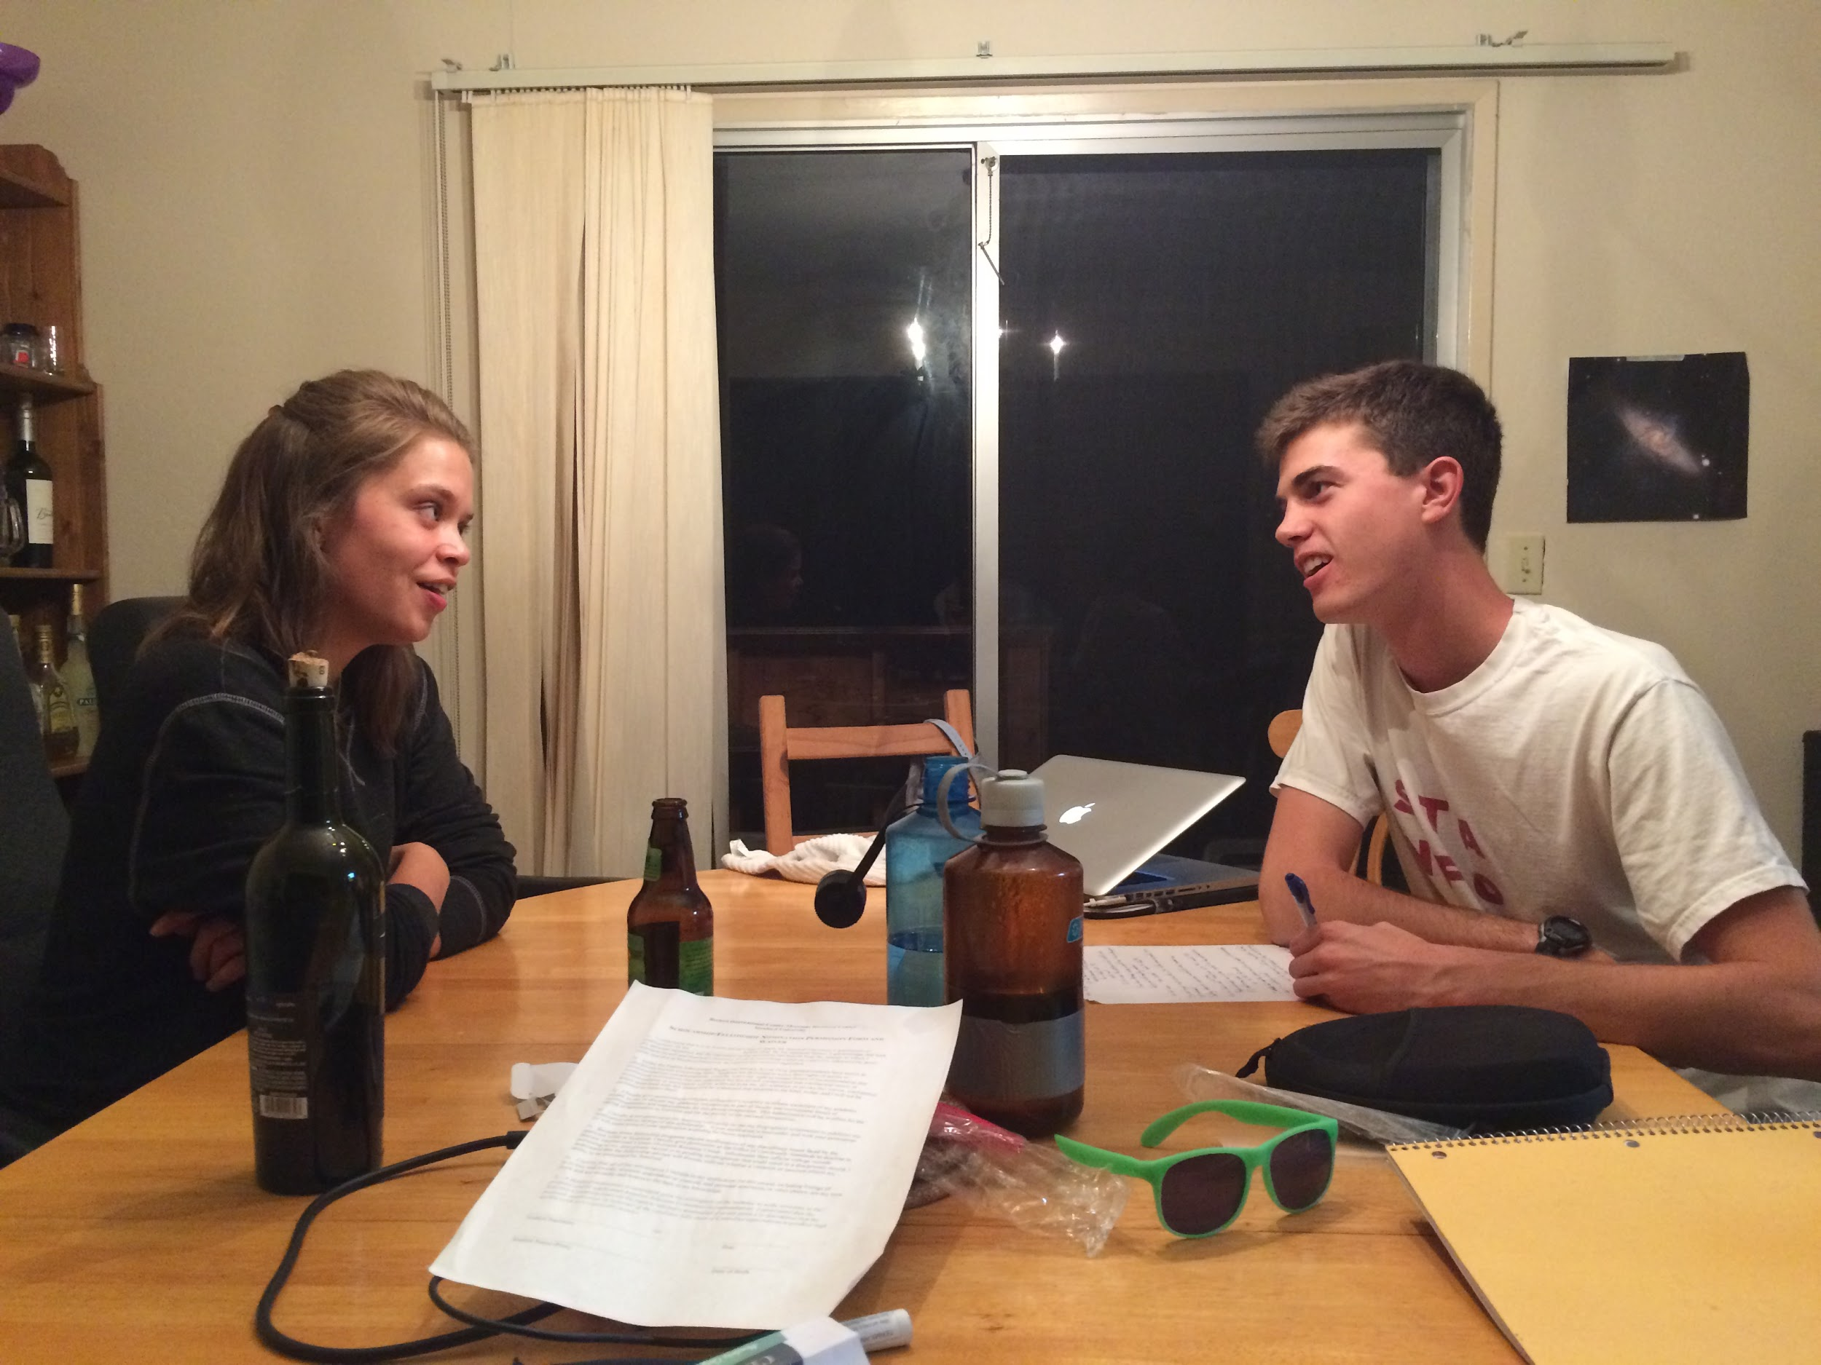
Tested the kernel of the idea - will people fund others’ sustainable actions, and will people be willing to take sustainable actions if there is a financial incentive?
Relatively successful with the cohort we were targeting
Needs further testing with other cohorts

Slide 15
Coupons for Action

Slide 16
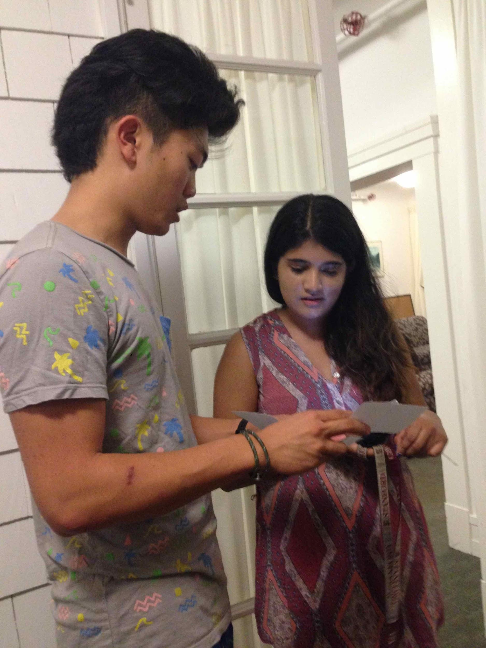
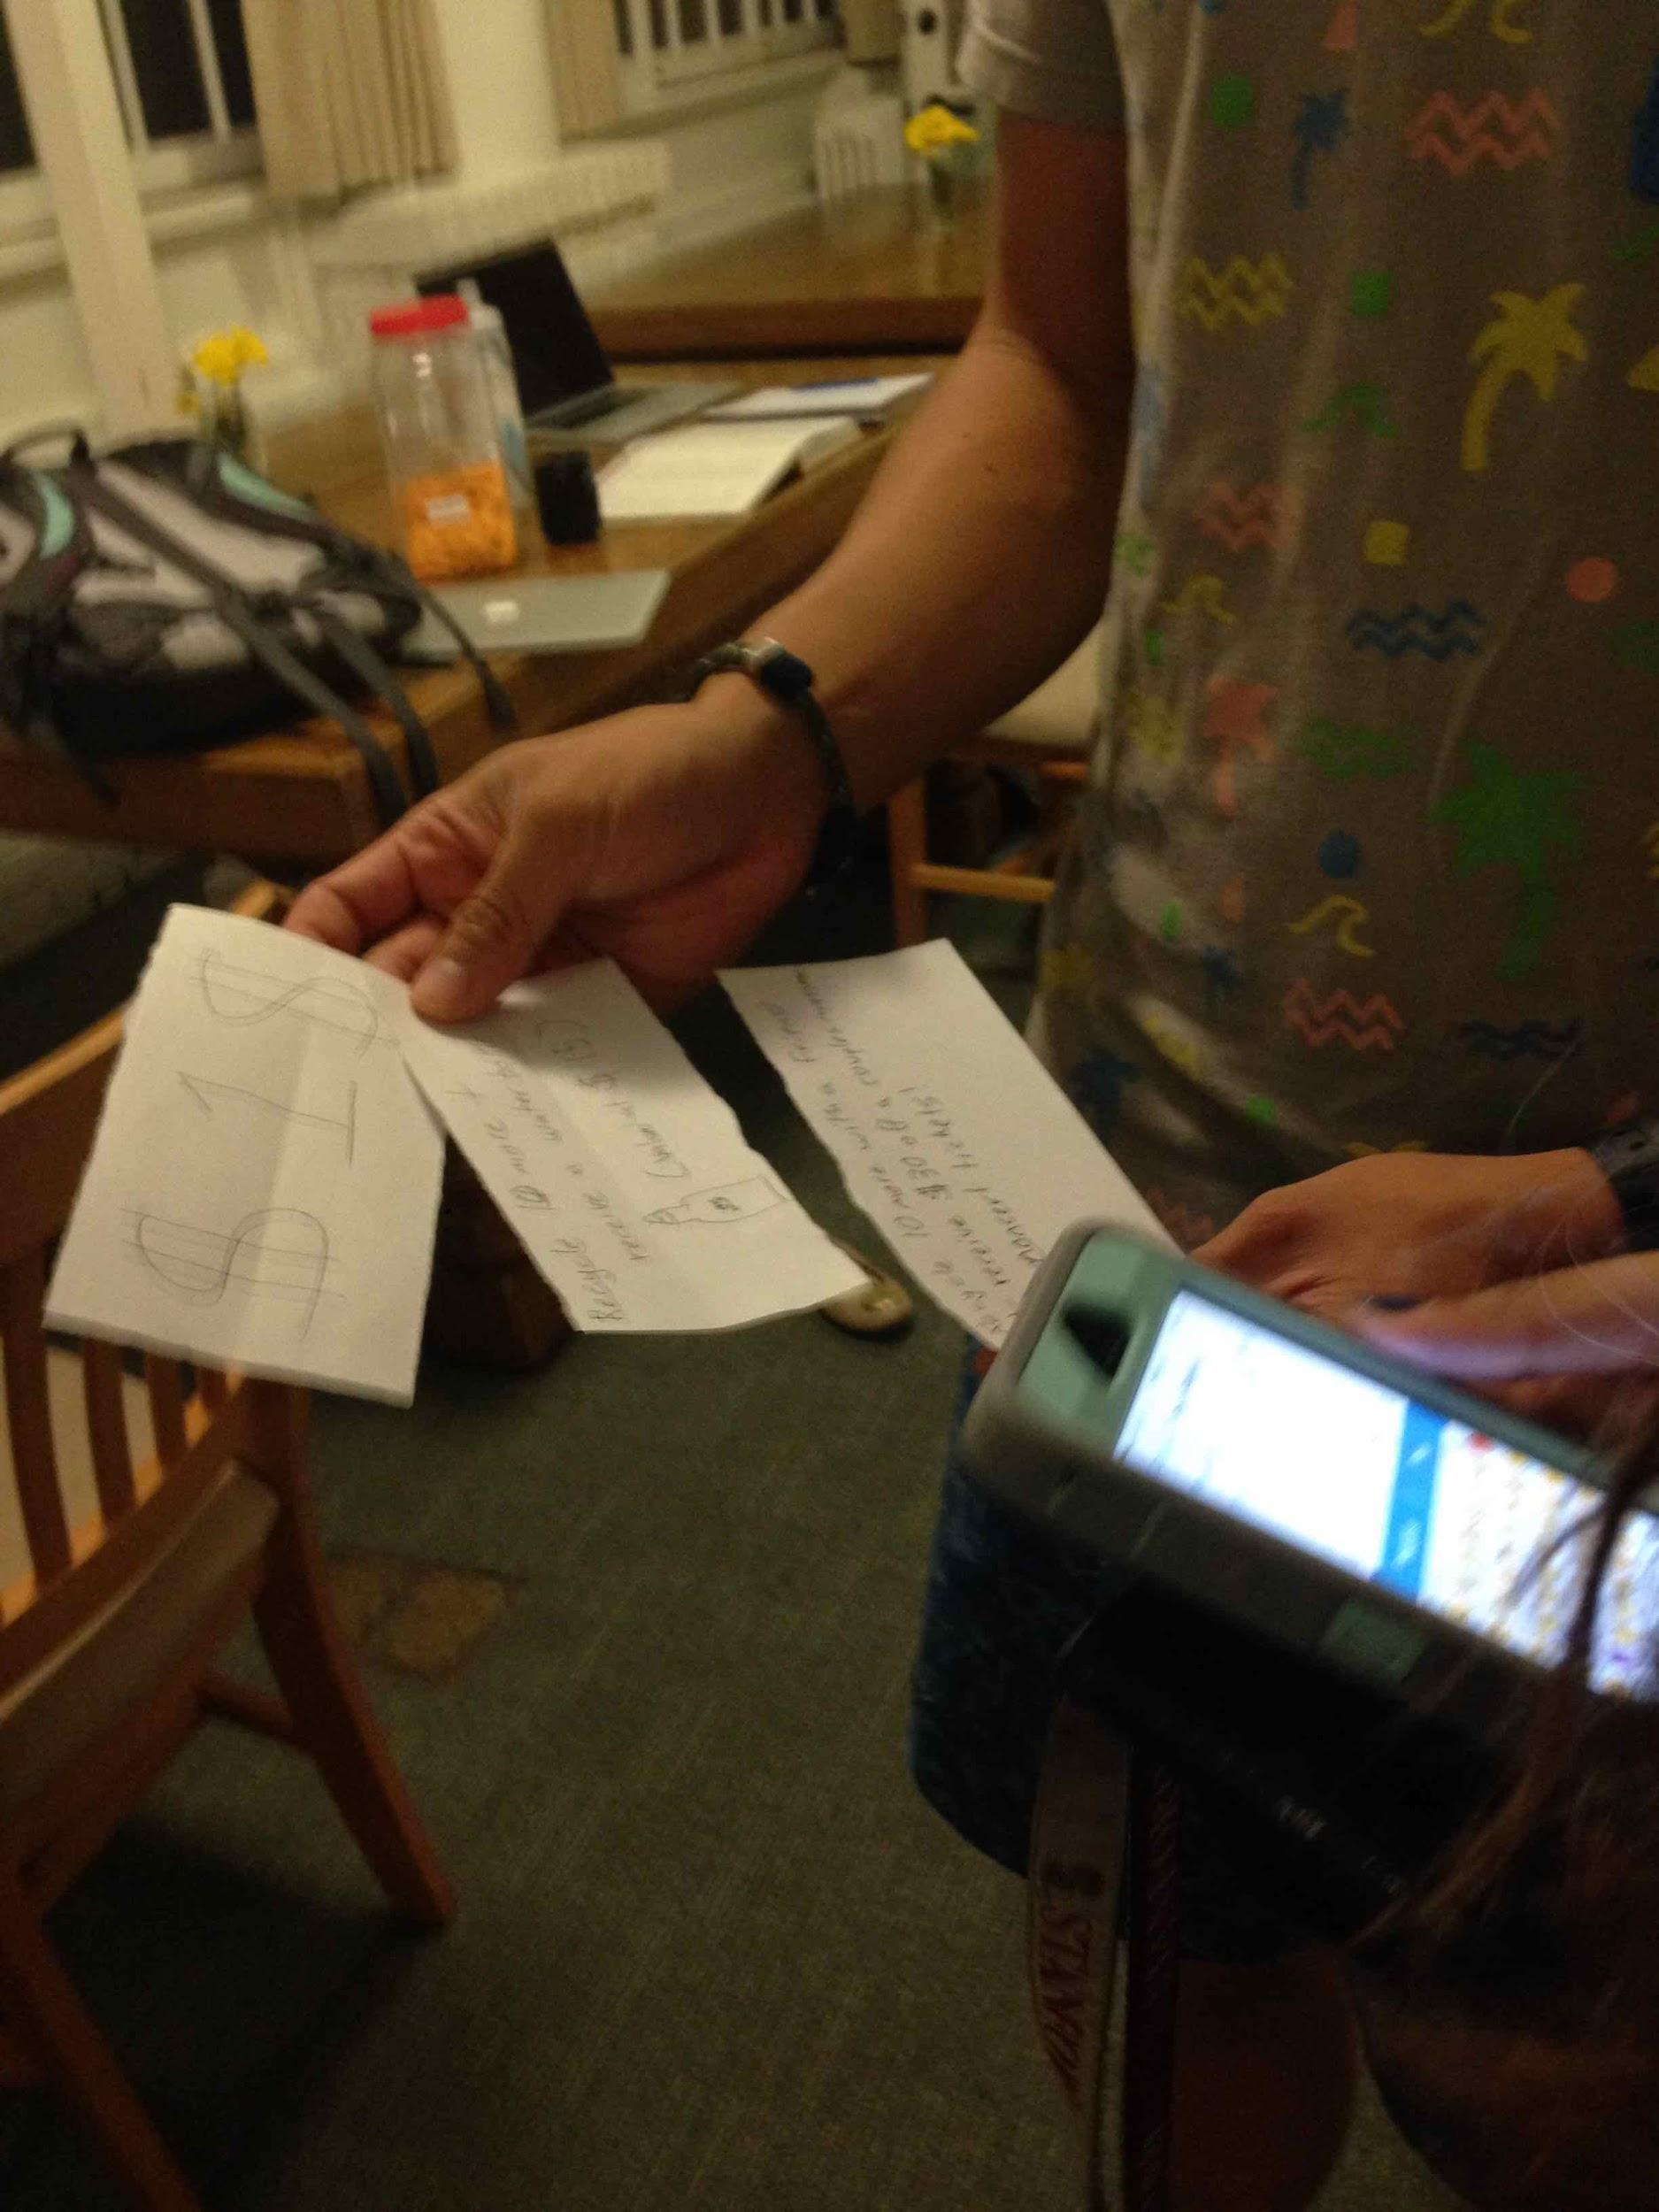

Slide 17
Rice for Action

Slide 18
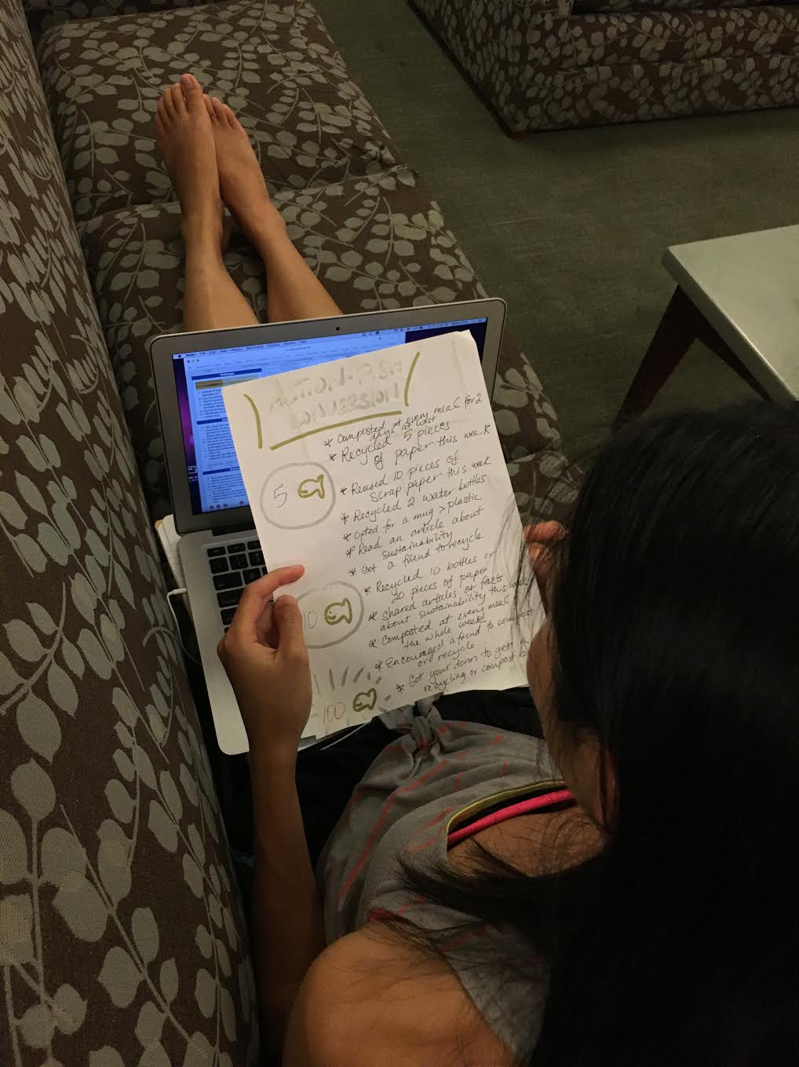
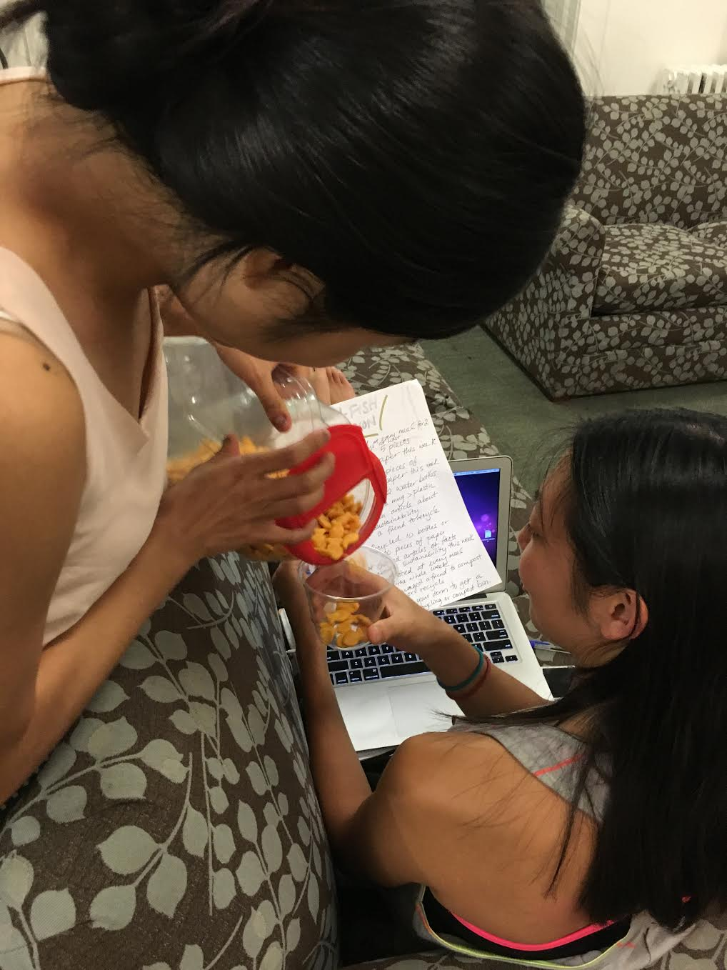

Slide 19
In Summary:
Interviews, POV’s, HMW’s, Solutions, and Experience Prototypes

