Slide 1
Sustainability Needfinding
Jonny Leung, Eric Hermann, Ngoc Bui

Slide 2
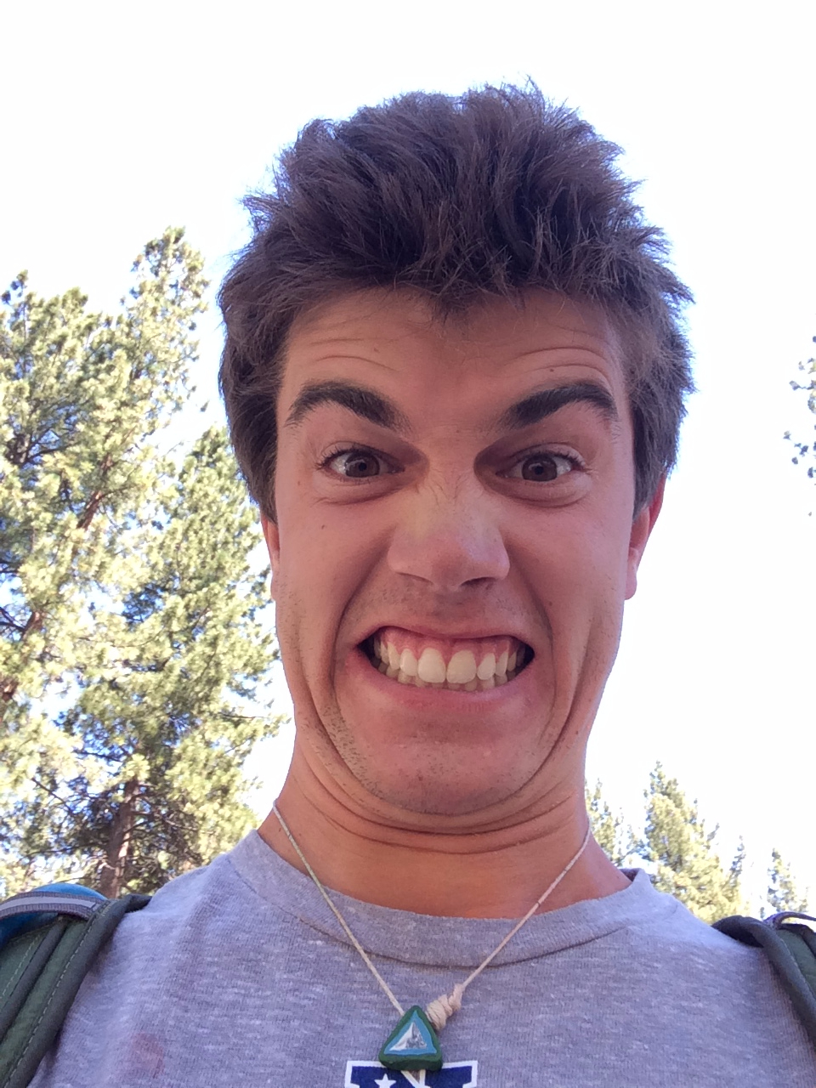
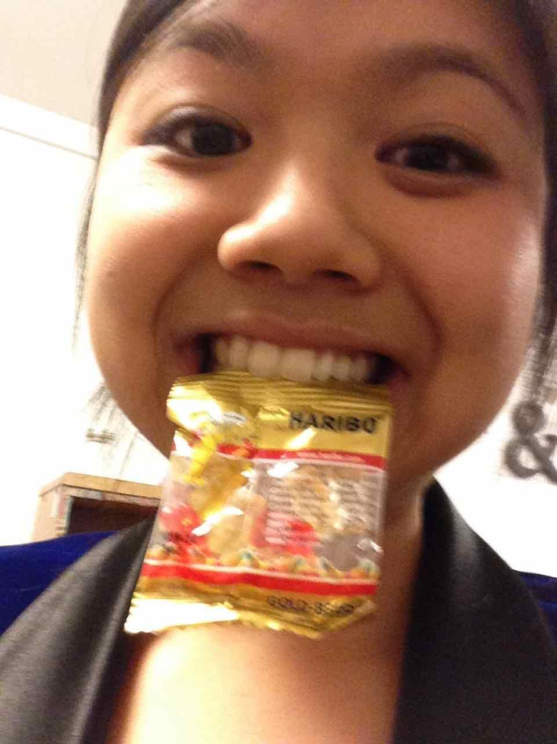
How Do We Make Sustainability Concrete?
Jonny
Eric
Ngoc

Slide 4


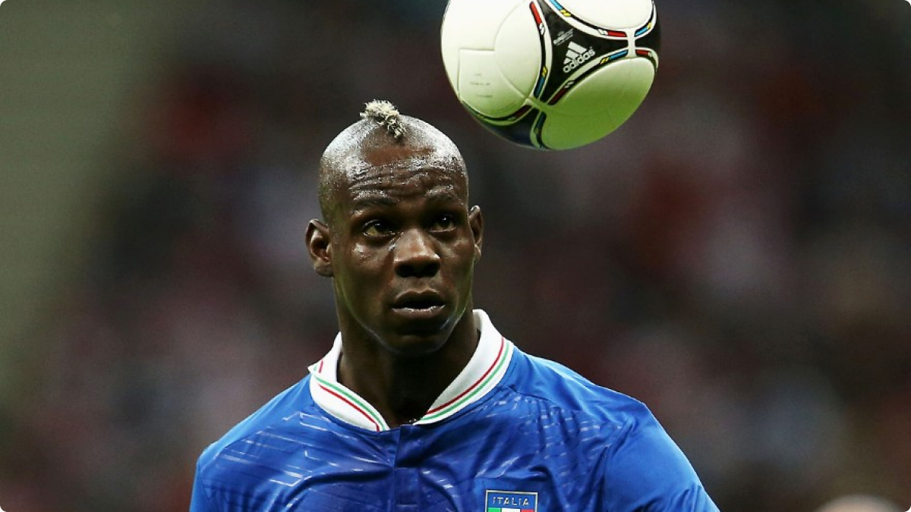
Participants
Looking for:
-Diversity of perspective
-Varied lifestyles/interests
-Technologically literate users

Slide 5
Participant 1: Sam
-25 year old Apple employee
-Lives in Los Altos Hills
-Chosen for perspective of commuter and employee
-Interviewed at home

Slide 6
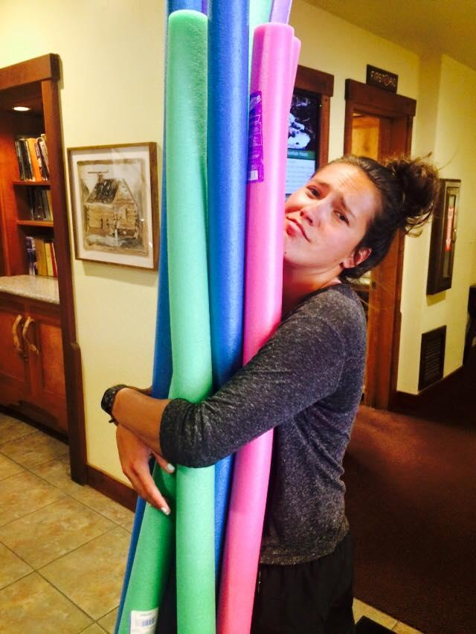
Participant 2: Annabah
-22 year old unemployed
-Lives in Salt Lake City, Utah
-Chemical Engineering Major
-Chosen for technical knowledge
-Interviewed at Tressider

Slide 7
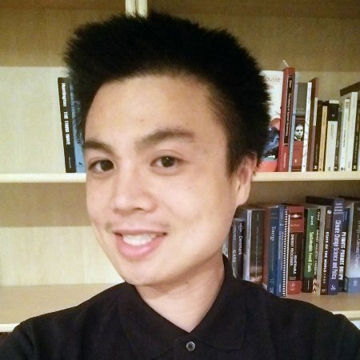
Participant 3: Kevin
-Stanford Lecturer
-Involved in Urban Studies
-Chosen for academic perspective
-Interviewed in Gates building

Slide 8
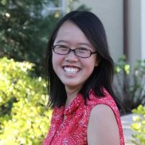
Participant 4: Gloria
-Junior at Stanford
-Product Design Major
-Born in Singapore
-Chosen for international perspective
-Interviewed in dorm room

Slide 9
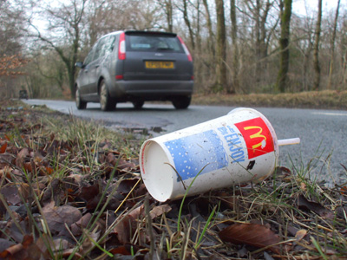
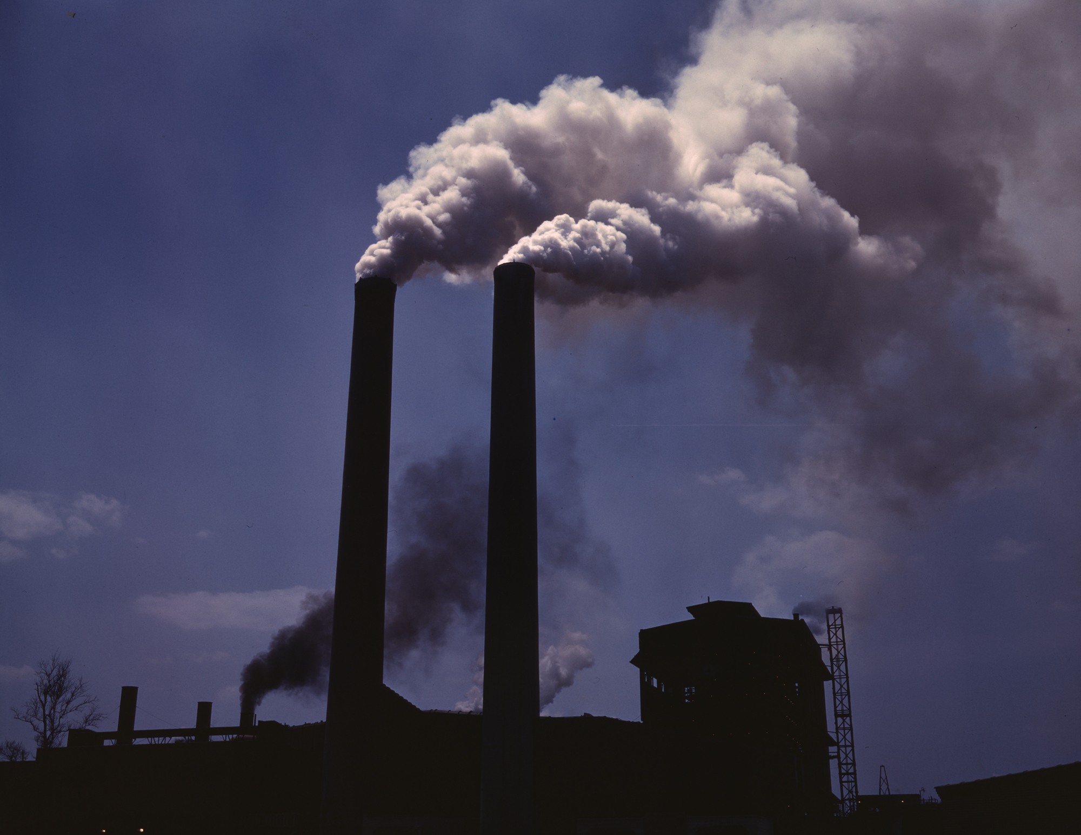
Interview Results - Sam
“I try to do things to reduce my environmental impact, but I have no sense for how much actual effect I have on the world.”
“The largest impact in my opinion will be at the policy level. The heaviest polluters and carbon emitters are corporations, and government policy is the best way to encourage sustainability.”

Slide 10

Interview Results-Annabah
“Without some sort of cheap alternative to today’s fuel sources, no major change can be made”
“Politicians will always fight for the most effective means of accomplishing their tasks. Even if it means denying some sort of obvious truth, they’ll keep fighting.”

Slide 11
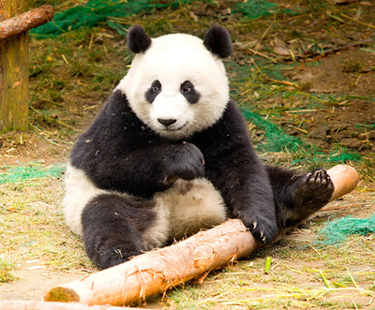
Interview Results-Kevin
“It’s not fair that humans ruining the planet and making it difficult for other species.”
“It’s about getting industries and policy makers to change.”

Slide 12
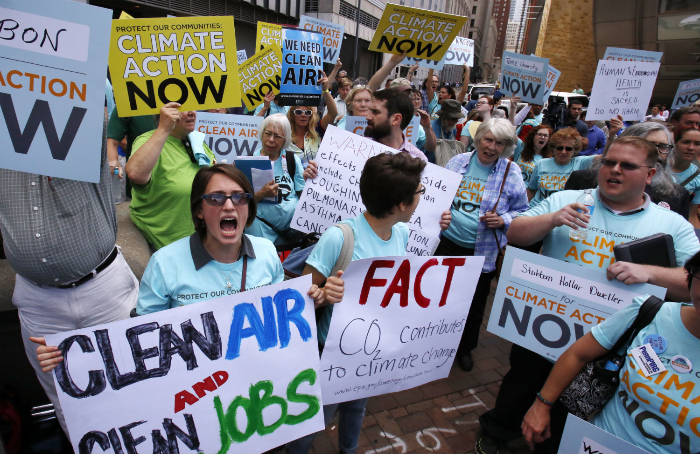
Interview Results-Gloria
“Seeing passionate people do this work inspires me.”
“Empty rhetoric gets to me.”

Slide 13
Empathy Map
Say
I care about sustainability
I wish I knew more
I want to have an impact
Think
personal vs. large scale
future generations
words vs. actions
Do
save where possible
follow policy decisions
compost
stay informed
Feel
frustration
lack of empowerment
unaware
helpless

Slide 14
Insight
People really want to help, but are not sure how. They don’t see themselves as the agents of change.

Slide 15
Summary
We met Sam, Annabah, Kevin and Gloria, and were amazed by how much they cared about the environment but how little they felt they could personally impact the environmental crisis.

