Slide 1
EcoKick
Eric Hermann
Jonny Leung
Ngoc Bui

Slide 2
PAY IT FORWARD
Notes:
Our value proposition is ‘pay it forward’. It reflects the mission of our app: to start a collective movement for sustainable living by encouraging individuals to make sustainable decisions through money and a social platform.

Slide 3
Individual Apathy
Collective Action
Notes:
The problem:
Our team wanted to address the lack of action amongst the normal person when it comes to the environment -- even when people express that they care a lot about the Earth. We found this stemmed from an inability to see the impact, a lack of information, or at times plain disinterest.
The solution:
EcoKick aims to address the problem by harnessing the personal, social, and financial positive impact of making sustainable choices. It enables individuals to see their impact (quantified by amount of money received for actions), learn about how others are being sustainable, and gain a financial reward for being environmentally aware.

Slide 4
Tasks
Simple Medium Complex
Join EcoKick
Receive money for actions
Share lifestyle changes
Notes:
The three tasks we created represent the core actions of EcoKick.
People are first invited to join EcoKick through a friend who shows them the platform.
Once they are a user, they can receive money for certain actions from others users who have pledged money for those actions.
Through social and financial reward, the user then begins to change their lifestyle. They then share their experience on EcoKick with others. The journey, in this way, creates collective action.
The tasks together illustrate how the social and financial aspect of living sustainability can be harnessed to encourage individuals to take action!

Slide 5
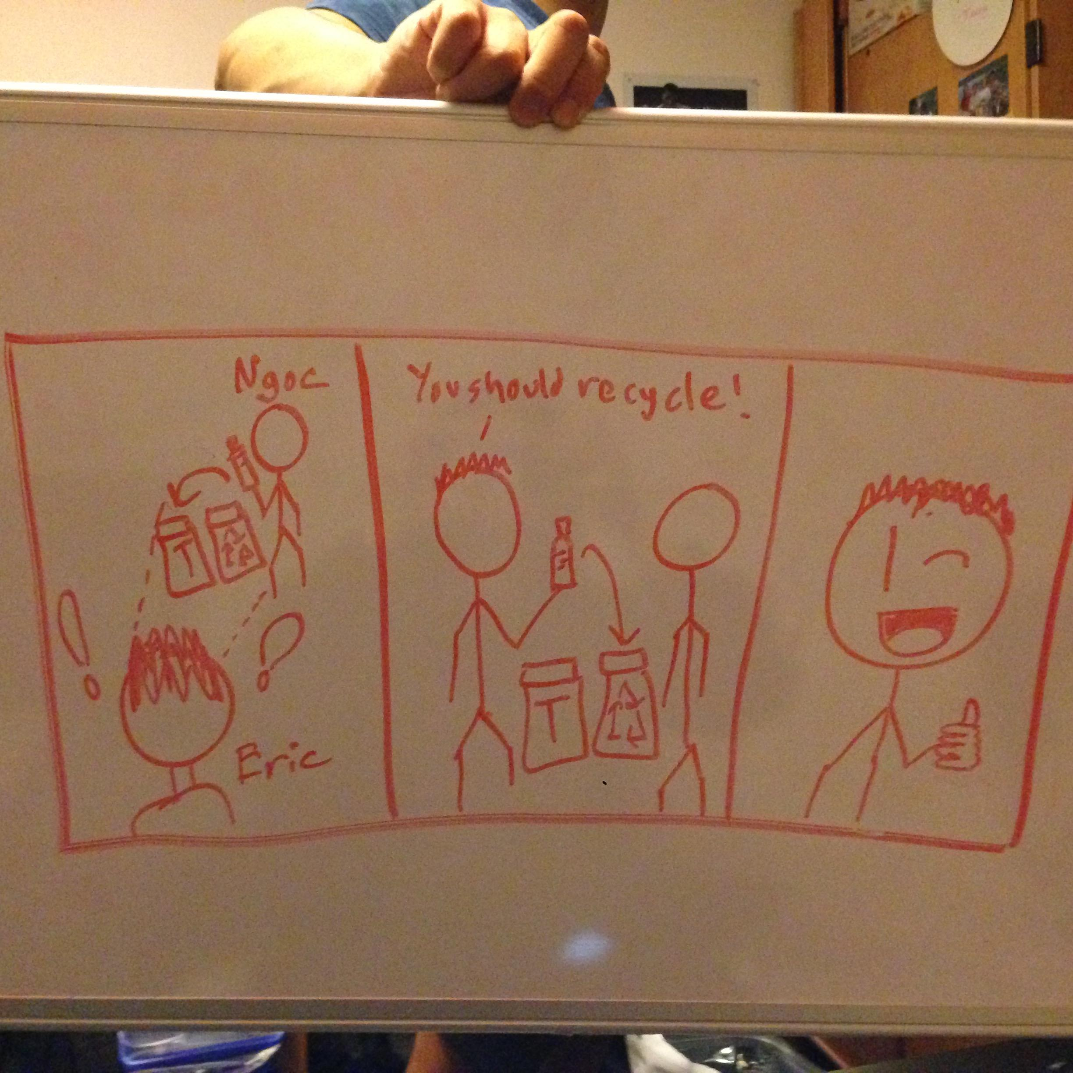
Join EcoKick

Slide 6
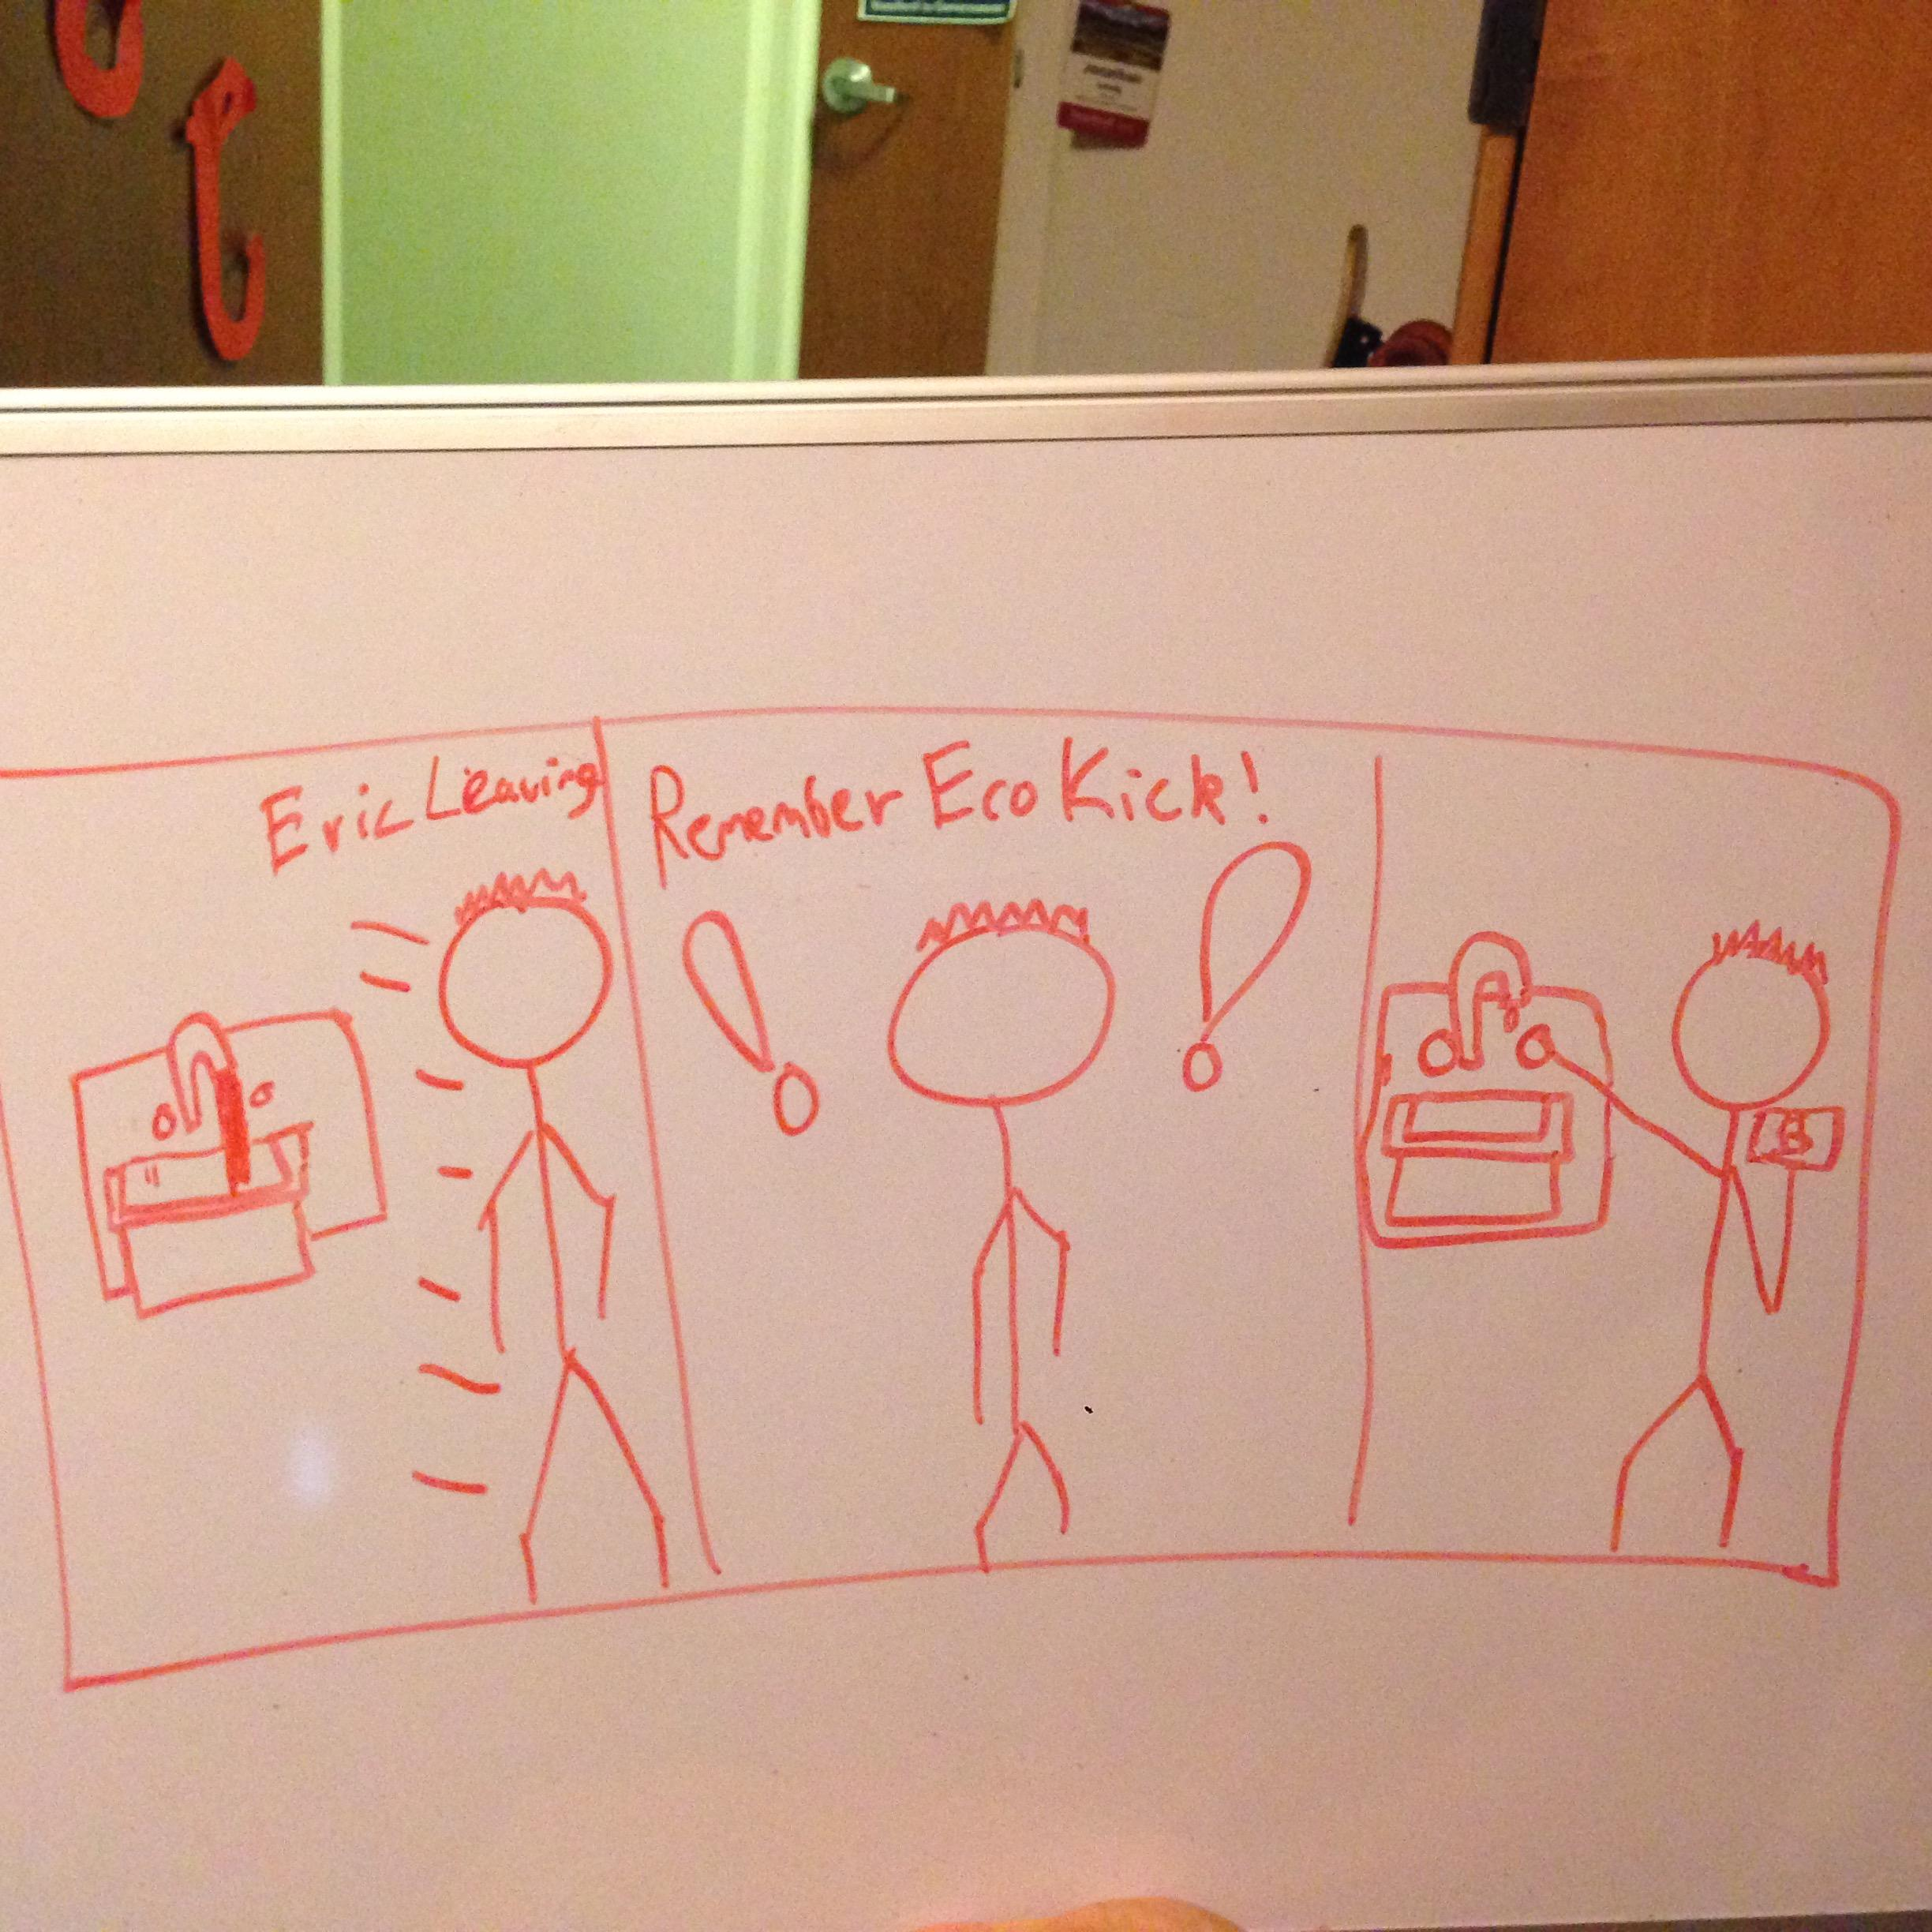
Receive money for actions

Slide 7
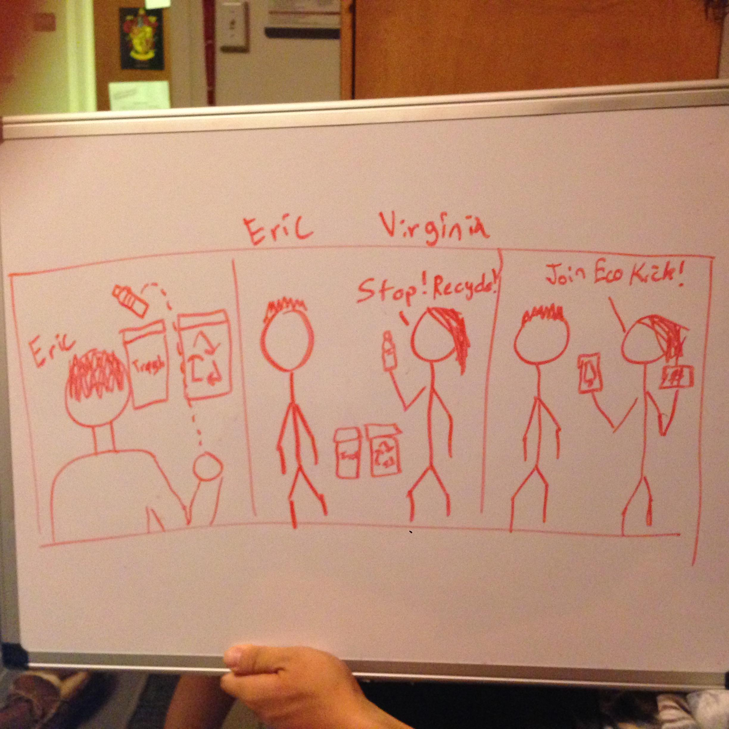
Share lifestyle changes

