Slide 1
Christian Medina
Ashwin Kumar
Scott Arkin
Adrian Harrison

Slide 2
Overview
Team Mission
Design Decision
Tasks
Testing
Suggested changes

Slide 3
Team Mission
DotTrain is a social platform that connects commuters with each other, allowing strangers to develop strong friendships over common interests.

Slide 4
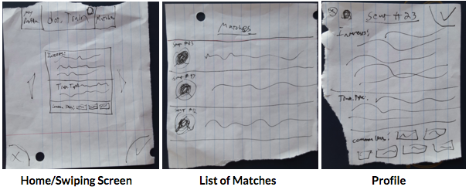
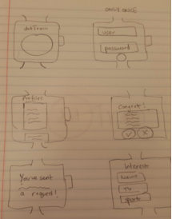
Design Decision

Slide 5
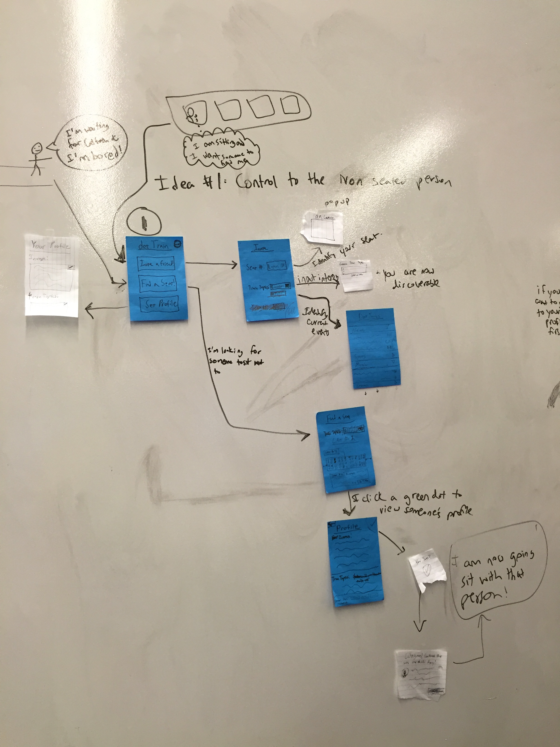
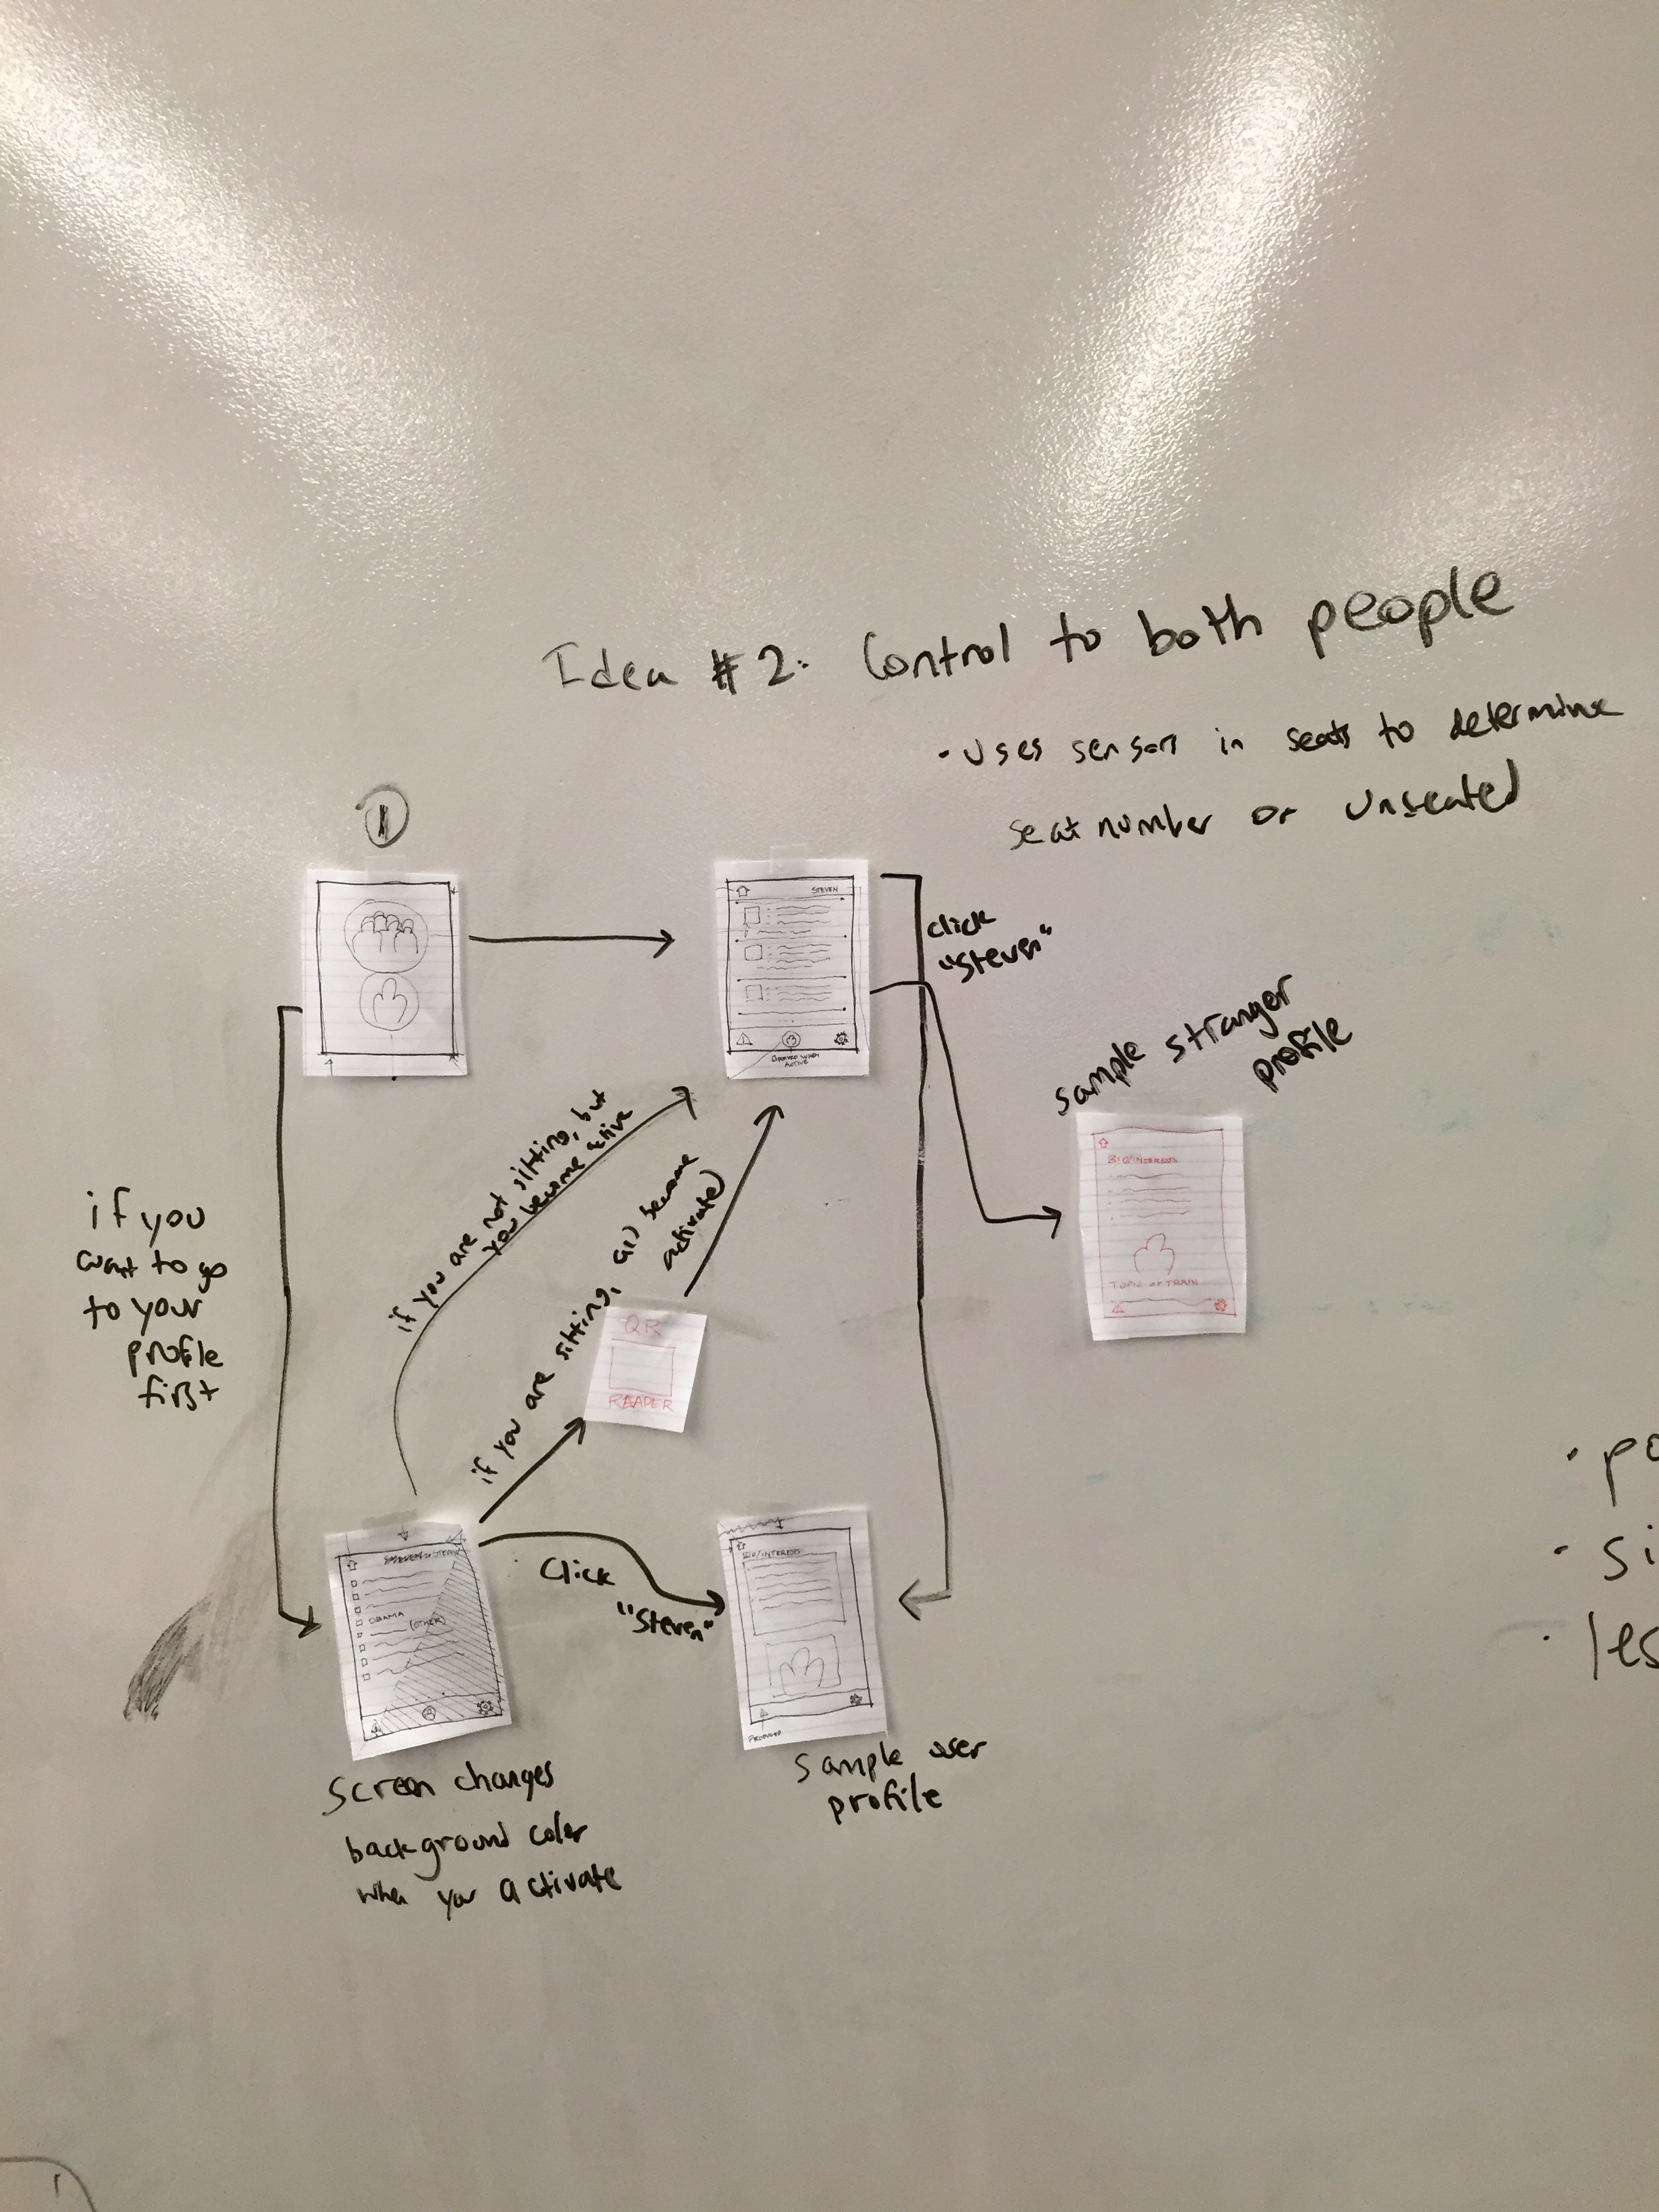

Slide 6
Task 1
Mark yourself as available and interesting

Slide 7
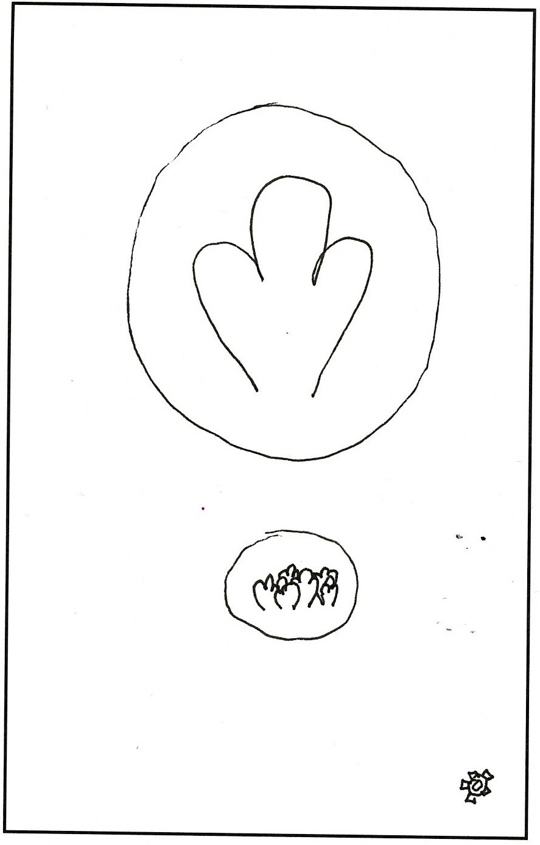
Home Screen
Activate your dot
Browse
interesting
dots

Slide 8
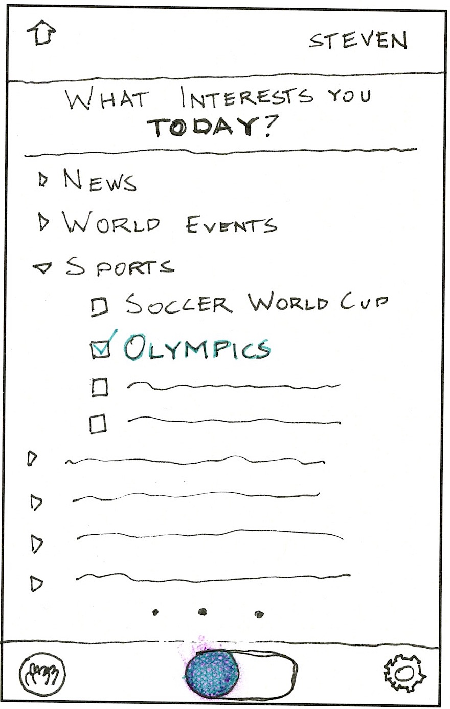
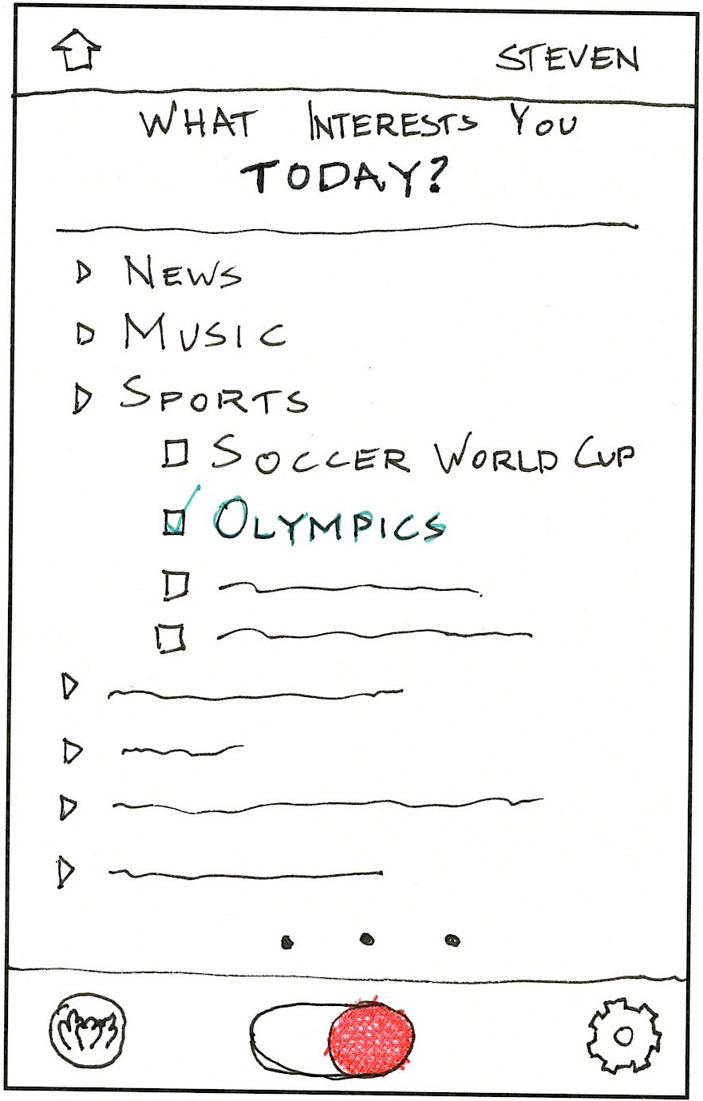

Slide 9
Task 2
Connect with an interesting person

Slide 10
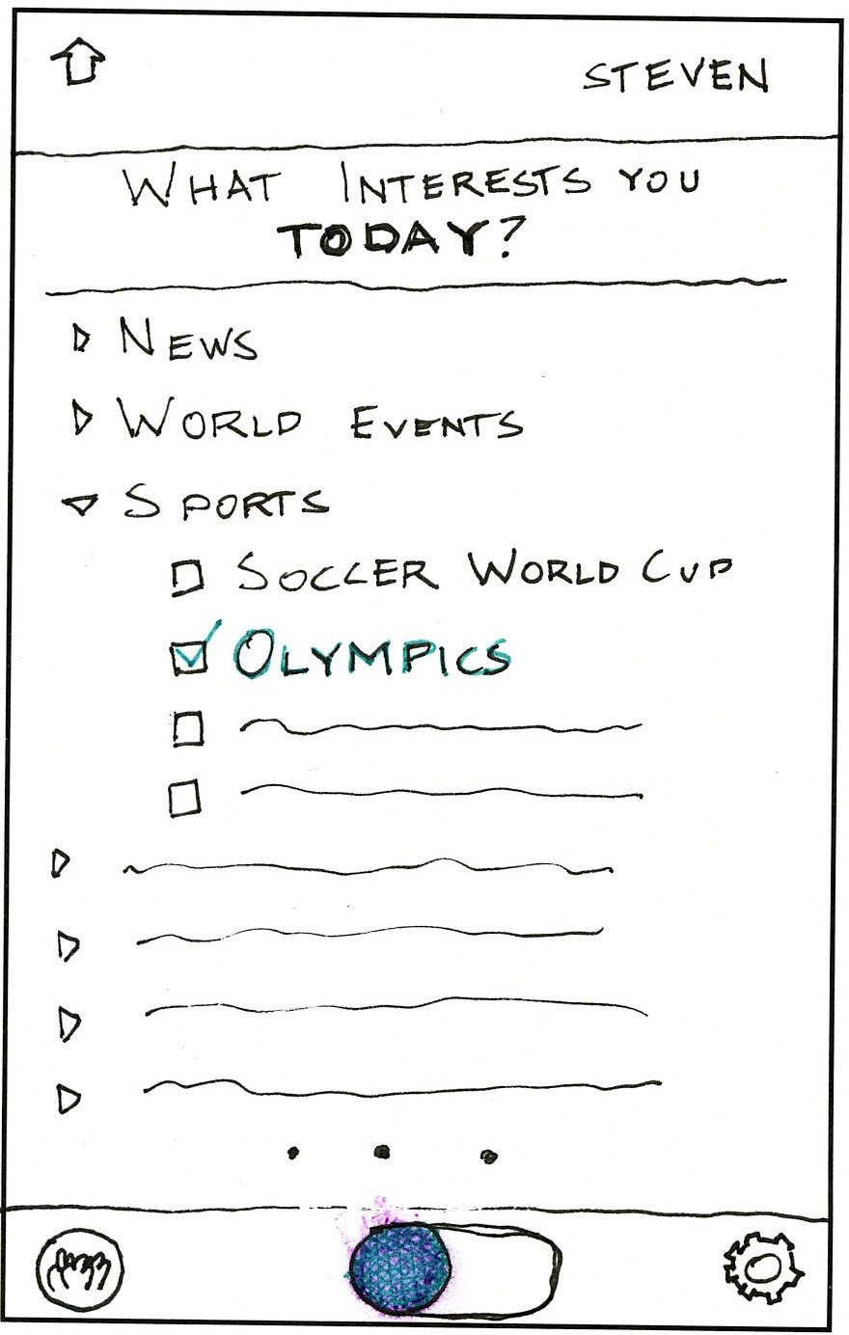

Slide 11
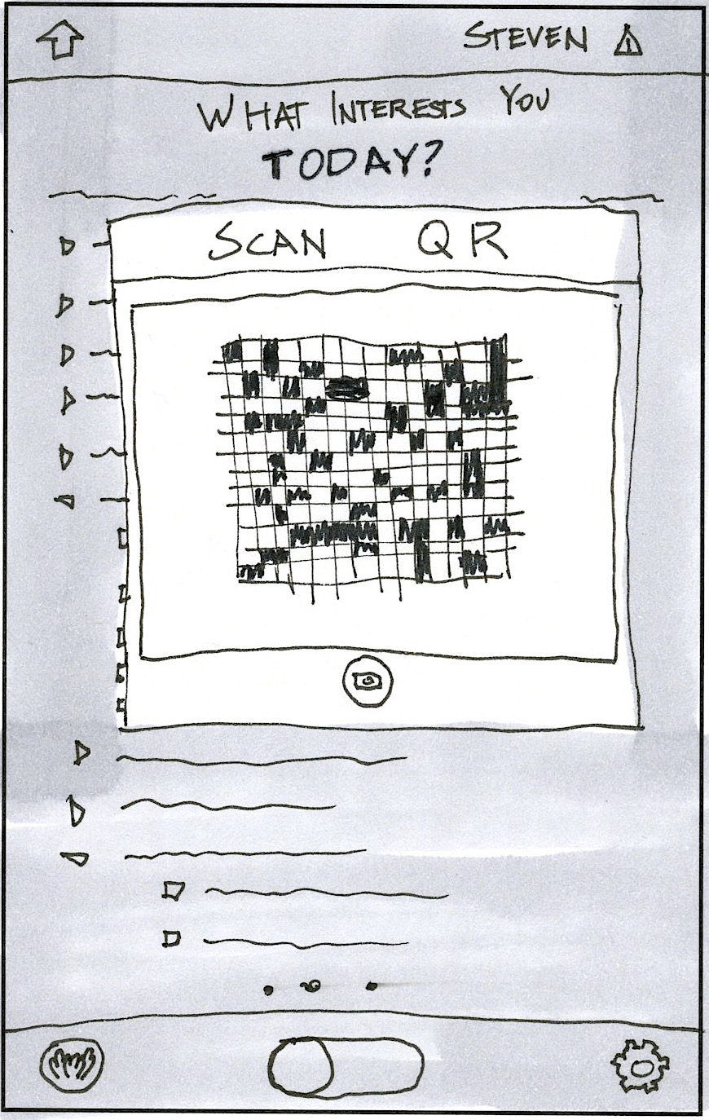
Location of the seat is recorded

Slide 12
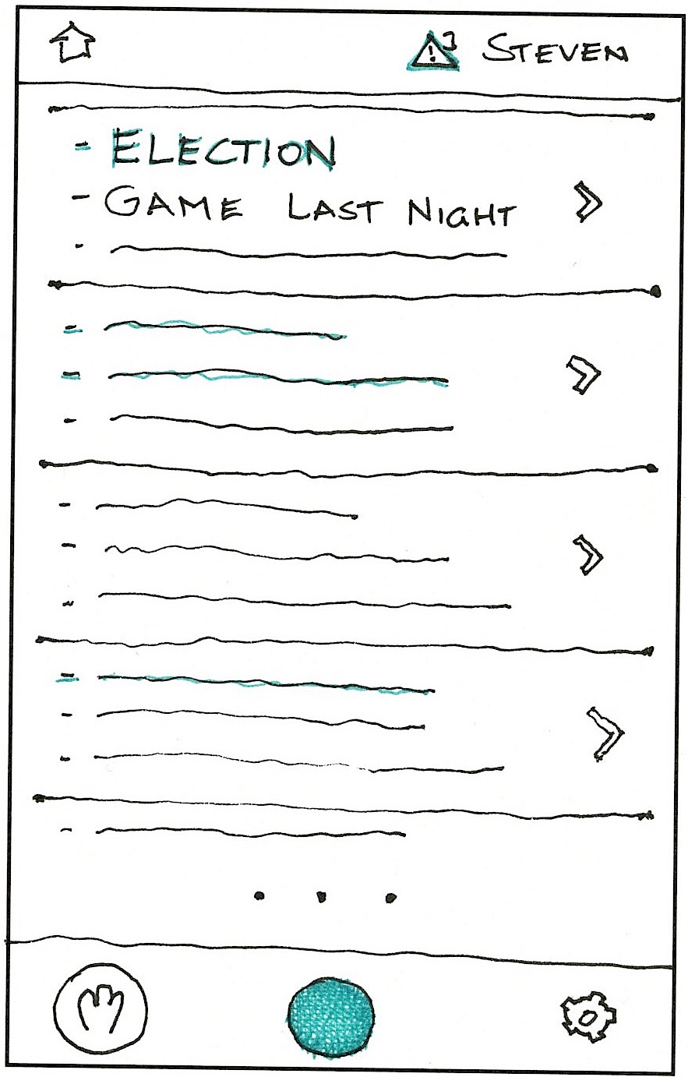
Browse
dots with
common
interests

Slide 13
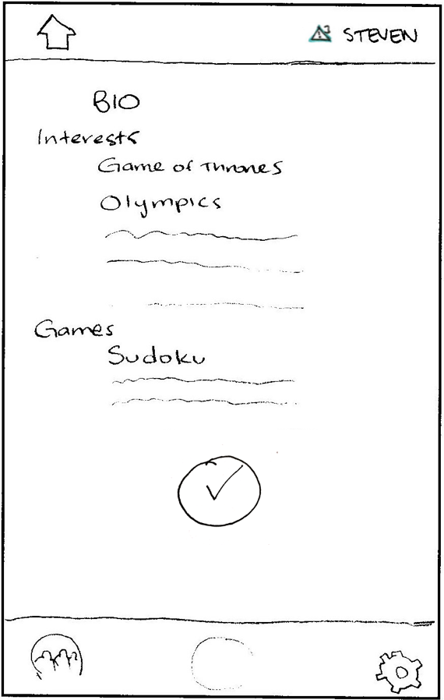
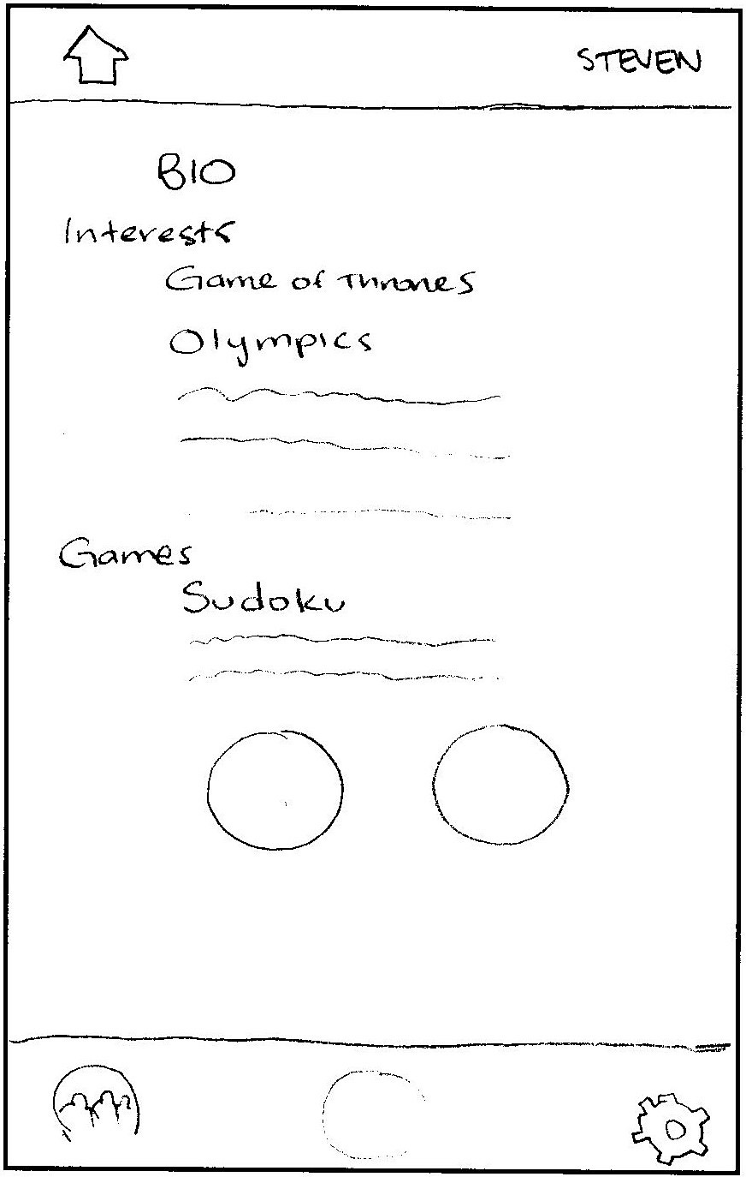
Hmm..
This person
seems interesting!
Let’s send
request!

Slide 14
Back to browsing

Slide 15
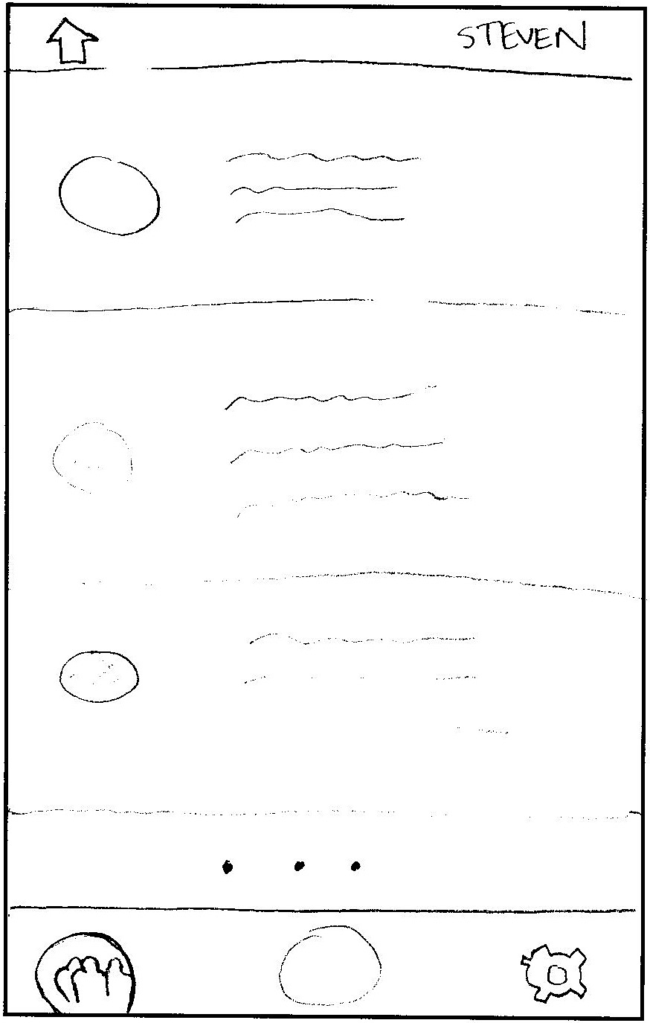
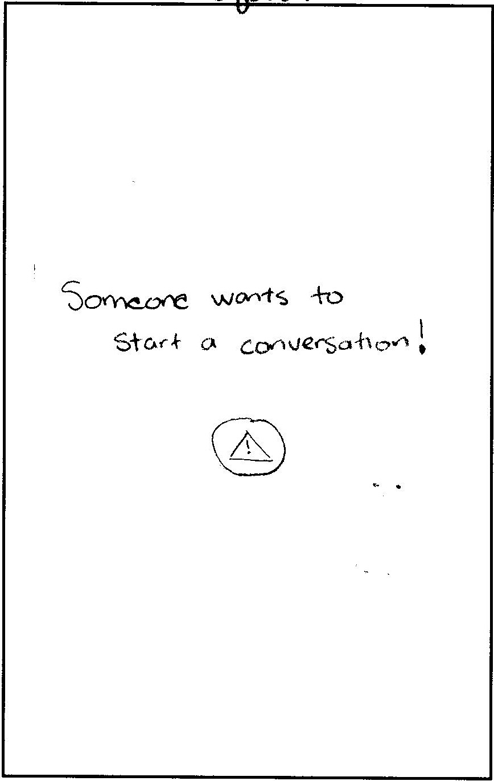

Slide 16
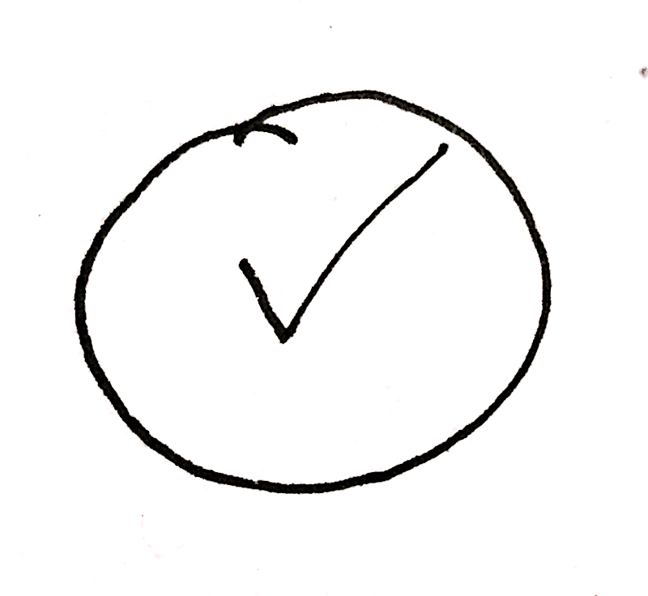

Slide 17
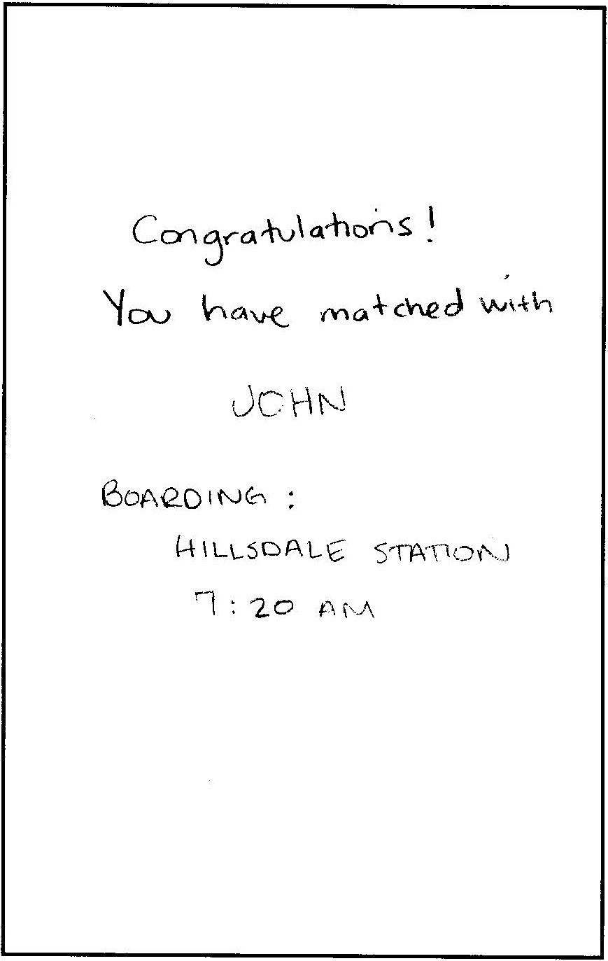

Slide 18
Task 3
Play a game

Slide 19
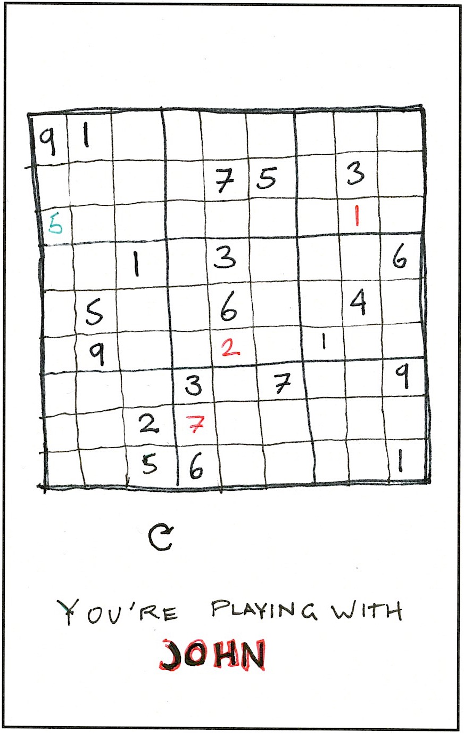
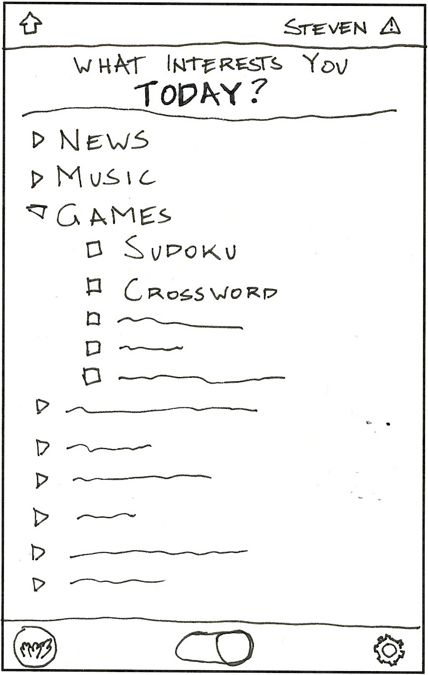
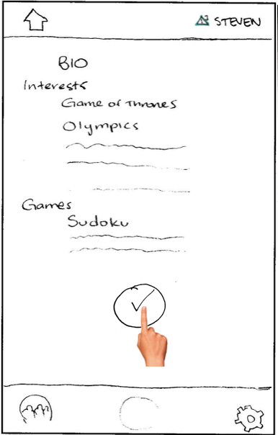

Slide 20
Testing

Slide 21
Method
Participants
Procedures
Test Measures

Slide 22
Results
Participant 1 - 20s, male
Easily finished task 1 and 2
Trouble with task 3
Confused about notifications and icons
Better way to reject

Slide 23
Participant 2 - 20s, female
Easily finished all tasks
Excited when she got a match
Very observant

Slide 24
Participant 3 - 20s, female
Trouble with task 1
Misclicked when becoming available
Easily finished task 2,3
Notification: “alarming”
QR scanner disappear automatically

Slide 25
Participant 4 - 20s, male
Trouble with task 1
Declaring interests
Trouble with task 2,3
Back out of profile - swipe
Difficulty with QR scanner - instructions?

Slide 26
Suggested UI Changes
Home Screen
Notification Icon
QR Code System

