Slide 1
Clean Plate
Michael Zhu, Brandon Liu, and Bryan McLellan

Slide 2
Help yourself, help feed the world.
Americans waste as much as 40% of all food produced in the United States. Meanwhile, 48 million Americans live in food insecure households. “Clean Plate” takes the food from restaurants that otherwise would have been wasted and lets you deliver it to homeless shelters and food banks in exchange for a discount on your meal.

Slide 3
Tasks
Task 1: Notified that food is available for pick-up at your current location (Simple)
Receive notification on your phone
pick up food
place food in your car
Task 2: Navigate to the homeless shelter/food bank (Complex)
App automatically calculates where the nearest homeless shelter is
Gives you step by step directions on how to get there
Task 3: Deliver food to shelter (Medium)
Have food inspected at shelter
Pass inspection and app confirms delivery

Slide 4
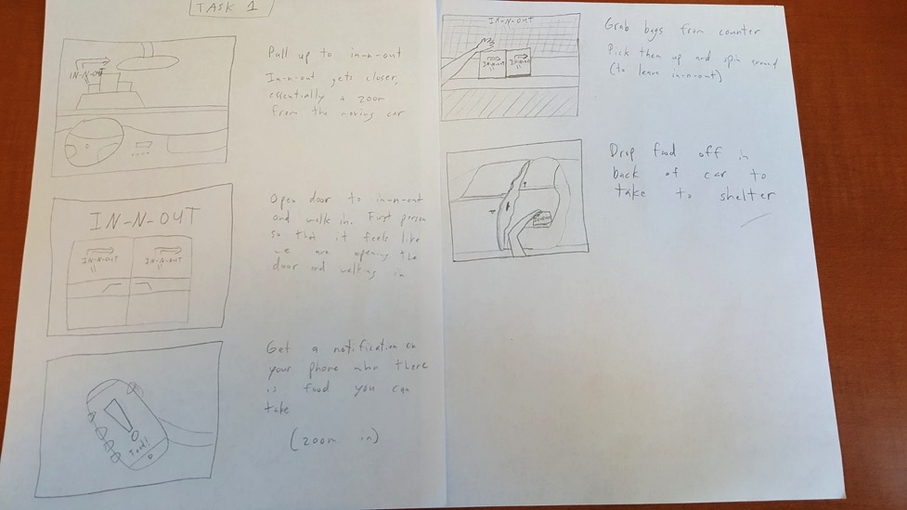
Storyboard - Task One, Get food notification

Slide 5
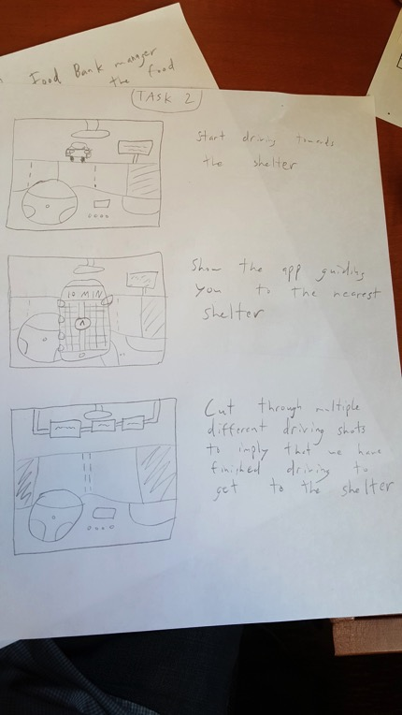
Storyboard - Task Two, Navigate to homeless shelter / food bank

Slide 6
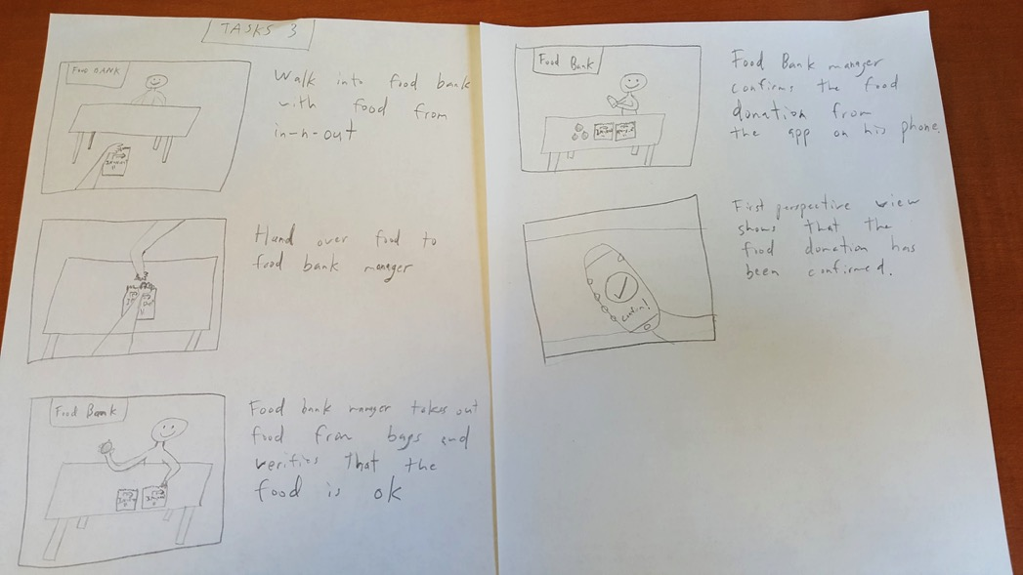
Storyboard - Task Three, Deliver food

Slide 7
Video Link

