Slide 1
Exploring Sustainability through Food
Notes:
I am going to be talking about how we expanded on our needfinding process to find new POVs and prototype some solutions

Slide 2
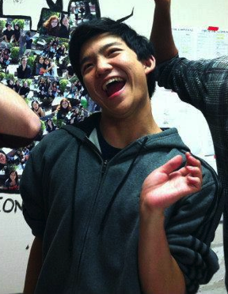
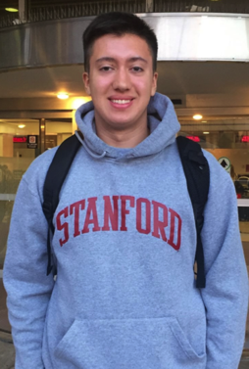
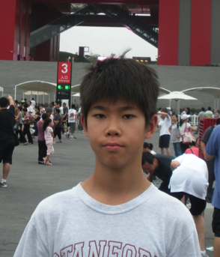
The Team
Michael Zhu
Brandon Liu
Bryan McLellan

Slide 3
Focus on Food

Slide 4
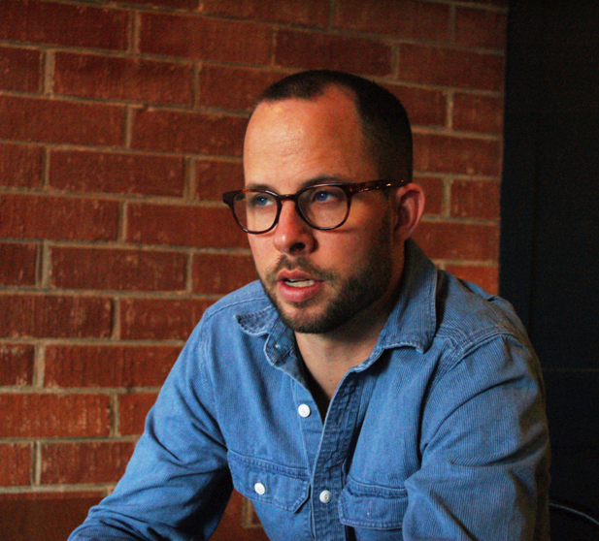
Initial POV From Last Week
Met Guillaume Bienaime
Realized how new restaurants waste food because they do not know how much to order
Would be game-changing to stop new restaurants from wasting so much food

Slide 5
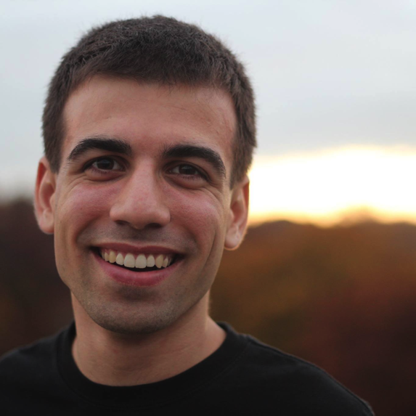
David Kay
Stanford Senior
President of People for Animal Welfare
Author of petition for a sustainability-themed dining hall
Advocate of Meatless Mondays campaign

Slide 6
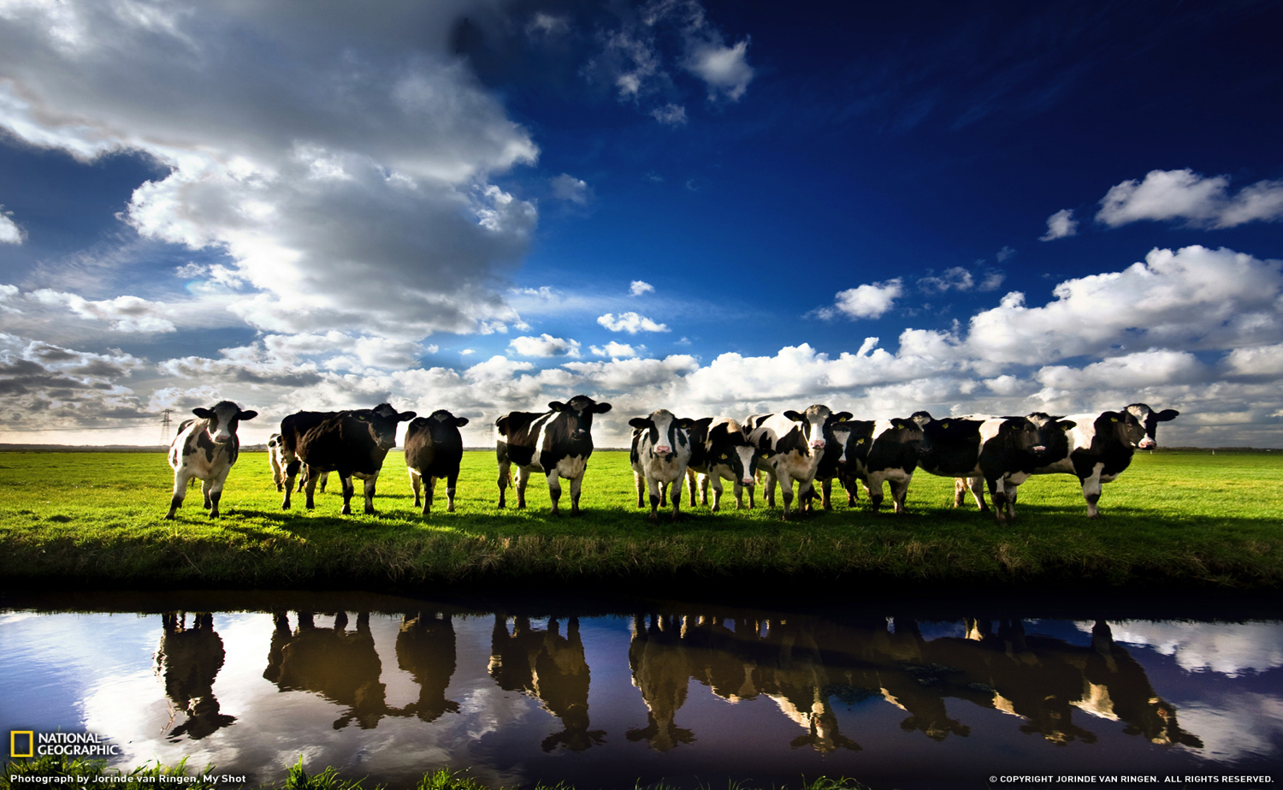
We were shocked to realize how much of an effect eating meat and consuming animal products has on the environment

Slide 7
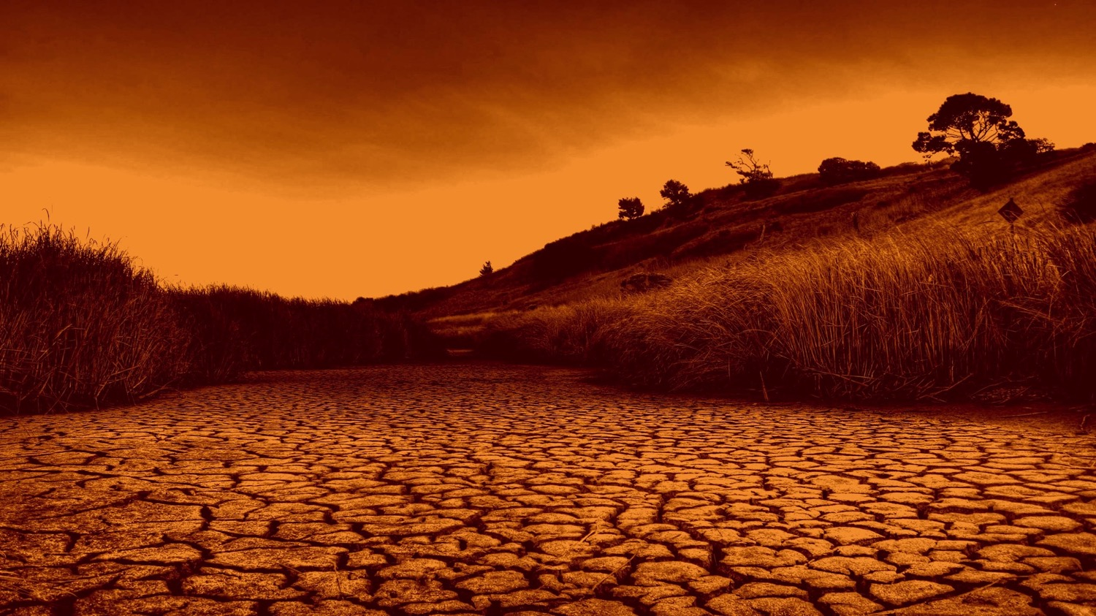
It would be game-changing to make others aware of the effects that eating meat and consuming animal products has on the environment

Slide 8
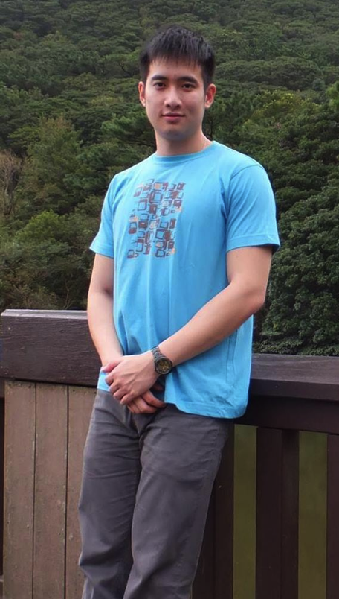
Bryan Cheong
Stanford Sophomore
Originally from Singapore
Math & Computational Science Major

Slide 9
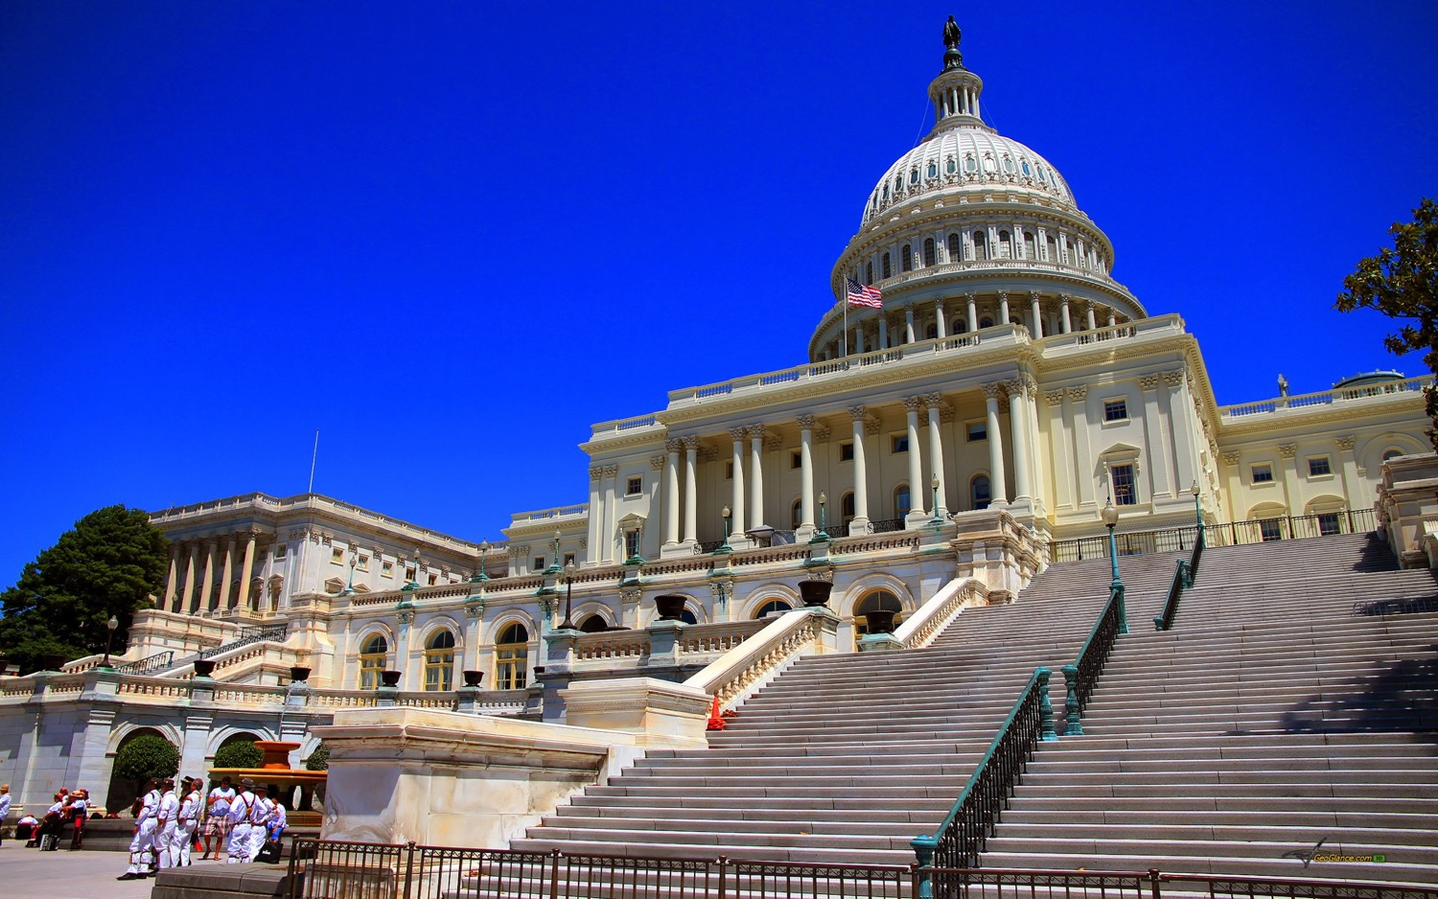
We were surprised to learn that Bryan believed that only through government initiative could we make impactful changes for sustainability

Slide 10
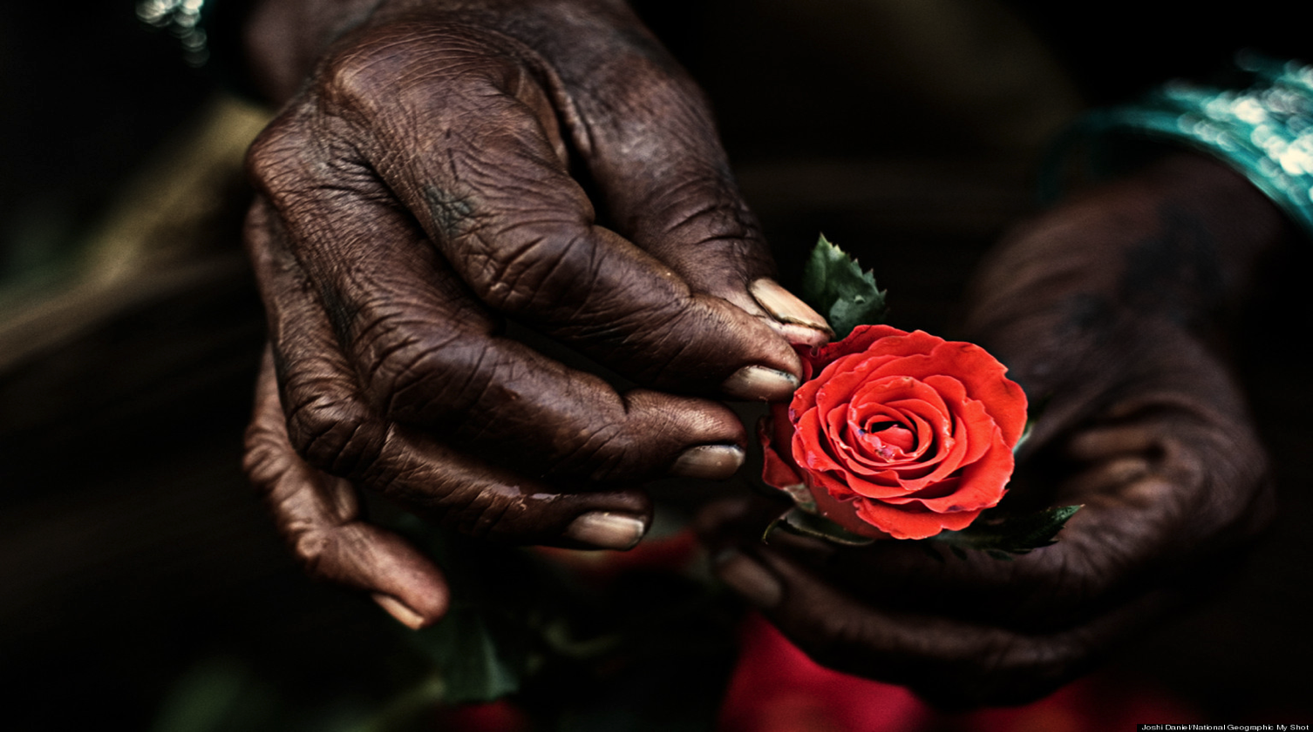
It would be game-changing if we could inspire people like Bryan Cheong and others to make a change through their concerted efforts without help from the government

Slide 11
How Might We …

Slide 12
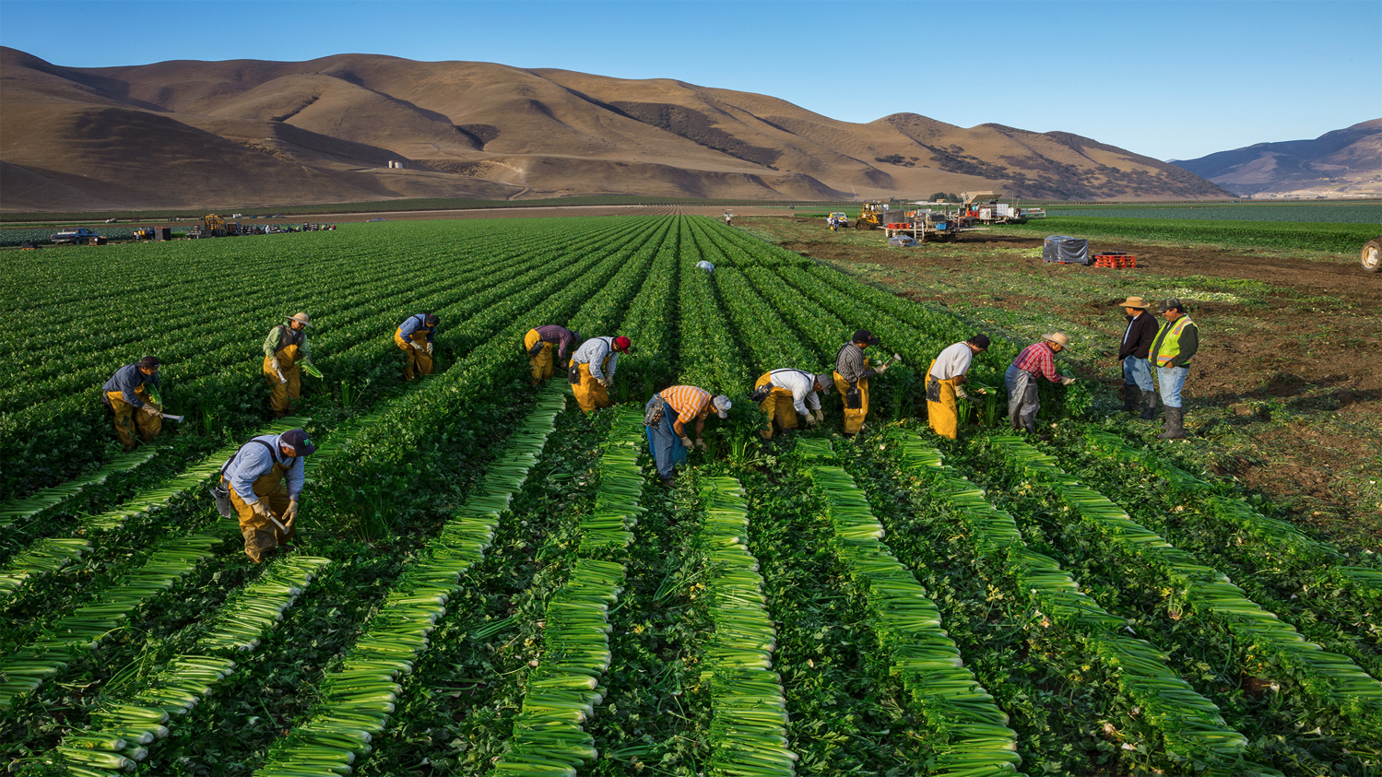
HMW #1
. . . create opportunities to make sustainable consumption a social effort
David Kay

Slide 13
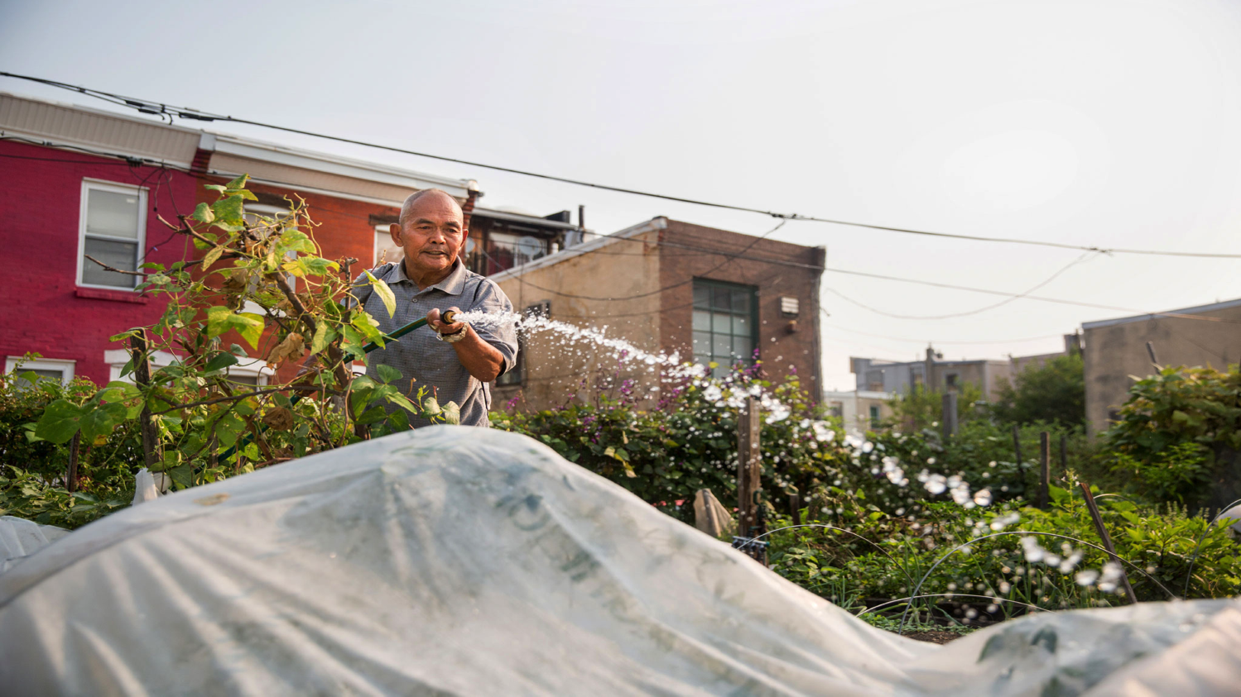
. . . quantify the impact that individual actions have with regard to food sustainability
Bryan Cheong

Slide 14
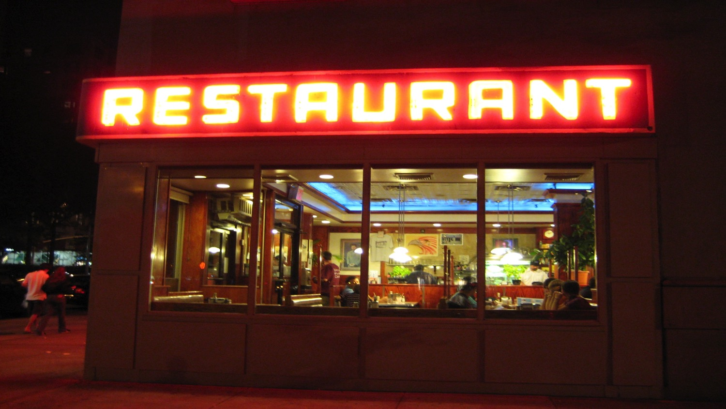
. . . get other people involved in helping new restaurants waste less food
Guillaume Bienaime

Slide 15
Experience Prototypes

Slide 16
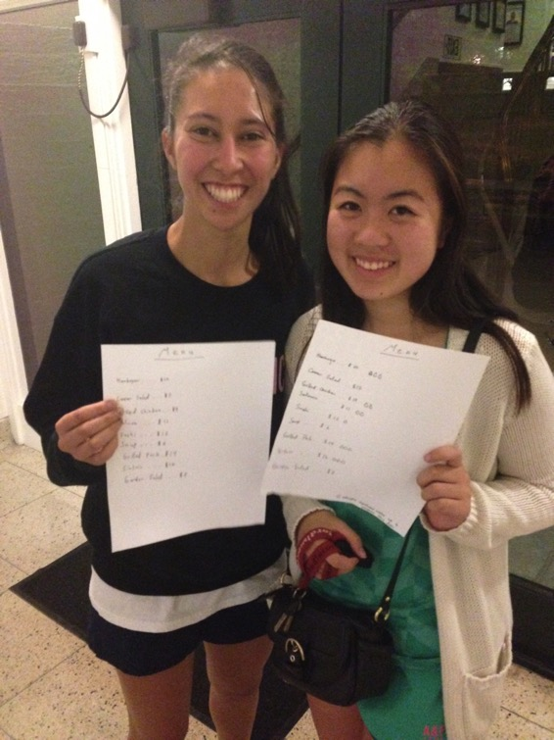
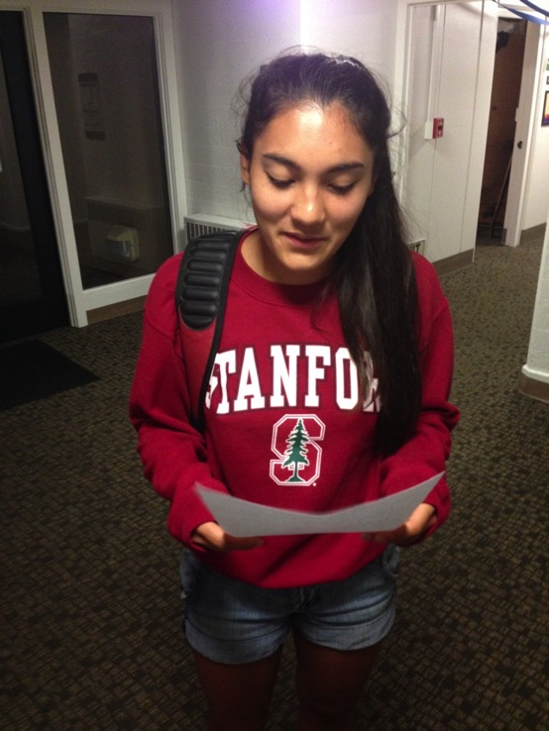

Slide 17
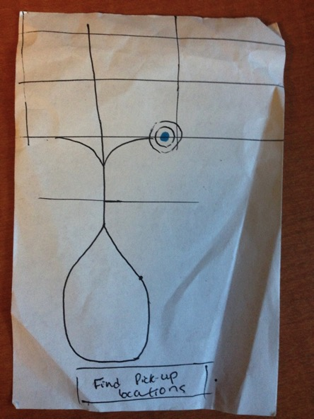
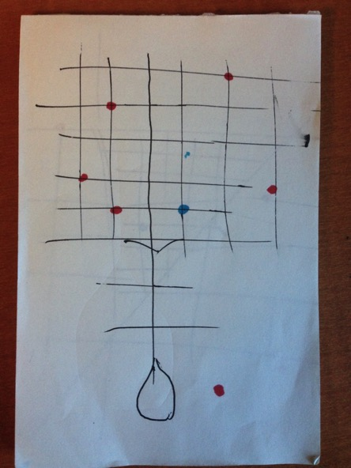
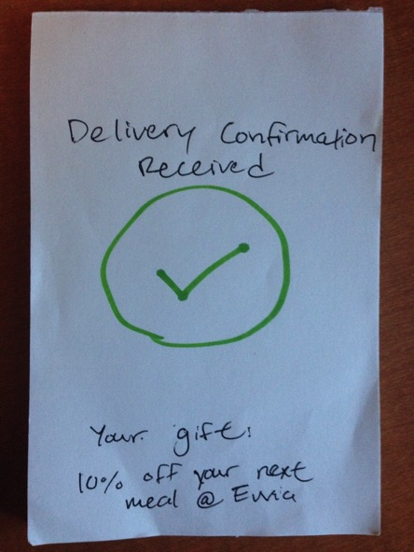

Slide 18
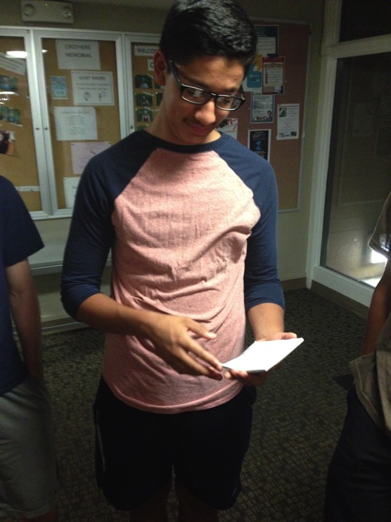
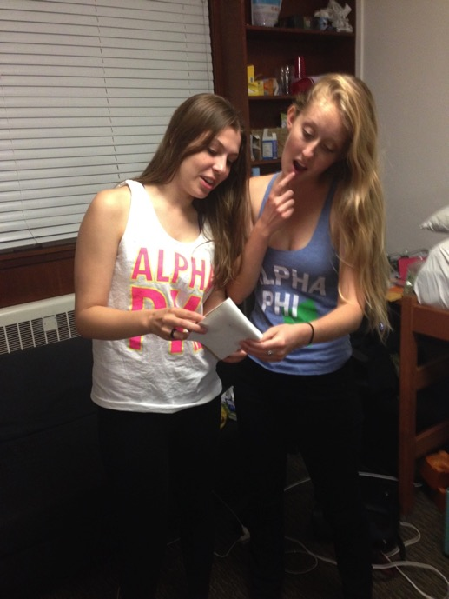

Slide 19
