Slide 1
A Clean Plate
Exploring Sustainability in the Food Industry

Slide 2
The Team
Michael Zhu
Bryan McLellan

Slide 3
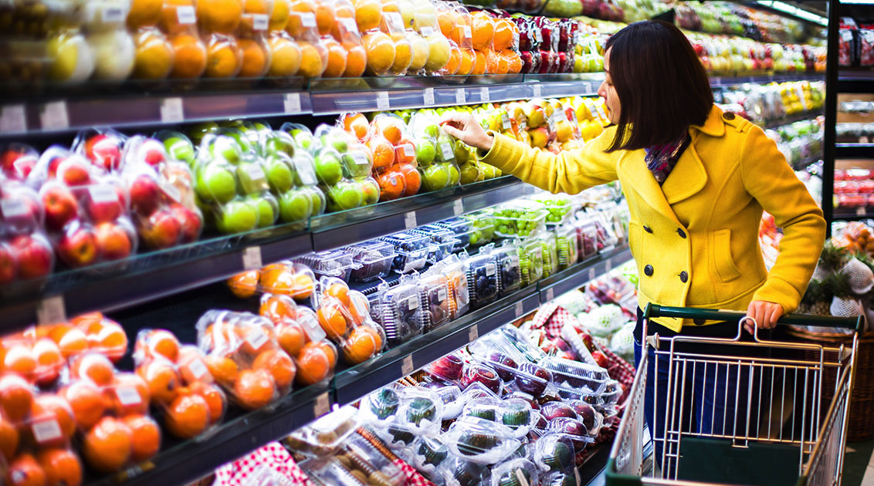
Food.

Slide 4
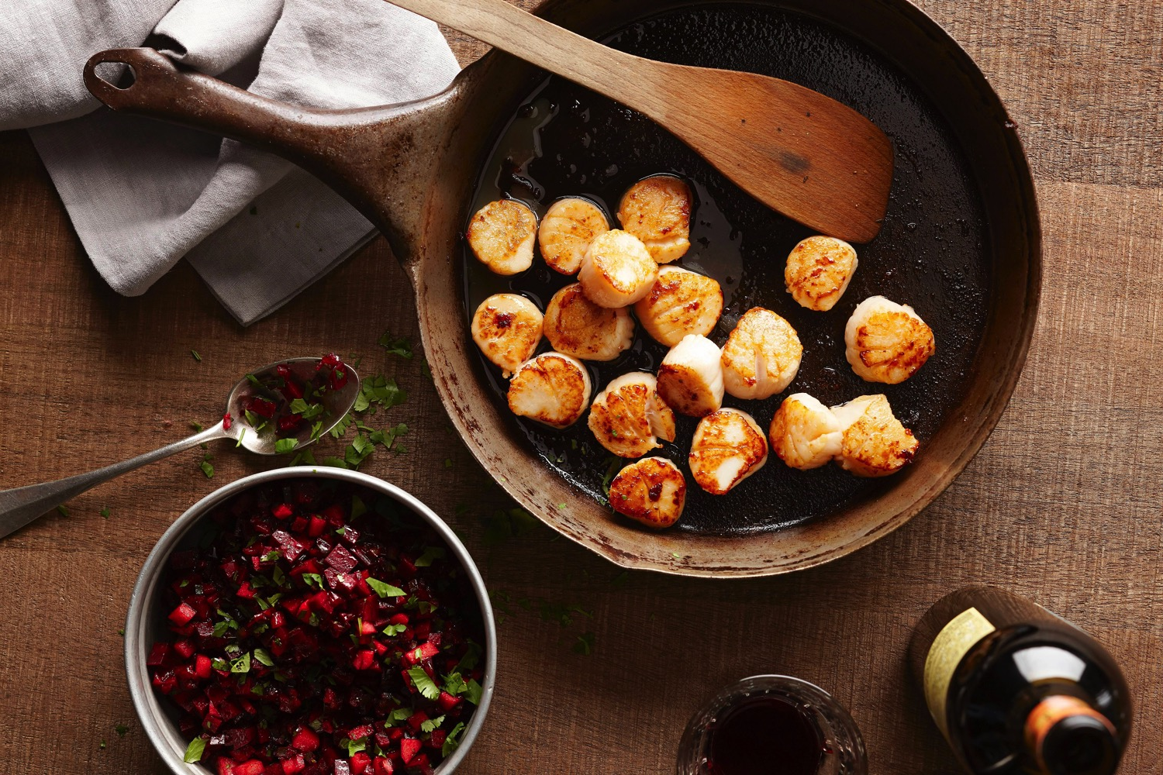
Notes:
The American Public Health Association (APHA) defines a "sustainable food system" as "one that provides healthy food to meet current food needs

Slide 5
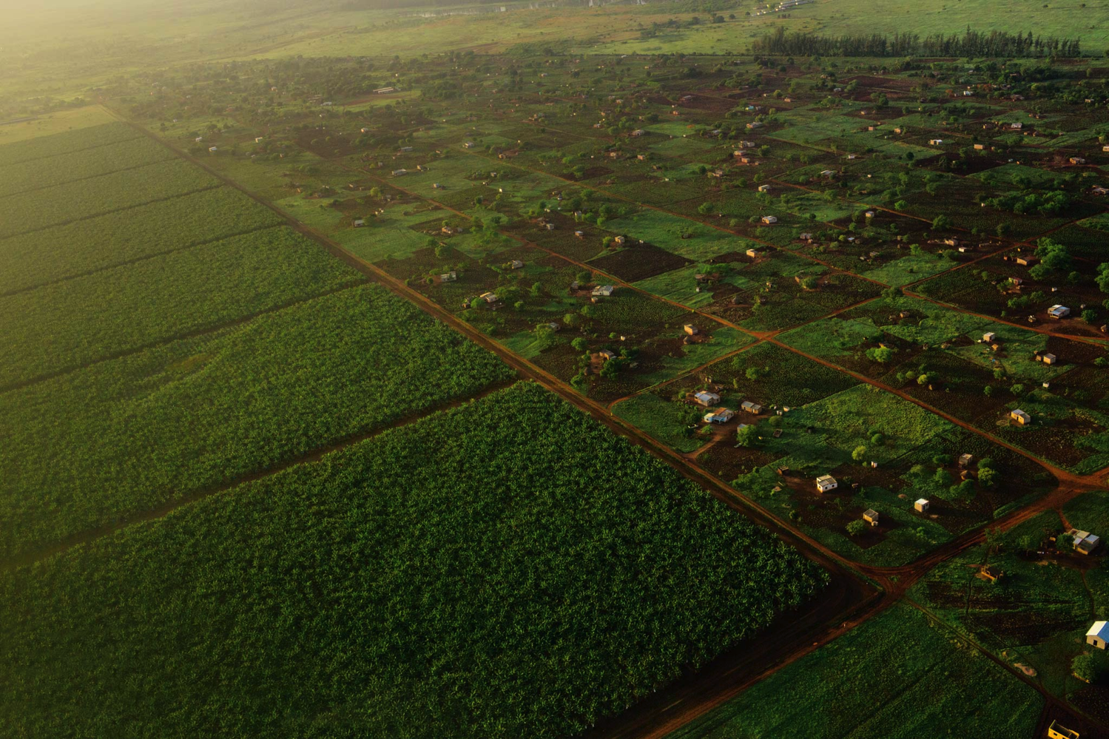
Notes:
while maintaining healthy ecosystems that can also provide food for generations to come with minimal negative impact to the environment.

Slide 6
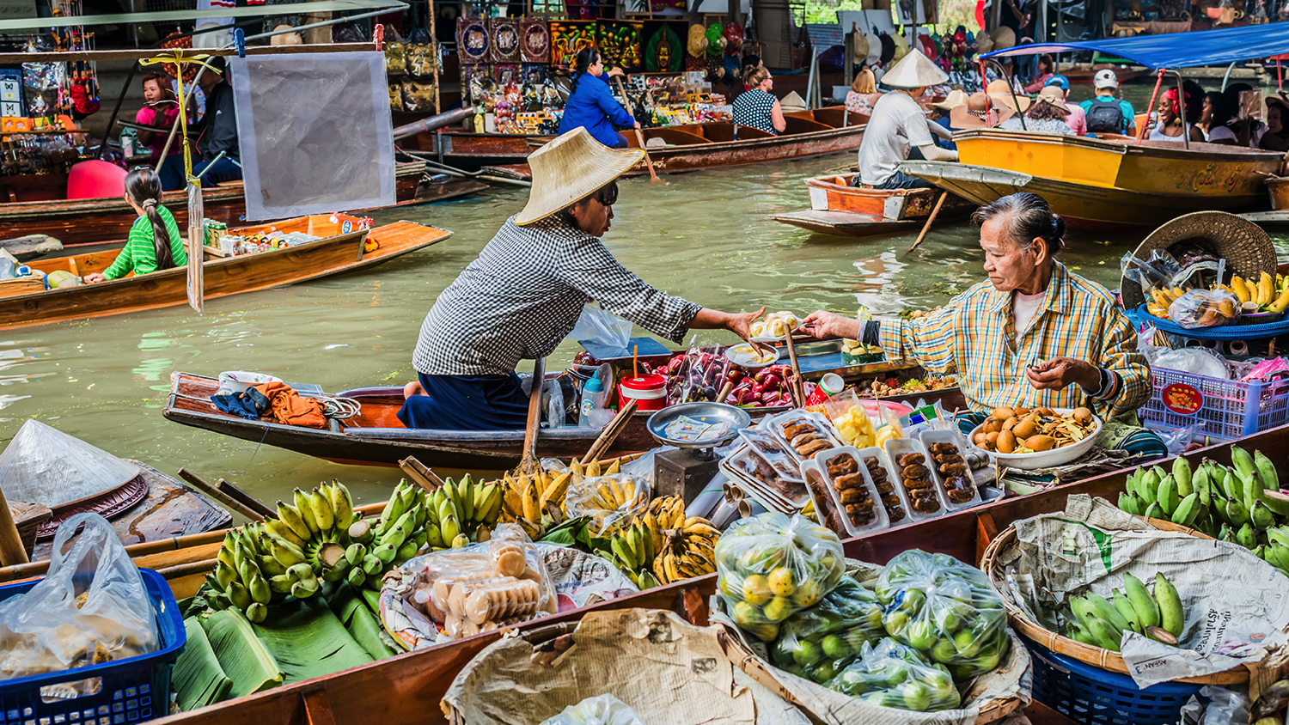
Notes:
A sustainable food system also encourages local production and distribution infrastructures and makes nutritious food available, accessible, and affordable to all.

Slide 7
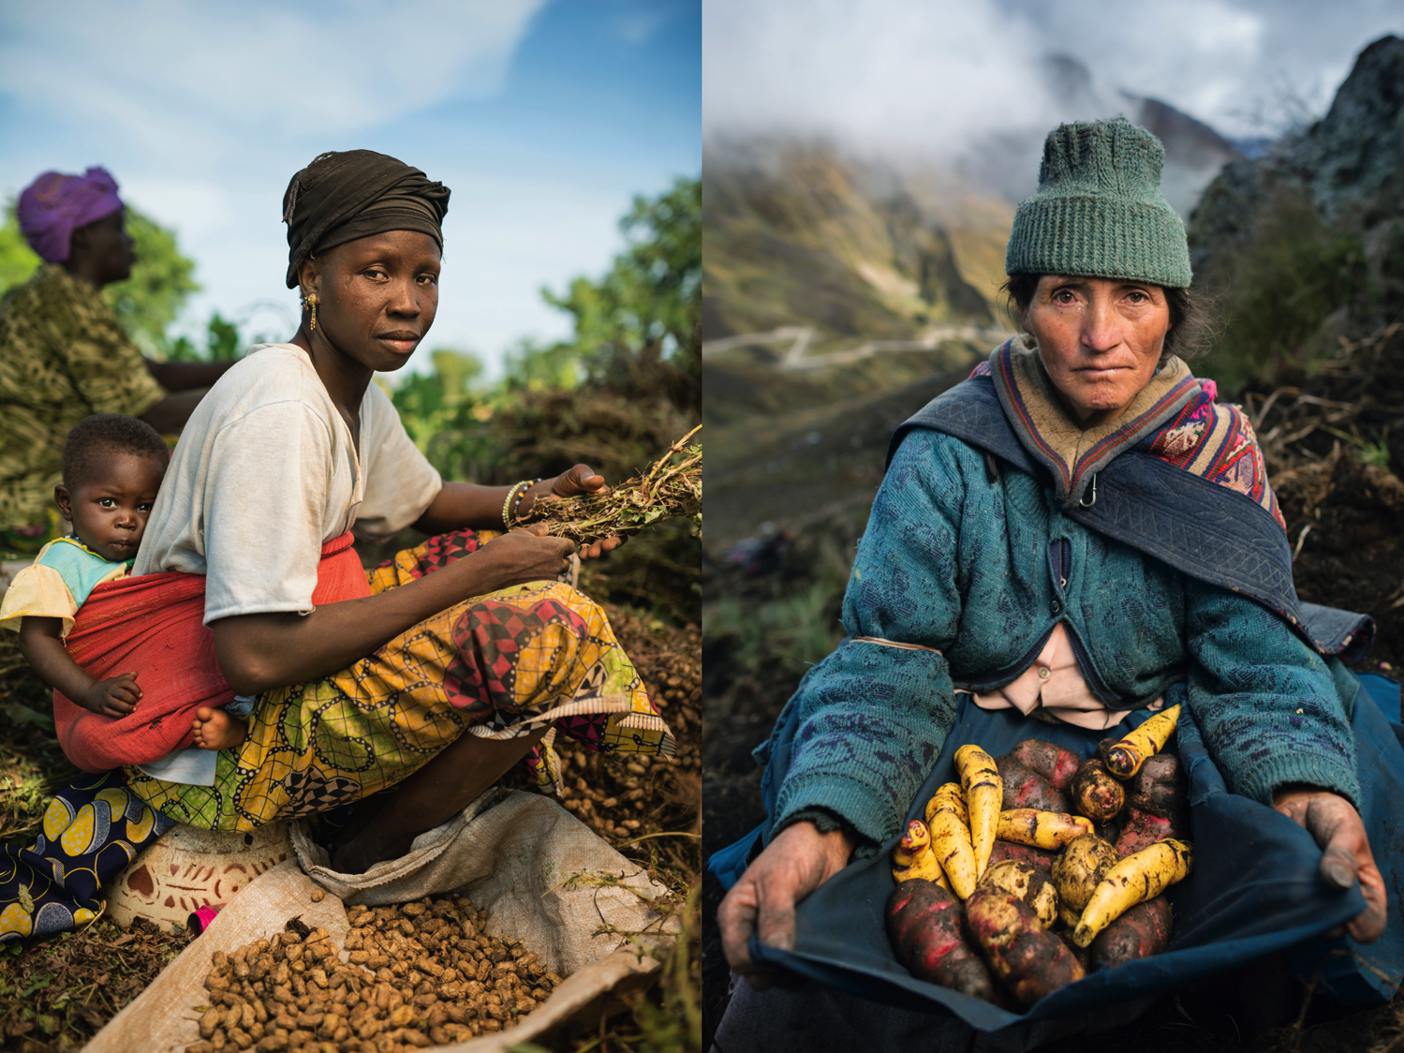
Notes:
Further, it is humane and just, protecting farmers and other workers, consumers, and communities.” So we have an ideal for food sustainability. But where do we stand today, and how do we move towards that ideal?

Slide 8
Restaurants
(processing)
Farm
Consumer
distribution
(us)
Grocery Stores
Notes:
To answer that question, we approached our needfinding with this simplified conception of the food industry in mind.

Slide 9
Say
Think
“People come here to have a real experience...People come here to sit down and be away from technology for an hour
“Being a small scale farmer, there’s just no way to produce for supermarket prices”
“How do they get to these products if they aren’t being served them at restaurants?”
“It’s about them understanding my needs”
“We can only sell...what’s appealing to the people”
“Especially in this area right here, [customers] are very socially conscious”
“They can tell they’re getting a better product”
“Waste is money...it’s about how good you are at your job”
Only way to consider other distributors is if they are unique.
Relying on servers to sell more of one food and not another
Having to be strategic with how to use the limited kitchen space and refrigerator space in terms of food
It’s not worth it to debate between distributors when there is already one trustworthy one
Local farm foods are much more nutritious
Stores are using too much industrialized agriculture
Consumers that are buying local foods are usually more socially aware
Grocery industry focuses on the quality of food they are bringing in, but ultimately the customer dictates what food is in the store
Get food every morning and label it and organize
People take food home and finish all of plates so not a lot of food left
Compost
Look at statistics about what people are buying and not
Raised dairy goats and chickens
Would sell out their whole van of milk at farmers market
Policies about what food to take and what food not to take
Wasting a fair amount of milk
Certain sense of trust between distributor and restaurant
Strong dedication to customer
Want stability in a distributor
Disappointment in processed foods after trying local flavors
Grocers care about the life of animals and farmers
They also want to satisfy the consumer
Frustration in getting local foods from small farms to more consumers
Mutual care between producers, vendors and consumers about sustainability.
Do
Feel
Notes:
So this is a overview of some of the key points we had in our empathy map, and in the next few slides we’ll be focusing in on a few of these and our interpretations of them, on an interviewee-by-interviewee basis.

Slide 10
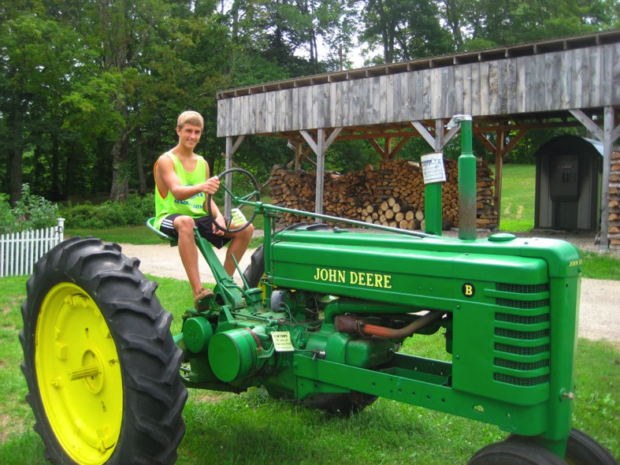
The Farmer
Dunchadhn Lyons
Sophomore, Stanford University
Olney, Maryland
Willow Grove Farm, Rockhill Orchard
Notes:
So the first person we interviewed was our friend Dunchadhn. He’s also a sophomore here, and he happens to have grown up on a farm in Maryland, working with dairy goats, chickens, and tending to crops and fruit trees. So Dunchadhn represents the farming perspective, specifically small-scale farming.

Slide 11
Barriers to entry: “Being a small-scale farmer, there’s just no way to produce for supermarket prices”
“The taste is better, the quality is better, the nutrition is better . . . they can tell they’re getting a better product”
“You don’t see as much of that wasting on the smaller scale, where you have the ability to repurpose”
“How do they get to these products if they aren’t being served them at restaurants?”
Notes:
We asked Dunchadhn to take us through a typical day on the farm, how it differs from industrial farming, and what he does with his products...

Slide 12
Down to earth.
Taste the difference.
Small farm, small reach.

Slide 13
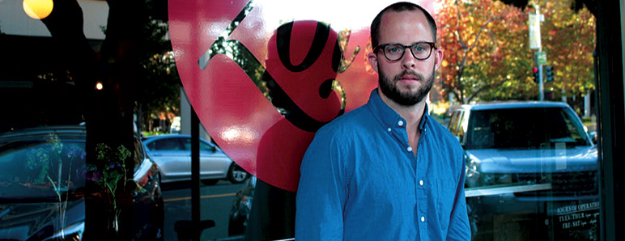
The Chef
Guillaume Bienaime
Executive Chef, Marché
Owner & Chef, Zola

Slide 14
“It’s about [distributors] understanding my needs”
Customer, food quality comes first
Hyperlocal restaurants: “It’s just trendy”
“People come here to have a real experience . . . People come here to sit down and be away from technology for an hour”
“Waste is money . . . it’s all about how good you are at your job”
Waste α 1/Experience
Notes:
Quality comes first, but correlates with locality and sustainability anyways

Slide 15
Customer first.
Eating is intimate.
Experience matters.

Slide 16
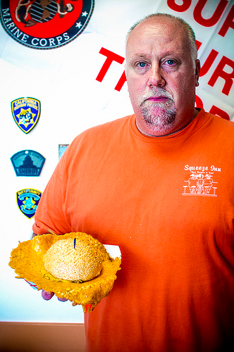
The Grocer
Eric Ostberg
Associate Store Team Leader, Whole Foods Palo Alto
Restaurant to grocery store

Slide 17
“We can only sell . . . what’s appealing to the people”
“We sell sustainable seafood because we want it to be around”
With regards to choosing distributors: “It’s above my paygrade; that’s done at a different level”
Consumers care: “Especially in this area right here, they’re very socially conscious”

Slide 18
People care.
And corporations too, ostensibly.
Transparency?
It’s happening here.

Slide 19
Summary
Farmers and producers face a barrier to enter the same market as food chains and supermarkets
Restaurants have formed set relationships with distribution channels
Lack of transparency of how food is selected at Whole Foods

