Slide 1
Medium-fi Prototype
Brandon Liu, Michael Zhu, Bryan McLellan

Slide 2
Give more. Get more. Waste less.

Slide 3
Mission Statement
Americans waste as much as 40% of all food produced in the United States. And yet 48 million people here live in food insecure households. CleanPlate seeks to empower the average citizen to bridge this gap by taking excess, quality food and produce from restaurants that otherwise would have wasted it and lets you deliver it to nearby homeless shelters and food banks.

Slide 4
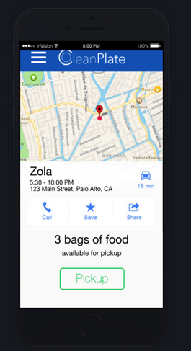
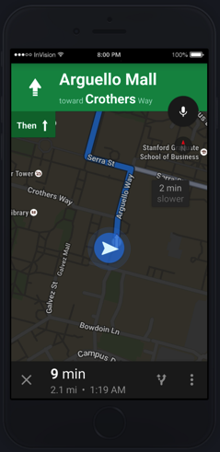
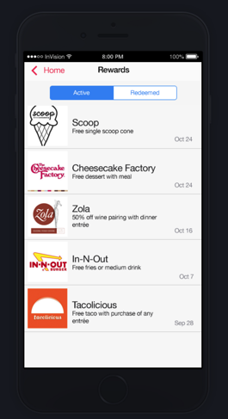
Task Flow Overview
2. Navigate to donation center (medium)
1. Find food (complex)
3. Access Rewards(simple)

Slide 5
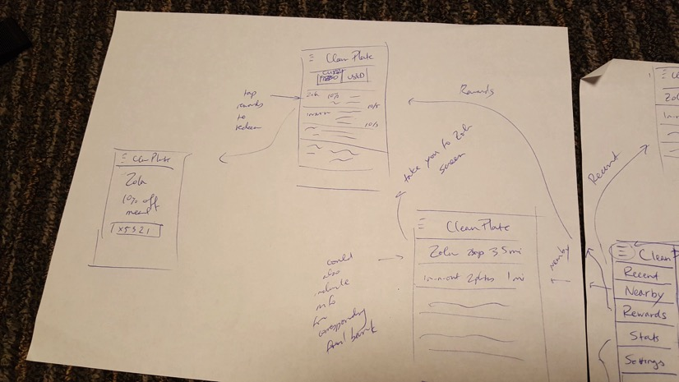
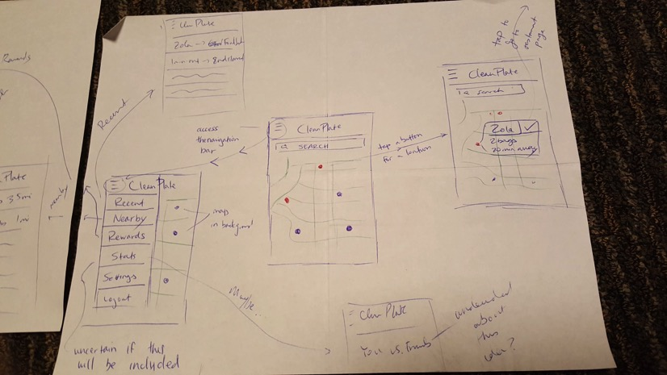
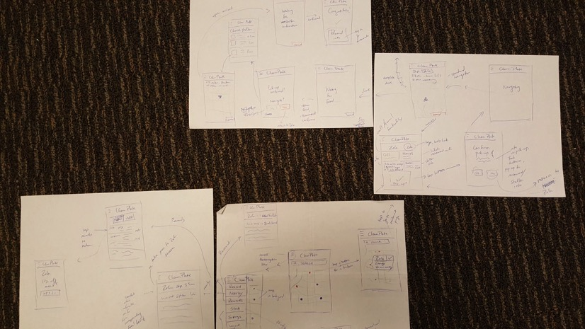
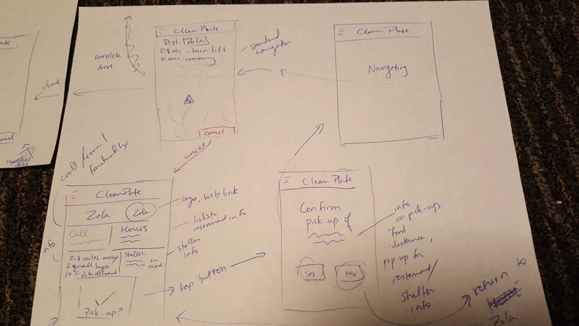
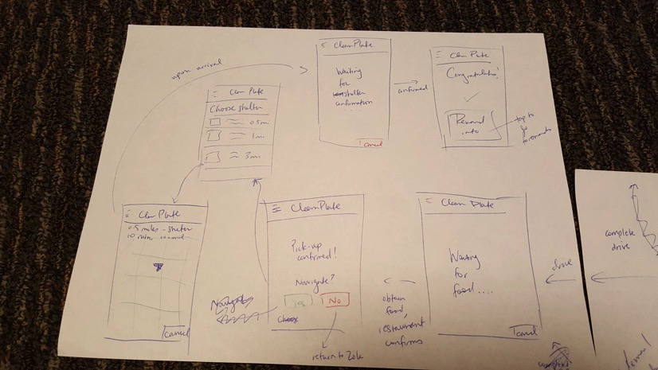
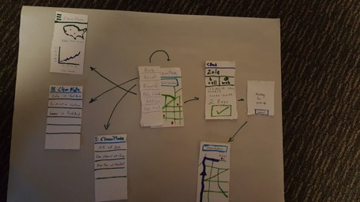
General changes - annotations
Annotated storyboard with more descriptive user interaction
Transition screens

Slide 6
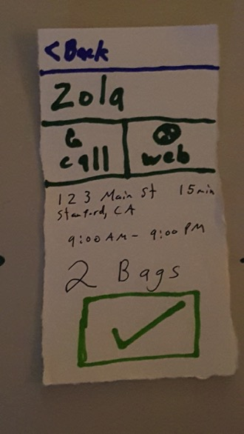
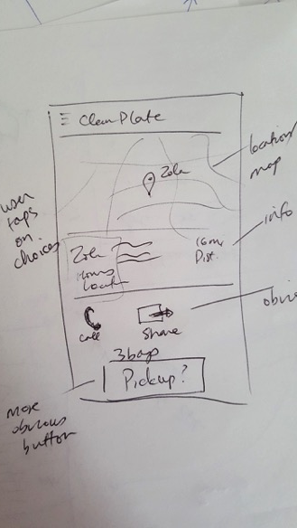
Changes (1) - Restaurant info page
Low-fi user testing found that users were confused by this page
Buttons are now very clear and easy to understand
Provide more info to the user

Slide 7
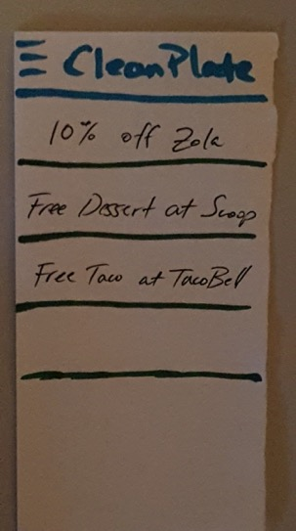
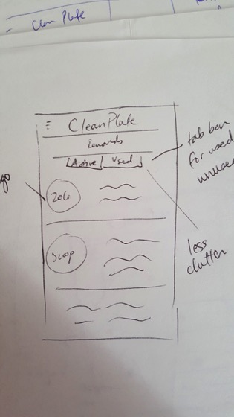
Changes (2) - Active vs Used Rewards
Removed clutter from used rewards taking up space
Logos added to design for rewards page
Easier to use (focuses on important info for user)

Slide 8
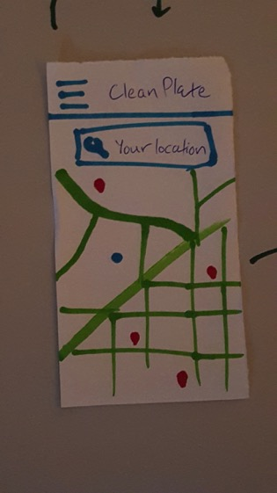
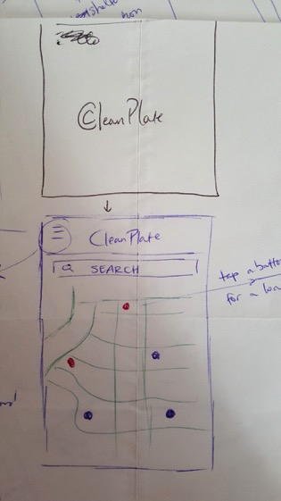
Changes (3) - Loading screen
Addition of loading screen when the user opens the app
Delay between opening the app and loading the home screen
Also modified our logo

Slide 9
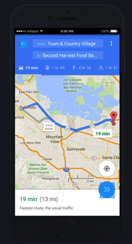
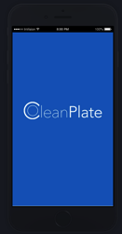
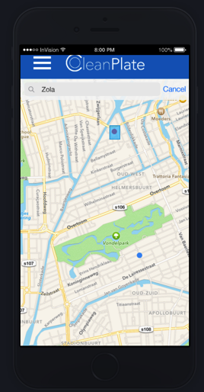
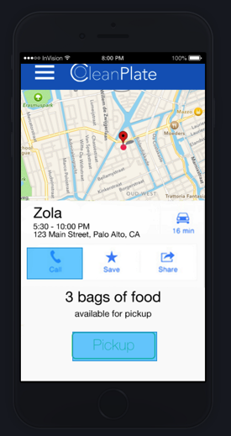
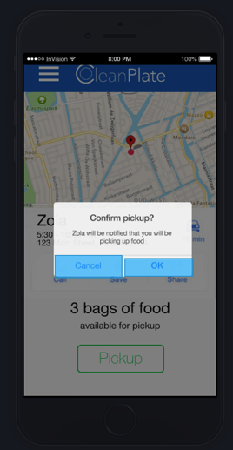
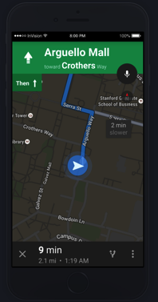
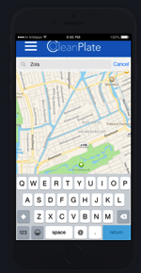
Medium-Fi Task Storyboard (Find food)
Landing page
*Selected buttons highlighted in blue
Restaurant information, food information
App directs you using GoogleMaps API
Search for and select a restaurant

Slide 10
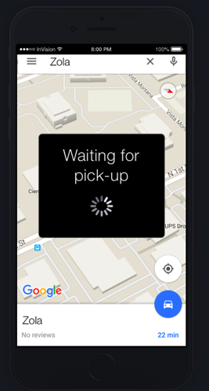
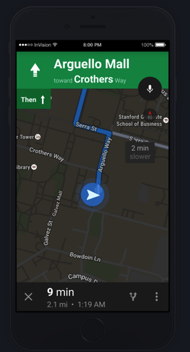
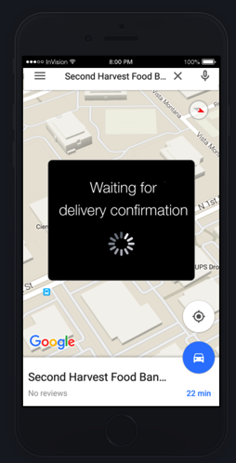
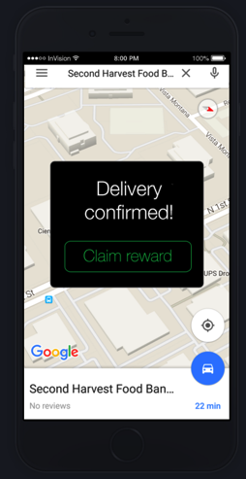
Medium-Fi Task Storyboard (Navigate to shelter)
Route information
After picking up food, directed to the shelter
Delivery confirmation, tap to go to rewards
Navigation screen
Upon arrival at the food bank

Slide 11
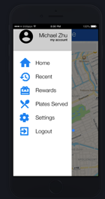
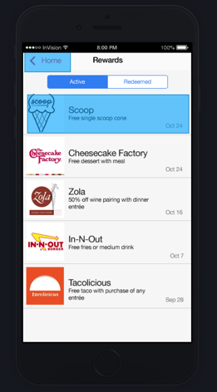
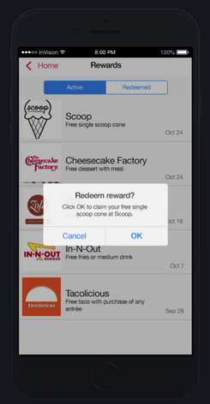
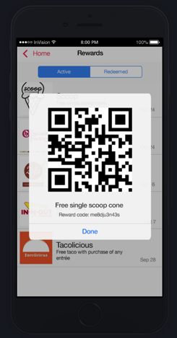
Medium-Fi Task Storyboard (Access Rewards)
Confirm or cancel redemption
Reward info: Expiration date specifics,
Access from delivery page or navbar
Select reward
Redeem
Scan code

Slide 12
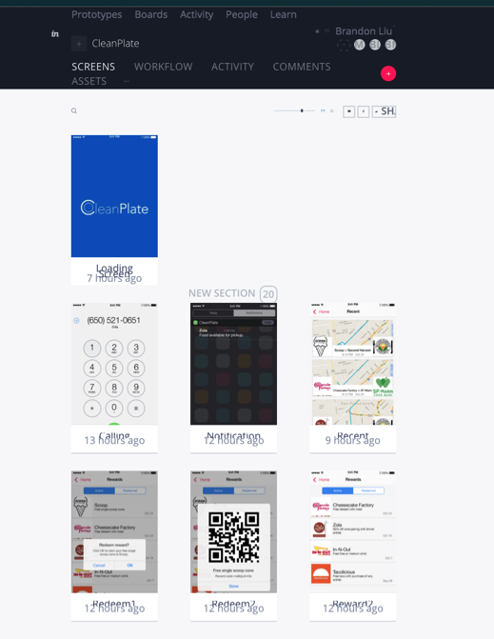
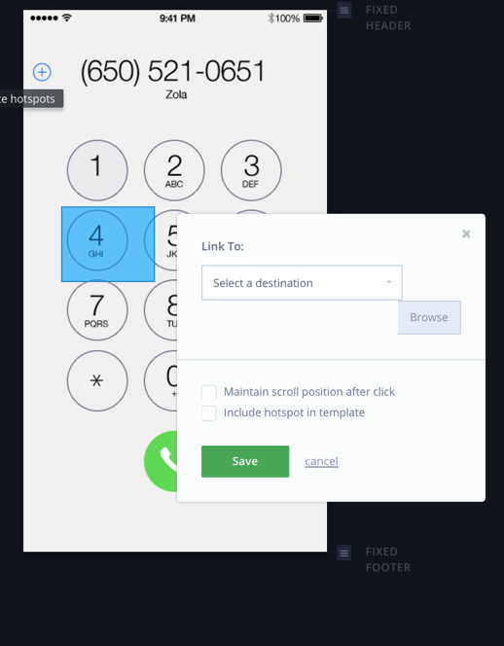
Prototyping tools - InvisionApp
Easy, displayable workflow
Allows you to connect “hot spots” between screens and link your app together with tap actions
Limited the actions / animations we could take between different layers of our application
Original plan to use Sketch + Origami
We used Photoshop + Invision

Slide 13
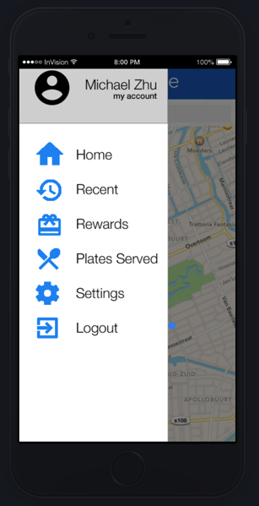
Current prototype limitations and tradeoffs
Single task flow: only choose Zola
ease of demonstration, also just medium-fi
App goes to directly to navigation to the shelter → but the actual app would allow you to pick a shelter to go to, be more flexible
For simplicity / focusing on the task
Navbar doesn’t entirely function: Plates Served, Settings, Logout → not essential to user experience with tasks
Navigation interface uses GoogleMaps API, so we did not flesh it out too much→ easier to follow

Slide 14
Medium-fi specifics (Wizard of Oz techniques)
Need to tap from the “navigating” to and from restaurants screens
Real application would simply move user to the next screen
Also need to manually navigate through “waiting” screens
Didn’t handcode any features yet, focusing on the user navigation through the application

Slide 15
