Slide 1
Clean Plate

Slide 2
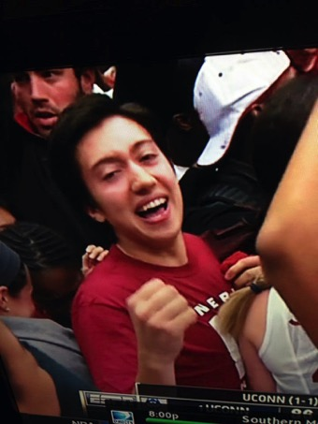
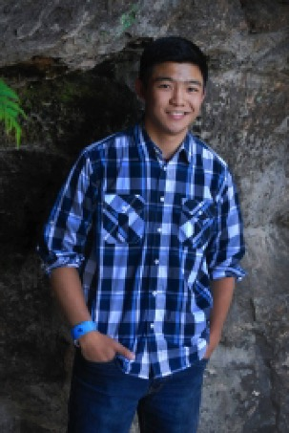
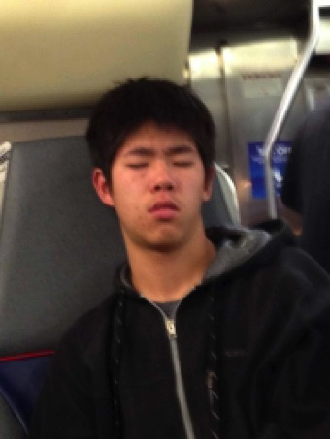
The Team
Bryan McLellan
Brandon Liu
Michael Zhu

Slide 3
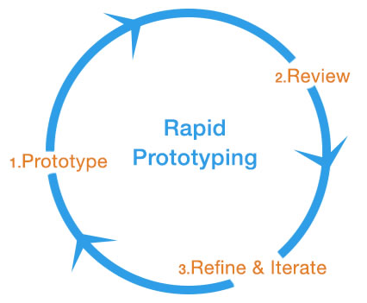

Slide 4
Give more, Waste less.

Slide 5
Mission Statement
Americans waste as much as 40% of all food produced in the United States. And yet 48 million people here live in food insecure households. Clean Plate seeks to empower the average citizen to bridge this gap by taking excess, quality food and produce from restaurants that otherwise would have wasted it and lets you deliver it to nearby homeless shelters and food banks.

Slide 6
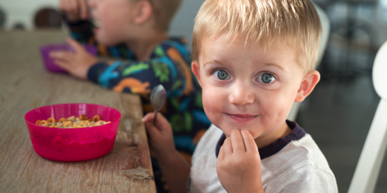
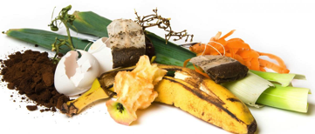
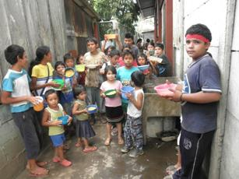
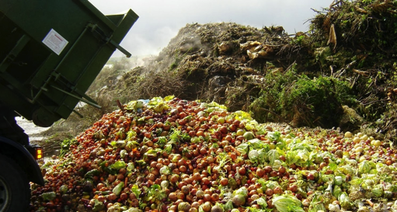
Clean Plate

Slide 7
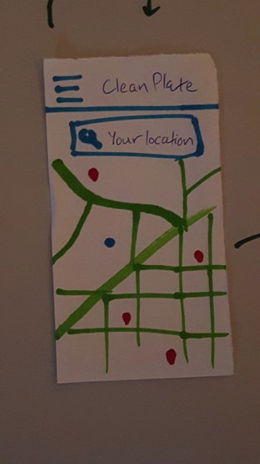
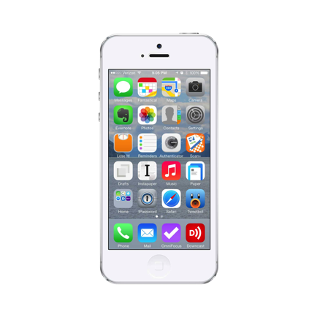
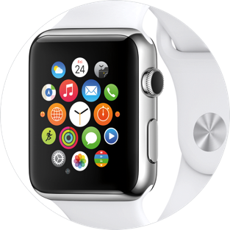
Interface
Mobile Application
Food sustainability needs to be as ubiquitous as our phones
Specific interface choices?
Notes:
easily accessible
plan trip on the go (impromptu spirit of this app) → can’t do this through web
navigation home page (comparisons to google map)
linear

Slide 8
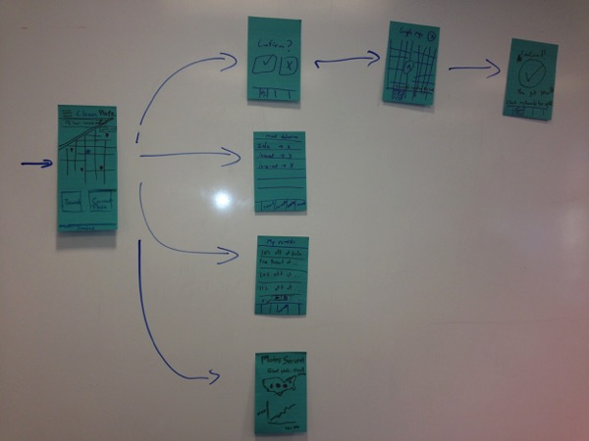
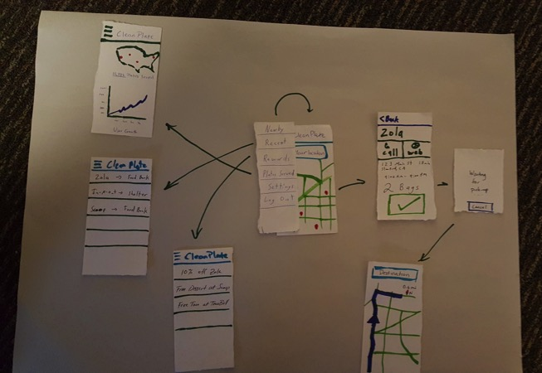
Low-fi Prototype Structure
BeginningInterface
Revised Low-fi Prototype
Notes:
elaborate on choosing to have the map in the center (gives idea of what’s around you) → as opposed to just having a main page

Slide 9
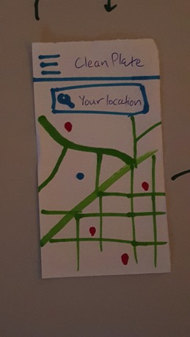
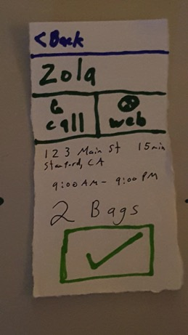
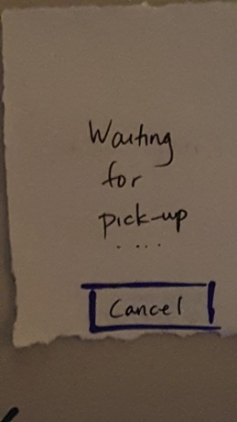
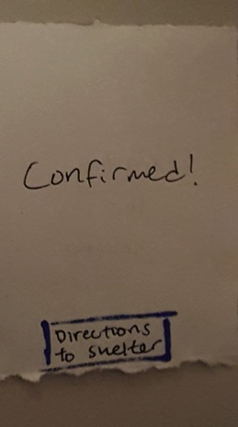
Task Structure and Flow - Find food (complex)

Slide 10
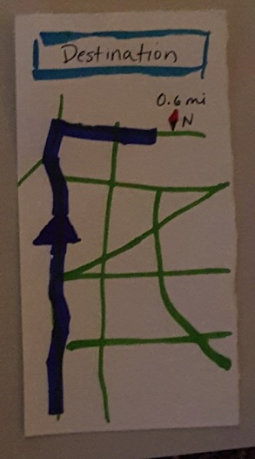
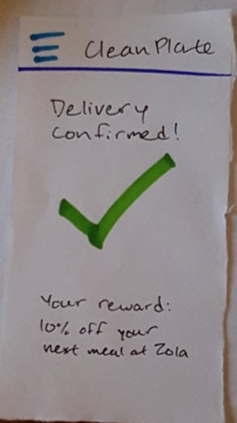
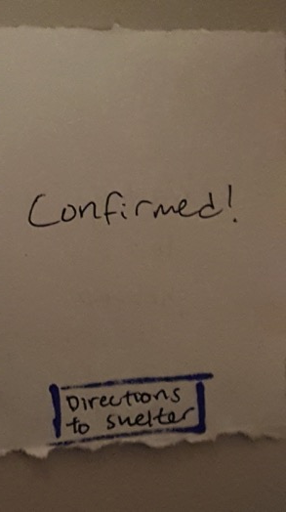
Task Structure and Flow - Navigate (medium)

Slide 11
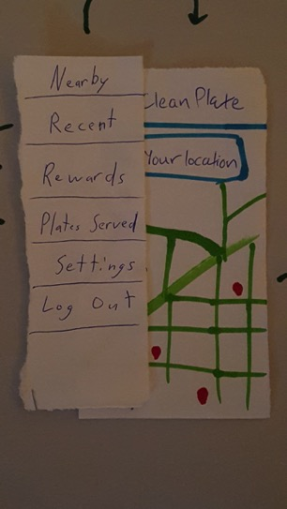
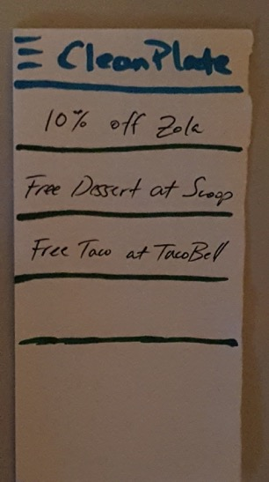
Task Structure and Flow - Access rewards (easy)

Slide 12
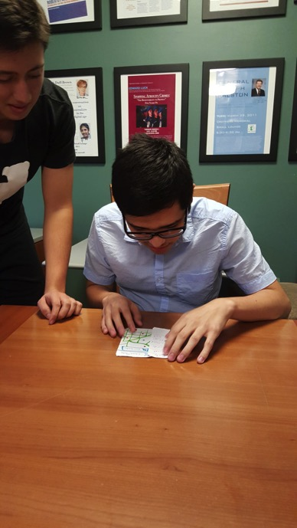
Experimental Methods
Test group sample
General, non-specific demo of prototype
Task-guided script
Group member roles
Facilitator/Demo
Notetaker
Observer
Log critical incidents/confusion
Test

Slide 13
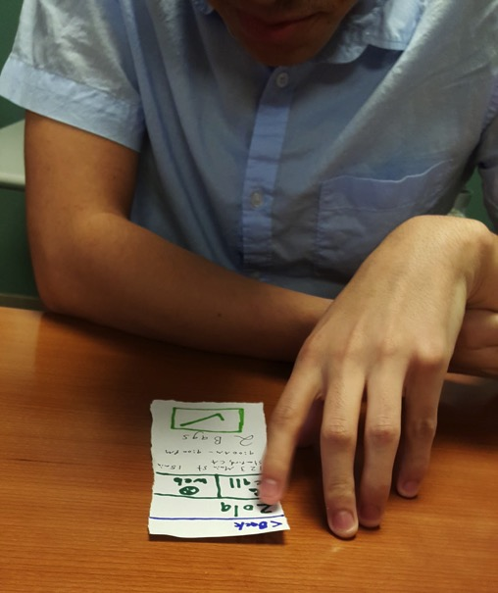
Experimental Results
Largely straightforward functionality
Participants completed tasks successfully
Parallels to existing applications
Navigating to the shelter was successful
General application navigation was easy, intuitive with navbar

Slide 14
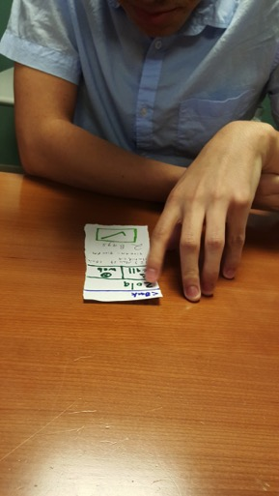
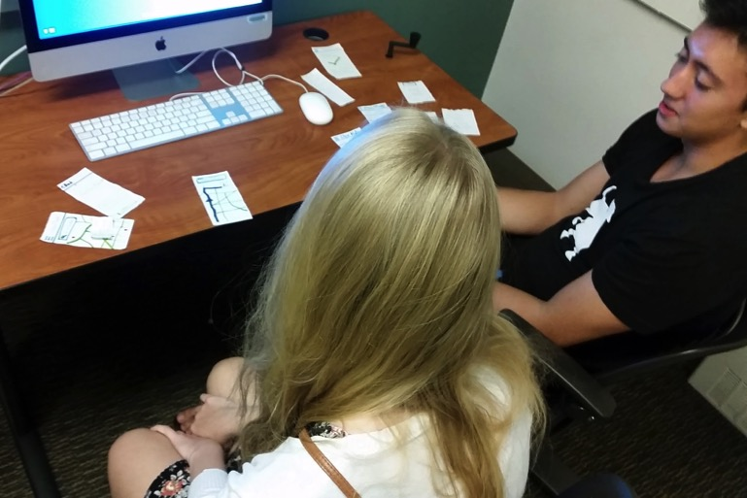
Experimental Results
Some difficulty with pick-up interface
Users want an idea of the time it will take to complete tasks
Unclear how to use the rewards → provide coupon code?
Not too much interest in stats

Slide 15
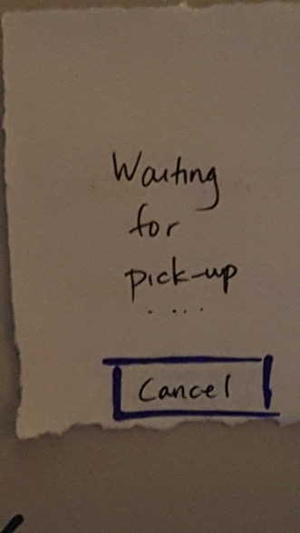
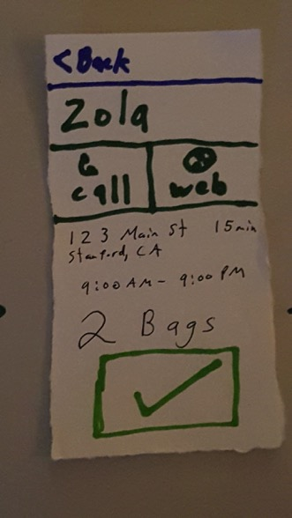
Feedback and Suggested UI Changes
Most suggestions from restaurant phase
Confused by pick-up screen: Where to go from here? → Label all buttons
Keep the information accessible through the process (e.g. how do I call them from this screen?)
Account for all user difficulty in finding/delivering food (e.g. Include a phone number for the shelter)
Users want more information
More social → post results/competition
Notes:
(01) wants distance from restaurant to shelter
(01) doesn’t know where he’s supposed to go at the confirm screen (what shelter / where you’re going / how far is it?) → repeat it on both the confirm (check and x page) and the initial page
(01) when you arrive at the place, you should be able to call the shelter (have a phone number, like Uber when the driver arrives)

Slide 16
Summary
Give more, waste less.
Interface choice - mobile application (map in the center)
Low-fi prototype
User testing
Insights: Give users more information about the tasks
Make it social

