Slide 1
Medium-Fi Prototyping
Isaiah B.-S., Larry L., Manuel R., Jacqueline L.

Slide 2
Mission Statement
“usense’s mission is to give
people the tools to care for their loved ones
despite the barrier of distance.”
usense - “Care from anywhere”

Slide 3
Task Overview
Setting an Alarm - Moderate
Dealing with a Distress Alert - Simple
Checking Location History - Moderate
Notes:
Alarm is an interactive experience, Distress Alert is lower level than emergency, Location History

Slide 4
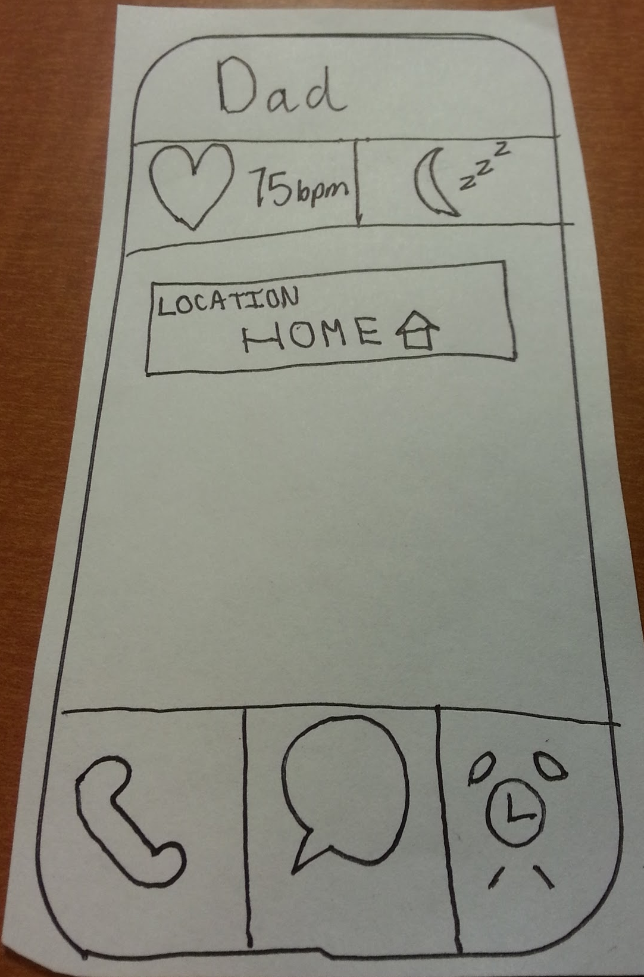
Revised UI Design: Home Screen
Notes:
Lines made the old ui too rigid and compartmentalized, white space was filled up with functionality of log, alarm clock moved up

Slide 5
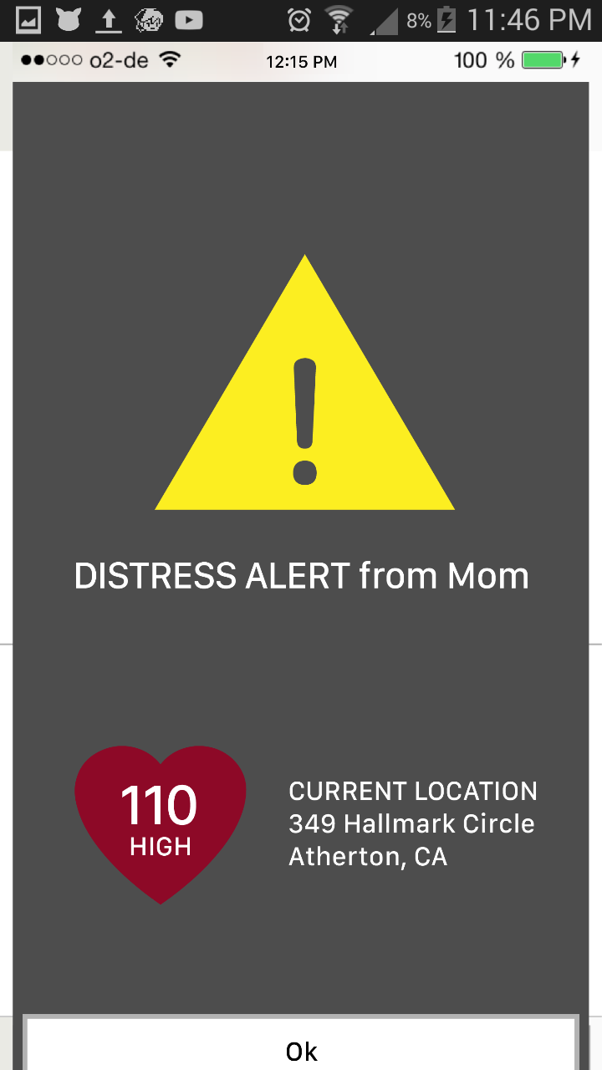
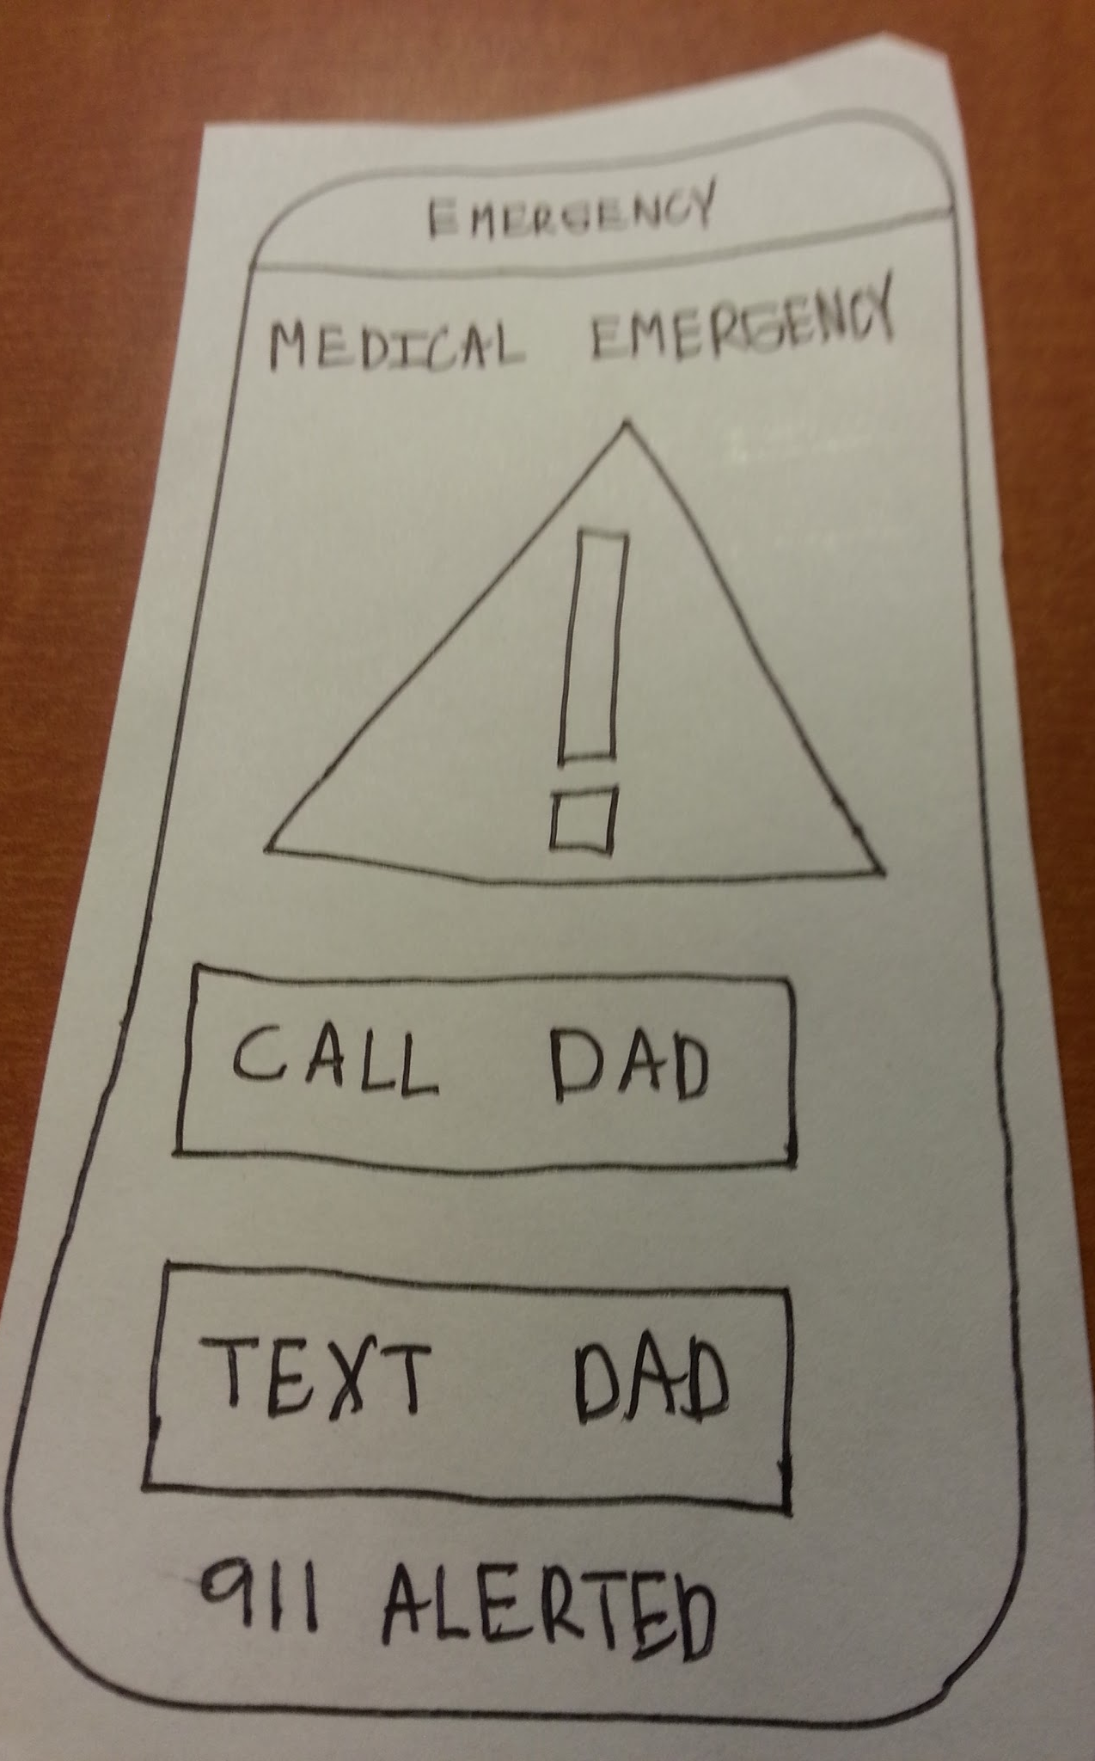
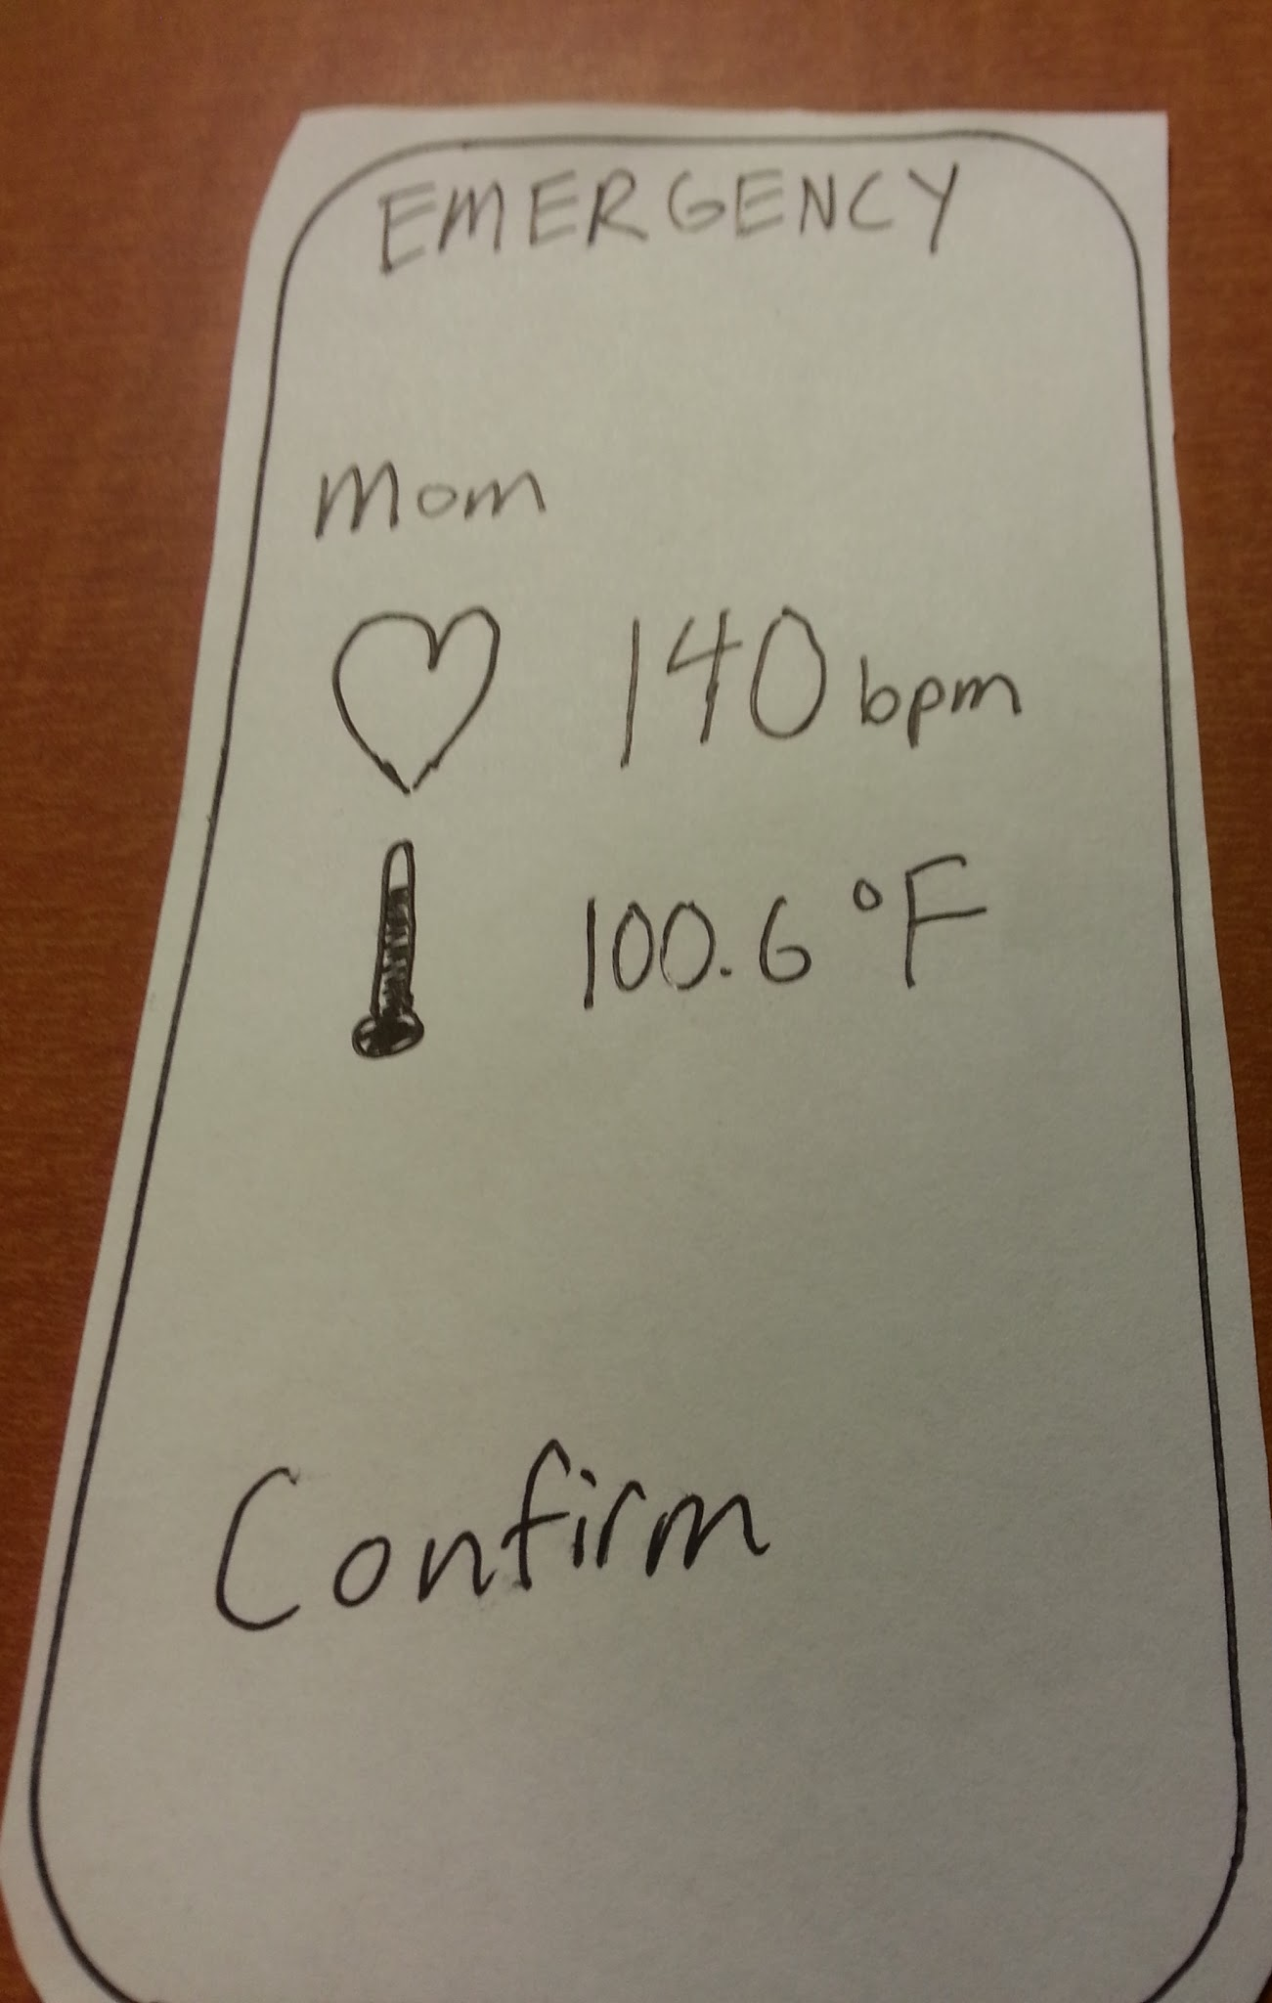
Revised UI Design: Emergency screen
Notes:
Two screens condensed into 1

Slide 6
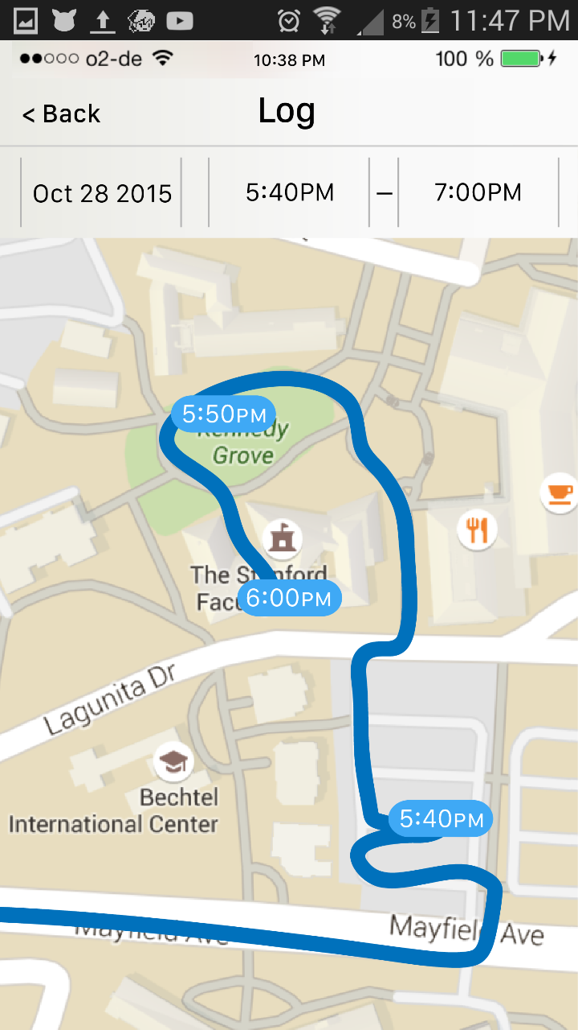
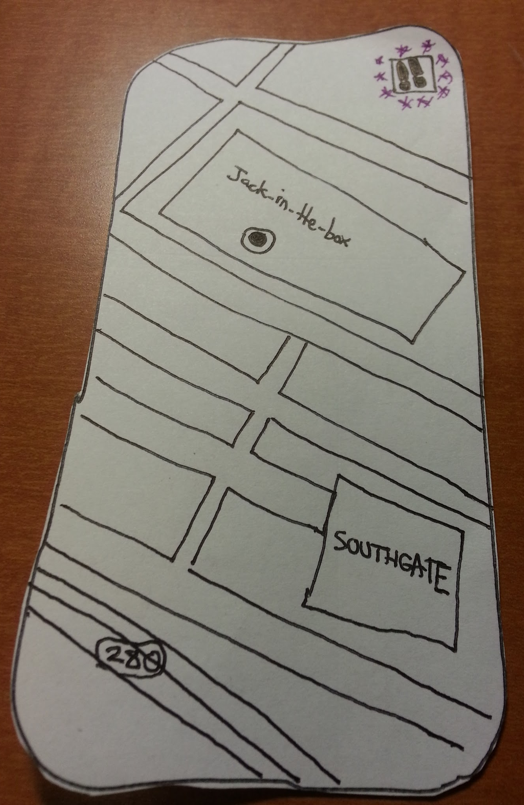
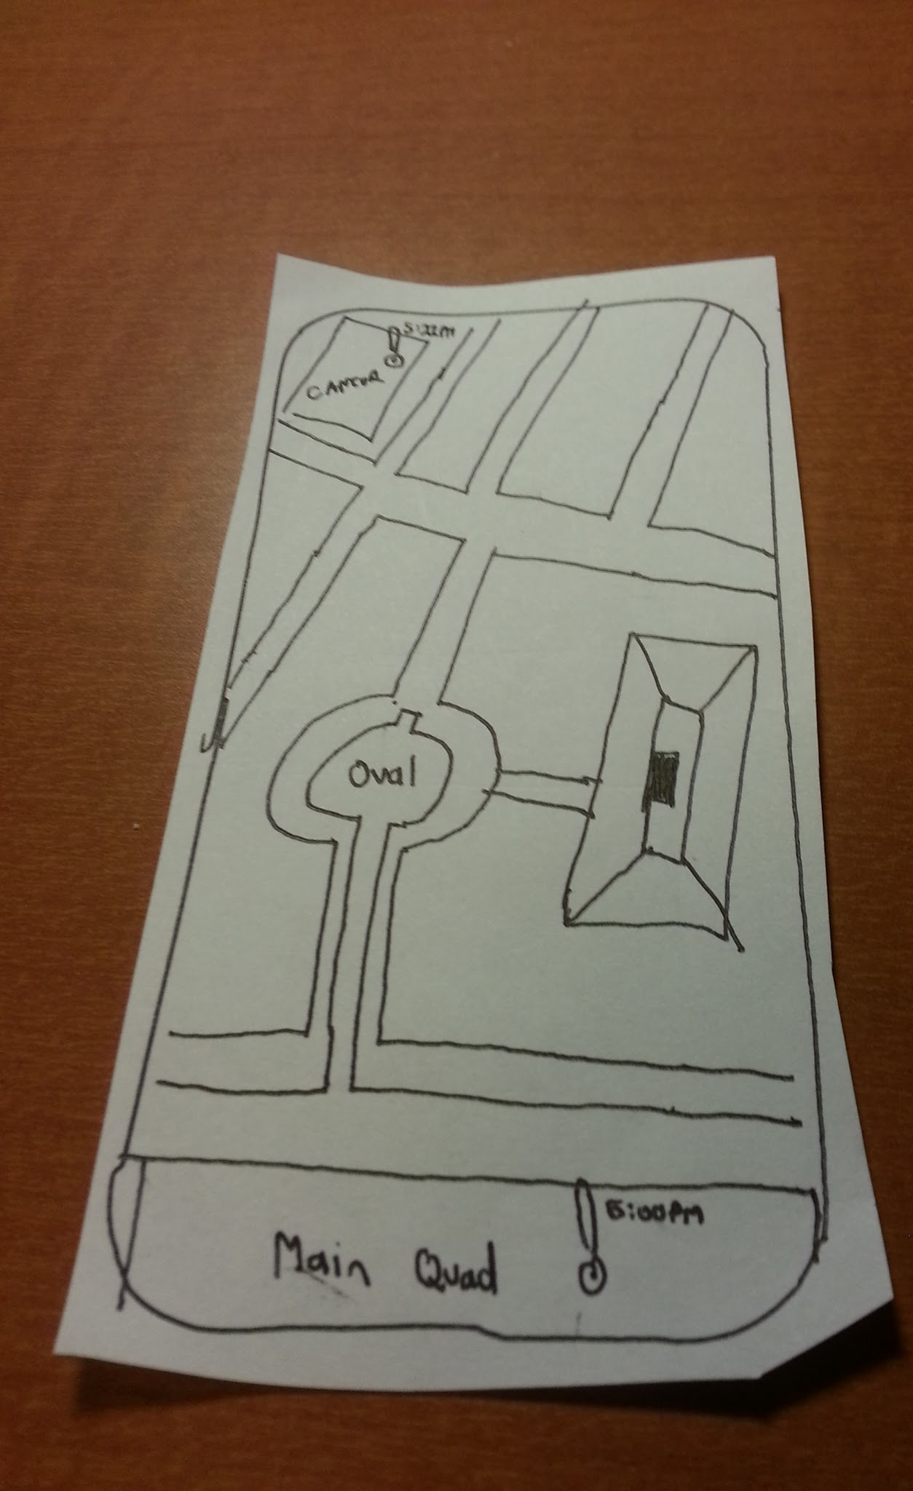
Revised UI Design: GPS

Slide 7
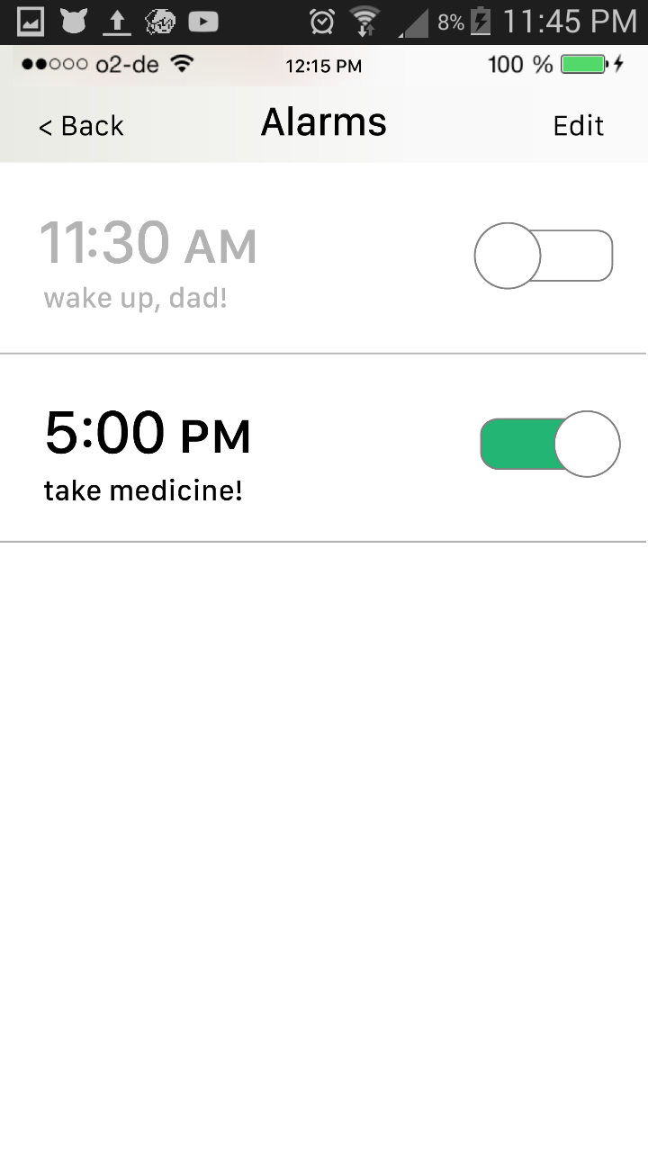
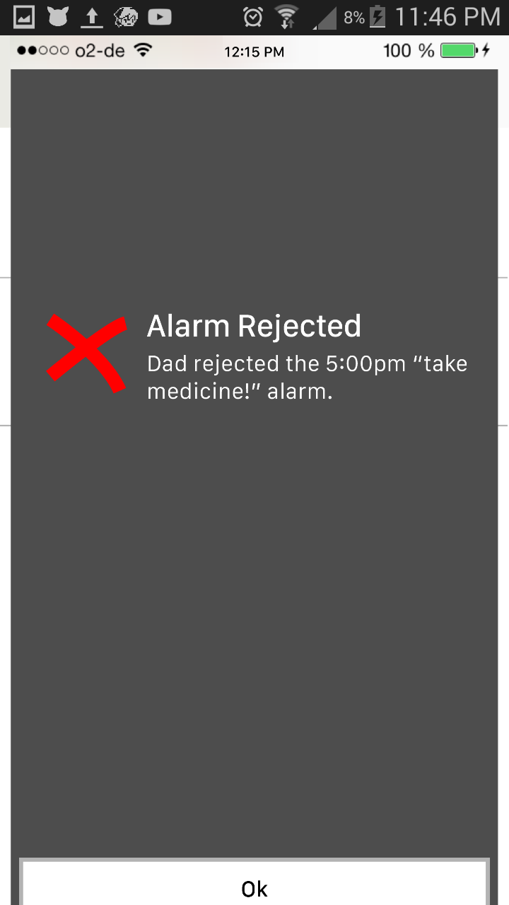
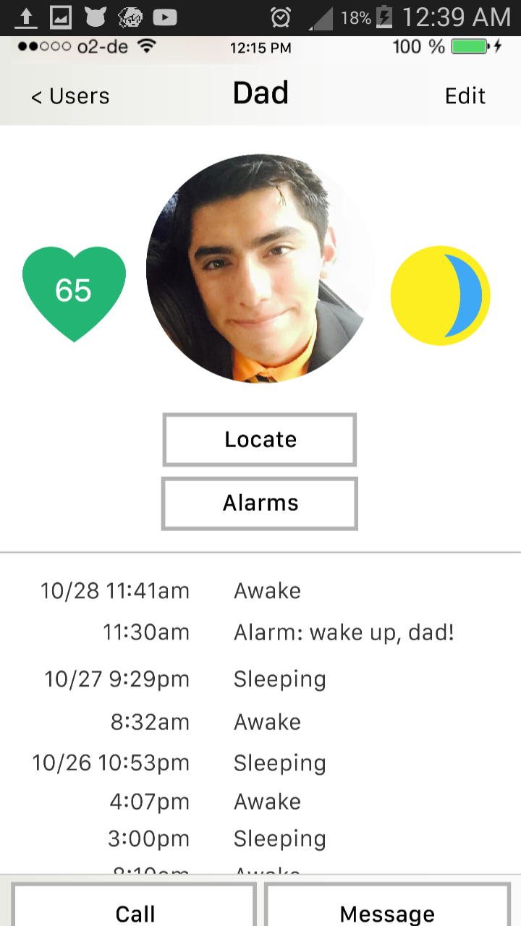
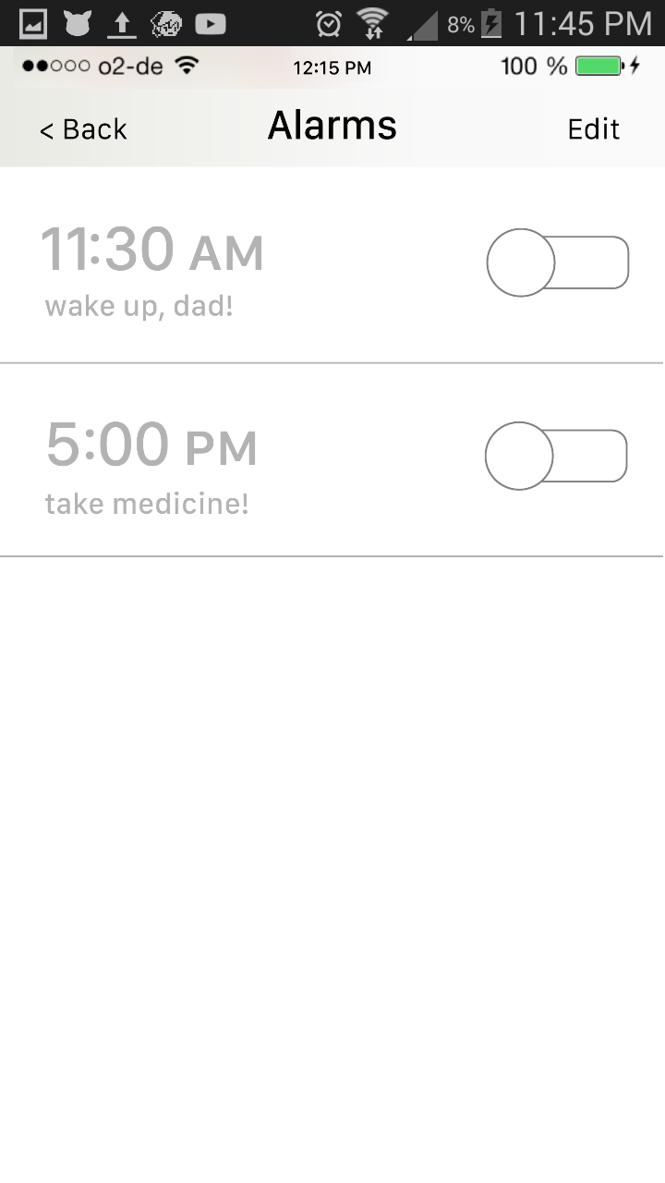
Task #1: Setting an Alarm

Slide 8
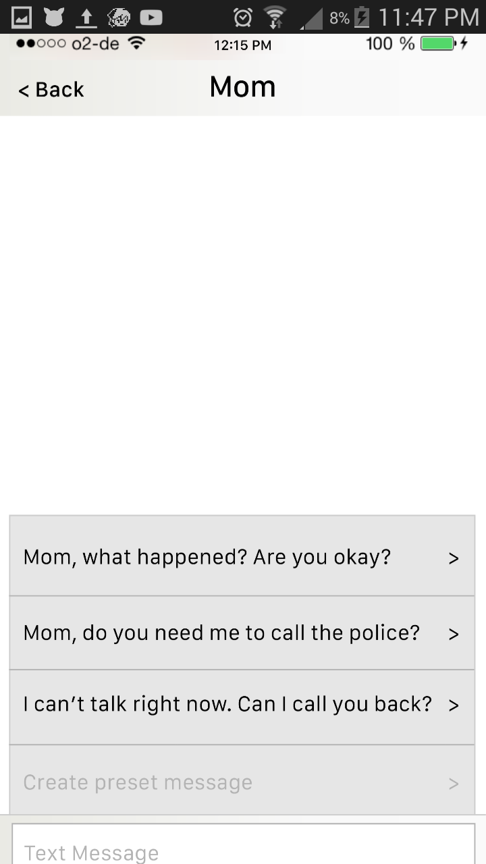
Task #2: Dealing with a Distress Alert

Slide 9
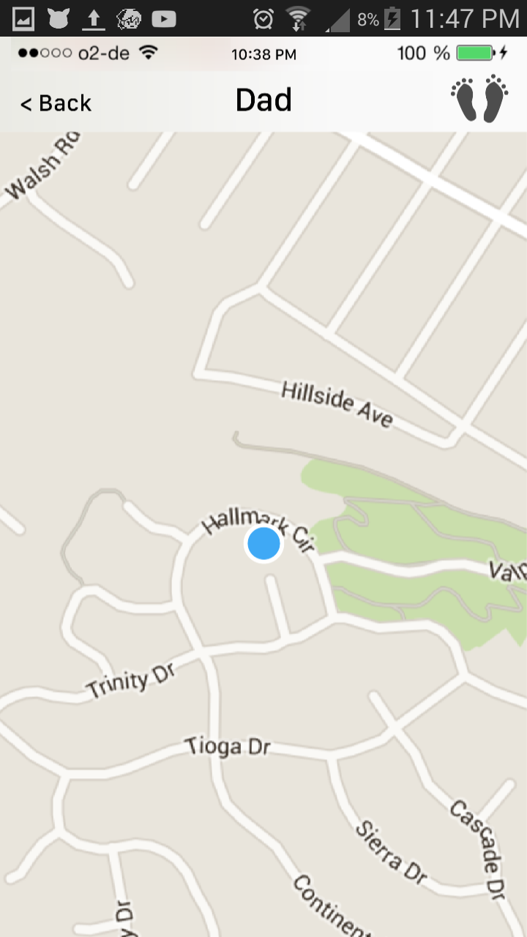
Task #3: Checking Location History

Slide 10
Tools Used
Marvel
Captures the feel of usense
Guides users when they get lost
Works on multiple platforms

Slide 11
Tradeoffs/Limitations
No user text input
No gestures (swiping)
Missing some functionality screens (heart rate)

Slide 12
Hand-Coded Features
User information is already entered

Slide 13
Link to Website
http://web.stanford.edu/class/cs147/projects/sharing/iba/

